Slide 1
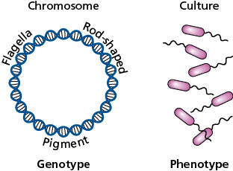
Courtesy of CRC Press/Taylor & Francis Group
Figure 2.1 The genotype and phenotype of bacteria. The genotype is carried in the bacterial DNA. It is all of the traits that are possible for the organism. For example, the DNA may code for flagella, rod-shaped cells, and production of pigment. The features that are currently displayed by the bacterial cell are the phenotype. For example, these bacteria in culture have flagella, are rod-shaped, and pigmented.
002x001

Slide 2
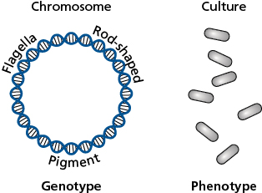
Courtesy of CRC Press/Taylor & Francis Group
Figure 2.2 The genotype does not always match the phenotype. It may be that a bacterial cell possesses the genetics for a trait, but it is not expressing it. The genotype may not be the same as the phenotype. For example, the chromosome may have the genes for flagella and the production of pigment, but these may not actually be present in the culture of bacteria.
002x002

Slide 3
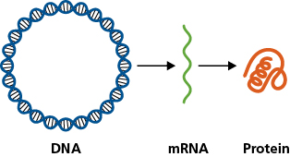
Courtesy of CRC Press/Taylor & Francis Group
Figure 2.3 DNA is the template for the production of mRNA, which is the template for the production of protein. DNA is used to make messenger RNA during transcription. This mRNA is then used to make proteins. Thus, the genetic information from the DNA encodes the information to make proteins.
002x003

Slide 4
Courtesy of CRC Press/Taylor & Francis Group
Figure 2.4 The start point of transcription is before the start of the gene. When identifying features in the DNA, the point at which transcription starts, generating mRNA, is labeled as +1. Those bases before it are negatively numbered and those after positively numbered. This allows for the recognition of other features in the DNA.
002x004

Slide 5
Courtesy of CRC Press/Taylor & Francis Group
Figure 2.5 RNA polymerase binds to DNA at the -10 and -35 regions. To initiate transcription, RNA polymerase binds to the DNA before a gene at two sites where the sequence is recognized by the RNA polymerase protein. These are the −10 and −35 regions, identified as being before the +1 start point of transcription. It is the σ subunit of RNA polymerase that recognizes and binds to the −10 and −35 sequences.
002x005

Slide 6
Courtesy of CRC Press/Taylor & Francis Group
Figure 2.6 The RNA polymerase forms an open complex with the DNA. At the −10 and −35 regions, RNA polymerase binds to the DNA. The RNA polymerase then breaks the hydrogen bonds between the DNA strands and opens the DNA double helix. This open complex gives the RNA polymerase access to the nucleotide bases of the DNA and allows the initiation of transcription.
002x006

Slide 7
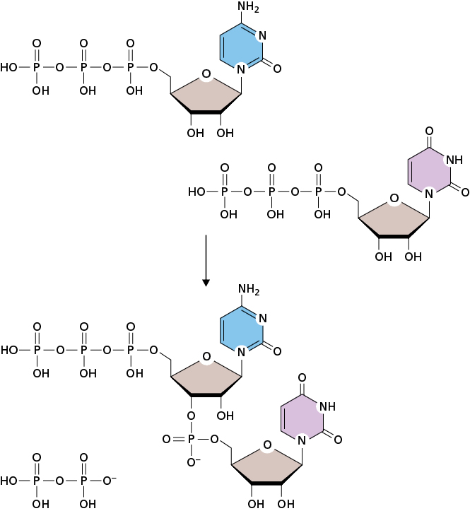
Courtesy of CRC Press/Taylor & Francis Group
Figure 2.7 The structure of the growing mRNA strand. As transcription occurs, mRNA is generated. The first ribonucleotide base of the mRNA strand retains the three phosphates attached to the ribose. When the next base is added, two of the phosphates on the second ribonucleotide are lost as the phosphodiester bond is created.
002x007

Slide 8
Courtesy of CRC Press/Taylor & Francis Group
Figure 2.8 RNA polymerase progresses along the DNA, incorporating bases into the mRNA. Once the DNA double helix is in an open complex formation, the RNA polymerase can start to generate mRNA based on the DNA sequence. From here, RNA polymerase progresses along the DNA, adding ribonucleotide bases to the mRNA.
002x008

Slide 9
Courtesy of CRC Press/Taylor & Francis Group
Figure 2.9 As elongation progresses, the sigma subunit of RNA polymerase disassociates. The sigma subunit of RNA polymerase, the σ factor, is only needed for the initiation of transcription. The sigma subunit is released from the RNA polymerase holoenzyme once 10 or so bases have been transcribed into mRNA. The RNA polymerase core enzyme then continues the process of elongation, while the σ factor can associate with another RNA polymerase and initiate a new round of transcription.
002x009

Slide 10
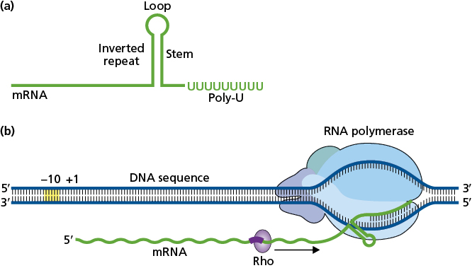
Courtesy of CRC Press/Taylor & Francis Group
Figure 2.10 Transcriptional terminators. (a) Rho-independent transcriptional terminators generate a stem-loop structure in the mRNA, which is followed by a region of several U’s. The stem-loop of mRNA forms due to complementary base pairing within an inverted repeat sequence. (b) Rho-dependent transcriptional terminators rely on the Rho protein, which is able to bind to mRNA at a specific sequence and then slide along the mRNA toward RNA polymerase. If the Rho catches up to the RNA polymerase, this causes transcription to terminate. In some cases a stem-loop in the mRNA can cause the RNA polymerase to pause giving the Rho protein time to catch up.
002x010

Slide 11
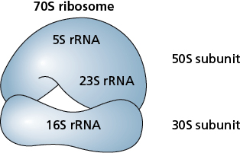
Courtesy of CRC Press/Taylor & Francis Group
Figure 2.11 The 70S bacterial ribosome is made up of subunits of proteins and ribosomal RNAs. The larger subunit is 50S. It contains proteins and the 5S rRNA and the 23S rRNA. The smaller subunit is 30S and contains proteins and the 16S rRNA. These subunits come together during bacterial translation.
002x011

Slide 12
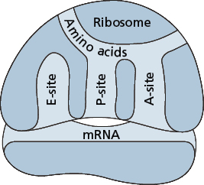
Courtesy of CRC Press/Taylor & Francis Group
Figure 2.12 The three tRNA binding sites of a bacterial ribosome. A cross section shows that there are three locations within the 70S ribosome of bacteria where the tRNAs involved in translation can be found. The first is the A-site, where a tRNA carrying an amino acid enters. This tRNA also carries an anticodon, which matches the mRNA sequence at the A-site. The amino acid on this tRNA will then form a peptide bond to the amino acid(s) attached to the tRNA in the P-site, growing the polypeptide chain by one more amino acid. The tRNA in the E-site has released its amino acid and is ready to exit the process when the ribosome moves along the mRNA to the next codon.
002x012

Slide 13
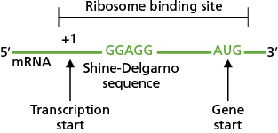
Courtesy of CRC Press/Taylor & Francis Group
Figure 2.13 The ribosome binds to the mRNA between the start of the transcript and the start of the gene. The ribosome recognizes a sequence between the start of the mRNA transcript and the start of the encoded gene and binds to this region. Specifically, there is a consensus sequence, the Shine−Dalgarno sequence that recruits the ribosome to begin translation.
002x013

Slide 14
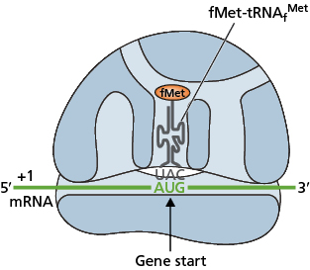
Courtesy of CRC Press/Taylor & Francis Group
Figure 2.14 The first tRNA recruited during translation is ￼. A specific tRNA starts the process of translation. This is fMet-tRNAfMet and it is recruited straight into the P-site of the ribosome. It contains the anticodon for the initiation codon that is at the start of the gene sequence, which is carried by the mRNA.
002x014

Slide 15
Courtesy of CRC Press/Taylor & Francis Group
Figure 2.15 Peptide bond formation. Peptide bonds are the bonds that join two amino acids together. Peptide bonds form inside the ribosome as a new amino acid is transferred from the tRNA to the growing peptide chain. The peptide bond (red) is formed between the C of the carbonyl group of one amino acid and the N of the α-amino group of the other amino acid. The OH from the carbonyl group of one amino acid and an H from the α-amino group of the other amino acid are released as H2O during peptide bond formation.
002x015

Slide 16
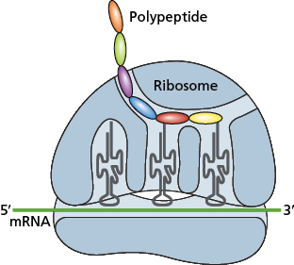
Courtesy of CRC Press/Taylor & Francis Group
Figure 2.16 The amino acid chain grows during elongation. As the ribosome progresses during translational elongation, new codons are accessible at the A-site. A tRNA with the corresponding anticodon will enter the A-site, bringing with it the associated amino acid. Present in the P-site is the previously used tRNA, now carrying the whole of the amino acid chain that has been formed. At the E-site is the tRNA previous to the one in the A-site, which has released the amino acids to the tRNA at the P-site and is ready to exit the ribosome.
002x016

Slide 17
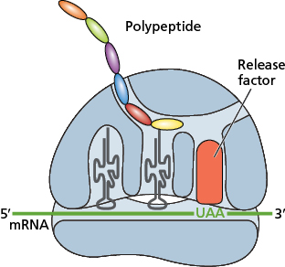
Courtesy of CRC Press/Taylor & Francis Group
Figure 2.17 Translation ends when a termination codon is reached by the ribosome. Rather than a tRNA bringing another amino acid to add, the presence of a termination codon at the A-site signals the ribosome to stop making the polypeptide. Release factor enters the A-site and triggers the end of translation, where the polypeptide is released from the tRNA in the P-site and both the tRNAs in the P-site and E-site are released. In the final phase, the ribosome dissociates and prepares to start a new round of translation.
002x017

Slide 18
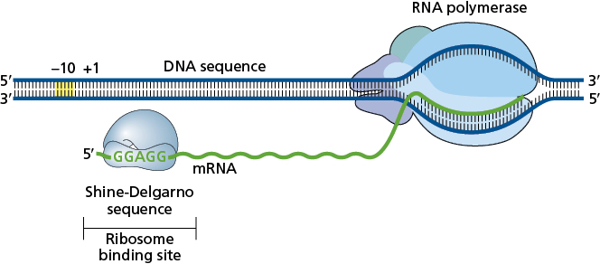
Courtesy of CRC Press/Taylor & Francis Group
Figure 2.18 In bacteria, the processes of transcription and translation are coupled. As the cell is transcribing a gene, the mRNA is being produced. Once enough of the mRNA is made for the ribosome to recognize its binding site, the mRNA can be used for translation. Therefore, proteins are produced from genes as the mRNA is being generated from them.
002x018

Slide 19
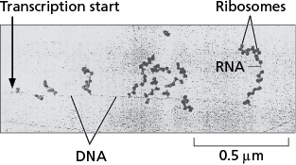
Courtesy of CRC Press/Taylor & Francis Group
Figure 2.19 Electron micrograph of coupled transcription−translation. Using high-resolution electron microscopes, it is possible to visualize the process of transcription and translation, demonstrating that in bacteria these processes happen together. Here the DNA strand can be seen, as well as the mRNA that is being transcribed from it. Note that several mRNAs are being made simultaneously. The mRNA is then coated with ribosomes, which translate the mRNA into protein. Note how many ribosomes are attached to the mRNA, simultaneously making several peptide chains from a single mRNA.
002x019

Slide 20
Courtesy of CRC Press/Taylor & Francis Group
Figure 2.20 Genes as polycistronic units. Groups of genes that are adjacent to one another can be transcribed together when they are part of a polycistronic unit. These are two or more genes that are transcribed into mRNA from the same promoter, generating one mRNA that encodes more than one gene.
002x020

Slide 21
Courtesy of CRC Press/Taylor & Francis Group
Figure 2.21 DNA has six reading frames. There are six reading frames in DNA, with three on the forward strand and three on the reverse. Reading frames are the sets of three nucleotides that make up a codon. There are therefore three different combinations of bases on the forward strand and three on the reverse strand.
002x021

Slide 22
Courtesy of CRC Press/Taylor & Francis Group
Figure 2.22 An ORF that is also a CDS. An open reading frame (ORF) is a reading frame in a section of DNA where there are no stop codons. When there is a start codon early in the ORF, then this feature is a coding sequence (CDS). Note the ATG start codon present immediately after the TGA stop codon at the start of the sequence.
002x022

Slide 23
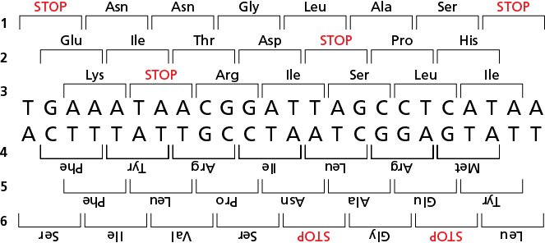
Courtesy of CRC Press/Taylor & Francis Group
Figure 2.23 The area between two stop codons in a reading frame is an open reading frame (ORF). The six reading frames of DNA are composed of codons. Some of these codons encode amino acids and some signal the termination of translation, a stop codon. The region between two stop codons in a reading frame is referred to as an open reading frame. A short ORF is shown here in reading frame 1, where a short segment of DNA has no stop codons in this frame.
002x023

Slide 24
Courtesy of CRC Press/Taylor & Francis Group
Figure 2.24 Single base changes may change the amino acid sequence. Single-nucleotide polymorphisms (SNPs) are changes in a single base of DNA. Depending on the position of the change in the codon, this may change the encoded amino acid, or it may not. As in the codon table (Table 2.1), the same amino acid can be encoded by more than one codon. These differ by one or two bases. As shown, when the bases change, shown in orange on the bottom DNA sequence, the amino acids stay the same in some cases and change in others. SNPs can also affect stop codons.
002x024

Slide 25
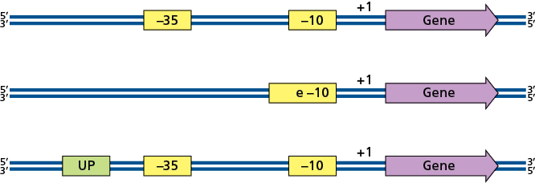
Courtesy of CRC Press/Taylor & Francis Group
Figure 2.25 The features of a promoter region. Promoter regions frequently include the −10 and −35 sequences that are recognized by the σ70 subunit of RNA polymerase. In some instances, an extended −10 region (e − 10) may be present, which compensates for the absence of a −35. An UP element can also be present upstream of the −35, which enhances RNA polymerase binding.
002x025

Slide 26
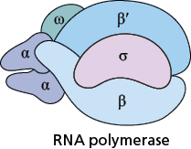
Courtesy of CRC Press/Taylor & Francis Group
Figure 2.26 The subunits of RNA polymerase. RNA polymerase is composed of six subunits as the RNA polymerase holoenzyme, with two α subunits, a β subunit, a β′ subunit, a ω subunit, and the σ subunit. The presence of the σ subunit completes the holoenzyme. Without the σ subunit, the RNA polymerase core enzyme remains.
002x026

Slide 27
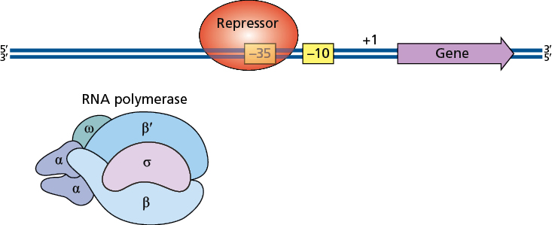
Courtesy of CRC Press/Taylor & Francis Group
Figure 2.27 The binding of a repressor protein to a promoter region. Repressor proteins are DNA binding proteins that are capable of binding to a promoter region and preventing the binding of RNA polymerase, thereby blocking the initiation of transcription.
002x027

Slide 28
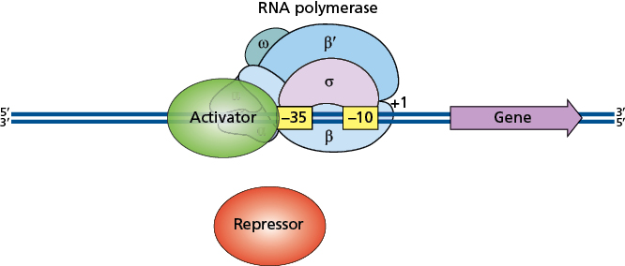
Courtesy of CRC Press/Taylor & Francis Group
Figure 2.28 The binding of an activator can compete with the binding of a repressor. Activator proteins are DNA binding proteins that assist in the binding of RNA polymerase to a promoter. When the binding sites for activators and repressors are close to one another or overlapping, only one of the proteins can bind. When the repressor binds, it prevents RNA polymerase from binding. When the activator binds, it enhances the binding of RNA polymerase and the initiation of transcription.
002x028

Slide 29
Courtesy of CRC Press/Taylor & Francis Group
Figure 2.29 Some activators bind distantly from the promoter. In some cases, the activator protein binds to a region that is upstream of the −35 region by some distance. It contributes to RNA polymerase binding, enhancing transcription, through the bending of DNA, which brings the activator together with the RNA polymerase.
002x029

Slide 30
Courtesy of CRC Press/Taylor & Francis Group
Figure 2.30 Divergent promoters drive transcription of genes on opposite strands. Some promoters overlap one another or are near to one another when the genes for which they drive transcription are on opposite strands. The placing of divergent promoters and their associated protein binding sites can mean that RNA polymerase for one promoter interferes with the binding of RNA polymerase for the other. Likewise, the binding of activators and repressors may influence transcription from both promoters.
002x030

Slide 31
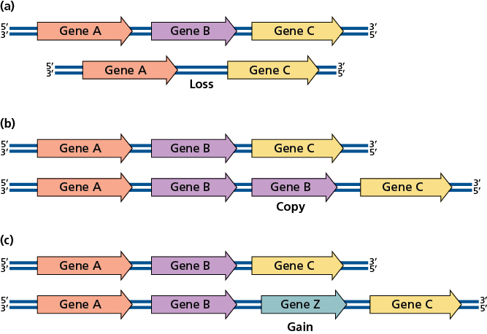
Courtesy of CRC Press/Taylor & Francis Group
Figure 2.31 Deletion of genes, duplication of genes, and addition of horizontally transferred genes. (a) During evolution, regions of DNA can be deleted from the genome, resulting in the loss of genetic material, potentially whole genes. (b) During evolution, regions of DNA can be duplicated, making a second copy of that segment of DNA. This can result in the gain of a second copy of some genes. (c) New genetic material can be added into the genome when DNA enters the bacteria from another cell. Once incorporated, this horizontally transferred material may result in a gain in function(s) for the bacteria through acquisition of horizontally transferred genes.
002x031

