Slide 1
Courtesy of CRC Press/Taylor & Francis Group
Figure 4.1 Coupled transcription−translation in bacteria has protein being translated as mRNA is transcribed. Transcription is initiated from a promoter (bent arrow) 5′ of co-transcribed genes. Once the ribosome binding site (RBS) for the first gene is represented in the mRNA, a ribosome can initiate translation into protein. RNA polymerase (RNAP) continues elongating the mRNA through the first gene and into the second. Once the ribosome binding site for the second gene is present on the mRNA, a ribosome can bind and protein can be made from the second gene as well. As one RNAP continues its elongation, another RNAP can transcribe more mRNA. Likewise, as one ribosome moves on from the RBS to translate the mRNA into protein, another ribosome can translate the same mRNA, generating more protein.
004x001

Slide 2
Courtesy of CRC Press/Taylor & Francis Group
Figure 4.2 The size of mRNA is dictated by the gene it encodes. The size of an mRNA is based upon the bacterial gene that it encodes. Transcription of the gene sequence into mRNA begins at the promoter (bent arrow) located 5′ of the start of the gene. Transcription continues past the end of the gene to a transcriptional termination signal. The mRNA is therefore larger than the gene because it also contains sequences before and after the gene, based on the signals for initiation and termination of transcription.
004x002

Slide 3
Courtesy of CRC Press/Taylor & Francis Group
Figure 4.3 The start point of transcription is between the promoter and the gene. DNA is transcribed into mRNA by RNA polymerase, which recognizes and binds to the promoter region (represented here with a bent arrow). The mRNA does not start at the promoter, however. RNA polymerase starts transcription at a point between the promoter region and the gene. This is the start point of transcription.
004x003

Slide 4
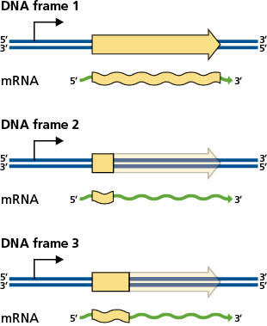
Courtesy of CRC Press/Taylor & Francis Group
Figure 4.4 When a gene is frame-shifted, it is still transcribed. The mRNA made from the gene is based on the signals for initiation and termination of transcription. If there is a frame-shift in the gene, this influences translation, but it will not impact upon transcription. In reading frame 1, the initiation codon and termination codon are in the same frame and the whole gene will be translated (yellow region). In reading frames 2 and 3, a frame-shift places a premature termination codon in-frame and only a portion of the gene is translated (yellow region). The transcript made from a frame-shifted gene is the same whether it is in or out of frame.
004x004

Slide 5
Courtesy of CRC Press/Taylor & Francis Group
Figure 4.5 Structure of an mRNA. Transcription of mRNA is from 5′ to 3′ and begins before the coding sequence of the gene at the promoter (bent arrow). The mRNA includes the 5′ untranslated region (5′ UTR) containing the ribosome binding site (RBS), followed by the initiation codon of the gene (here ATG on the DNA and AUG on the mRNA), the coding sequence of the gene (CDS), and then the termination codon (here TAA on the DNA and UAA on the mRNA). There is then a 3′ untranslated region (3′ UTR).
004x005

Slide 6
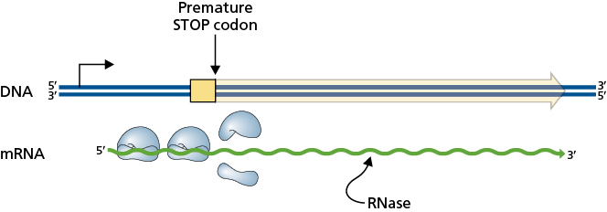
Courtesy of CRC Press/Taylor & Francis Group
Figure 4.6 An mRNA transcript that is not translated by ribosomes will be targeted for degradation by RNases. When there is a premature stop codon in a coding region, the mRNA is still made, however the full length of the mRNA is not translated into protein by the ribosomes. The ribosomes terminate translation, leaving a large portion of the mRNA unoccupied by ribosomes. When mRNA is not being translated, the lack of ribosomes along its length makes it a target for degradation by RNase enzymes. This removes transcripts from the cell that do not encode full proteins.
004x006

Slide 7
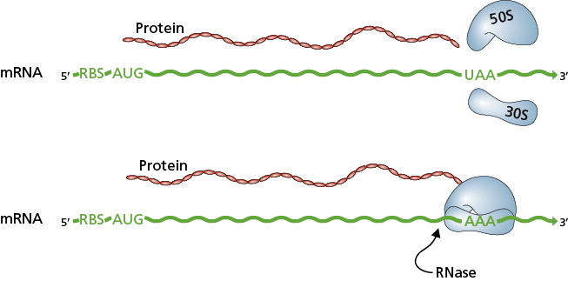
Courtesy of CRC Press/Taylor & Francis Group
Figure 4.7 Non-stop decay targets mRNA for degradation when the ribosome is stalled at the 3′ end. The ribosome binds to the mRNA at the ribosome binding site (RBS) and initiates translation of the gene at the initiation codon (here AUG). The ribosome will continue with translational elongation until it reaches a termination codon (here UAA). It will then terminate translation and disassociate from the mRNA as the 50S and 30S ribosomal subunits (top). If, however, the ribosome reaches the 3′ end of the mRNA and has still not encountered a termination codon, the ribosome stalls at the end of the mRNA, unable to progress and unable to disassociate without a termination codon signal to stop translation (bottom). A stalled ribosome at the end of an mRNA can be recognized by RNases and triggers the degradation of the mRNA by RNases, which recognize the stalled ribosome mRNA complex.
004x007

Slide 8
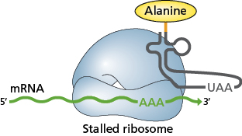
Courtesy of CRC Press/Taylor & Francis Group
Figure 4.8 Transfer messenger RNA resolves stalled ribosomes when there is no termination codon. Without a termination codon to signal translational termination, the translation machinery is unable to dissociate from the mRNA. A transfer messenger RNA (tmRNA) is able to enter the A-site of the stalled ribosome, carrying an alanine, and complete translation, using a termination codon carried on the tmRNA.
004x008

Slide 9
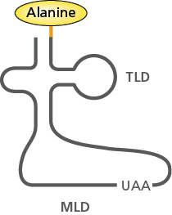
Courtesy of CRC Press/Taylor & Francis Group
Figure 4.9 The structure of a transfer messenger RNA is similar to a tRNA, but also has an mRNA-like region. Like a tRNA (TLD, tRNA-like domain), there is an acceptor stem and T-stem-loop on a tmRNA. Structurally, the D-stem-loop is different from a tRNA and there is no anticodon loop. Here there is a region that encodes a short peptide and a termination codon, like an mRNA (MLD, mRNA-like domain).
004x009

Slide 10
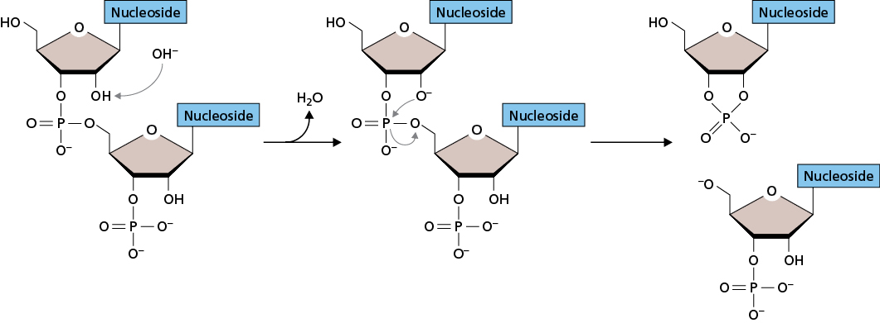
Courtesy of CRC Press/Taylor & Francis Group
Figure 4.10 RNA hydrolysis. RNA is not as stable as DNA, due to the structure of the ribose with its OH group on the 2′carbon. This OH group is liable to hydrolysis in the presence of free OH− ions, resulting in the release of H2O and the breaking of the ribose phosphate backbone.
004x010

Slide 11
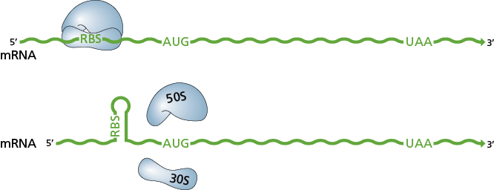
Courtesy of CRC Press/Taylor & Francis Group
Figure 4.11 Secondary structures in mRNA can impact upon translation. Initiation of translation requires access to the ribosome binding site (RBS) by the ribosome (top). If a secondary structure of the mRNA at the location of the ribosome binding site prevents 30S from gaining access to the site, translation cannot occur (bottom). Secondary structures in mRNA can interfere with the translation process; if the RBS is not available translation of the mRNA does not occur.
004x011

Slide 12
Courtesy of CRC Press/Taylor & Francis Group
Figure 4.12 Secondary structures formed by mRNA can disrupt the progress of ribosomes along the mRNA during translation. These can influence the expression of the mRNA into protein. If the encoded amino acids correspond to abundant tRNAs, then the progression of the ribosome during translational elongation is rapid (top). If, however, the ribosome moves more slowly to await a less common tRNA, the secondary structure formed by the mRNA stalls the ribosome (bottom).
004x012

Slide 13
Courtesy of CRC Press/Taylor & Francis Group
Figure 4.13 Translational termination and secondary structures. Translational termination occurs when the termination codon aligns within the A site, triggering termination. If the ribosome progresses through translational elongation too rapidly, the correct alignment with the termination codon may not occur (top). In order for this process to happen efficiently, a secondary structure in the mRNA can slow the progression of the ribosome enough so that the termination codon aligns properly within the ribosomal A site.
004x013

Slide 14
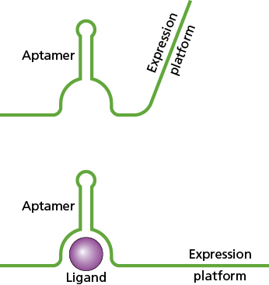
Courtesy of CRC Press/Taylor & Francis Group
Figure 4.14 A riboswitch controls the expression of the mRNA that contains it. The aptamer region (top) binds to a specific metabolite (bottom), causing a structural change in the mRNA. The differences in the bound and unbound states influence the expression of the gene.
004x014

Slide 15
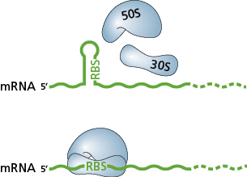
Courtesy of CRC Press/Taylor & Francis Group
Figure 4.15 An RNA thermometer alters transcription based on temperature. The secondary structure of the mRNA in an RNA thermometer blocks the ribosome binding site (RBS) from being accessible by the ribosome’s 50S and 30S subunits (top). The mRNA is therefore not translated. At higher temperatures, the hydrogen bonds between the secondary structure forming nucleotides break, making the RBS accessible (bottom). The ribosome binds to the mRNA and translation is initiated.
004x015

Slide 16
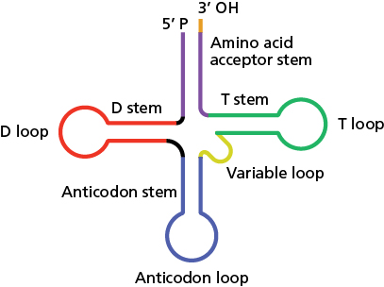
Courtesy of CRC Press/Taylor & Francis Group
Figure 4.16 The structure of tRNAs. There are three stem loop structures in a tRNA, and optionally an additional variable loop. Starting from the 5′ end of the tRNA, these are the D-stem, D-loop, anticodon-stem, anticodon-loop, the optional variable loop, the T-stem, and the T-loop. The fourth stem, the amino acid acceptor stem, is formed by the beginning (5′) and end (3′) of the tRNA strand.
004x016

Slide 17
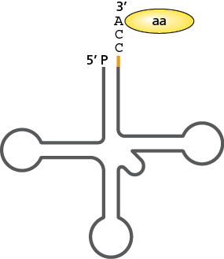
Courtesy of CRC Press/Taylor & Francis Group
Figure 4.17 An amino acid is added to the adenine at the 3′ end of the tRNA by an aminoacyl-tRNA synthetase. The end of the tRNA contains a CCA motif, which may be part of the transcribed tRNA or it may be added later. The amino acid is added to either the 2′ or 3′ hydroxyl group of the adenine.
004x017

Slide 18
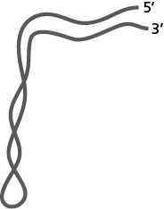
Courtesy of CRC Press/Taylor & Francis Group
Figure 4.18 The tertiary structure of tRNA forms an L-shape. The two arms of the L-shape are made by the stacking of the stems, with the D-stem stacking on the anticodon stem and the amino acid acceptor stem stacking on the T-stem.
004x018

Slide 19
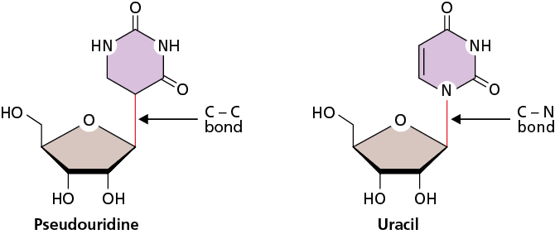
Courtesy of CRC Press/Taylor & Francis Group
Figure 4.19 Some tRNAs contain the modified nucleotide pseudouridine. Pseudouridine (left) is similar to uracil (right), however, the bond between the ribose sugar and the base is a carbon−carbon (C−C) bond rather than a carbon−nitrogen (C−N) bond.
004x019

Slide 20
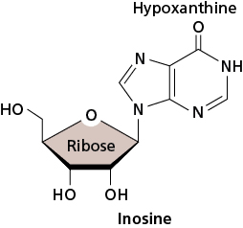
Courtesy of CRC Press/Taylor & Francis Group
Figure 4.20 Some tRNAs contain the modified nucleotide inosine. Inosine is made when a hypoxanthine is attached to a ribose sugar.
004x020

Slide 21
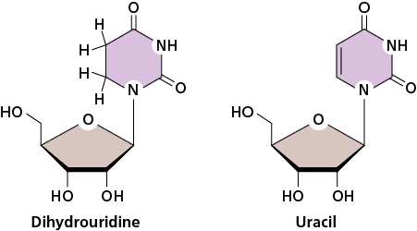
Courtesy of CRC Press/Taylor & Francis Group
Figure 4.21 Some tRNAs contain the modified nucleotide dihydrouridine. Dihydrouridine is similar to uracil, however, the addition of two hydrogens means there are no longer any double bonds in the pyrimidine ring structure.
004x021

Slide 22
Courtesy of CRC Press/Taylor & Francis Group
Figure 4.22 The Hfq protein assists in the binding of an ncRNA to its targeted mRNA. Base pairing between the ncRNA and mRNA forms double-stranded RNA. This is targeted by RNases within the bacterial cell, resulting in cleavage and degradation of the mRNA.
004x022

Slide 23
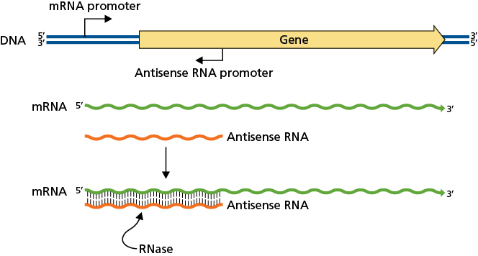
Courtesy of CRC Press/Taylor & Francis Group
Figure 4.23 Antisense RNAs are encoded on the opposite strand of the gene they regulate. The sequence of the antisense RNA is perfectly complementary to the gene sequence that has been transcribed into the mRNA because it is generated from the same DNA template, just on the opposite strand. Base pairing between the antisense RNA and the mRNA from the gene forms double-stranded RNA, which is targeted for degradation by RNases.
004x023

