Slide 1
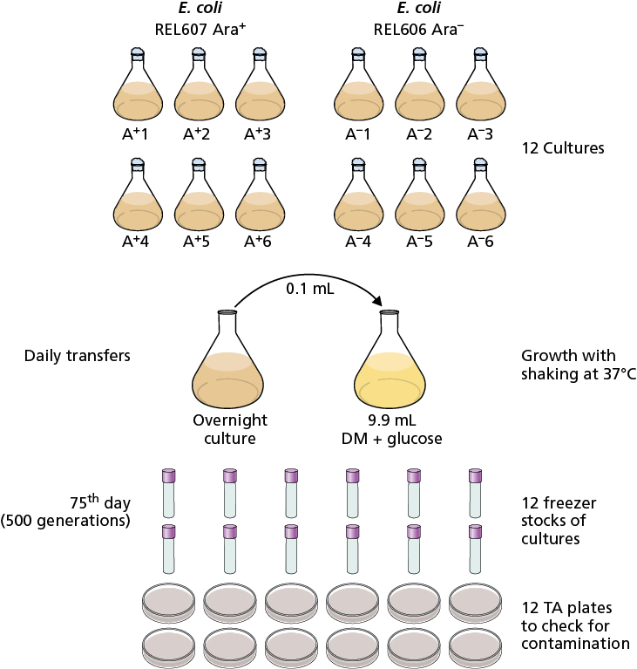
Courtesy of CRC Press/Taylor & Francis Group
Figure 15.1 Experimental evolution experiments. Richard Lenski’s research group has been growing E. coli cultures continuously since February 1988. These E. coli started from a single culture and have been through over 50,000 generations. The experimental design involves the growth of 12 cultures that are continuously maintained. There are six cultures of E. coli REL607, which is Ara+, and six cultures of the isogenic strain E. coli REL606, which is Ara−. Each day 0.1 ml of media containing growth from the previous day’s culture is transferred into 9.9 ml of DM media with glucose and grown at 37°C with shaking. Each 75th day, freezer stocks are made of each culture and the cultures are checked for contamination by inoculating some of the culture onto TA plates and incubating these at 37°C to confirm that only E. coli are growing.
015x001

Slide 2
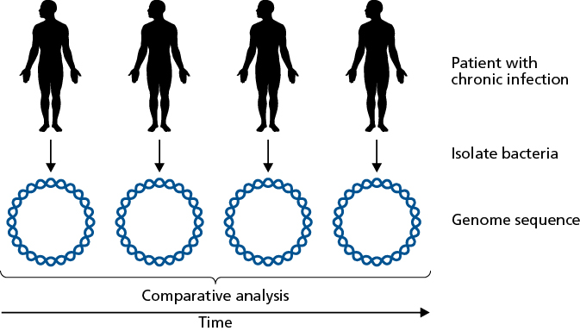
Courtesy of CRC Press/Taylor & Francis Group
Figure 15.2 Within-host evolution of bacteria. Genome sequencing has enabled researchers to monitor the changes to the bacterial genome that occur within the host during the course of the infection. In patients with a chronic infection (or other long-term infection), the bacteria are isolated at various times during the course of the infection in a single patient and genome sequenced. Whether as complete circular genomes (shown here) or unassembled sequence reads, the data is comparatively analyzed to investigate the within-host evolution of the bacteria.
015x002

Slide 3
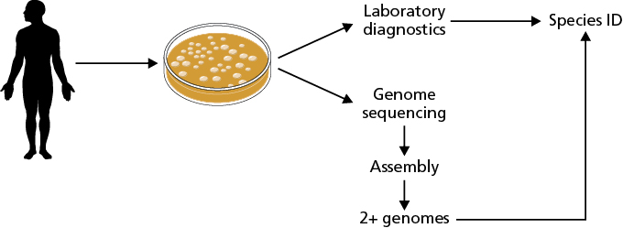
Courtesy of CRC Press/Taylor & Francis Group
Figure 15.3 Infections can be caused by more than one strain of the same species. When the infection-causing bacteria are isolated from a patient, laboratory diagnostics can identify the species of the bacteria, however this will not identify the presence of more than one strain of the same species in the patient. Genome sequencing of the isolated bacteria can result in assembly of the data into two or more distinct genomes, making it clear that there are multiple infecting strains of the bacterial species.
015x003

Slide 4
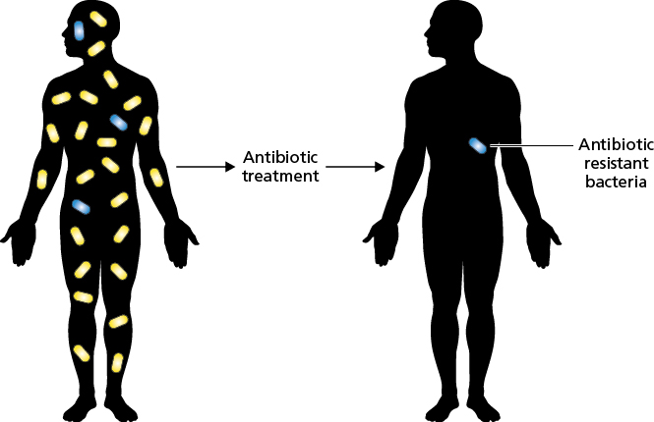
Courtesy of CRC Press/Taylor & Francis Group
Figure 15.4 Antibiotic resistance evolution in microbiome bacteria. When antibiotics are used against an infection (yellow bacteria), there is a chance that resistance can arise in the bacteria that are part of the microbiome in the body (blue bacteria). Thus, the evolution of resistance can be observed.
015x004

Slide 5
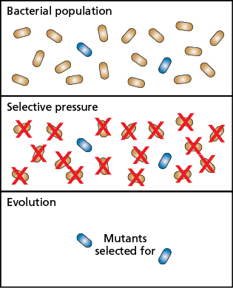
Courtesy of CRC Press/Taylor & Francis Group
Figure 15.5 Evolution selects for mutations already present in the population, it does not cause mutations. Evolution does not cause mutations to occur in response to selective pressures. Rather, selection acts on the bacterial population and those cells with mutations that give them an advantage (blue) will out compete the other cells in the population.
015x005

Slide 6
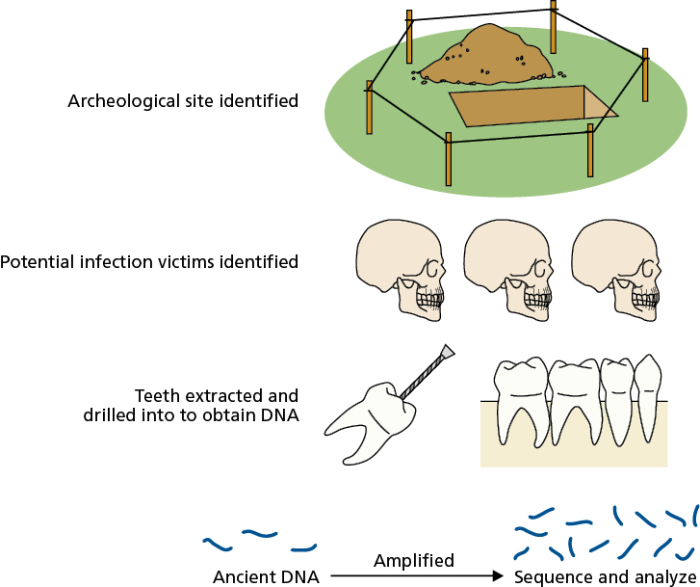
Courtesy of CRC Press/Taylor & Francis Group
Figure 15.6 Genomic data can be obtained from Yersinia pestis historic plague cases. An archeological site with buried plague victims is identified and the skeletons exhumed. DNA is extracted by drilling into the teeth. The extracted fragments of DNA are amplified and then genome sequenced and analyzed.
015x006

Slide 7
Courtesy of CRC Press/Taylor & Francis Group
Figure 15.7 Neisseria meningitidis evolved to have a capsule only about 200 years ago. N. meningitidis causes potentially fatal diseases, yet genomic investigations show that the bacterial capsule, a vital virulence trait that contributes to its pathogenesis, has been recently acquired via horizontal gene transfer (HGT) around 1805. The bacterial cells, Gram-negative diplococci, were then able to express a capsule and cause meningococcal disease.
015x007

Slide 8
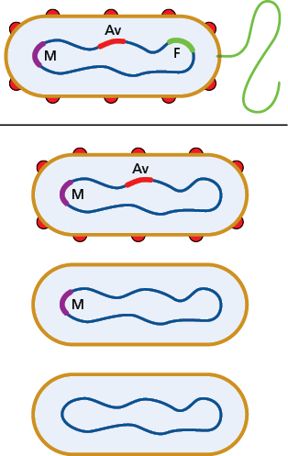
Courtesy of CRC Press/Taylor & Francis Group
Figure 15.8 Reductive genome evolution eliminates genetic material that is no longer needed in a niche. Evolution eliminates the unneeded genetic material. Shown here is a bacterial cell with flagella genes (F, green), antigenically variable surface proteins (AV, red), and an assortment of metabolic pathways to take advantage of a range of environments (M, purple). When this cell enters a new environment where these traits offer no advantage, they can be lost over time and eliminated from the genome.
015x008

Slide 9
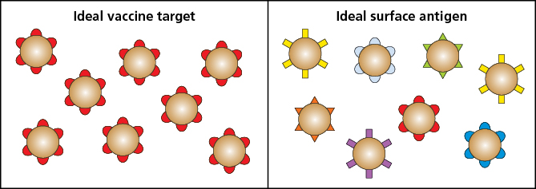
Courtesy of CRC Press/Taylor & Francis Group
Figure 15.9 Ideal vaccine targets (for humans) versus ideal surface antigens (for bacteria). When humans design vaccines, an ideal vaccine target is an antigen present on all bacteria and that is identical on all bacteria (left). The ideal surface antigen for bacteria is changeable, to avoid recognition by the immune system (right). The opposite nature of these ideals complicates efforts at vaccine design.
015x009

Slide 10
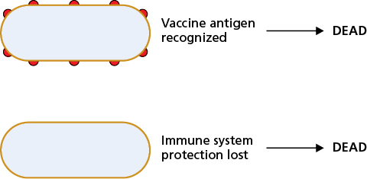
Courtesy of CRC Press/Taylor & Francis Group
Figure 15.10 Vaccination against bacterial antigens is essential for survival. An alternative strategy to vaccine design is to find a vaccine target that the bacteria has to express on its surface, where the vaccine-primed immune system can see it and target the cell for killing (top cell), or doesn’t express it on its surface and the immune system can then target the cell for killing (bottom cell). In either state, the immune system eliminates the bacterial cell. Without vaccination, it is essential that the bacterial cell expresses this antigen to avoid killing by the immune system, therefore vaccination against this antigen means the bacterial cell is killed whether it expresses the antigen (by the vaccine) or not (by the immune system).
015x010

Slide 11
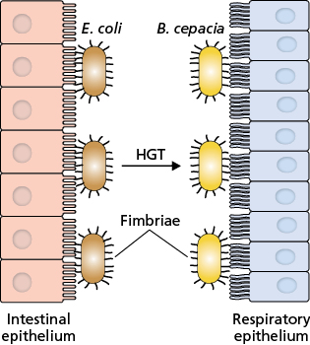
Courtesy of CRC Press/Taylor & Francis Group
Figure 15.11 Class 5 fimbriae from E. coli aid B. cepacia in causing disease. The class 5 fimbriae of enterotoxigenic E. coli allow these bacteria to attach to the epithelial cells of the small intestine (left). Horizontal gene transfer of the class 5 fimbriae system from E. coli to B. cepacia enables these bacteria to bind to the epithelial cells of the lungs of cystic fibrosis patients (right).
015x011

Slide 12
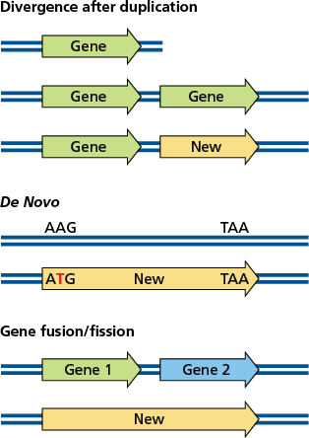
Courtesy of CRC Press/Taylor & Francis Group
Figure 15.12 Evolution of new genes. New genes can arise by three different mechanisms. After duplication of a gene, the sequence can diverge into a new gene (top). A new gene can arise de novo, as new, from a noncoding region when a mutation generates an initiation codon (middle). Fusion of two gene sequences creates a new gene (bottom) and likewise fission dividing a gene into two can generate two new genes (bottom in reverse).
015x012

