Slide 1
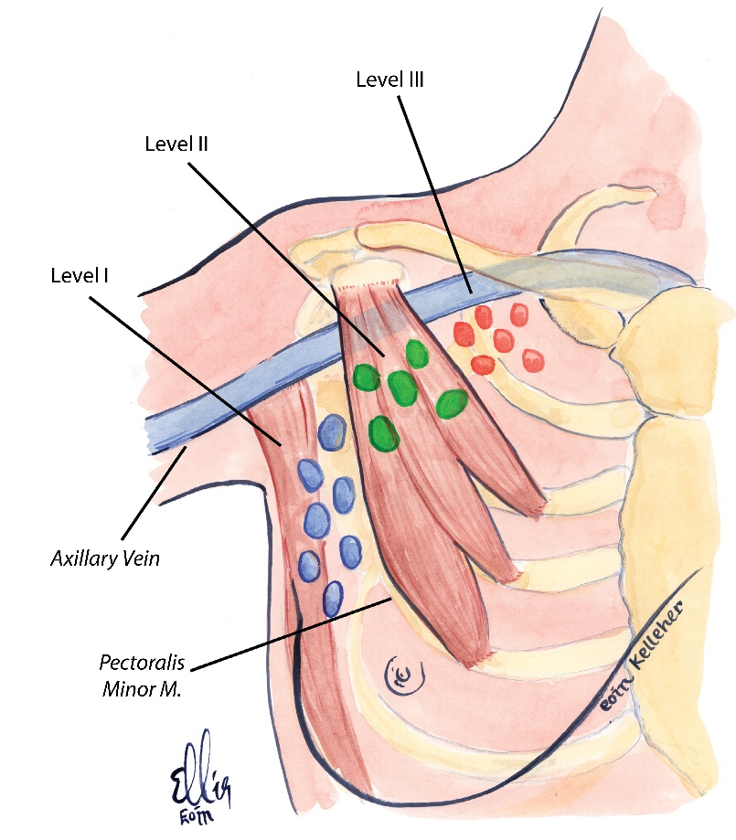
Courtesy of CRC Press/Taylor & Francis Group

Slide 2
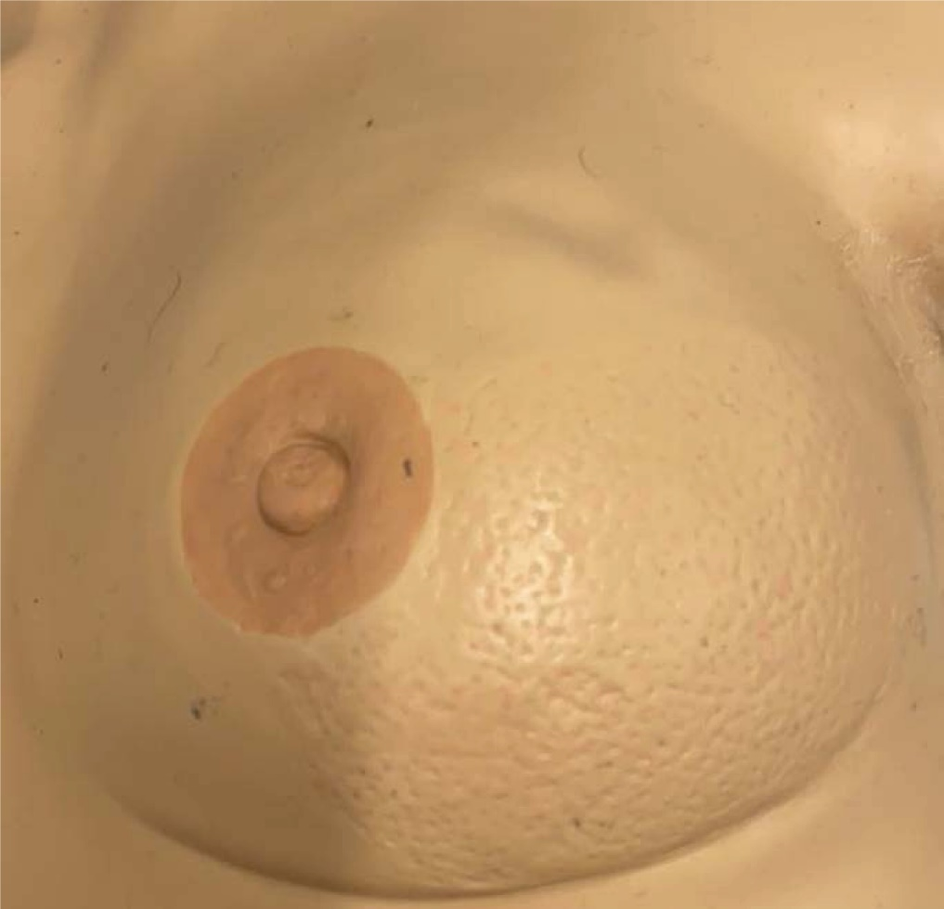
Courtesy of CRC Press/Taylor & Francis Group
Figure 8.1 Image of Peau d’orange.

Slide 3
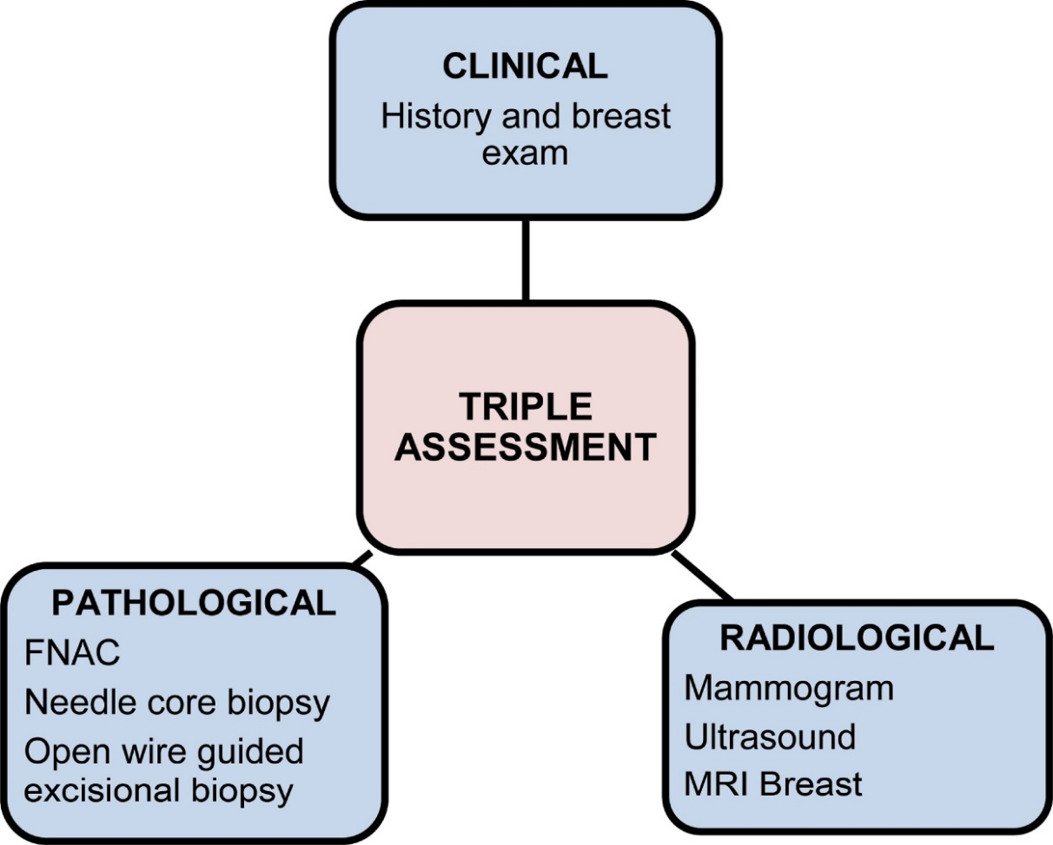
Courtesy of CRC Press/Taylor & Francis Group
Figure 8.2 Triple assessment.

Slide 4
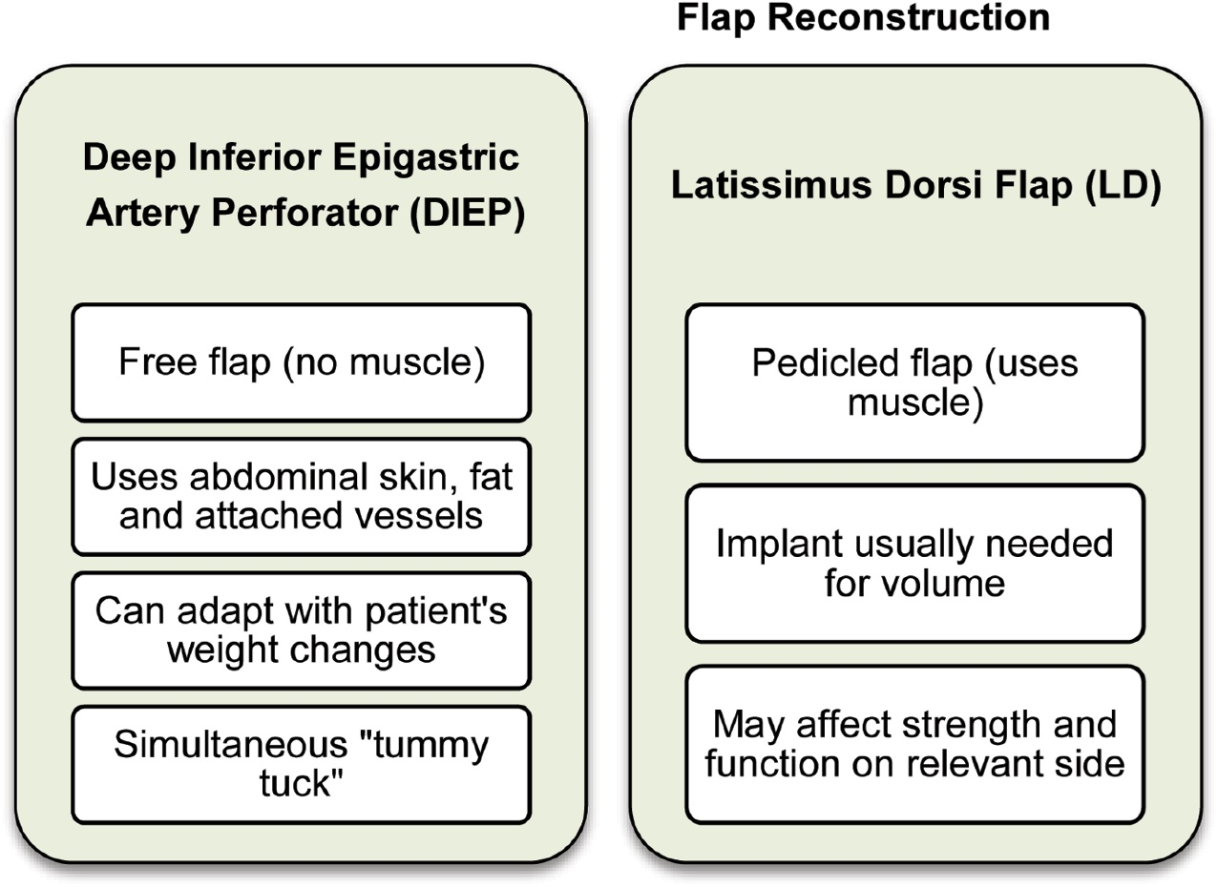
Courtesy of CRC Press/Taylor & Francis Group
Figure 8.3 Flap reconstruction.

Slide 5
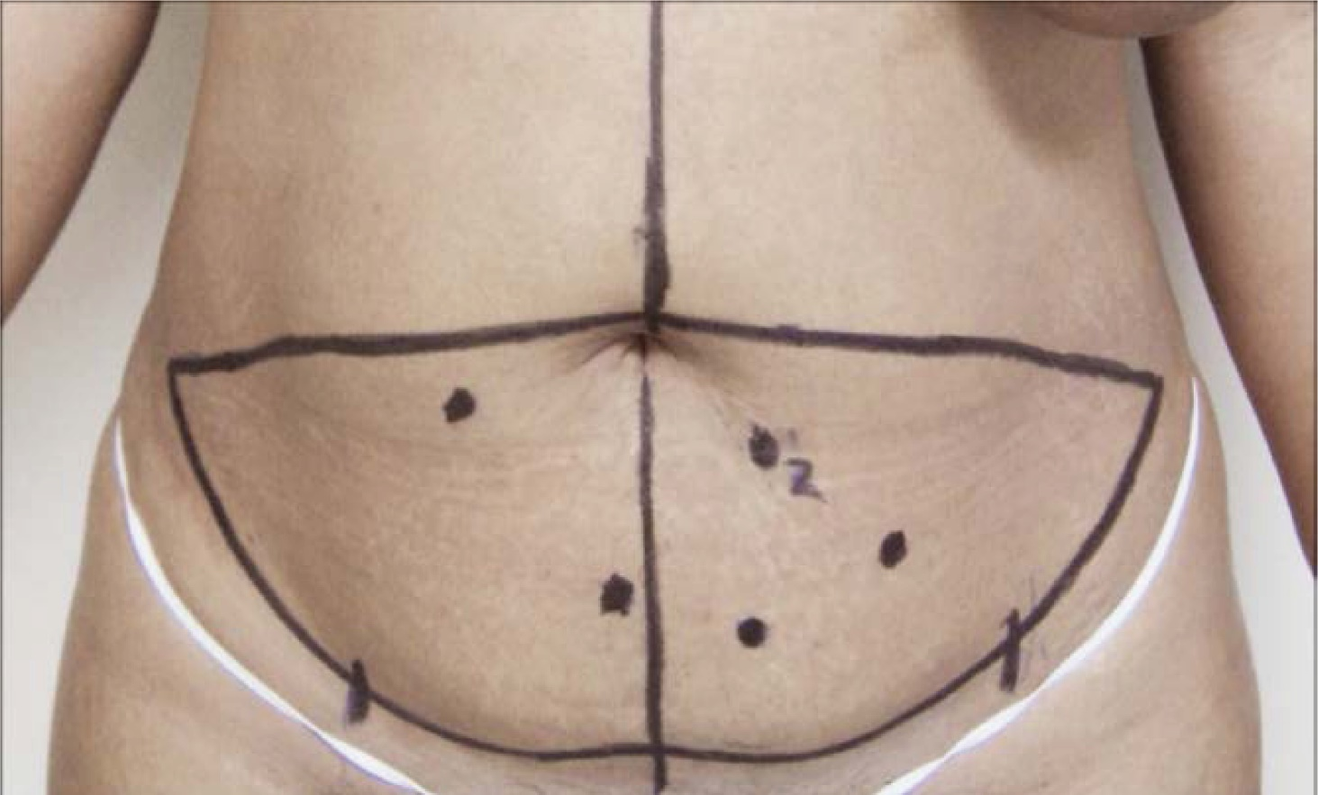
Courtesy of CRC Press/Taylor & Francis Group
Figure 8.4 Mapping of DIEP flap for breast reconstructive surgery. Courtesy of Mr Jamie Martin-Smith

Slide 6
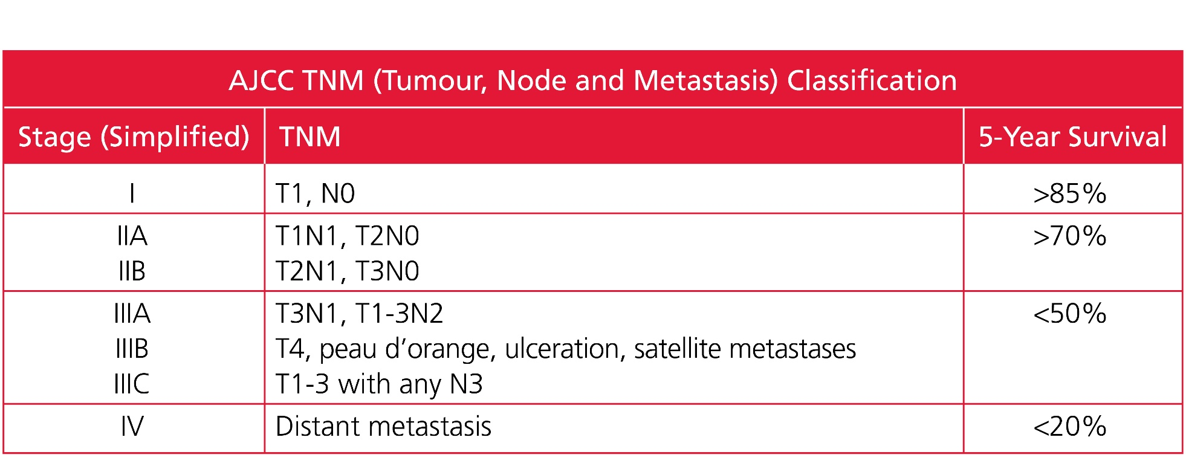
Courtesy of CRC Press/Taylor & Francis Group
Table 8.1 American Joint Committee on Cancer TNM Classification

Slide 7
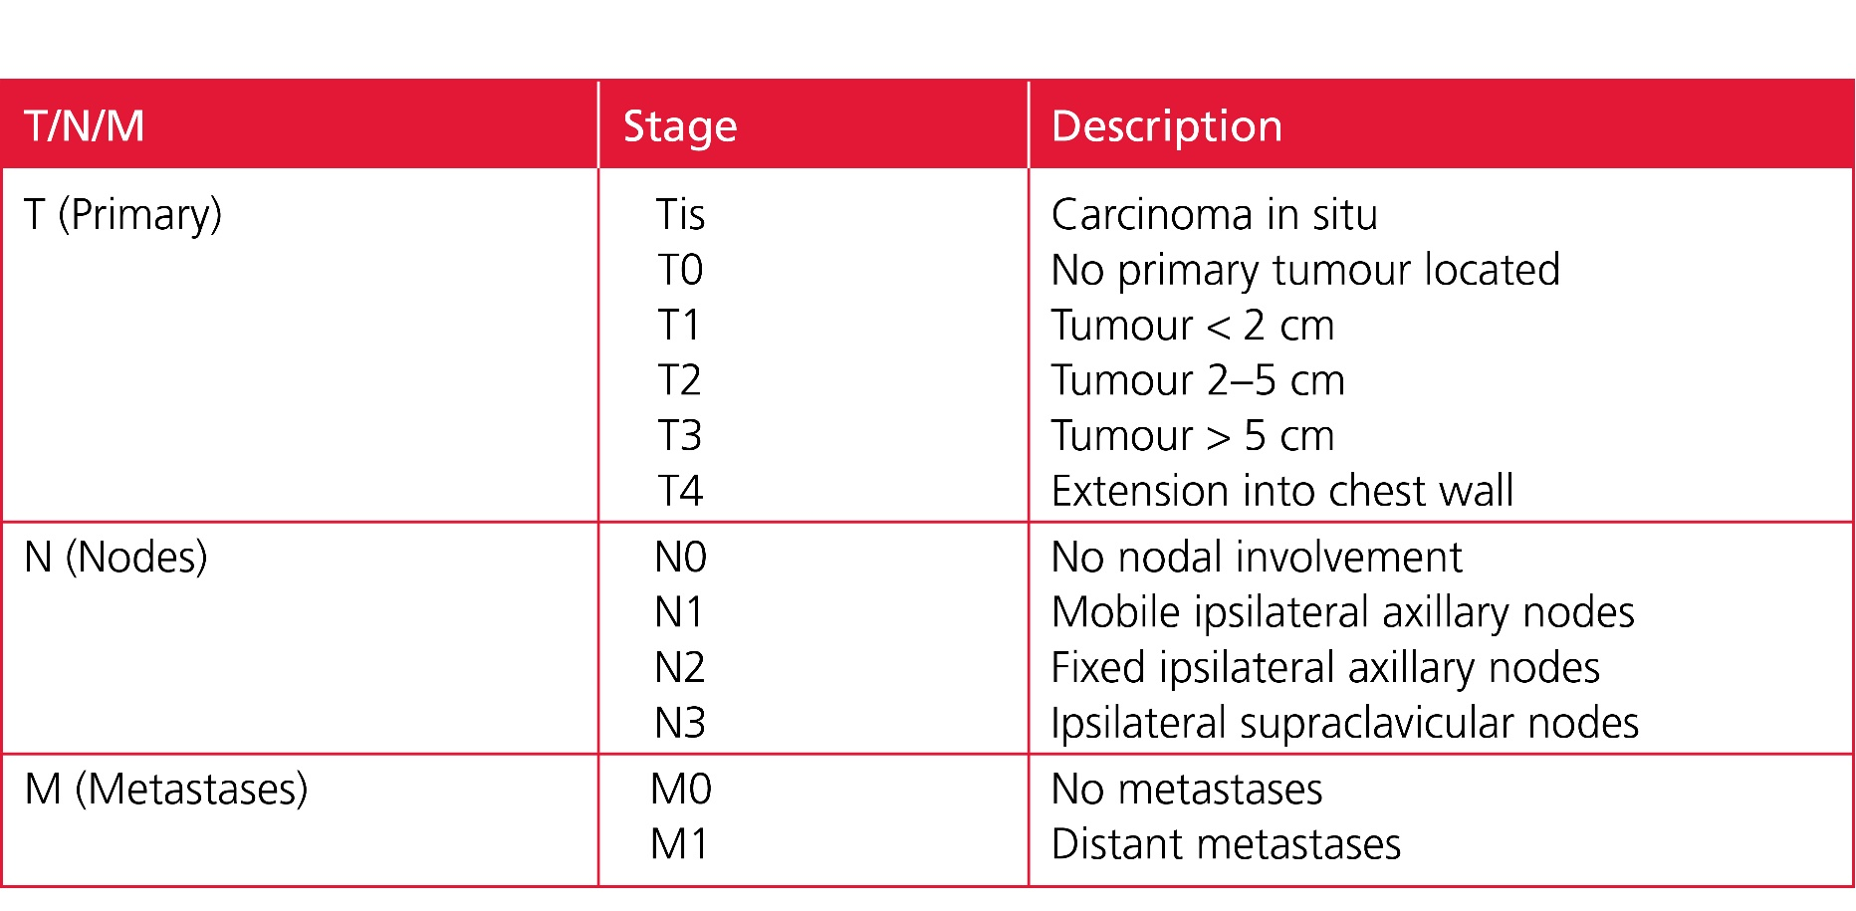
Courtesy of CRC Press/Taylor & Francis Group
Table 8.2 TNM Staging

Slide 8
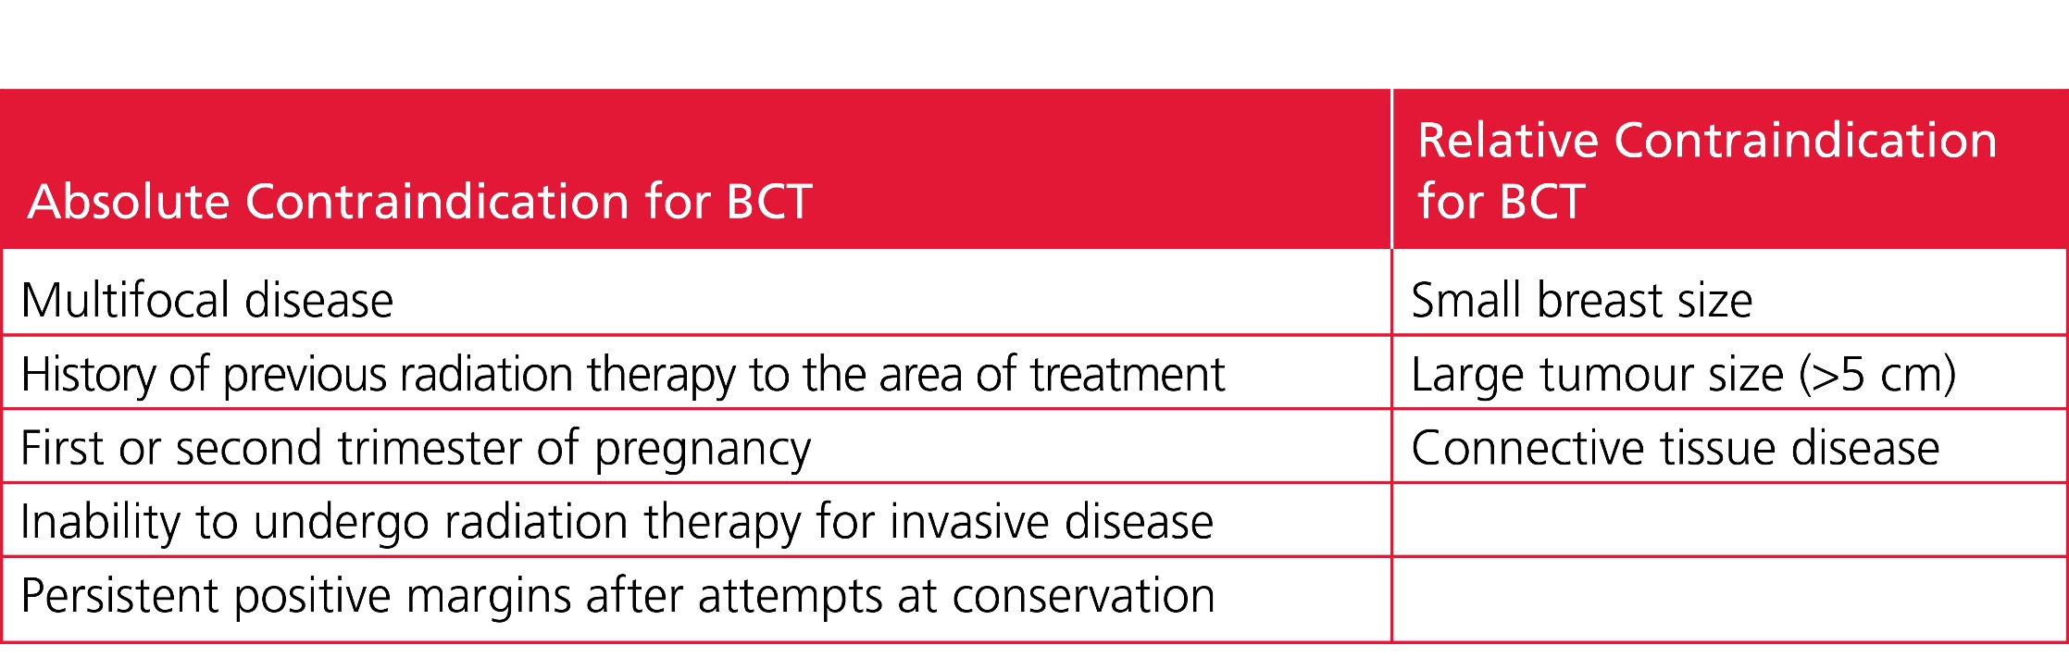
Courtesy of CRC Press/Taylor & Francis Group
Table 8.3 Contraindication for Breast-Conserving Therapy

