Slide 1

Syntax
Chapter 5
A Concise Introduction to Linguistics (5th Edition)
Bruce M. Rowe and Diane P. Levine

Slide 2
This PowerPoint relates to these Learning Objectives:
Define the term syntax.
Analyze the statement “Syntax is basically subconscious knowledge.”
Discuss what is meant by saying that language has a hierarchical structure.

Slide 3
Syntax
Syntax is a level of grammar that specifically refers to the arrangement of words and morphemes in the construction of sentences.
It also deals with how these combined structures interface with external behaviors such as speech, sign language, and writing to make the combined structures useful in communication.
Syntactic rules are basically subconscious. People apply them automatically and without noticing, and using the syntax is usually obligatory.

Slide 4
Syntax
Descriptive grammar or descriptive syntax refers to the mostly subconscious rules of a language that one uses to combine smaller units into sentences. The term also refers to the study of these rules.
When linguists study syntax, they are interested in describing the subconscious knowledge that people possess about the syntax of their language. Linguists are not prescribing how they should construct sentences.
They listen to what people actually say and then attempt to discover the rules being used.
Prescriptive grammar or prescriptive syntax refers to the concept that there is a correct and an incorrect way to speak, write, or sign.
What an English teacher or a teacher of other languages does in a grammar class by telling you that there is a correct or incorrect way to write or speak is called prescriptive syntax or prescriptive grammar.

Slide 5
Syntax
Syntax is our competence to generate speech from the stored language in our minds—the sounds, words, and rules. It is not just grammar or parts of speech.
Syntax is analogous to making a smoothie. The raw material is put into a machine (the brain), then the machine functions in a specific way to create something meaningful (speech comes out).
It’s syntax that turns one thing into another—the generator of speech.
Even our thoughts are governed by syntax

Slide 6
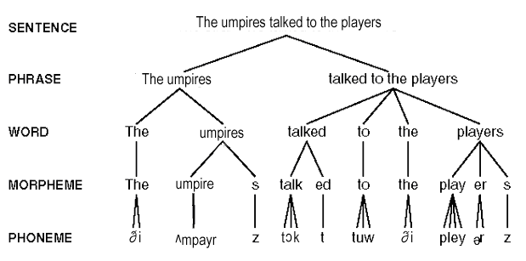
Syntax

