Slide 1
Sustainable Management
A Complete Guide for Faculty and Students
Third Edition
Prof Dr Petra Molthan-Hill
Co-Chair UN PRME Working Group on Climate Change & the Environment
Professor of Sustainable Management and Education for Sustainable Development
Nottingham Business School, Nottingham Trent University, UK

Slide 2
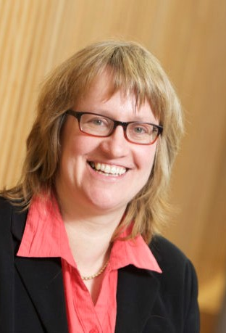
Introduction
Prof Dr Petra Molthan-Hill is Co-Chair of the United Nations Principles for Responsible Management Education (PRME) Working Group on Climate Change and Environment and Professor of Sustainable Managment and Education for Sustainable Development (ESD) at Nottingham Business School, Nottingham Trent University, UK.
She is an international multi-award-winning expert for Climate Change Mitigation Tools, Greenhouse Gas Management and ESD and leads the ‘Climate Literacy Training for Educators, Communities, Organisations and Students’ (CLT-ECOS) distributed worldwide.
She has worked with organisations from SMEs to bigger organizations like the NHS on how to reduce GHG emissions and is lead author of the 'Handbook of Carbon Management. A Step-by-Step Guide to High-Impact Climate Solutions for Every Manager in Every Function ' https://www.routledge.com/The-Handbook-of-Carbon-Management-A-Step-by-Step-Guide-to-High-Impact-Climate/Molthan-Hill-Winfield-Howarth-Mazhar/p/book/9781032227603

Slide 3

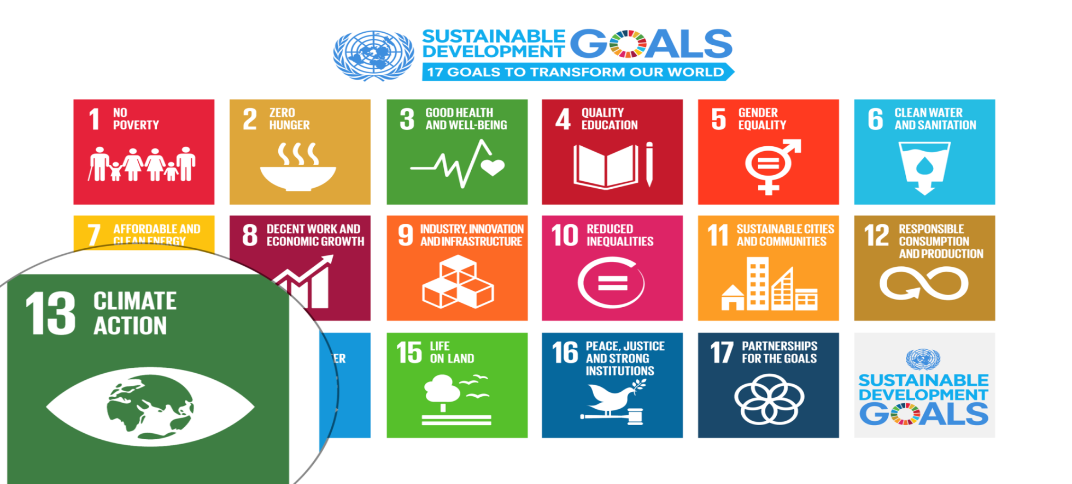
UN Sustainable Development Goals
Notes:
Carbon Dioxide equivalent gives us a level playing field to understand the effects of various activities

Slide 4
Climate Change Mitigation Education into the core curriculum of every discipline
Developing values, knowledge and skills required to make choices and decisions that minimize the use of natural resources, emissions, waste and pollution; while contributing to the development of new solutions to the climate crisis (e.g., rethinking the way we live, buy and consume, how our daily lives are organized, how we socialize, exchange, share, educate and build identities).
Taking individual and/or collective action with the potential to have immediate, direct impact (e.g., reducing energy consumption, using non-polluting and renewable energy sources, environmental conservation, re-forestation and re-greening).
Contributing to policy development with long-term positive impact on societal behaviour by examining economic systems, social structures, cultural patterns, lifestyle expectations, consumerism, wealth distribution, aspirations and value systems and their underlying responsibility for excessive greenhouse gas production.
Table published in: Molthan-Hill, P et al (2021), Climate change education at universities: Relevance and strategies for every discipline. in: Handbook of Climate Change Adaptation and Mitigation (3rd edition), Springer: Cham, Switzerland. Adapted from definitions provided by Mochizuki Y, Bryan A (2015) Climate change education in the context of education for sustainable development: Rationale and principles. Research 9(1): 4-26.
Notes:
The second one is Climate Change Mitigation Education: Every Graduate needs to know how to best mitigate climate change- what are the best strategies and tools in operations, supply chain management, economics, investment to reduce carbon emissions?

Slide 5
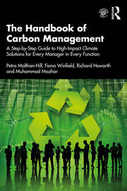
Integrated into every discipline/function
The Handbook of Carbon Management: A step-by-step guide to high-impact climate solutions for every manager in every function (Routledge)
Procurement and Supply: pushing the boundaries to remove carbon emissions
Marketing for a better climate
Pension funds, accounts and other investments
GHG emissions accounting
Climate communication and reporting to internal and external stakeholders
https://www.routledge.com/The-Handbook-of-Carbon-Management-A-Step-by-Step-Guide-to-High-Impact-Climate/Molthan-Hill-Winfield-Howarth-Mazhar/p/book/9781032227603

Slide 6

Pass it on

Slide 7
Want to find out more?
Please contact Prof Dr Petra Molthan-Hill
petra.molthan-hill@ntu.ac.uk

