Slide 1
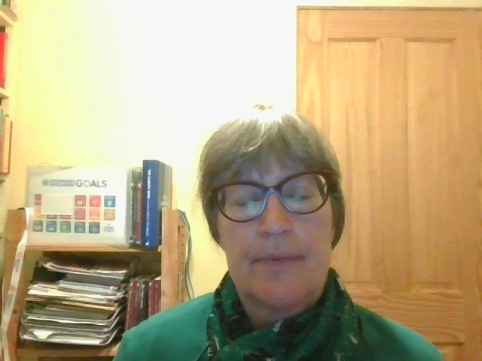
Chapter 1
The structure and purpose of this book
Prof Dr Petra Molthan-Hill
Co-Chair UN PRME Working Group on Climate Change & the Environment
Professor of Sustainable Management and Education for Sustainable Development
Nottingham Business School, Nottingham Trent University, UK

Slide 2
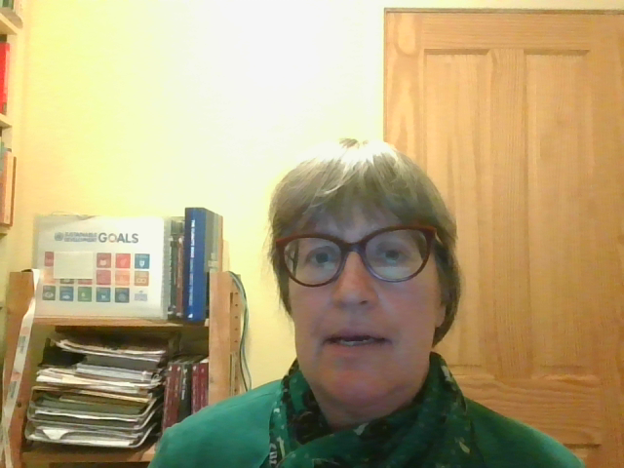
First edition – third edition
Sustainability issues are relevant to all organisations of all sizes
and in all sectors. Increasingly, organisations themselves are
demanding sustainability literacy skills for a wide range of roles
and responsibilities. If learners can gain these skills, they are
therefore improving both their own employability as well as
their ability to contribute to making their future workplace and
society more sustainable. Yet despite this, and an ever-growing
emphasis on employability within the education sector, there
are currently few examples of sustainability literacy being
addressed across the curriculum in mainstream education.
( Robinson, 2009 : 130)
An understanding of ‘responsible leadership’ will incorporate authentic, values-driven, inclusive, ethical, sustainable, systemic and transformative leadership which considers the interests and perspectives of different stakeholders, both now and for the future, while focusing on addressing climate change and other key challenges, for example, leading towards net zero in fair and inclusive ways.
(QAA, 2023: 4)

Slide 3

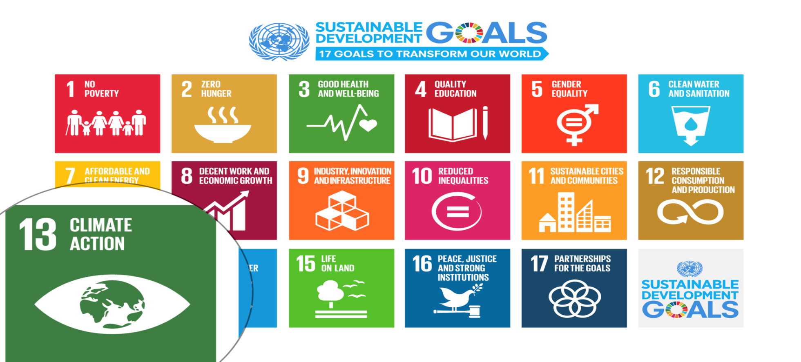
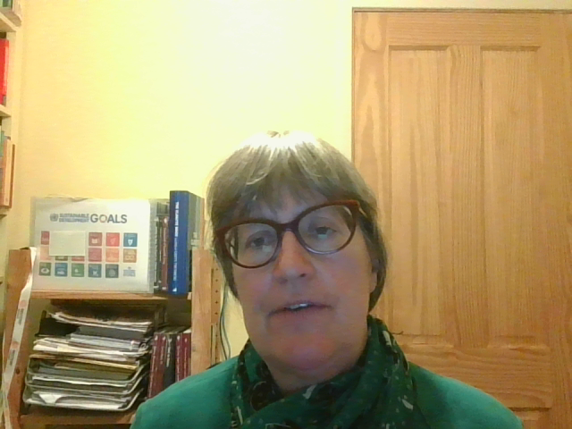
UN Sustainable Development Goals (SDGs)
Notes:
Carbon Dioxide equivalent gives us a level playing field to understand the effects of various activities

Slide 4
Climate Change Mitigation Education into the core curriculum of every discipline
Developing values, knowledge and skills required to make choices and decisions that minimize the use of natural resources, emissions, waste and pollution; while contributing to the development of new solutions to the climate crisis (e.g., rethinking the way we live, buy and consume, how our daily lives are organized, how we socialize, exchange, share, educate and build identities).
Taking individual and/or collective action with the potential to have immediate, direct impact (e.g., reducing energy consumption, using non-polluting and renewable energy sources, environmental conservation, re-forestation and re-greening).
Contributing to policy development with long-term positive impact on societal behaviour by examining economic systems, social structures, cultural patterns, lifestyle expectations, consumerism, wealth distribution, aspirations and value systems and their underlying responsibility for excessive greenhouse gas production.
Table published in: Molthan-Hill, P et al (2021), Climate change education at universities: Relevance and strategies for every discipline. in: Handbook of Climate Change Adaptation and Mitigation (3rd edition), Springer: Cham, Switzerland. Adapted from definitions provided by Mochizuki Y, Bryan A (2015) Climate change education in the context of education for sustainable development: Rationale and principles. Research 9(1): 4-26.
Notes:
The second one is Climate Change Mitigation Education: Every Graduate needs to know how to best mitigate climate change- what are the best strategies and tools in operations, supply chain management, economics, investment to reduce carbon emissions?

Slide 5
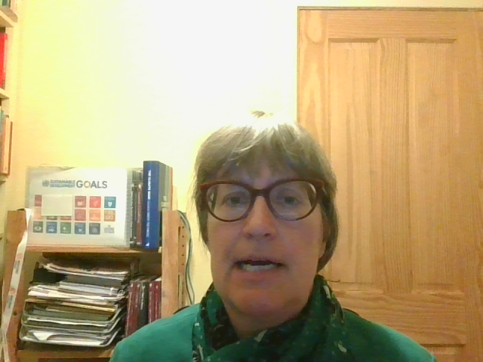
Chapter 1-6 Setting the scene
Chapter 1 The structure and purpose of this book
Chapter 2 A new framework for embedding sustainability into the business school curriculum
Chapter 3 Climate Change Mitigation Education in Business Schools: Now It Is Time to Save the Day!
Chapter 4 Sustainable and Employable Graduates
Chapter 5 Integrating the three pillars of sustainability: social, environmental and economic
Chapter 6 PRME, the UN Global Compact and the Sustainable Development Goals

Slide 6
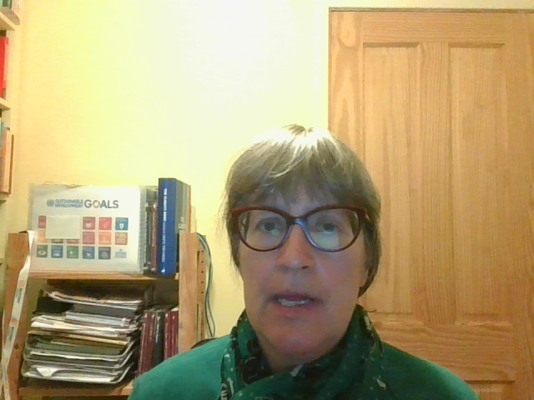
Structure Chapter 7- 18
Chapter brief: This outlines the learning outcomes and content of the chapter.
Core text: Here you will find an introduction to the key definitions and concepts to be studied in the subject concerned, which are later applied in the seminars.
Three fully developed sessions (for sessions of approximately 50–60 minutes): Each of these sessions is ready to be delivered without further preparation required by the educator. They can also be studied independently by you as a student. We recommend, however, that they are used in a group, as an exchange of ideas and understanding would be beneficial. Most seminars can be broken down into different exercises so that shorter activities can also be chosen. The three seminars in any one subject area mostly use different learning methods, e.g., an artwork, a game, or a case study.
Additional teaching/learning materials and ideas: This section in each chapter offers short summaries of additional ideas for teaching/self-study such as movies or websites. Most of them are designed for additional sessions of about 60 minutes in length, but some larger activities are also suggested, such as consultancy projects, which could cover a whole term/module.
Further reading: Here you will find on average five recommendations for deepening your knowledge in this area. Each book or article recommended is summarised in a short paragraph outlining the key benefits for the reader.

Slide 7

Want to find out more?
Please contact Prof Dr Petra Molthan-Hill
petra.molthan-hill@ntu.ac.uk

