Slide 1
10.1 The Higgs Boson and Drawing Inferences with Statistics
After reading this section, you should be able to:
Identify three roles of statistical inference and illustrate them with examples
Describe how probability theory extends the reach of statistics
Distinguish frequency distribution from probability distribution

Slide 2


Slide 3
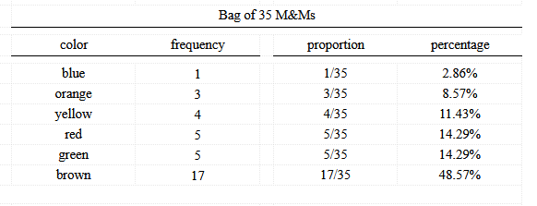

Slide 4
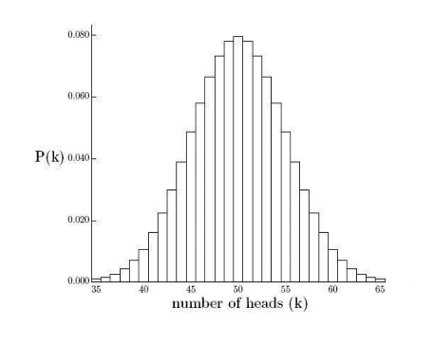

Slide 5
