Slide 1
10.2 Statistics in Estimation
After reading this section, you should be able to:
Define sample mean and sample standard deviation and indicate how these differ from mean and standard deviation for descriptive statistics
Describe how inferential statistics is used to estimate population values from a sample
Indicate how sample size and representativeness matter for estimation

Slide 2
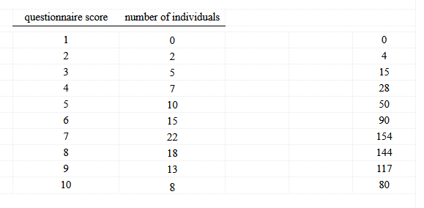

Slide 3


