Slide 1
11.4 Causal Modeling
After reading this section, you should be able to:
Describe how causal modeling can yield causal knowledge
Define causal Bayes nets and describe how they are developed and applied
Identify three assumptions of causal Bayes nets and discuss their significance

Slide 2
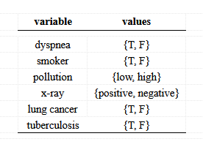

Slide 3
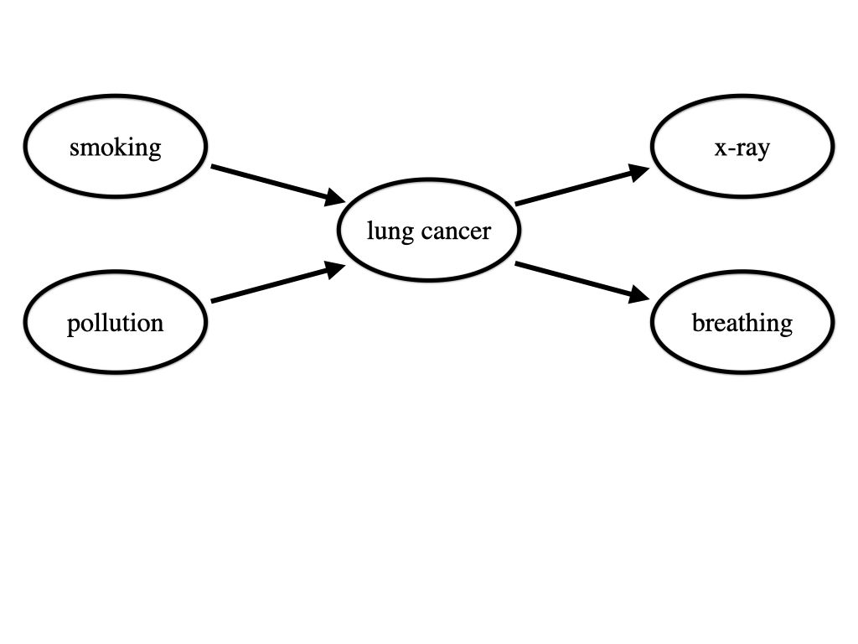

Slide 4
