Slide 1
13.2 Participation in Science
After reading this section, you should be able to:
Describe how people with some social identities have been historically excluded from or marginalized in science
List three ways in which diversity of scientists is beneficial to science
Indicate how members of the public can be included in scientific research and how this can affect scientific research

Slide 2
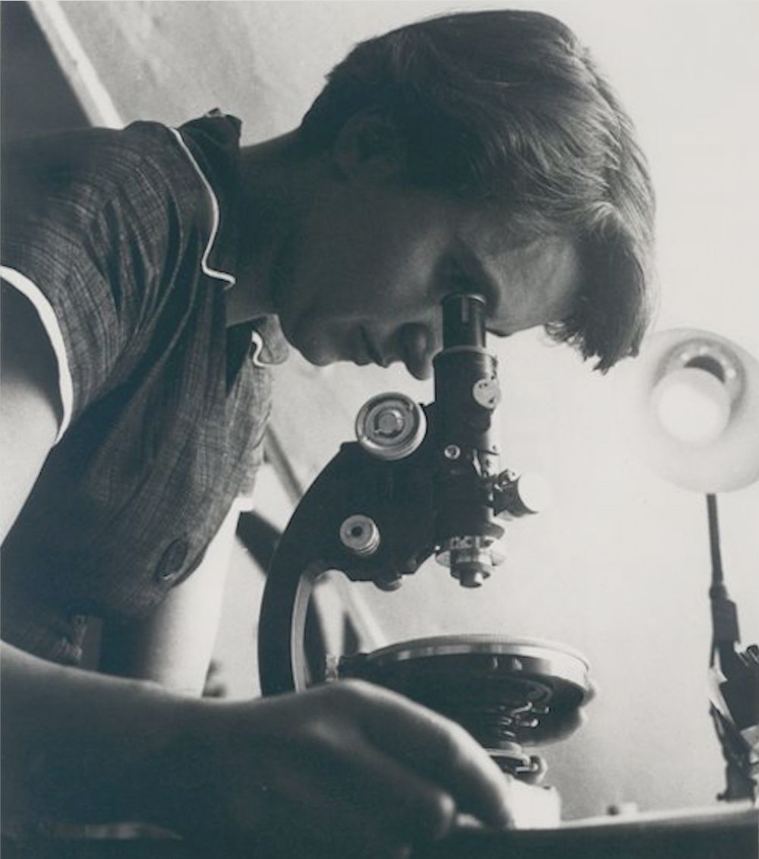

Slide 3
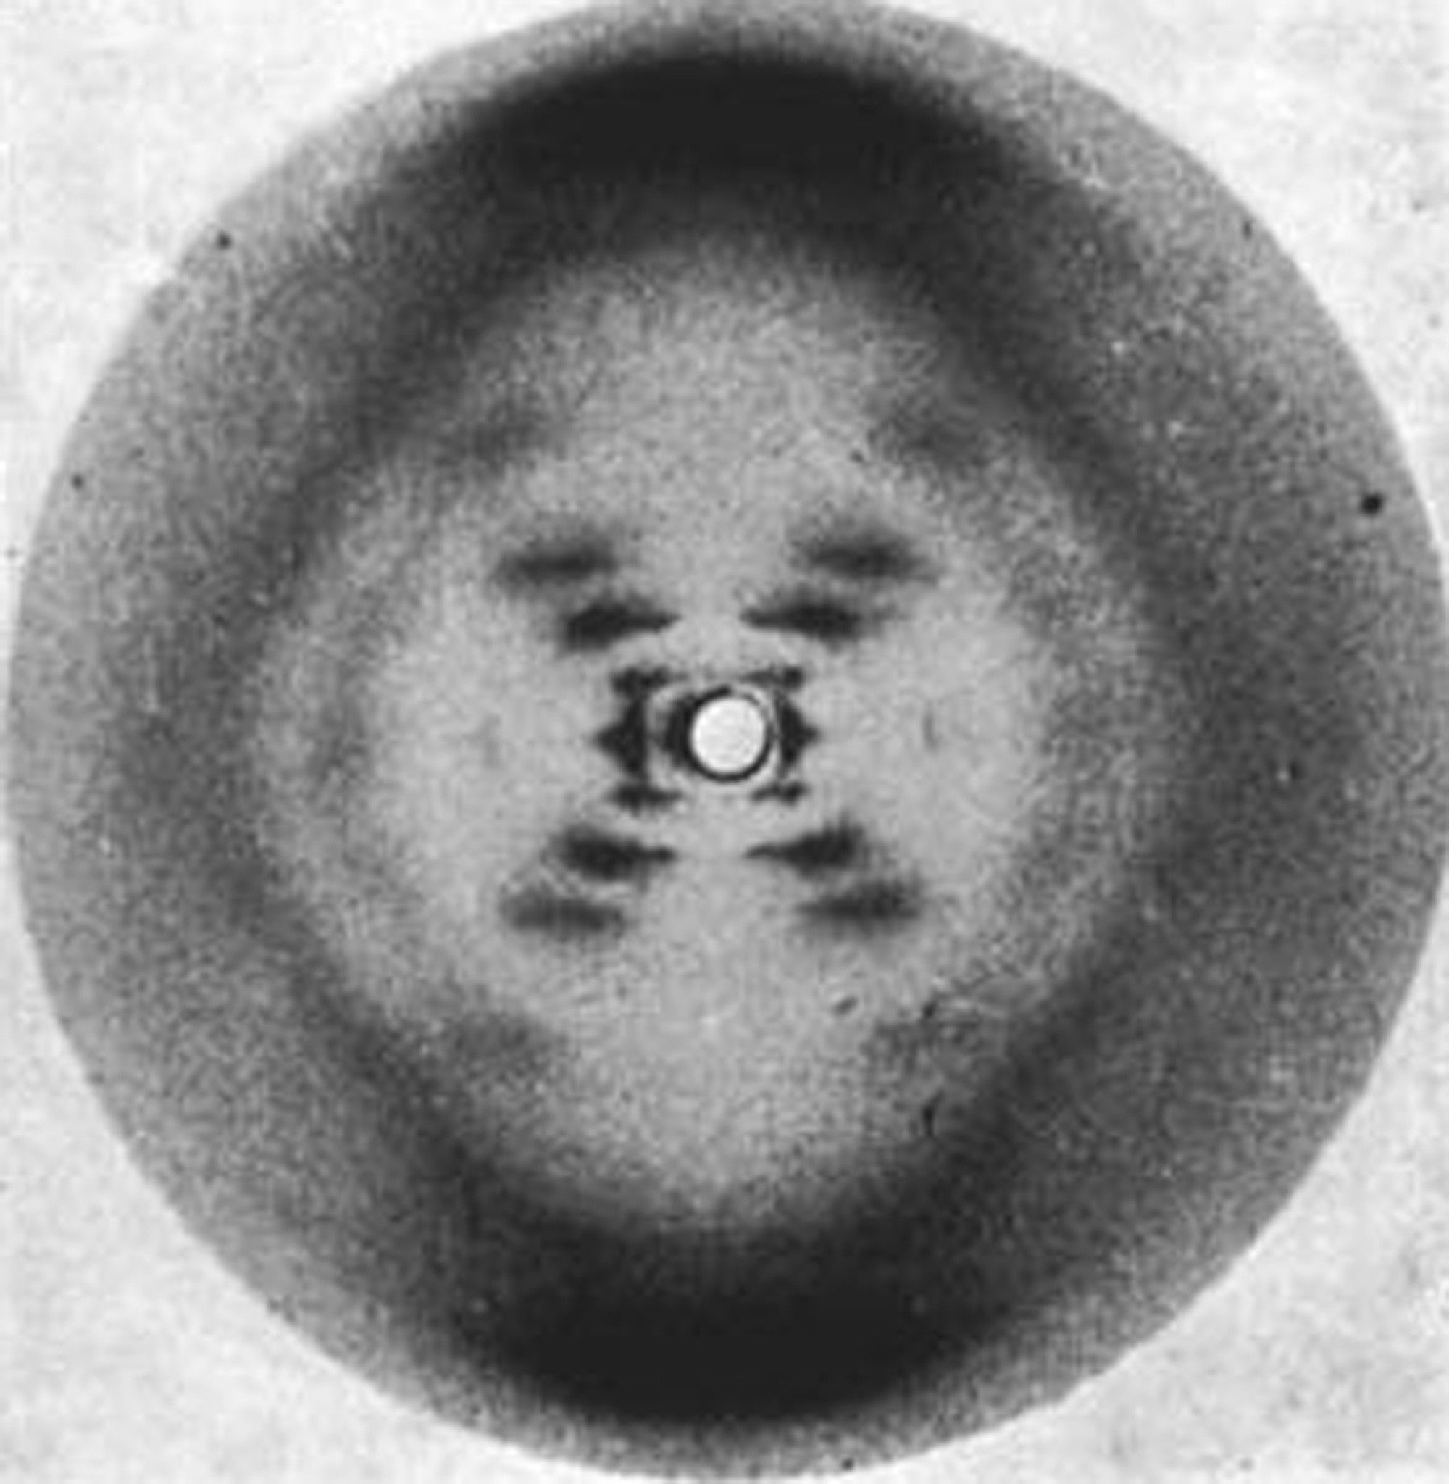

Slide 4
