Slide 1
2.1 Public Health and How Values Shape Science
After reading this section, you should be able to:
Define biological sex and gender and say how each might be relevant to health outcomes
Describe the germ theory of disease and social determinates of health, saying what is important about each focus in health research
Describe how social values influence scientific research aims

Slide 2
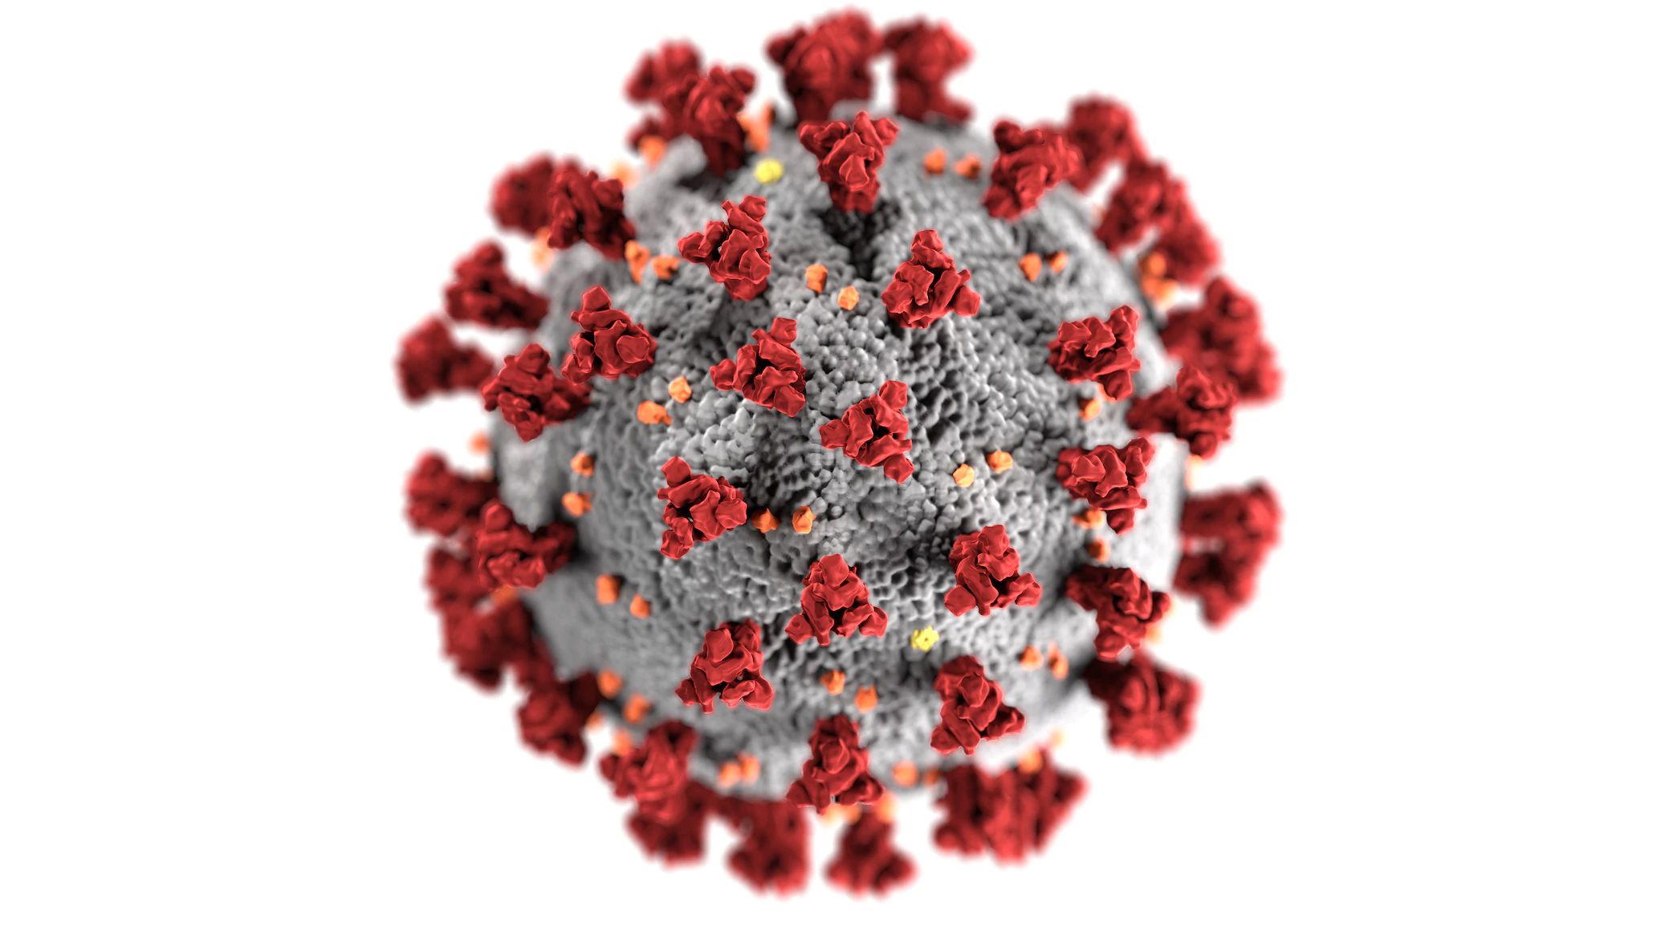

Slide 3


Slide 4
 | Medicine | Public Health
Target | Individuals | Whole populations
Aim | Prevent and treat particular health conditions | Improve overall community health, including disease prevention
Relevant Sciences | Biological sciences, pharmacology, bioinformatics/bioengineering | Sociology, environmental sciences

