Slide 1
​2.2 Variety of Scientific Aims and Methods
After reading this section, you should be able to:
Identify why there is not a single, unified scientific method
Explain how different scientific aims and circumstances influence scientific methods
Characterize the roles of the following in science: experiments and observational studies, modeling, scientific arguments, statistical reasoning, and theorizing

Slide 2
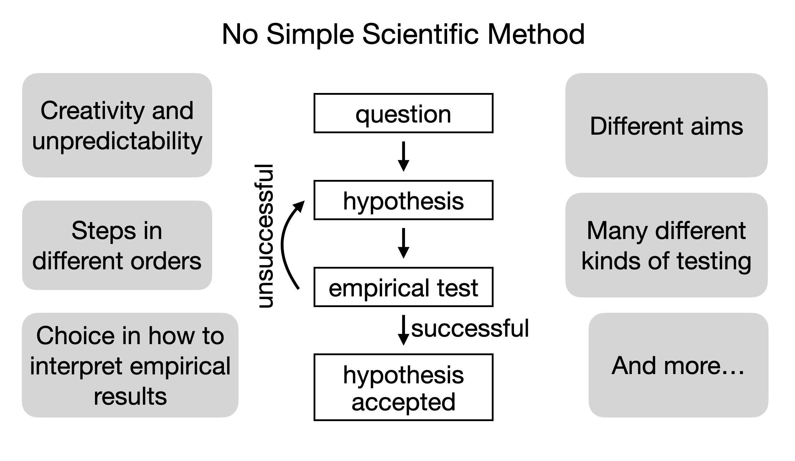

Slide 3
Types of Variety | Examples
Phenomenon studied | Covid-19, heart disease, or environmental pollution
Focal aspect of the phenomenon | Structure and biological action of SARS-Cov-2, epidemiological models of disease spread, or how virus affects different genders and races
Goal of the research | Specific theoretical knowledge, connections to knowledge of other phenomena, medical treatment, prediction, or public-policy guidance

