Slide 1
2.4 Science’s Origin and Knowledge Across Culture​​​​s
After reading this section, you should be able to:
Describe how scientific methods for gaining knowledge about the world are similar to and different from strategies employed in daily life
List innovations from the Islamic Golden Age and the Scientific Revolution and their significance for science
Indicate three areas of investigation to which indigenous knowledge is particularly relevant and describe why it’s relevant

Slide 2
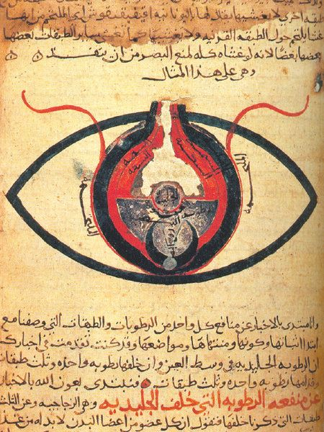

Slide 3
