Slide 1
4.1 Palaeontology and Non-Experimental Studies
After reading this section, you should be able to:
Describe how scientists have learned about woolly mammoth and mastodon life histories
Give examples of when an experiment is impossible, impractical, and unethical
List three varieties of empirical investigation that can be used when intervention is not possible

Slide 2
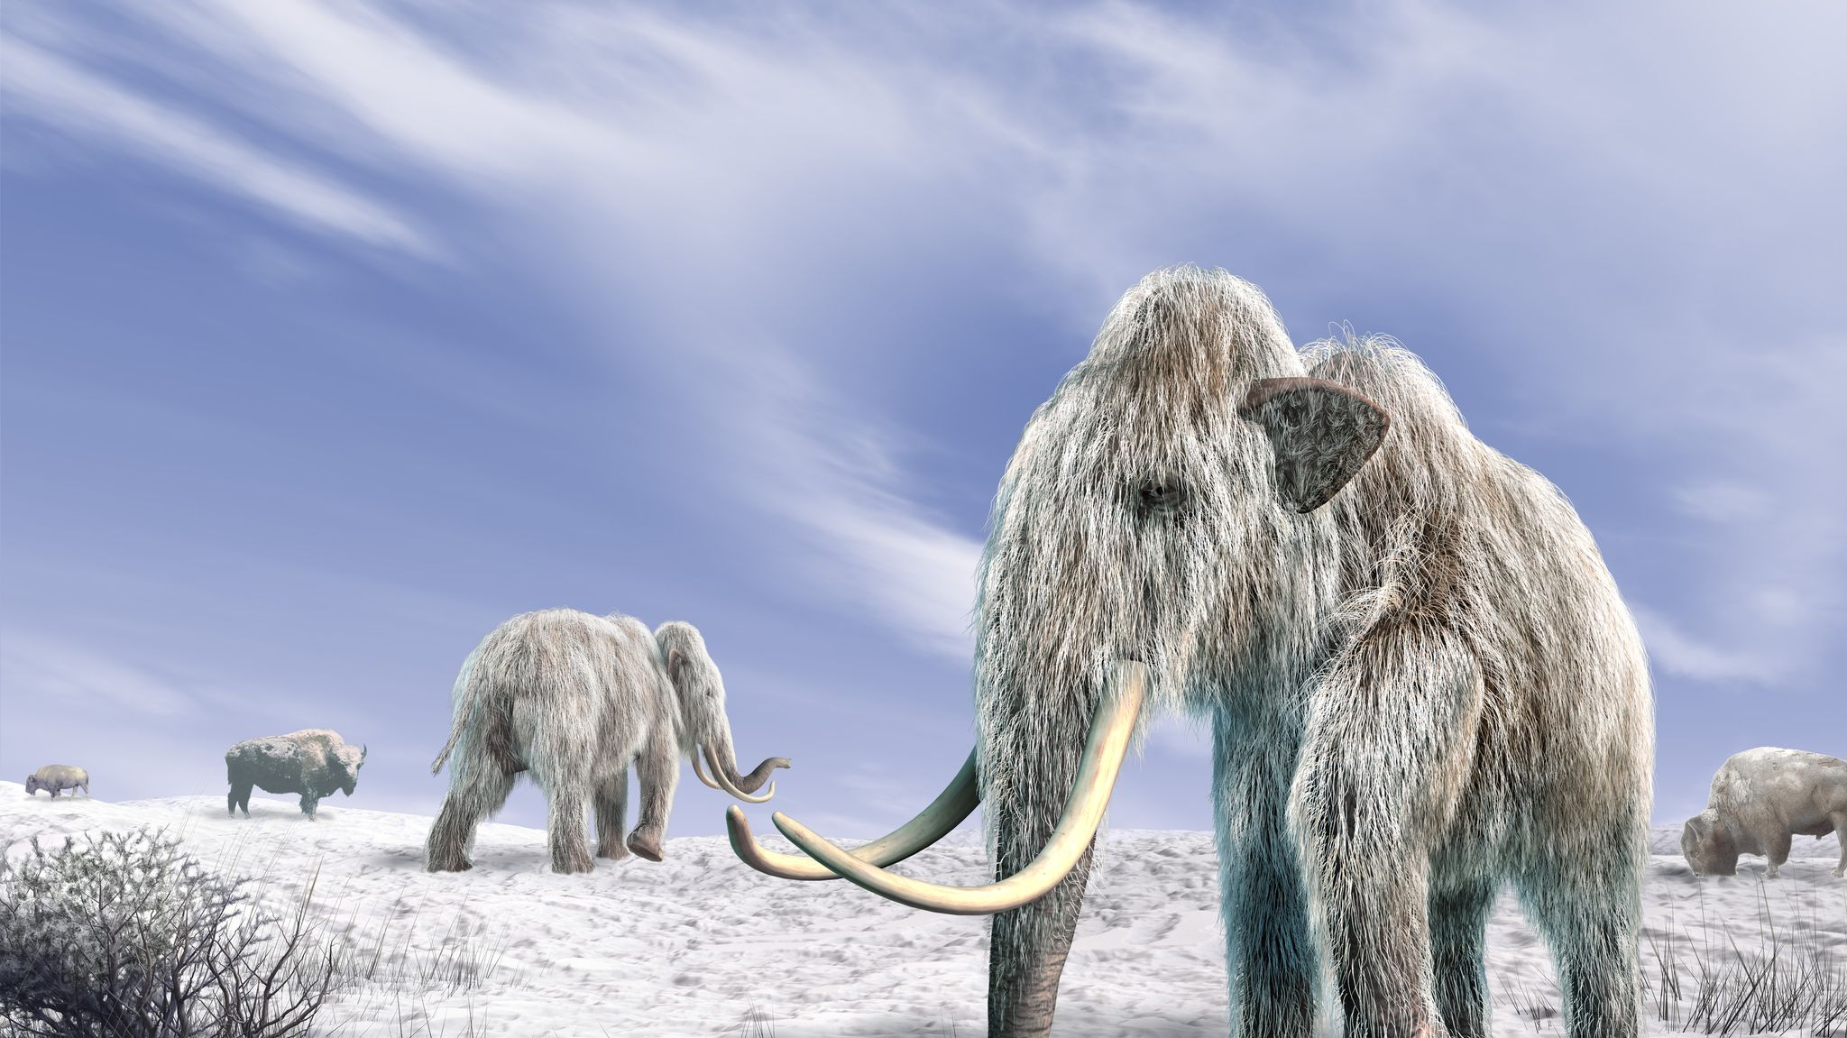

Slide 3
