Slide 1
4.2 Observational Studies
After reading this section, you should be able to:
Describe and give an example of natural experiments, longitudinal studies, cohort studies, case studies, and phenomenological analysis
Indicate three ways observational studies can manage extraneous variables
Characterize the similarities and differences between each type of observational study and experiments

Slide 2
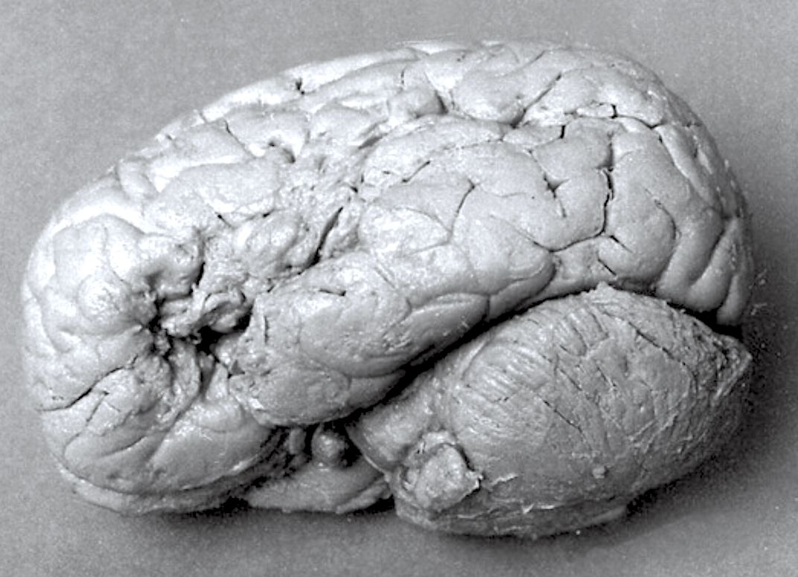

Slide 3
