Slide 1
5.3 Varieties of Models
After reading this section, you should be able to:
Define data model, say how they are used, and list the three steps to construct one
Give examples of models of these five types: scale, analog, mechanistic, mathematical, computer
Describe the prisoner’s dilemma and iterated prisoner’s dilemma models and what scientists learned from each

Slide 2
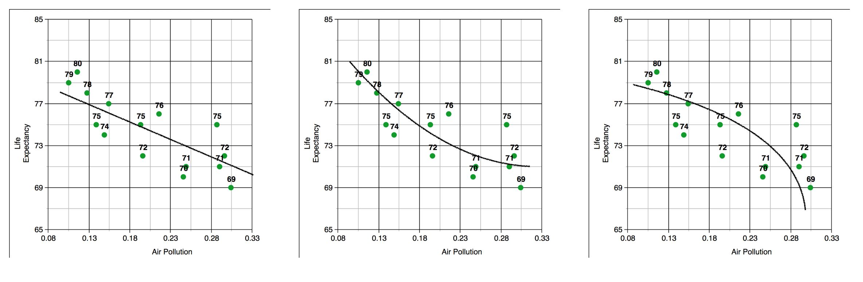

Slide 3
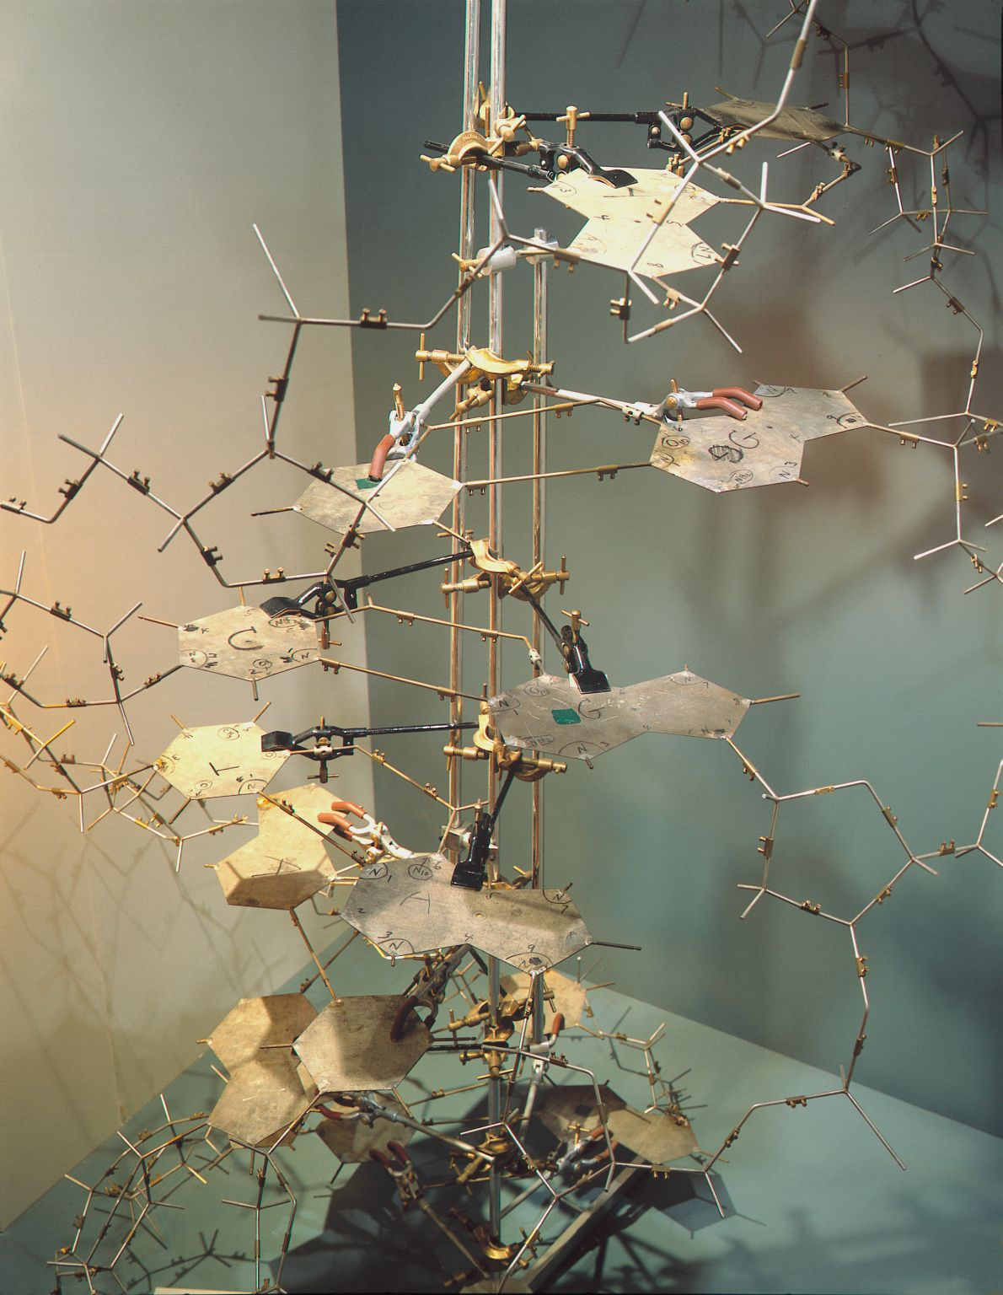

Slide 4
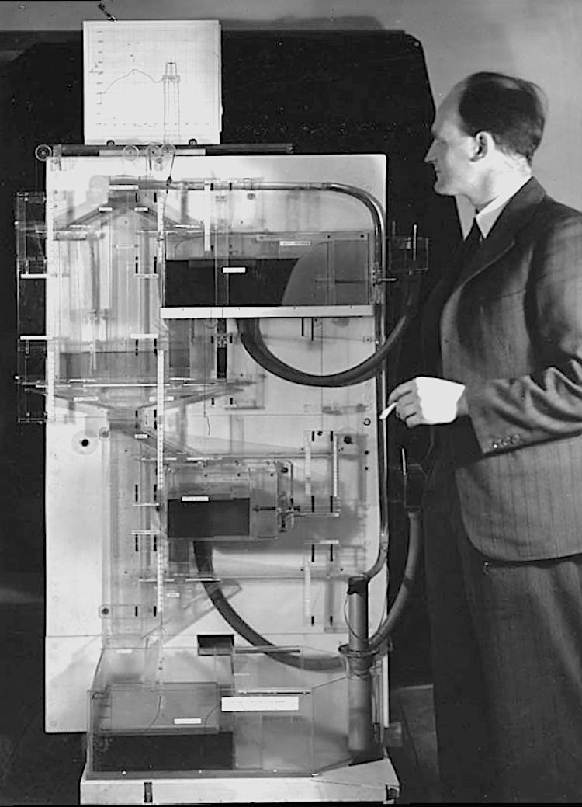

Slide 5
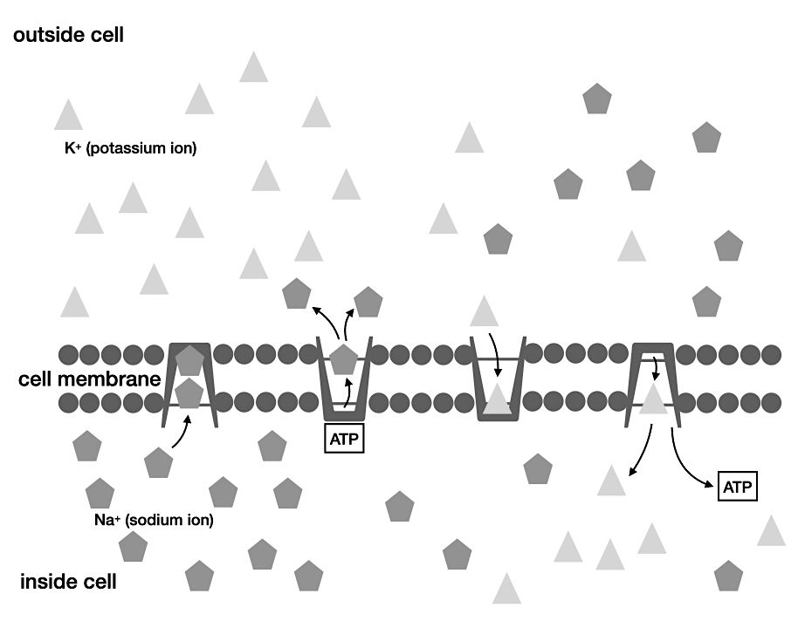

Slide 6
