Slide 1
6.4 Axiomatic Methods and Modeling
After reading this section, you should be able to:
Characterize the axiomatic method and indicate how it is used in science
Articulate how deductive inference is used in mathematical modeling
Describe how non-Euclidean geometry and the James Webb Space Telescope exemplify roles of deductive reasoning in science

Slide 2
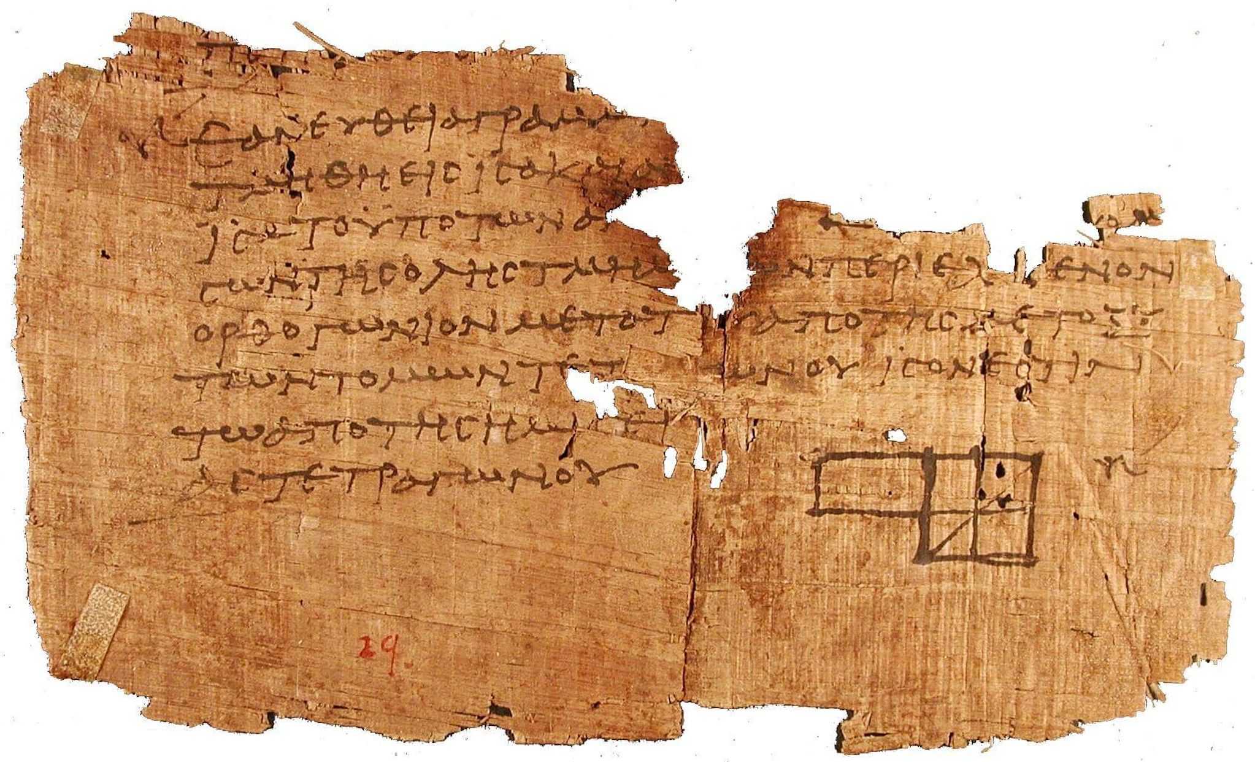

Slide 3
