Slide 1
7.3 Abductive Inference
After reading this section, you should be able to:
Define abductive inference and articulate its similarities and differences from both deductive and inductive inference
Indicate how scientific arguments in favor of continental drift and pan-African evolution exemplify abductive inference
Describe five explanatory considerations that contribute to the strength of abductive inferences

Slide 2
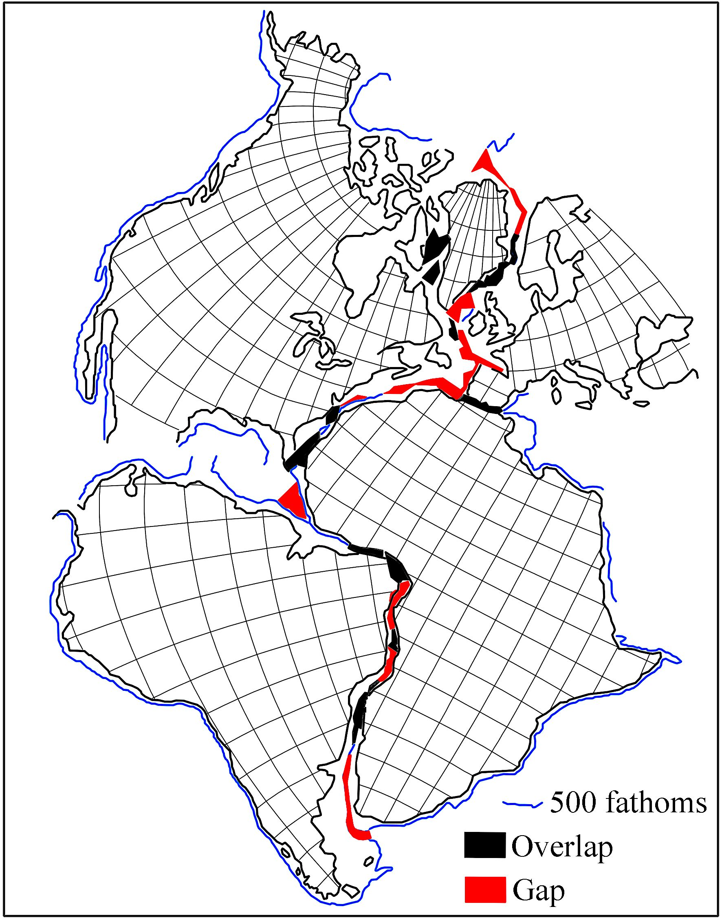

Slide 3


Slide 4
