Slide 1
9.1 World Religions and Two Uses of Statistics
After reading this section, you should be able to:
Characterize what statistical information reveals about religious belief worldwide
Describe what statistics is and what purposes it serves
Indicate two differences between descriptive and inferential statistics

Slide 2
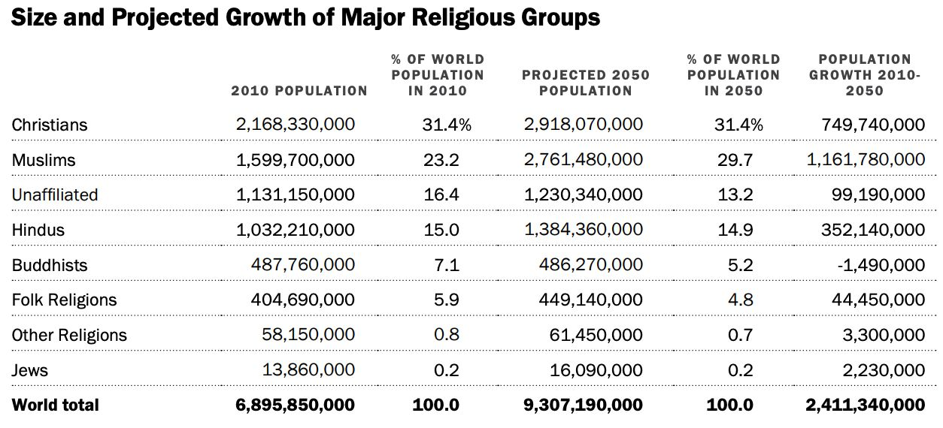

Slide 3
