Slide 1
9.2 Statistical Distribution and Correlation
After reading this section, you should be able to:
Identify and evaluate pie charts, bar charts, histograms, and scatterplots
Characterize different types of statistical distributions
Define statistical independence and correlated variables and evaluate direction and strength of correlations from a scatterplot, regression analysis, or correlation coefficient

Slide 2
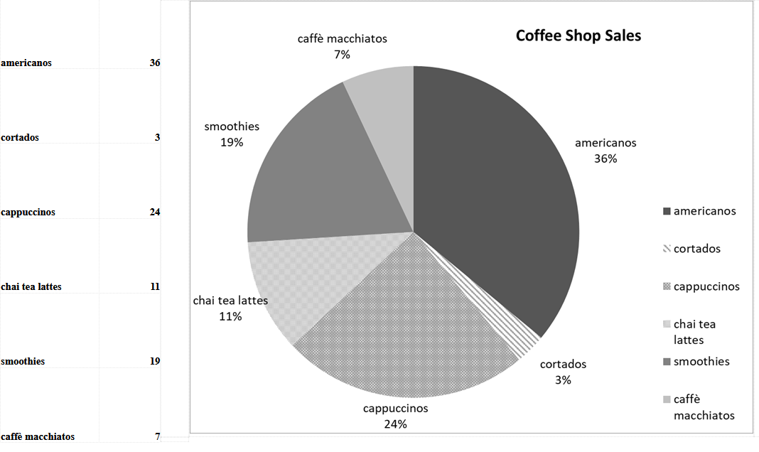

Slide 3
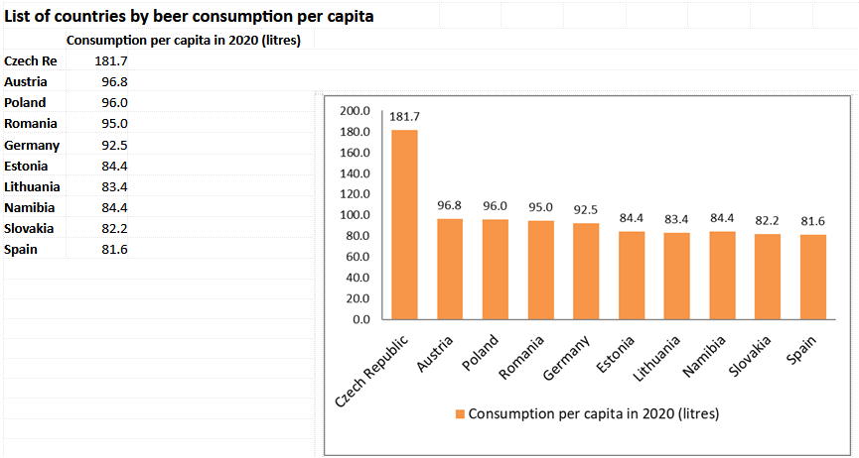

Slide 4
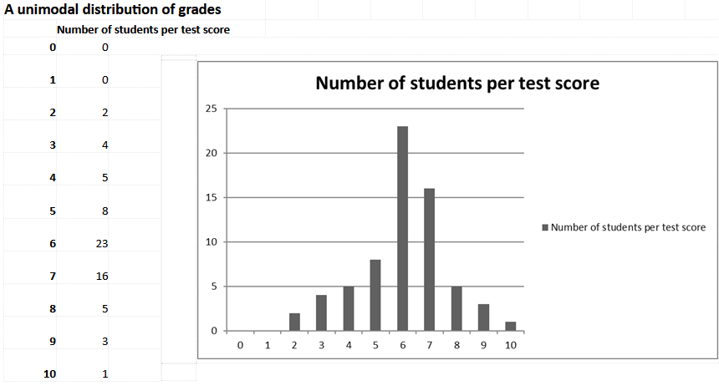

Slide 5
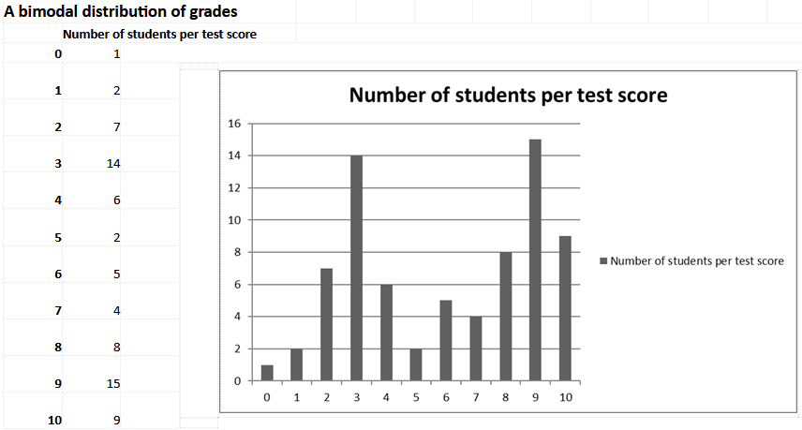

Slide 6
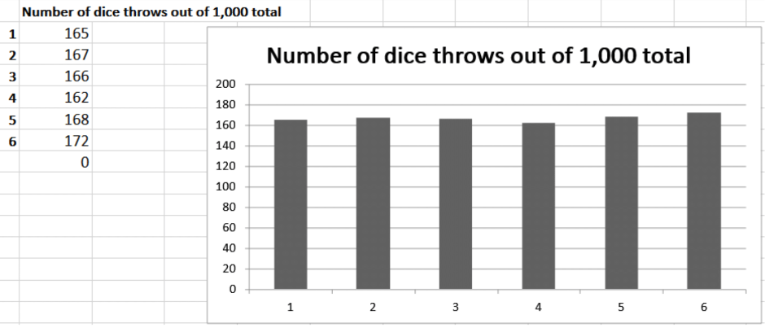

Slide 7
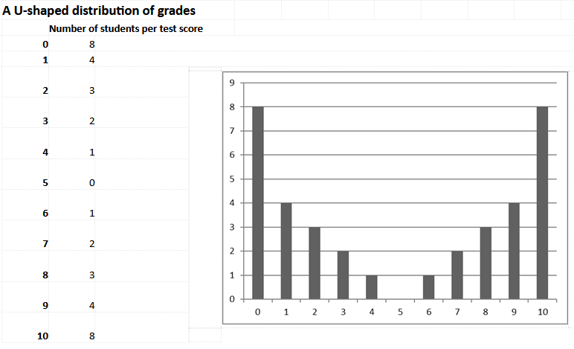

Slide 8
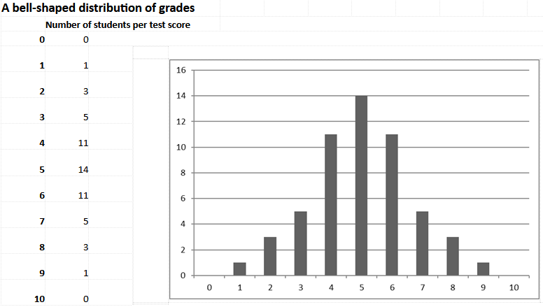

Slide 9
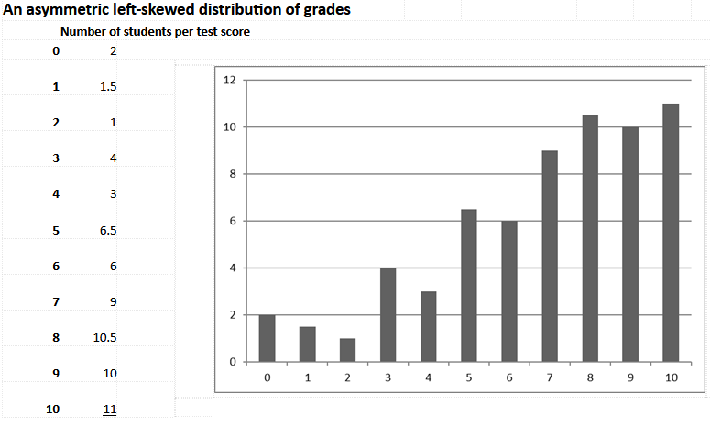

Slide 10
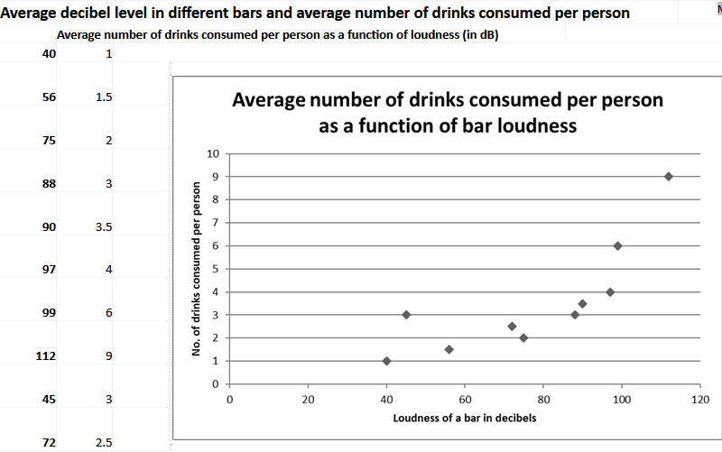

Slide 11
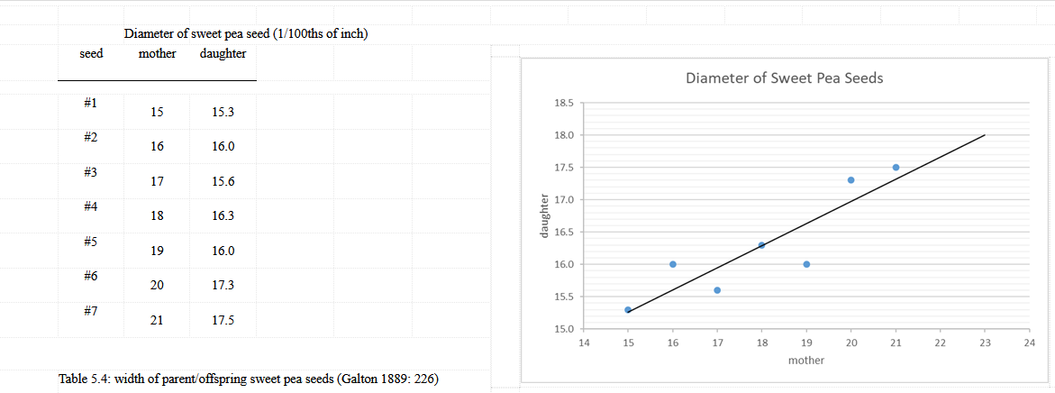

Slide 12
