Slide 1
9.3 Central Tendency and Variability
After reading this section, you should be able to:
Explain the difference between the central tendency and the variability of a dataset
Define three measures of central tendency and find each for a dataset: mode, median and mean
Define three measures of variability and find each for a dataset: range, variance and standard deviation

Slide 2
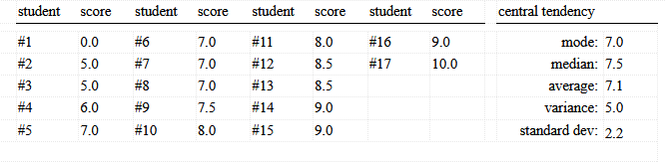

Slide 3
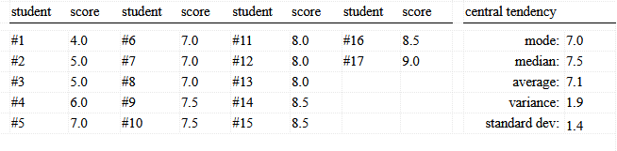

Slide 4
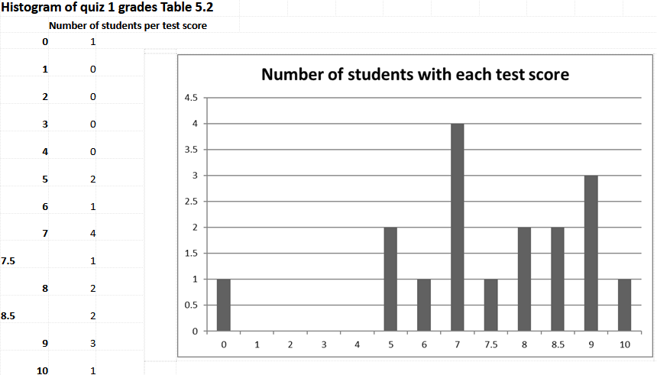

Slide 5
