Slide 1
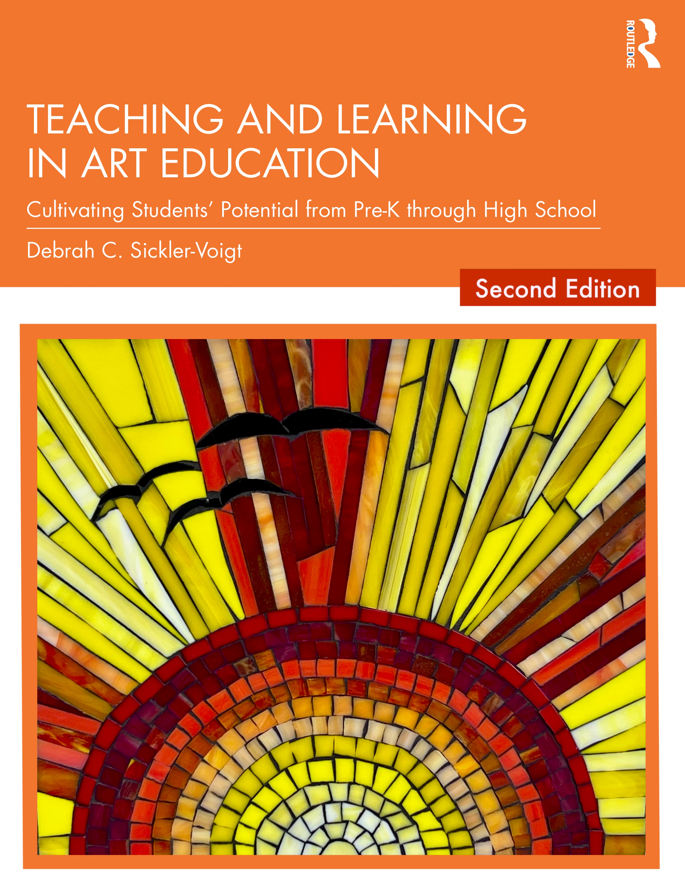
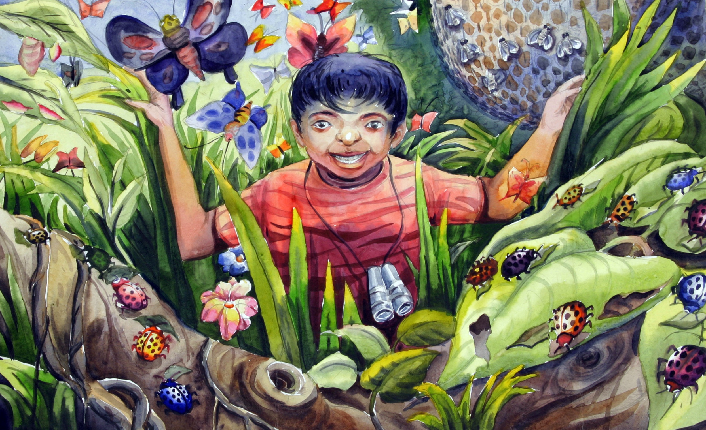
CHAPTER 2. The Transformative Art Curriculum Teaching and Learning in Art Education, 2nd Ed.
Debrah C. Sickler-Voigt, Author & Presentation Developer ©
Notes:
Welcome to Teaching and Learning in Art Education, 2nd Edition, Chapter 2!
TLAE as a theoretically-based, practical textbook to prepare preservice educators for their teaching careers and to support in-service educators in improving their existing practices. Its timely second edition with its updated framework remains dedicated to assisting educators in all stages of their careers through effective curricular planning, instruction, assessment, and management to foster student learning and cultivate educators’ meaningful, creative, and rewarding careers.
This textbook and instructional resources resulted from the contributions of many individuals, including teachers, students, artists, organizations, family, mentors, and Routledge’s editorial/production team. Its teachings are based on the author’s research, communications, and professional interpretations of teachers, artists,’ and designers’ works with the aim of being respectful of diversified peoples and representing their teachings in a truthful and non-biased manner.
Book Cover Artwork: Paula Gale
Right Image: Jana Swastik, 12 years old, The Park Institution, Kolkata, India. 38th ICEFA Lidice.

Slide 2

Chapter 2 Topics
Designing a Transformative Art Curriculum
Lessons and Unit Plans
Notes:
Spotlight on Student Art #2: Biodiversity
Image: Jana Swastik, 12 years old, The Park Institution, Kolkata, India. 38th ICEFA Lidice.

Slide 3

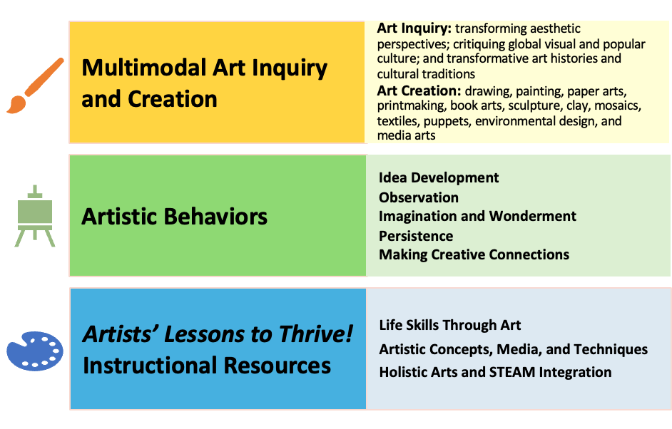
Link Chapter 2’s teachings with TLAE’s Transformative
Art Education Framework
Notes:
Class instruction: Ask students to build on prior learning and personal experiences to make personal connections between this chapter’s teachings and TLAE’s Transformative Art Education framework.

Slide 4
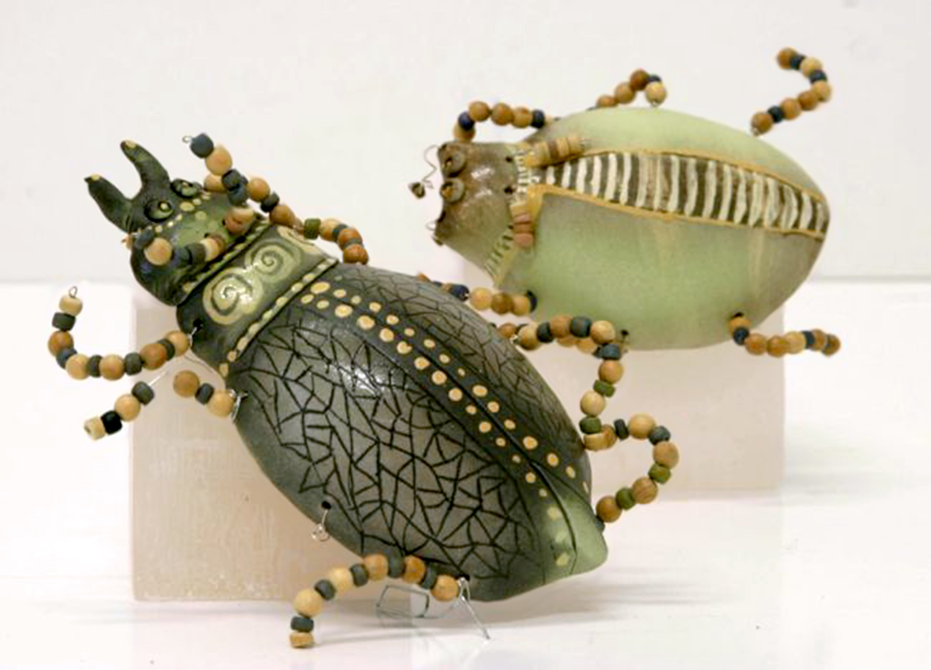
Transformative Art Curriculum 1
Is an organized instructional plan designed to foster student growth in their cognitive development, applications of the artistic behaviors, artistic expression, and social-emotional well-being.
Driven by contemporary teaching and learning practices, it anticipates the knowledge, performances, and dispositions students are expected to achieve over a given period.
Notes:
Class instruction: Discuss how a well-designed transformative art curriculum feels professionally rewarding to teach and invigorating for students to learn. Identify how its different components (standards, goals, ideas in context, big ideas, global artworks, etc.) encourage the class to make personal connections.
Image: Dagnija Butlere, 8 years old, Livänu bërnu un jauniešu centrs, Livani, Latvia. Agnis Salminš, 9 years old, Livänu bërnu un jauniešu centrs, Livani, Latvia. 38th ICEFA Lidice.

Slide 5
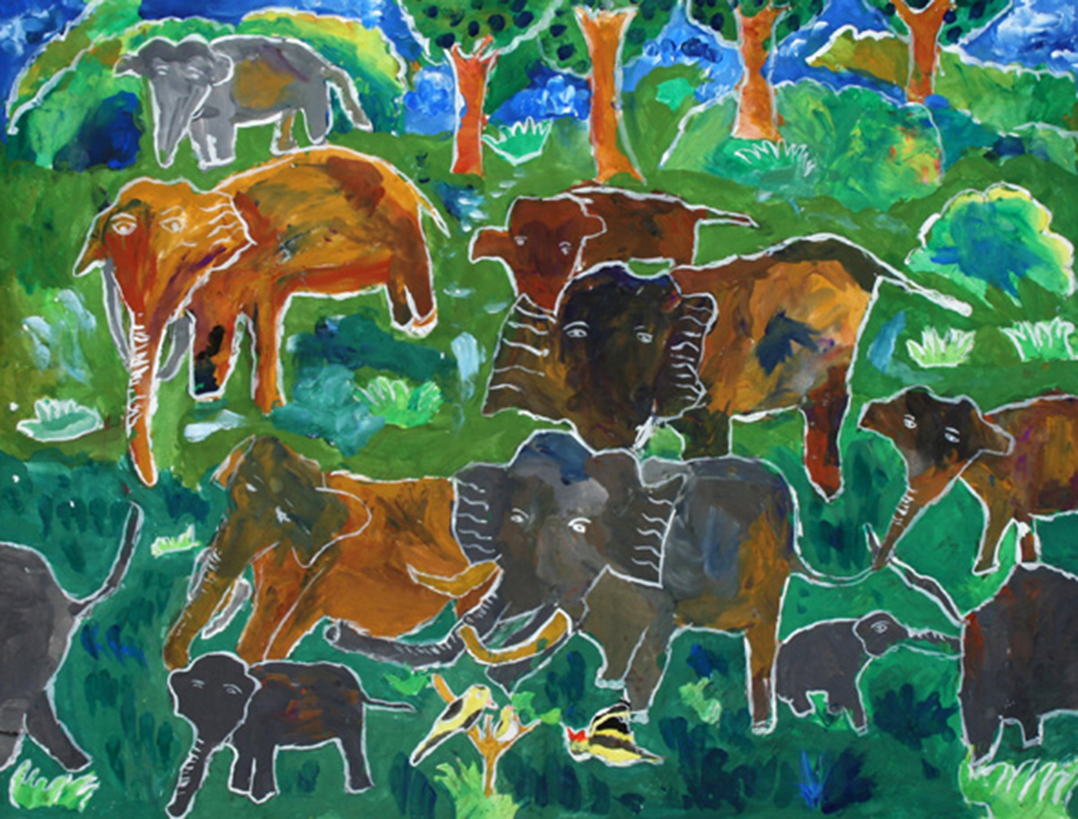
Transformative Art Curriculum (TAC) 2
The TAC values teacher and student agency, providing flexibility for students to make personally-driven choices as lifelong learners.
Teachers nurture student growth through inclusive learning tasks that encourage their development, inquisitive mindsets, and can-do mentalities.
Notes:
Class instruction: Identify strategies to encourage students’ ideation, experimentation, and creative risk taking and how to assist students who fear trying new tasks and applying the artistic behaviors.
Image: G.U.D. Abgywardana Maggona, 10 years old, Sri Lanka National Foundation for Child Art, Rajagiriya, Sri Lanka. 39th ICEFA Lidice.

Slide 6
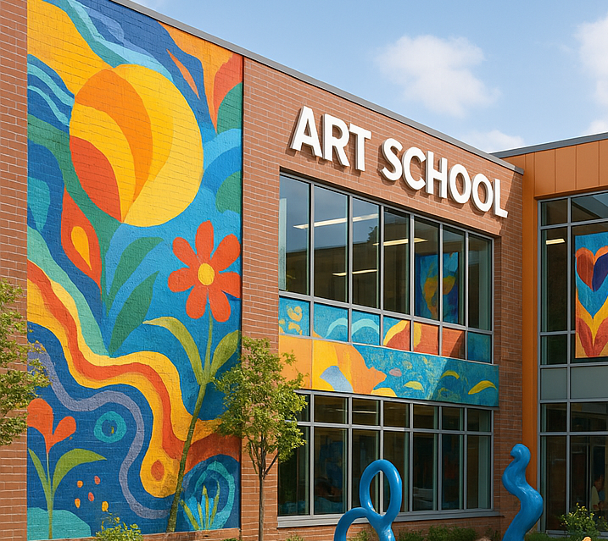
Transformative Art Curriculum 3
“Curriculum constitutes everything that is learnt at school, whether that is intentional or not” (Jefferson & Anderson, 2021, p. 30).
Notes:
Class instruction: Lead a class discussion using this quote: “Curriculum constitutes everything that is learnt at school, whether that is intentional or not” (Jefferson & Anderson, 2021, p. 30).
Image: Copilot image cropped.
Reference:
Jefferson & Anderson, 2021

Slide 7
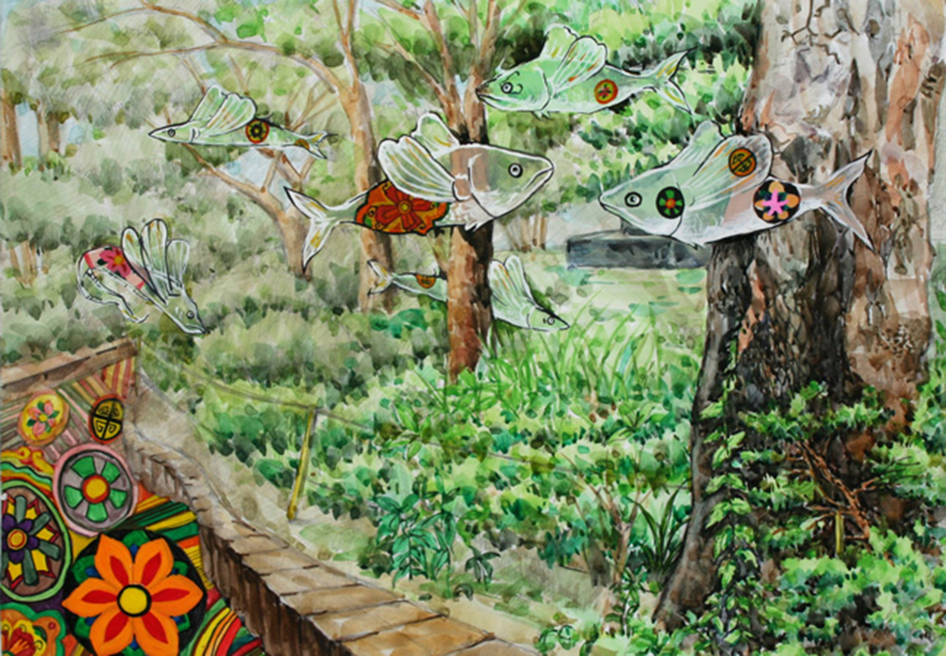
Approaches to Transformative Art Curriculum
Value subjects as co-equal disciplines.
Include authentic integration tasks.
Apply subject’s specialized language, skills, and standards
Integrate hands-on learning, artistic behaviors, and student choices.
Utilize teacher’s expert guidance to foster student growth.
Notes:
Image: Lee Da Young, 14 years old, Busan Middle School of Arts, Busan, Korea, South. 39th ICEFA Lidice.
Reference:
Sickler-Voigt, 2023

Slide 8

Standards 1
Comprehensive Art Education
National Visual Arts Standards
Standards signify the learning outcomes teachers expect students to achieve.
The National Visual Arts Standards are voluntary standards developed by leading arts organizations with input from art educators and visual artists.
Notes:
Reference:
National Coalition for Core Arts Standards, 2014

Slide 9
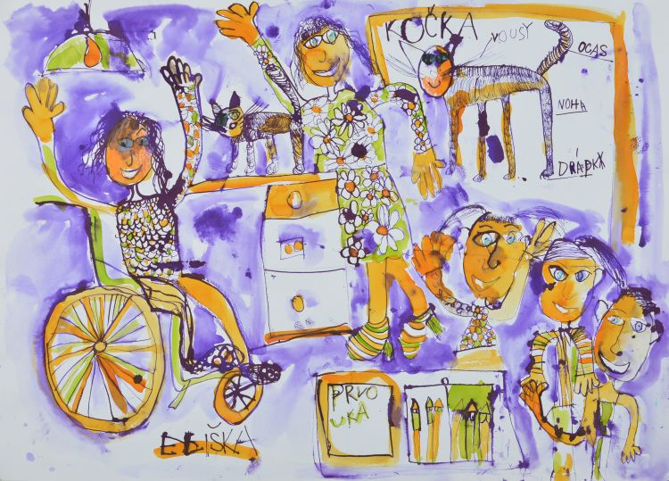
Standards: Balanced Approach to The Transformative Art Curriculum 2
At times, all students will study a particular art medium, technique, artist, or big idea as a class to build foundational knowledge and skills.
Students can later apply their acquired knowledge to participate in student-driven learning tasks.
Students try tasks they might not normally choose on their own to build competencies while still having choices.
Notes:
Image: Eliška Andrlová (7 years), MŠ, ZŠ a PrŠ při centru ARPIDA, o.p.s., České Budějovice, Czech republic. 44th ICEFA Lidice.

Slide 10
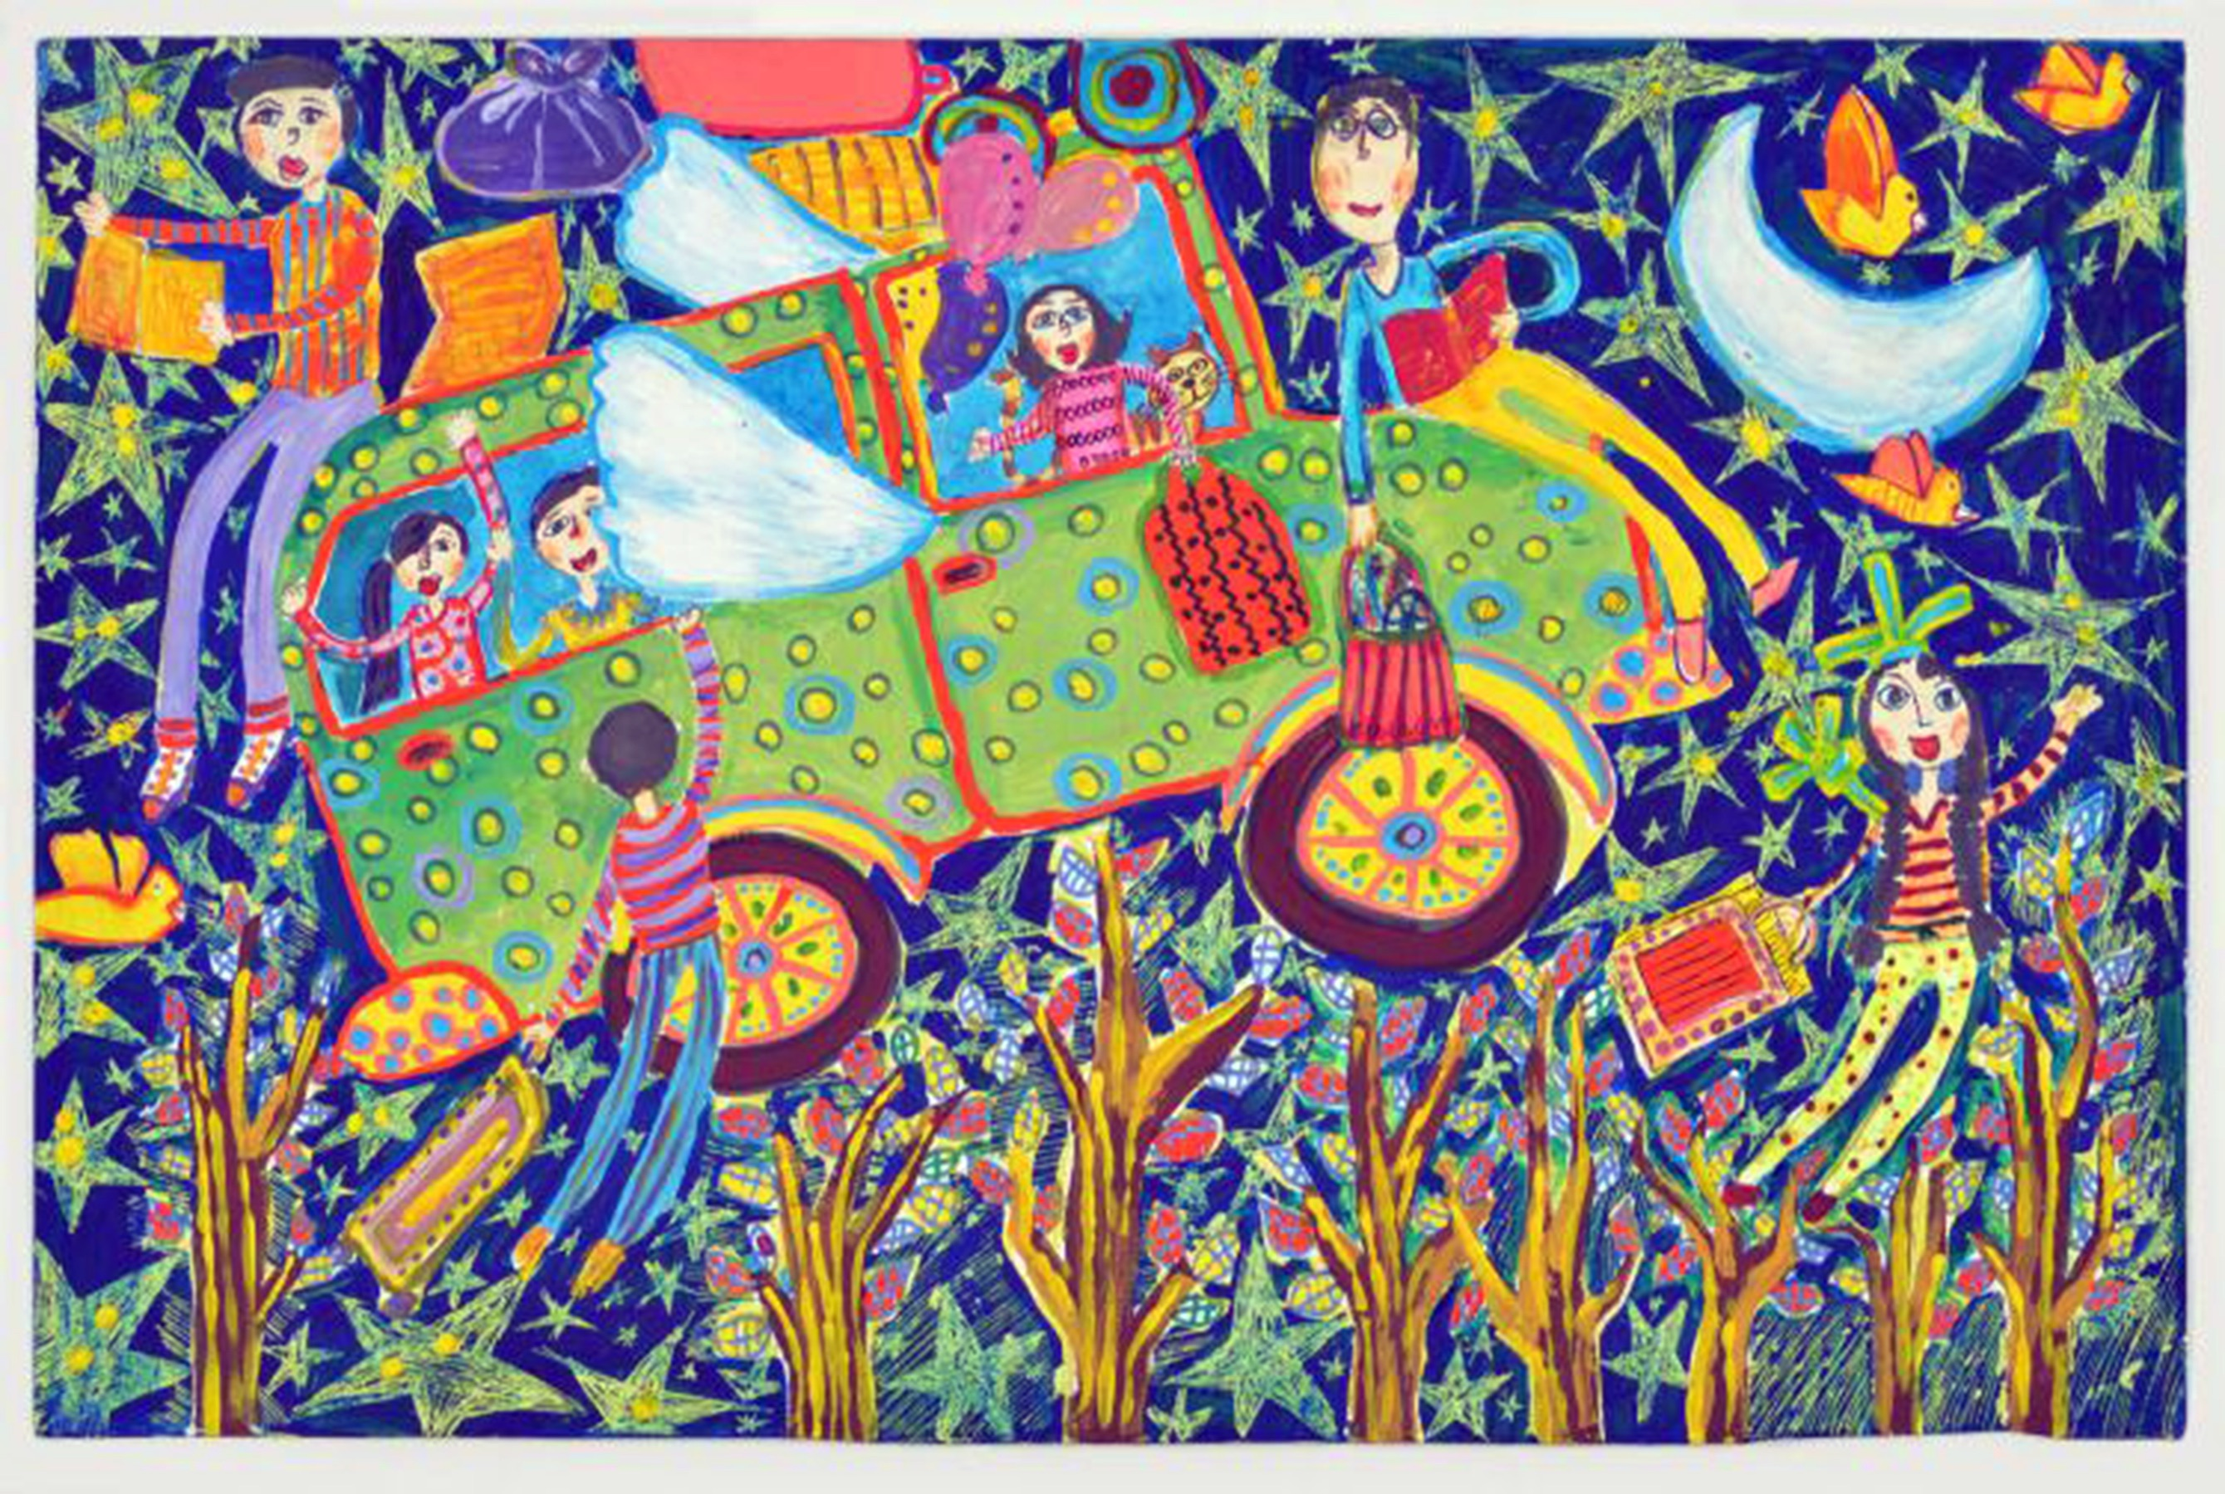
Standards 3
Organized by grade level (Pre-K-12). They present what students can achieve.
Encourage personal ideas, expertise, and interpretations.
National Visual Arts Standards (NVAS) are a model for mandated state/district standards.
Notes:
Image: Setayesh Sadeghi, 13 years old, Kanoon - Institute for Intellectual Development of Children & Young Adults, Tehran, Iran. 45th ICEFA Lidice.
References:
McTighe & Wiggins, 2012
National Coalition for Core Arts Standards, 2014

Slide 11

Standards 4
Smilan and Siegesmund (2024) invited educators to perceive the standards as “a palette of possibilities that the individual teacher can creatively explore with their students” (p.7).
Yes, we can!
Notes:
Image: Openclipart https://openclipart.org/download/226530/Artists-Palette-And-Brush.svg

Slide 12
Discipline Based Art Education (DBAE) and Art for Life’s (AFL) 3 Added Disciplines
Art Production
Aesthetics
Art Criticism
Art History
Visual Culture Studies
Contemporary Technologies
Creative Self-Expression in a Social Context
Notes:
References:
Anderson & Milbrandt, 2005
Clark, et al., 1987

Slide 13

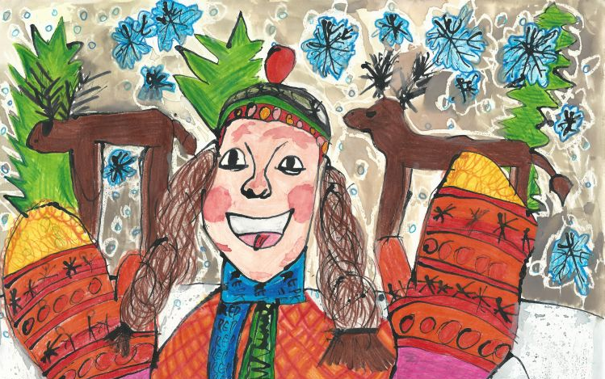
Comprehensive Art Education and The National Visual Arts Standards
Creating
Presenting
Responding
Connecting
National Visual Arts Standards Framework
Notes:
Class instruction: Explain the following:
Creating is the act of conceptualizing, making, and manipulating art and other works.
Presenting is the process of introducing, explaining, and/or showing artworks, performances, products, collections, and ideas to impart knowledge and prompt interpretations.
Responding occurs when students reply to big ideas, essential questions, and content in art history, aesthetics, visual culture, the environment, and/or other subjects.
Connecting represents students’ abilities to make associations and synthesize information to generate new ideas, link concepts, elaborate upon what already exists, explain context, and develop creative works.
Image: Viktória Repková, 9 years old, Plavnica - ZŠ s MŠ, Plavnica 244, Slovak Republic. 45th ICEFA Lidice.
Reference:
National Coalition for Core Arts Standards, 2014

Slide 14


Standards 5
The NVAS anchor standards communicate the level of general knowledge students need to become proficient and literate in art.
Performance standards “translate the anchor standards into specific, measurable learning goals.”
Notes:
Class instruction: Describe how the NVAS performance standards present competencies for Pre-K-8 and High School students at proficient, accomplished, and advanced levels. Benchmarks identify levels of student achievement within a given period for each grade level. When students reach beyond established benchmarks, educators will then apply norm-referencing to compare the qualities of different students’ artworks to establish new benchmarks (Siegesmund & Smilan, 2024a).
Class instruction: Introduce Model 2.1. National Coalition for Core Arts Standards.
Image: Lída Hašlarová, 15 years old, Eliška Hlavatá, 10 years old, Štěpánka Hlavatá, 7 years old, Anna Machová, 10 years old, Tamara Nádassy, 14 years old, Anna Vetešníková, 11 years old, ZUŠ, Mšeno, Czech Republic. 43rd ICEFA Lidice.
References:
National Coalition for Core Arts Standards, 2014
Siegesmund & Smilan, 2024a

Slide 15
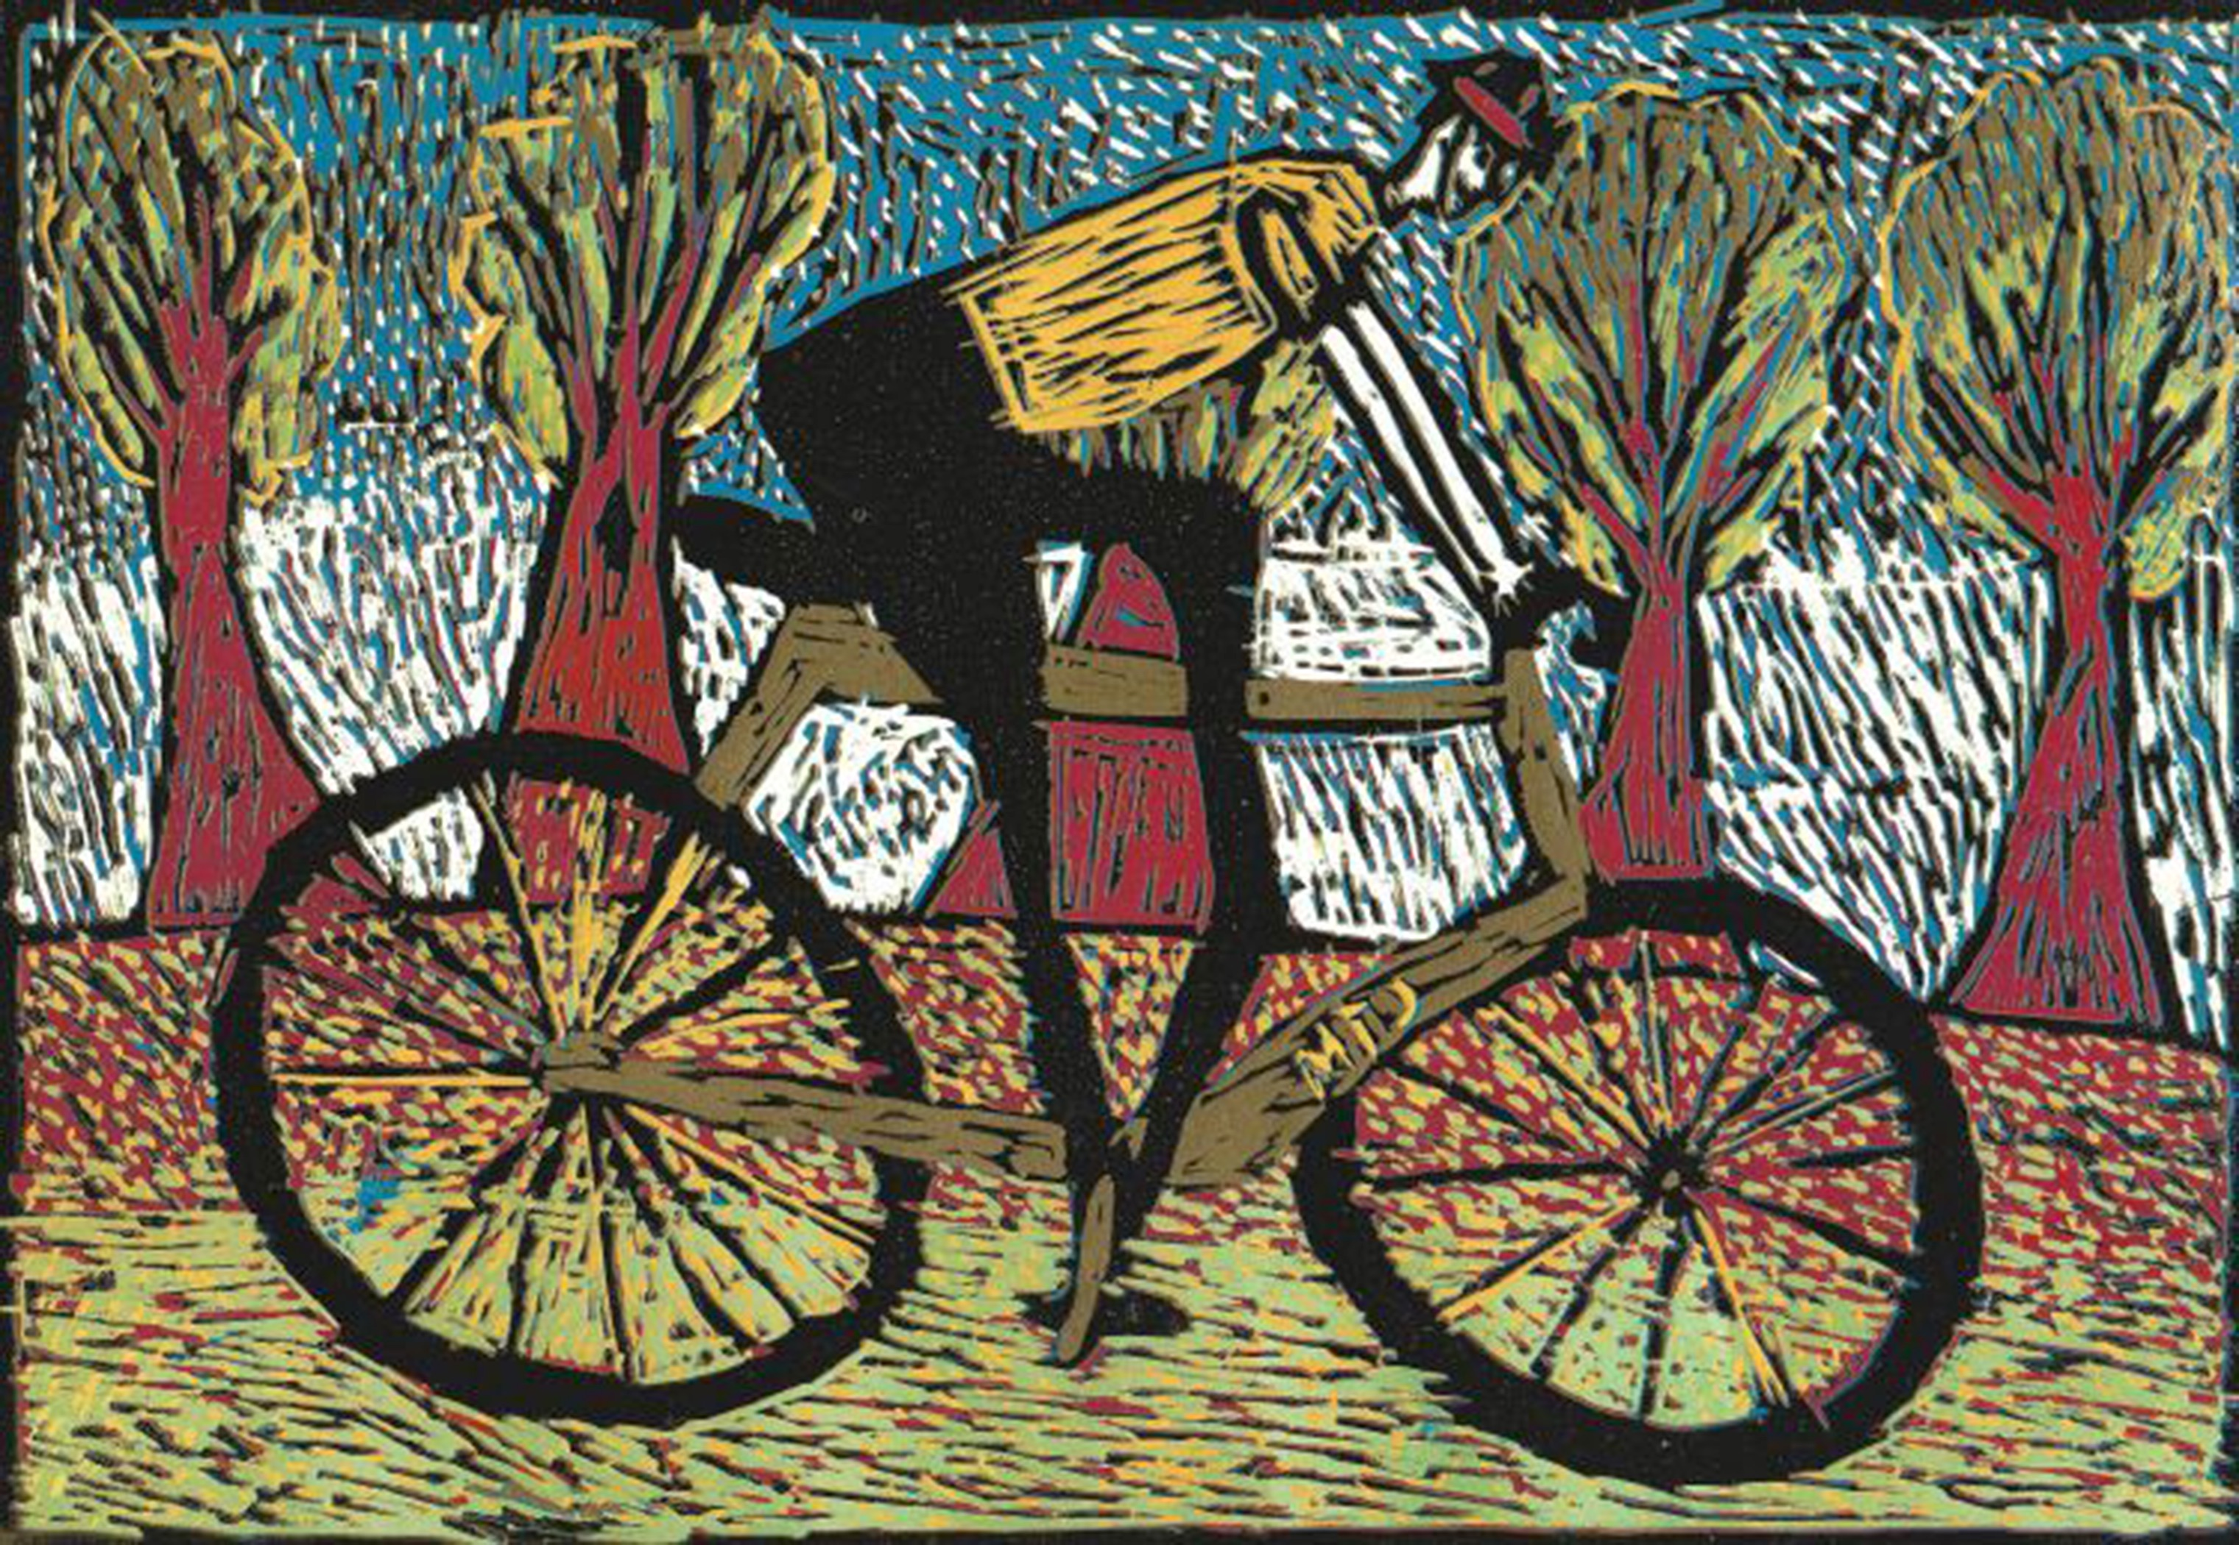
Goals 1
Focus on relevant and attainable learning outcomes.
Apply backwards design.
Refer to standards.
Are guides to plan daily learning targets.
Build on students’ prior knowledge.
Notes:
Image: Júlia Olekšáková, 11-years-old, ZUŠ, Spišská Belá, Slovak Republic. Source: ICEFA Lidice, 43rd Exhibition.

Slide 16

Backwards Design
Educators design art curricula with end goals in mind.
Notes:
Image: Frist Art Museum
Reference:
Wiggins & McTighe, 2005

Slide 17
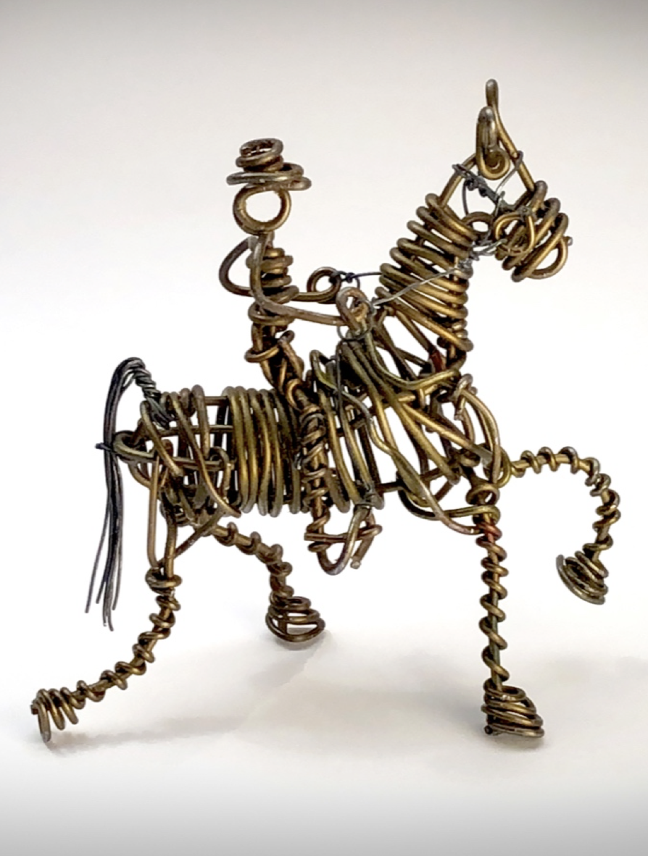
Goals 2
As lifelong learners, students will draw from their combined educational experiences as artistically literate practitioners who care about our world’s diverse cultures, traditions, and histories and will set personally driven goals and apply their creative thinking and problem-solving skills to life’s varied situations.
Notes:
Image: Vannoy Streeter, Tennessee Walking Horse. Jonathan Griffith, photo.
Reference:
Jefferson & Anderson, 2021
NCCAS, 2014b

Slide 18
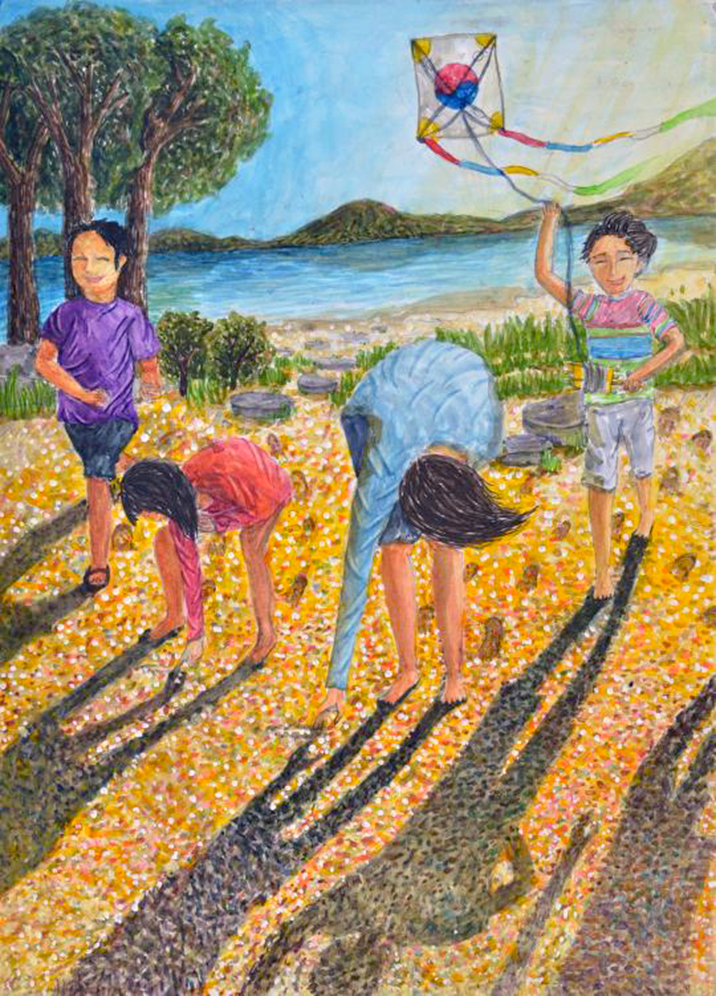
Transformative Dispositions
Dispositions identify the expressive outcomes and affective behaviors and attitudes students cultivate given their active involvement in TAE.
Some dispositions result from long-term goals that take time to foster.
They are not assessed on a report card. They have tremendous value to students and aid instruction.
Notes:
Class instruction: Have students review the sampling I Can Statements of transformative art education student disposition targets. Then, discuss their benefits in integrating them into the transformative art curriculum.
Image: Lee Min Hye, 13 years old, Busan Middle School of Arts, Busan, Korea, South. 43rd ICEFA Lidice.
References:
Chappuis et al., 2012
Siegesmund & Smilan, 2024b

Slide 19
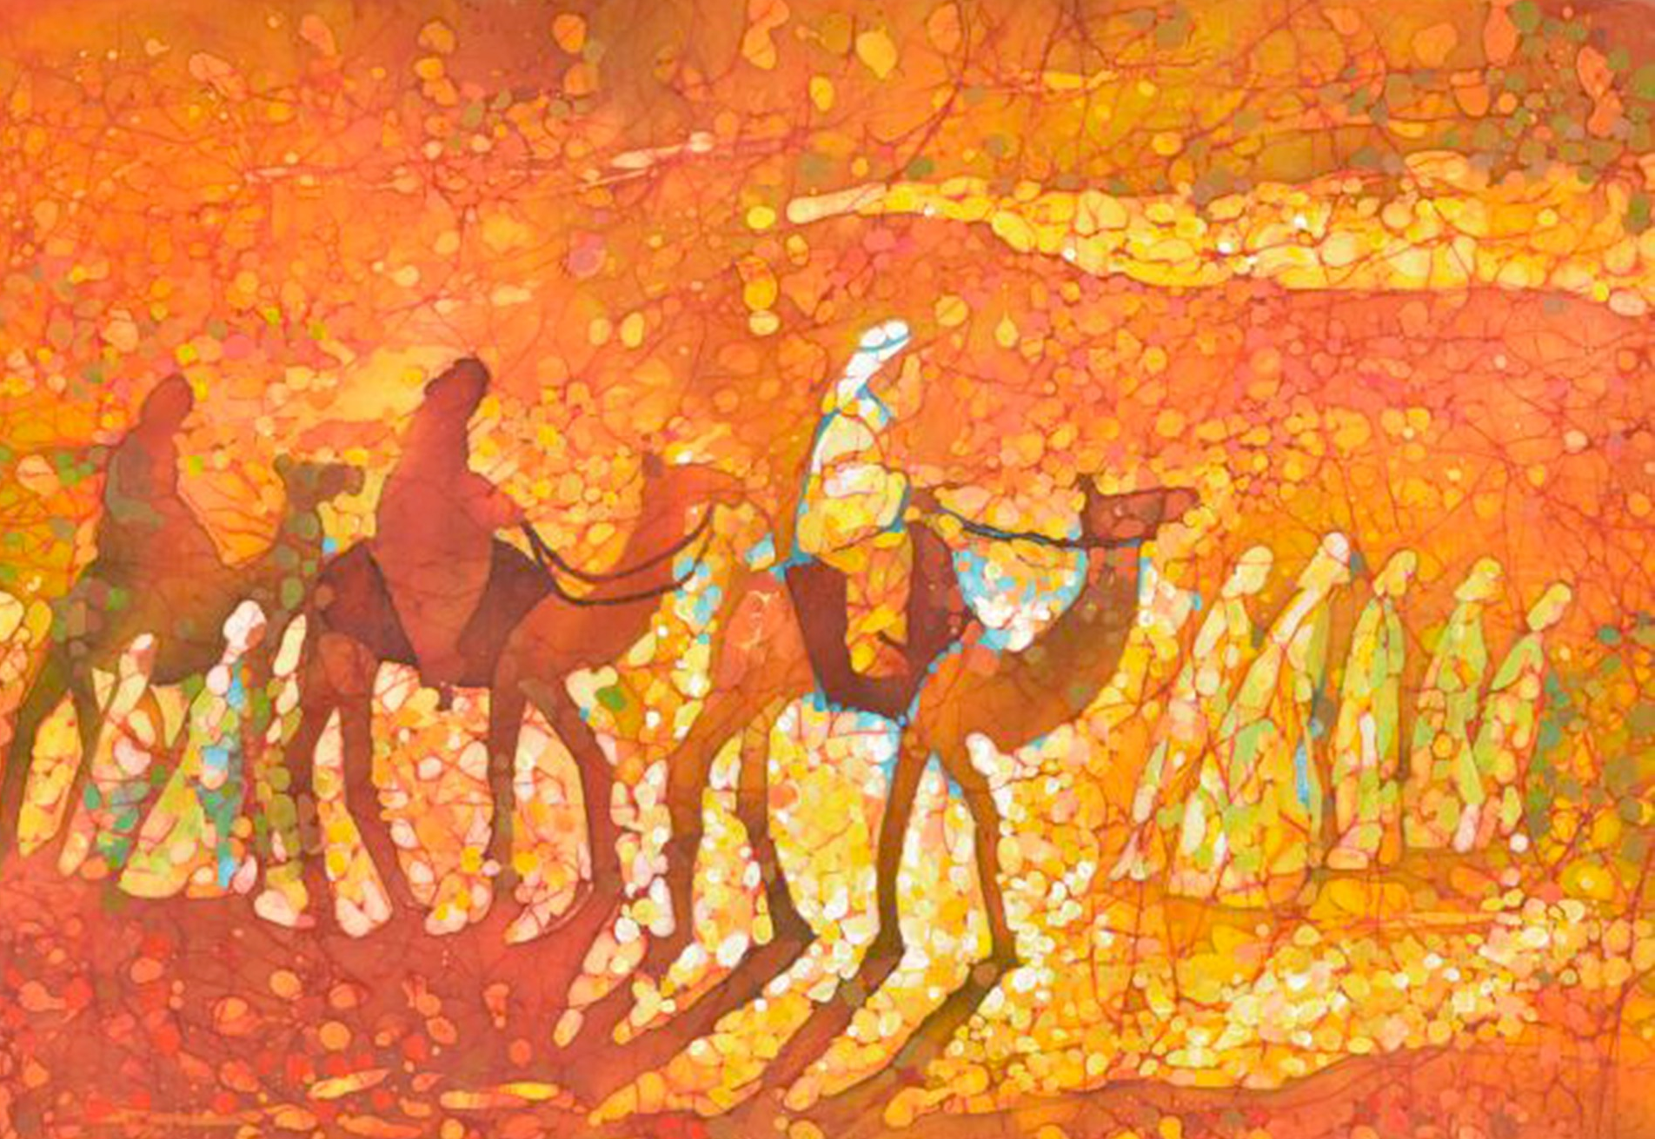
Scope and Sequence
Scope refers to the parameters of the content that teachers and students cover in the curriculum and the time it will take.
Sequence is the progression of the curriculum. Teachers break down curricular content into manageable components and build on students’ prior learning.
Notes:
Image: Maria Smuneva, 16 years old, GUDO Vitebskii oblastnoi dvorets detei i molodozhi, Vitebsk, Belarus. 45th ICEFA Lidice.

Slide 20
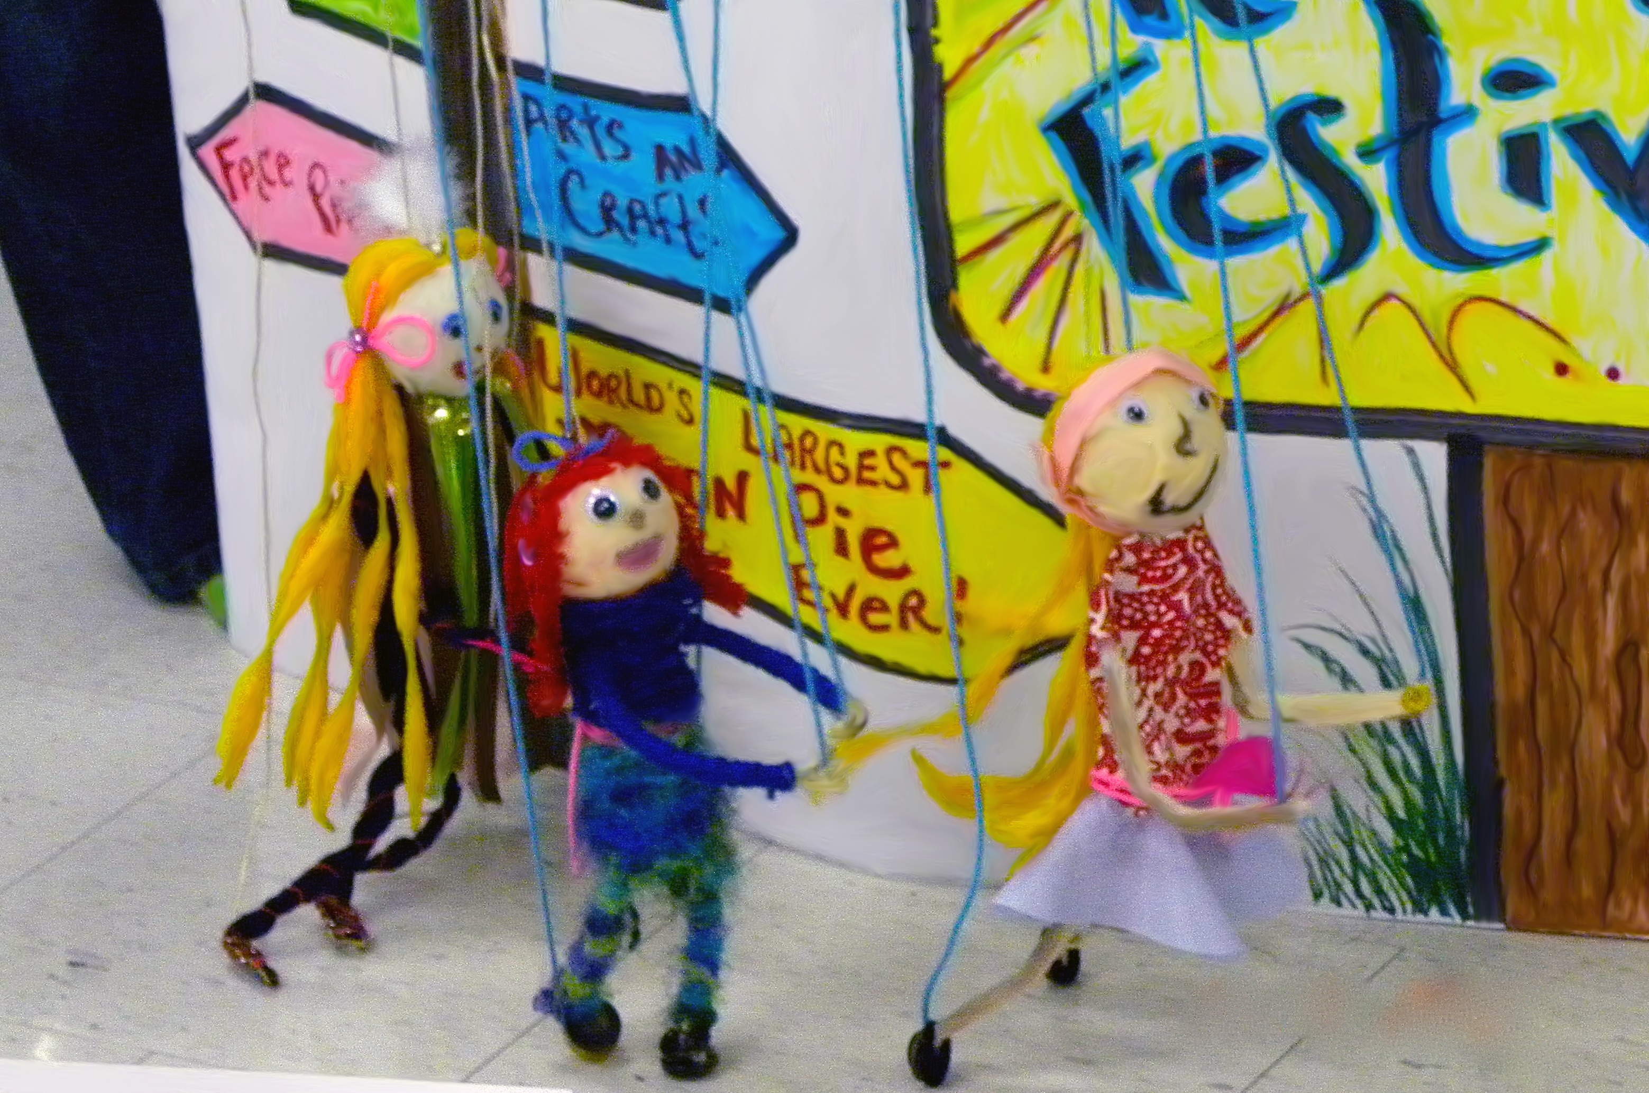
Lessons and Unit Plans
A lesson plan documents and explains how teachers propose to teach students a task, concept, process, or big idea.
A unit plan is a series of two or more lessons that are connected by big ideas, concepts, media, artists, subject, and other content.
Notes:
Class instruction: Introduce the model Comprehensive Art Education Lesson Plan and Weekly Art Curriculum Planning Template on the textbook’s companion website. Students will learn about assessment in Chapter 3.
Image: Marionette performance video still. Elementary students, USA. Author and Abbey Logan, teachers.

Slide 21
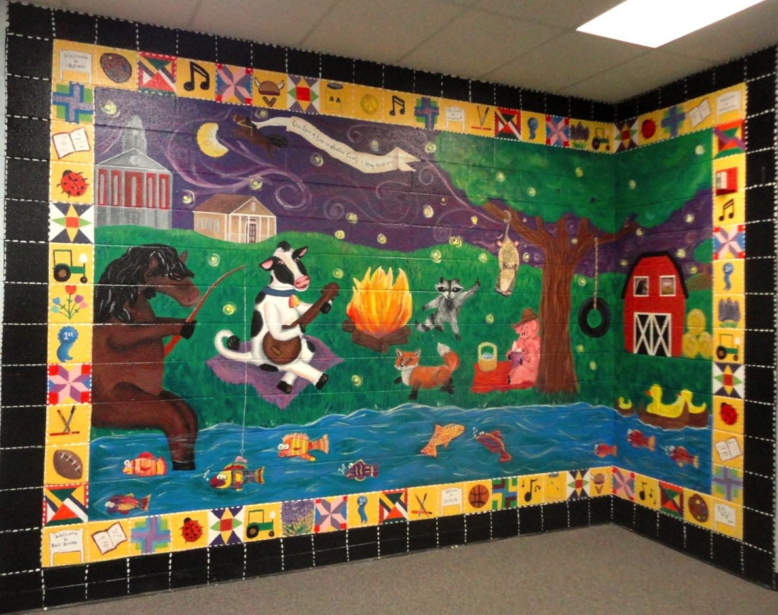
Rationale
Is a written statement that explains the value of a lesson or unit and how it connects to students’ growth and development.
Identifies the big idea and essential questions that drive a lesson or unit.
Includes brief contextual information, like how artistic behaviors, multimodal learning tasks, and TAE life skills augment learning.
Notes:
Class instruction: Reference the sample rationales on TLAE’s website and have the students identify their qualities and components. Then, have students practice writing rationales and share them with the class. They can begin this process collaboratively as a class and then move into small group and independent work. Explain to students that with practice they will become skilled in writing original rationales.
Image: Community mural. Elementary students, USA. Author and Abbey Logan, teachers. Pamela McColly photo.

Slide 22
Objectives
Learning objectives are clear measurable student behaviors that identify learning goals and expectations.
The Student Will
Measurable Behavior
Stimulus
Criteria
Write measurable objectives to identify the summative tasks students are to accomplish.
Notes:
Class instruction: Reference TLAE’s model objectives in the textbook and on its website. Have the students identify their qualities and components. Then, have students practice writing objectives and share them with the class. They can begin this process collaboratively as a class and then move into small group and independent work. Explain to students that with practice they will become skilled in writing original objectives.
Class activity: Explain that summative objective results include art production activities, writing, research, presentations, discussions, and other targeted actions.

Slide 23
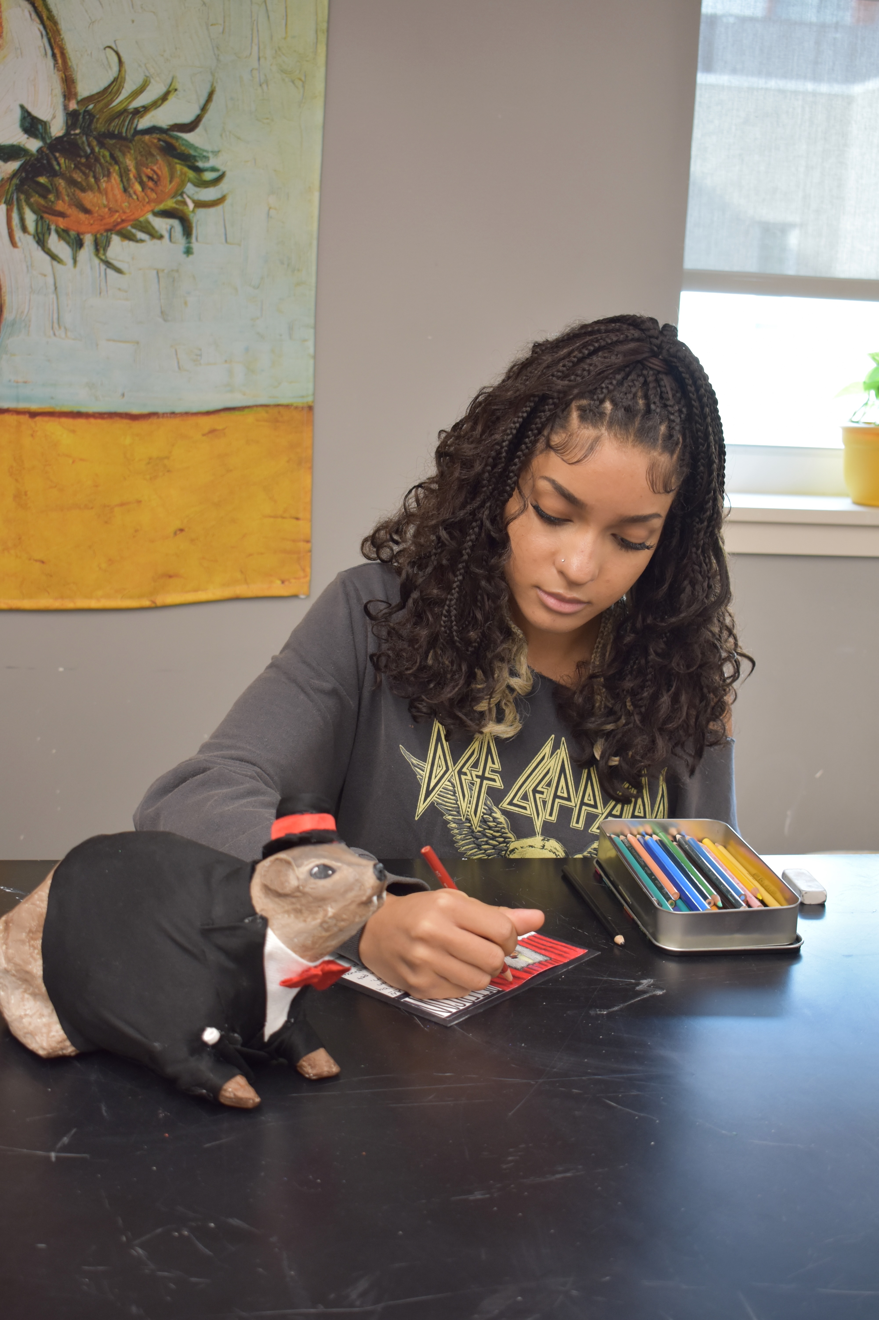
Objectives: Unpacking the Standards
Analyze and interpret key concepts identified within the standards to develop objectives and produce predetermined student performances.
McTighe and Wiggins (2012) referred to this process as “unpacking” the standards.
Notes:
Class instruction: Access the mandated standards in your community. Invite the class to develop original objectives that correlate with the standard(s) they have selected.
Image: Alivia Richardson, 16-years-old. Source: Brianna Shetzler, teacher.

Slide 24
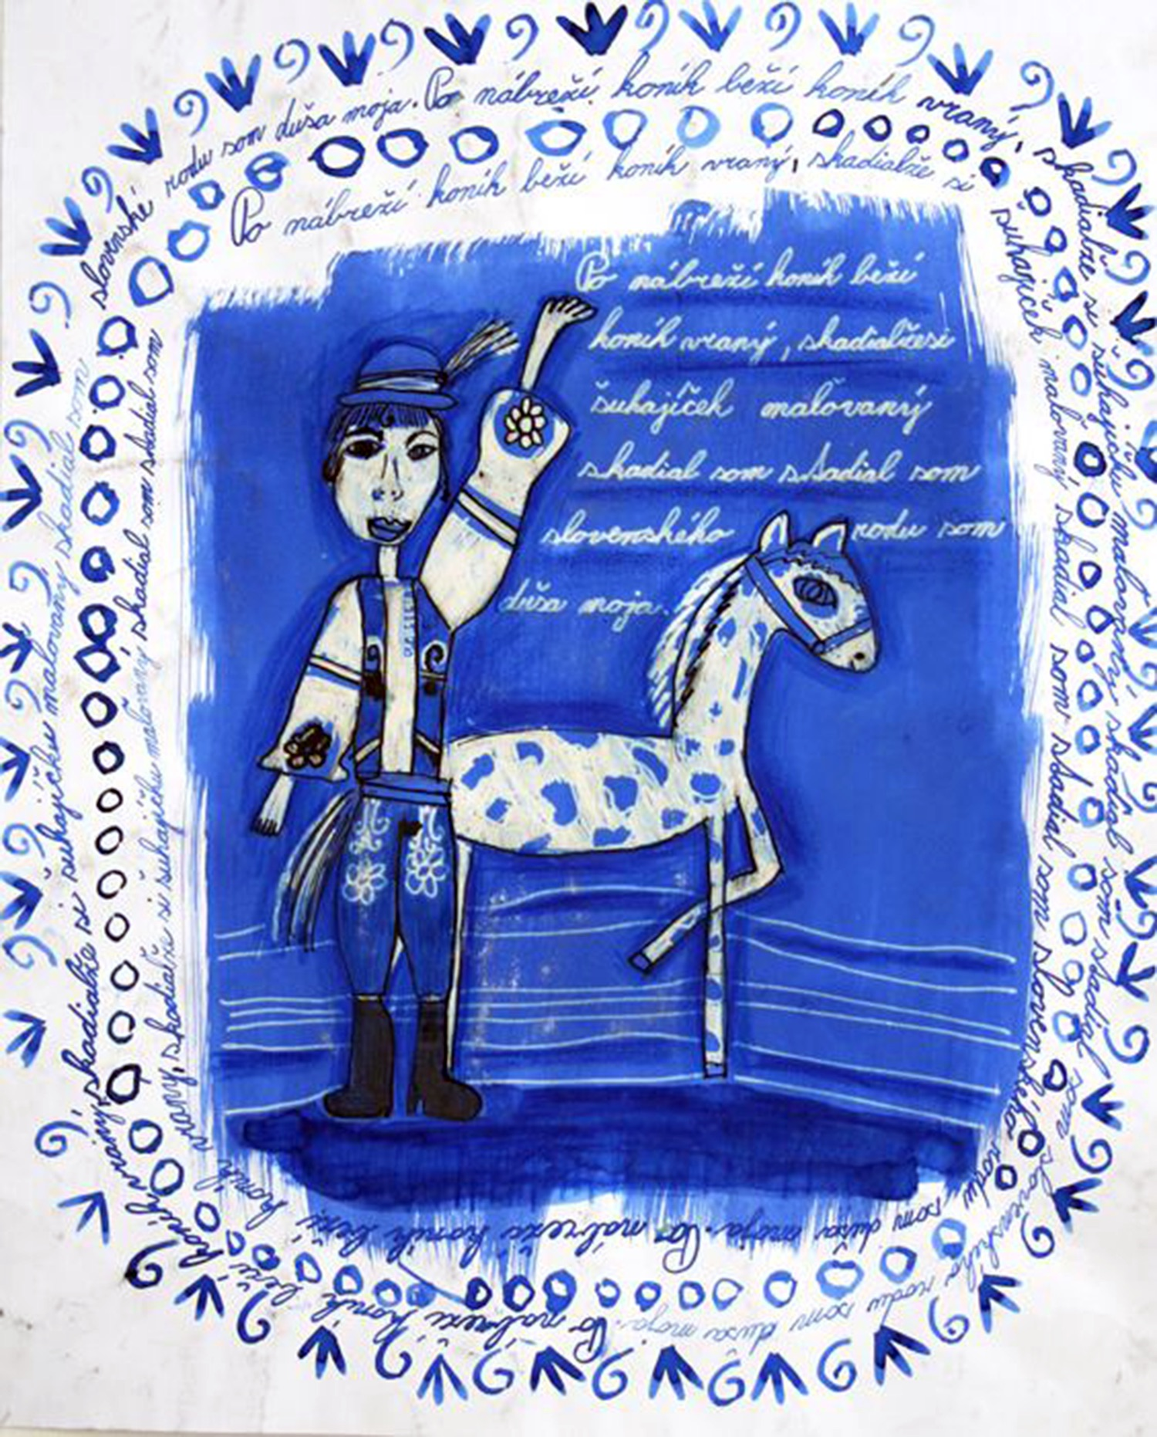
Objectives & Bloom: Domains L. Anderson & Krathwohl’s Revised Bloom’s Taxonomy
Cognitive Domain
Affective Domain
Psychomotor Domain
Bloom’s Taxonomy classifies objectives into cognitive, affective, and psychomotor domains to stimulate students’ full minds, emotions, and bodies.
Notes:
Class instruction: Explain the characteristics of each domain.
Cognitive Domain
Focuses on the development of mental abilities and intelligence (recall art history facts; evaluate art, etc.)
Affective Domain
Centers on human feelings and emotions (representations of emotion through art; learning varying perspectives; and demonstrating empathy)
Psychomotor Domain
Concentrates on kinesthetic learning through physical motions (using motor skills to create art and make discoveries).
References:
Anderson et al., 2001
Bloom et al., 1956
Image: Barbora Verešová, 8 years old, Súkromná ZUŠ, Trenčín, Slovak Republic. 41st ICEFA Lidice.

Slide 25
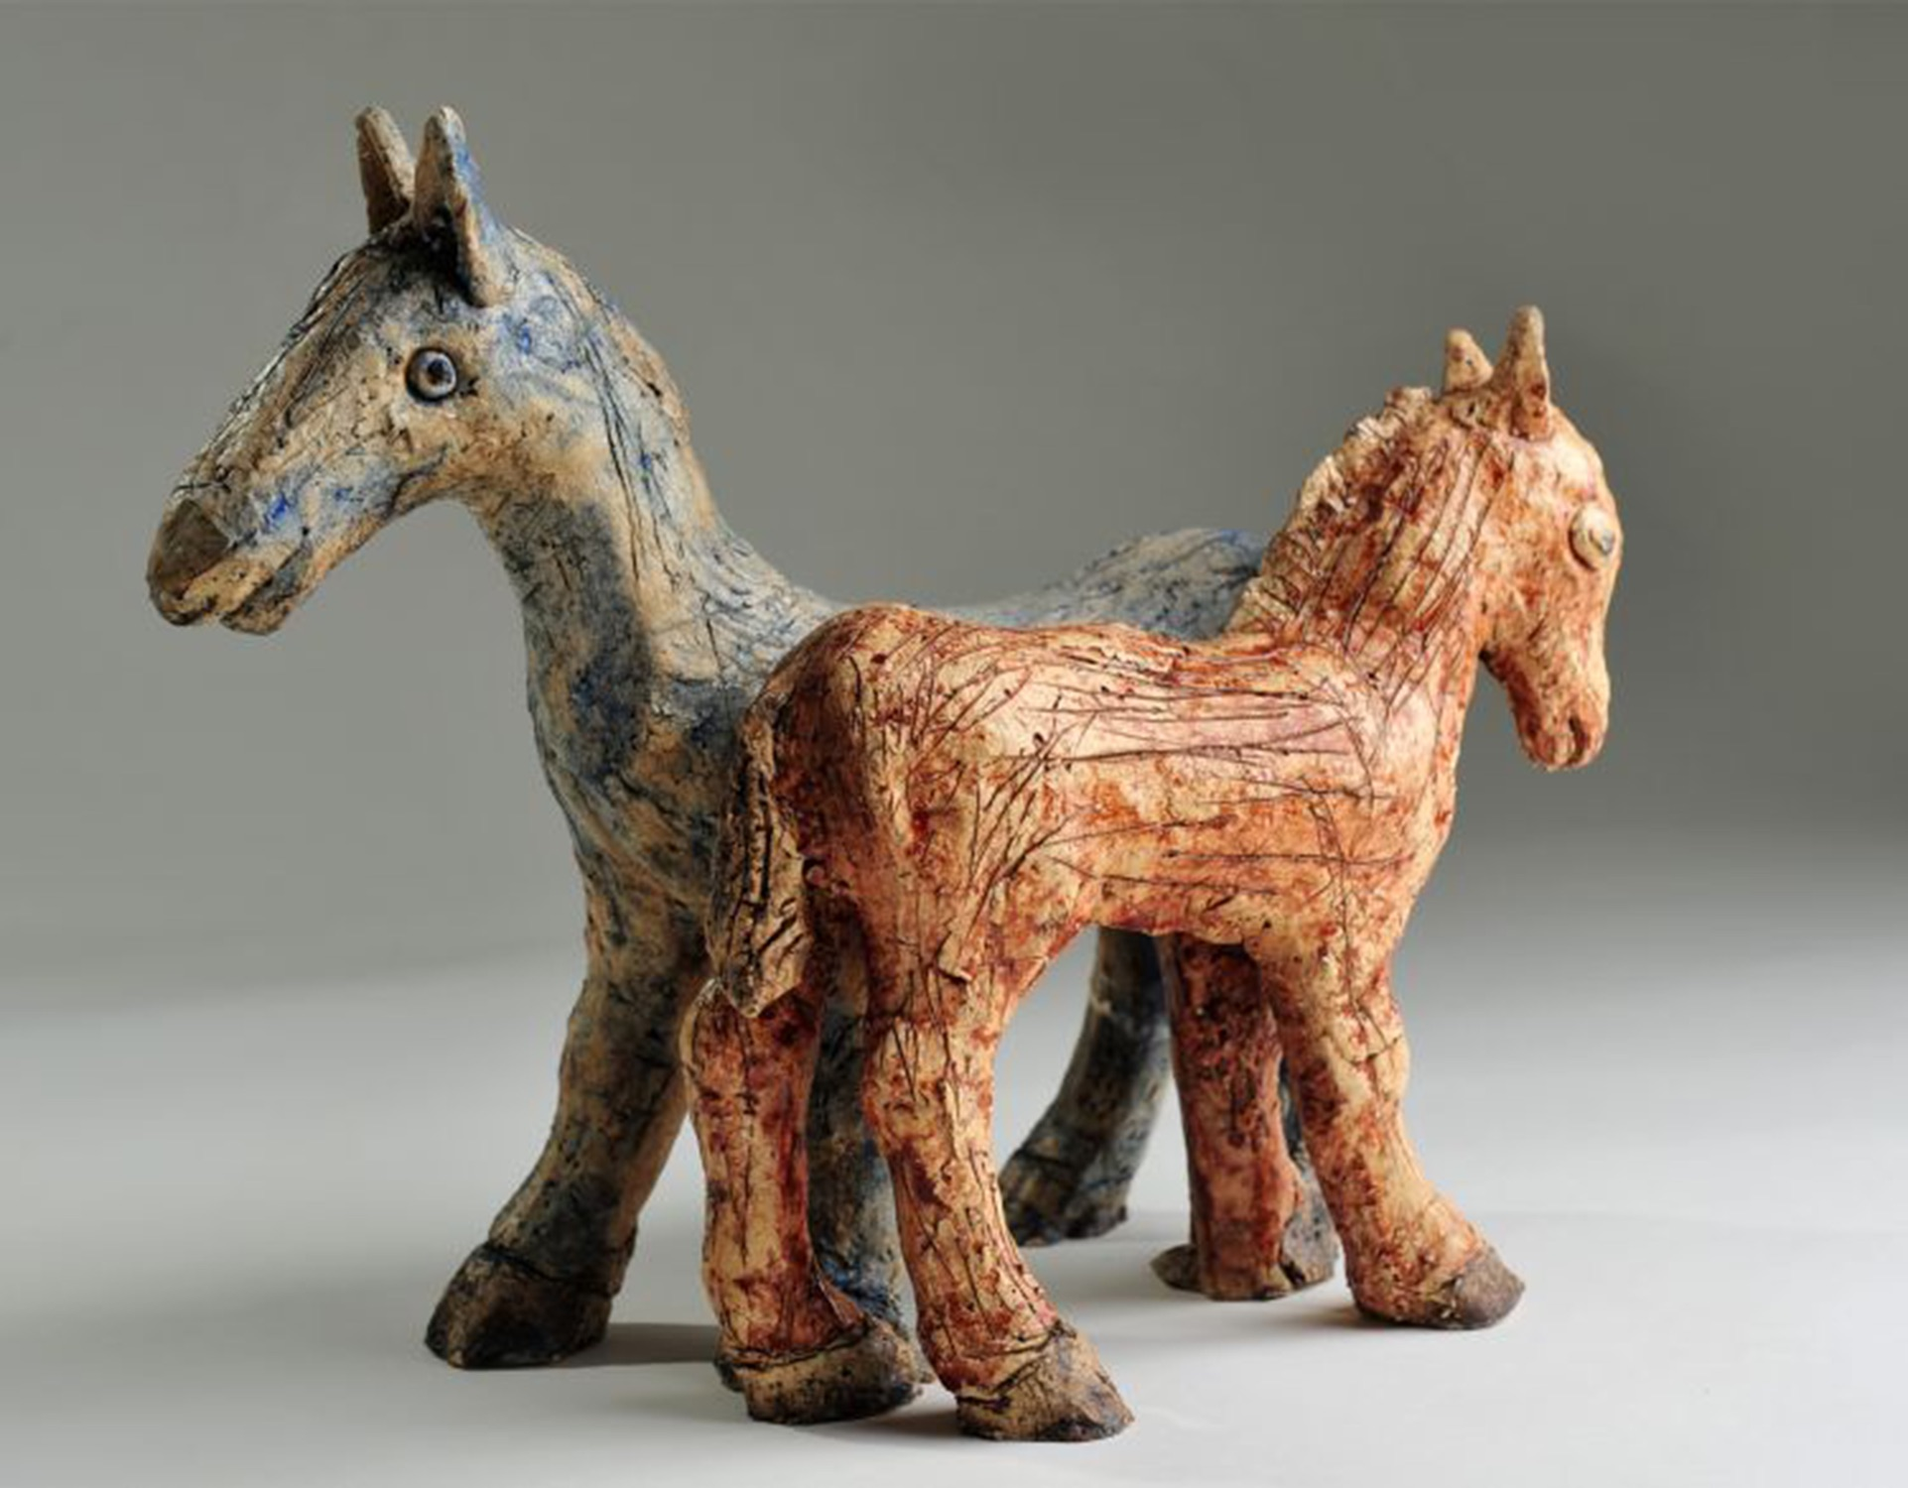
Objectives & Bloom L. Anderson & Krathwohl’s Revised Bloom’s Taxonomy See TLAE’s Website
Remember
Understand
Apply
Analyze
Evaluate
Create
Notes:
Class instruction: Refer to Bloom’s Taxonomy on TLAE’s website.
Image: Sophie Kazecká, 10 years old, Viktorie Kazecká, 7 years old, ZUŠ, Plzeň, Czech Republic. 42nd ICEFA Lidice.
References:
Anderson et al., 2001
Bloom et al., 1956

Slide 26

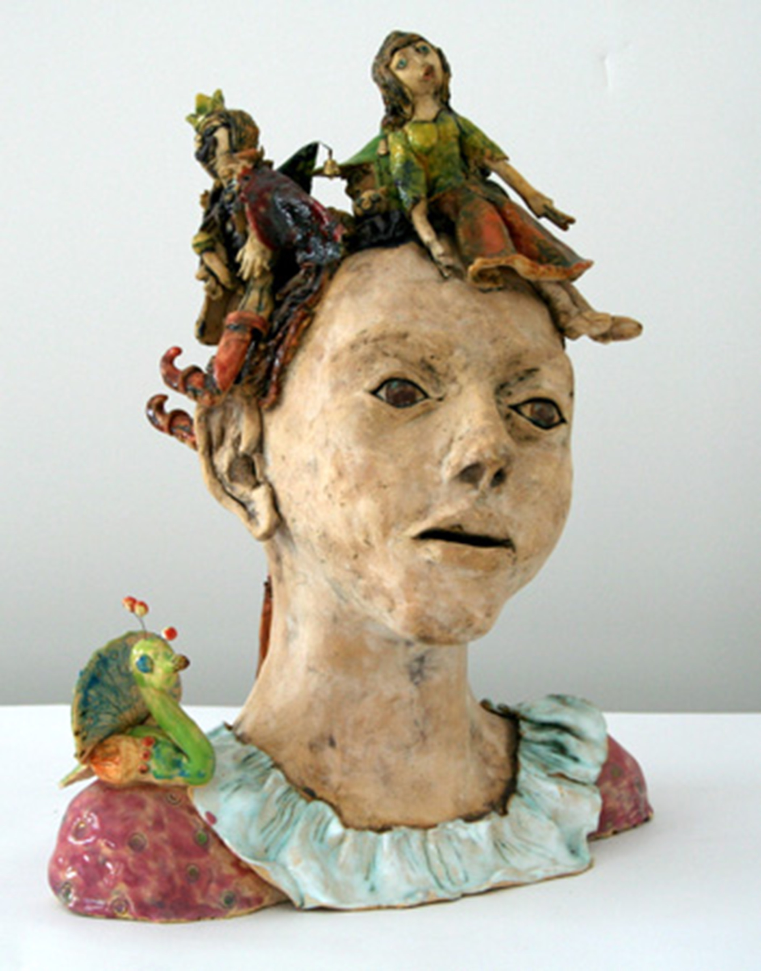
Objectives & Bloom: Types of Knowledge L. Anderson & Krathwohl’s Revised Bloom’s Taxonomy See TLAE’s Website
Factual Knowledge
Conceptual Knowledge
Procedural Knowledge
Meta-Cognitive Knowledge
Notes:
Class instruction: Explain each of the following:
Factual Knowledge
Basic knowledge
Conceptual Knowledge
Interrelationships: how things connect
Procedural Knowledge
Methods and inquiry
Meta-Cognitive Knowledge
Awareness of cognition, especially one’s own cognition
Image: Barbora Římalová, 10 years old, Dům dětí a mládeže Praha 3 - Ulita, Praha 3 - Žižkov, Czech Republic. 39th ICEFA Lidice.
References:
Anderson et al., 2001
Bloom et al., 1956

Slide 27

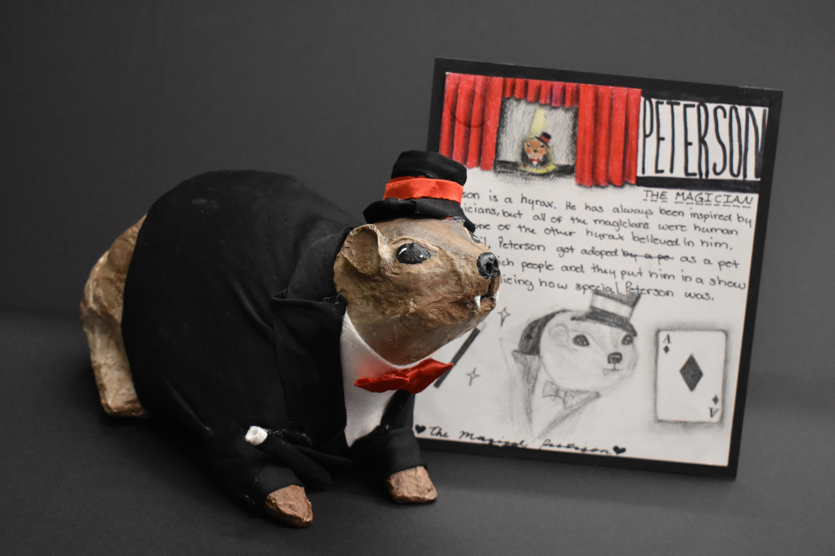
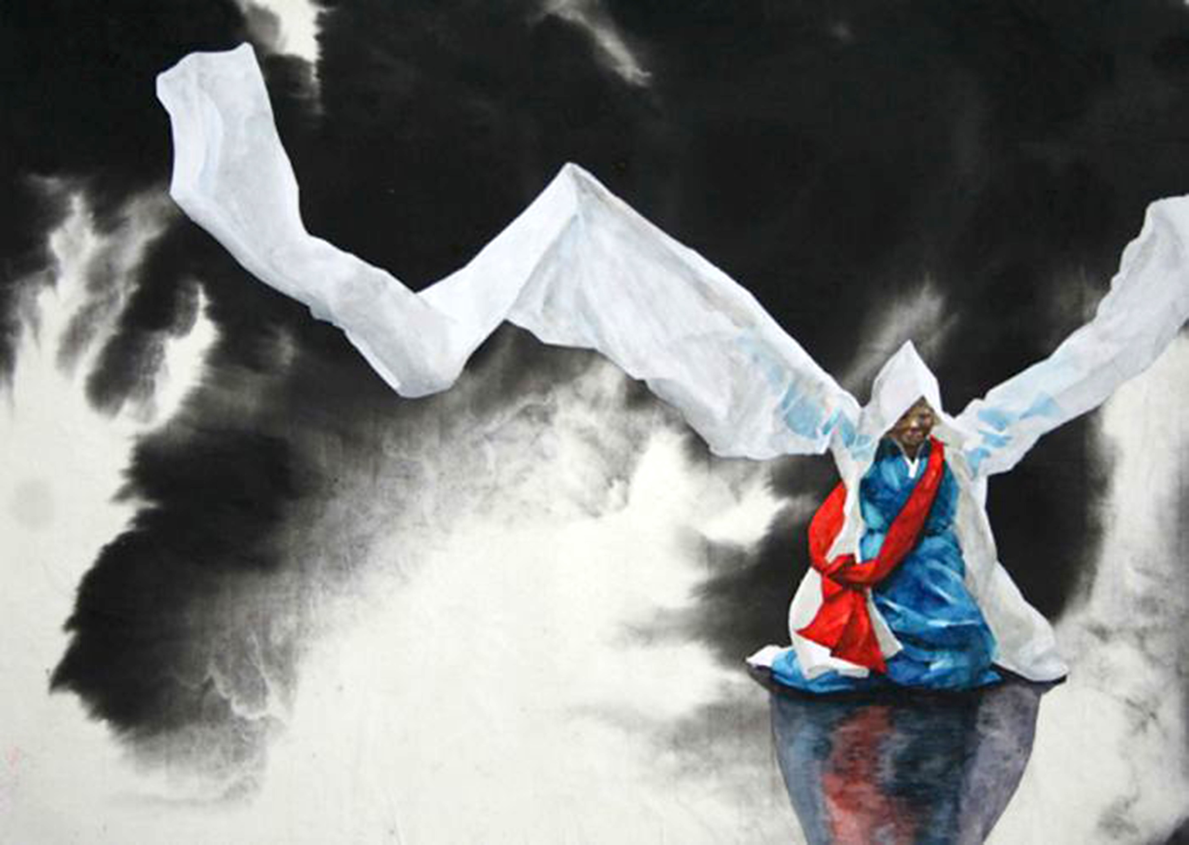
Objectives & Bloom L. Anderson & Krathwohl’s Revised Bloom’s Taxonomy
How do these artworks correlate with Bloom’s cognitive, affective, and psychomotor domains?
Notes:
Class instruction: Look at the slide images to answer: How do these artworks correlate with Bloom’s Taxonomy and its cognitive, affective, and psychomotor domains?
Left Image: Alivia Richardson, 16-years-old. Source: Brianna Shetzler, teacher.
Top Right Image: Park So Jin, 15 years old, Busan Middle School of Arts, Busan, Korea, South. 41st ICEFA Lidice.
Bottom Right Image: Sophie Kazecká, 10 years old, Viktorie Kazecká, 7 years old, ZUŠ, Plzeň, Czech Republic. 42nd ICEFA Lidice.
References:
Anderson et al., 2001
Bloom et al., 1956

Slide 28
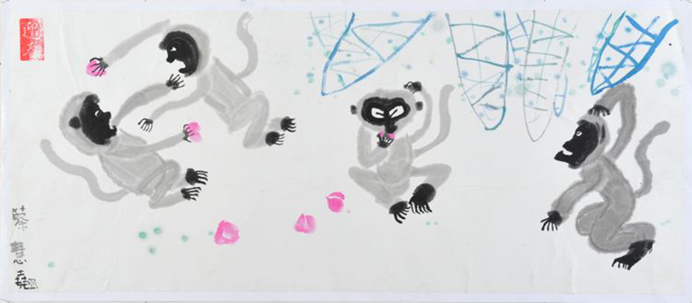
Open-Ended and Closed-Ended Objectives
1. Given an example of a color wheel, students will use tempera paint to mix the three secondary colors.
2. Given a trip to a nature reserve and a class presentation on contemporary artists that portray animals in their art, students will select at least one of the reserve’s animals to create an artwork using the medium of their choice that represents an aspect of the animal’s (animals’) behavior(s) and habitat(s), has a sense of unity, and demonstrates effective craftspersonship.
Read the objectives. Which one is open-ended and which one is closed-ended? Explain why.
Notes:
Class instruction: Explain how TLAE’s TAE framework calls upon students to develop creative, autonomous solutions, which are best achieved through open-ended objectives.
Class instruction: Read the following objectives. Which one is open-ended and which one is closed-ended? Explain why.
Class instruction: Use these examples to invite students to practice writing original open-ended and closed-ended objectives. Have students choose from the textbook’s artworks as inspirations to write original objectives.
Image: Choi Wai Kiu, 11 years old, Simply Art, Hong Kong, China. 42nd ICEFA Lidice.

Slide 29
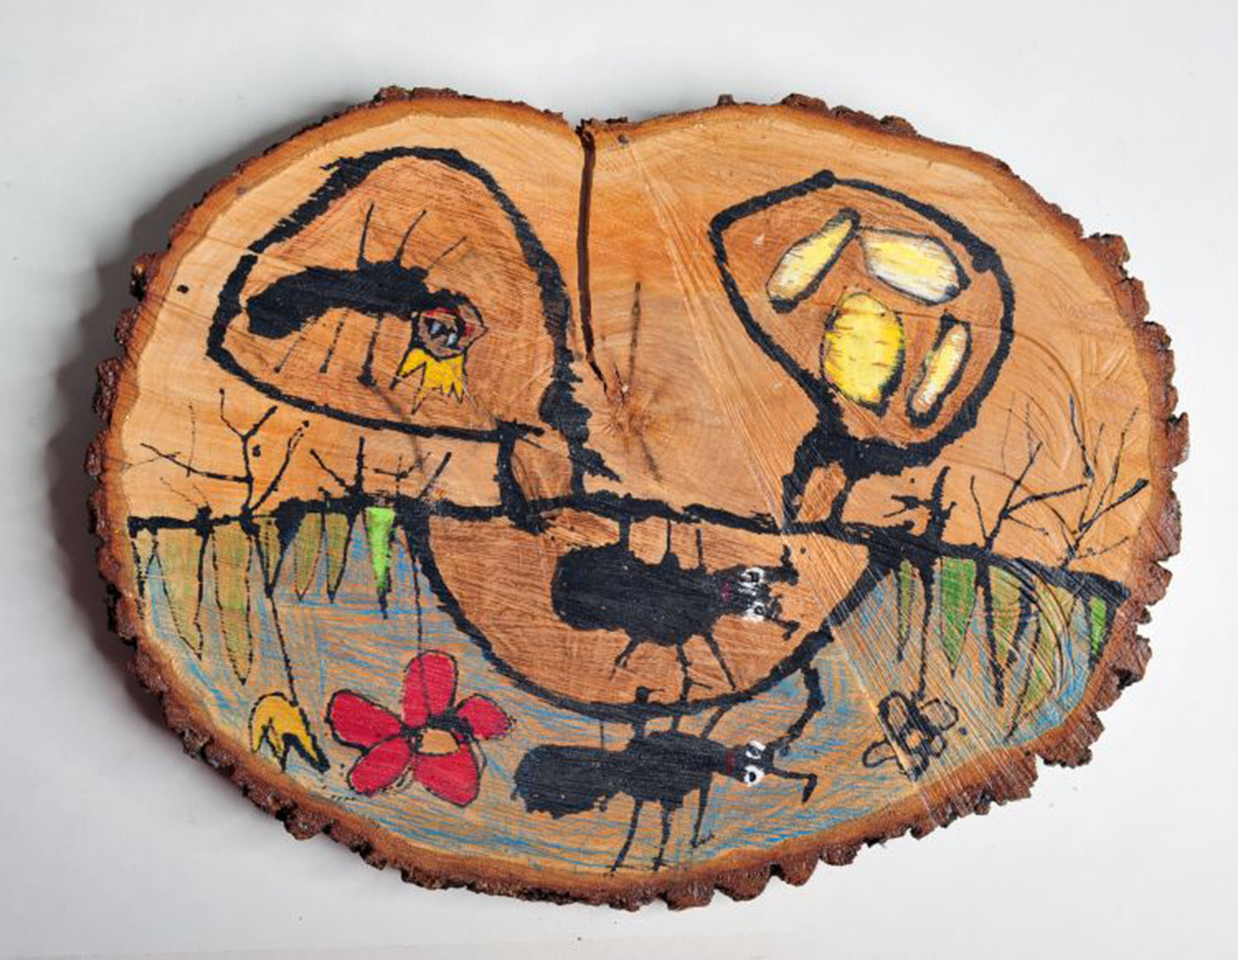
Learning Targets
Learning targets pinpoint the essential knowledge and achievements educators expect students to attain through active participation in the choice-based art curriculum.
Notes:
Image: Markéta Matoušková, 6 years old, MŠ, Dolní Cerekev, Czech Republic. 42nd ICEFA Lidice.
Reference:
Chappuis et al., 2012

Slide 30
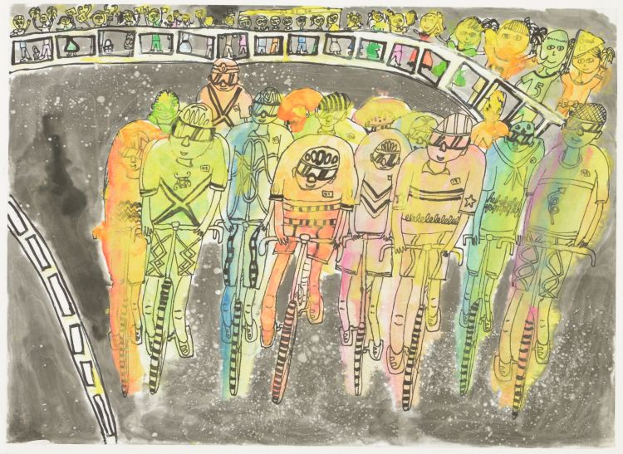
Types of Learning Targets (Chappuis, Stiggins, Chappuis, and Arter) See TLAE’s Website
Knowledge
Skill
Reasoning
Product
Disposition
Notes:
Class instruction: Explain the following:
Knowledge:
Identify and remember facts and artistic procedures
Recognize concepts relating to art and big ideas in written and oral formats.
Reasoning:
Solve problems; make predictions; analyze and classify art; make inferences; write comparison papers; and summarize ideas (portfolio and artist statements).
Skill:
Demonstrate skill to perform with art media and processes, present works for a display, and talk about their work.
Product:
Synthesize concepts and knowledge to produce creative products.
include artworks and collections in journals and portfolios.
Disposition:
Identify students’ expressive outcomes and affective behaviors and attitudes.
Include long-term goals that take time to foster.
Image: Ng Tin Wai Kylie, 8 years old, Simply Art, Hong Kong, China. 45th ICEFA Lidice.
Reference:
Chappuis et al., 2012

Slide 31

Transforming Objectives into Daily Learning Targets 1
Teachers deconstruct targets into I can statements to check that students understand targets’ full meanings.
Some visual arts performance tasks require multiple skills and forms of knowledge to accomplish.
Daily learning targets may span several days or class periods for students to master.
Notes:
Image: Generated by Copilot.
Reference:
Chappuis et al., 2012

Slide 32
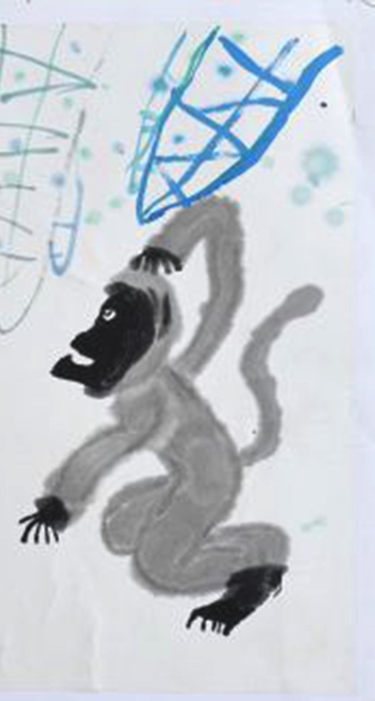
Transforming Objectives into Daily Learning Targets 2
Learning Targets
As an artist, I can create an artwork that portrays my personal connection to a biodiverse environment.
I can select the medium of my choice.
I can create a composition that shows unity and craftspersonship.
I can portray the environment using design qualities of my choice. (These may include space, foreground, middle ground, background, and value.)
Objective
The student will create an artwork that portrays a personal connection to a biodiverse environment using the medium of choice. The student’s artwork will have a unified composition, show craftspersonship, and apply effective design qualities to represent the environment (i.e. space, foreground, middle ground, background, and value).
Notes:
Class instruction: Discuss with students how objectives and their associated learning tasks can become transformative. While the model objective and learning targets may not be transformative as written, their applications can foster transformative mindsets and actions when students use their art to bring awareness to protecting biodiverse environments and learn to believe in their abilities to develop impactful artworks to solve problems and communicate their beliefs and feelings.
Class instruction: Use these examples to invite students to transform different objectives into daily learning targets.
Image: Choi Wai Kiu, 11 years old, Simply Art, Hong Kong, China. 42nd ICEFA Lidice.

Slide 33
Deconstructing Objectives and Learning Targets
As an artist, I can create an artwork that portrays my personal connection to a biodiverse environment. Students need to:
Understand the meaning of a person connection.
We will model examples.
Recognize different types of biodiverse environments.
We will provide multi-/inter-/transdisciplinary instruction on biodiverse environments.
Notes:
Class instruction: Invite students to deconstruct sample objectives and daily learning targets.
Class instruction: Ask students to identify how the boy wears a tiger-striped shirt, carries binoculars, and smiles to show his connection to the biodiverse environment.

Slide 34
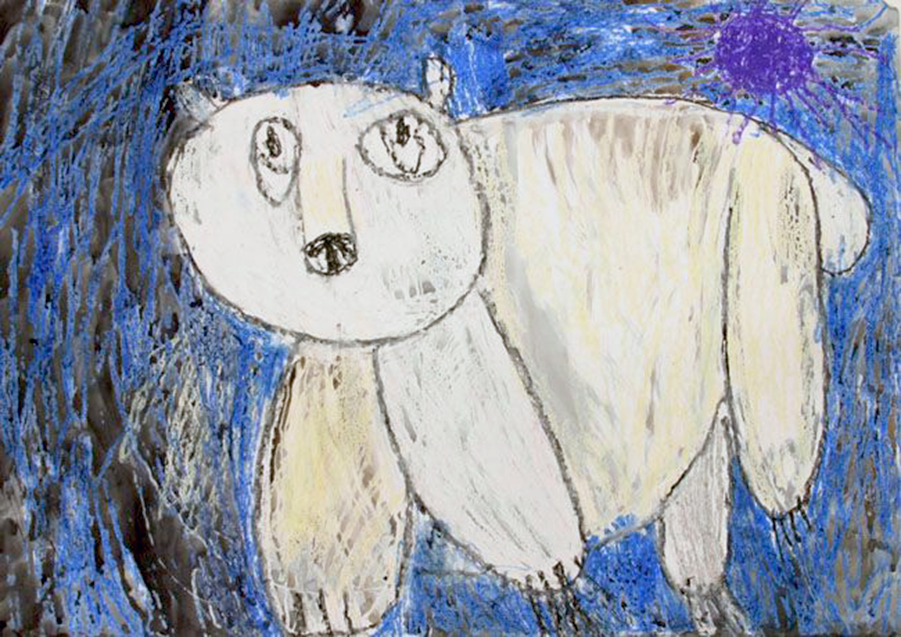
Procedures 1
Identify the steps teachers have determined to be necessary for students to complete a lesson or unit so that they can reach objectives and learning targets.
Differ from objectives because objectives identify only the end result of student actions.
Notes:
Image: Maria Popova, 4 years old, Detskaya khudozhestvennaya galereya, Volgograd, Russia. 38th ICEFA Lidice.

Slide 35
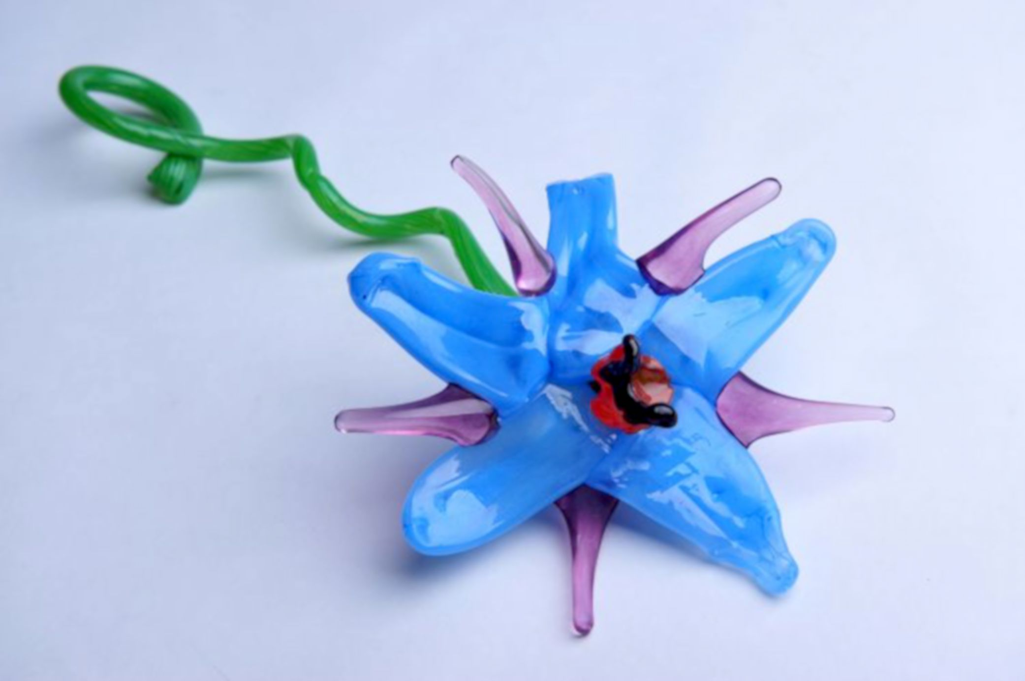
Procedures 2
Set
Group Learning
Instructional Strategies
Independent Practice
Accommodations
Closure
Notes:
Class instruction: Explain the following and ask the class to write sample lesson procedures.
Set
Set. The set (or hook) is a brief activity or event teachers present at the beginning of a lesson designed to capture students’ full attention (Wiggins & McTighe, 2005). Our sets can include the learning modalities, visual, auditory, kinesthetic, and tactile learning, which define the ways students learn through their senses (Thompson, 2018).
responding; brainstorming; making connections;
storytelling; demonstrations; readings;
making predictions; performing reviews; and, self-reflections
Instructional Strategies
Instructional strategies impart key information to students. The forms of instruction we select will change according to curricular content and students’ needs.
presenting targets, goals, objectives, and assessments;
explaining vocabulary; eliciting students answers; teaching multi-/inter-/transdisciplinary connections;
integrating multimedia instructional resources; making connections to the standards; and linking learning content with the artistic behaviors and lifelong learning skills.
Group Learning
Students collaborate during guided group practice tasks under teachers’ watchful supervision.
deconstructing learning targets; practicing tasks;
responding to content and context; making connections;
taking alternative positions; assessing their current knowledge to set new goals and preparedness to work
towards transformations.
Independent Practice
Independent student learning practices including class activities and homework assignments.
self-reflect;
apply daily learning targets and resources to achieve tasks; create and present art;
apply the artistic behaviors and problem-solving skills; and,
self-assess works in a journal or portfolio.
Accommodations
Accommodations introduce the procedures we develop to ensure all students can participate in lessons and meet objectives.
Teachers modify learning targets;
break down vocabulary and steps;
make visual demonstrations;
meet with students individually;
facilitate peers’ assistance;
offer additional time; and,
develop extension activities.
Closure
Closure summarizes a lesson’s, unit’s, or day’s activities, during which teachers and students review the lesson’s big idea, essential questions, objectives, and key content.
Teachers and students summarize learning activities,
conduct reviews;
check for understanding;
self-reflect;
participate in class critiques; and,
cleanup.
Image: Simona Habeltová, 11 years old, ZUŠ, Mšeno, Czech Republic, 42nd ICEFA Lidice.
References:
Glanz, J. (2009). Teaching 101: Classroom strategies for the beginning teacher. Thousand Oaks, CA: Corwin Press.
Thompson, J. G. (2018). The first-year teacher’s survival guide: Ready-to-use-strategies, tools, & activities for meeting the challenges of each school day (4th ed.). San Francisco, CA: Josey-Bass.

Slide 36
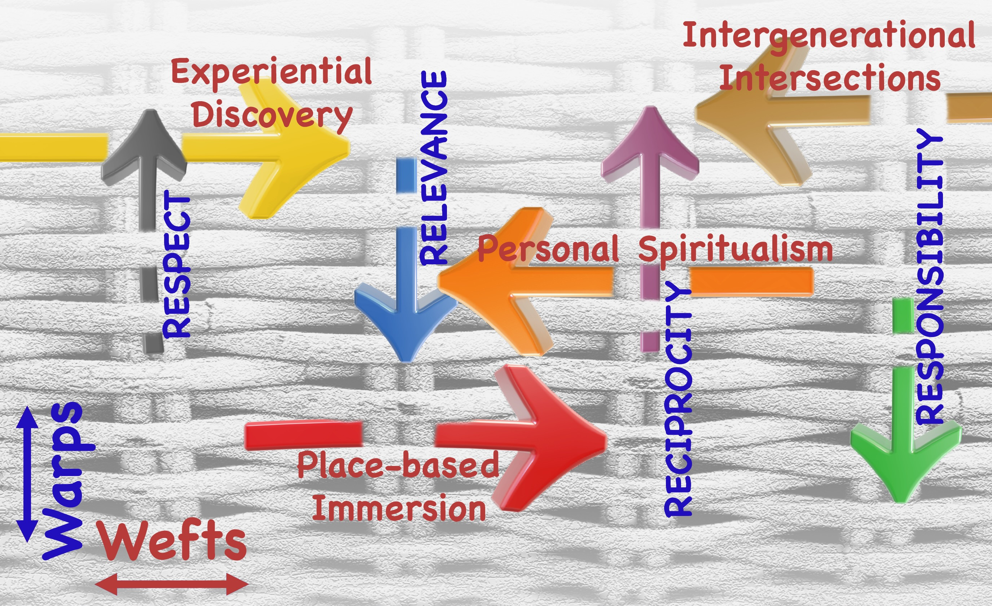
Teaching Tips to Thrive #2.1 Mara Pierce and Lori Santos
Honoring and Engaging Indigenous Pedagogy in the Classroom
Respect
Relevance
Responsibility
Reciprocity
An Indigenous Pedagogy is a varied set of First Nations’ ways of knowing that engages us in an understanding of how the world is interconnected, specifically through community, language, identity, place, and spirit.
Notes:
Class instruction: Discuss Teaching Tips to Thrive #2.1 and Mara Pierce and Lori Santos’s
methods to honor and engage Indigenous pedagogy in the classroom.
Image: This basket analogy supports educators in carrying Indigenous Pedagogy into their classrooms and curricular practices. Source: Mara Pierce and Lori Santos.

Slide 37
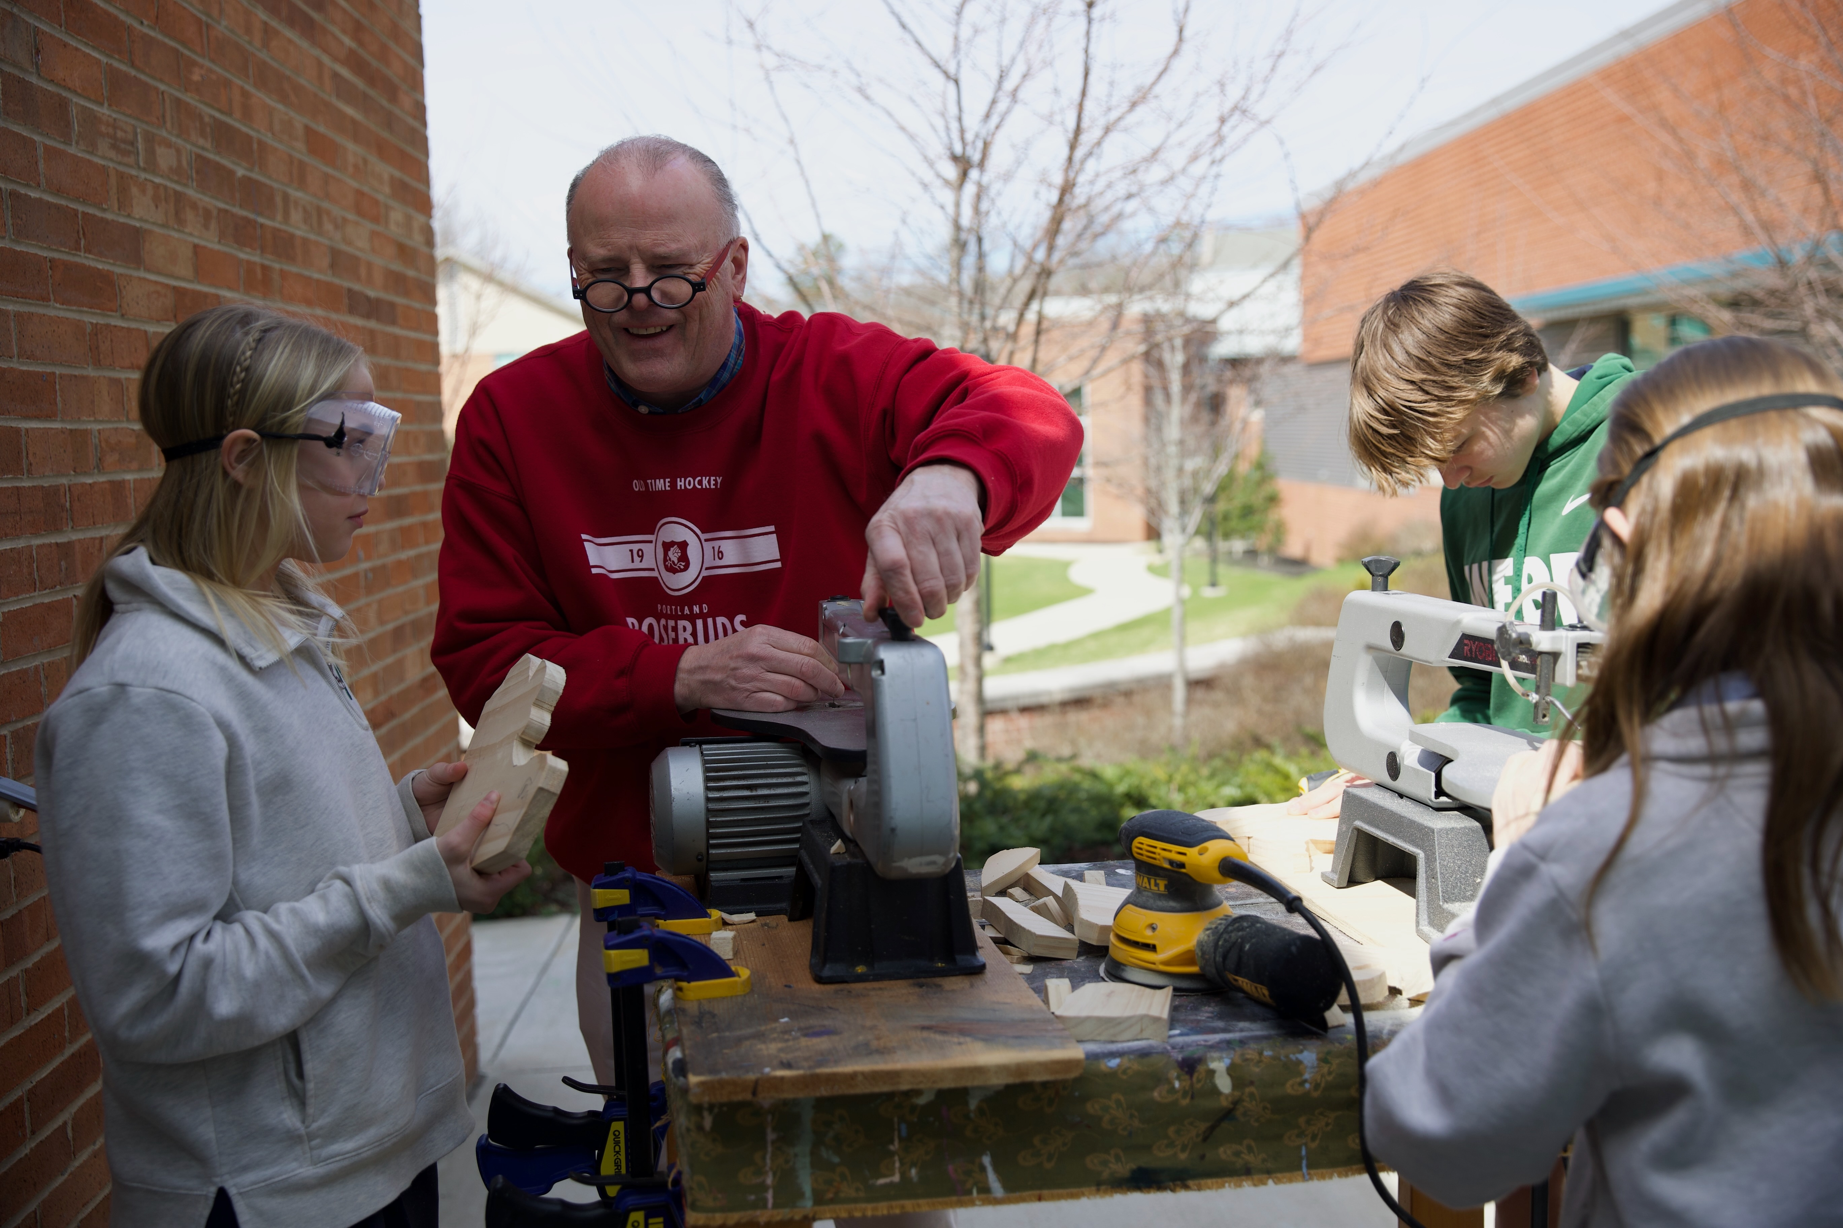
Teaching Tips to Thrive #2.2 Todd Johnson Curriculum and The Gift of Time
“I want to grow an appreciation for the process. I want time for mistakes and corrections. I want to give my students enough time to do their best work.”
Two 2D units in painting/drawing and printmaking; and there are two 3D units in sculpture and ceramics.
Notes:
Class instruction: Discuss Teaching Tips to Thrive #2.1 and how Todd Johnson’s curricular methods provide his students with the gift of time.
Image: Todd Johnson guides students in operating shop equipment to produce sculptures. Photo: Cathy Dowhos-O'Gorman

Slide 38
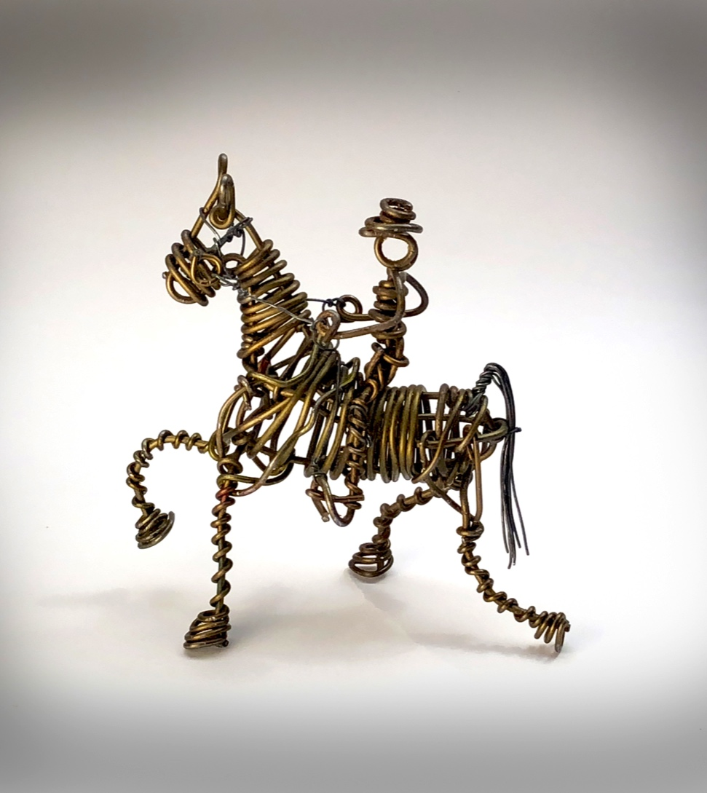
Vannoy Streeter: The Tennessee Wire Man Artists’ Lessons to Thrive! 2.1.
Big Idea: Community
Wire Sculptures
Notes:
Class activity: Have the class open the textbook to Artists’ Lessons to Thrive! 2.1. Participate in its learning targets.
Image: Vannoy Streeter, Tennessee Walking Horse. Jonathan Griffith, photo.

Slide 39
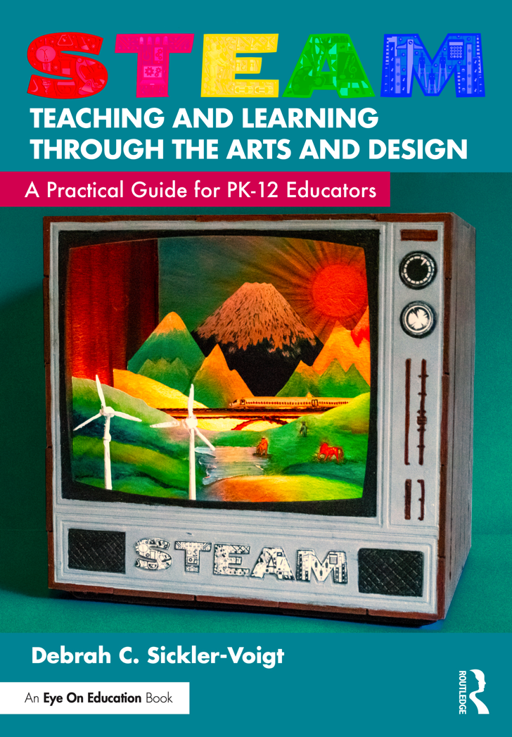
Artists’ Lessons to Thrive! Instructional Resources
Utilize TLAE’s and STEAM Teaching and Learning Through the Arts and Design’s Artists’ Lessons to Thrive! as resources to assist you in developing your Pre-K-12 curriculum.
Notes:
Left Image: Paula Gale, book cover artwork
Right Image: This is a book cover of STEAM Teaching and Learning Through the Arts and Design: A Practical Guide for PK-12 Educators.

Slide 40

Approaches to Teacher and Student Transformative Growth Charts
Teacher: Recognize the benefits of teacher autonomy and best practices when designing a TAC enabling me to meet my students’ needs and strengthens my teaching’s effectiveness.
Student: Employ personal and group choices to independent and collaborative curricular tasks to gain a sense of ownership and responsibility when learning and creating.
Notes:
Class Activity: Open the textbook to Chapter 2’s Teacher and Student Transformative Growth Charts. Model 2.3 TLAE’s Overview of Approaches to Teacher Transformative Growth and Model 2.4 TLAE’s Overview of Approaches to Student Transformative Growth. Discuss the meanings of these transformative actions. Build on their list of actions.
Image: Midjourney AI, prompted by Netha Hussain, CC0, via Wikimedia Commons. https://commons.wikimedia.org/wiki/File:Quilling_pattern_of_a_mountain_02.png

Slide 41
Chapter 2 Summary
Designing a Transformative Art Curriculum
Lessons and Unit Plans
Standards
Writing a Rationale
Goals
Transformative Dispositions
Scope and Sequence
Objectives
Transforming Objectives into Daily Learning Targets
Deconstructing Objectives and Learning Targets
Procedures
Notes:
Thanks for participating in Teaching and Learning in Art Education’s 2nd Ed. Chapter 2!
Book Cover Artwork: Paula Gale
Chapter References
Anderson, L. W., (Ed.), Krathwohl, D. R,. (Ed.), Airasian, P. W. , Cruikshank, K. A. , Mayer, R. E. , Pintrich, P. R. , … Wittrock, M. C. (2001). A taxonomy for learning, teaching, and assessing: A revision of Bloom’s Taxonomy of Educational Objectives (Complete ed.). Longman.
Anderson, T. (1997). Talking with kids about art: A model for art criticism. School Arts, 97 (1), 21–24.
Bloom, B. S. , Engelhart, M. D. , Furst, E. J. , Hill, W. H. , & Krathwohl, D. R. (1956). Taxonomy of educational objectives: The classification of educational goals. Handbook I: Cognitive Domain. David McKay.
Chappuis, J. , Stiggins, R. , Chappuis, S. , & Arter, J. (2012). Classroom assessment for student learning: Doing it right: Using it well (2nd ed.). Upper Pearson.
Clark, G. A. , Day, M. D. , & Greer, W. D. (1987). Disciplined-based art education: Becoming students of art. Journal of Aesthetic Education, 21 (2), 129–193.
Flavell, J. H. (1979). Metacognition and cognitive monitoring: A new area of cognitive-developmental inquiry. American Psychologist, 34(10), 906–911.
Jefferson, M., & Anderson, M. A. (2021). Transforming education: Reimagining learning, pedagogy and curriculum. Bloomsbury Academic.
McTighe, J. , & Wiggins, G. (2012). From Common Core Standards to curriculum: Five big ideas. http://grantwiggins.files.wordpress.com/2012/09/mctighe_wiggins_final_common_core_standards.pdf
Moses, K. (1999). Outsider art of the south. Schiffer.
Moss, C. M. , & Brookhart, S. M. (2012). Learning targets: Helping students aim for understanding in today’s lesson. Association for Supervision and Curriculum Development.
National Coalition for Core Arts Standards . (2014a). National Core Arts Standards. www.nationalartsstandards.org
National Coalition for Core Arts Standards . (2014b). National Core Arts Standards: A conceptual framework for arts learning. https://www.nationalartsstandards.org/sites/default/files/NCCAS%20%20Conceptual%20Framework_0.pdf
Perkins, D. N. (1994). the intelligent eye: Learning to think by looking at art. J. Paul Getty Trust.
Pierce, M., & Santos, L., (2023). Teaching art through engaging decolonizing viewpoints: Privileging an indigenous lens. Journal of Cultural Research in Art Education, 40, 134-153
Podsiadlik, E. & Parker-Katz, M. (2019). Transforming teacher education: Nurturing innovative pathways of collaboration essential to democratizing teacher education. In A. E. Lopez & E. L. Olan (Eds). Transformative pedagogies for teacher education: Critical action, agency and dialogue in teaching and learning contexts (pp.197-212). Information Age Publishing.
Sellen, B. (2000). Self-taught, outsider, and folk art: A guide to American artists, locations, and resources. McFarland.
Sickler-Voigt, D. C. (2006). Southern African American art: Chronicles of shared history, religious zeal, and personal expression. Journal of Cultural Research in Art Education, 24, 71–82.
Sickler-Voigt, D. C. (2023). STEAM teaching and learning through the arts and design: A practical guide for PK-12 educators. Routledge.
Siegesmund, R. & Smilan, C. (2024a). Art education assessment and the industrial educational complex. In C. Smilan & R. Siegesmund (Eds.). Authentic secondary art assessment: Snapshots from art teacher practice (pp.13-19). Routledge.
Siegesmund, R. & Smilan, C. (2024b). Educational aims, goals, and objectives: Balancing instructional objectives and expressive outcomes. In C. Smilan & R. Siegesmund (Eds.). Authentic secondary art assessment: Snapshots from art teacher practice (pp.20-23). Routledge.
Smilan, C. & Siegesmund, R. (2024). Introduction: Authentic secondary art assessment: Snapshots from art teacher practice. In C. Smilan & R. Siegesmund (Eds.). Authentic secondary art assessment: Snapshots from art teacher practice (pp.1-10). Routledge.
Thompson, J. G. (2018). The first-year teacher’s survival guide: Ready-to-use-strategies, tools, & activities for meeting the challenges of each school day (4th ed.). San Francisco, CA: Josey-Bass.
Yakamovich, J., & Wright, T. (2021). Care-full, convivial, curious: Weaving Canadian artists’ conceptions of art as a form of transformative environmental education. Journal of Environmental Education, 52(4), 223–238. https://doi-org.ezproxy.mtsu.edu/10.1080/00958964.2021.1929801
Wiggins, G. , & McTighe, J. (2005). Understanding by design (2nd ed.). Upper Pearson.

