Slide 1

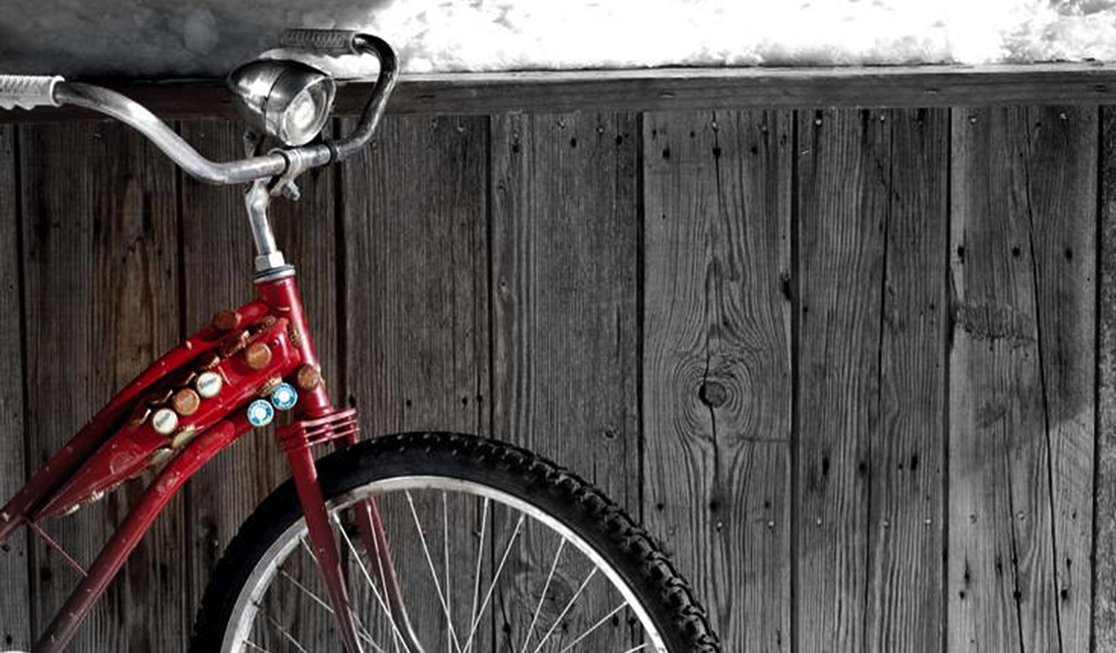
CHAPTER 3. Assessment and Evaluation for the Visual Arts Teaching and Learning in Art Education, 2nd Ed.
Debrah C. Sickler-Voigt, Author & Presentation Developer ©
Notes:
Welcome to Teaching and Learning in Art Education, 2nd Edition, Chapter 3!
TLAE as a theoretically-based, practical textbook to prepare preservice educators for their teaching careers and to support in-service educators in improving their existing practices. Its timely second edition with its updated framework remains dedicated to assisting educators in all stages of their careers through effective curricular planning, instruction, assessment, and management to foster student learning and cultivate educators’ meaningful, creative, and rewarding careers.
This textbook and instructional resources resulted from the contributions of many individuals, including teachers, students, artists, organizations, family, mentors, and Routledge’s editorial/production team. Its teachings are based on the author’s research, communications, and professional interpretations of teachers, artists,’ and designers’ works with the aim of being respectful of diversified peoples and representing their teachings in a truthful and non-biased manner.
Book Cover Artwork: Paula Gale
Right Image: Coley Lee, 13 years old, USA. Mike Muller, teacher.

Slide 2

Chapter 3 Topics
Assessment
Developing an Art Assessment Action Plan
Evaluation
Notes:
Spotlight on Student Art #3: Inner Drive
Image: Coley Lee, 13 years old, USA. Mike Muller, teacher.

Slide 3

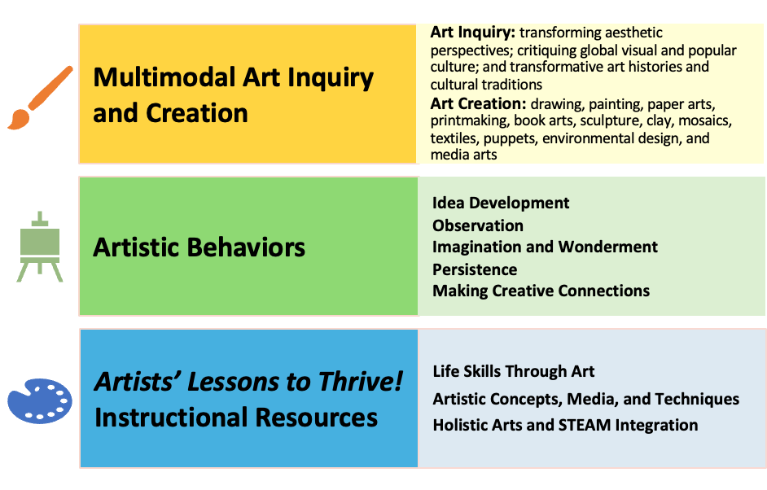
Link Chapter 3’s teachings with TLAE’s Transformative
Art Education Framework
Notes:
Class instruction: Ask students to build on prior learning and personal experiences to make personal connections between this chapter’s teachings and TLAE’s Transformative Art Education framework.

Slide 4
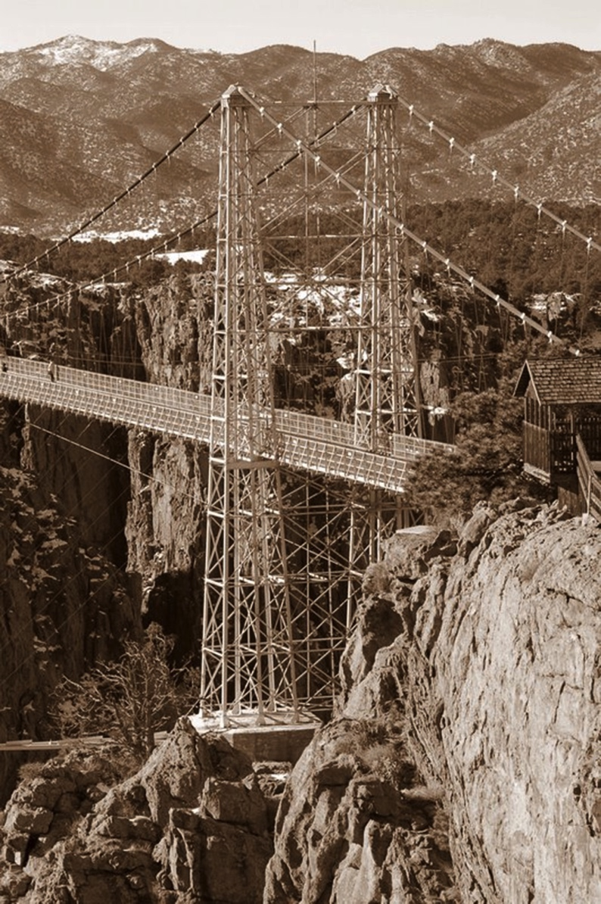
Assessment 1
Measures anticipated and unanticipated student learning outcomes.
Appraises expressive outcomes.
Directs teaching and learning practices.
Is ongoing.
Notes:
Image: Coley Lee, 13 years old, USA. Mike Muller, teacher.

Slide 5
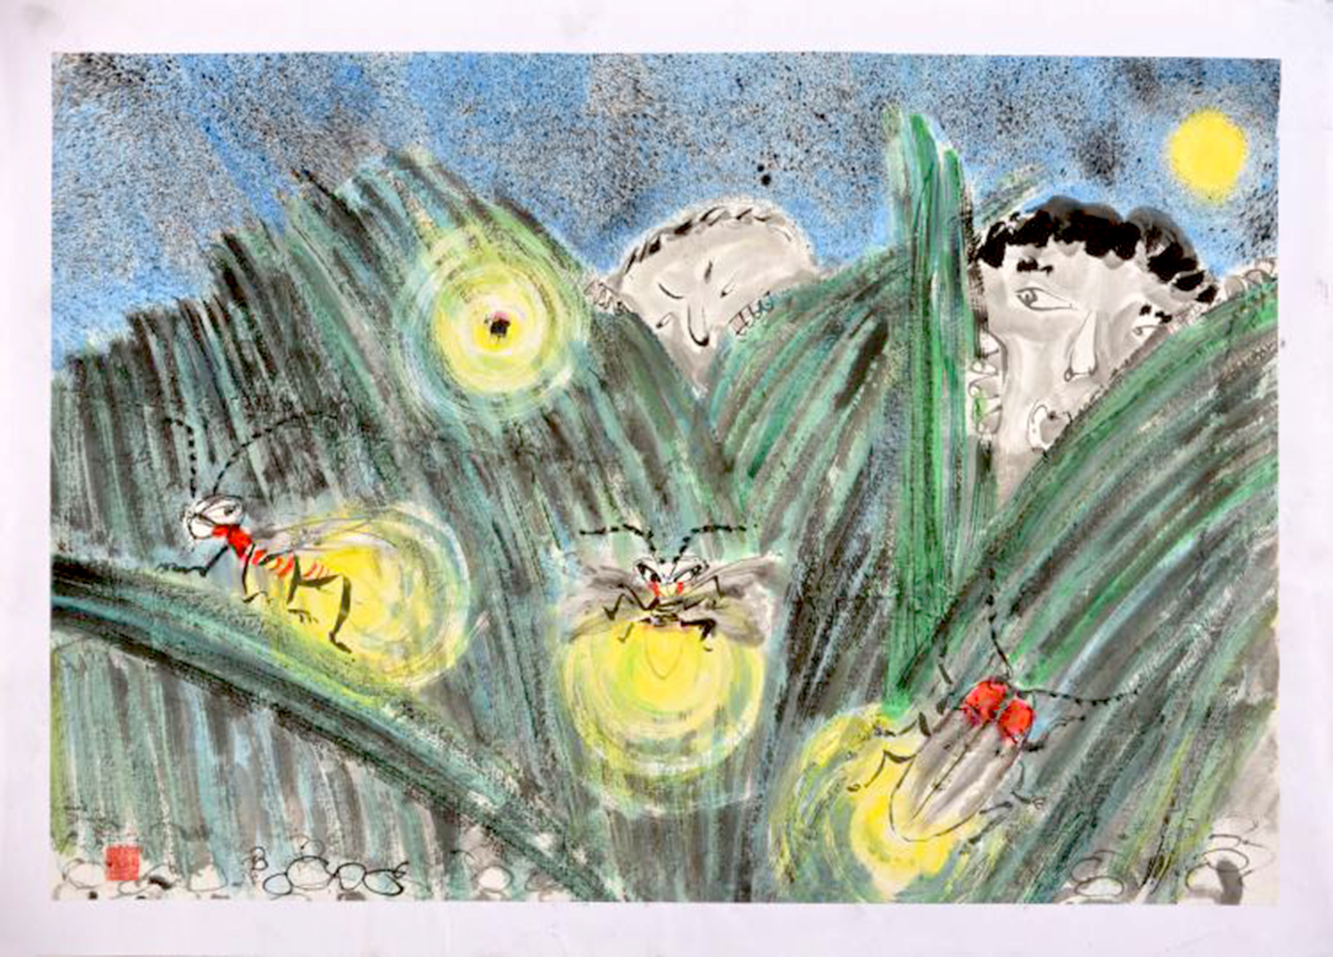
Visual Arts Assessments
Present discipline-specific challenges differing from other academic subjects.
Measure and appraise artistic behaviors including acquiring artistic skills, applying art production methods to communicate ideas, and generating deep understandings about art’s meaning and its functions in society.
Notes:
Image: Lau You Gi, 7 years old, Simply Art, Hong Kong, China. Light theme from 43rd ICEFA Lidice.

Slide 6


Assessment 2
A single assessment cannot measure or appraise all that students need to achieve. Assessments have different functions.
Notes:
Class instruction: Explain to the class that assessments have different functions.
Ask them to contemplate why single assessment cannot measure or appraise all that students need to achieve.
Image: Coley Lee, 13 years old, USA. Mike Muller, teacher.

Slide 7
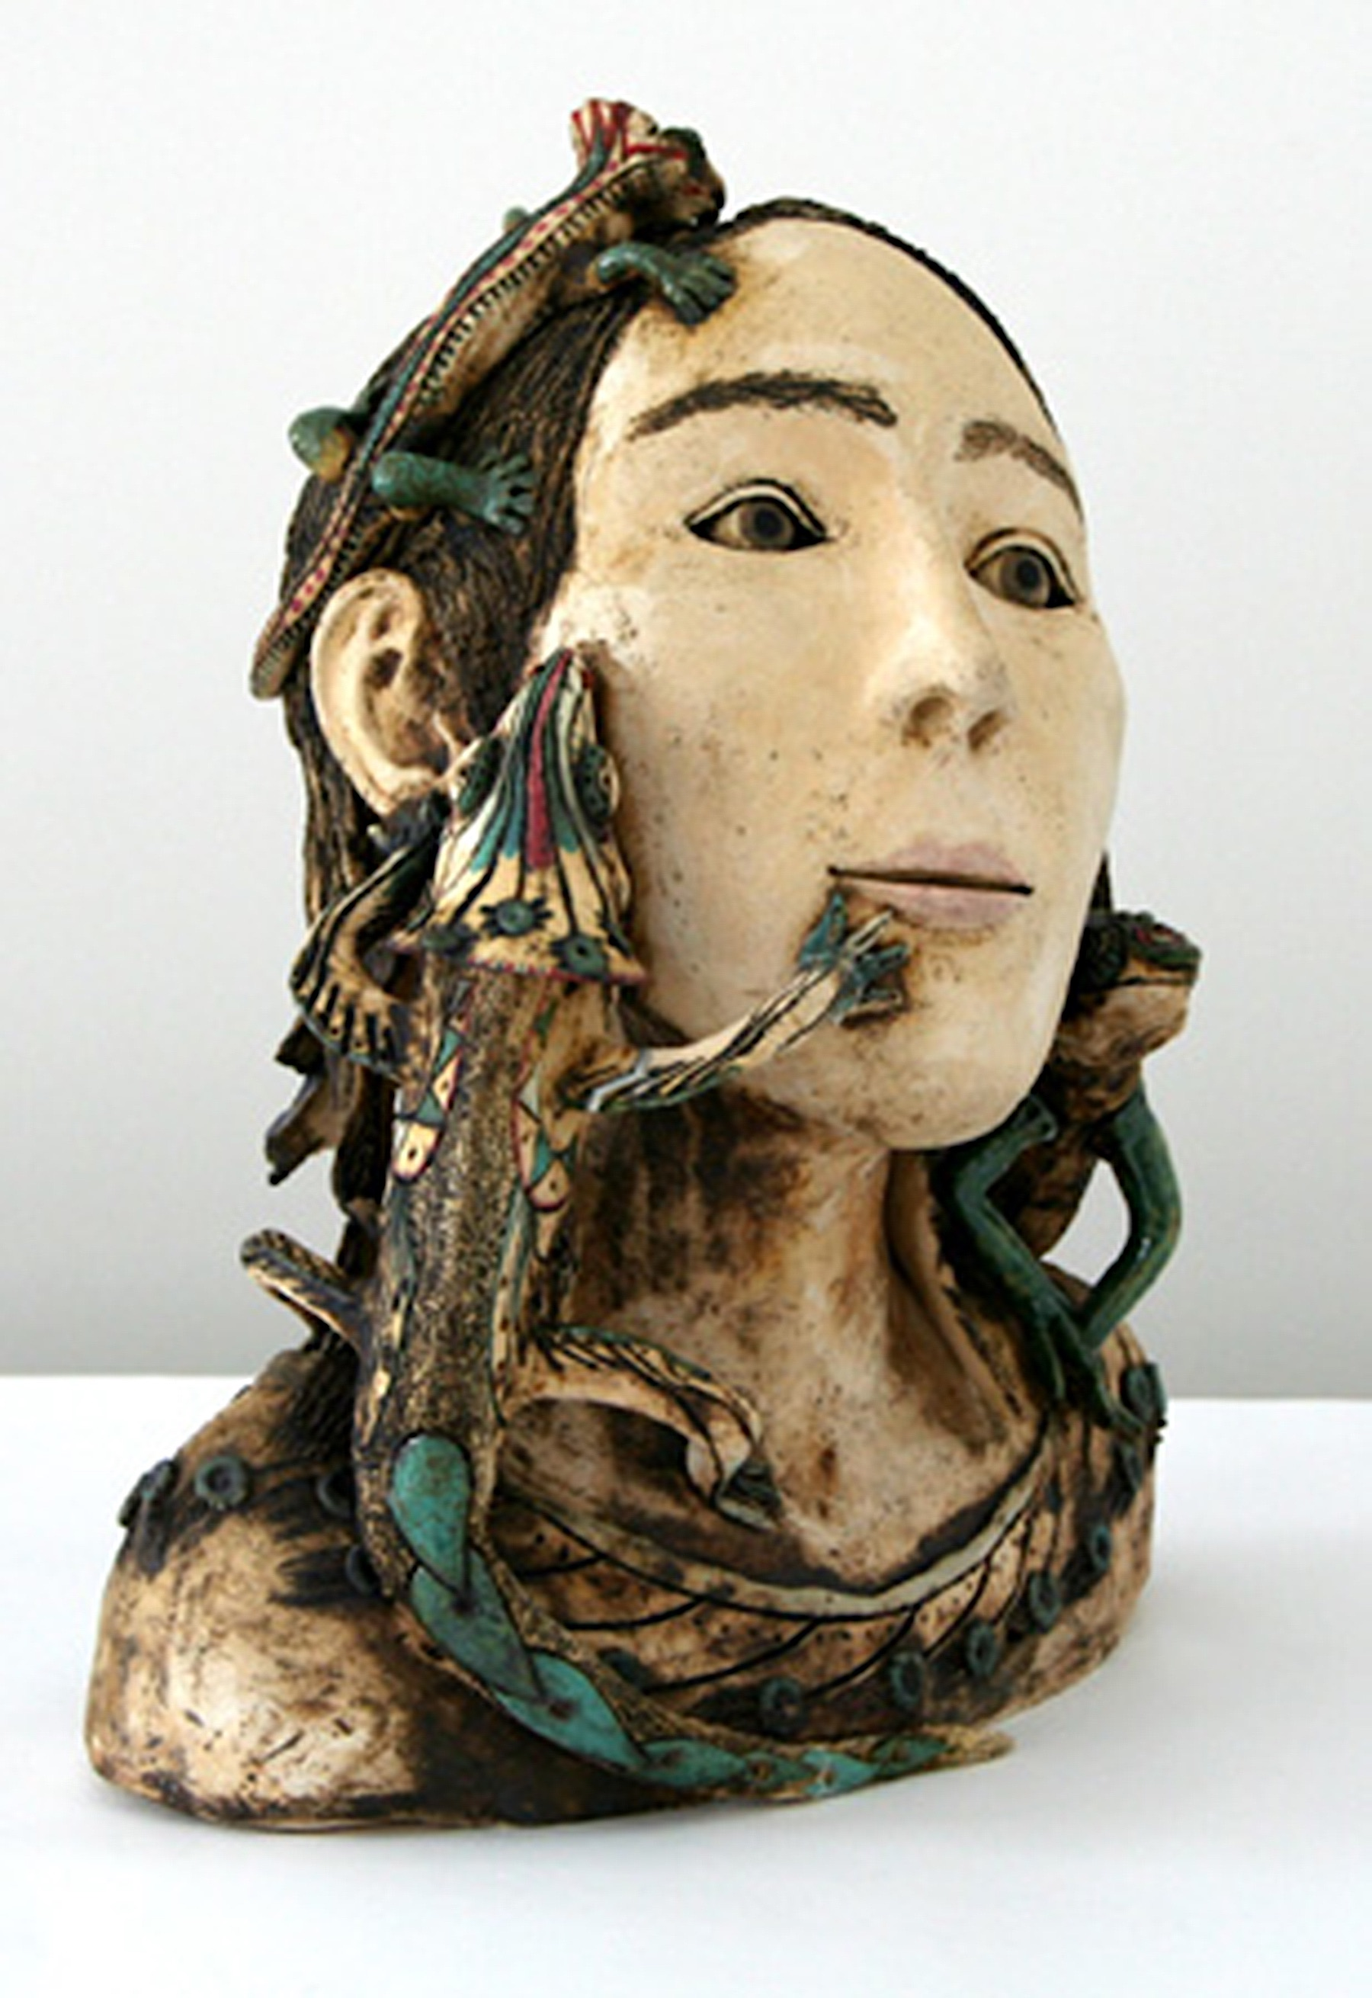
Assessment: Assessment Literacy
Assessment literate teachers know how to use, create, and implement different assessments.
They select assessments that produce the most accurate results to inform instruction, accommodate students’ needs, and improve teaching and learning.
Notes:
Image: Veronika Kolářová, 15 years old, Dům dětí a mládeže Praha 3 - Ulita, Praha 3 - Žižkov, Czech Republic. 39th ICEFA Lidice.

Slide 8

Assessment Literacy
Apply knowledge and professional intuitions to design and implement assessments.
Analyze assessment results and reflect on ways to continue to augment students’ development and attainment of learning targets.
Notes:
Class instruction: After discussing the meaning of assessment literate teachers, ask students to describe in their own words how becoming assessment literate teachers can benefit them in their own teaching careers.
Image: Coley Lee, 13 years old, USA. Mike Muller, teacher.

Slide 9
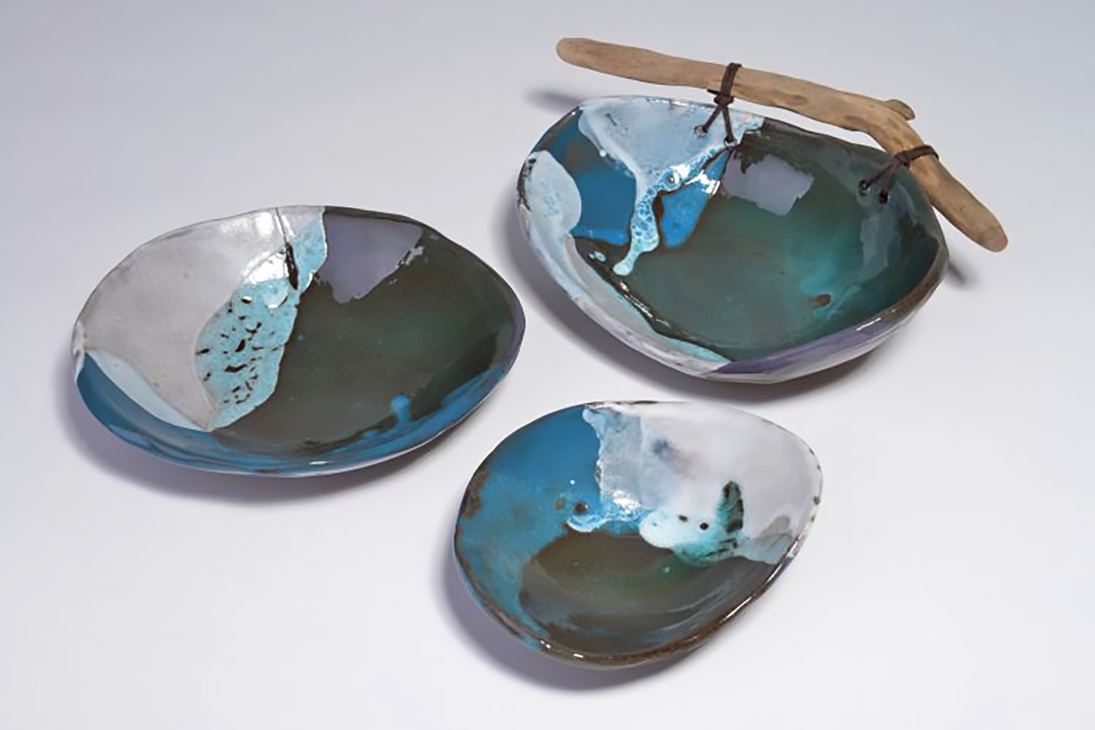
Performance Assessments
Measure learning targets resulting in students’ creative products and performances derived from lesson objectives, student learning outcomes, and curricular goals.
Artworks
Critiques
Presentations
Inquiry Methods
Tests
Notes:
Class instruction: Discuss how performance assessments often result in grades.
Image: These ceramic pieces represent travel. Una Bukša, 13-years-old, Césu BJC, Césis, Latvia. Source: ICEFA Lidice, 46th Exhibition.

Slide 10

Quantitative Assessment Methods 1
Numeric Scores
(100% )
Grading Scales
Tests
Rubrics
Not all that we want and need to know about students and our teaching practices can be measured quantitatively.
Quantitative Assessments
Notes:
Image: https://openclipart.org/detail/306464/white-board-colour

Slide 11
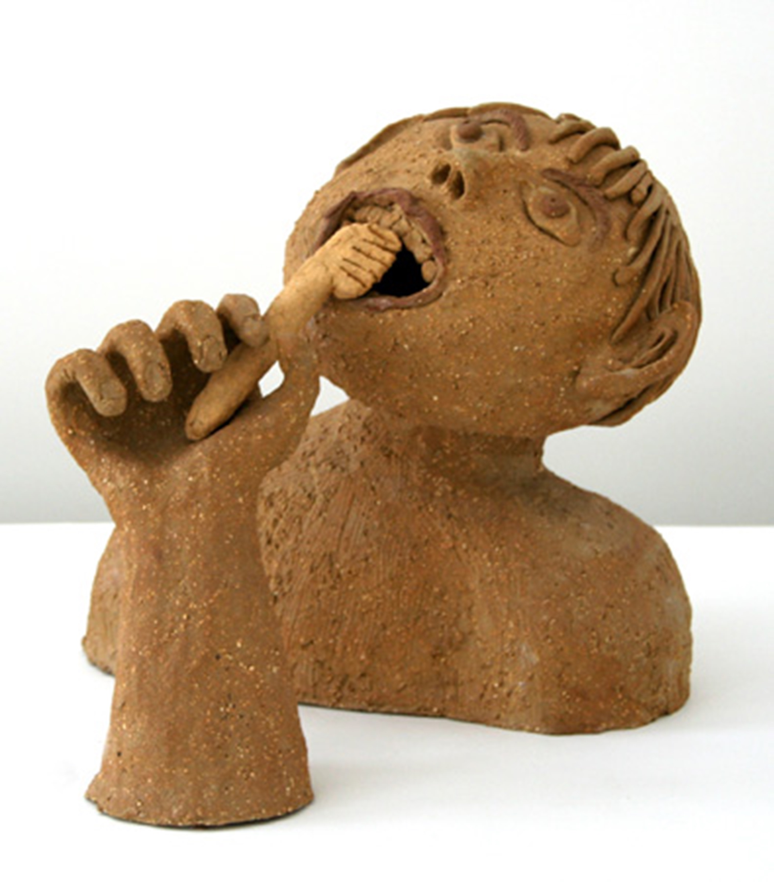
Qualitative Assessment Methods 2
Qualitative assessments appraise students’ expressive outcomes resulting from participating in comprehensive learning tasks. They include artistic behaviors, dispositions, inquiries, and experiences.
Reflective Communications
Observations
Focused Revisions
Anecdotal Evidence
Notes:
Class instruction: Introduce qualitative assessments and compare them to quantitative assessments. Ask the class to contemplate how using both quantitative and qualitative assessments inform us about our teaching practices and student learning.
Image: Jiří Manďák, 12 years old, ZUŠ, Zlín - Malenovice, Czech Republic. 39th ICEFA Lidice.
References:
Eisner, 2002

Slide 12

Authentic Assessment 1
Authentic assessment appraises student learning outcomes and expressive outcomes that reach beyond the classroom with transformative, real world applications.
Notes:
Image: Hiba Khamlichi, 13 years old, Rabat, Morocco. Agriculture theme from 42nd ICEFA Lidice.
References:
Anderson & Milbrandt, 2005
Chappuis et al., 2012

Slide 13
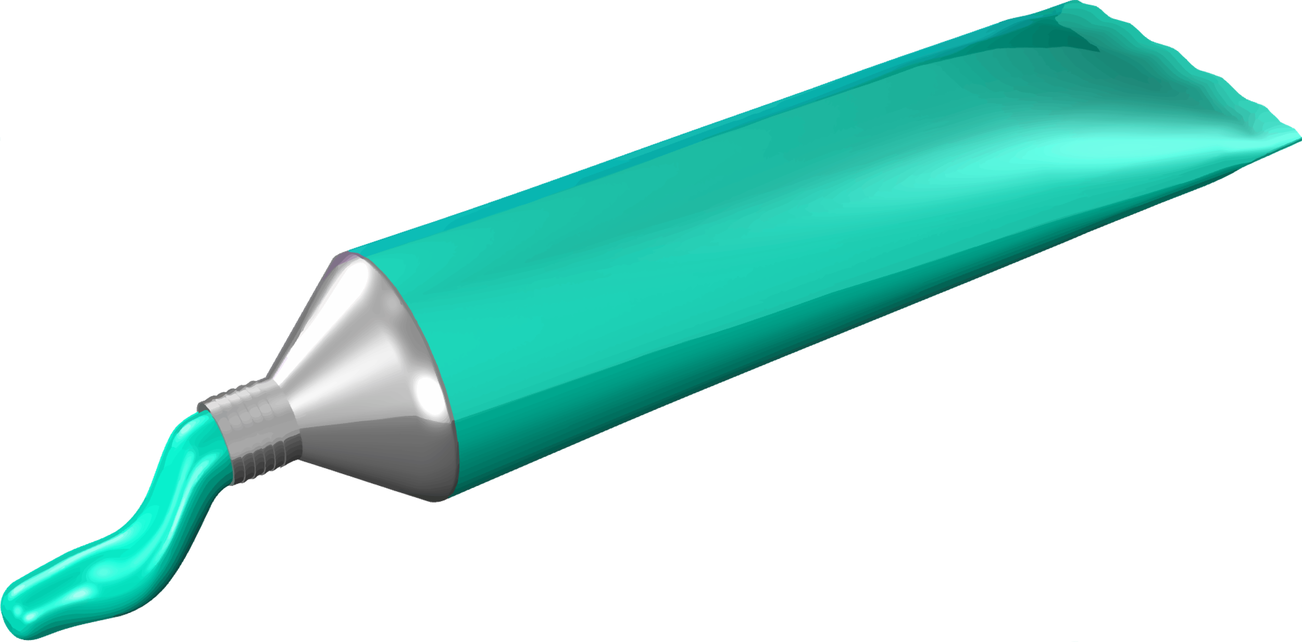

Authentic Assessment 3
Teachers and students collaborate to make curricular decisions and assess performances, work samples, and dispositions.
Students value learning knowledge for itself, not just for the sake of earning a grade.
Observations
Teacher-Student Conferences
Anecdotal Records
Journals and Portfolios
Notes:
Top Image: https://openclipart.org/detail/282278/paint-tube-colour-6
Bottom Image: https://openclipart.org/detail/282273/paint-tube

Slide 14

Developing an Art Assessment Action Plan
Integrates best practices and contemporary research.
Utilizes quantitative and qualitative assessment methods.
Identifies and explains relationships.
Informs administrators and policy makers.
Substantiates teaching and assessment methodologies.
Summarizes findings.
Notes:
Image: https://openclipart.org/detail/178987/pencil-cup

Slide 15

Developing an Art Assessment Action Plan’s Components
(1) Setting Goals and Writing Objectives
(2) Selecting Assessments
(3) Managing and Analyzing Performance Data
Notes:
Class instruction: Have the class open the textbook to Model 3.1. Art Assessment Action Plan and discuss its contents. Ask the class to visualize how they would utilize it to guide their own assessment practices. Have students write a 9-week, semester, or year’s curriculum and complete the Art Assessment Action Plan with their original responses.
Image: Asal Yar-Ahmadi, 6 years old, KANOON - Institute for Intellectual Development of Children & Young Adults, Tehran, Iran. 38th ICEFA Lidice.

Slide 16

(1) Setting Goals and Writing Objectives (Developing an Art Assessment Action Plan)
Identify learning goals through backwards design.
Set achievable short- and long-term goals.
Align with benchmarks, grade level performance descriptors, and objectives unpacked from standards.
Develop age-appropriate goals.
Build on students’ prior knowledge.
Foster student agency
Notes:
Image: Mwangi Mungai,11 years old, Private Studio of Mary Muringi Aurilia, Nairobi, Kenya. 45th ICEFA Lidice.
References:
Siegesmund & Smilan, 2024
Wiggins & McTighe, 2005

Slide 17
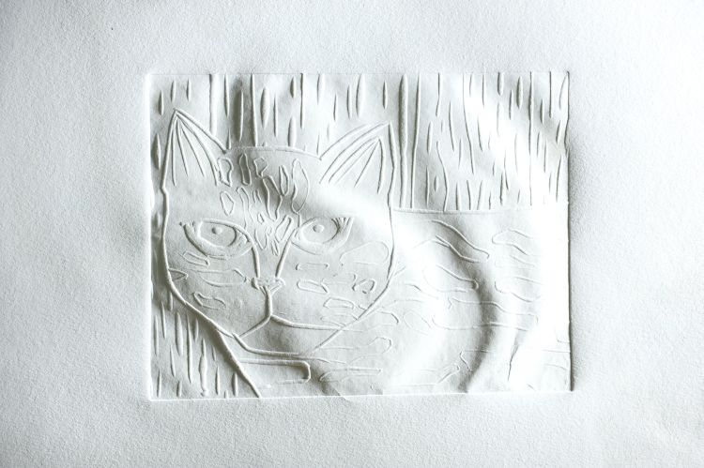
(2) Selecting Assessments (Developing an Art Assessment Action Plan)
Informal Assessment
Formative Assessment
Summative Assessment
Notes:
Class instruction: Explain the following:
Informal assessment assesses student behaviors formatively and checks for understanding without assigning grades. It transpires through one-on-one, small group, and whole class interactions.
Formative assessment collects data during a learning activity to identify what students understand and have yet to comprehend. Formative assessments provide teachers and students with immediate feedback before assigning summative grades.
Summative assessment measures learning targets at the completion of one or more tasks, including results from art lessons, journals, portfolios, essays, and capstone projects. Summative assessment results are useful in identifying levels of student achievement, assigning diagnostic grades, and providing feedback for student growth.
Explain how summative assessments differ from evaluations that include standardized test results, report card grades, and evaluated performances.
Image: Innes Withersová, 8 years old, Sdružení Roztoč, Roztoky, Czech Republic. 42nd ICEFA Lidice.

Slide 18
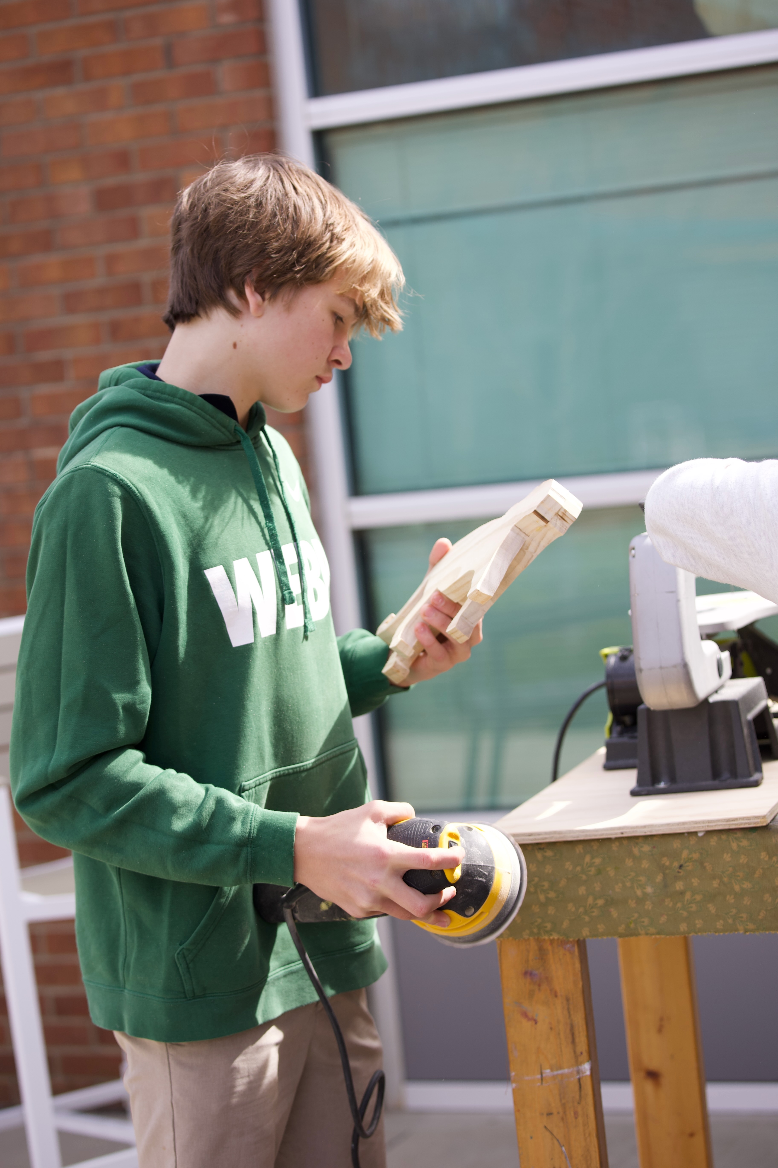
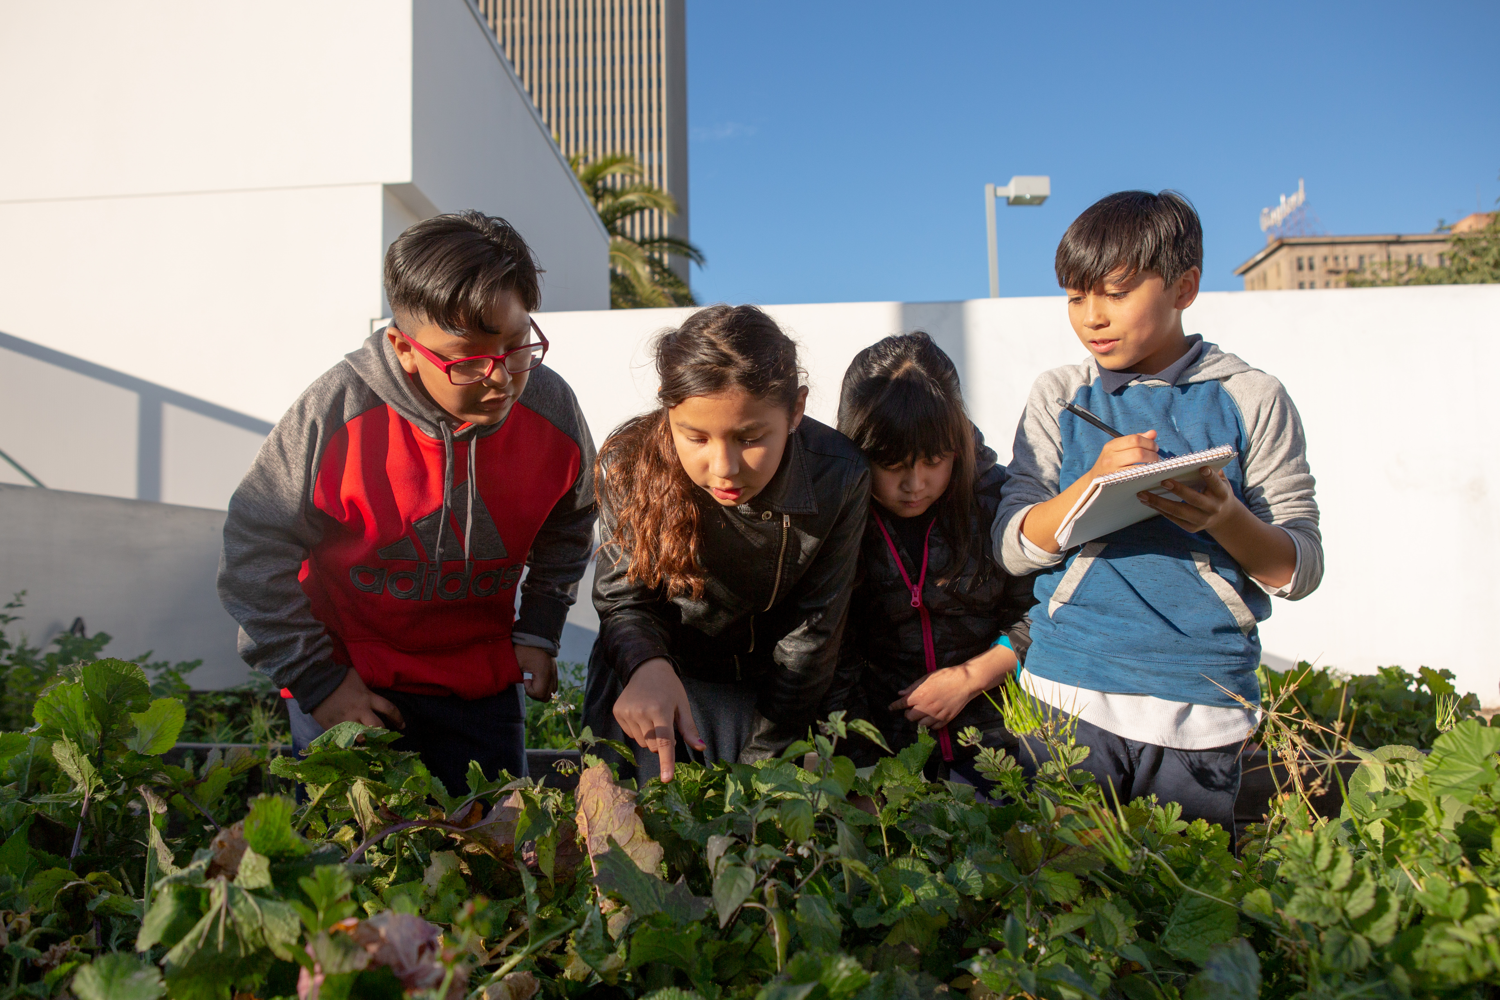
Self and Peer Assessments
Notes:
Class instruction: Explain the following:
Self-Assessment refers to individual students measuring their own performances using self-reflection and class assessment instruments as applicable to make necessary adaptations to tasks at hand.
Peer Assessment transpires when students offer fellow students constructive feedback about a learning target or behavior during a project.
Left Image: A middle schooler applies formative self-assessment while sanding a wooden sculpture. Source: Todd Johnson, teacher; Cathy Dowhos-O'Gorman, photo
Right Image: Photo by Allison Shelley/The Verbatim Agency for EDUimages. (CC BY-NC 4.0).

Slide 19
Simplified Numeric Scoring (2) Selecting Assessments, Developing an Art Assessment Action Plan
70 points—the minimum grade of “C” for completing the assignment
15 points for learning outcomes of design skills
15 points for learning outcomes of media application
Studio Art Project
Worth 100 Points
Notes:
Class instruction: Have the class open the textbook and introduce Model 3.2. Simplified Numeric Scoring with Full Targets and Model 3.3. Simplified Numeric Scoring with Abbreviated Targets.
Image: Sofija Sofrenić, 8 years old, Children's Cultural Center Belgrade, Beograd, Serbia. 43rd ICEFA Lidice.
Reference:
Henry, C. (1990). Grading student artwork: A plan for effective assessment. In B. E. Little (Ed.), Secondary art education: An anthology of issues (pp. 61-68). Reston, VA: National Art Education Association.

Slide 20

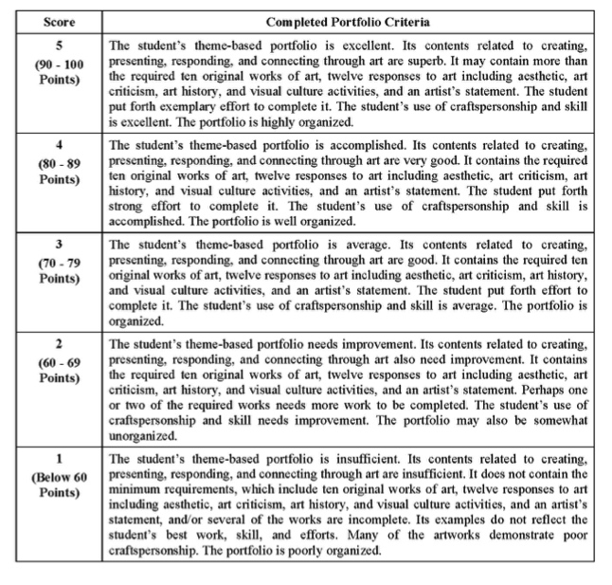
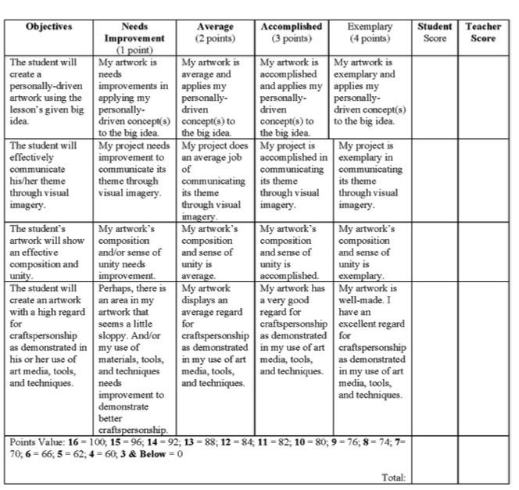
Rubric (2) Selecting Assessments, Developing an Art Assessment Action Plan
Analytic
(Scoring) Rubric
A rubric is a scoring device in table format. It contains measurable objectives or “I can” statements.
It defines levels and qualities of student performances through performance descriptors.
Holistic Rubric
Notes:
Class instruction:
Explain the following:
An analytic rubric presents rubric criteria on its far-left column, with each criterion placed in a separate row.
A holistic rubric differs from an analytic rubric because it displays all criteria clustered together, which teachers use to assess a summative product or performance as a whole.
Review Model 3.4. Analytic Rubric Components and the sample rubrics on TLAE’s website and have the students identify their qualities and components. Then, have students practice developing a rubric as a class. Then they can move into small group and independent work. Explain to students that with practice they will become skilled in writing original rubrics.
Reference:
Brookhart, 2013

Slide 21
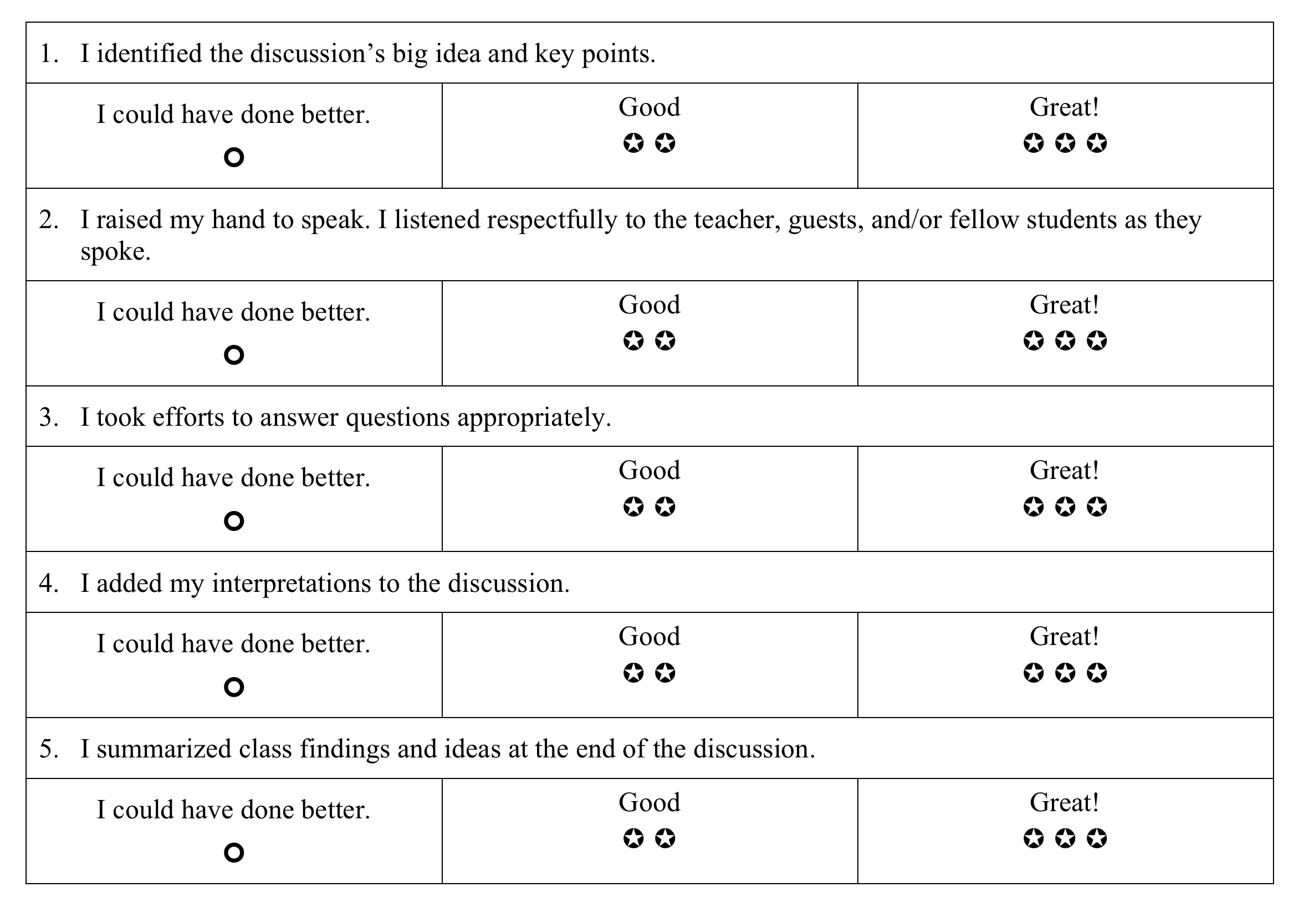
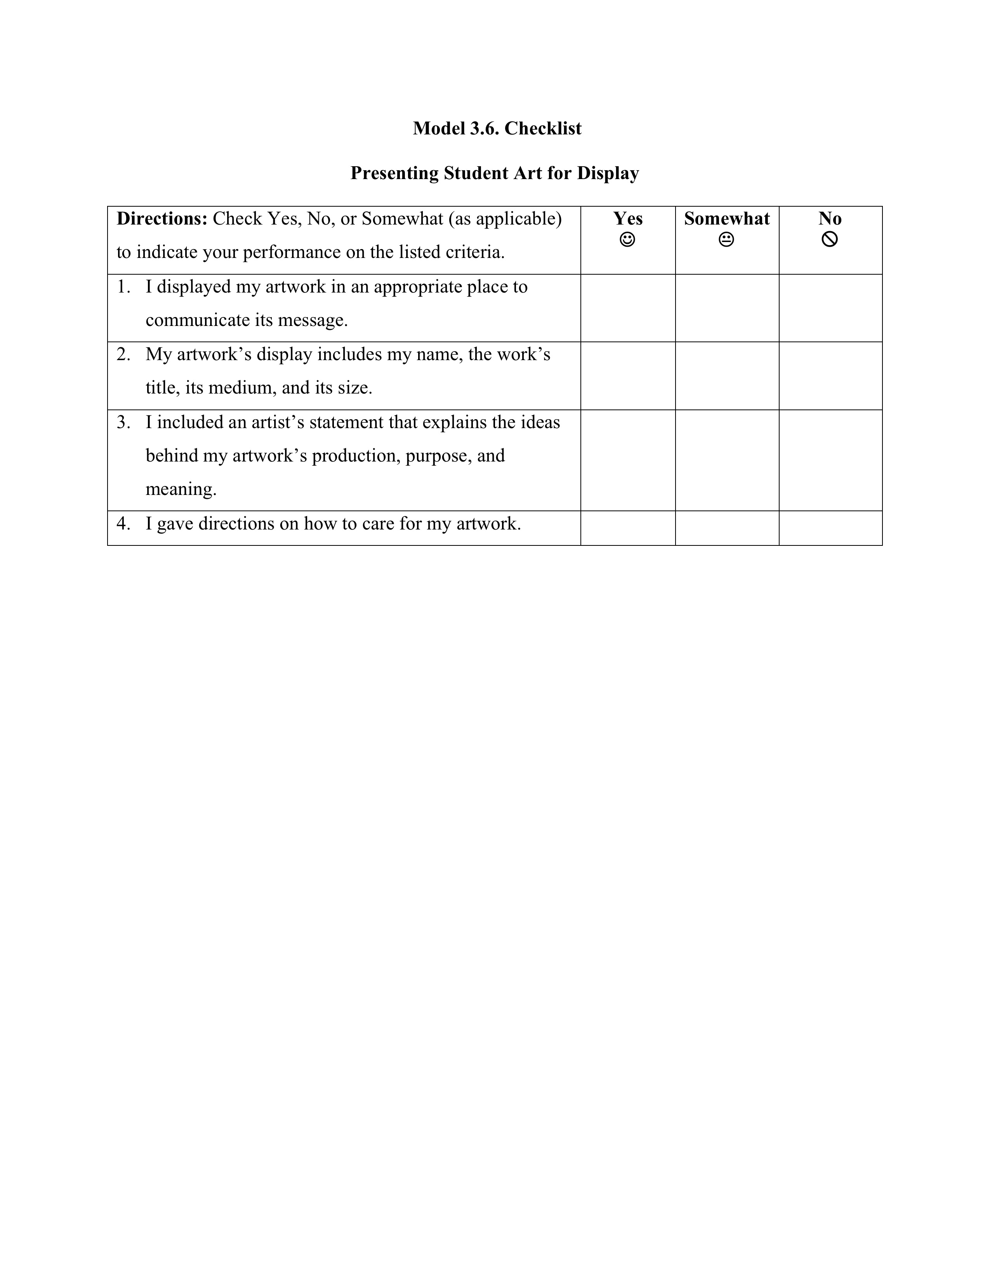
Rating Scales and Checklists (2) Selecting Assessments, Developing an Art Assessment Action Plan
A rating scale lists learning outcomes next to symbols that represent the level of performance.
A checklist measures actions and observable behaviors without rating the quality of the performance indicator.
Notes:
Class activity: Have students open their books and identify the qualities of Model 3.5. Rating Scale and Model 3.6. Checklist. Then, have students practice developing a rating scale and checklist as a class. Then they can move into small group and independent work. Explain to students that with practice they will become skilled in writing original rating scales and checklists.

Slide 22
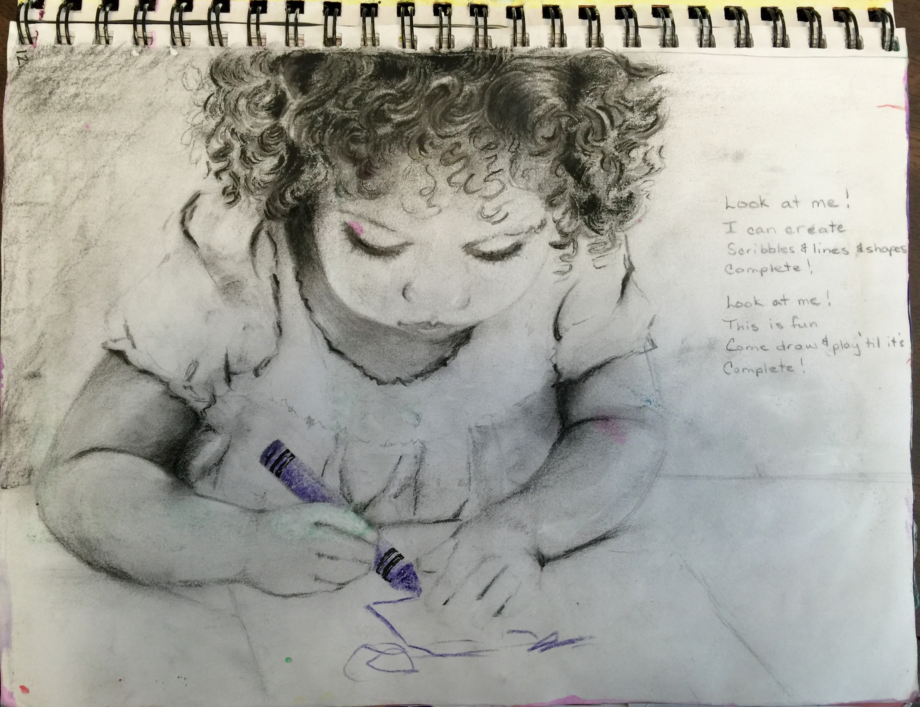
Art Journals (2) Selecting Assessments, Developing an Art Assessment Action Plan
Create art.
Write.
Make interpretations.
Present ideas.
Record observations.
Reflect.
Build ideas and content.
Notes:
Image: Rebecca Frasier journal page. USA, Author, teacher.
Reference:
Anderson & Milbrandt, 2005

Slide 23
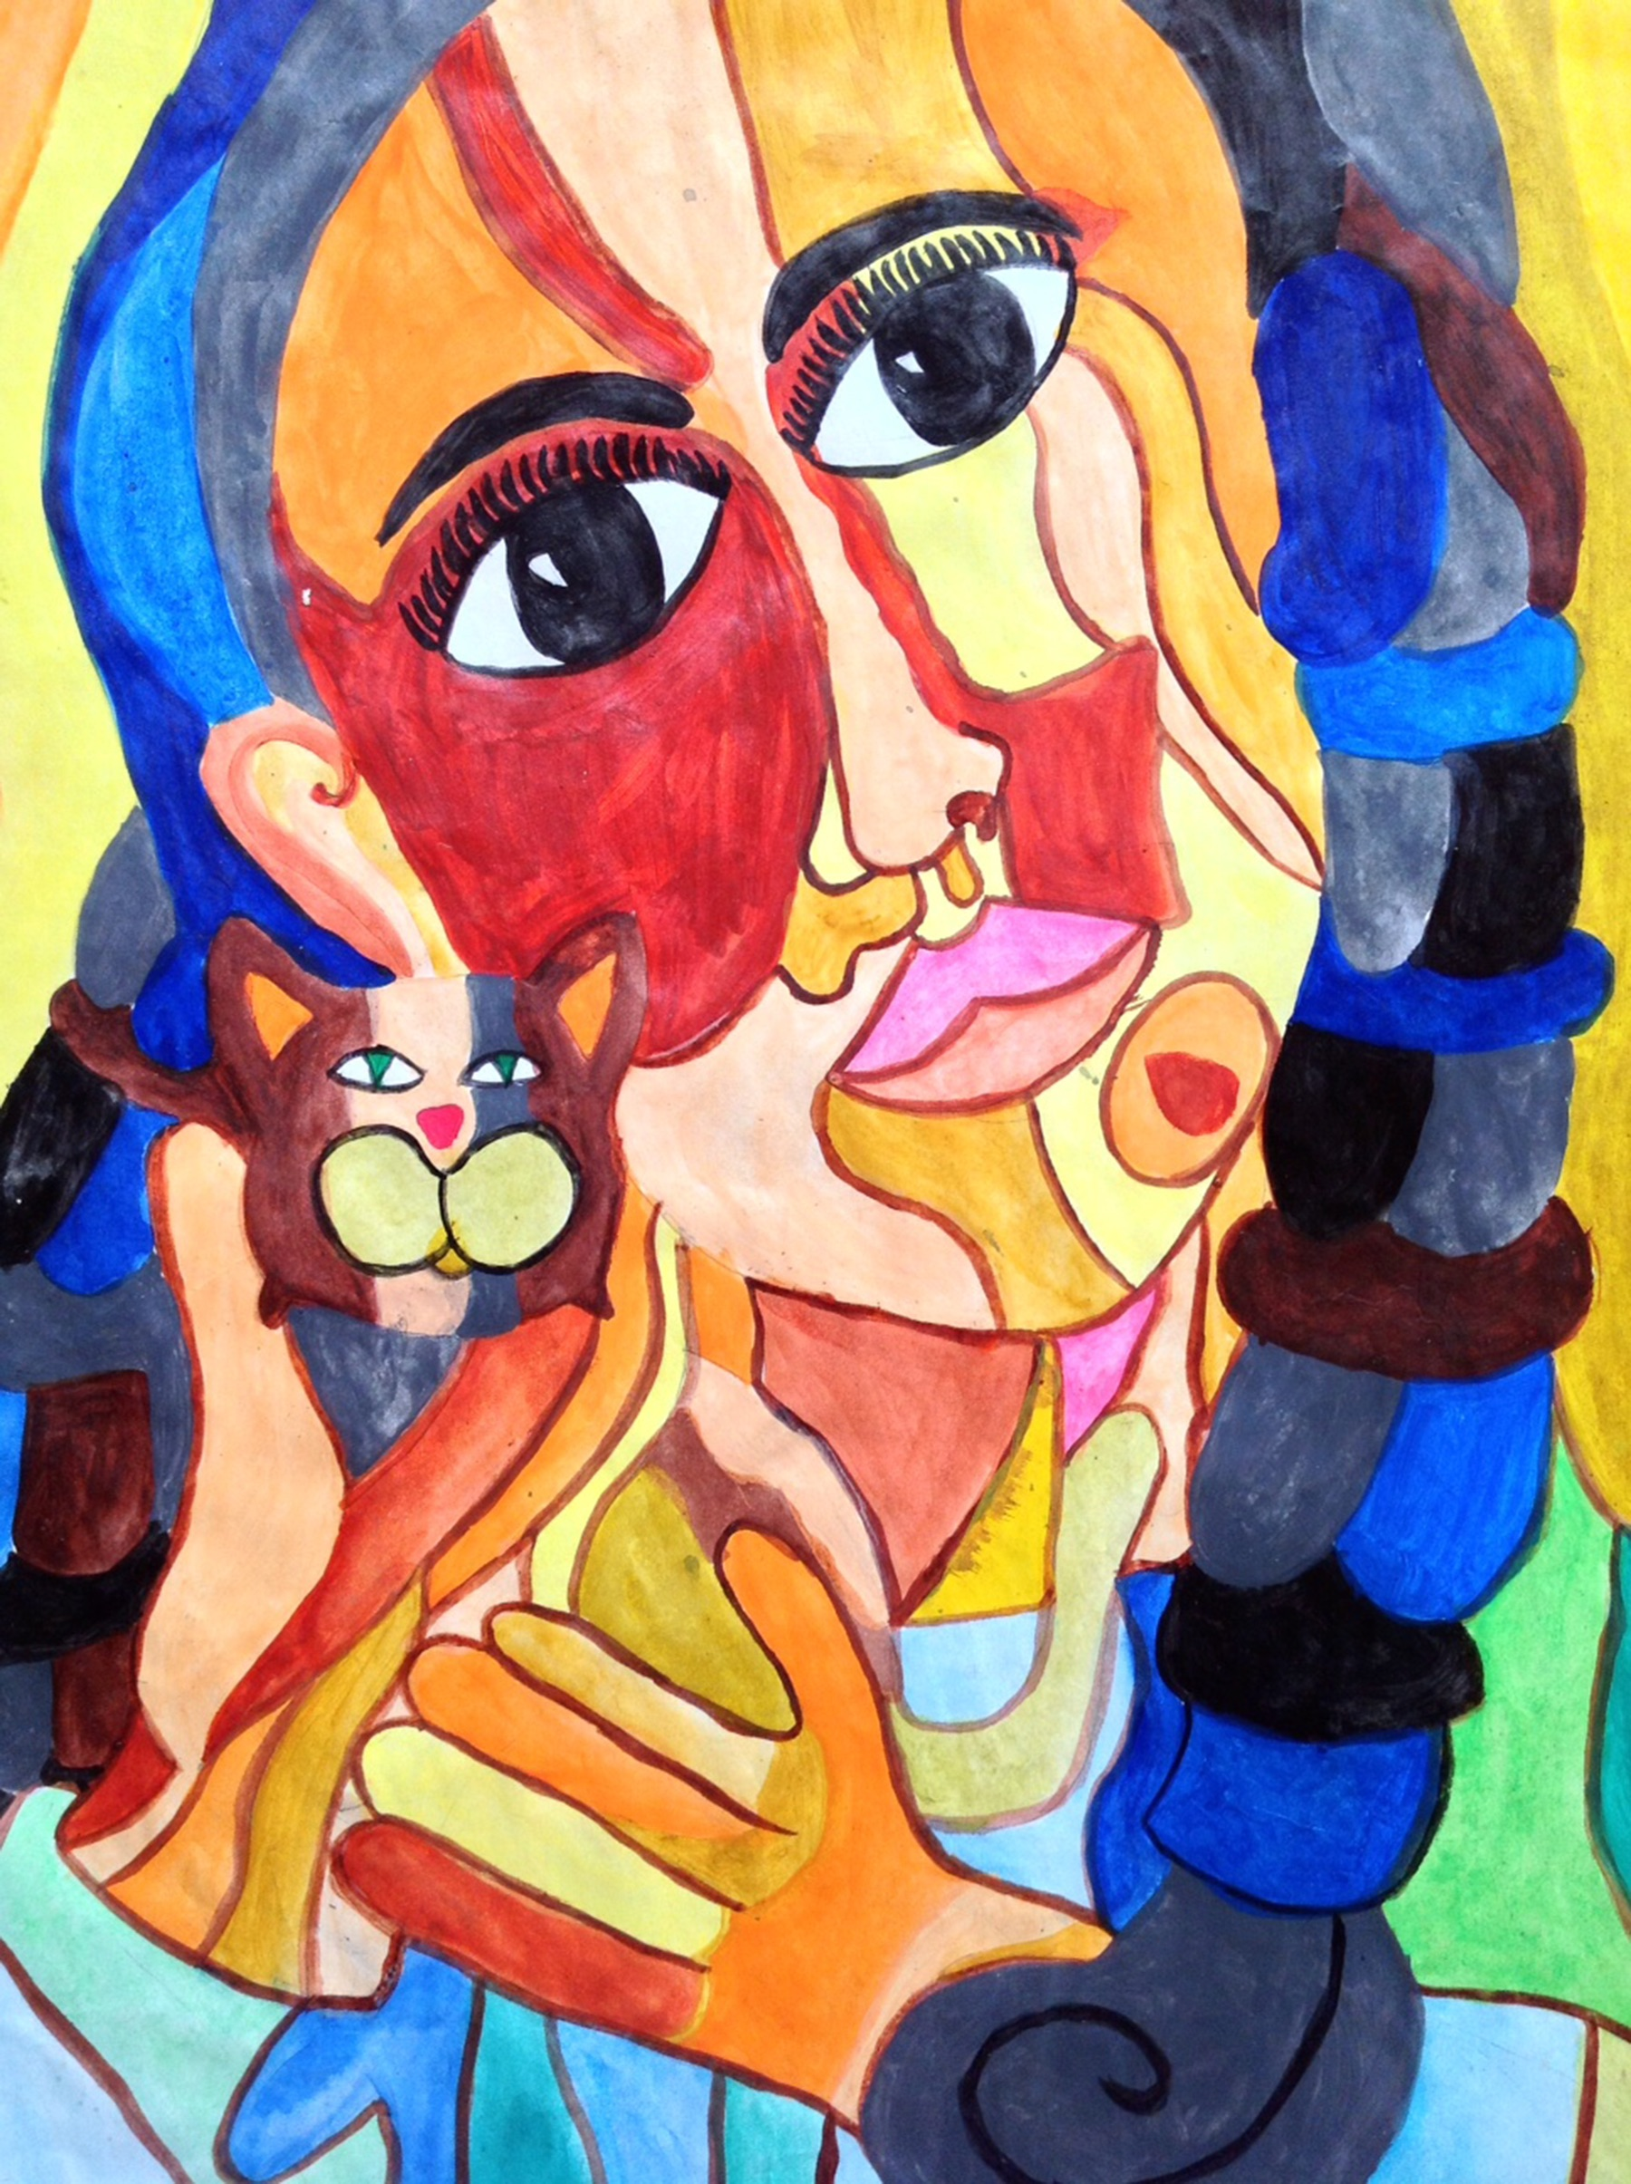


Portfolios (2) Selecting Assessments, Developing an Art Assessment Action Plan
Portfolios are assessment instruments that contain a collection of student selected artifacts created over an extended time.
Notes:
Class instruction: Explain how portfolios differ from working folders that store all materials students collect and create.
Left Image: Nirel Kadzo, 14 years old, Kenya. Lisa Wee, teacher. Works in Nirel’s portfolio represent her interest in drawing stylized human forms.
Right Image: https://openclipart.org/download/241184/1455575981.svg
Reference:
Chappuis et al., 2012

Slide 24

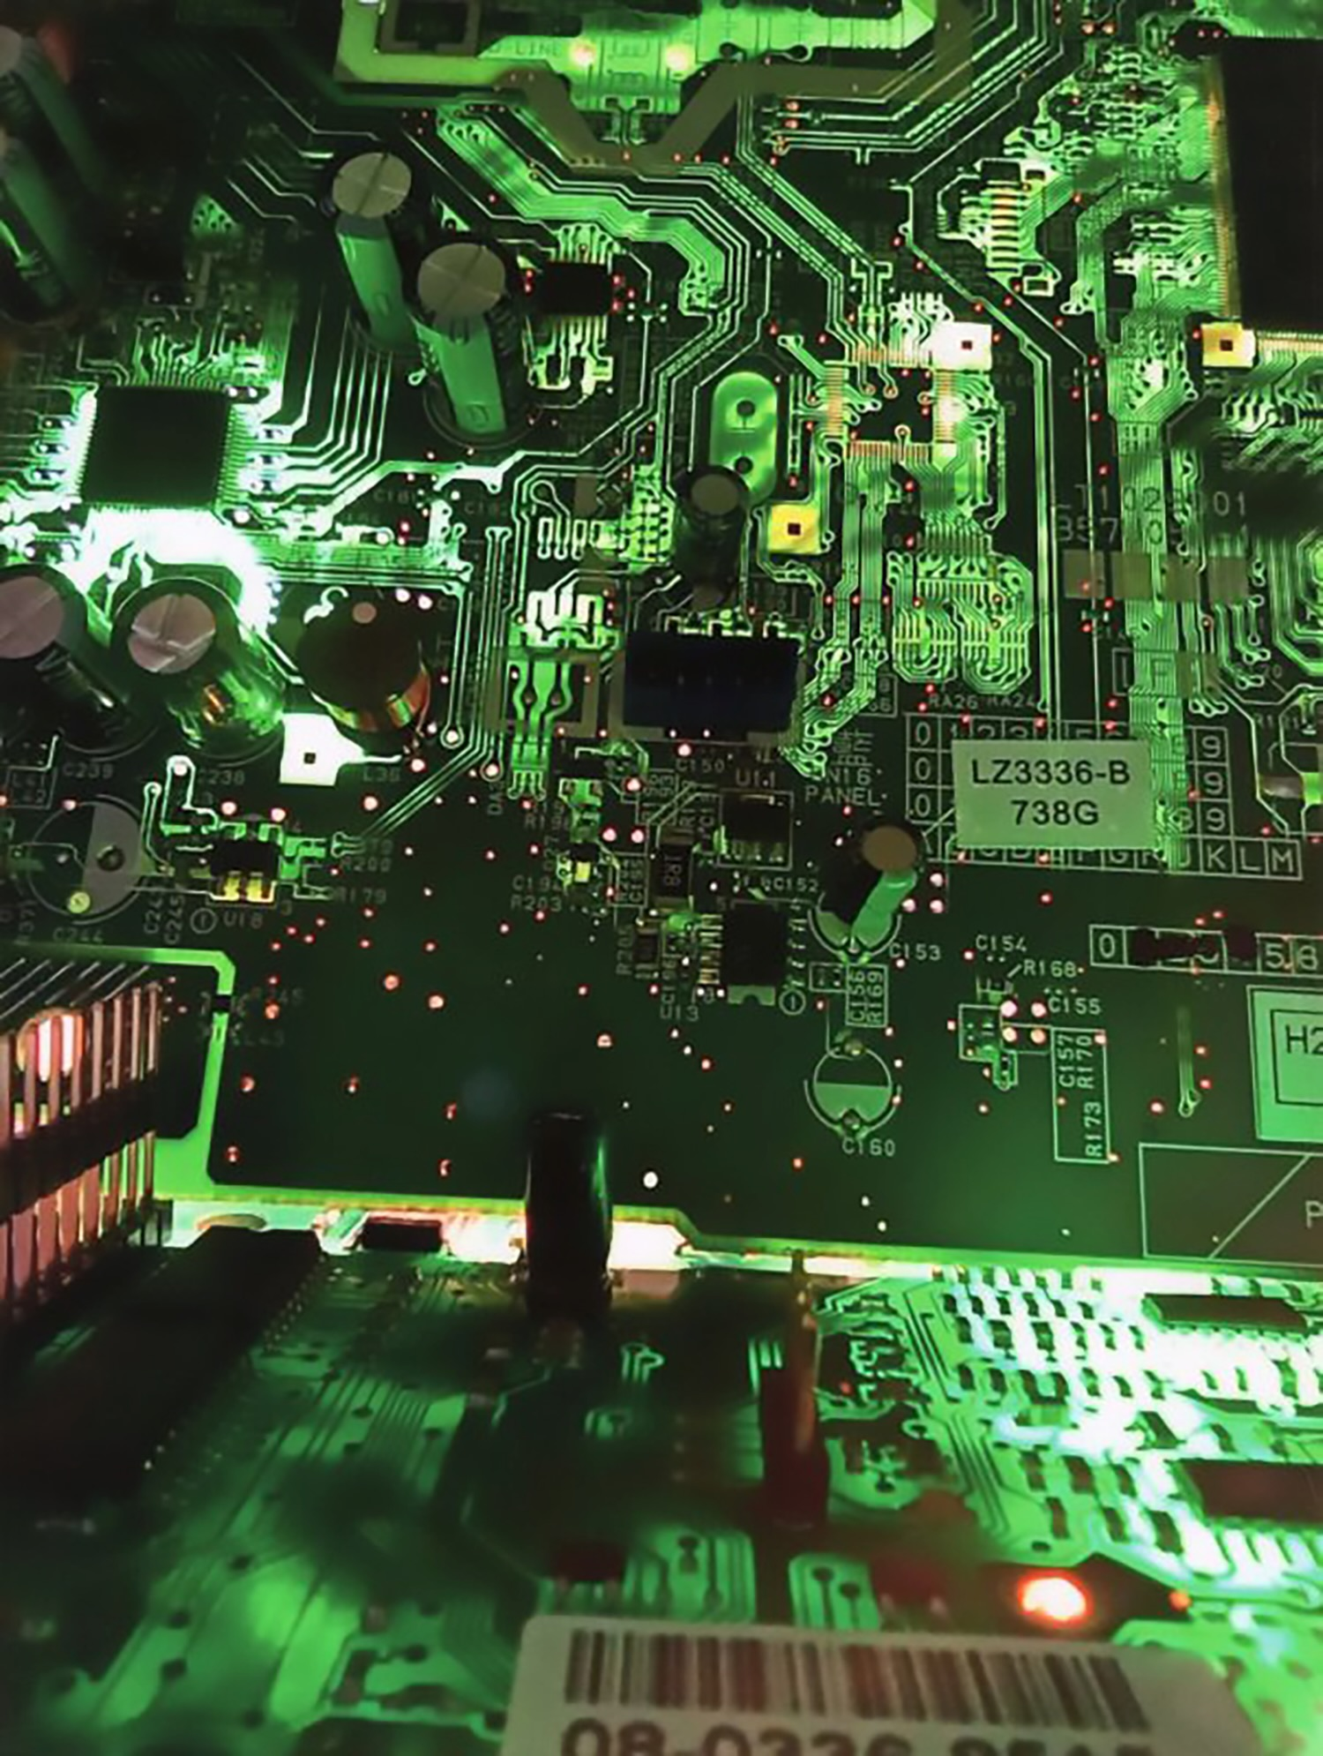
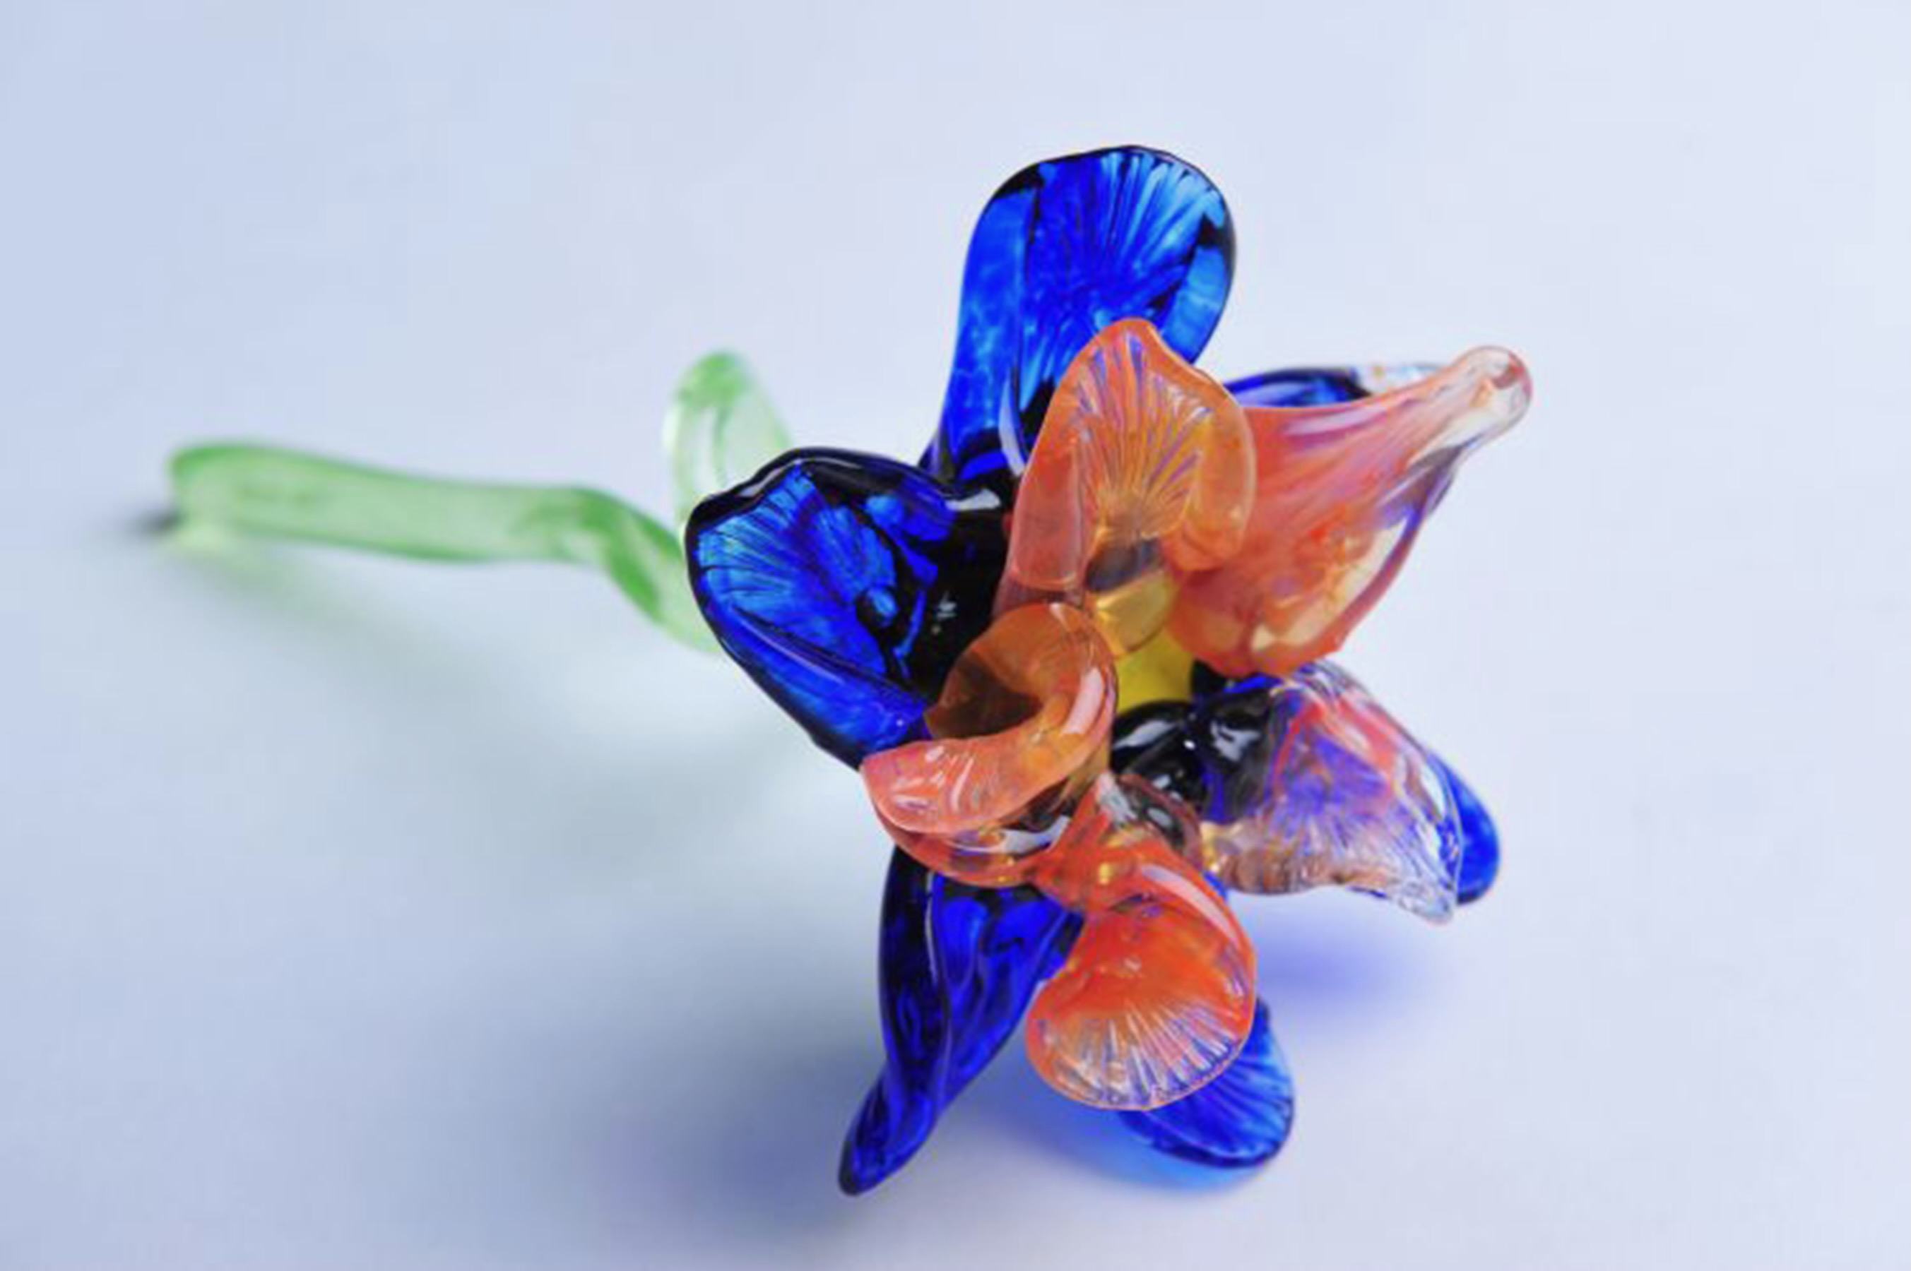
Student Portfolio Development
Exploring textures to communicate meaning.
Age 9
Age 12
Age 16
Notes:
Class Discussion: Eliška’s portfolio documents how she has used glass sculpture and photography to communicate meaning and explore the qualities of texture.
Left Image: Eliška Hlavatá, 9 years old, ZUŠ, Mšeno, Czech Republic. 42nd ICEFA Lidice.
Middle Image: Eliška Hlavatá, 12 years old, ZUŠ, Mšeno, Czech Republic. 45th ICEFA Lidice.
Right Image: Eliška Hlavatá, 16 years old, ZUŠ, Mšeno, Czech Republic. 49th ICEFA Lidice.

Slide 25

(3) Managing and Analyzing Performance Data (Developing an Art Assessment Action Plan) 1
Teachers document how they manage and analyze performance data and dispositions based on assessments and appraisals.
They maintain physical and/or virtual spaces to collect, organize, and store assessment results.
Notes:
Image: Frist Art Museum

Slide 26
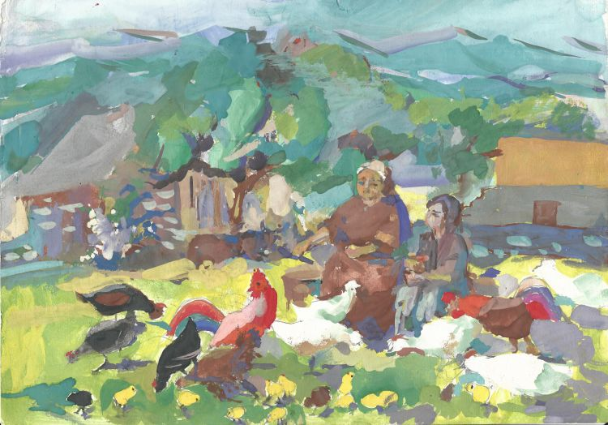
(3) Managing and Analyzing Performance Data (Developing an Art Assessment Action Plan) 2
Preselect intervals to analyze data.
Use analysis to identify patterns and draw inferences.
Find trends in student achievement and learning gaps.
Categorize assessment data and code data into relevant themes.
Notes:
Image: Arutiun Davidovich Vardanian, 9 years old, Detskaia khudozhestvennaia shkola O. Sharambeiana, Dilizhan, Armenia, 42nd ICEFA Lidice.

Slide 27
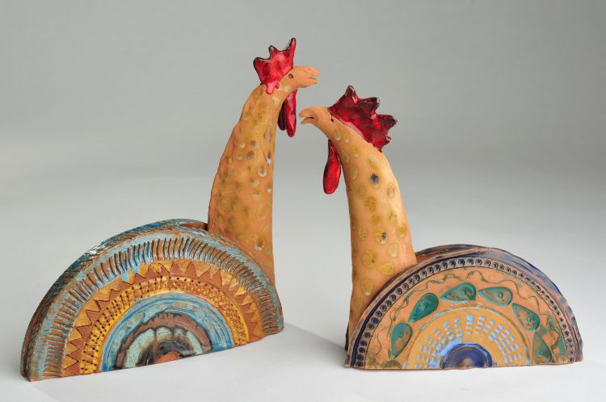
(3) Managing and Analyzing Performance Data (Developing an Art Assessment Action Plan) 3
Identify where students were before/during instruction and after summative assessments.
Clarify how planning, instruction, and assessment impacted target attainment and dispositions.
Make informed interpretations and judgments based on careful analyses.
Notes:
Image: Roberts Pauls Jaunzemnieks, 13 years old, BJC Milgravis, Riga, Latvia. 42nd ICEFA Lidice.

Slide 28

Validity and Reliability (3) Managing and Analyzing Performance Data, Developing an Art Assessment Action Plan
Reliability refers to an assessment’s ability to produce similar results, given comparable circumstances and students’ unchanged knowledge.
Validity refers to the ability of an assessment to measure or appraise what it intends to.
Notes:
Image: Barbora Vašková, 14 years old, Czech Republic. 33rd ICEFA Lidice.
Reference:
Chappuis, J., Stiggins, R., Chappuis, S., & Arter, J. (2012). Classroom assessment for student learning: Doing it right—using it well (2nd ed.). Upper Saddle River, NJ: Pearson.

Slide 29

Quantitative and Qualitative Methods (3) Managing and Analyzing Performance Data, Developing an Art Assessment Action Plan
We will collect and interpret qualitative data to understand concepts and student dispositions that cannot be measured by quantitative methods alone, such as students’ applications of the artistic behaviors, life skills through art competencies, and transformative actions driven by best practices and needs.
Notes:
Class instruction: Discuss how we can keep a log to document when we provided students with oral and written feedback about their work and encouraged them to make revisions to assignments before submitting them for formal summative grades. For example, when students struggle, we will recommend focused revision so they can achieve success in small increments by completing one task or target at a time (Chappuis et al., 2012).
Image: Photo by Allison Shelley/The Verbatim Agency for EDUimages. (CC BY-NC 4.0).
Reference:
Chappuis et al., 2012

Slide 30

Evaluation
Evaluation is a summative judgment of student, teacher, and program effectiveness.
Report Card Grades
Standardized Test Results
Summative Results of Combined Performances
Measurement of Overall Progress
Notes:
Class instruction: Educational experts use evaluations to assemble data over a given time, analyze findings, identify strengths and weaknesses, and develop strategies to improve effectiveness.
Image: Yap Melissa Chia Chean, 9 years old, Yeow Chye Art Centre, Penang, Malaysia. 39th ICEFA Lidice.

Slide 31

Evaluation: Evaluative Grading 1
Elementary and Secondary Education Act: The U.S. Government allocates funds to support children’s education. The law requires states to evaluate students through standardized tests.
In 2015, Congress implemented the Every Student Succeeds Act (ESSA) with the reauthorization of ESEA.
ESSA identifies the visual arts as part of a well-rounded education. ESSA’s evaluative measures include portfolios and project-based assessments.
Notes:
Image: Yap Melissa Chia Chean, 9 years, Yeow Chye Art Centre, Penang, Malaysia. 39th ICEFA Lidice.
Reference:
U.S. Congress, 2016

Slide 32
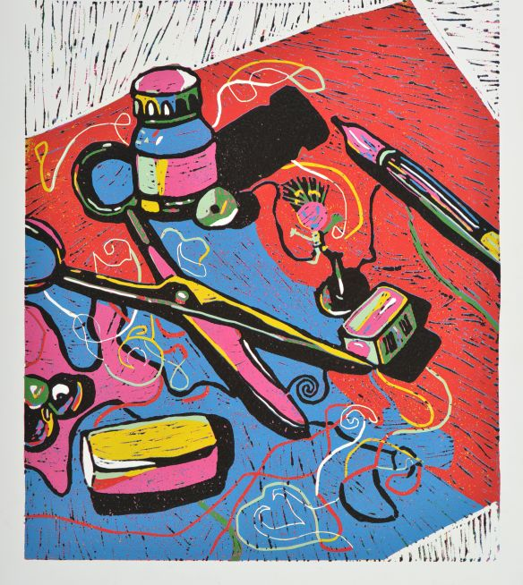
Evaluation: Model Cornerstone Assessments
Model Cornerstone Assessments (MCAs) are embedded in the curriculum at second, fifth, eighth, and high school grades.
They exemplify how learning in the arts reaches beyond what can be measured by standardized tests alone.
Notes:
Class instruction: Explain how the Model Cornerstone Assessments include grade level targets, rubrics, checklists, and student self-assessments that are applicable as summative evaluations. The MCAs assessment instruments “anchor the curriculum around the most important performances that students should be able to do (on their own) with acquired content knowledge and skills” (NCCAS, 2014, p. 14). Educators can conduct these evaluations individually and/or work in teams at school and district levels to evaluate student performances (Sabol, 2018).
Image: Gréta Lukovičová, 14 years old, ZUŠ, Holíč, Slovak Republic, 44th ICEFA Lidice.
References:
National Coalition for Core Arts Standards, 2014b
Sabol, 2018a

Slide 33


Evaluation: Evaluative Grading 2
Evaluative grading reports summative judgments of student learning in art, often using qualitative descriptors, such as an “A” for excellent. It limits evaluation grades to students’ achievements only.
Median scores can be the most accurate representation of student performances.
Notes:
Class instruction: Explain how grade books contain recorded formative and summative assessments and calculations of summative evaluations.
Class instruction: Clarify how median scores can be the most accurate representation of performances for students who may have received extreme scores, such as a zero, that significantly lowered their grades.
Image: Watanabe Mako, 13 years old, Dreamy Art School, Nara, Japan, 44th ICEFA Lidice.
Reference:
Quinn, 2013

Slide 34
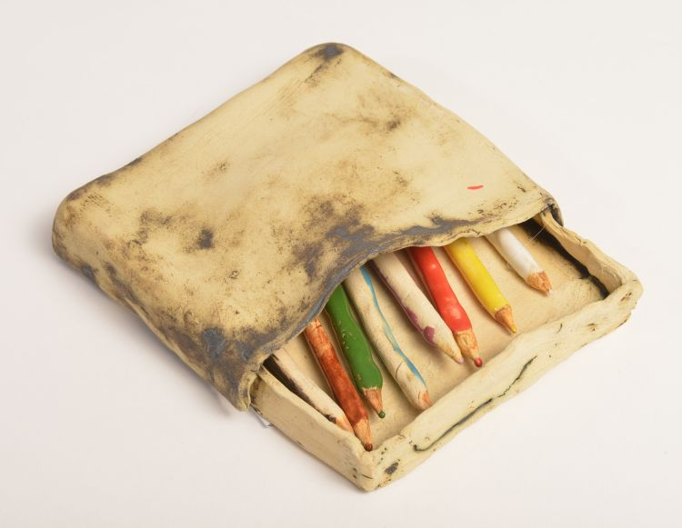
Evaluation: Evaluative Grading 3
Students will not reach their fullest potential and many learning targets without exerting effort and appropriate conduct.
Teachers can develop extra tasks and assess students to replace older assessments taken prior to a student’s proficiency.
Notes:
Class instruction: When teaching students with special needs, teachers will refer to students’ IEP (individualized education program), as the goals identified in modified assessment plans may differ from standard grade-level targets. See Chapter 6 for more information.
Image: Adéla Rosenkranzová, 13 years old, 11. ZŠ, Most, Czech Republic, 44th ICEFA Lidice.
References:
Chappuis et al., 2012
Quinn, 2013

Slide 35

Evaluation: Teacher Evaluations
Quality teacher evaluations improve instruction and student learning, evaluating planning, instruction, and assessments competencies.
They identify student performances and the effectiveness of the learning environment.
The best teacher evaluations have merit beyond the evaluation period.
Teachers use student growth portfolios to show evidence of all learners’ progress.
Notes:
Class instruction: Explain how administrators use teacher evaluations to check for quality and identify if lessons are well organized and managed.
Class instruction: Many teacher education programs in the United States use the edTPA performance assessment to measure pre-service teachers’ readiness for the teaching profession. Address the one(s) used in your region.
Image: https://openclipart.org/detail/261063/pluma
References:
Sickler-Voigt, 2018
Pearson Education. 2018

Slide 36
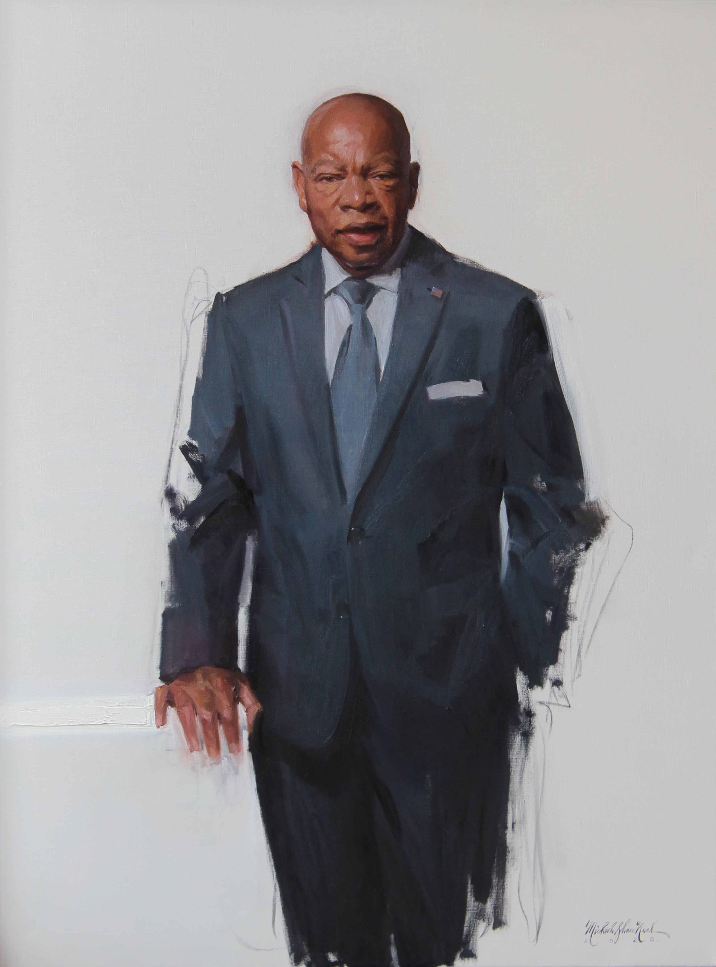
Shane Michael Neal: Artists’ Lessons to Thrive! 3.1
Big Idea:
Courage
Notes:
Class instruction: Have the class open the textbook to Artists’ Lessons to Thrive! 3.1. Participate in its learning targets.
Image: Michael Shane Neal. 2020. Congressman John Lewis. National Portrait Gallery, Smithsonian Institution; gift of Jeffery and Cindy Loring in admiration of Congressman John Lewis. 121.9 × 97.2 cm (48 × 38 1/4").

Slide 37
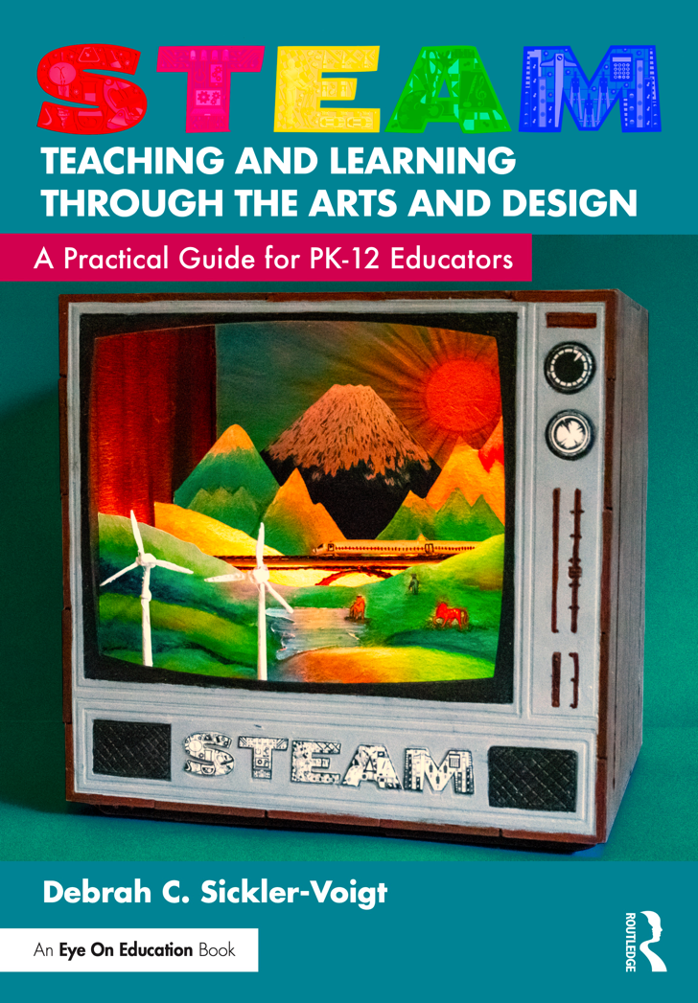
Artists’ Lessons to Thrive! Assessments
Apply what you have learned about assessment to incorporate appropriate assessments to TLAE’s and STEAM Teaching and Learning Through the Arts and Design’s Artists’ Lessons to Thrive! instructional resources.
Notes:
Left Image: Paula Gale, book cover artwork
Right Image: This is a book cover of STEAM Teaching and Learning Through the Arts and Design: A Practical Guide for PK-12 Educators.

Slide 38
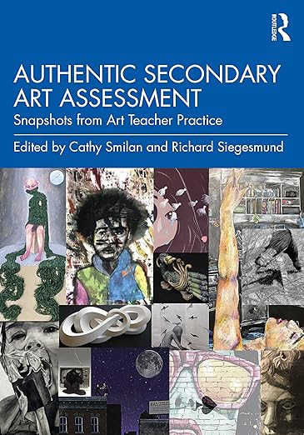
Teaching Tips to Thrive #3.1 Cathy Smilan Assessing Expressive and Predictive Outcomes
Assessment beyond skills-based learning, requires curriculum that fosters empathy and encourages introspective risk-taking that is only possible when the art classroom is a safe environment in which to explore and share what to some may seem controversial.
“We establish criteria for individual self-expression and global understandings through practice with materials and processes.”
Notes:
Class instruction: Discuss Teaching Tips to Thrive #3.1 and Cathy Smilan’s methods for assessing expressive and predictive outcomes.
Image: Authentic Secondary Art Assessment Snapshots from Art Teacher Practice, book cover Edited By Cathy Smilan and Richard Siegesmund, Copyright 2024
ISBN 9781032493572
https://www.routledge.com/Authentic-Secondary-Art-Assessment-Snapshots-from-Art-Teacher-Practice/Smilan-Siegesmund/p/book/9781032493572

Slide 39

Approaches to Teacher and Student Transformative Growth Charts
Teacher: Become an assessment literate educator who knows how to use, create, implement, and analyze the results of different assessments and evaluations to improve my teaching and student learning.
Student: Utilize assessments and evaluations to identify my growth and areas for improvement, reflect on my dispositions, and analyze how I demonstrated agency to solve artistic challenges and to achieve my curricular goals.
Notes:
Class Activity: Open the textbook to Chapter 3’s Teacher and Student Transformative Growth Charts. Model 3.7 TLAE’s Overview of Approaches to Teacher Transformative Growth and Model 3.8 TLAE’s Overview of Approaches to Student Transformative Growth. Discuss the meanings of these transformative actions. Build on their list of actions.
Image: Midjourney AI, prompted by Netha Hussain, CC0, via Wikimedia Commons. https://commons.wikimedia.org/wiki/File:Quilling_pattern_of_a_mountain_02.png

Slide 40
CHAPTER 3. Summary
Assessment
Developing an Art Assessment Action Plan
Evaluation
Setting Curricular Goals and Writing Objectives
Selecting Assessments
Informal Assessment; Formative Assessment; Summative Assessment; Simplified Numeric Scoring; Rubrics; Rating Scales and Checklists; Art Journals; Portfolios
Managing and Analyzing Performance Data
Validity and Reliability
Quantitative and Qualitative Methods
Evaluative Grading
Teacher Evaluations
Notes:
Thanks for participating in Teaching and Learning in Art Education’s 2nd Ed. Chapter 3!
Book Cover Artwork: Paula Gale
Chapter References
Anderson, T. , & Milbrandt, M. (2005). Art for life. Boston, MA: McGraw Hill.
Andrade, H. , Hefferen, J. , & Palma, M. (2014). Formative assessment in the visual arts. Art Education, 67 (1), 34–40.
Armstrong, C. L. (1994). Designing assessment in art. National Art Education Association.
Bliss, J. (2018, January 5). The Nashville artist who ate fajitas with a Supreme Court Justice then painted her portrait. The Tennessean. https://www.tennessean.com/story/life/2018/01/05/nashville-artist-who-ate-fajitas-supreme-court-justice-then-painted-her-portrait/919369001/
Boughton, D. (2024). Contemporary dilemmas in the assessment of art learning: Promoting creativity, assessing teachers, and “doing” the standards. In C. Smilan & R. Siegesmund (Eds.). Authentic secondary art assessment: Snapshots from art teacher practice (pp. 24-30). Routledge.
Brookhart, S. M. (2013). How to create and use rubrics for formative assessment and grading. ASCD.
Chappuis, J. , Stiggins, R. , Chappuis, S. , & Arter, J. (2012). Classroom assessment for student learning: Doing it right: Using it well (2nd ed.). Upper Pearson.
Chin, C. (2013). Cultivating divergent thinking: Conceptualization as a critical component of artmaking. Art Education, 66 (6), 28–32.
Eisner, E. (2002). The arts and the creation of mind. Yale University Press.
Henry, C. (1990). Grading student artwork: A plan for effective assessment. In B. E. Little (Ed.), Secondary art education: An anthology of issues (pp. 61–68). National Art Education Association.
Lewis, J. & D’Orso, M. (1998). Walking with the wind: A memoir of the movement. Simon & Shuster.
Ludwig, J. K. (2010). Creative wildfire: An introduction to art journaling: Basics and beyond. Quarry Books.
Meier, M. E. (2018). Assess what matters most: Recommendations for gathering information about student learning. https://www.arteducators.org/learn-tools/assessment-papers-for-art-education
National Coalition for Core Arts Standards . (2014a). National Core Arts Standards. www.nationalartsstandards.org
National Coalition for Core Arts Standards . (2014b). National Core Arts Standards: A conceptual framework for arts learning. https://www.nationalartsstandards.org/sites/default/files/Conceptual%20Framework%2007-21-16.pdf
Neal, M. S. (2023, August 15). Mentoring. Michael Shane Neal. https://www.michaelshaneneal.com/the-spectator/mentoring
Pearson Education . (2018). edTPA. www.edtpa.com/Home.aspx
Quinn, T. (2013). On grades and grading: Supporting student learning through a more transparent and purposeful use of grades. Rowman & Littlefield Education.
Sabol, F. R. (2018a). Model Cornerstone Assessments (MCAs): A powerful tool for measuring student achievement in visual arts education. www.arteducators.org/learn-tools/assessment-white-papers-for-art-education
Sabol, F. R. (2018b). Some guiding principles for conducting assessments in visual arts education. www.arteducators.org/learn-tools/assessment-white-papers-for-art-education
Sickler-Voigt, D. C. (2018). Changing mindsets about edTPA: From test anxiety to demonstrating teacher competencies through authentic teaching and assessment practices. In Assessment Papers for Art Education, Section II. National Art Education Association. https://www.arteducators.org/learn-tools/assessment-papers-for-art-education
Sickler-Voigt, D. C. (2023). STEAM teaching and learning through the arts and design: A practical guide for PK-12 educators. Routledge.
Siegesmund, R. & Smilan, C. (2024). Educational aims, goals, and objectives: Balancing instructional objectives and expressive outcomes. In C. Smilan & R. Siegesmund (Eds.). Authentic secondary art assessment: Snapshots from art teacher practice (pp. 20-23). Routledge.
Smilan, C. (2024). Afterword: Rethinking assessment—post-pandemic. In C. Smilan & R. Siegesmund (Eds.). Authentic secondary art assessment: Snapshots from art teacher practice (pp.263-266). Routledge.
Smilan, C. & Siegesmund, R. (2024). Introduction: Authentic secondary art assessment: Snapshots from art teacher practice. In C. Smilan & R. Siegesmund (Eds.). Authentic secondary art assessment: Snapshots from art teacher practice (pp. 1-10). Routledge.
U.S. Congress . (2016). S.1177: Every Student Succeeds Act (ESSA). www.congress.gov/bill/114th-congress/senate-bill/1177/text?overview=closed
Wiggins, G. , & McTighe, J. (2005). Understanding by design (2nd ed.). Pearson.

