Slide 1

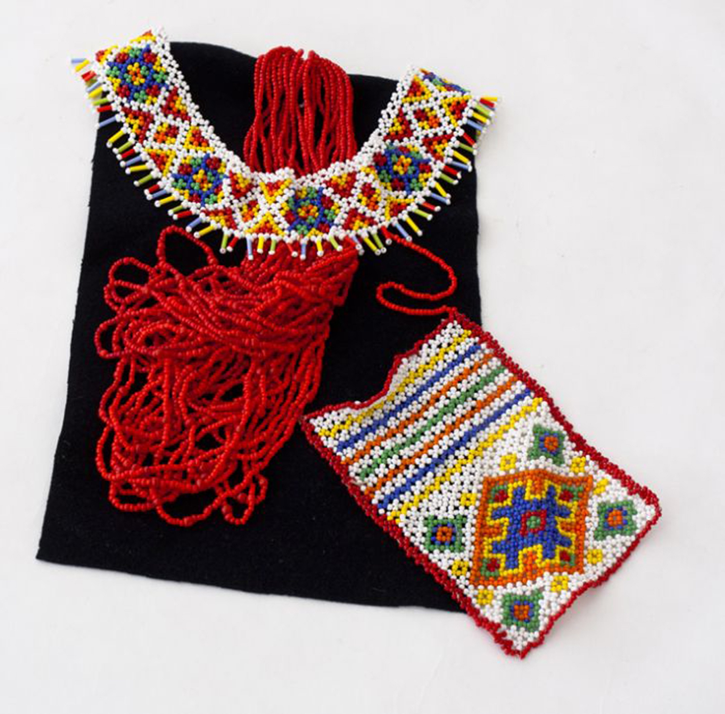

CHAPTER 4. Classroom Management in The Visual Arts Teaching and Learning in Art Education, 2nd Ed.
Debrah C. Sickler-Voigt, Author & Presentation Developer ©
Notes:
Welcome to Teaching and Learning in Art Education, 2nd Edition, Chapter 4!
TLAE as a theoretically-based, practical textbook to prepare preservice educators for their teaching careers and to support in-service educators in improving their existing practices. Its timely second edition with its updated framework remains dedicated to assisting educators in all stages of their careers through effective curricular planning, instruction, assessment, and management to foster student learning and cultivate educators’ meaningful, creative, and rewarding careers.
This textbook and instructional resources resulted from the contributions of many individuals, including teachers, students, artists, organizations, family, mentors, and Routledge’s editorial/production team. Its teachings are based on the author’s research, communications, and professional interpretations of teachers, artists,’ and designers’ works with the aim of being respectful of diversified peoples and representing their teachings in a truthful and non-biased manner.
Book Cover Artwork: Paula Gale
Right Image: Anastasia Vitalievna Banshikova,13 years old, Gorodskoy Dvorec Detskogo Tvorchestva Goricvit, Krivoj Rog, Ukraine. 41st ICEFA Lidice.

Slide 2

Chapter 4 Topics
Transformative Classroom Management
Positive Behavior Interventions and Supports, Transformative Social-Emotional Learning
Classroom Management Strategies for Teaching Art
Confronting Violence, Bullying, and Victimization
Notes:
Spotlight on Student Art #4: Practice Makes Perfect
Left Image: Svetlana Andreevna Verbickaya, 9 years old, Gorodskoy Dvorec Detskogo Tvorchestva Goricvit, Krivoj Rog, Ukraine. 41st ICEFA Lidice.
Right Image: Anastasia Vitalievna Banshikova,13 years old, Gorodskoy Dvorec Detskogo Tvorchestva Goricvit, Krivoj Rog, Ukraine. 41st ICEFA Lidice.

Slide 3

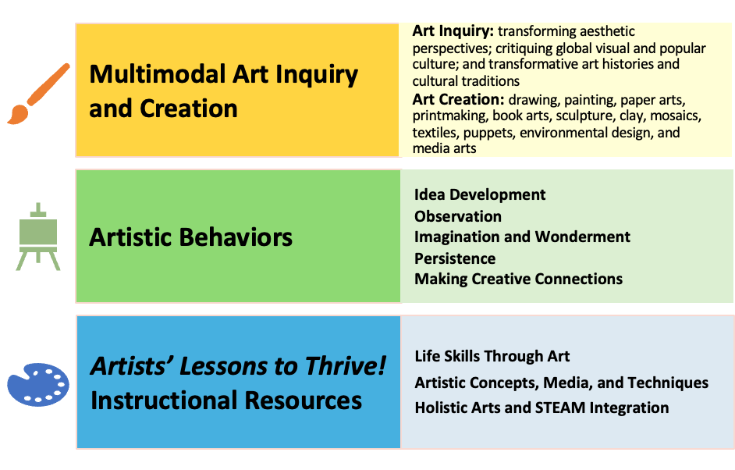
Link Chapter 4’s teachings with TLAE’s Transformative
Art Education Framework
Notes:
Class instruction: Ask students to build on prior learning and personal experiences to make personal connections between this chapter’s teachings and TLAE’s Transformative Art Education framework.
Book Cover Artwork: Paula Gale

Slide 4
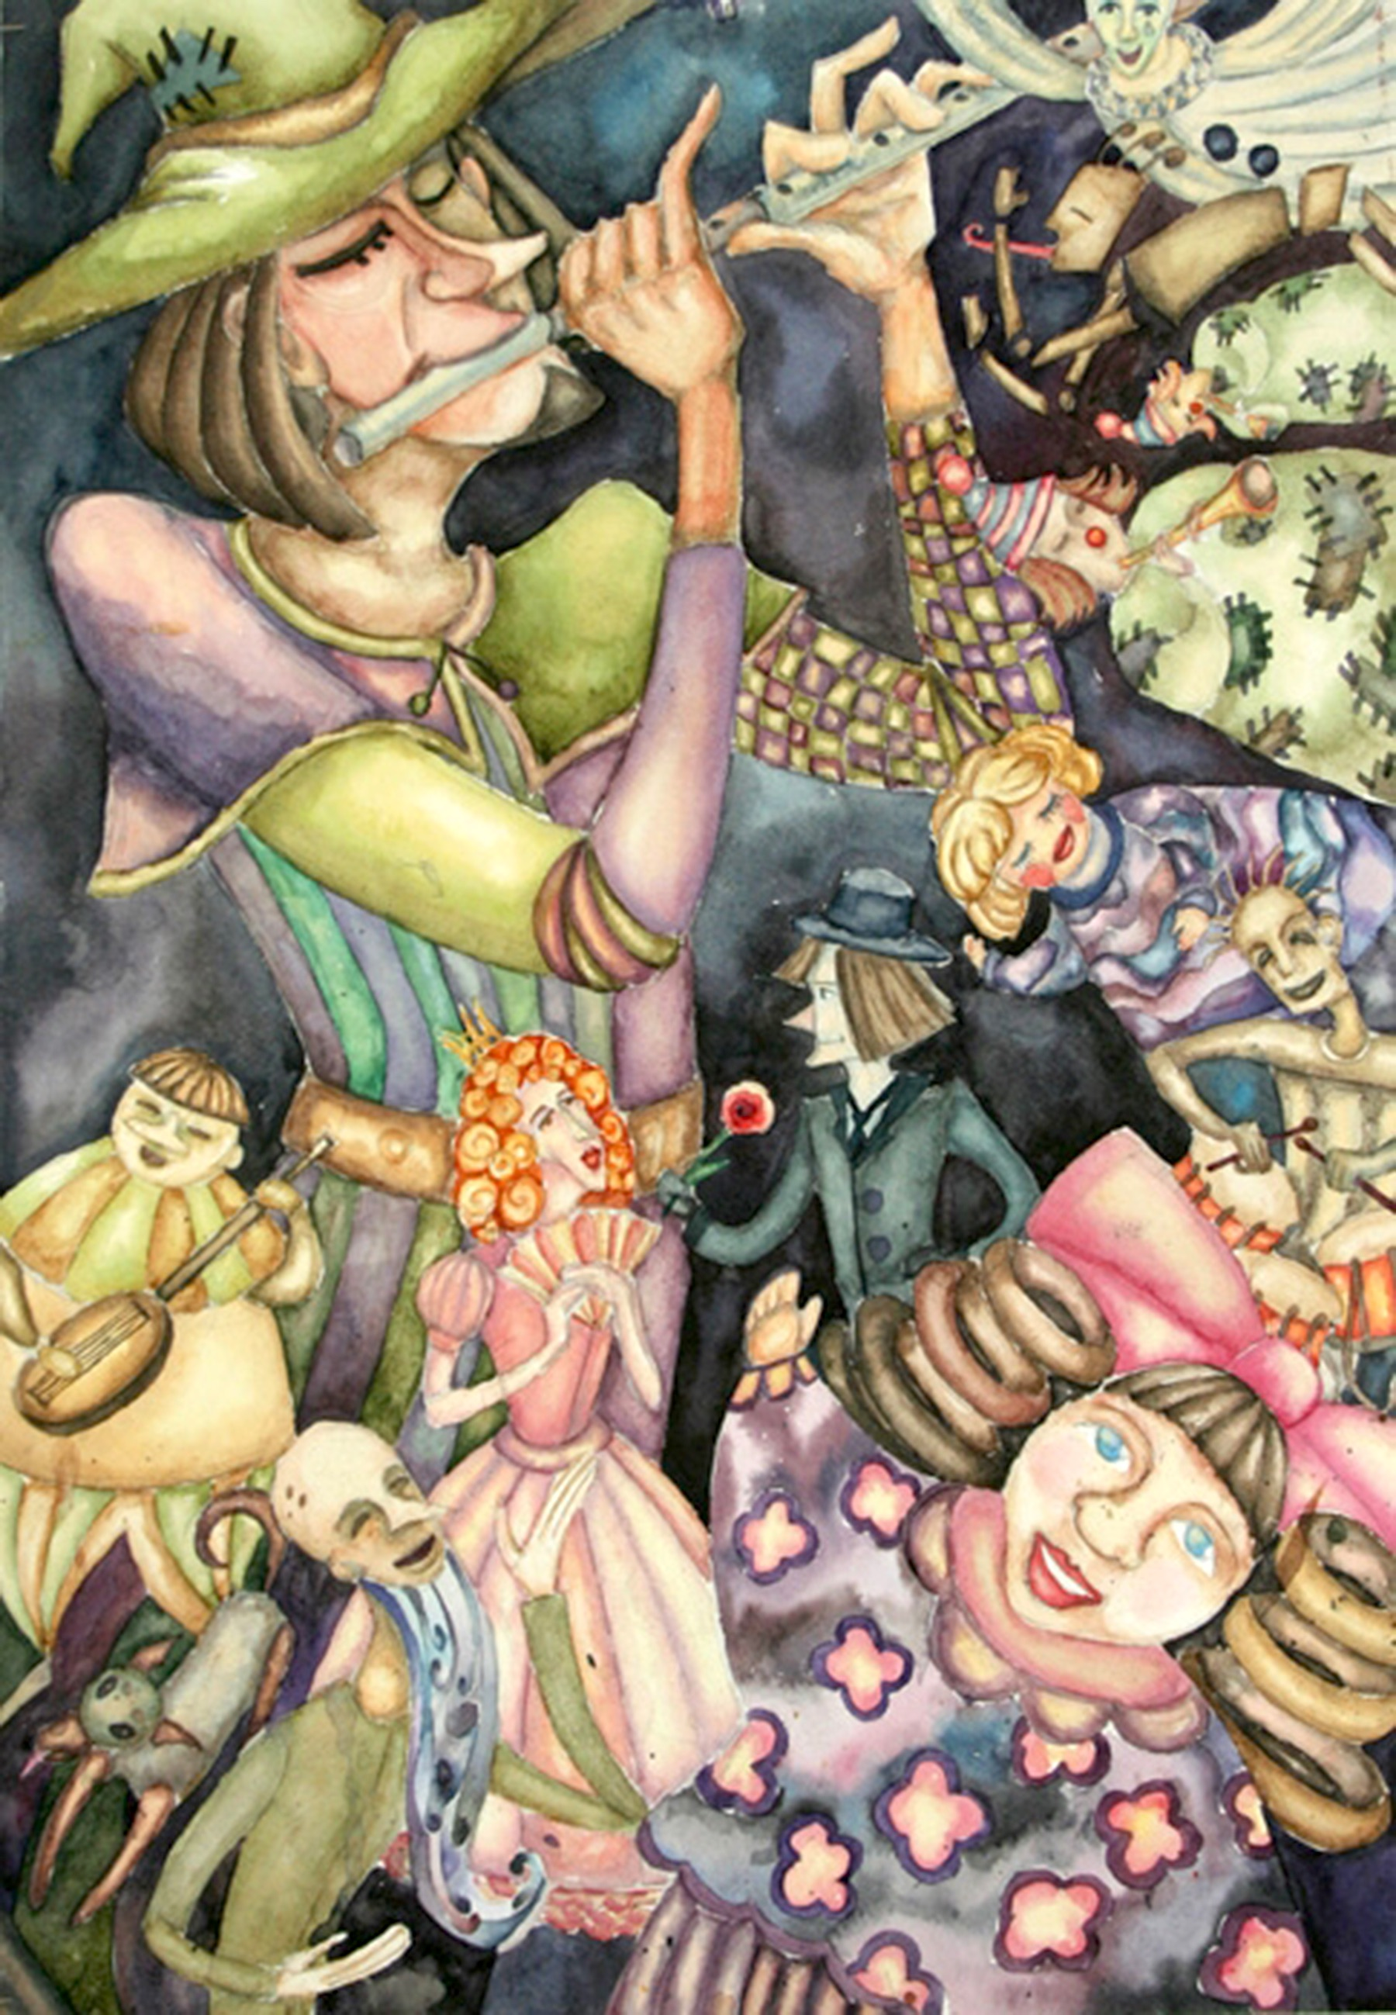
Classroom Management
Classroom management encompasses the organizational procedures teachers apply to all stages of the learning process so that students attain learning outcomes and reach their fullest potential.
Teachers create a safe, structured, and predictable learning environment.
Notes:
Class instruction: Ask the class to contemplate how classroom management differs from discipline practices that result in punitive and controlling learning environments.
Image: Elizaveta Kapitsa, 15 years old, Art School, Grodno, Belarus. 40th ICEFA Lidice.

Slide 5
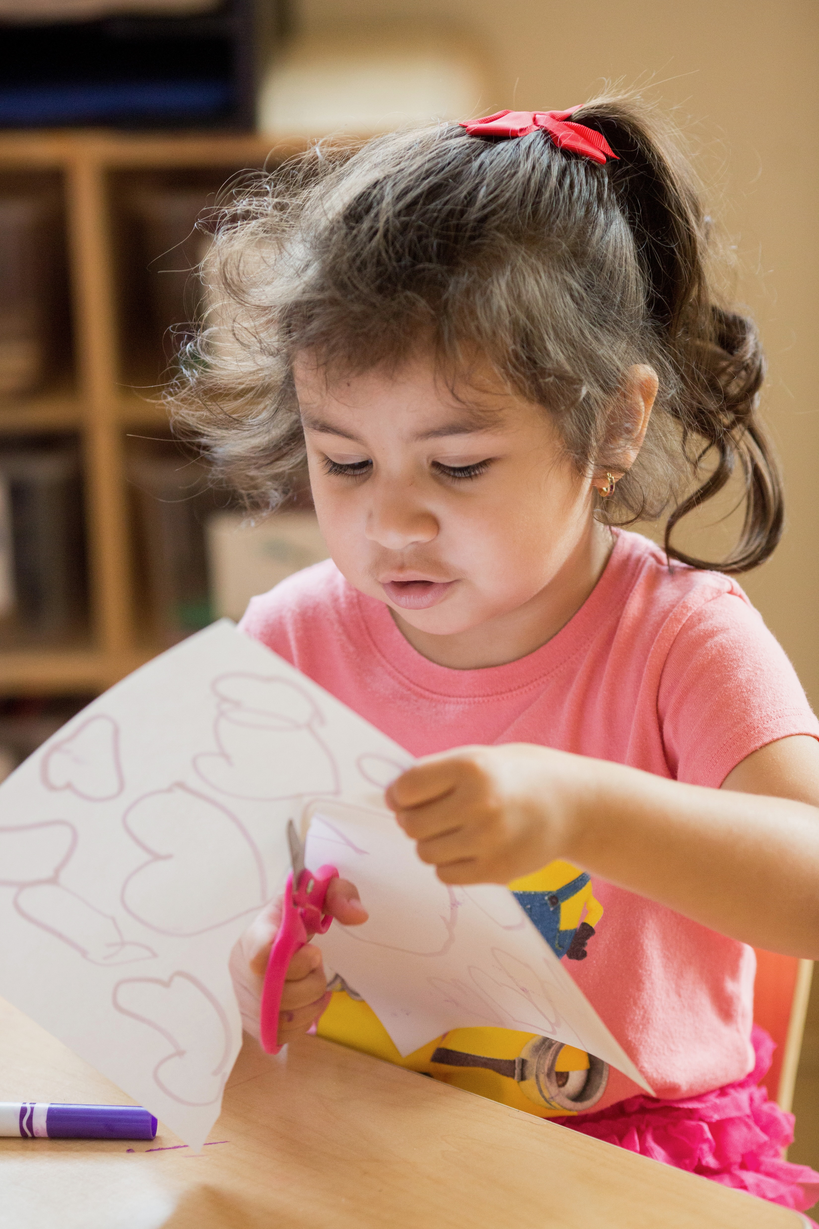
Transformative Classroom Management & Teacher Introspection
Transformative classroom management (TCM) fosters holistic pathways to support all teachers and students. It begins with becoming introspective of our behaviors, strengths, vulnerabilities, and biases.
Introspection enables us to identify how potential conflicts and challenges can arise when our ideals, instructional methods, and perceptions about classroom management may not match our actual art instruction and students’ behaviors and needs.
Notes:
Class instruction: Brainstorm with the class the qualities can make classroom management transformative.
Image: Photo by Allison Shelley/The Verbatim Agency for EDUimages. (CC BY-NC 4.0).
Reference:
Jefferson & Anderson, 2021

Slide 6
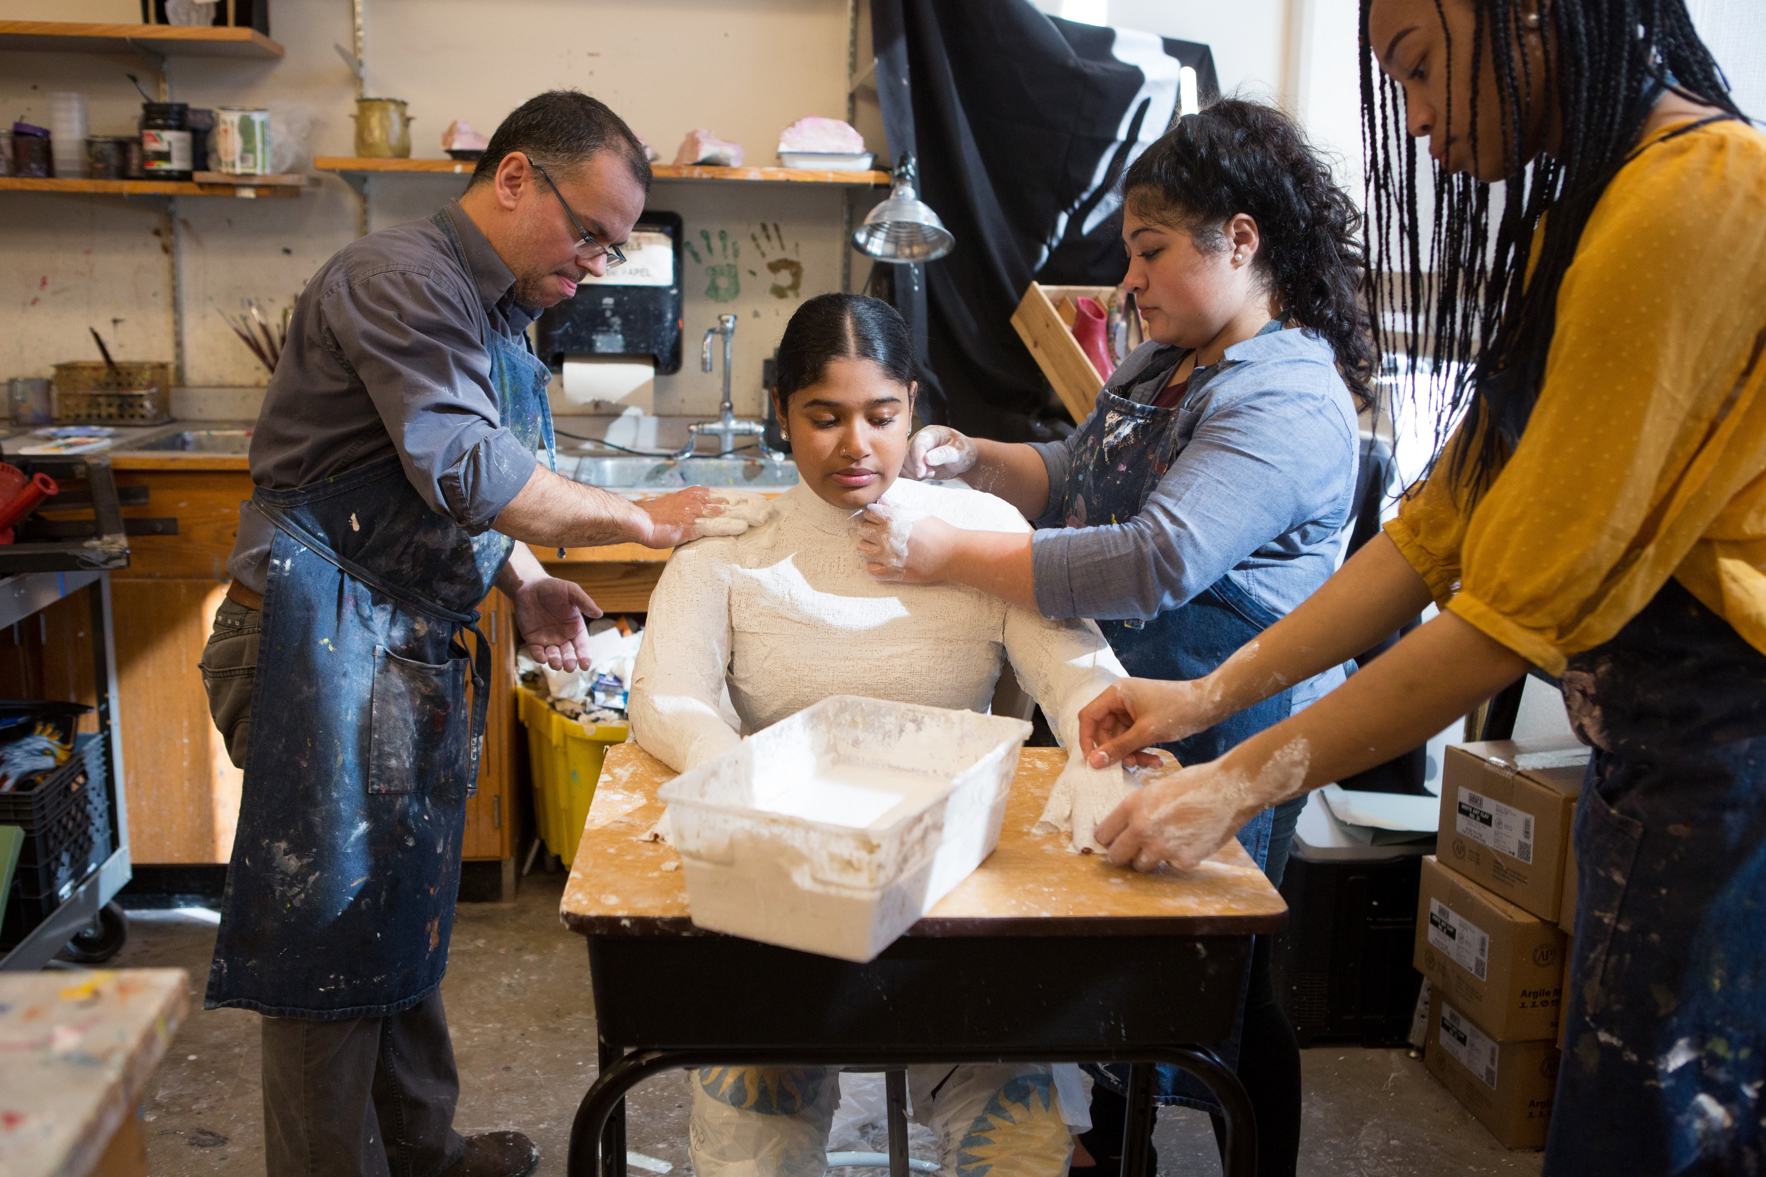
Culturally Responsive Teaching and Classroom Management
Integrate students’ diverse cultural identities and incorporate communal values into the curriculum.
Know who our students are and recognize how intersectionalities inform classroom dynamics.
Move beyond Eurocentric perceptions validating only one way of cultural understanding.
Notes:
Image: Photo by Allison Shelley/The Verbatim Agency for EDUimages. (CC BY-NC 4.0).
Reference:
Gay, 2018

Slide 7
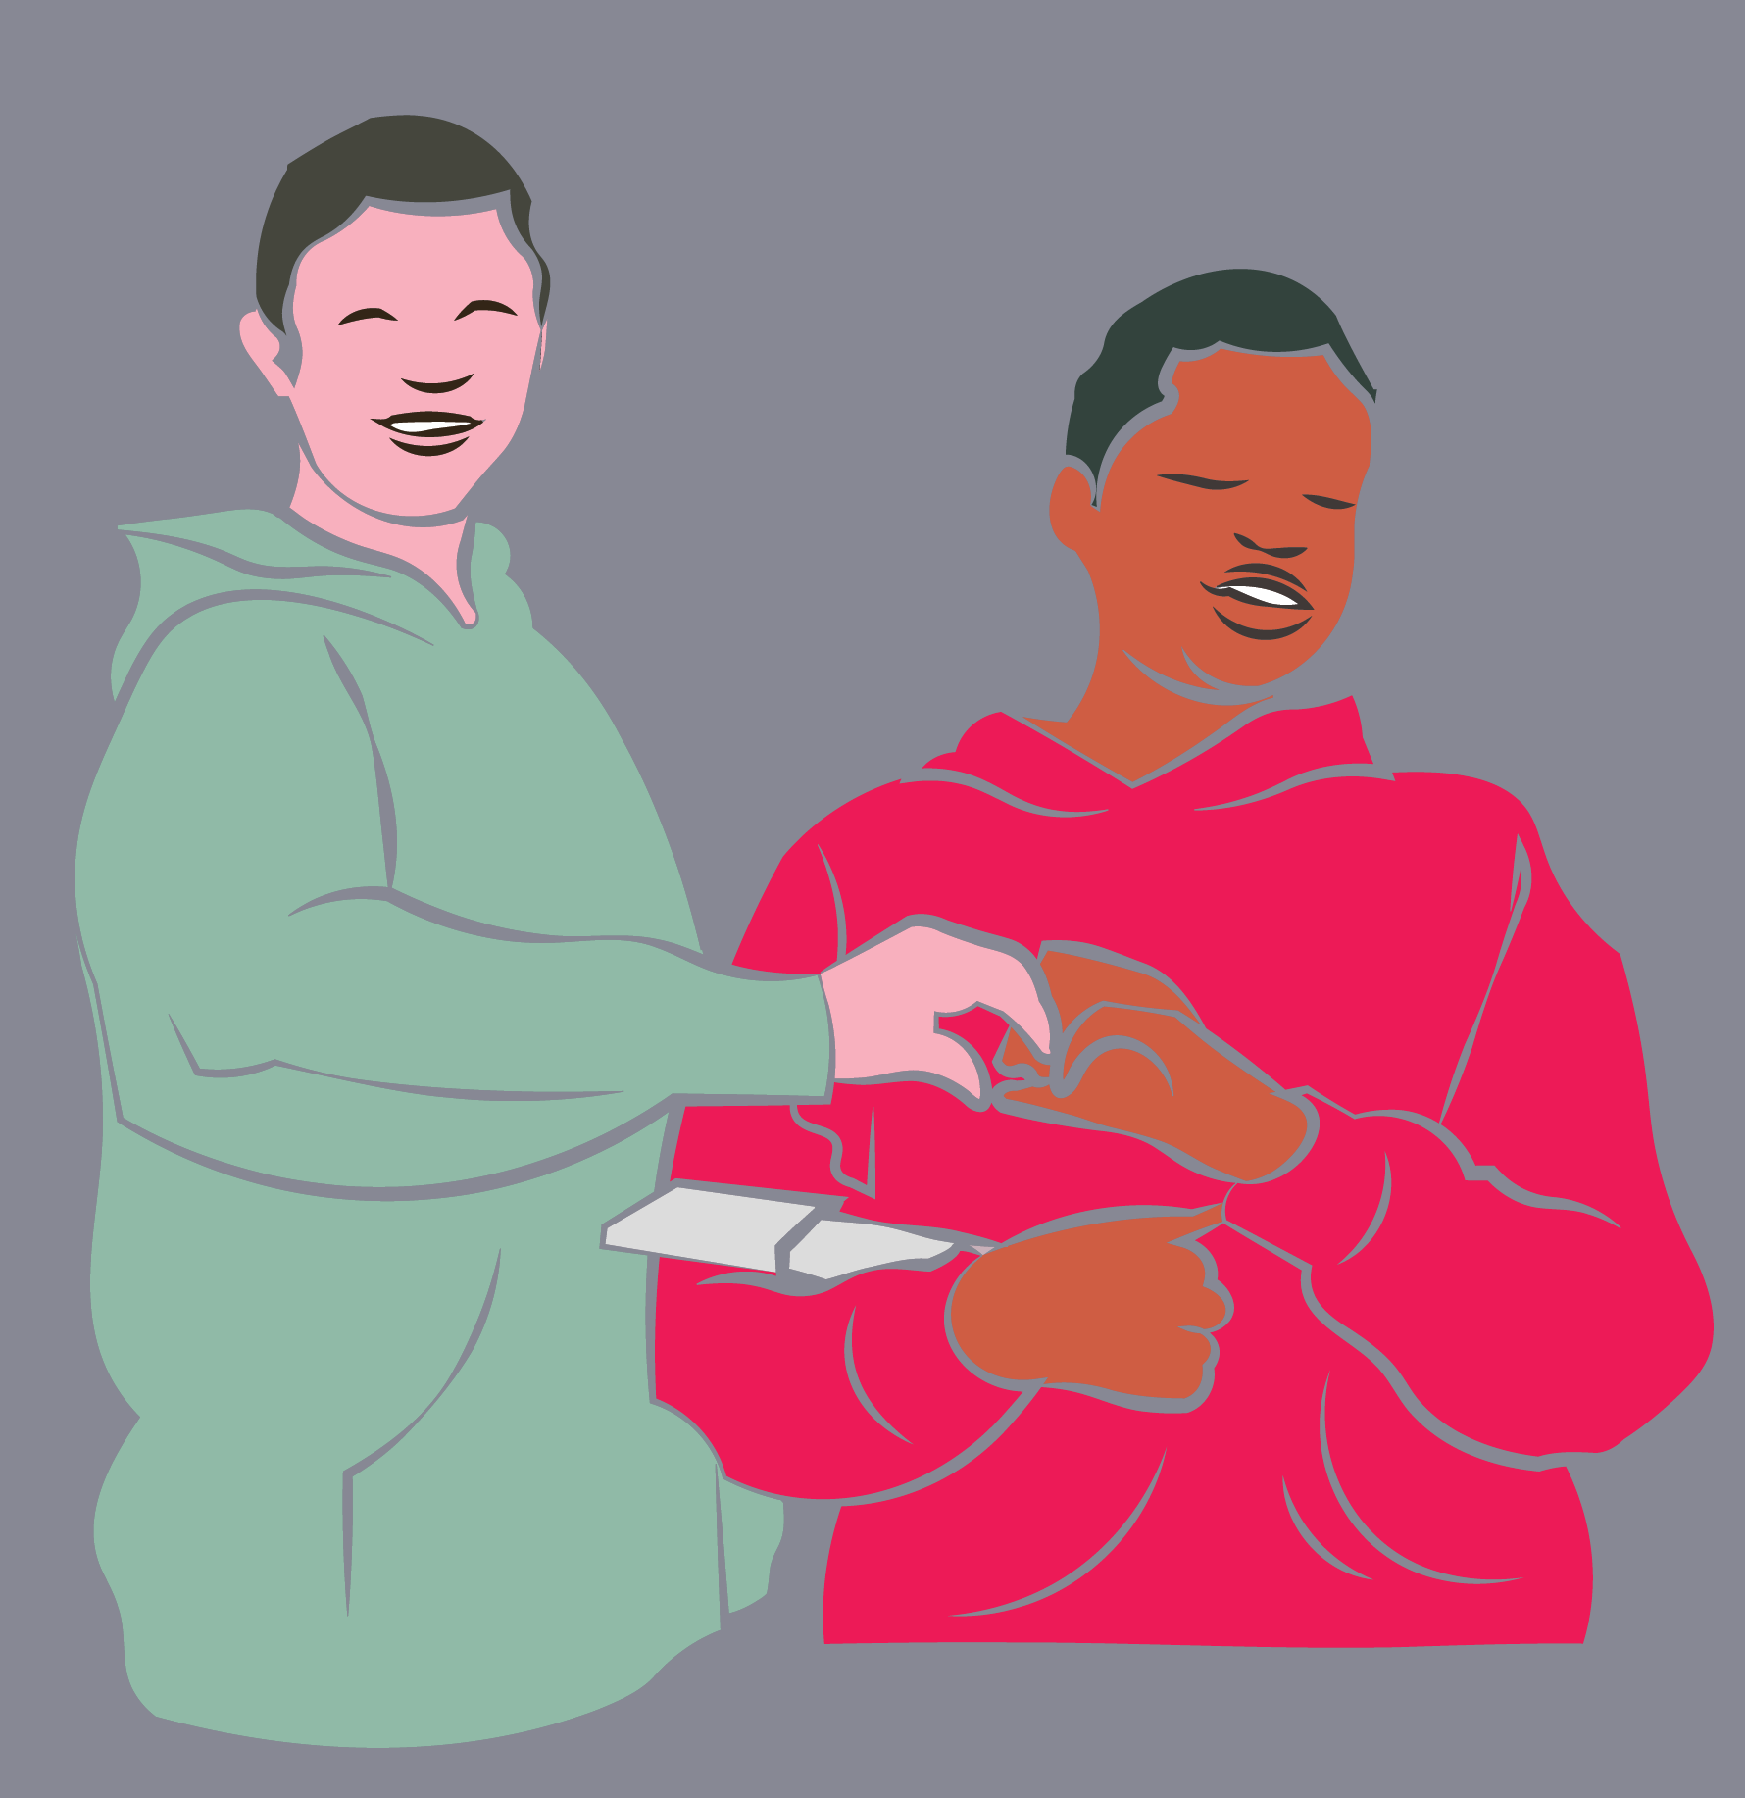
Equitable, Supportive Classrooms Culturally Responsive Teaching and Classroom Management
Address the needs of racially, ethnically, and linguistically diverse students and those with special needs and adverse childhood experiences.
Acknowledge systemic inequities in discipline and expulsion rates caused by biased practices and lack of culturally responsive teaching.
Recognize and challenge cognitive biases that distort perceptions of race, culture, religion, and ability.
Notes:
Class instruction: Discuss how exploring biases resulting from inaccurate perceptions and lack of knowledge can help educators in enacting transformative classroom management procedures to cultivate supportive learning experiences for all students.
Image: This is a selfie scene for the stop motion animation Route 66 Cross Country Road Trip. USA. Source: Author, Monica Leister, Amber Buck, and Joshua Harper.
References:
Butler et al., 2023
Lane et al., 2023
McCarthy, et al., 2023

Slide 8
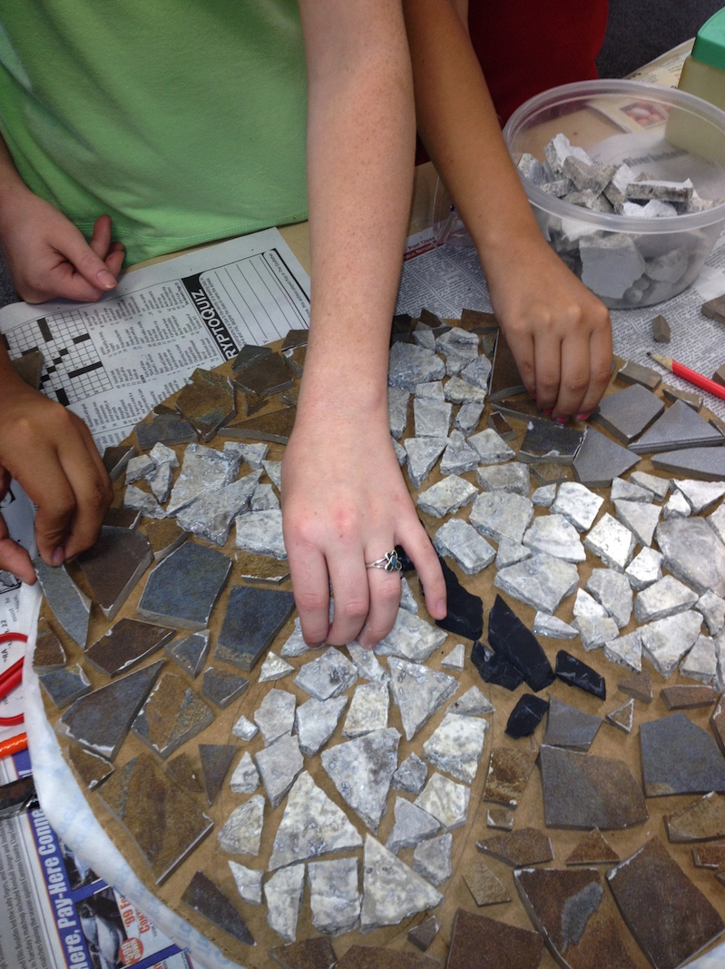
Supporting All Learners
Students may act out due to unmet basic needs, attention-seeking, bad days, or adverse childhood experiences.
Disabilities can lead to hyperactive, impulsive, or aggressive behaviors that impact classroom conduct.
Biological, cultural, and environmental factors may cause students to blurt out, refuse work, or seek excessive attention.
Notes:
Image: Elementary students design a mosaic. USA. Author, teacher. Pamela McColly, photo.
Reference:
Lane et al., 2023

Slide 9
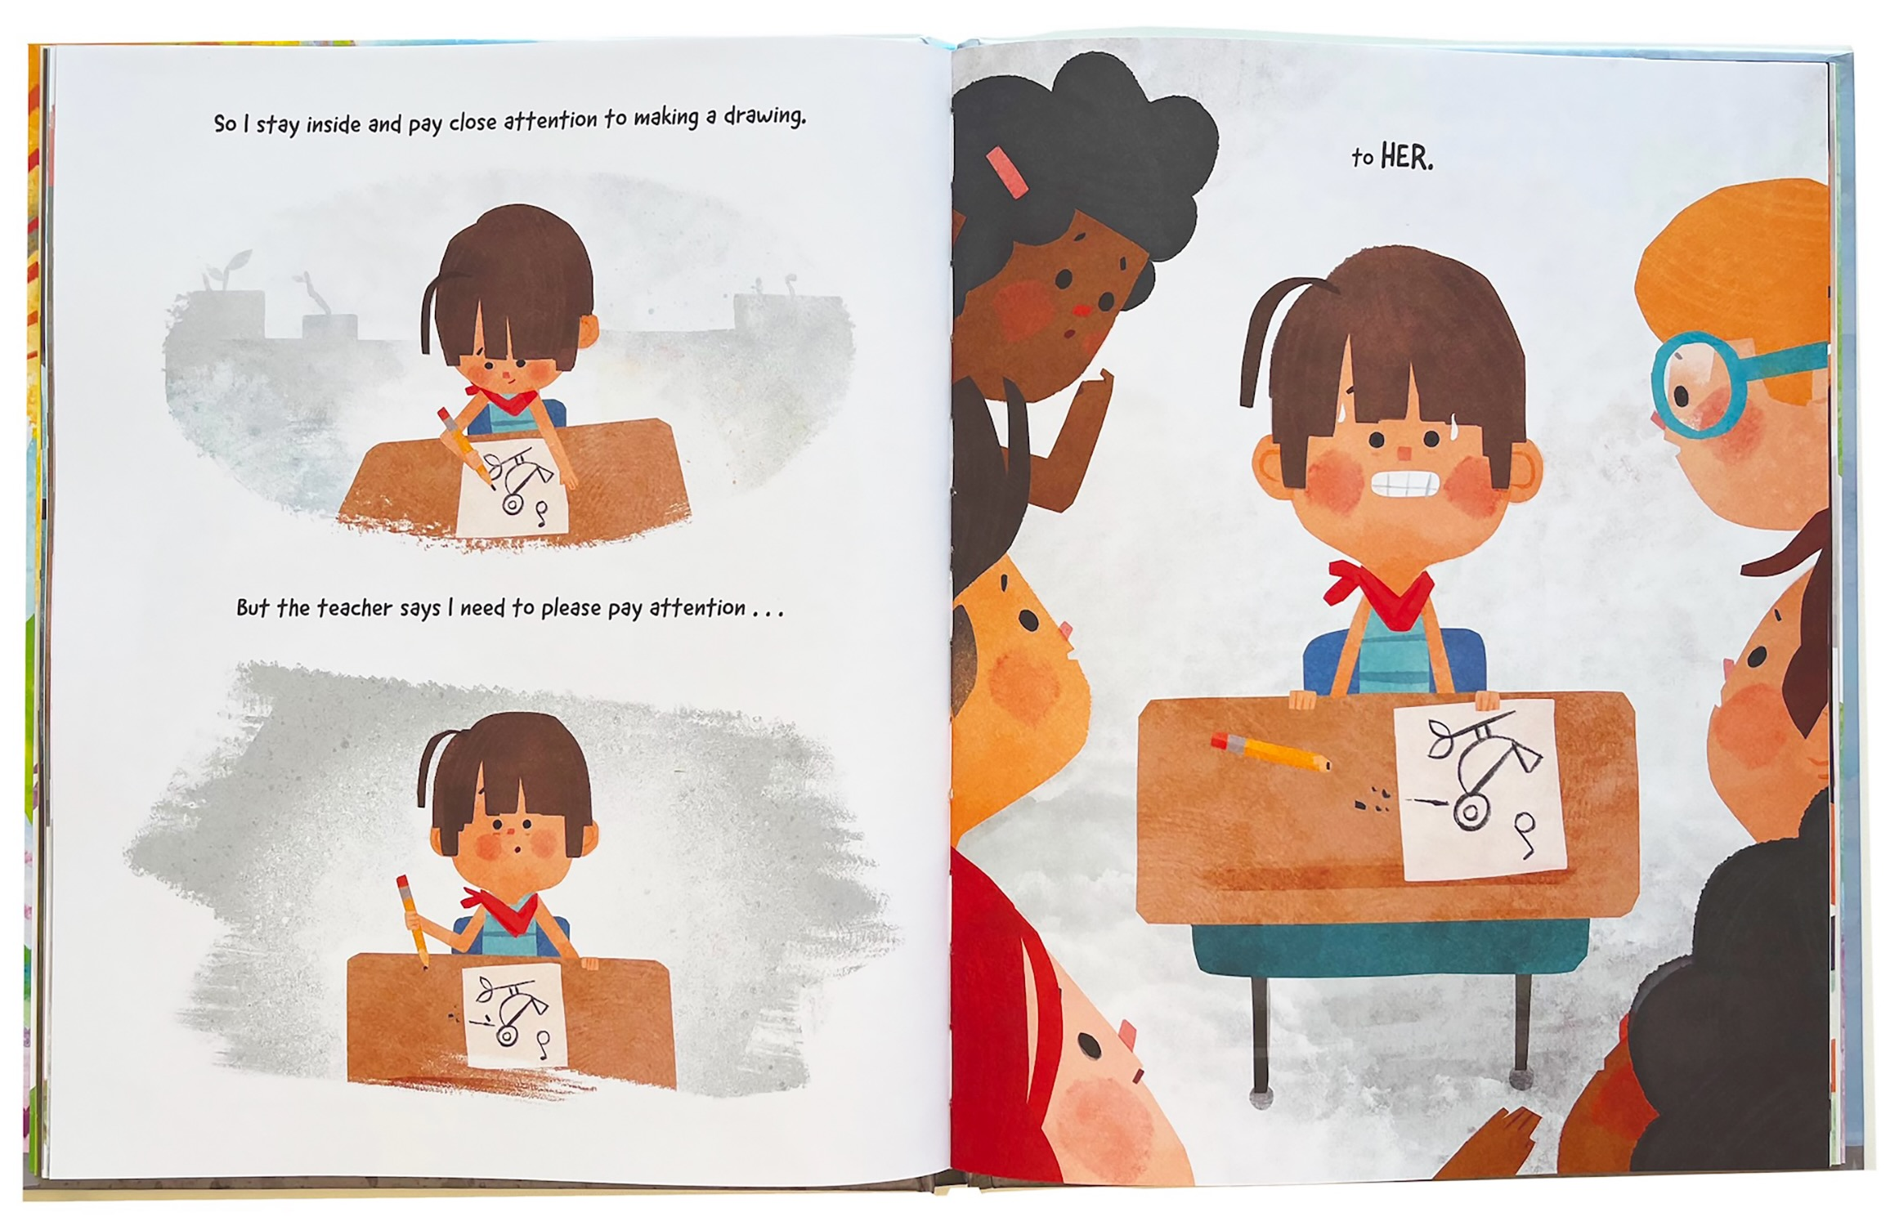
Situational Appropriateness
Students may not understand why their behavior is inappropriate, leading to confusion and emotional distress.
Honor students’ cultural norms while helping them understand which behaviors are acceptable in school.
Model how school-accepted behaviors may differ from those in students’ homes, communities, and peer groups.
Notes:
Image: Chad Otis’s book The Bright Side described his childhood challenges with following classroom rules. Written and Illustrated by Chad Otis.
Reference:
Montague & Kwok, 2023

Slide 10

Home and Communal Values
Learning students’ home and community values helps clarify behavioral expectations and prevent misunderstandings.
In some cultures, overlapping speech, physical touch, and defending others are appropriate, while walking away may be seen as disrespectful.
Culturally responsive practices reduce disciplinary actions by creating inclusive school rules that reflect diverse identities.
Notes:
Class instruction: Discuss how in some cultures overlap, speaking while someone else is speaking, is customary, touching others serves as a form of communication, and verbally and/or physically defending others is culturally appropriate, whereas walking away is not (Leverson et al., 2021).
Class instruction: Discuss how learning students’ home and communal values and teaching school similarities and differences eliminates misunderstandings. These transformative practices reduce disciplinary actions against RELD students because it acknowledges students’ and communities’ cultural identities to develop representative and inclusive school rules and policies.
Image: Nikitha V., 13-years-old, Young Envoys International, Hyderabad, India
Reference:
Leverson et al., 2021

Slide 11
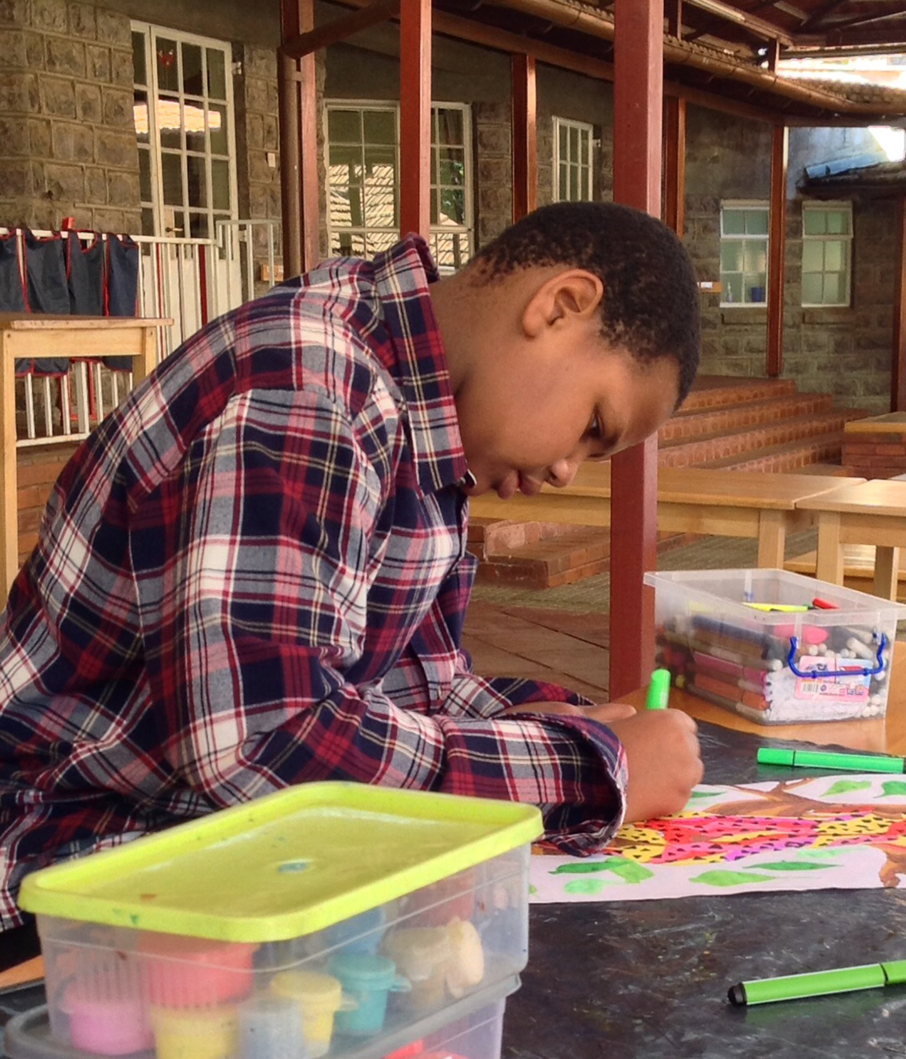
Transformative Classroom Management
Teachers have more time to teach art and students have more time to learn and cultivate artistic behaviors.
Treat students fairly.
Create a student-centered learning environment.
Use culturally appropriate methods.
Build positive and respectful relationships.
Consider students’ perspectives.
Use modeling and positive reinforcements.
Notes:
Class instruction: Invite students to share in a discussion about how:
Effective classroom managers take steps to prevent minor off-task behaviors from escalating.
One student’s off-task behaviors can cause other students to mimic negative behaviors and amplify disruptions.
Punitive and controlling learning environments limit students’ positive communications and interactions with teachers and peers. Positive behavior interventions and supports and transformative social emotional learning offer guidance we can apply to our classroom management practices.
Image: A student uses art supplies organized in clear boxes. Kenya. Source: Lisa Wee, teacher.
References:
Harris & Garwood, 2021
Sickler-Voigt, 2023

Slide 12

Positive Behavior Interventions and Supports (PBIS)
PBIS’s framework supports student growth, teacher well-being, and reduces disciplinary issues through positive school environments.
Local context including family and community input ensure culturally responsive practices and clear, appropriate discipline policies.
Uses the visual arts to reflect school culture and student identities, using multimodal, culturally relevant artmaking to counter stereotypes and biases.
Notes:
Image: Frist Art Museum

Slide 13
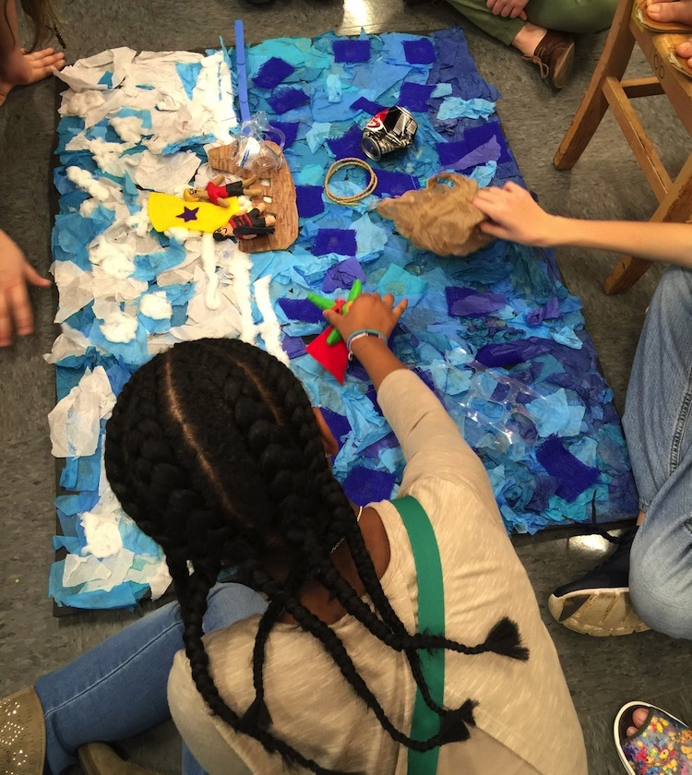
Transformative Social-Emotional Learning (tSEL)
Fosters identity, agency, belonging, curiosity, and collaborative problem-solving to support student and teacher growth.
Promotes culturally responsive, inclusive school policies by involving families and communities and encouraging fair, evidence-based discipline.
Supports student-directed learning through project-based learning and youth participatory action research, resulting in real-world creative outcomes.
Notes:
Class instruction: Discuss how youth participatory action research empowers students to pose questions and work with teachers as equal partners to solve problems. This method gives students a voice and encourages them to identify and address the challenges they are experiencing.
Image: Students create a stop motion film. USA. Author and Monica Leister, teachers.
Reference:
Jagers et al., 2021

Slide 14
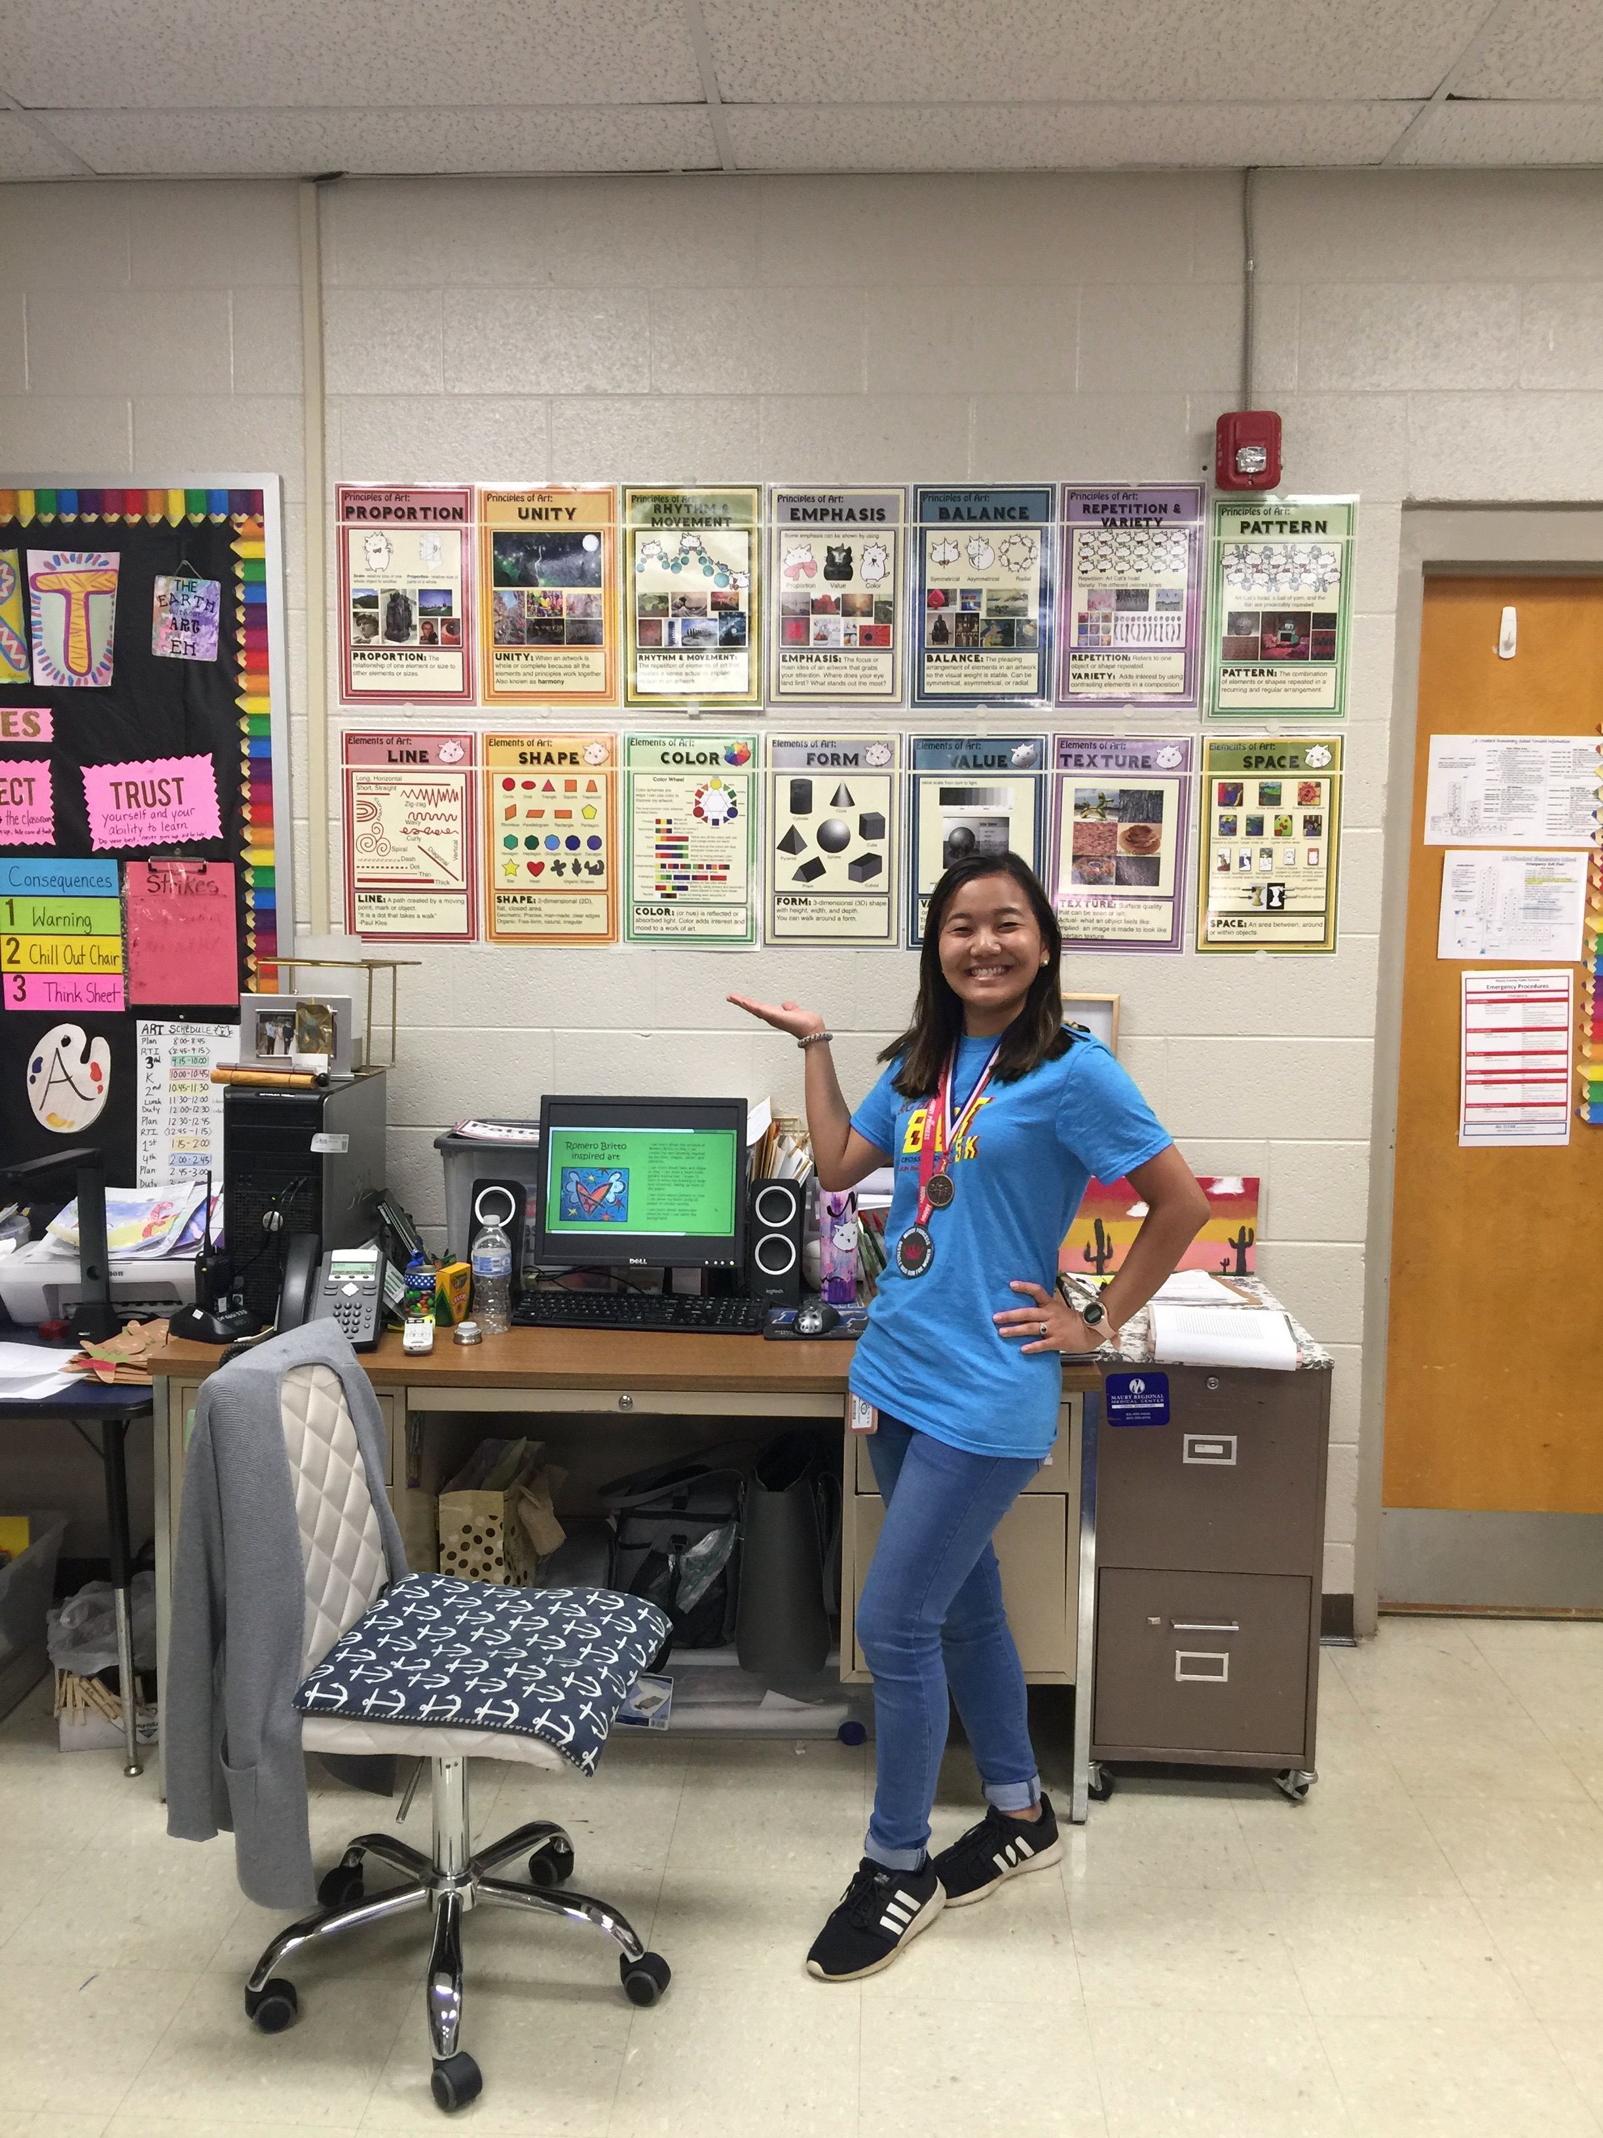
Classroom Management Strategies for Teaching Art
Greet students at the door.
Design safe and inviting classroom spaces that encourage learning.
Implement classroom management procedures from the onset that students can understand and follow.
Notes:
Image: Natsumi Kajisa Gregory proudly presents her posters and classroom management displays. Pamela McColly, photo.
Reference:
Wong, H. K. & Wong, R. T. (2009). How to be an effective teacher: The first days of school (4th ed.). Mountain View, CA: Harry K. Wong.

Slide 15

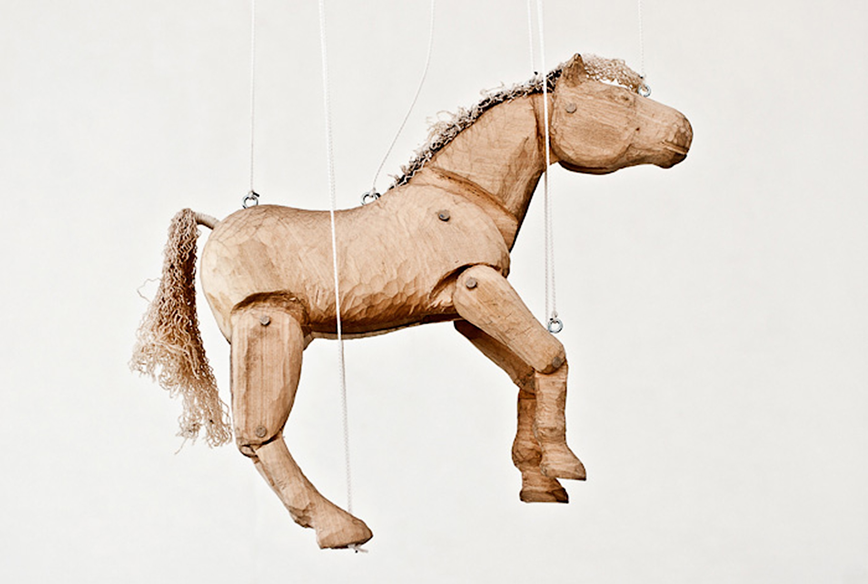
Managing Teaching and Learning
Students use their time productively in a nurturing learning community with consistent expectations.
Students feel personally invested in their work and appreciate positive class interactions.
Notes:
Image: Josefína Vávrová, 15 years old, ZŠ, Praha 1, Czech Republic. 40th ICEFA Lidice.

Slide 16
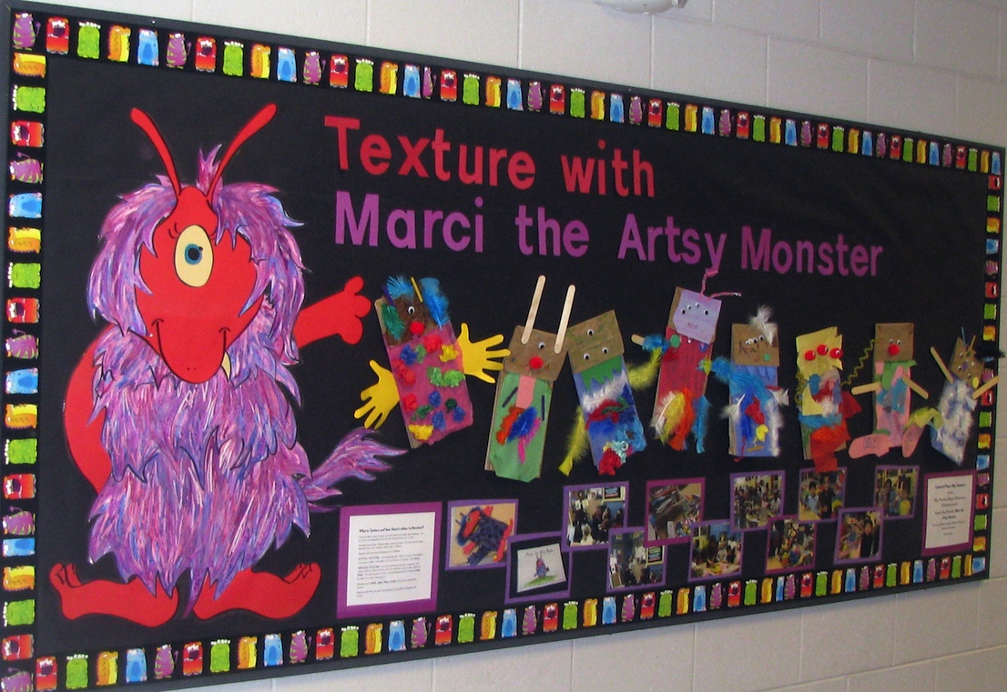
Creating a Classroom Management Plan
Anticipate how students will achieve learning outcomes.
Use families and community members to identify culturally responsive actions to guide teaching and learning expectations.
Limit classroom management actions (rules) to five or less.
Notes:
Image: This bulletin board features kindergarten artworks and a teacher-made character. It teaches about diversity and texture. USA. Selina Hyzer, teacher.

Slide 17
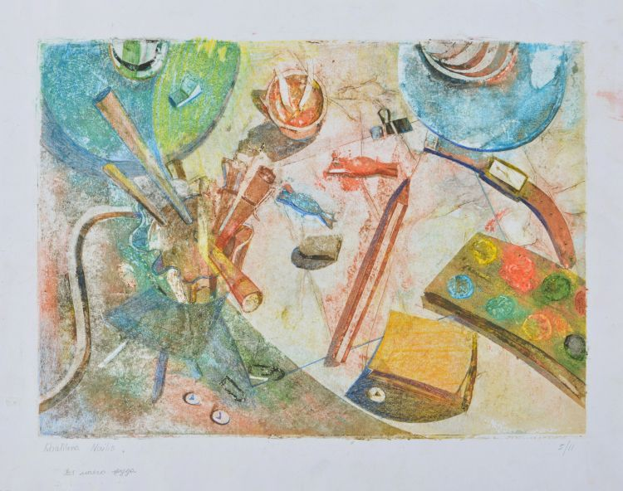
Creating a Classroom Management Plan
Care
Awareness
Respect
Embrace
What steps will you take to manage your classroom?
Notes:
Class instruction: Have the class open the textbook and introduce Model 4.1 Classroom Management Plan for Teaching Art and Model 4.2. My CARE Action Plan. Discuss how to manage develop an effective classroom management plan and appropriate rewards for on-task behaviors and consequences to correct off-task behaviors.
Class instruction:
Care represents the positive values and actions students demonstrate to each other, their teachers, and other living beings.
Awareness teaches students how to become mindful about their minds, bodies, and spirits; learning objectives/targets; goals; and the class environment.
Respect promotes a positive learning environment and includes respect for oneself, others, materials, school, learning, and the community.
Embrace fuses the concepts of care, awareness, and respect because it calls upon students to embrace learning processes and the big ideas that drive the curriculum.
Image: Nailia Khalilova, 8 years old, Artlife Azerbaijan group Masterkids, Baku, Azerbaijan. 43rd ICEFA Lidice.

Slide 18
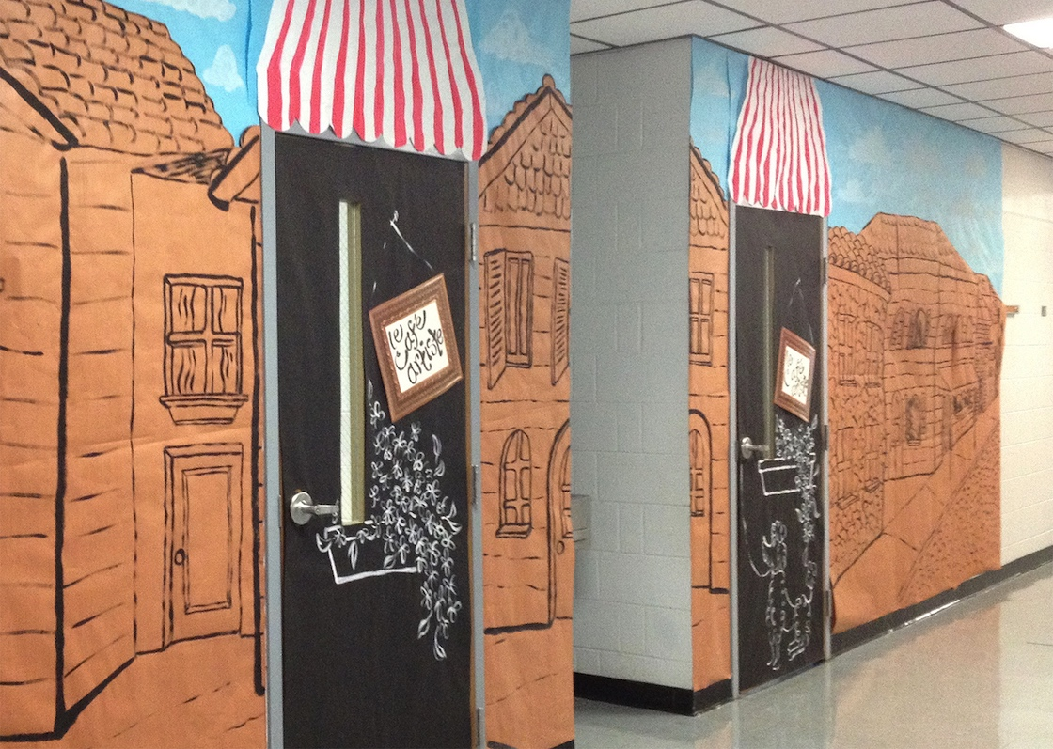
Presenting Well-Designed Classroom Environments
Classroom spaces impact students’ physical and psychological safety, ability to focus, and participation.
Teachers identify where furniture, supplies, and equipment belong for productive learning.
Notes:
Image: Cassie Stephen’s decorated the spaces outside of her classroom with an international theme.
Reference:
Broome, 2013

Slide 19
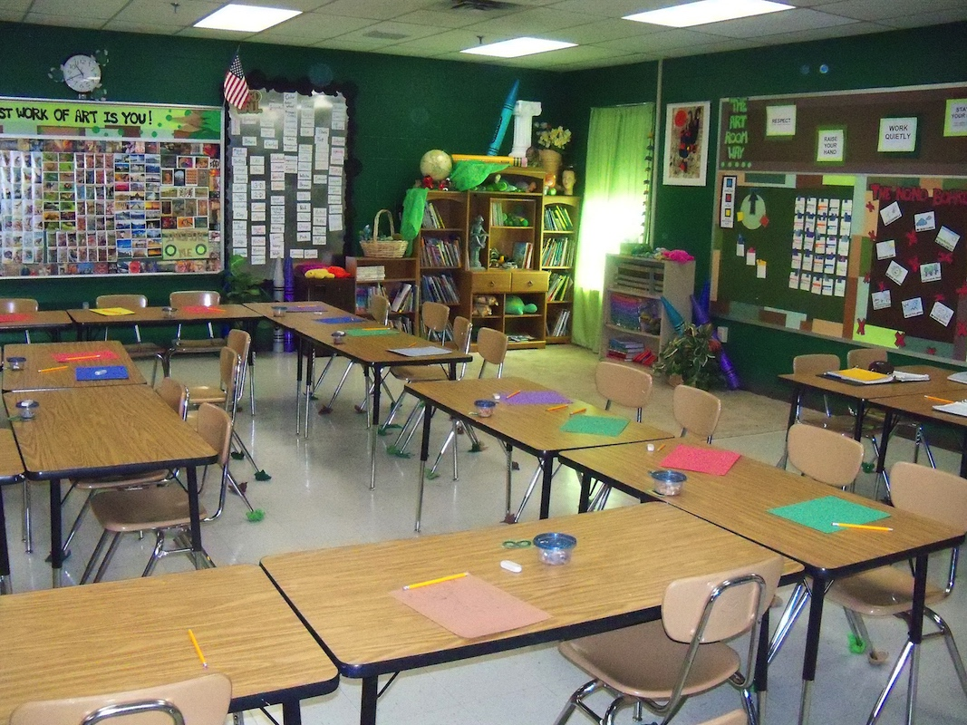
Organizing Learning Zones
Plan a flexible and mobile classroom layout for learning tasks.
Make learning spaces visible with clear access to instructional resources.
Create seating charts to learn students’ names, facilitate attendance, and provide structure.
Notes:
Class instruction: Discuss options for moving chairs and desks for particular learning tasks and using locations like a carpeted area and diverse learning centers.
Image: Mr. E.’s (Ted Edinger’s) classroom is highly organized.

Slide 20

Managing Supplies and Equipment 1
U.S. Public Law 100-695 Labeling of Hazardous Art Materials mandates that toxicologists identify chronic hazards from art supplies.
AP (Approved Product) Seal
CL (Cautionary Label) Seal
Material Safety Data Sheets (MSDS)
Notes:
Class instruction: Discuss the following. If school art supplies are available in the classroom, pull them out and have students locate which products include these seals.
AP (approved product) seal: Products are certified to be made with safe materials.
CL (Cautionary Label) seal: products are safe when users carefully follow the package directions.
Many manufacturers and distributors post product specific material safety data sheets (MSDS) online.
Image: Eva Šonská, 7 years old, ZUŠ, Mladá Boleslav, Czech Republic, 39th ICEFA Lidice.
References:
Art and Creative Materials, 2024
U.S. Consumer Product Safety Commission, 2021

Slide 21

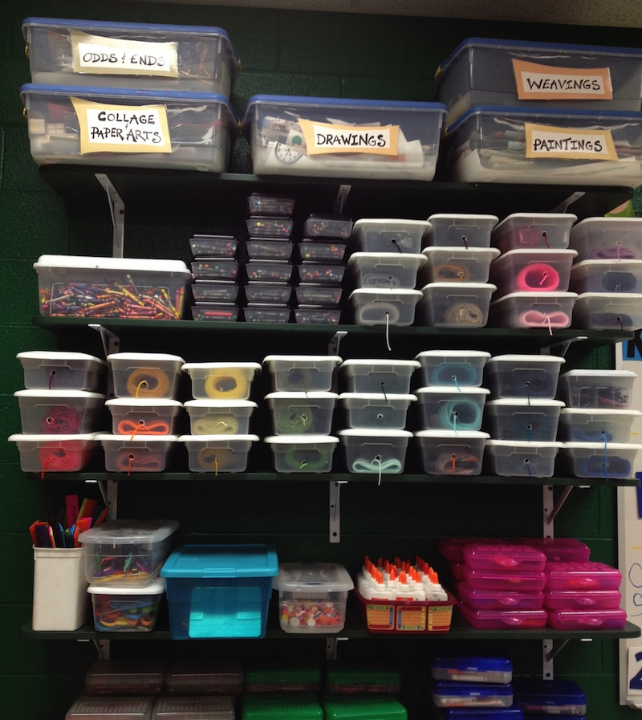
Managing Supplies and Equipment 2
Plan the storage, distribution, and cleanup of art supplies and equipment to save time and teach students independence.
Label supply boxes and color code their contents to keep supplies in order.
Notes:
Image: Student art supplies are located in clear plastic bins. USA. Ted Edinger, teacher.

Slide 22
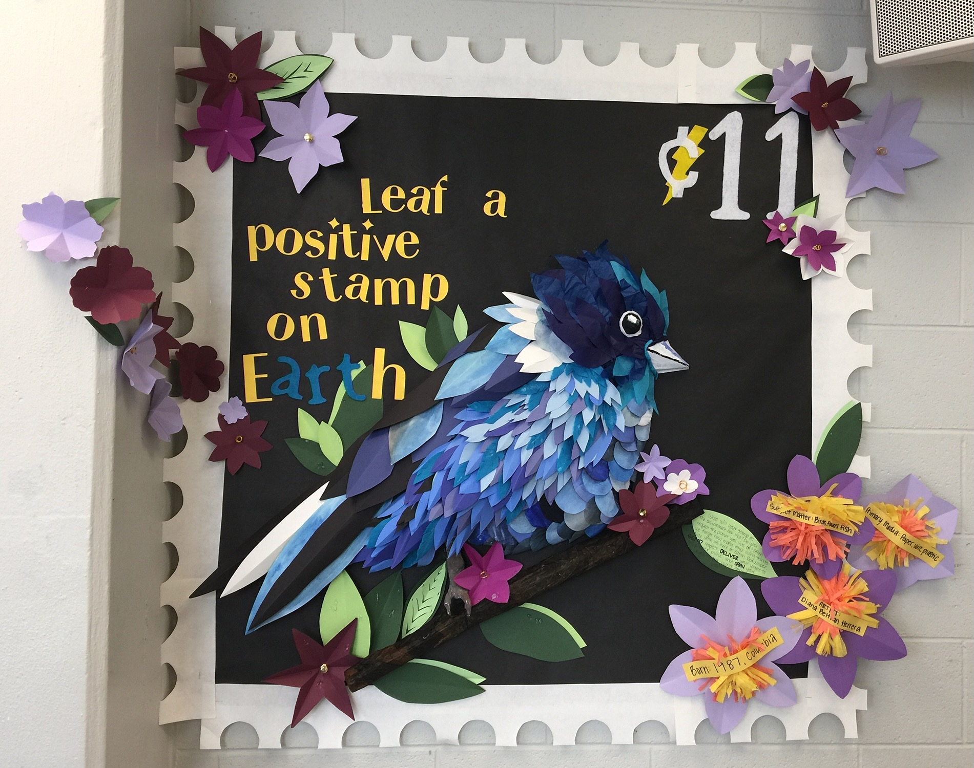
Preparing Visuals and Displays
Visual resources identify the types of learning teachers anticipate from students.
Bulletin boards include:
Art
Big Ideas
Contextual Information
Academic Vocabulary
Title
Fine Details and Interactive Parts
Notes:
Image: This bulletin board’s three-dimensional design, inspired by artist Diana Beltran Herrera, serves as a teaching tool that adds visual excitement to the classroom.

Slide 23
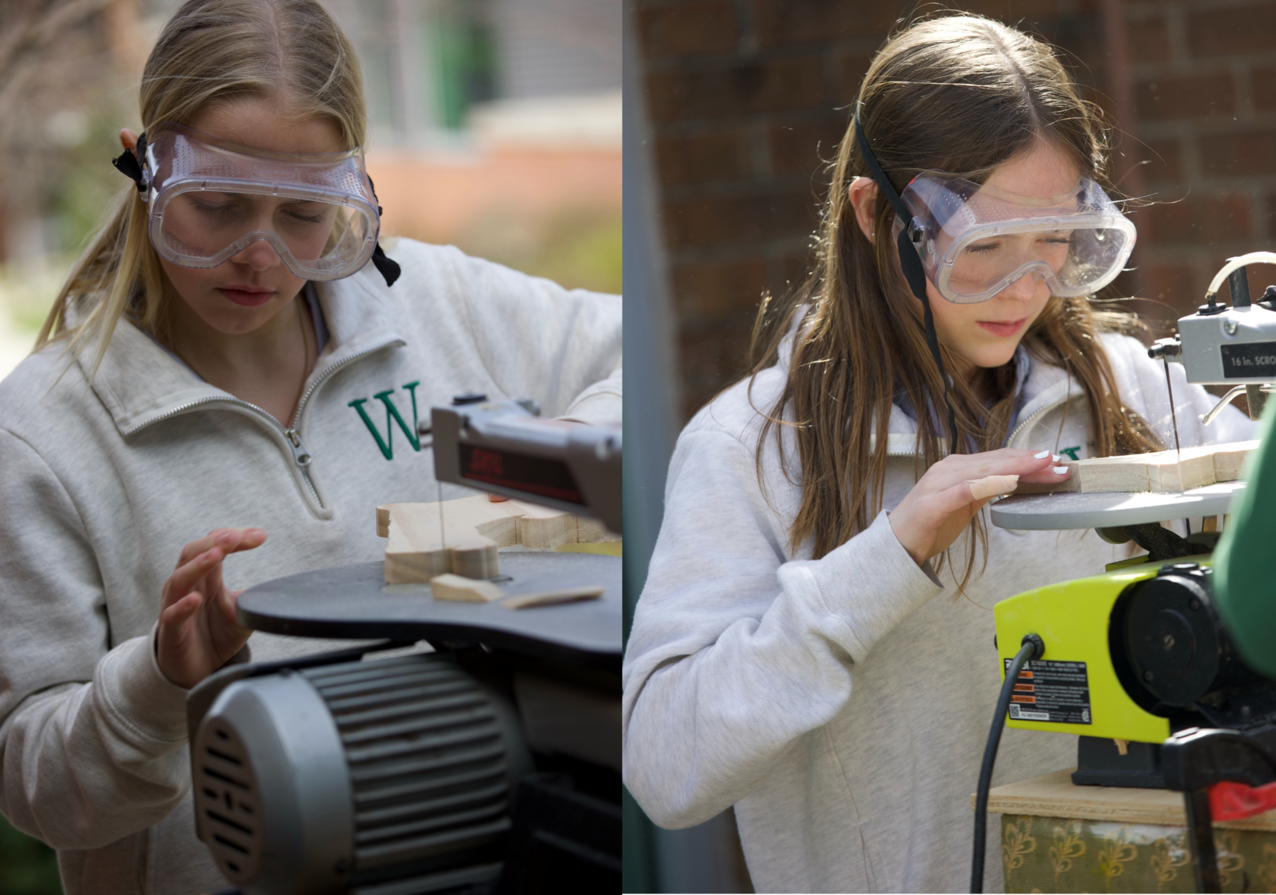
Responding to Classroom Management Through the Transformative Art Curriculum
Teachers can reinforce each of the positive actions identified in a classroom management plan (like care, respect, awareness, and embrace) through the transformative art curriculum.
By participating in class discussions and producing creative projects, students can identify personal reasons for embracing learning tasks to achieve desired results.
Notes:
Image: Middle school students Devon Lederer and EllaJane Barger wear safety goggles and concentrate as they cut with scroll saws. Source: Todd Johnson, teacher; Cathy Dowhos-O'Gorman, photo

Slide 24
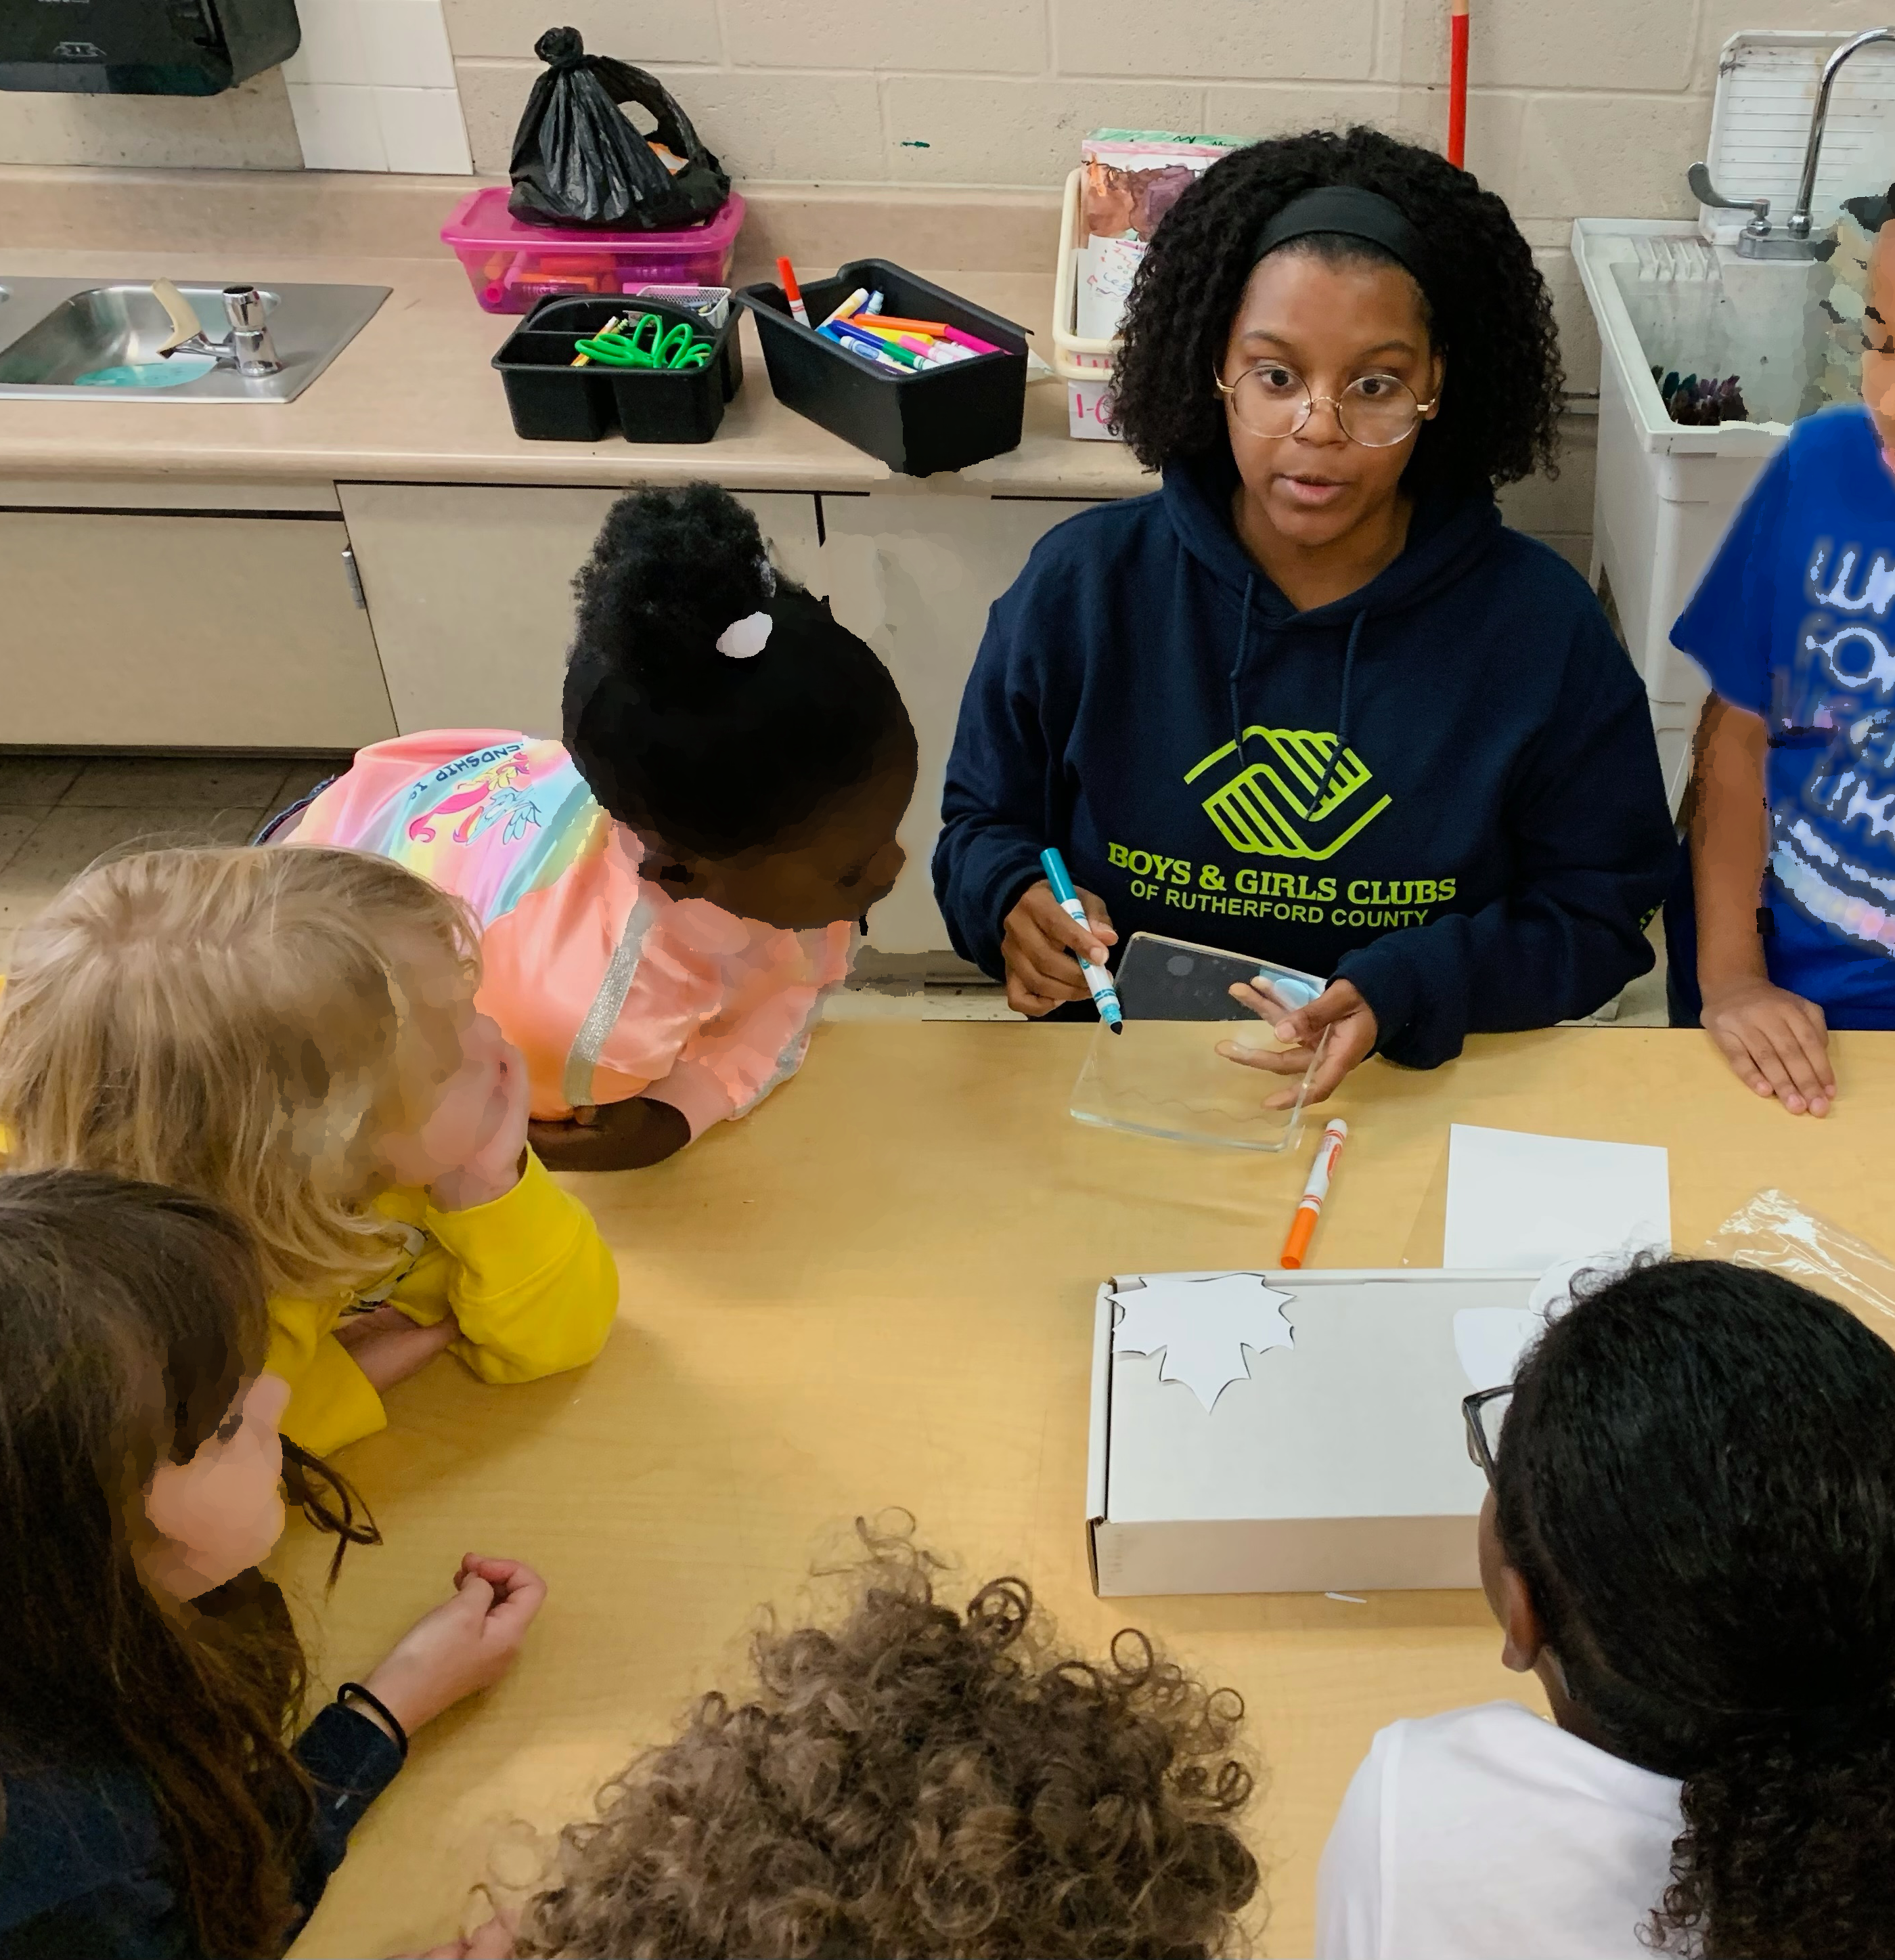
Connecting in a Safe Learning Community
Well-managed classrooms are places for students to form positive relationships and learn empathy and fairness for all people.
Class discussions offer constructive opportunities for students to share feelings about the things they witnessed at school, the broader community, and in the media.
Notes:
Class instruction: Discuss with students the possibility ofcollaborating with a school’s guidance counselor to facilitate lessons, problem-based learning, and/or Youth Participatory Action Research to answer the questions that are concerning students.
Image: Art educator Amber Buck is teaching early childhood learners.

Slide 25

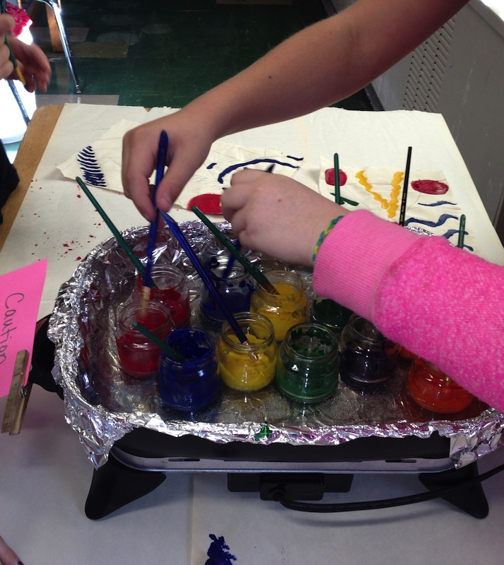
Surmounting Classroom Management Challenges
Teachers must be adept in their roles as inspirational leaders who minimize classroom management challenges.
Lack of classroom management skills that remain uncorrected can result in a greater chance of job dissatisfaction and burnout.
Notes:
Image: Middle school students heed hot pink warning signage. USA. LeAnne Deats teacher.

Slide 26
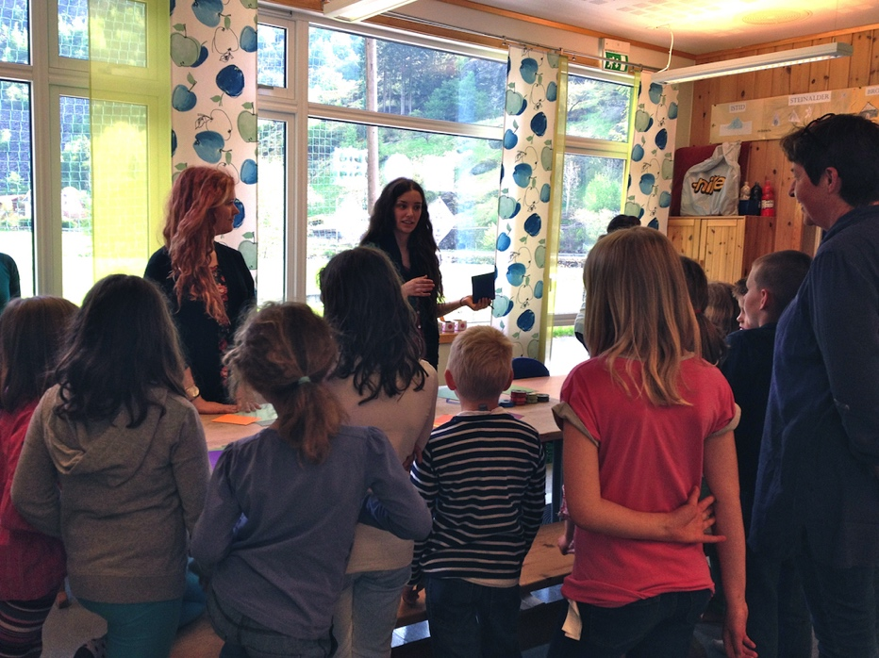
Managing Students with Confidence
Students have high expectations for teachers.
Students recognize teacher confidence and authority.
They read teacher body language.
Teachers listen and teach students to be responsible for their behaviors.
They check that students follow class routines.
Notes:
Class instruction: Ask the class to brainstorm ways to project teacher confidence through body language and to identify strategies to calm students when they are upset.
Image: Pre-service teachers from the United States give a demonstration to elementary children in Norway. Author, teacher.

Slide 27
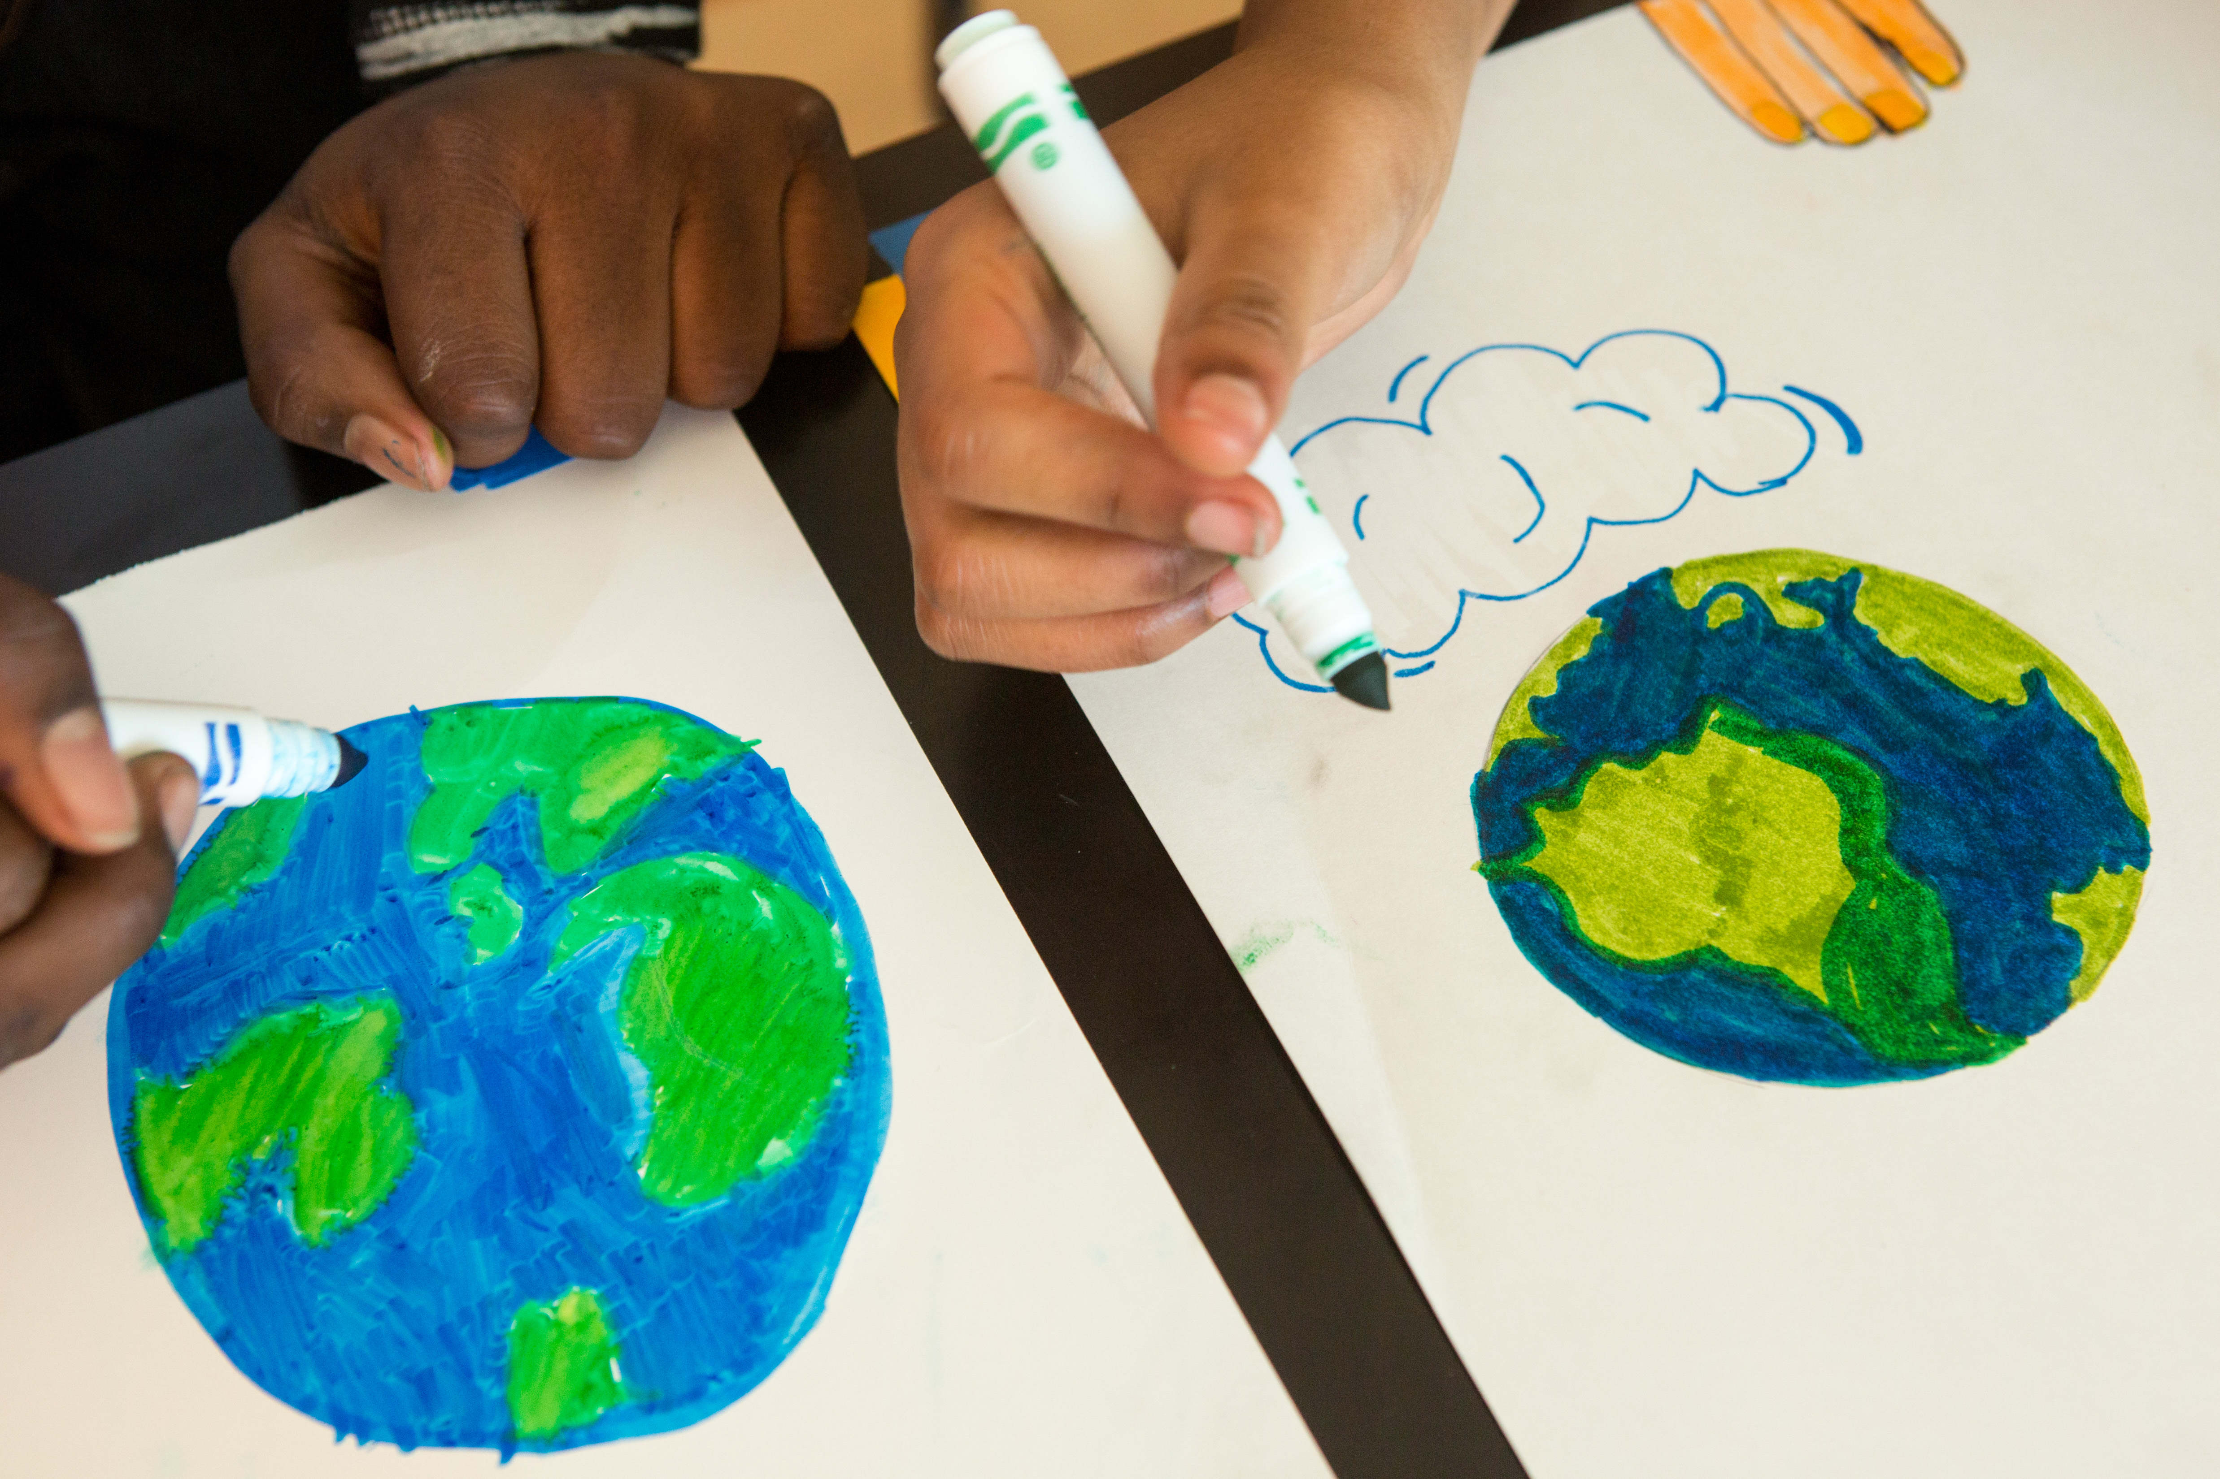
Setting High Expectations for All Students
Focus on students’ abilities.
Help diversified learners achieve learning outcomes.
Teach how to overcome obstacles and set attainable goals.
Notes:
Image: Photo by Allison Shelley/The Verbatim Agency for EDUimages. (CC BY-NC 4.0).

Slide 28
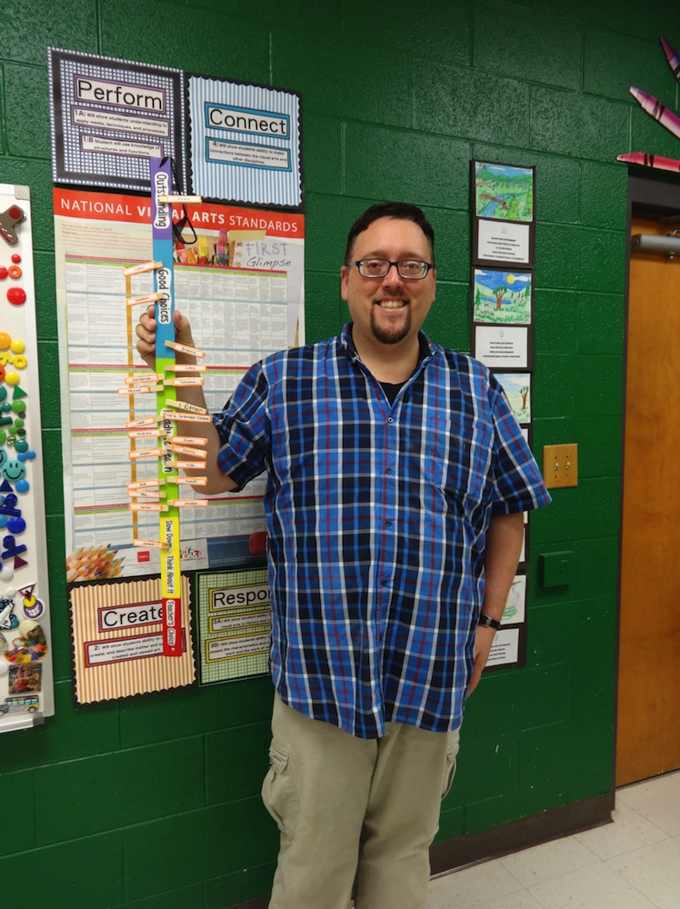
Instructing Students When They Are Ready to Learn
Begin instruction when students are ready to learn.
Understand that students cannot learn with diverted attention.
Use class routines.
Teach students the behaviors they anticipate.
Know how to direct students’ attention at all points during instruction.
Motivate students to participate in the full learning process.
Notes:
Image: Mr. E., Ted Edinger, demonstrates one of his classroom management procedures.

Slide 29
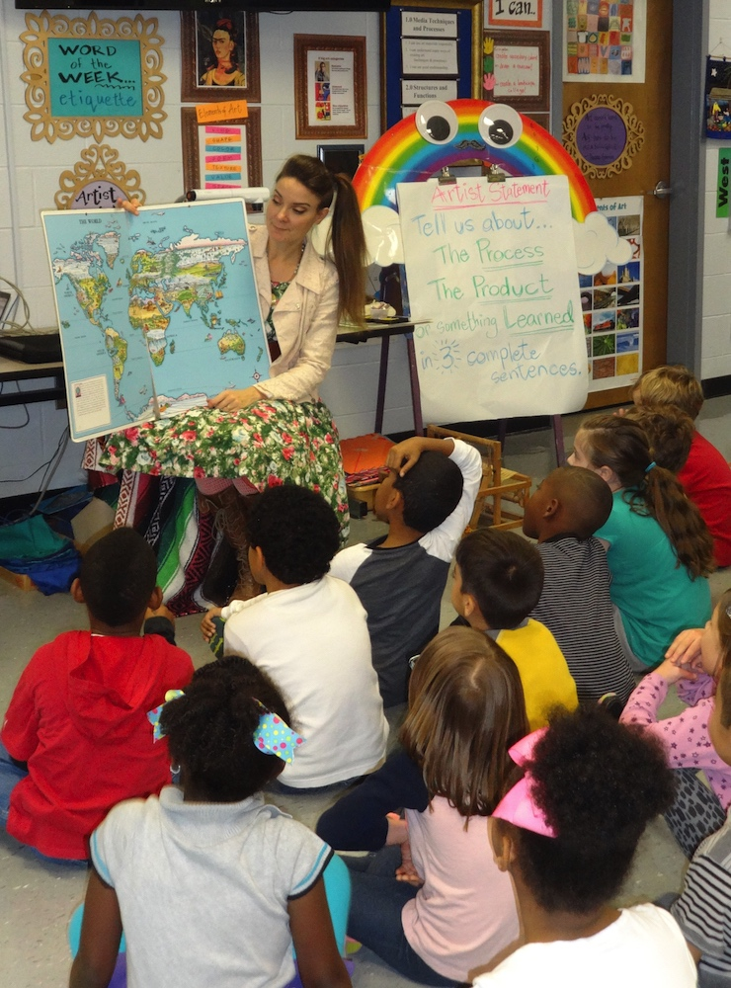
Demonstrating Professionalism
Look and act like professionals.
Wear attire that is neat, clean, and follows the employer’s dress code.
Differentiate the line between teacher mentoring and friendship with peers.
Use social media wisely.
Notes:
Class instruction: Discuss how transformative classroom managers can help students who struggle with forming peer friendships to transition from relying on teachers alone for positive class interactions by facilitating class collaborations including flexible grouping (placing students into different learning groups), project-based learning, and youth participatory action research.
Image: Cassie Stephens is prepared for teaching and demonstrates professionalism.

Slide 30

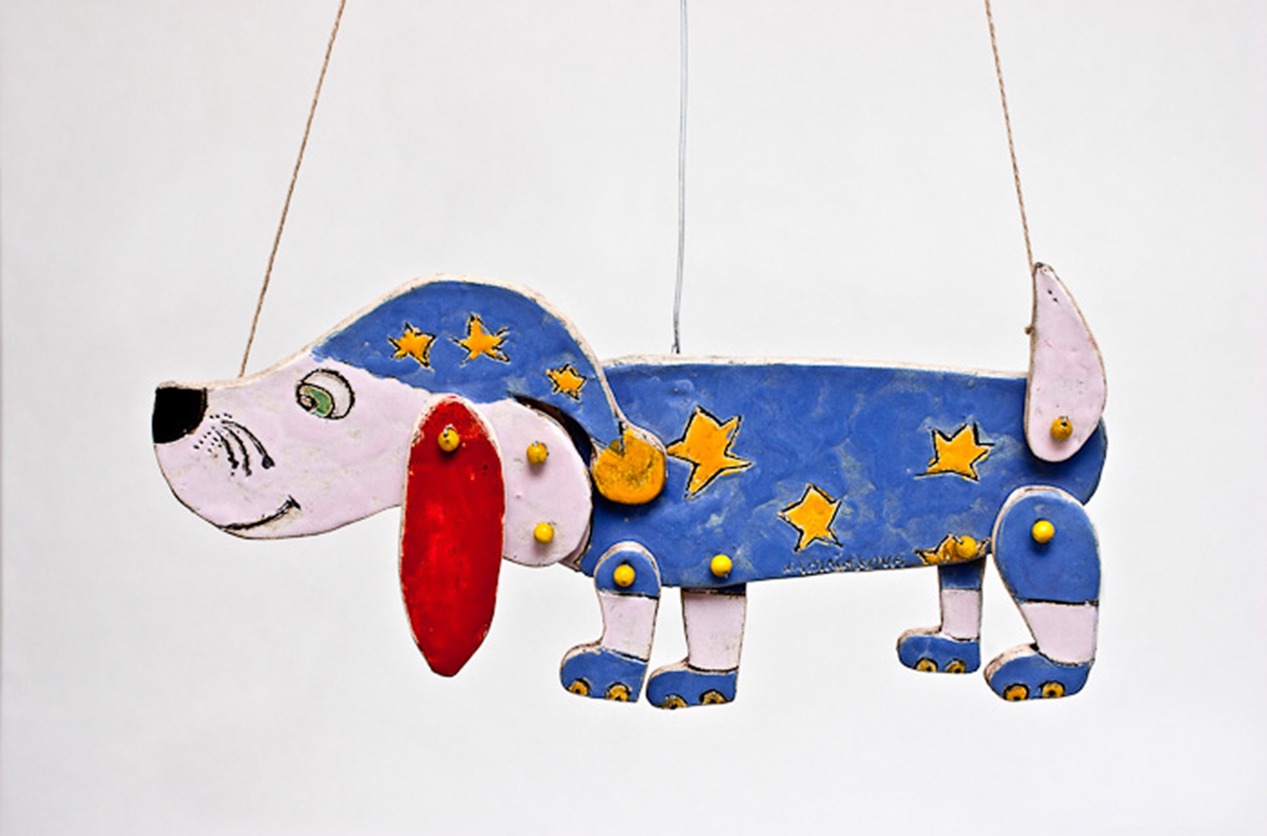
Conveying Appropriate Responses to Negative Comments and Behaviors
Some students may direct hurtful behaviors toward teachers.
Teachers should remain calm and redirect off-task behaviors using a firm and clear voice.
Teachers explain to students how a particular rule was broken and identify the consequences for the behavior.
Notes:
Image: Nikola Rabiňáková, 11 years old, ZŠ, MŠ, ZUŠ, Jesenice, Czech Republic. 40th ICEFA Lidice.

Slide 31
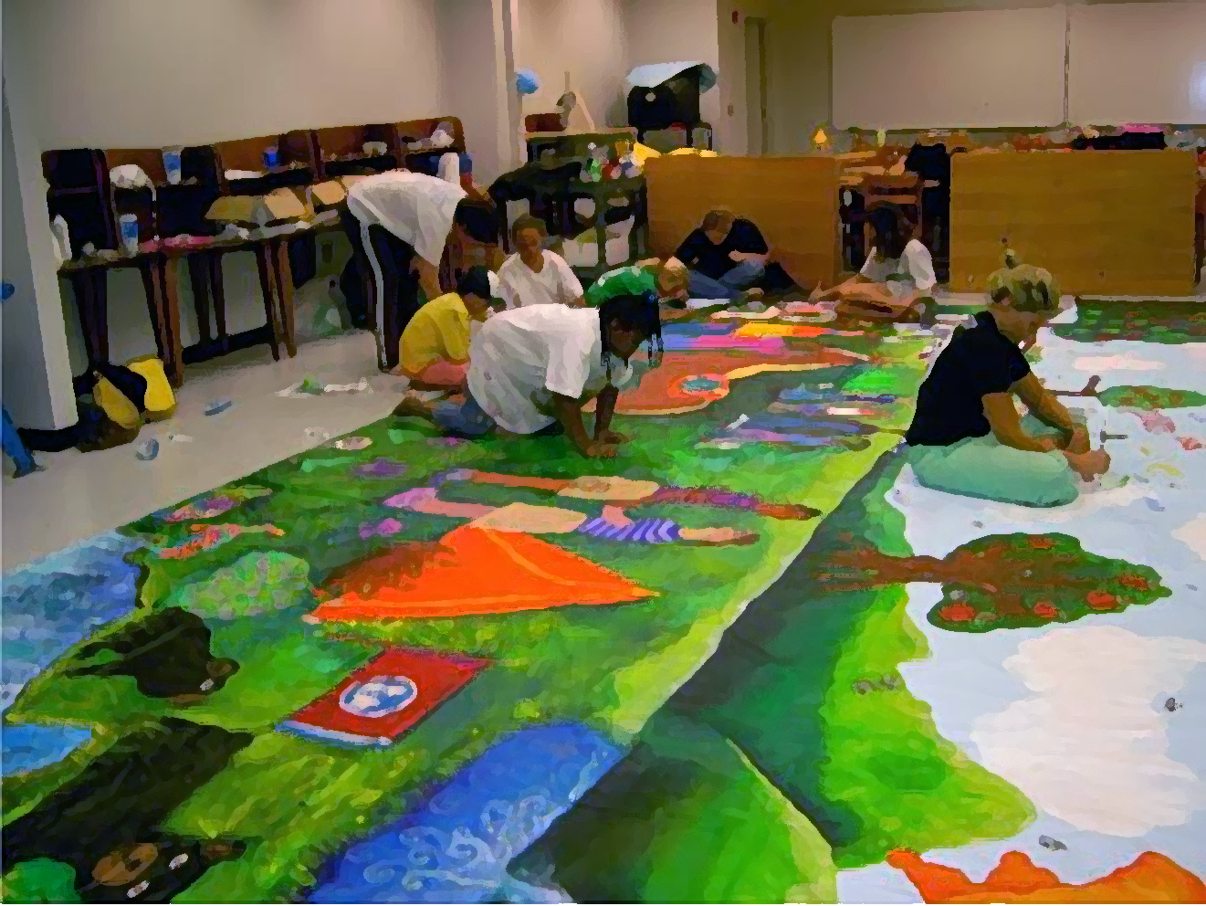
Confronting Violence, Bullying, and Victimization 1
Acts of school-related violence include harassment, intimidation, theft, property damage, and physical harm ranging from minor fights to aggravated assault.
Globally, up to one billion children experience violence annually, with most incidents occurring outside school; daily threats often involve humiliation, rumors, and theft.
School shootings have led to widespread fear and the implementation of lifesaving safety procedures and drills to protect students and staff.
Students painting a Kids Guernica Peace Mural.
Notes:
Image: Students are painting a Kids Guernica Peace Mural in Tennessee.
Reference:
Irwin et al, 2023
McMahon et al., 2014
World Health Organization, 2022

Slide 32
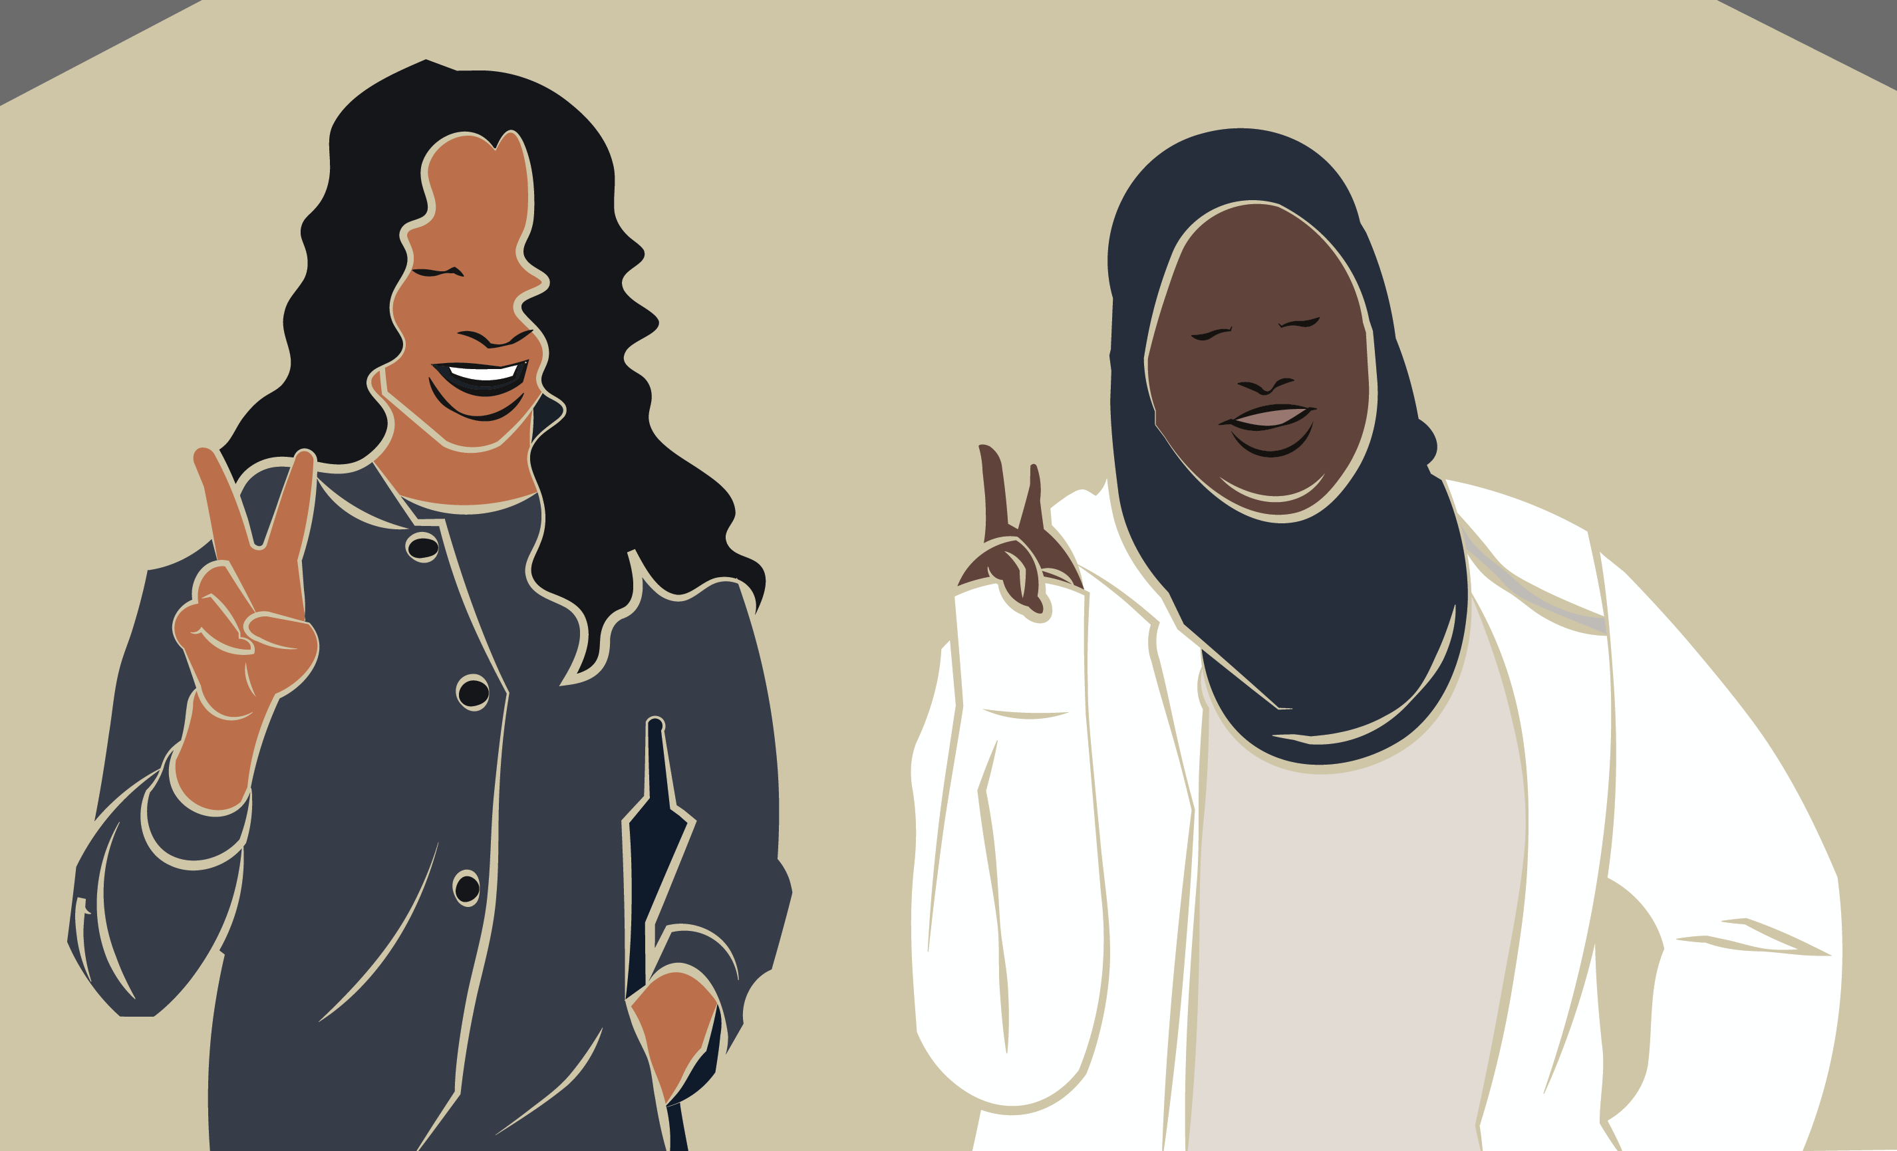
Confronting Violence, Bullying, and Victimization 2
Acts of violence and victimization include harassment through obscene gestures/language; intimidation; property damage; stealing; and acts of physical harm.
Students’ Peace Symbols
Notes:
Image: This is a selfie scene for the stop motion animation Route 66 Cross Country Road Trip. USA. Source: Author, Monica Leister, Amber Buck, and Joshua Harper.

Slide 33
Confronting Violence, Bullying, and Victimization 3
Students who bully inflict harm based on a peer’s age, race, ethnicity, culture, social status, and personalities, as well as having perceived weaknesses.
LGBTQ+ are often the recipients of the harshest bullying attacks.
Bullying is the intentional act of harming another person. It includes harmful verbal statements and social exclusions.
Notes:
Book Cover Artwork: Paula Gale

Slide 34
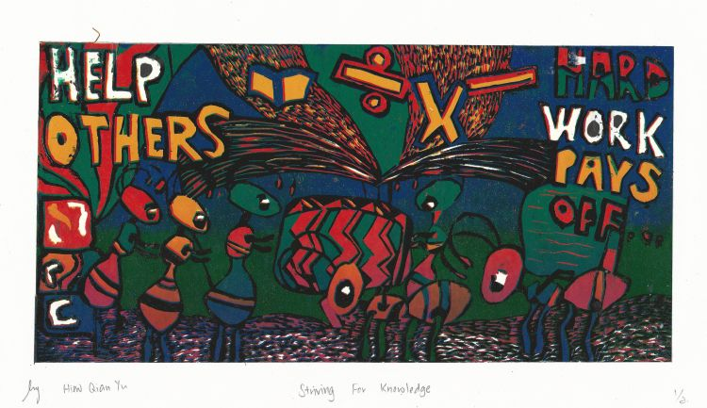
Confronting Violence, Bullying, and Victimization 4
Teachers can confront and prevent some incidents of violence and bullying by teaching right and wrong.
They demonstrate the types of behaviors expected in the classroom and beyond.
Notes:
Image: Hiew Qian Yu, 15-years-old, Si Ling Secondary School, Singapore - Woodlands, Singapore. 44th ICEFA Lidice

Slide 35

Confronting Violence, Bullying, and Victimization 5
Violence can appear in students’ art. Teachers should ask students what the artworks are about.
Administrators can offer further guidance when students’ images (and actions) are concerning.
Notes:
Class instruction: Discuss how violence in students’ art can be innocent, playful, and historical, as well as signs of harmful intentions and abuse. When teachers have reasonable cause to suspect abuse, they are legally obligated as mandated reporters of child abuse to contact child protective services to begin an investigation.
Image: Iulia Tolmacheva, 10 years old, Detskaya Khudozhestvenaya shkola No. 2, Ufa, Russia. 41st ICEFA Lidice.

Slide 36
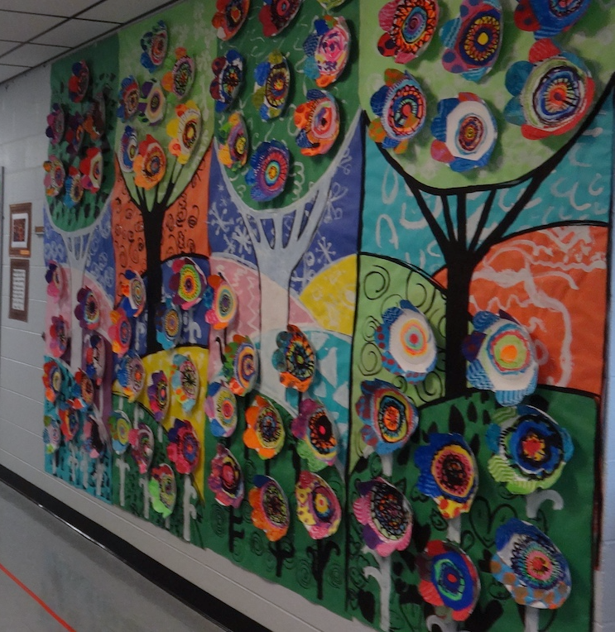
Confronting Violence, Bullying, and Victimization 6
Schools are safer when principals and policy makers:
Recognize the challenges teachers and students face.
Seek strategies and resources to support learning essentials
Foster a school community of care and respect for all
Provide teachers with student-centered classroom management trainings.
Notes:
Image: Cassie Stephen’s decorates her school’s hallways.

Slide 37
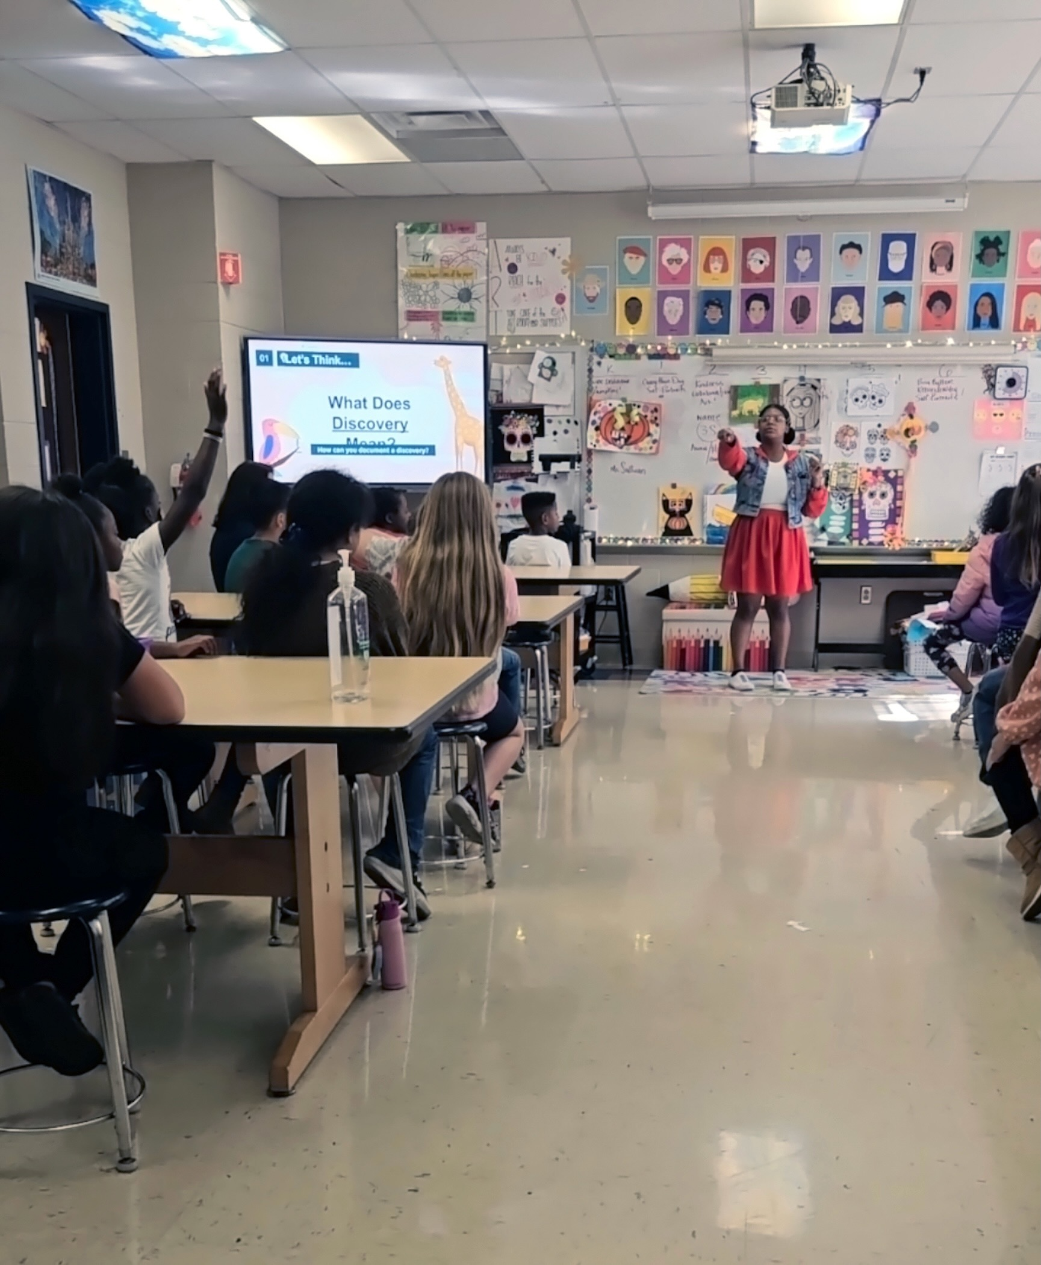
Teaching Tips to Thrive #4.1 Amber Buck Authentic Teaching and Classroom Management
Authentic teaching has become an effective tool that allows me to manage K – 12th grade students.
Consistent frameworks include (a) setting clear expectations, (b) cultivating optimistic environments, and (c) planning engaging curriculum.
Notes:
Class instruction: Discuss Teaching Tips to Thrive #4.1 and Amber Buck’s methods for authentic teaching and classroom management.
Image: Amber Buck is teaching an elementary art lesson.

Slide 38


Oleana: A Fairytale Reality Through Fair Made Procedures Artists’ Lessons to Thrive! 4.1.
Big Idea: Fair Procedures
Textile Design
Notes:
Class instruction: Have the class open the textbook to Artists’ Lessons to Thrive! 4.1. Participate in its learning targets.
Left and Right Images: Photos by Solveig Hisdal, Oleana©.

Slide 39
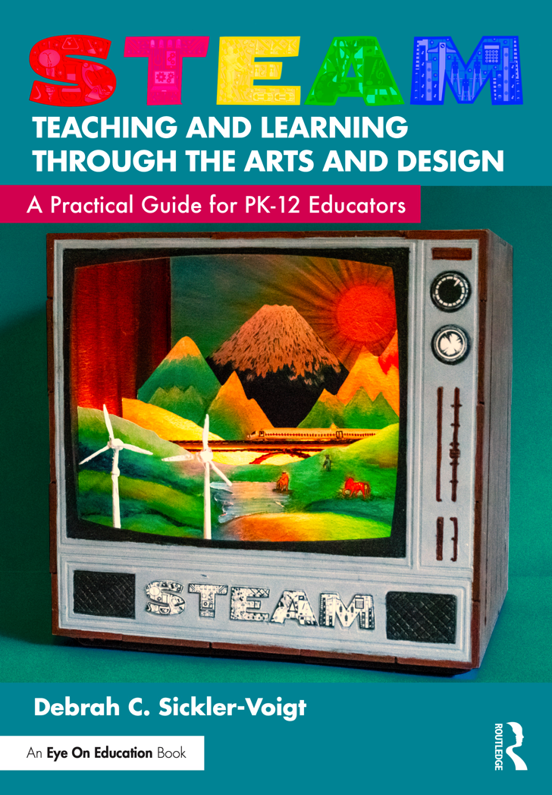
Artists’ Lessons to Thrive! Classroom Management
Utilize TLAE’s and STEAM Teaching and Learning Through the Arts and Design’s Artists’ Lessons to Thrive! instructional resources to address important life skills through art and facilitate classroom management learning tasks.
Notes:
Left Image: Paula Gale, book cover artwork
Right Image: This is a book cover of STEAM Teaching and Learning Through the Arts and Design: A Practical Guide for PK-12 Educators.

Slide 40

Approaches to Teacher and Student Transformative Growth Charts
Teacher: Understand what classroom management is and what its challenges are to be prepared to model expected behaviors to students as a transformative classroom manager by teaching them situational appropriateness that honors their cultural norms and reinforces which behaviors are acceptable and unacceptable in educational spaces.
Student: Learn situational appropriateness to understand teachers’ and schools’ expectations for my school behaviors and how they may differ from the behaviors accepted within my home community and with my friends and families.
Notes:
Class Activity: Open the textbook to Chapter 4’s Teacher and Student Transformative Growth Charts. Model 4.3 TLAE’s Overview of Approaches to Teacher Transformative Growth and Model 4.4 TLAE’s Overview of Approaches to Student Transformative Growth. Discuss the meanings of these transformative actions. Build on their list of actions.
Image: Midjourney AI, prompted by Netha Hussain, CC0, via Wikimedia Commons. https://commons.wikimedia.org/wiki/File:Quilling_pattern_of_a_mountain_02.png

Slide 41
Chapter 4 Summary
Managing Teaching and Learning
Classroom Management Strategies for Teaching Art
Confronting Violence, Bullying, and Victimization
Creating a Classroom Management Plan
Presenting Well-Designed Classroom Environments
Responding to Classroom Management Through the Transformative Art Curriculum
Connecting in a Safe Learning Community
Surmounting Classroom Management Challenges
Positive Behavior Interventions and Supports, Transformative Social-Emotional Learning
Notes:
Thanks for participating in Teaching and Learning in Art Education’s 2nd Ed. Chapter 4!
Book Cover Artwork: Paula Gale
Chapter References
Art and Creative Materials. (2024). How we keep creativity safe. https://www.acmiart.org/materials-safety
Butler, B. R., Gladney, D., Lo, Y., and Caldera, A. (2023) Culturally responsive instruction. (2023). In E. J. Sabornie & D. L. Espelage (Eds.) Handbook of classroom management (3rd ed., pp. 477-498). Routledge.
Center on PBIS. (2024). What is PBIS? https://www.pbis.org/pbis/what-is-pbis
Cinquemani, S. (2014). “I look cool; He’s dead now”: Reconsidering children’s violent play art. Art Education, 67 (3), 13–18.
Diket, R. M. , & Mucha, L. G. (2002). Talking about violent images. Art Education, 55 (2), 11–17.
Gay, G. (2018). Culturally responsive teaching: Theory, research, and practice (3rd ed.). Teachers College Press.
Harris, A. H., & Garwood, J. D. (2021). Reclaim your challenging classroom: Relationship-based behavior management. Corwin.
Irwin, V., Wang, K., Cui, J., & Thompson, A. (2023). Report on indicators of school crime and safety: 2022. National Center for Education Statistics, U.S. Department of Education, and Bureau of Justice. https://nces.ed.gov/pubsearch/pubsinfo.asp?pubid=2023092
Jagers, R. J., Skoog-Hoffman, A., Barthelus, B., & Schlund, J. (2021). Transformative social emotional learning: In pursuit of educational equity and excellence. American Educator, 45(2), 12–17.
Jefferson, M., & Anderson, M. A. (2021). Transforming education: Reimagining learning, pedagogy and curriculum. Bloomsbury Academic.
Lane, K. L., Menzies. H. M., Smith-Menzies, L., & Lane, K. S. (2023). Classroom management to support students with disabilities. In E. J. Sabornie & D. L. Espelage (Eds.) Handbook of classroom management (3rd ed., pp.499-516). Routledge.
Leverson, M., Smith, K., Mcintosh, K., Rose, J., & Pinkelman, S. (2021). PBIS cultural responsiveness field guide: Resources for trainers and coaches. Center on PBIS, University of Oregon. www.pbis.org
McCarthy, C. J., Mosley, K. C., & Dillard, J. B. (2023). Teacher stress and classroom management. In E. J. Sabornie & D. L. Espelage (Eds.) Handbook of classroom management (3rd ed., pp. 189-210). Routledge.
McMahon, S. , Martinez, A. , Espelage, D. , Rose, C. , Reddy, L. , Lane, K. , & Brown, V. (2014). Violence directed against teachers: Results from a national survey. Psychology in the Schools, 51 (7), 753–766. doi:10.1002/pits.21777
Montague, M. L., Kwok, A. (2023). Teacher training and classroom management. In E. J. Sabornie & D. L. Espelage (Eds.) Handbook of classroom management (3rd ed., pp. 249-270). Routledge.
National Coalition for Core Arts Standards . (2014). National Core Arts Standards. www.nationalartsstandards.org
Rose, C.A., Espelage, D.L., & Robinson, L.E. (2023). Emerging issues in school bullying research and prevention. In E. J. Sabornie & D. L. Espelage (Eds.) Handbook of classroom management (3rd ed., pp. 167-185). Routledge.
Scott T. M., & Nakamura, J. (2023). Effective instruction as the basis for classroom management. In E. J. Sabornie & D. L. Espelage (Eds.) Handbook of classroom management (3rd ed., pp. 15-30). Routledge.
Sickler-Voigt, D. C. (2023). STEAM teaching and learning through the arts and design: A practical guide for PK-12 educators. Routledge.
U.S. Consumer Product Safety Commission. (2021). Art and craft safety guide. https://www.cpsc.gov/s3fs-public/blk_media_5015_0.pdf
Valestrand, K. , Aarhus, S. , & Hisdal, S. (2010). Oleana: From dream to fairytale reality ( J. Eriksen , Trans.). Oslo, Norway: Cappelen Damm.
Wong, H. K. , & Wong, R. T. (2009). How to be an effective teacher: The first days of school (4th ed.). Harry K. Wong.
World Health Organization. (2022). Violence against children. https://www.who.int/news-room/fact-sheets/detail/violence-against-children

