Slide 1
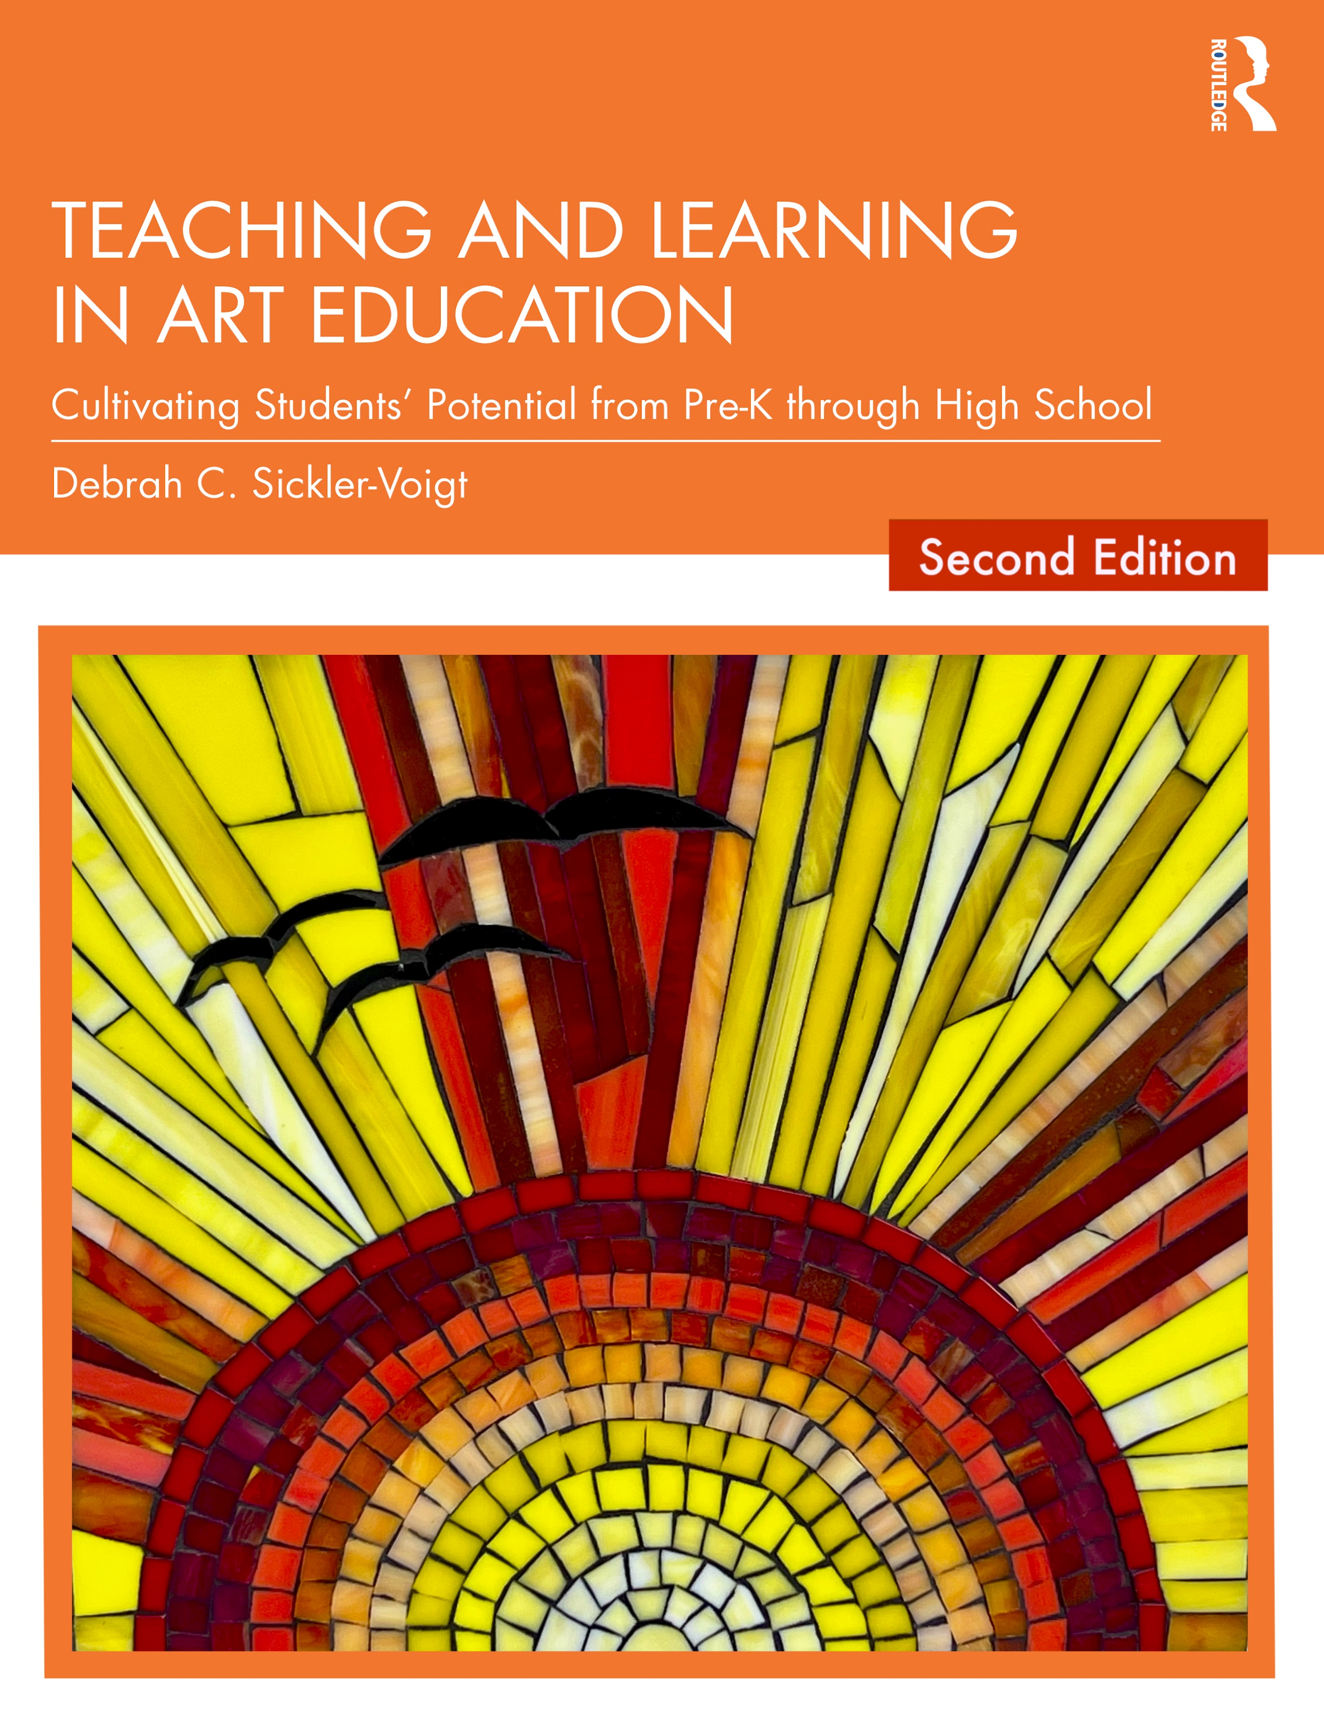
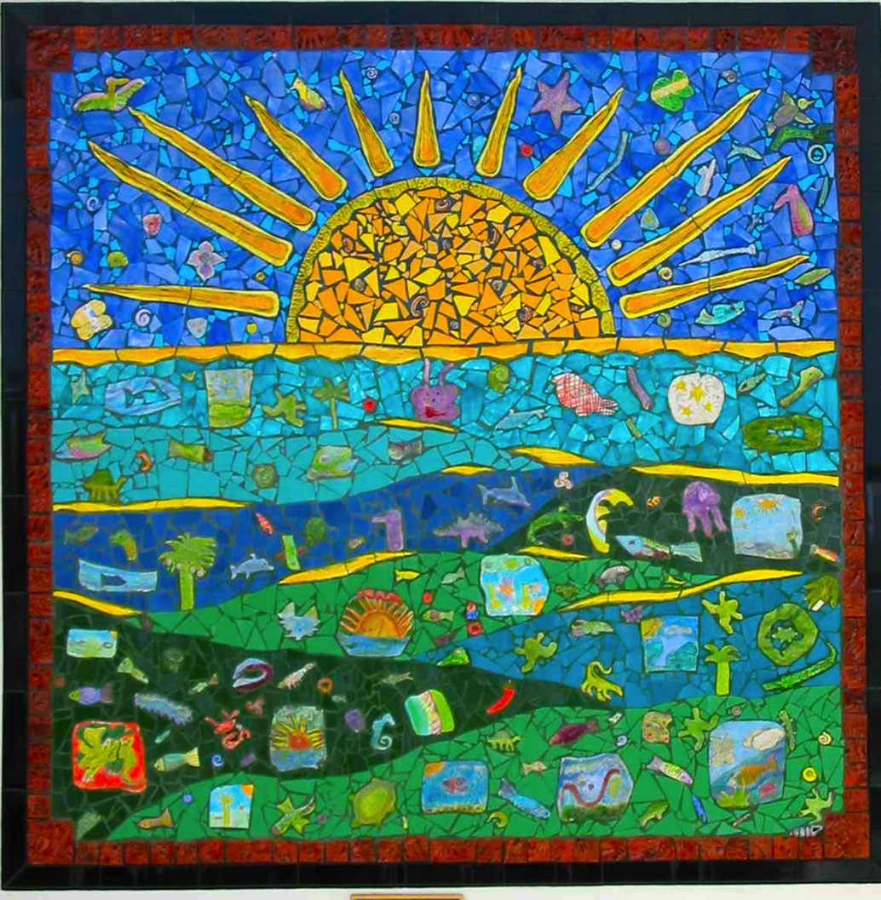
CHAPTER 6. Diversified Learners Teaching and Learning in Art Education, 2nd Ed.
Debrah C. Sickler-Voigt, Author & Presentation Developer ©
Notes:
Welcome to Teaching and Learning in Art Education, 2nd Edition, Chapter 6!
TLAE as a theoretically-based, practical textbook to prepare preservice educators for their teaching careers and to support in-service educators in improving their existing practices. Its timely second edition with its updated framework remains dedicated to assisting educators in all stages of their careers through effective curricular planning, instruction, assessment, and management to foster student learning and cultivate educators’ meaningful, creative, and rewarding careers.
This textbook and instructional resources resulted from the contributions of many individuals, including teachers, students, artists, organizations, family, mentors, and Routledge’s editorial/production team. Its teachings are based on the author’s research, communications, and professional interpretations of teachers, artists,’ and designers’ works with the aim of being respectful of diversified peoples and representing their teachings in a truthful and non-biased manner.
Book Cover Artwork: Paula Gale
Right Image: Collaborative K-8 project. USA. Carlos Alves and JC Carroll, artists-in-residence. United Arts Council of Collier County. (Cropped Detail)

Slide 2
Chapter 6 Topics
Gifted and Talented: Learners with High Abilities
Children with Disabilities
At-Promise Students
English Learners
LGBTQ+
Teaching and Accommodating Diversified Learners
Notes:
Spotlight on Student Art #6: Equality
Image: Collaborative K-8 project. USA. Carlos Alves and JC Carroll, artists-in-residence. United Arts Council of Collier County. (Cropped Detail)

Slide 3

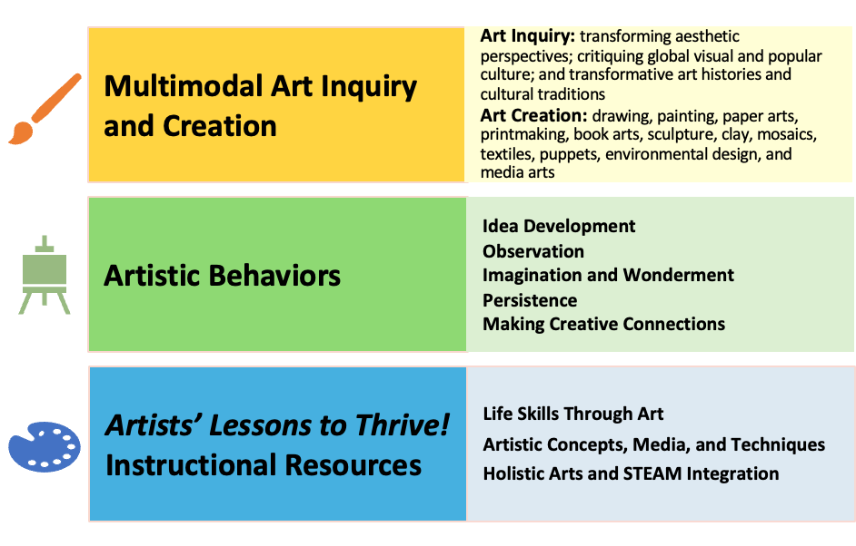
Link Chapter 6’s teachings with TLAE’s Transformative
Art Education Framework
Notes:
Class instruction: Ask students to build on prior learning and personal experiences to make personal connections between this chapter’s teachings and TLAE’s Transformative Art Education framework.
Book Cover Artwork: Paula Gale

Slide 4

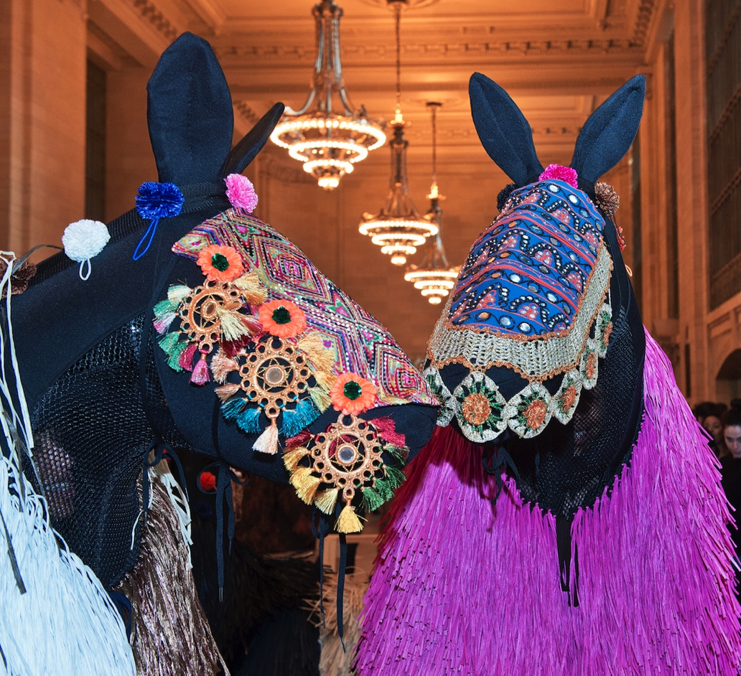
Diversified Learners 1
Diversified learners represent the wide variety of students teachers educate across our planet. As unique individuals, students have varying abilities and come from different cultural, racial, socioeconomic, and linguistic backgrounds.
Notes:
Image: Nick Cave. Heard-NY. Original Photo by Patrick Cashin. Image courtesy of Metropolitan Transportation Authority of the State of New York. Flickr, CC BY 2.0. https://creativecommons.org/licenses/by/2.0/

Slide 5

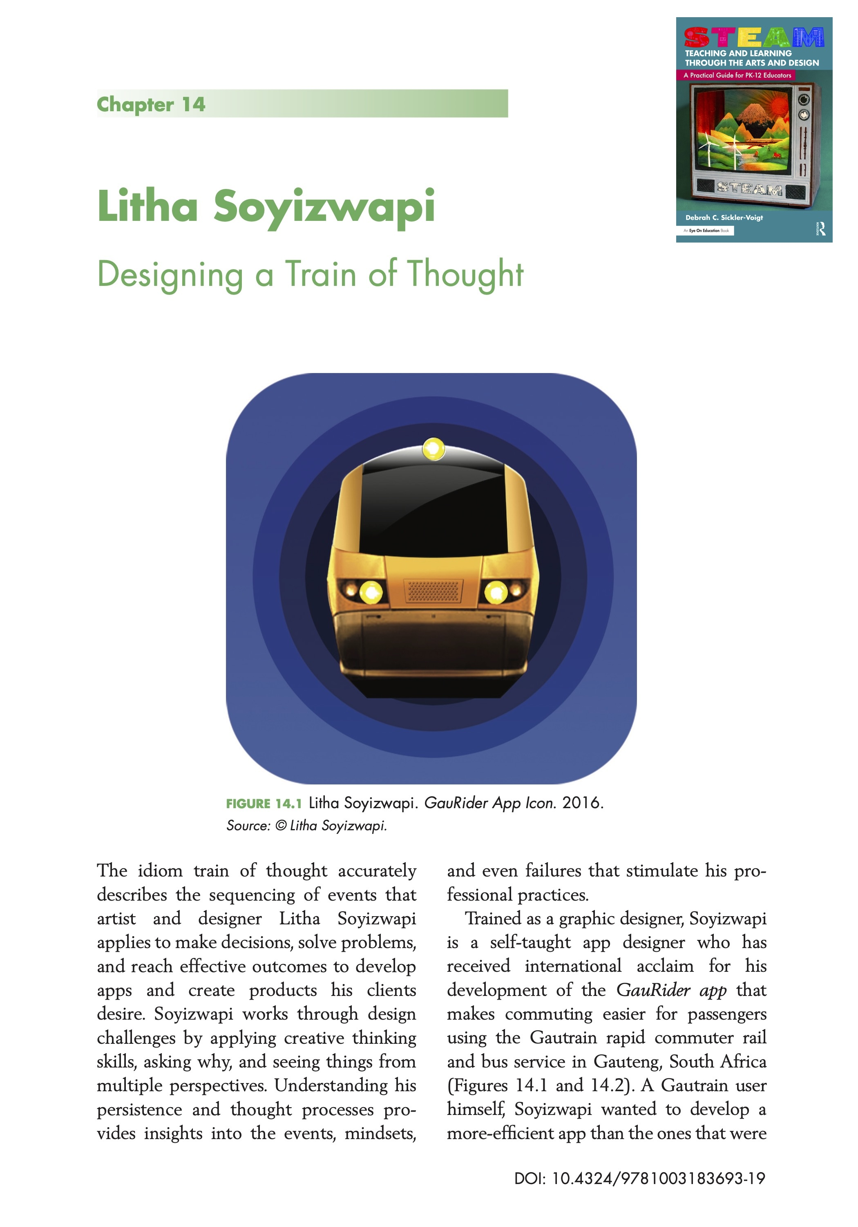
Diversified Learners 2
Self-efficacy describes students’ beliefs about their capabilities to produce effective results, overcome obstacles, rebound from setbacks, observe people like themselves succeed, and hear from someone else they can attain new skills.
Resiliency describes people’s abilities to succeed despite obstacles. Resilient students develop positive relationships with mentors, demonstrate agency, benefit from multisystem supports, and use creative skills to see alternatives to their current realities.
Notes:
Class instruction: Explain how artists like students are diverse. Educators can use their curriculum to teach students about artists who share similar backgrounds to themselves, their societal contributions, and how they overcame risk factors to produce art.
Image: This is an Artists’ Lessons to Thrive Chapter on Litha Soyizwapi in the book STEAM Teaching and Learning Through the Arts and Design: A Practical Guide for PK-12 Educators.
References:
Bandura, 1997
Masten et al., 2021

Slide 6
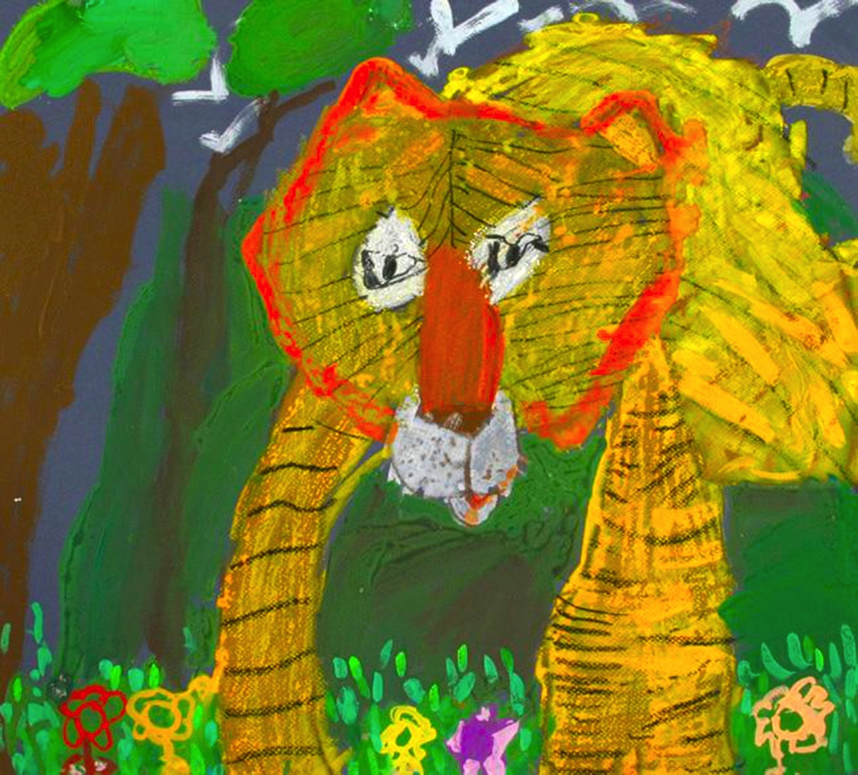
Gifted and Talented: Learners with High Abilities 1
Gifted and talented education provides students with the resources and learning environments necessary to excel at accelerated rates and depths of learning.
Notes:
Image: Lau Kin Gi, 4 years old, Simply Art, Hong Kong, China. 38th ICEFA Lidice.

Slide 7
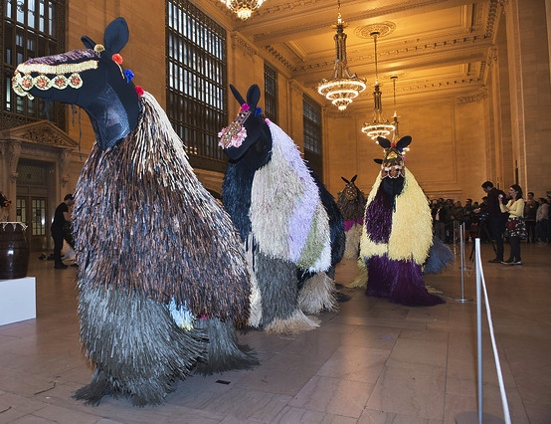
Gifted and Talented: Learners with High Abilities 2
Talent describes children’s propensities and above average accomplishments in disciplines including the visual arts.
Notes:
Image: Nick Cave. Heard-NY. Original Photo by Patrick Cashin. Image courtesy of Metropolitan Transportation Authority of the State of New York. Flickr, CC BY 2.0. https://creativecommons.org/licenses/by/2.0/

Slide 8

Gifted and Talented: Learners with High Abilities 4
“Students, children, or youth who give evidence of high achievement capability in areas such as intellectual, creative, artistic, or leadership capacity, or in specific academic fields, and who need services or activities not ordinarily provided by the school in order to fully develop those capabilities.” - US Congress
Notes:
Image: Stepánka Hlavatá (13 years), ZUS, Mseno, Czech Republic. 49th ICEFA Lidice
Reference:
U.S. Department of Education, 2002

Slide 9
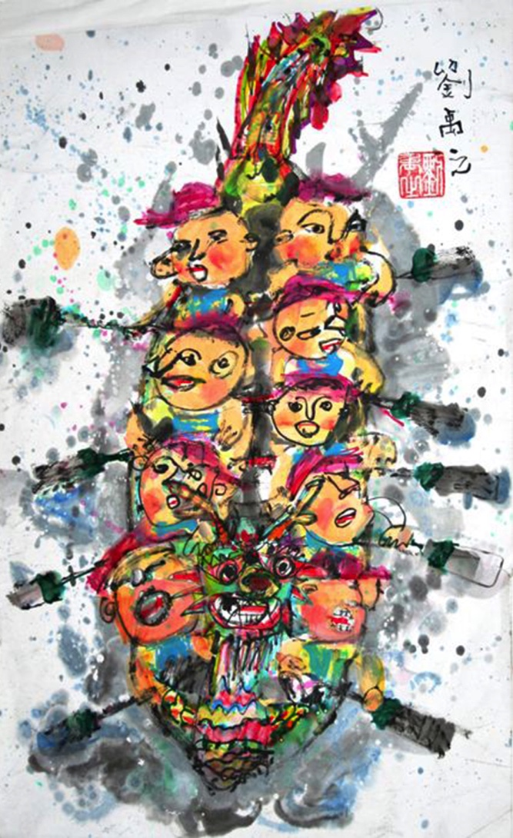
Gifted and Talented: Learners with High Abilities 5
Children identified as gifted and talented learn faster than same-aged peers and can apply learning content in greater depth.
Notes:
Image: Lau You Gi, 5 years old, Simply Art, Hong Kong, China. 41st ICEFA Lidice.

Slide 10
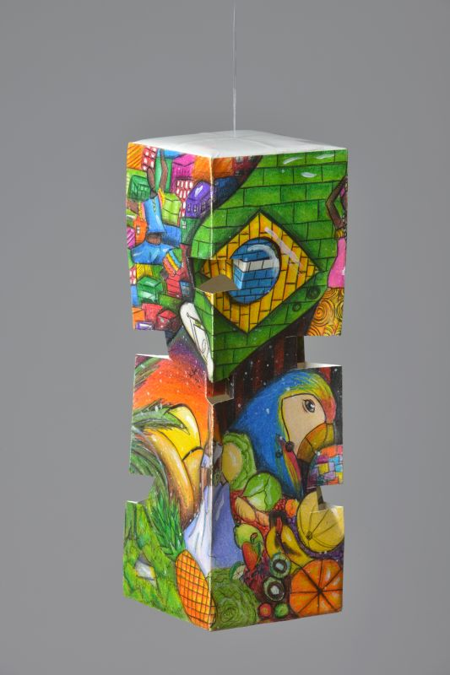
Gifted and Talented: Learners with High Abilities 6
Developing deep interests in the visual arts at young ages
Focusing on art projects longer than peers
Designing more complicated and innovative creations
Wanting to participate in extracurricular arts activities
Producing a larger body of works in a shorter time span than peers
Creating art journals and portfolios as learning resources
Having a keen ability to write and talk about art
Becoming motivated when working with talented peers
Seeing art professionals as role models
Notes:
Images: Helena Rodrigues Ribeiro, 12-years-old, Escola Municipal Dr. Augusto Glória, São João,Brazil. 51st ICEFA Lidice

Slide 11
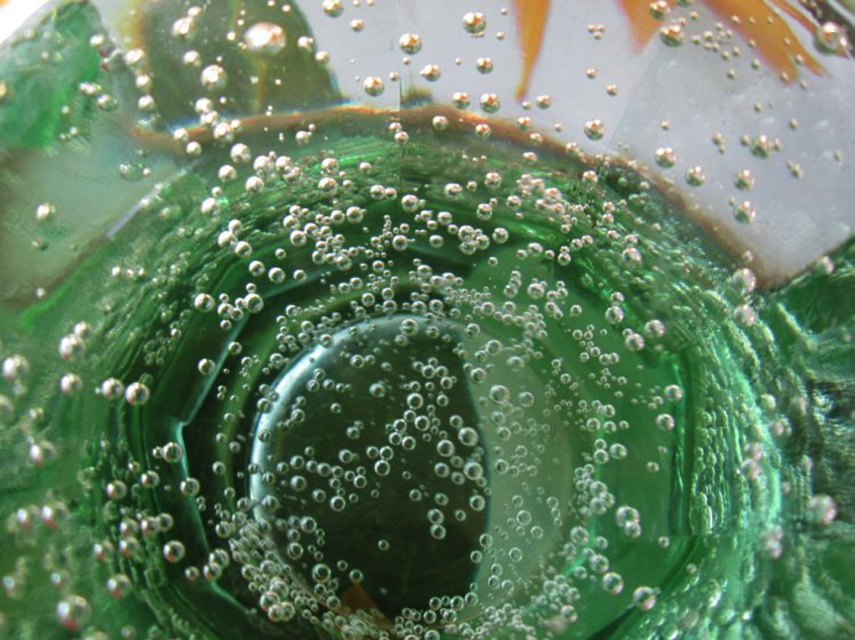
Gifted and Talented: Learners with High Abilities 7
Enrichment is the practice of providing students, who are gifted and talented, with experiences that reach beyond the scope of typical age-appropriate lessons.
Independent research on big ideas, artists, and methods
Extension activities related to lessons
Creations at learning centers with talented peers
Collaborations with mentors
Community art projects
Notes:
Image: Štěpánka Hlavatá, 7 years old, ZUŠ, Mšeno, Czech Republic. 43rd ICEFA Lidice.

Slide 12
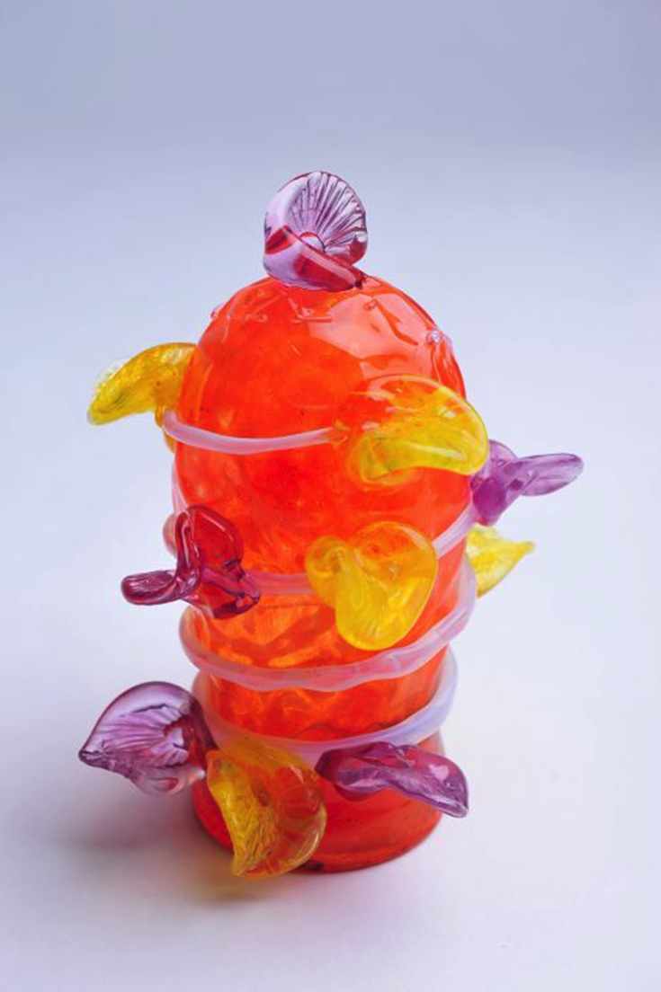
Gifted and Talented: Learners with High Abilities 8
Intelligence quotient (IQ) tests have a median score of intelligence set at 100 points. Individuals with an IQ score of 130 or more are classified as gifted.
Torrance Test of Creative Thinking measures a child’s mental characteristics including fluency, flexibility, originality, elaboration, resistance to premature closure, and abstractness of titles.
Notes:
Class instruction: Explain that Lewis Terman expanded Alfred Binet’s research to identify intellectually gifted children and adults.
Image: Václav Böhm, 8 years old, ZUŠ, Mšeno, Czech Republic. 42nd ICEFA Lidice.

Slide 13
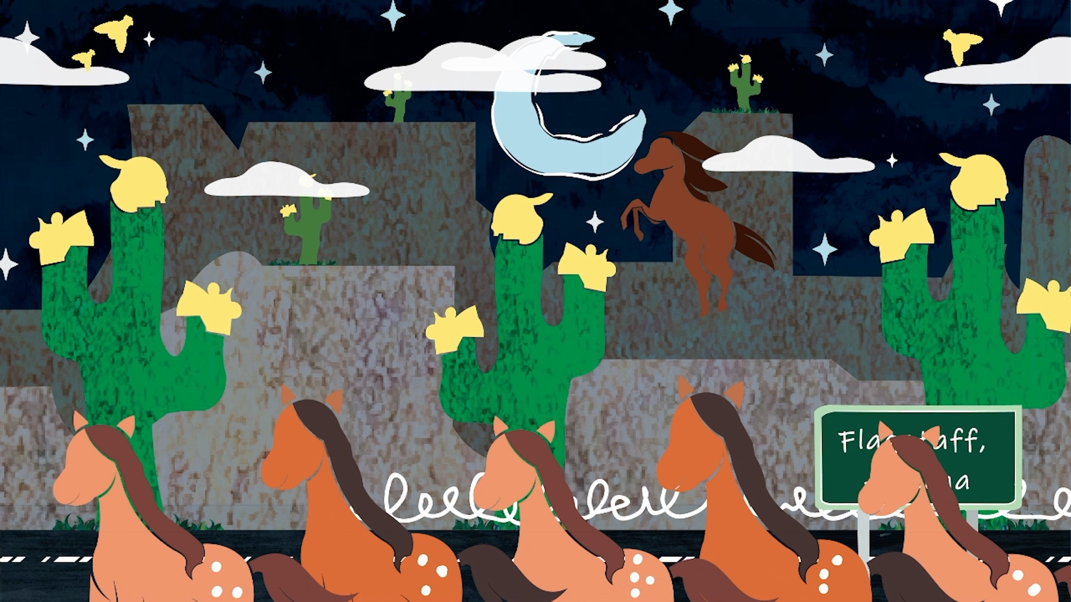
Gifted and Talented: Learners with High Abilities 9
TLAE’s TAE framework support equity by encouraging creativity, critical thinking, and student agency through interdisciplinary, arts-based learning.
Notes:
Image: This is a scene from the stop motion animation Route 66 Cross Country Road Trip. USA. Source: Author, Monica Leister, Amber Buck, and Joshua Harper.

Slide 14
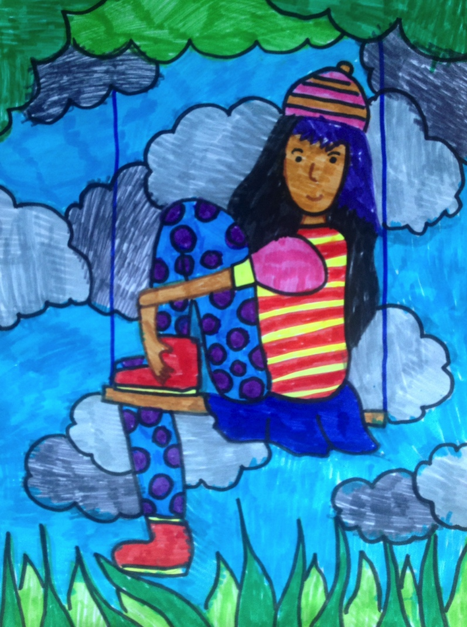
Gifted and Talented: Learners with High Abilities 10
Giftedness and talent belong to all cultures, genders, and classes.
Students’ may be unnoticed if school faculty and administration focus solely on children’s achievements and productivity.
Notes:
Class instruction: Explain the following about students who are gifted:
Girls, low-income students, and those from racially, ethnically, and linguistically diverse backgrounds often remain unidentified.
Early academic gaps in language arts and math contribute to underidentification, making early intervention in the first three years of school essential.
Creative abilities are often missed when schools focus only on academic performance; social and environmental factors can cause gifted students to hide their talents or underachieve.
Image: Khushi Malde, 14 years old. Kenya. Lisa Wee, teacher.

Slide 15
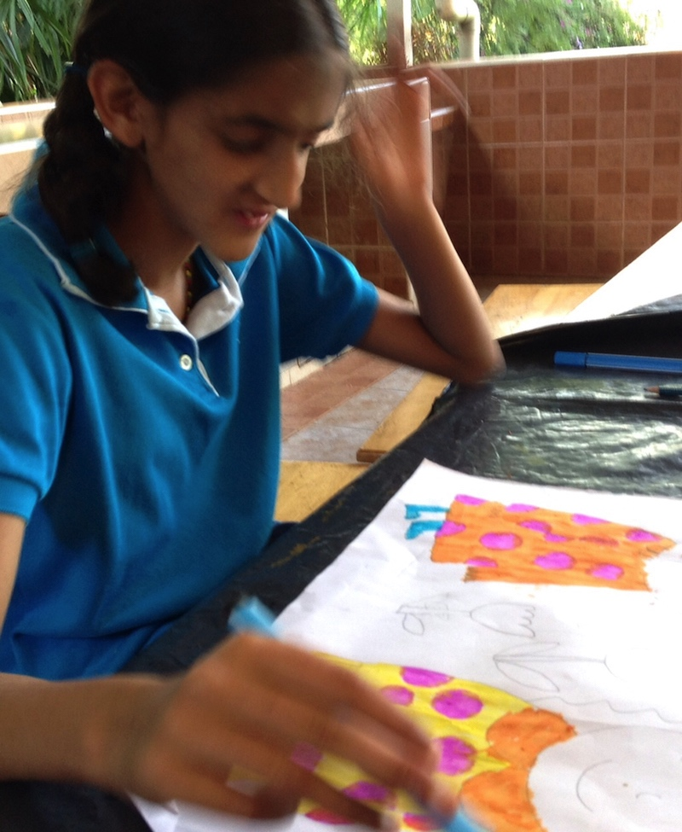
Gifted and Talented: Learners with High Abilities 11
Students who are gifted or talented and also identified with having a disability are referred to as twice exceptional.
Notes:
Image: Khushi Malde, 14 years old. Kenya. Lisa Wee, teacher.

Slide 16
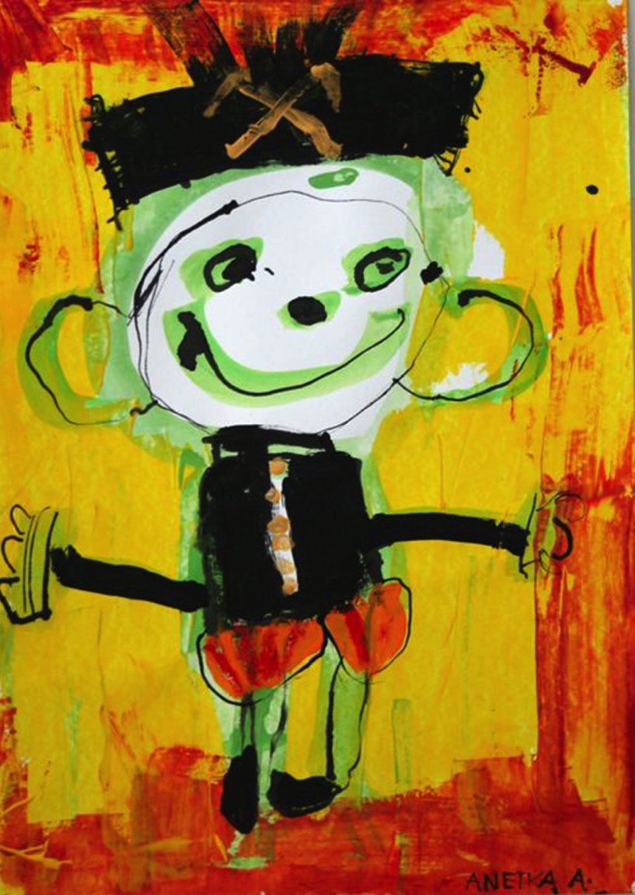
Children with Disabilities 1
The term children with disabilities applies to students who have been diagnosed with a disability, multiple disabilities, or an exceptional circumstance.
249 million children and adolescents have a disability.
15% of the school population has a disability. The severity varies from student to student.
Notes:
Class instruction: Explain to the class that most teachers teach students with disabilities.
Image: Aneta Ampapová, 4 years old, MŠ a spec. pedagog. centrum, Jihlava, Czech Republic. 41st ICEFA Lidice.

Slide 17

Children with Disabilities 2
The U.S. Congress
Intellectual Disability
Hearing Impairment (Including Deafness)
Speech or Language Impairment
Visual Impairment (Including Blindness)
Serious Emotional Disturbance
Orthopedic Impairment
Other Health Impairment
Specific Learning Disability
Deaf-Blindness
Multiple Disabilities
Traumatic Brain Injury
Autism
Notes:
Image: Disability symbols 16.png: NPS Graphics, put together by WcommonsPictograms-nps-accessibility-wheelchair-accessible.svg: NPS Graphics, converted by ZyMOSPictograms-nps-accessibility-low vision access.svg: NPS Graphics, converted by ZyMOSPictograms-nps-accessibility-sign language interpretation.svg: NPS Graphics, converted by ZyMOSAutismbrain.jpg: National Institutes of Mental Health, National Institutes of Healthderivative work: Hamiltonham, Public domain, via Wikimedia Commons

Slide 18
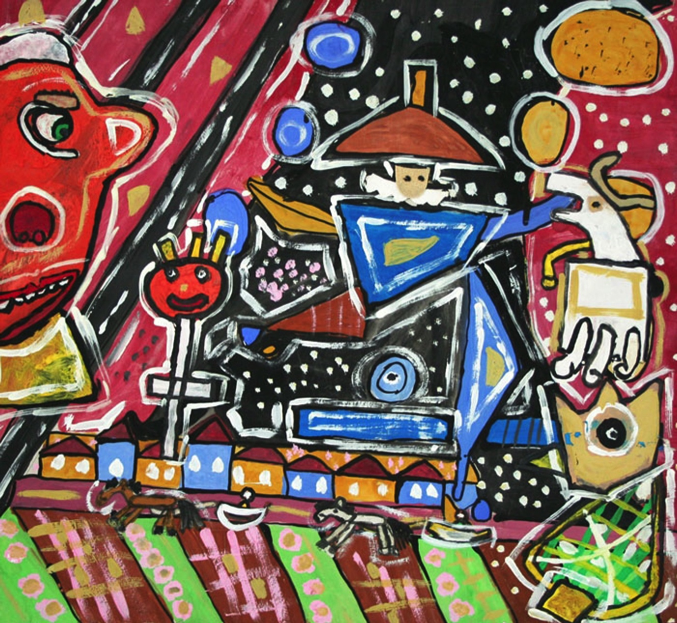
Children with Disabilities 3
Disabilities are a universal part of the human experience, not an exception. All people have the potential for developing a disability at some point in their lives.
A population that views disability as a regular part of the human experience is better prepared to advocate for all human’s equal rights as valuable members of society.
Notes:
Image: Ján Bartoš, 16 years old, Špeciálna ZŠ internátna, Topoľčany, Slovak Republic. 40th ICEFA Lidice.

Slide 19
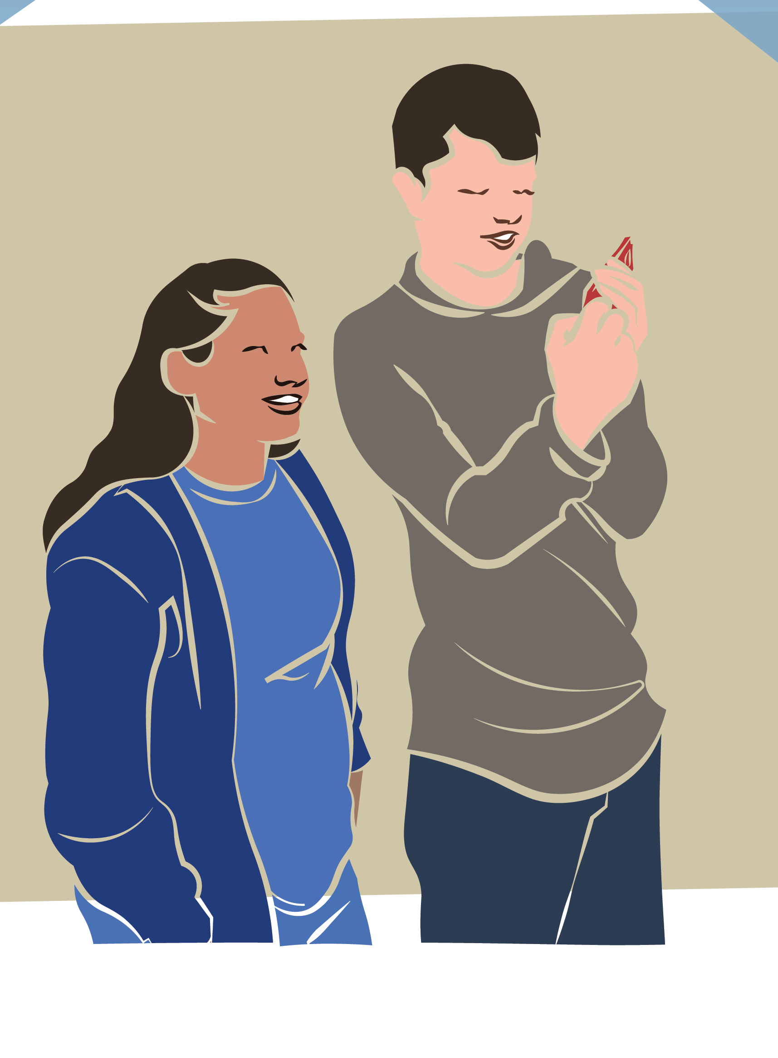
Children with Disabilities 4
UNICEF’s (2021) biopsychosocial approach to disability recognizes the intersections of biology, psychology, and social factors shape disability.
Its multidimensional perspective identifies students’ abilities to function and participate equally given necessary resources and accommodations.
It differs from perceiving disability as medical diagnoses with related impairments and limitations.
Notes:
Image: This is a selfie scene for the stop motion animation Route 66 Cross Country Road Trip. USA. Source: Author, Monica Leister, Amber Buck, and Joshua Harper.
Reference:
UNICEF, 2021

Slide 20
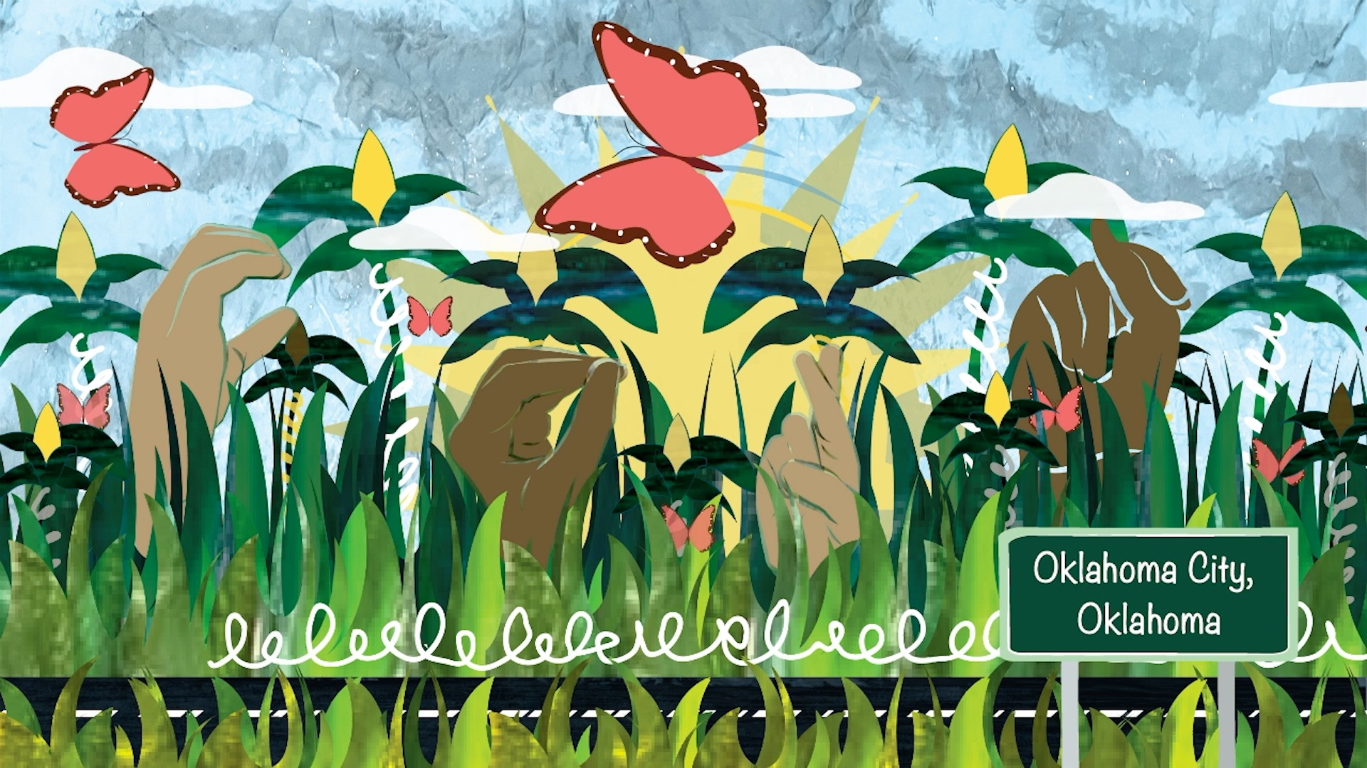
Children with Disabilities 5
In 1975, U.S. Congress passed Public Law 94-142 titled Education for All Handicapped Children Act. It became the Individuals with Disabilities Education Act (IDEA) in 1990.
In the United States, IDEA serves approximately 7 million children with educational institutions providing children with services to obtain a free, appropriate, public education (FAPE).
Notes:
Class instruction: Introduce students to the Definitions of Disability Terms from the Individuals with Disabilities Educational Improvement Act. Sec. 300.8. (c). These definitions are available on this textbook’s website.
Image: This is a scene from the stop motion animation Route 66 Cross Country Road Trip. USA. Source: Author, Monica Leister, Amber Buck, and Joshua Harper.

Slide 21

Children with Disabilities 6
Specific Learning Disability, 35%
Speech or Language Impairment, 21%
Other Health Impairment, 12%
Autism, 8%
Intellectual Delay, 6%
Emotional/Behavioral Disability, 6%
Multiple Disabilities, 2%
Hearing Impairments, 1% or Less
Orthopedic Impairments, 1% or Less
Deaf-Blindness, 1% or Less
Traumatic Brain Injury, 1% or Less
Visual Impairments 1% or Less
Notes:
Image: https://openclipart.org/download/222000/Crayons.svg

Slide 22
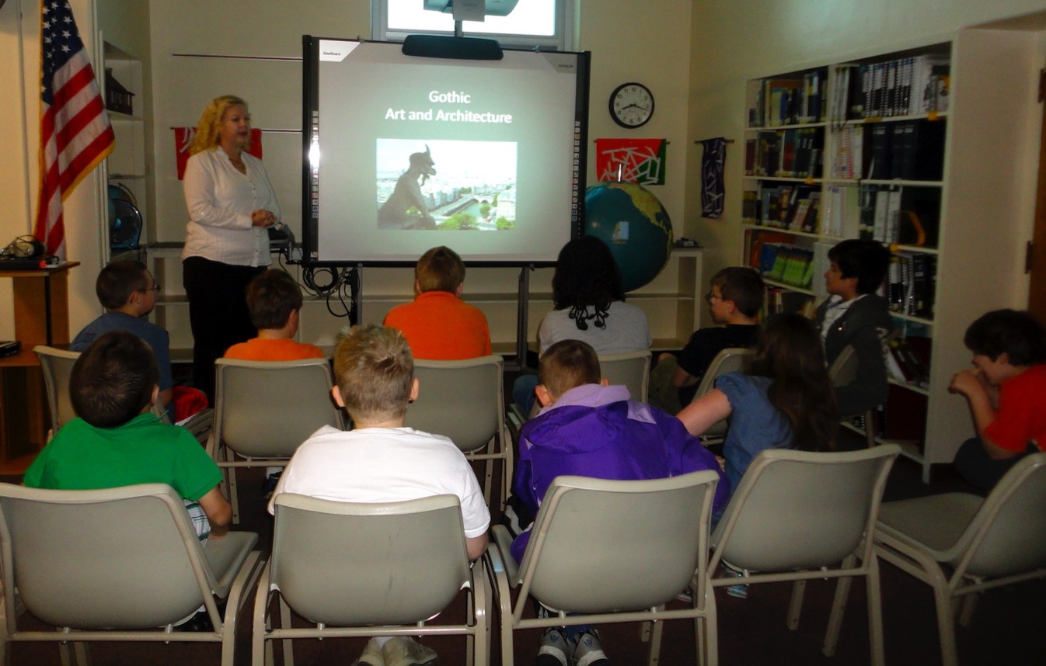
Children with Disabilities 7
IDEA mandates that learning takes place in the least restrictive environment: the most appropriate educational setting to accommodate students’ needs.
95% of students attend regular schools. 5% of students attend specialized schools or at home, a residential center, a hospital facility, or a correctional institution.
Notes:
Class instruction: Explain to the class that a child’s least restrictive environment might be a specialized school or care facility with services not available in typical schools.
Image: Art teacher Monica Leister presents a lesson to her students. USA.

Slide 23
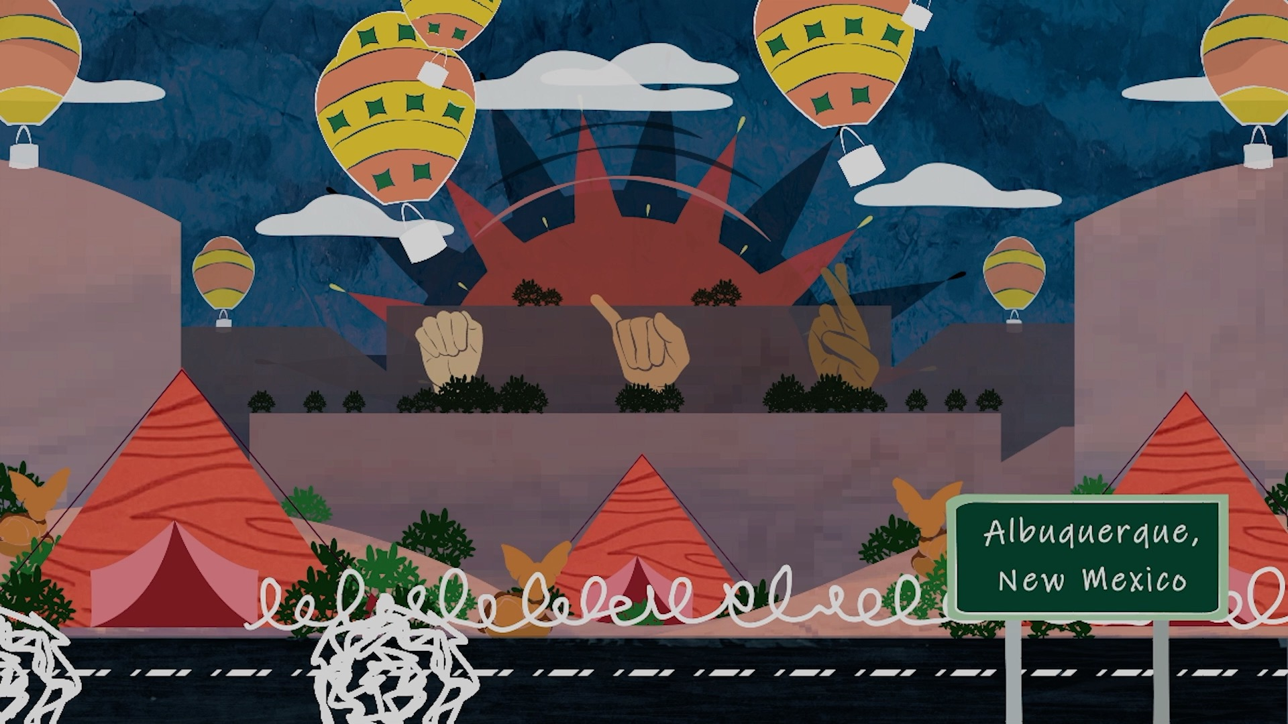
Children with Disabilities 8
IDEA requires that students with disabilities receive an instructional plan to determine how they can best reach learning objectives in all subjects of study through an IEP.
An individualized education program (IEP): is “a written statement for each child with a disability that is developed, reviewed, and revised in accordance with” the law.
Notes:
Class instruction: Explain to the class that a group of experts, called an IEP team, assesses children’s educational needs and abilities at regular intervals.
Image: This is a scene from the stop motion animation Route 66 Cross Country Road Trip. USA. Source: Author, Monica Leister, Amber Buck, and Joshua Harper.

Slide 24
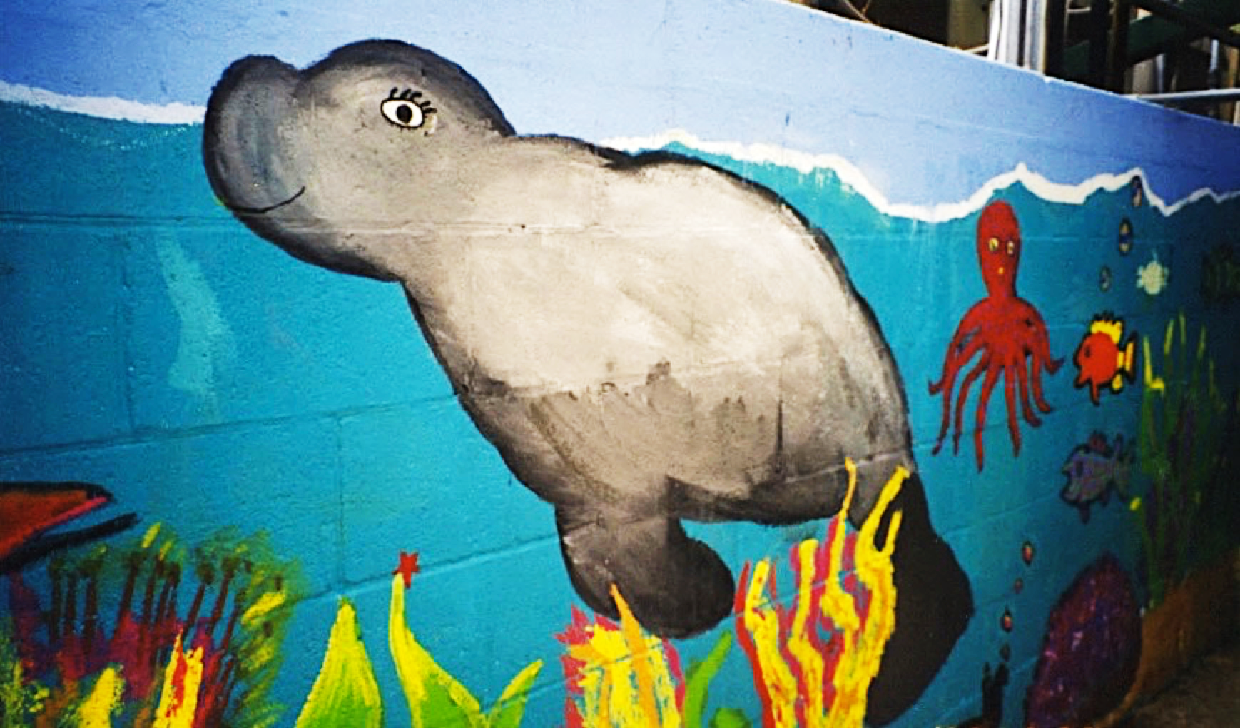
Children with Disabilities 9
The IEP Team:
Assesses children’s educational needs and abilities.
Listens to parents’ input and concerns.
Analyzes teacher observations and anecdotal information.
Reviews recent student evaluations.
Keeps parents informed.
Seeks parental consent when making decisions.
Develops an IEP to identifies actions and resources students need.
Reassesses the IEP and make further accommodations as necessary.
Notes:
Image: Florida Arts and Community Enrichment, USA, Jill Harper, Director.

Slide 25
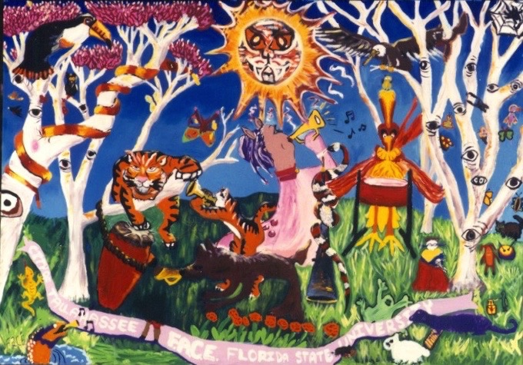
Children with Disabilities 9
Parents can request procedural due process, a legal safeguard to mediate IEP differences.
Notes:
Class instruction: Explain to the class that parents will receive notice of any changes to the child’s IEP in language they can understand.
Image: Florida Arts and Community Enrichment, USA, Jill Harper, Director.

Slide 26
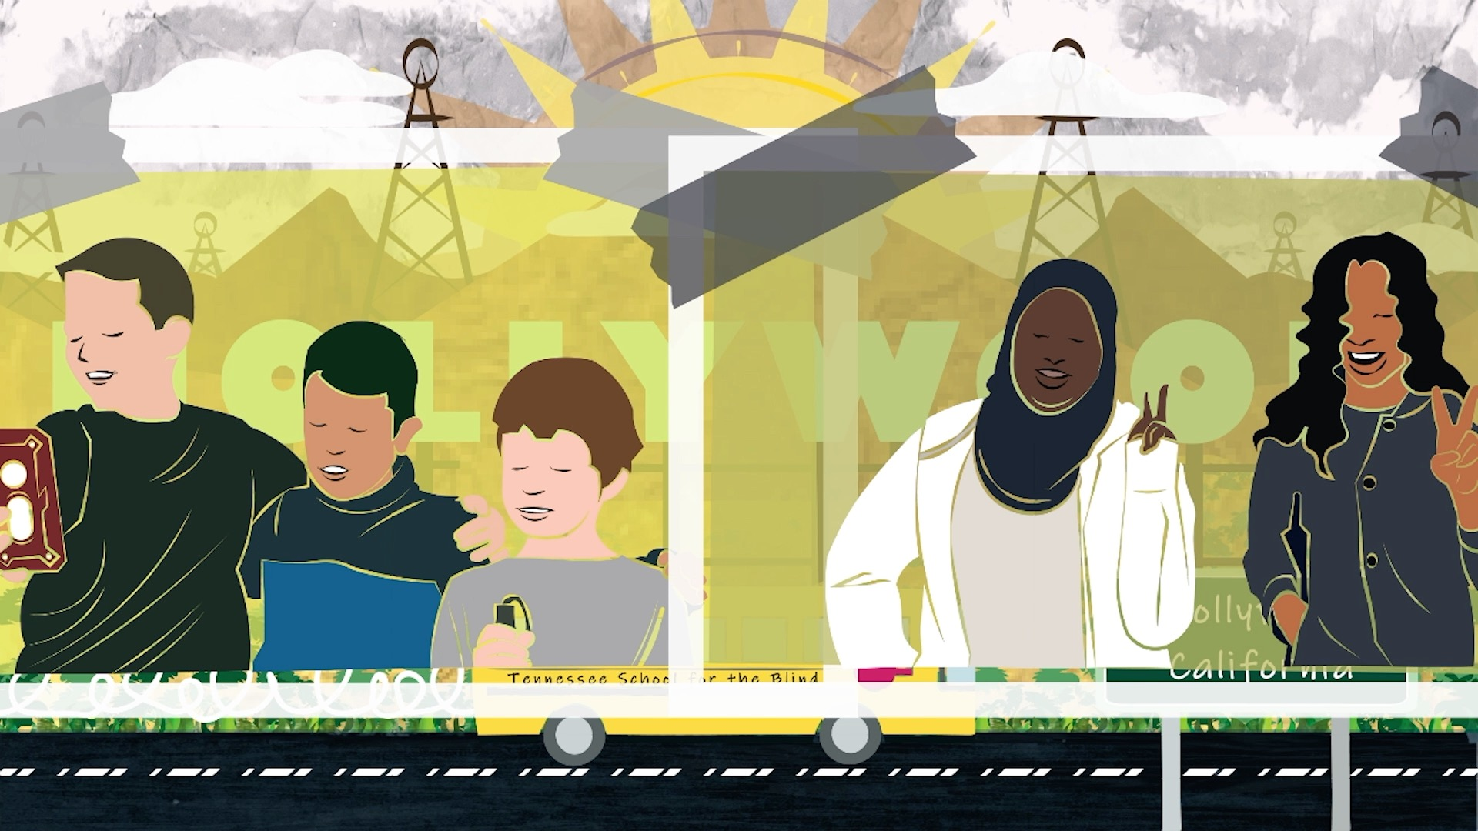
Section 504 of the Rehabilitation Act of 1973 Children with Disabilities
“A student must be determined to: (1) have a physical or mental impairment that substantially limits one or more major life activities; or (2) have a record of such an impairment; or (3) be regarded as having such an impairment” (U.S. Department of Education, 2023, #10).
Section 504 does not distribute funds for students with disabilities or identify specific disabilities.
Notes:
Image: This is a scene from the stop motion animation Route 66 Cross Country Road Trip. USA. Source: Author, Monica Leister, Amber Buck, and Joshua Harper.

Slide 27
Children with Disabilities 10
Students with disabilities who attend regular schools spend approximately 80% of their school day in classes shared with students without disabilities.
Students with disabilities may also learn part or full time in a resource classroom with a qualified resource teacher who delivers instruction.
Notes:
Class instruction: Explain to the class that students with disabilities may require the assistance of a teacher aid in the general classroom or benefit from supplementary learning opportunities, such as tutoring.
Image: Collaborative K-8 project. USA. Carlos Alves and JC Carroll, artists-in-residence. United Arts Council of Collier County.

Slide 28

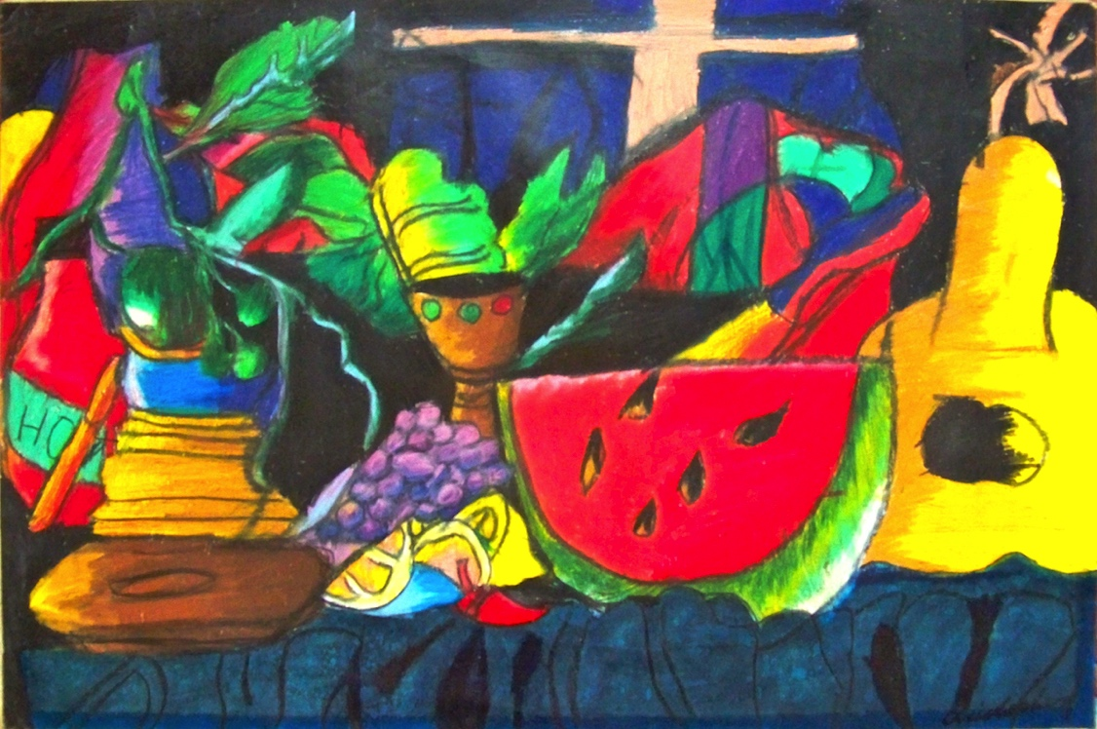
At-Promise Students 1
At-promise are students who are more likely to drop out of school. They belong to all racial groups and live in big cities, rural communities, and in the suburbs.
Notes:
Class instruction: Explain that the term at-promise identifies students’ capabilities and the need to provide supports to mitigate the risks potentially hindering their academic success.
Image: Christopher Williams, 5th Grade, USA. Author, teacher.

Slide 29

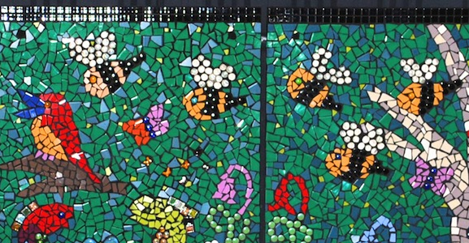
At-Promise Students 2
Quality Education
Nutritious Foods
Healthcare
Affordable Housing
Sanitation
Clean Water
School Supplies
Spiritual/
Emotional Well-Being
Poverty is a multidimensional deprivation that extends beyond material resources and contributes to risk factors. Individuals have limited access to basic human needs.
Notes:
Image: Group project with Kindergarten students, Australia. Courtesy of the artist, Julee Latimer ©. www.juleelatimer.com

Slide 30

At-Promise Students 3
Students who read below grade level have limited or only partial knowledge of the reading skills they need and face greater academic risks.
When children cannot read at grade level by the end of 3rd grade, they will most likely continue to read below grade level.
Notes:
Image: Jana Růžičková, 11 years old, ZUŠ, Pelhřimov, Czech Republic, 44th ICEFA Lidice.

Slide 31
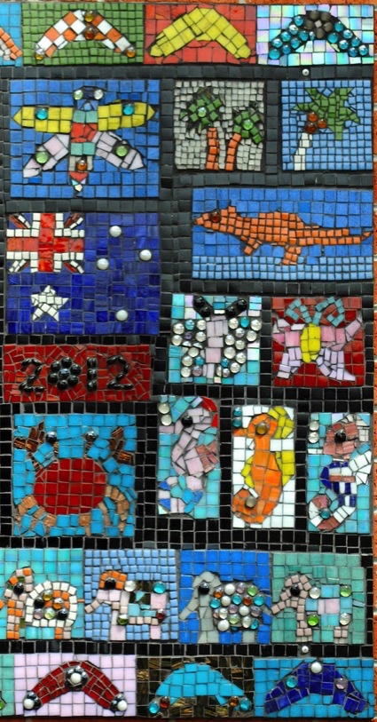
At-Promise Students 4
Students’ risk factors increase with absences, especially unexcused ones.
Physical and/or chronic illnesses can affect student learning and attendance.
Some parents prevent their children from attending school.
Some students fear school commutes.
Notes:
Image: 8-and-9-year-old students, Australia. Courtesy of the artist, Julee Latimer ©. www.juleelatimer.com

Slide 32

At-Promise Students 5
Truancy is an unexcused absence from school. It can be punishable by law.
Delinquency includes negative social behaviors such as acting out, gang involvement, committing violent offenses, and participating in illegal behaviors.
Notes:
Class instruction: Explain to the class that children and adolescents who have greater feelings of rejection, poor grades, and lack of support from their parents are more likely to become truant. Truancy can lead to delinquency.
Image: This is a scene from the stop motion animation Route 66 Cross Country Road Trip. USA. Source: Author, Monica Leister, Amber Buck, and Joshua Harper.

Slide 33


At-Promise Students 6
School-based resources support students’ access to healthcare, meals, social services, and/or laundry facilities.
Teachers and school staff’s personalized text messages, postcards, and home visits offer families helpful information, including students’ quantities of missed school days and missed assignments.
Notes:
Image: https://openclipart.org/download/37279/mail.svg
https://openclipart.org/download/204996/pen-uliphant-remix-monsterBraingames.svg

Slide 34
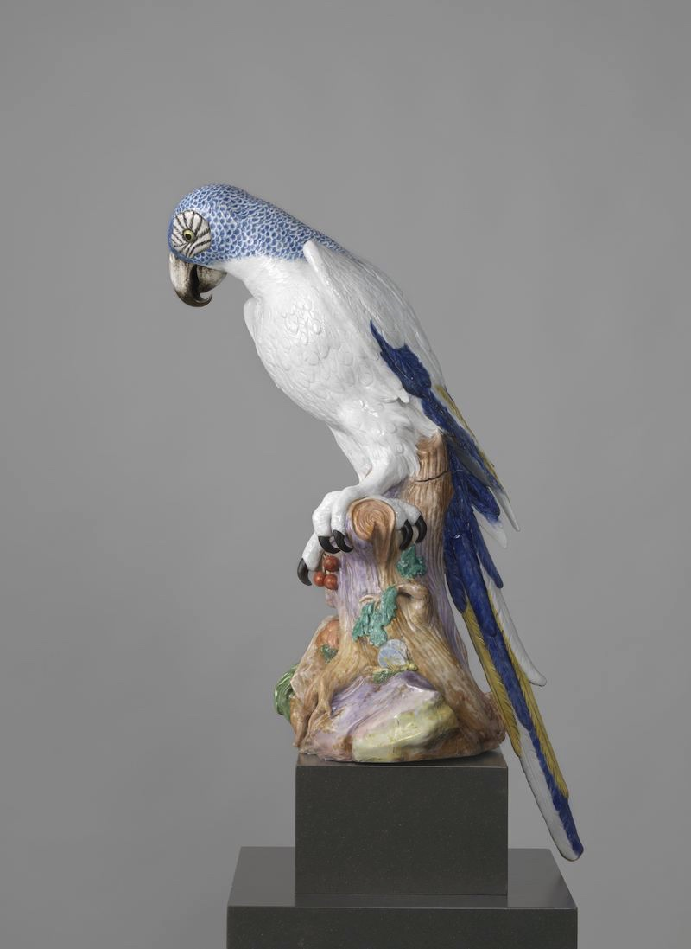
At-Promise Students 7
Adverse childhood experiences (ACEs) result from traumatic experiences impacting students’ cognitive and social-emotional well-being due to neglect, abuse, violence, and grief/
Traumas include family, historical, medical, racial, and refugee and immigrant traumas, as well as poverty, natural and human-caused disasters; and community and school violence.
Notes:
Image: Blue Macaw, Meissener Porzellan Manufaktur, 1731 porcelain (material), h 82.0cm. Public Domain, Rijksmuseums. http://hdl.handle.net/10934/RM0001.COLLECT.315407
References:
Guarino & Chagnon, 2018
United Nation’s Children Fund, 2021

Slide 35
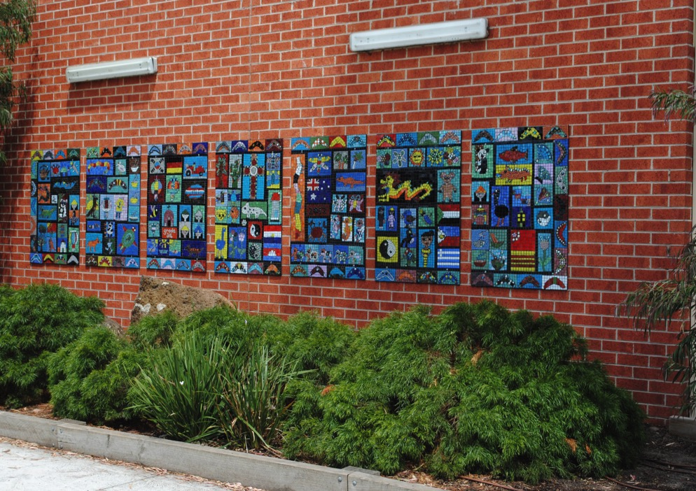
English Learners 1
English learners (ELs) are children living in English speaking countries who are learning to speak English.
Globally, 40% of students learn in a language they do not understand, which can result in learning barriers and academic hindrances.
Notes:
Class instruction: Explain to the class the definition for English learners differs from children learning English as a foreign language in their native countries. ELs belong to diverse cultures, ethnicities, religions, and socioeconomic backgrounds. They may be born in English- or non-English speaking countries. Their parents may or may not be fluent in English.
Image: 8-and-9-year-old students, Australia. Courtesy of the artist, Julee Latimer ©. www.juleelatimer.com
Reference:
UNESCO, 2023

Slide 36
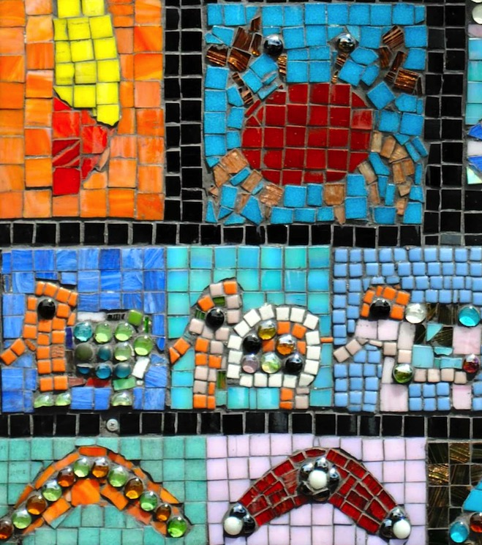
English Learners 2
Congress passed the English Language Acquisition, Language Enhancement, and Academic Achievement Act so that ELs receive a quality education.
Students typically spend 2-3 years in specialized language programming.
Notes:
Class instruction: Explain to the class that schools test ELs to determine yearly progress in reading, writing, speaking, and listening to English. Classes may be taught by ELs specialists.
Image: 8-and-9-year-old students, Australia. Courtesy of the artist, Julee Latimer ©. www.juleelatimer.com

Slide 37
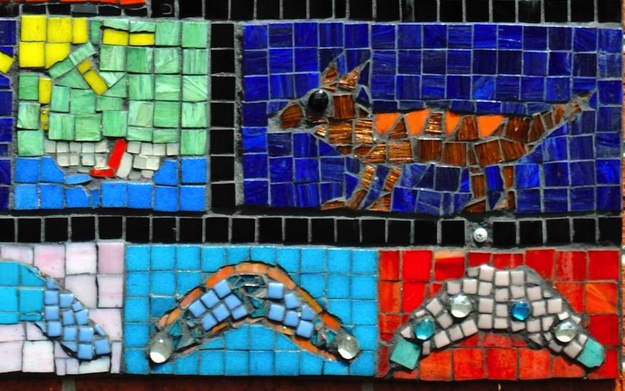
English Learners 3
ELs require 5-7 years to become completely fluent in English. They are typically two academic years behind same-aged peers.
UNESCO advocates for young EL learners to receive at least six years of bilingual education, including cultural instruction.
Notes:
Class instruction: Explain to the class that language barriers may cause children to repeat grades and lead to dropping out of school.
Image: 8-and-9-year-old students, Australia. Courtesy of the artist, Julee Latimer ©. www.juleelatimer.com
Reference:
UNESCO, 2023

Slide 38

English Learners 4
Bilingualism offers students many rewards, including developing flexible and abstract thinking patterns and gaining career advantages given their multilingual communication skills.
ELs who have had interruptions in their education often struggle with reading, writing, and formal speaking in their native languages.
Notes:
Class instruction: Explain the following:
Some ELs fled their native homes as refugees and unaccompanied minors. They may have experienced ACEs and many newly immigrated ELs live in poverty.
Schools may unintentionally hinder their academic success by denying access to advanced courses until they are fully proficient in English.
Language barriers can also mask giftedness. Arts and physical education teachers are often the first educators to recognize ELs’ giftedness given their disciplines’ specialized knowledge forms.
Image: https://commons.wikimedia.org/wiki/File:MUTCD-OH_D5-H20.svg Public Domain
References:
Brulles, 2021
Gottschalk, 2020
U.S. Department of Education, 2017
U.S. Department of Health and Human Services, 2023

Slide 39
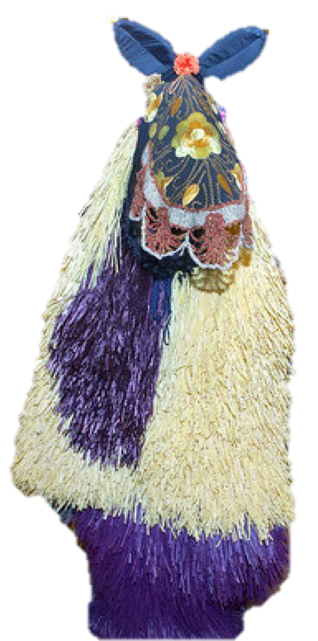
LGBTQ+ 1
LGBTQ+ identifies lesbian, gay, bisexual, transgendered, queer students. It encompasses intersex, agender, bigender, nonbinary, gender fluid, questioning, asexual, and two-spirit.
They have diverse backgrounds and abilities. Like all students, they can contribute positively to their schools and communities, supporting important causes and helping others through their leadership, service, and creativity.
Notes:
Class instruction: Explain to the class that LGBTQ+ risk factors are significantly reduced when students have the support of school policies, teachers, parents, and peers. Educators should teach all students about human rights and the resiliency of diversified populations.
Image: Nick Cave. Heard-NY. Original Photo by Patrick Cashin. Image courtesy of Metropolitan Transportation Authority of the State of New York. Flickr, CC BY 2.0. https://creativecommons.org/licenses/by/2.0/ (Cropped & Background removed)

Slide 40
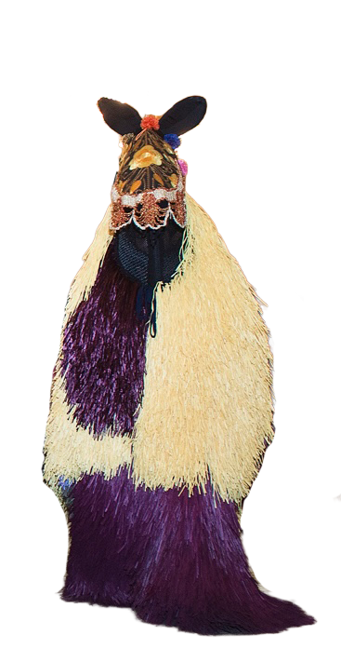
LGBTQ+ 2
Students are part of a minority population. They can experience greater harassment, bullying, and suicide risks.
Those who feel safe at school experience greater academic achievement and have access to communal supports, like Gay-Straight Alliances/Gender and Sexuality Alliances (GSA).
Over 80% feel unsafe having experienced harassment or assault at school.
Notes:
Image: Nick Cave. Heard-NY. Original Photo by Patrick Cashin. Image courtesy of Metropolitan Transportation Authority of the State of New York. Flickr, CC BY 2.0. https://creativecommons.org/licenses/by/2.0/ (Cropped & Background removed)

Slide 41
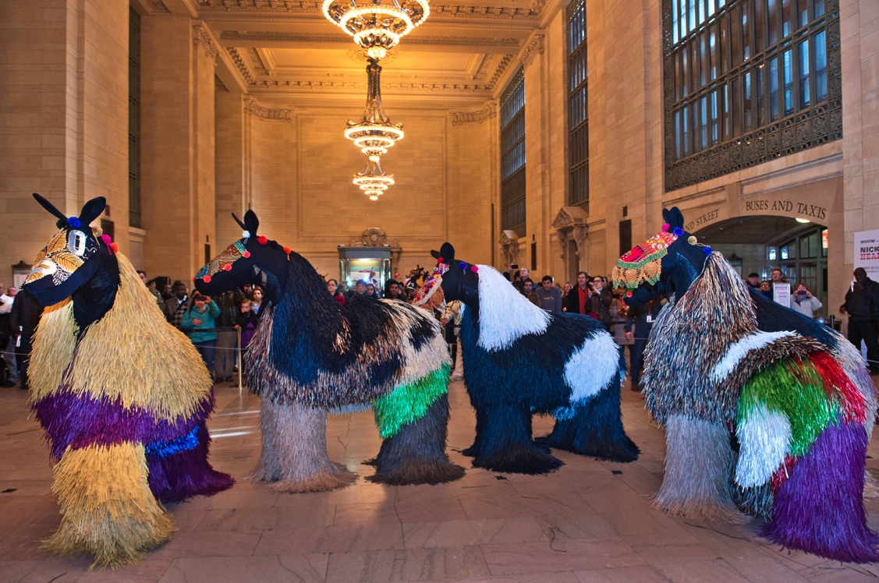
LGBTQ+ 3
Several communities have developed supportive LGBTQ+ laws and policies. Teachers sponsor an LGBTQ+ club.
Other communities have restricted LGBTQ+ civil rights by prohibiting inclusive curricula, books, identity expressions, participation in sports and clubs, and facility access.
Teach the contributions of LGBTQ+ artists.
Notes:
Class instruction: Best teaching practices invite educators to utilize age-appropriate topics in social justice and ethics to teach about fairness and equity for all. While some educators can openly teach the contributions of LGBTQ+ artists, some policies have restricted LGBTQ+ civil rights by prohibiting inclusive curricula, books, identity expressions (gender affirming choices, dress codes, pronoun choices, names), participation in sports and clubs, and facility access (GLSEN, 2024). School policies and laws regarding LGBTQ+’s civil rights may fluctuate as they are decided in courts and shaped by politics.
Image: Nick Cave. Heard-NY. Original Photo by Patrick Cashin. Image courtesy of Metropolitan Transportation Authority of the State of New York. Flickr, CC BY 2.0. https://creativecommons.org/licenses/by/2.0/
Reference:
GLSEN, 2024

Slide 42
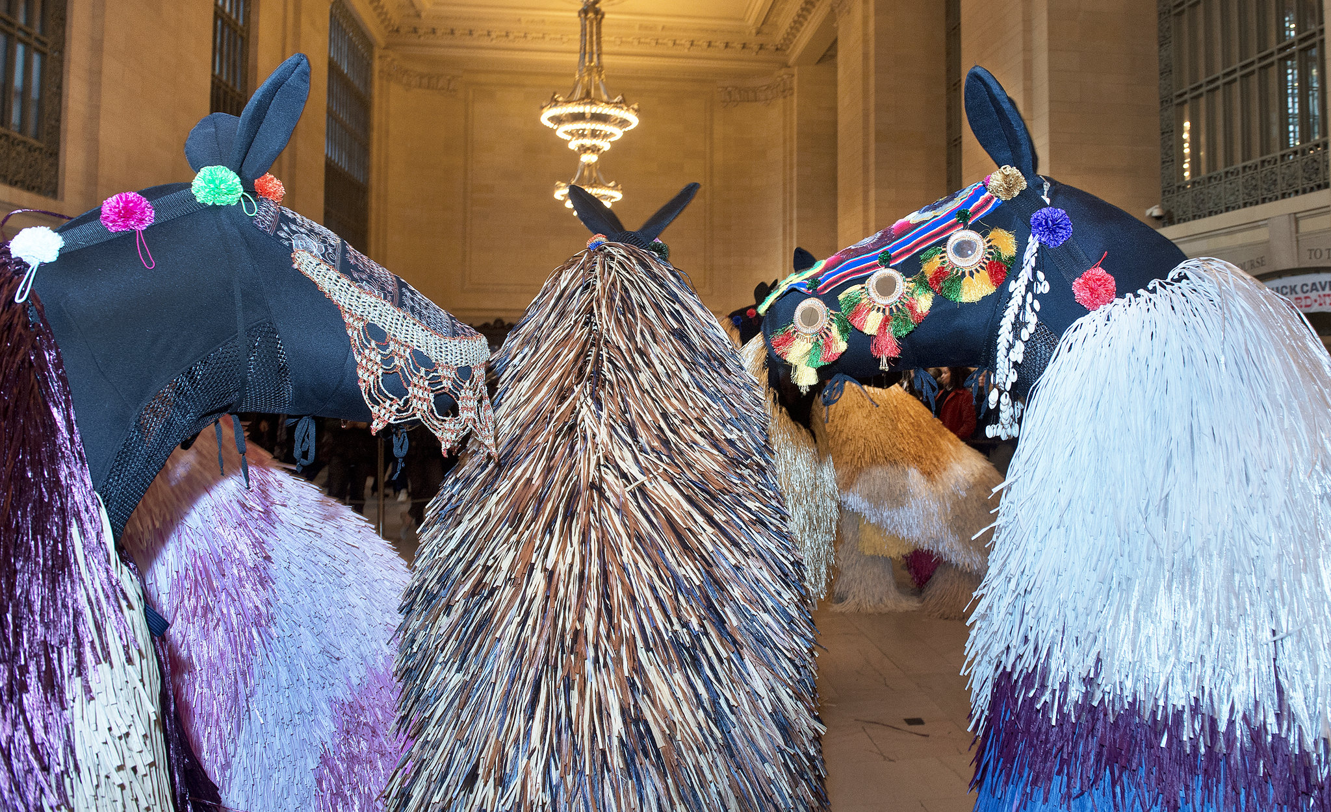
LGBTQ+ 4
In communities prohibiting LGBTQ+ curricular content, the TAC can continue to teach life skills through art and age-appropriate subject matter, fostering healthier, happier, and more productive lives, including students forming healthy (loving) relationships, students treating themselves and others kindly, and respecting their own and others’ minds and bodies.
Notes:
Class instruction: Discuss the following with the class:
In communities prohibiting LGBTQ+ curricular content, the transformative art curriculum can continue to teach life skills through art and age-appropriate subject matter, fostering healthier, happier, and more productive lives, including students forming healthy (loving) relationships, students treating themselves and others kindly, and respecting their own and others’ minds and bodies.
Image: Nick Cave. Heard-NY. Original Photo by Patrick Cashin. Image courtesy of Metropolitan Transportation Authority of the State of New York. Flickr, CC BY 2.0. https://creativecommons.org/licenses/by/2.0/

Slide 43
Teaching and Accommodating Diversified Learners Through Art 1
United Nations Secretary-General:
Education must be transformative and bring shared values to life. It must cultivate an active care for the world and for those with whom we share it. Education must also be relevant in answering the big questions of the day. (p. 20)
Notes:
Image: This is a scene from the stop motion animation Route 66 Cross Country Road Trip. USA. Source: Author, Monica Leister, Amber Buck, and Joshua Harper.
Reference:
United Nations Secretary-General, 2012

Slide 44

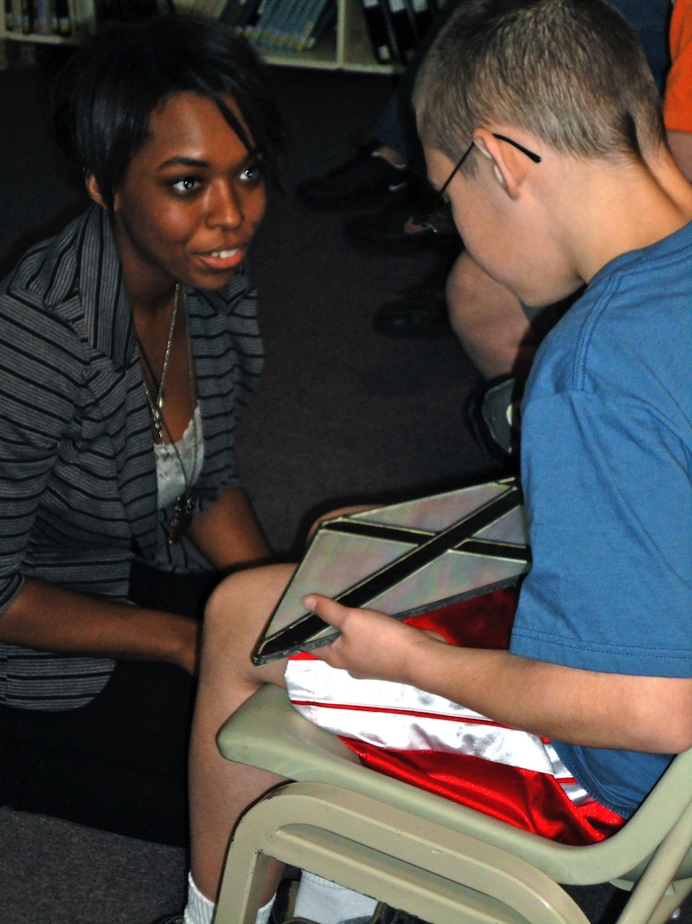
Teaching and Accommodating Diversified Learners Through Art 2
TLAE’s TAE framework values teacher and student agency in answering questions, demonstrating care, and making transformations to cultivate all students’ potential, enhance teaching, and develop inclusive communities.
Professional developments and working directly with diversified learners assists educators in being better prepared to employ flexible teaching methodologies and make student accommodations.
Notes:
Image: A middle childhood student participates in a tactile learning task with a pre-service teacher. USA. Author, Monica Leister, and Nichole Dawson Rich, teachers.

Slide 45
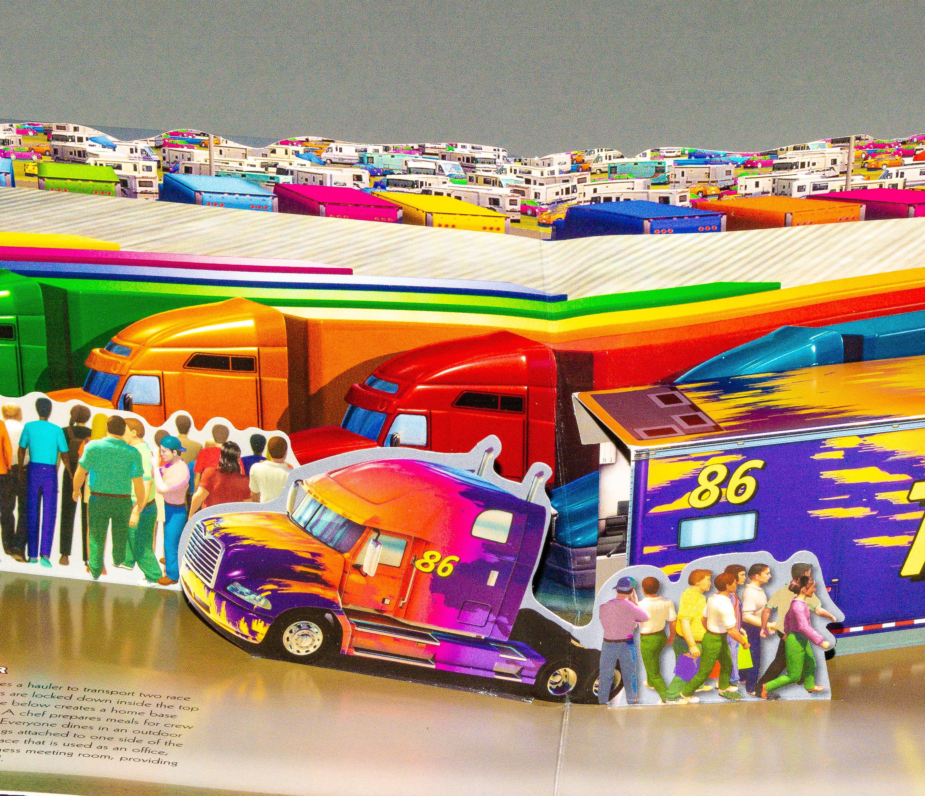
Teaching and Accommodating Diversified Learners Through Art: Artists’ Examples
Blakemore’s book-engineering methods draw inspirations from her childhood due to dyslexia and synesthesia impacting how she learns and processes information.
Blakemore did not learn how to read until age nine. She read in dark rooms to mute the contrast of the black type and tilted her books in many directions to process text more clearly.
Notes:
Class instruction: Explain the following:
Artist Sally Blakemore’s self-initiated accommodations and artistic knowledge resulted in her development of 360° engineered popups that physically engage students with books. Her experiences serve as inspirations to foster students’ unique learning and processing methods. (See Artists’ Lesson to Thrive! 1.3 and STLAD; Sickler-Voigt, 2023).
Image: Pop-up book. © Sally Blakemore
Reference:
Sickler-Voigt, 2023

Slide 46
Teaching and Accommodating Diversified Learners Through Art: Visual Recall
Traditional art instruction often relies on visual recall, which disadvantages the 20% of students who struggle with mental imagery.
Visually Triggered Ideated Somatic Knowledge (V-TISK) refers to the process by which visual-based artistic activities are intertwined with ideating bodily knowledge leading to deeper comprehension. Students benefit from multimodal approaches that support different cognitive styles, such as using language, touch, and sound to ideate and create.
Artists with aphantasia’s art-making strategies, like using factual associations, sensory compensation, and 3D modeling, offer inclusive methods for students.
4% of students have aphantasia—a lifelong and complete absence of voluntary visual imagery—which exists on a spectrum. Their production of quality artworks becomes less difficult when visual scaffolding, like photographs and AI-generated images tailored to students’ styles, is provided during instruction.
Notes:
References:
Sahara, 2022
Sahara, 2023
Sahara et al. 2025

Slide 47
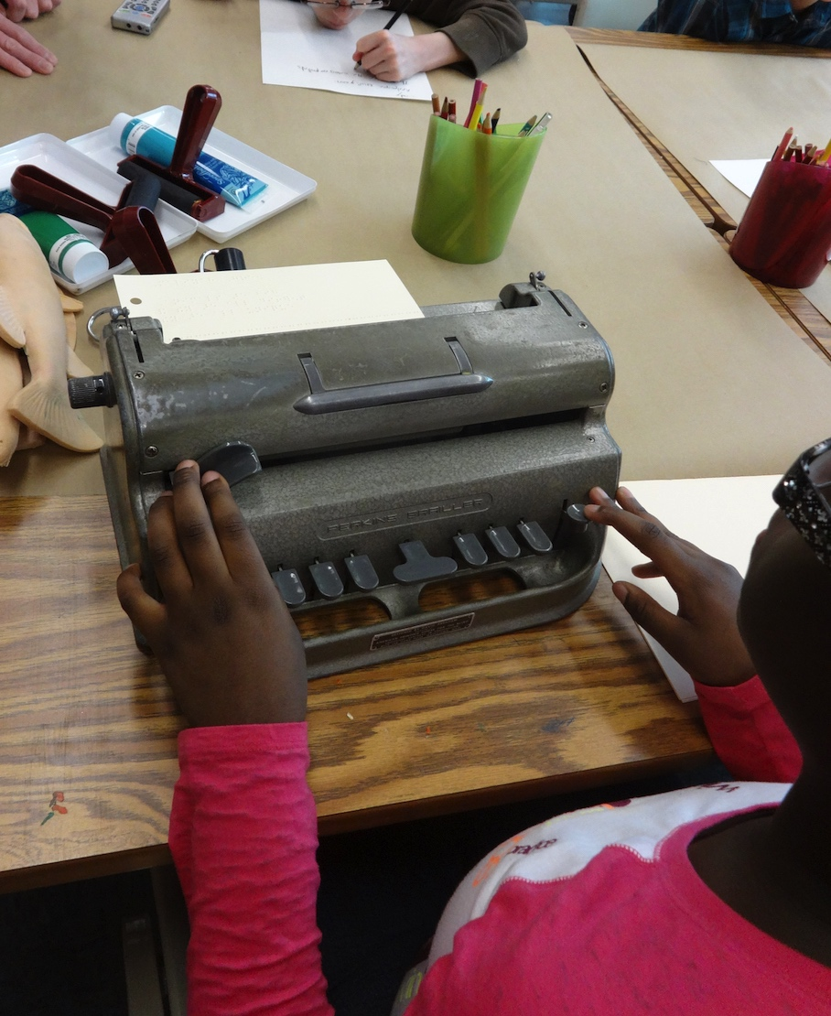
Inclusive Classroom Design 1
Universal Design
Inclusive Classrooms
Notes:
Class instruction: Explain the following:
Universal design: built environment specialists develop environmental spaces in which all humans can interact comfortably without obstacles that leave people out.
Universal Design for Learning builds on universal design by built environment specialists and is a curricular approach that utilizes customized spaces and resources to promote individual student success while reducing barriers to learning.
Teachers prepare inclusive classrooms, learning environments that are supportive and accessible to all students through their planned arrangements of furniture, equipment, materials, and learning tasks. Students can work independently, in groups, and come together as a whole class.
Image: A student types at a braille machine during a printmaking lesson. USA. Author and Monica Leister, teachers.

Slide 48
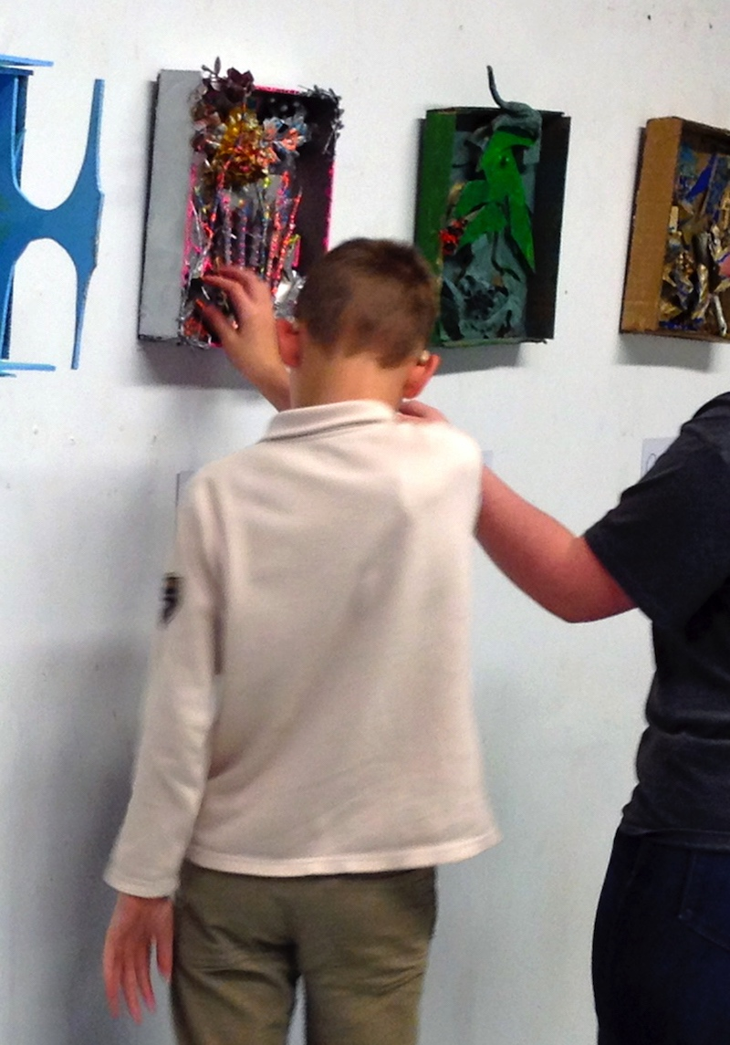
Inclusive Classroom Design 2
Accessible Passageways
Supplies within Reach
Inclusive Signage for LGBTQ+
Accommodating Seating Arrangements
Clutter Free Environments
Notes:
Image: A student walks through an class exhibition space and touches the artworks. USA. Author and Monica Leister, teachers.

Slide 49
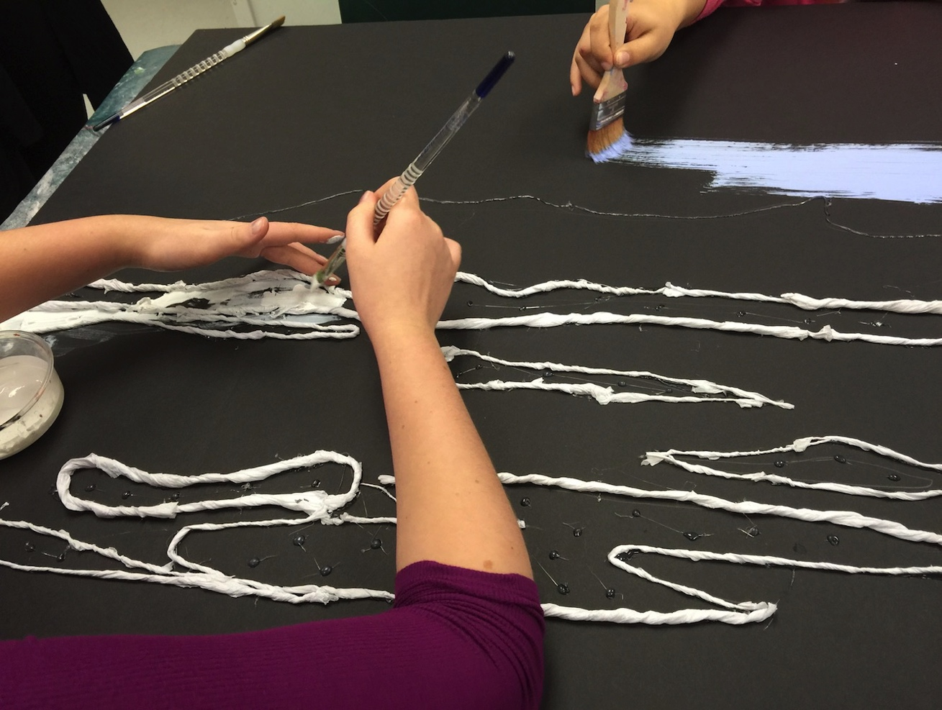
Adaptive Art Supplies 1
Teachers use specialized art supplies, equipment, instructional resources, and procedures to help students learn.
Notes:
Class activity: Review different types of adapted art supplies, such as
Computer devices for writing,
Art materials with thick grips,
Mouthstick for control, and
Clay and blocks to develop hand strength, grip, and coordination.
Image: Students who are blind paint within textured spaces. USA. Author, pre-service teachers, and Monica Leister, teachers.

Slide 50
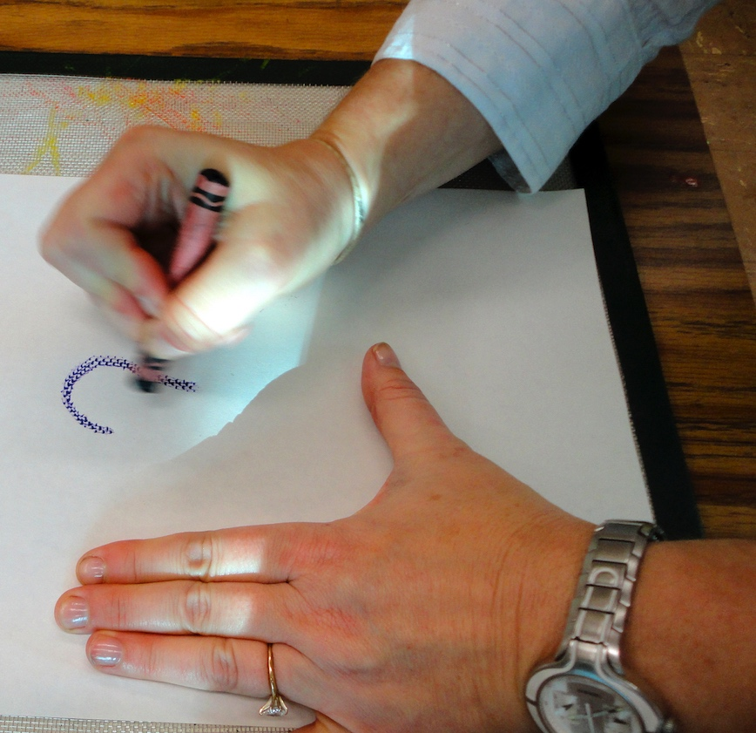
Adaptive Art Supplies 2
Select black markers to produce bold lines.
Place a sheet of paper on screen to draw with crayons that leave a raised wax surface.
Secure paper to a work surface.
Try gloves, paintbrushes, and spreading utensils for students not to touch materials directly.
Prepare sensory boxes for learning.
Use checklists and picture schedules that show class routines in a timetable format.
Notes:
Image: Monica Leister, teacher, demonstrates how she teaches students with visual impairments to draw on screen with crayons. USA.

Slide 51
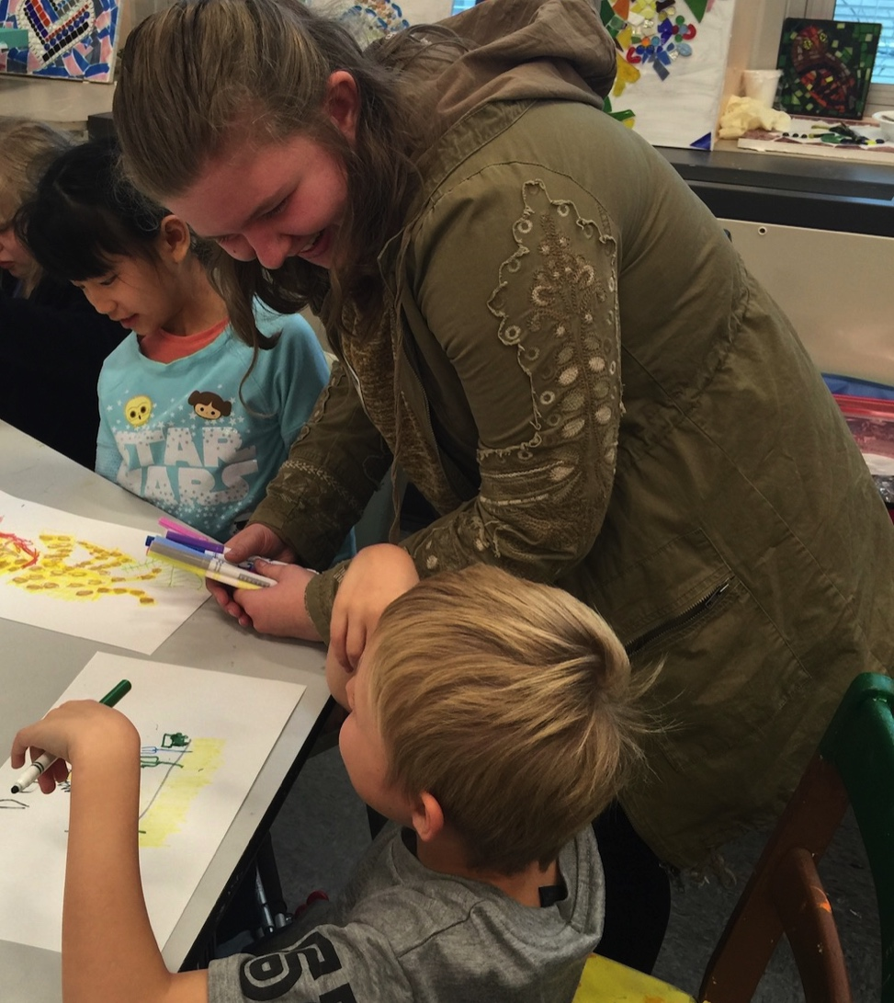
Safe and Empowering Communications 1
Focus on People First Language as opposed to ableism.
Expand people first language to safeguard students who may be called derogatory names for being different.
Notes:
Class instruction: Explain the following:
People first language focuses on people’s abilities rather than limitations. It shifts the focus from using medical terminology as a human descriptor.
People first language rejects ableism, discriminating against people who do not fit limited perceptions of what people’s able minds and bodies should be.
Teachers can expand people first language to safeguard students who may be called derogatory names for being different, including LGBTQ+, ELs, and learners with high abilities.
Image: Pre-service teacher Bobby Shuey talks to a student during an art lesson. Author and Monica Leister, teachers.

Slide 52
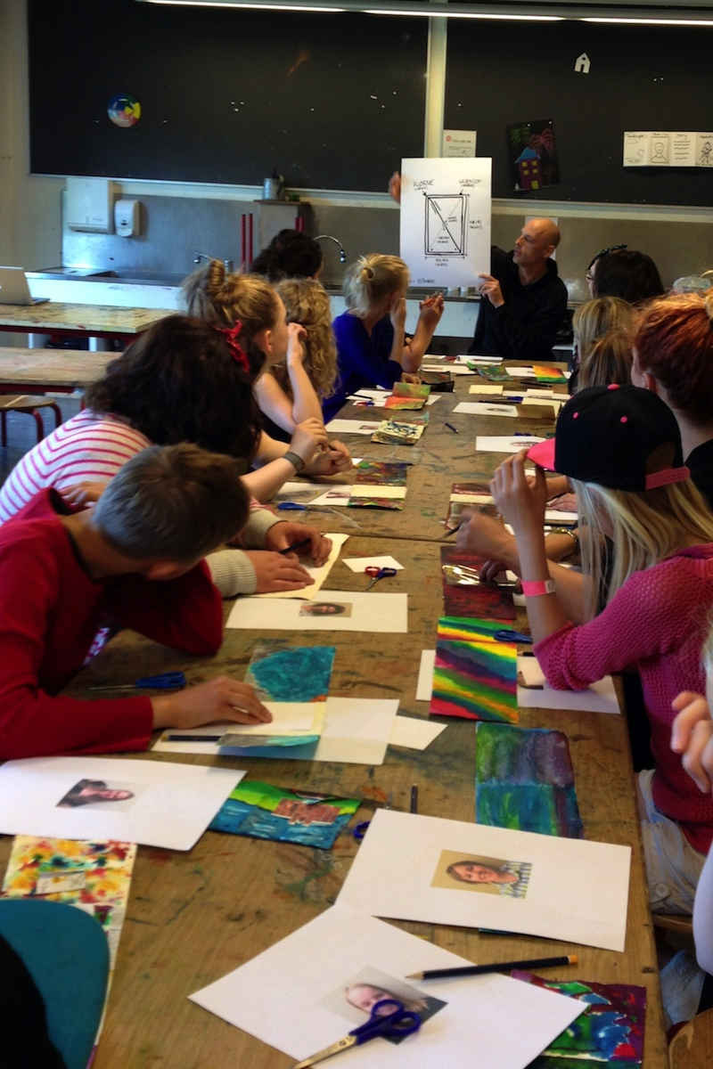
Safe and Empowering Communications 2
Plan small group interactions.
Students can work together to solve problems.
Students can help clarify concepts to peers.
Small group discussions can be less intimidating.
Notes:
Class instruction: Explain the following:
Small group interactions provide students with opportunities to work closely with peers and articulate their thoughts.
Students can work together to solve problems. Such collaborations offer feelings of control and camaraderie to students.
Students with strong verbal skills can help clarify concepts and/or words that peers may not understand.
Image: Early adolescents receive instruction in English with Danish signage Denmark. Author and Todd Tosten, teachers.

Slide 53

Safe and Empowering Communications 3
Teach methods for students to calm their bodies and behaviors to reduce fear and anxiety.
Incorporate quiet reflective moments into lessons.
Notes:
Class instruction: Explain the following:
Calming strategies can assist students in managing their behaviors and coping with changes. Teachers can incorporate quiet reflective moments into lessons for students to observe art, interpret what they see, and find the appropriate words to articulate their thoughts.
Image: Julee Latimer ©. Tulip, detail. Image by HONE photography. Courtesy of the artist. www.juleelatimer.com

Slide 54
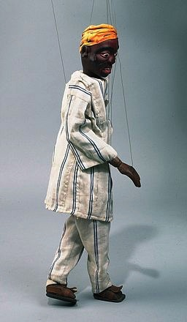
Safe and Empowering Communications 4
Journaling and art tasks assist students in communicating their thoughts.
Students become frustrated when their work is not perfect. Classes can discuss how artists practice, experiment, manipulate materials and make revisions.
Notes:
Image: Danaye, AIDS! If I Had Known! Marionette, 1993. Story by Danaye and Members of the Togolese Association of Women Against AIDS (ATFS). Tropenmuseum, part of the National Museum of World Cultures. (CC BY-SA 4.0). https://hdl.handle.net/20.500.11840/166747

Slide 55
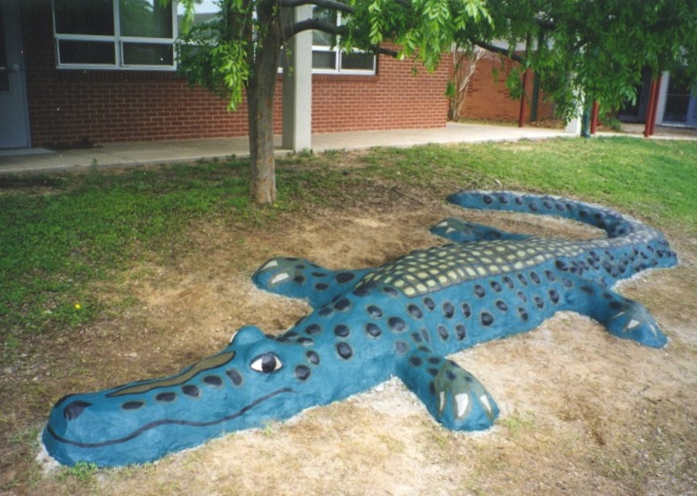
Safe and Empowering Communications 5
Self-efficacy: students’ beliefs about their capabilities to produce effective results based on their abilities to overcome obstacles, rebound from setbacks, observe people similar to themselves succeed, and hear from someone else that they attain new skills.
Collective efficacy
Notes:
Class instruction: Teach the class that collective efficacy is self-efficacy among all participants within a given community. Individuals abandon personal interests to assist the. Students achieve collaborative goals.
Image: Florida Arts and Community Enrichment. Jill Harper, director. Ellen Alt, artist in resident.

Slide 56
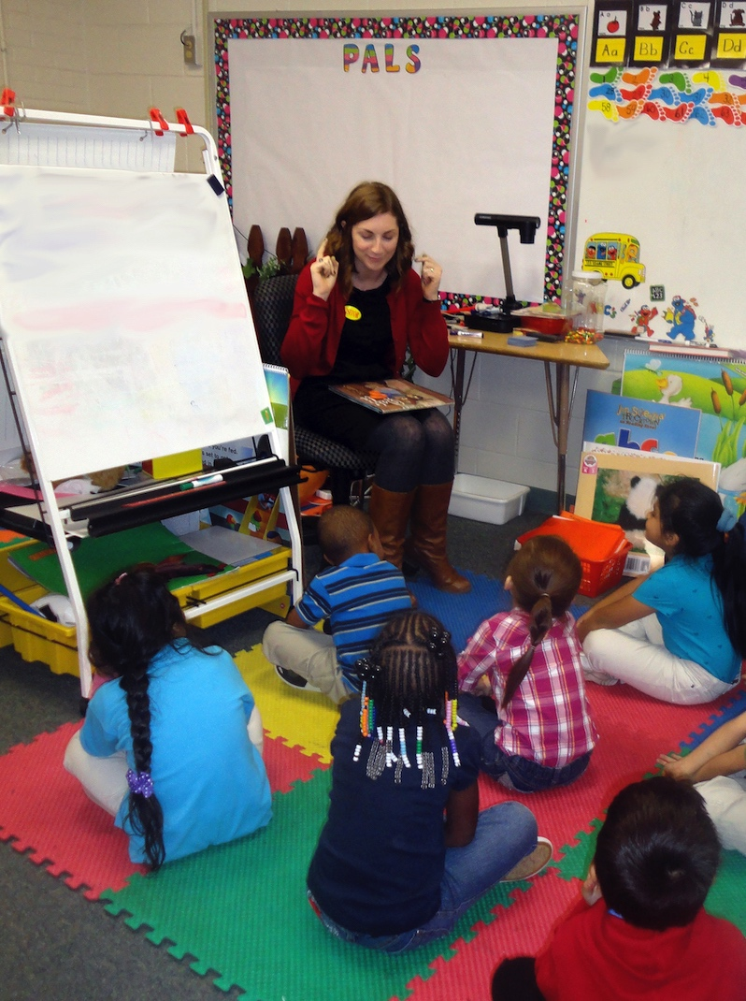
Building Art Vocabulary and Inquiry Skills 1
Translate important vocabulary.
Prepare lists of academic terms.
Focus on 5-8 new words in depth at one time.
Break down key terms.
Use language that students understand.
Present class content at grade level.
Notes:
Class instruction: Inform the class that each subsequent school year the academic language students are expected to know becomes more difficult.
Image: Early childhood students participate in a story. USA, Author and Sara Nixon, teachers.

Slide 57
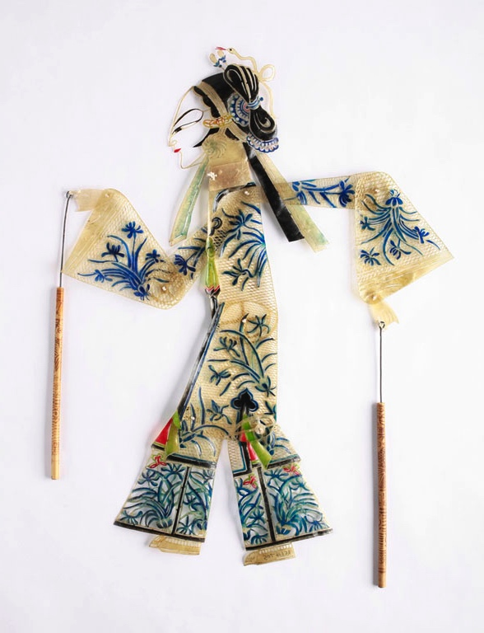
Building Art Vocabulary and Inquiry Skills 2
Build students’ academic vocabulary.
Teach artists’ specialized language.
Have students analyze the meanings of art.
Develop literacy-based art projects.
Notes:
Class instruction: Teachers build students’ academic vocabulary by connecting artistic tasks with substantial conversations, art-based readings, creative writings, art production tasks, and reflective journaling. Invite a class discussion on augmenting students’ academic vocabulary through art.
Image: Hai Lu, Han peoples. 20th century. Peking, China, Fairy from the Chinese folktale "The White Snake.” Accession number: 85.1.16705. Michelle Pemberton, Photographer. The Children’s Museum of Indianapolis. CC BY-SA 3.0 via Wikimedia Commons. https://creativecommons.org/licenses/by-sa/3.0/

Slide 58
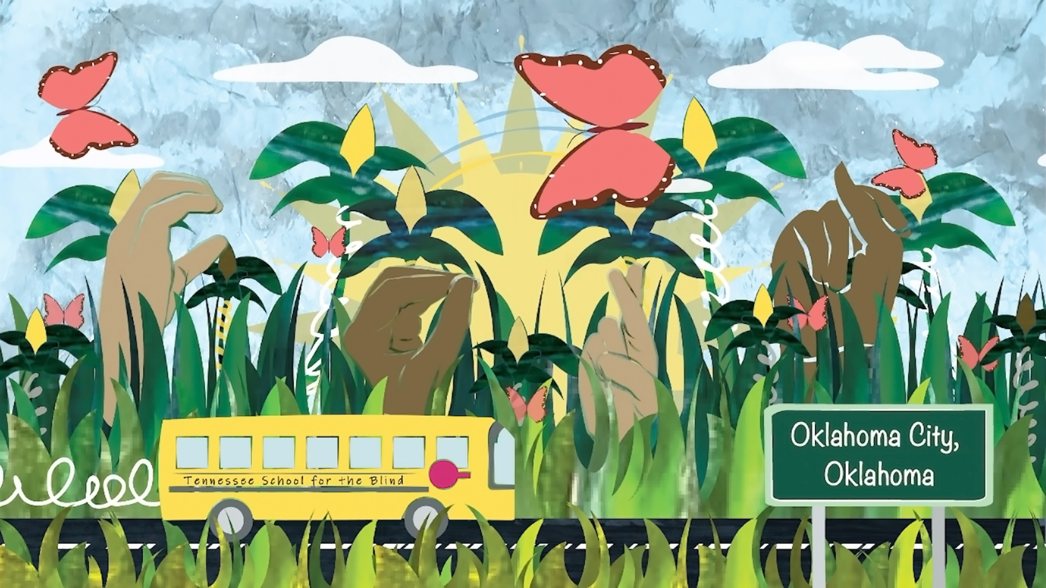
Teaching Tips to Thrive #6.1 Monica Leister Advocating for Students with Visual Impairments
Many people outside of my school think that when someone is blind, they live in a world of complete darkness, unable to see or even enjoy art, much less create art. I felt that my student art exhibits were more than just simply showcasing their work but making the community aware that students who are blind and visually impaired can be talented passionate artists.
Notes:
Class instruction: Discuss Teaching Tips to Thrive #6.1 and Monica Leister’s methods for advocating for students with visual impairments.
Image: This is a scene from the stop motion animation Route 66 Cross Country Road Trip. USA. Source: Author, Monica Leister, Amber Buck, and Joshua Harper.

Slide 59
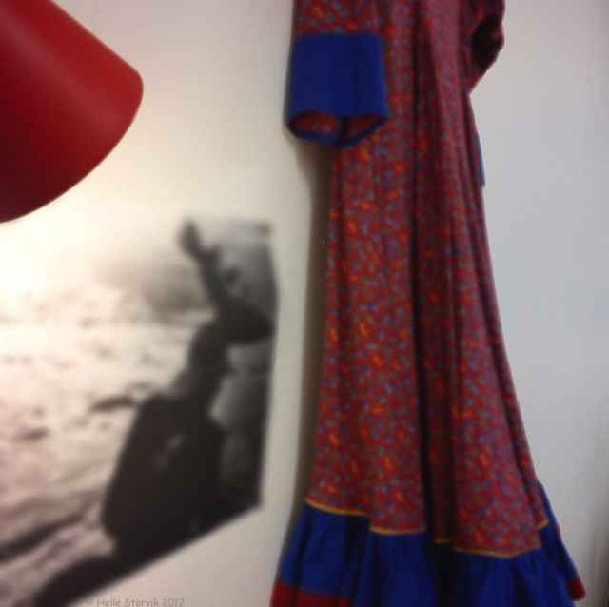
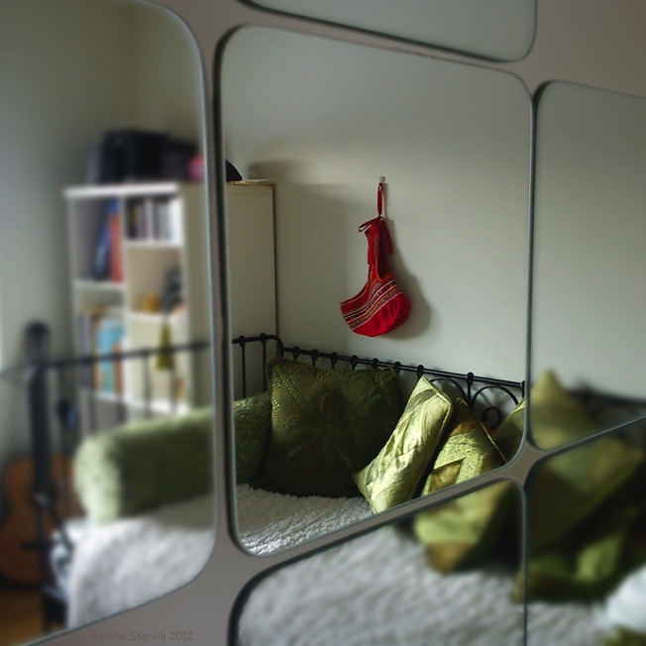
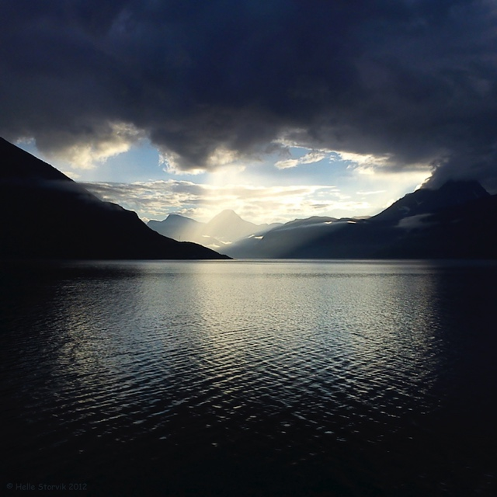
Helle Storvik: Sites of Assimilation and Rejuvenation Artists’ Lessons to Thrive! 6.1.
Big Ideas: Assimilation & Rejuvenation
Photography
Notes:
Class instruction: Have the class open the textbook to Artists’ Lessons to Thrive! 6.1. Participate in its learning targets.
Left Image: Helle Storvik, "And me, am I not a part of it?" The Fjord, 2012, Photoshop-painted photo printed on canvas, 47.24 × 47.24 × 1.18 in. (120 × 120 × 3 cm).
Center Image: Helle Storvik, "And me, am I not a part of it?" The Sami Dress, 2012, Photoshop-painted photo printed on canvas, 47.24 × 47.24 × 1.18 in. (120 × 120 × 3 cm).
Right Image: Helle Storvik, "And me, am I not a part of it?" The Sami Headgear, 2012, Photoshop-painted photo printed on canvas, 47.24 × 47.24 × 1.18 in. (120 × 120 × 3 cm).

Slide 60

Artists’ Lessons to Thrive! Accommodations
Apply your knowledge of diversified learners to add accommodations to TLAE’s and STEAM Teaching and Learning Through the Arts and Design’s Artists’ Lessons to Thrive! instructional resources.
Notes:
Left Image: Paula Gale, book cover artwork
Right Image: This is a book cover of STEAM Teaching and Learning Through the Arts and Design: A Practical Guide for PK-12 Educators.

Slide 61

Approaches to Teacher and Student Transformative Growth Charts
Teacher: Advocate for students’ equal rights as valuable society members and recognize students’ abilities to function and participate equally given necessary resources and accommodations.
Student: Work towards becoming resilient so I can succeed despite challenges, learn from mentors and supportive systems, and use my creativity to find new solutions.
Notes:
Class Activity: Open the textbook to Chapter 6’s Teacher and Student Transformative Growth Charts. Model 6.1 TLAE’s Overview of Approaches to Teacher Transformative Growth and Model 6.2 TLAE’s Overview of Approaches to Student Transformative Growth. Discuss the meanings of these transformative actions. Build on their list of actions.
Image: Midjourney AI, prompted by Netha Hussain, CC0, via Wikimedia Commons. https://commons.wikimedia.org/wiki/File:Quilling_pattern_of_a_mountain_02.png

Slide 62
Chapter 6 Topics
Gifted and Talented: Learners with High Abilities
Children with Disabilities
At-Promise Students
English Learners
LGBTQ+
Teaching and Accommodating Diversified Learners
Inclusive Classroom Design
Adaptive Art Supplies
Safe and Empowering Communications
Building Art Vocabulary and Inquiry Skills
Notes:
Thanks for participating in Teaching and Learning in Art Education’s 2nd Ed. Chapter 6!
Book Cover Artwork: Paula Gale
Chapter References
Ackerman, B. P. , Brown, E. D. , & Izard, C. E. (2004). The relations between persistent poverty and contextual risk and children’s behavior in elementary school. Developmental Psychology, 40 (3), 367–377.
Alabbasi A.M.A., Paek, S.H., Kim, D., & Cramond, B. (2022) What do educators need to know about the Torrance Tests of Creative Thinking: A comprehensive review. Frontiers in Psychology, 13. https://doi.org/10.3389/fpsyg.2022.1000385
Baker, S. , Lesaux, N. , Jayanthi, M. , Dimino, J. , Proctor, C. P. , Morris, J. , … Newman-Gonchar, R. (2014). Teaching academic content and literacy to English learners in elementary and middle school (NCEE 2014–4012). Washington, DC: National Center for Education Evaluation and Regional Assistance (NCEE), Institute of Education Sciences, U.S. Department of Education. http://ies.ed.gov/ncee/wwc/publications_reviews.aspx
Bandura, A. (1997). Self-efficacy: The exercise of control. W. H. Freeman & Company.
Benko, J. (2011). SAMI: The people who walk with reindeer. National Geographic, 220 (5), 62–81.
Bettencourt, G. M., Irwin, L. N., Todorova, R., Corwin, Z. B., & Hallett, R. E. (2023). The possibilities and precautions of using the designation “at-promise” in higher education research. Journal of Postsecondary Student Success, 2(2), 15-27–27. https://doi.org/10.33009/fsop_jpss132261
Blix, B. , Hamran, T. , & Normann, H. (2013). Struggles of being and becoming: A dialogical narrative analysis of the life stories of Sami elderly. Journal Of Aging Studies, 27 (3), 264–275.
Brulles, D. (2021). Leading gifted Hispanic learners toward self-advocacy. In J. L. Davis & D. Douglas (Eds.), Empowering underrepresented gifted students: Perspectives from the field (pp. 43-60). Free Spirit.
Center for Applied Special Technology. (2019). About universal design for learning. http://www.cast.org/our-work/about-udl.html?utm_source=udlguidelines&amp;utm_medium=web&amp;utm_campaign=none&amp;utm_content=homepage#.XTIexi2ZN0s
Coalition of Immokalee Workers . (2018). About CIW. http://ciw-online.org/about/
Curran, M. E. (2003). Linguistic diversity and classroom management. Theory into Practice, 42 (4), 334–340.
English Language Acquisition, Language Enhancement, and Academic Achievement Act. Pub. L. 89–10. 114th Cong. (2015). https://uscode.house.gov/view.xhtml?path=/prelim@title20/chapter70/subchapter3/partA&edition=prelim
Figenschau, M. (2011). Helle Storvikneset and Åslaug Krokann Berg. https://translate.google.com/translate?sl=no&amp;tl=en&amp;js=y&amp;prev=_t&amp;hl=en&amp;ie=UTF-8&amp;u=http%3A%2F%2Fwww.lassagammi.no%2Fhelle-storvik-og-aslaugkrokann-berg.4956247-97565.html&amp;edit-text=&amp;act=url (Original Norwegian www.lassagammi.no/helle-storvik-ogaslaug-krokann-berg.4956247-97565.html).
GLSEN. (2024). Model local education agency policies on implementing Title IX and other federal nondiscrimination protections for LGBTQIA2S+ young people in k-12 schools. https://www.glsen.org/sites/default/files/2024-04/Model%20Local%20Education%20Agency%20Policies.pdf
Gargiulo, R. M. , & Metcalf, D. (2017). Teaching in today’s inclusive classrooms: A universal design for learning approach (3rd ed.). Cengage Learning.
Garrison-Brook, L. (2024). Examining purpose to strengthen mentoring's impact on at-promise youth. In B. Kutsyuruba & F.K. Kochan (Eds.), Mentoring for wellbeing in schools (pp. 47-68). Information Age Publishing.
Glazer. D. (2023). An experience beyond words: Trauma-informed ideas for child and adolescent services supporting Ukrainian refugees. Clinical Child Psychology and Psychiatry. 28(1) 15–20.
Gottschalk, B. (2020). Dispelling misconceptions about English language learners: research-based ways to improve instruction. ASCD.
Gorski, P. (2008). The myth of the “culture of poverty.” Educational Leadership, 65(7), 32–36.
Greene, R. W. (2014). Lost at school: Why our kids with behavioral challenges are falling through the cracks and how we can help them. Scribner.
Guarino, K. & Chagnon, E. (2018). Trauma-sensitive schools training package: Understanding trauma and its impact. Washington, DC: National Center on Safe Supportive Learning Environments. https://safesupportivelearning.ed.gov/trauma-sensitive-schools-training- package
Jagers, R. J., Skoog-Hoffman, A., Barthelus, B., & Schlund, J. (2021). Transformative social emotional learning: In pursuit of educational equity and excellence. American Educator, 45(2), 12–17.
JamievstheVoid. (2018, October 9). I have APHANTASIA (and you may too...without realising it!) [Video]. YouTube. https://www.youtube.com/watch?v=ewsGmhAjjjI&t=1s
Jordan, P. (2023). Attendance playbook: Smart strategies for reducing student absenteeism post-pandemic. https://www.future-ed.org/wp-content/uploads/2023/05/Attendance-Playbook.5.23.pdf
Kantawala, A. (2023). Artistic advocacy: A Conversation on art, education, and LGBTQ+: Advocacy in inclusive spaces with Courtnie Wolfgang and Kim Cosier. Art Education, 76(6), 58-65. https://doi.org/10.1080/00043125.2023.2283399
Klingner, R. (2022). Twice-exceptional children and their challenges in dealing with normality. Education Sciences, 12, 268. https://doi.org/10.3390/ educsci12040268
Kosciw, J. G., Clark, C. M., & Menard, L. (2022). The 2021 national school climate survey: The experiences of LGBTQ+ youth in our nation’s schools. GLSEN. https://www.glsen.org/sites/default/files/2022-10/NSCS-2021-Full-Report.pdf
Kraft, M. , & Keifer-Boyd, K. (2013). Including difference: A communitarian approach to art education in the least restrictive environment. National Art Education Association.
Loesl, S. D. (2010). Understanding and interpreting the ASD “puzzle”. In B. L. Gerber & J. Kellman (Eds.), Understanding students with autism through art (pp. 71–82). National Art Education Association.
Long, D. A., McCoach, D. B., Siegle, D., Callahan, C. M., & Gubbins, E. J. (2023). Inequality at the starting line: Underrepresentation in gifted identification and disparities in early achievement. AERA Open, 9, 1–25. https://doi.org/10.1177/23328584231171535
Maree, J. G. K. , & van der Westhuizen, C. N. (2009). Giftedness and diversity: Research and education in Africa. In L. Shavinina (Ed.), International handbook on giftedness (pp. 1409–1425). Springer.
Masten, A. S., Lucke, C. M., Nelson, K. M., & Stallworthy, I. C. (2021). Resilience in development and psychopathology: Multisystem perspectives. Annual Review of Clinical Psychology, 17(1), 521–549. https://doi.org/10.1146/annurev-clinpsy-081219-120307
McFarland, J. , Hussar, B. , Wang, X. , Zhang, J. , Wang, K. , Rathbun, A. , … Bullock Mann, F. (2018). The Condition of Education 2018 (NCES 2018–144). U.S. Department of Education. Washington, DC: National Center for Education Statistics. https://nces.ed.gov/pubsearch/pubsinfo.asp?pubid=2018144
Mead, S. (2010). Reading for life. American Prospect, 21 (6), A2–A5.
National Center for Education Statistics. (2023). Students With Disabilities. U.S. Department of Education, Institute of Education Sciences. https://nces.ed.gov/programs/coe/indicator/cgg
National Education Association. (2020, July). Understanding trauma: Key takeaways. https://www.nea.org/sites/default/files/2020-07/UnderstandingTrauma_Key_Takeaways.pdf
Rothstein, R. (2008). Whose problem is poverty? Educational Leadership, 65 (7), 8–13.
Sahara, O. (2022). The significance of media arts education from a cognitive science approach. In A. D. Knochel & O. Sahara (Eds.), Global media arts education: Mapping global perspectives of media arts in education (pp. 165–179). Palgrave Macmillan. https://doi.org/10.1007/978-3-031-05476-1_10
Sahara, O. (2023). How can arts education contribute to cognitive diversity? The proposition of inclusive arts education contributing to our cognitive diversity including aphantasia. Art Education Studies, 44, 155–166. Art Education Association (Japan)
Sahara, O., Ishihara, Y., & Takahashi, N. (2025, March 22). Cultivating synesthesia and balancing personal traits through art education in the AI era: Developing generative AI to support aphantasia [Conference presentation]. NAEA 2025, Louisville, KY.
Semple, R. H. , Lee, J. , Rosa, D. , & Miller, L. F. (2010). A randomized trial of mindfulness-based cognitive therapy for children: Promoting mindful attention to enhance social-emotional resiliency in children. Journal of Child & Family Studies, 19, 218–229.
Sickler-Voigt, D. C. (2023a). Media arts and assistive technologies as empowering global communication tools for students with visual impairments. In A. D. Knochel, O. Sahara (Eds.), Global Media Arts Education: Mapping Global Perspectives of Media Arts in Education (pp. 251-266). Palgrave. https://doi.org/10.1007/978-3-031-05476-1_15
Sickler-Voigt, D. C. (2023b). STEAM teaching and learning through the arts and design: A practical guide for PK-12 educators. Routledge.
Silverman, L. K. , & Miller, N. B. (2009). A feminine perspective of giftedness. In L. Shavinina (Ed.), International handbook on giftedness (pp. 99–128). Springer.
Spencer, P. E. , & Marschark, M. (2010). Evidence-based practice in educating deaf and hard-of-hearing students. Oxford University Press.
Spielman, R. M., Jenkins, W. J., & Lovett, M. D. (2020). Psychology. (2nd ed.). Openstax.
Storvik, H. , Boine, M. , Johansen, R. , & Berg, Å. K. (2012). Er vi her ennå? Norway: Aslaug Krokann Berg and Helle Storvik.
Turanovic, J. J., & Siennick, S. E. (2022). The causes and consequences of school violence: A review. National Institute of Justice. https://www.ojp.gov/pdffiles1/nij/302346.pdf
United Nations Children’s Fund (UNICEF) . (2013). The state of the world’s children 2013: Children with disabilities. https://violenceagainstchildren.un.org/sites/violenceagainstchildren.un.org/files/documents/other_documents/sowc_2013-main_report_en.pdf
United Nations Children’s Fund. (2021). Seen, counted, included: Using data to shed light on the well-being of children with disabilities. UNICEF. https://data.unicef.org/resources/children-with-disabilities-report-2021/
United Nations Secretary-General. (2012). Global education initiative first. https://www.gcedclearinghouse.org/sites/default/files/resources/%5BENG%5D%20Global%20Education%20First%20Initiative_0.pdf
UNESCO. (2023). 40% don’t access education in a language they understand. https://www.unesco.org/gem-report/en/articles/40-dont-access-education-language-they-understand
U.S. Congress . (2016). S.1177: Every Student Succeeds Act (ESSA). www.congress.gov/bill/114th-congress/senate-bill/1177/text?overview=closed
U.S. Department of Education . (2017). The benefits of being bilingual—A review for teachers and other early education program providers. https://www2.ed.gov/documents/early-learning/talk-read-sing/bilingual-en.pdf
U.S. Department of Education . (2023). Protecting students with disabilities: frequently asked questions about Section 504 and the education of children with disabilities. https://www2.ed.gov/about/offices/list/ocr/504faq.html
U.S. Department of Education. (2024a). Office for Civil Rights: Resources for LGBTQI+ students. https://www2.ed.gov/about/offices/list/ocr/lgbt.html
U.S. Department of Education. (2024b). Office for Civil Rights: Title IX of the Education Amendments Acts of 1972. https://www.govinfo.gov/content/pkg/COMPS-748/pdf/COMPS-748.pdf
U.S. Department of Education Individuals with Disabilities Education Act . (2017). Sec. 300.8 Child with a disability. https://sites.ed.gov/idea/regs/b/a/300.8
U.S. Department of Education Institute of Education Sciences . (2018). Children and youth with disabilities. http://nces.ed.gov/programs/coe/indicator_cgg.asp
U.S. Department of Health and Human Services (2023, Feb. 1). Unaccompanied children released to sponsors by state: Office of Refugee Resettlement, An Office of the Administration for Children and Families. https://www.acf.hhs.gov/orr/grant-funding/unaccompanied-children-released-sponsors-state
Weinstock, J. (2013). Assimilation of the Sámi: Its unforeseen effects on the majority populations of Scandinavia. Scandinavian Studies, 85 (4), 411–430.
The White House. (2025, January 29). Ending radical indoctrination in K-12 schooling. https://www.whitehouse.gov/presidential-actions/2025/01/ending-radical-indoctrination-in-k-12-schooling/
Winner, E., & Drake, J. E. (2022). The child as visual artist. Cambridge University Press.

