Slide 1

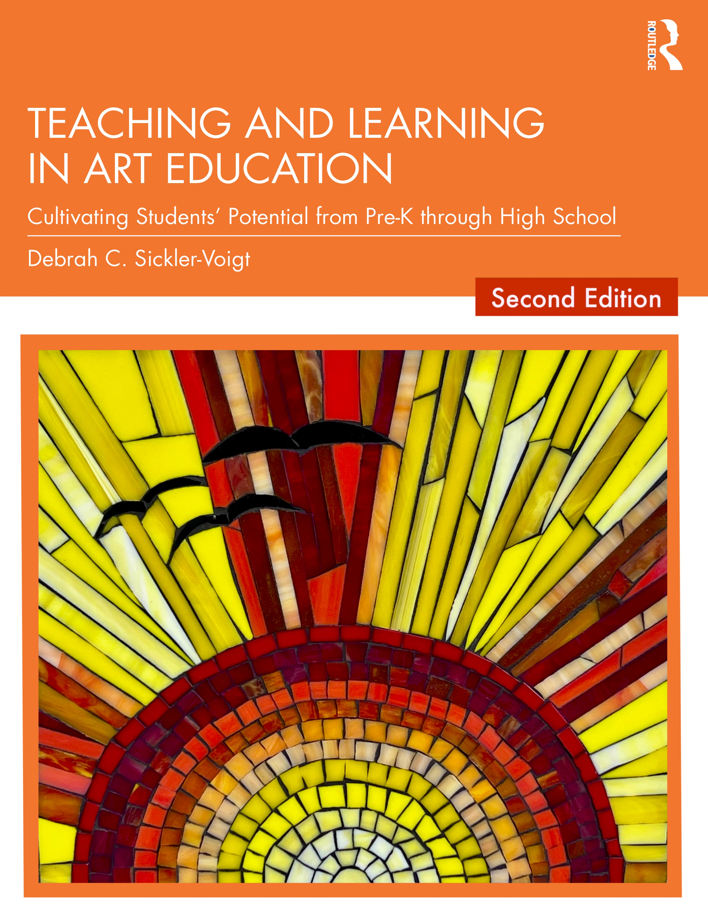
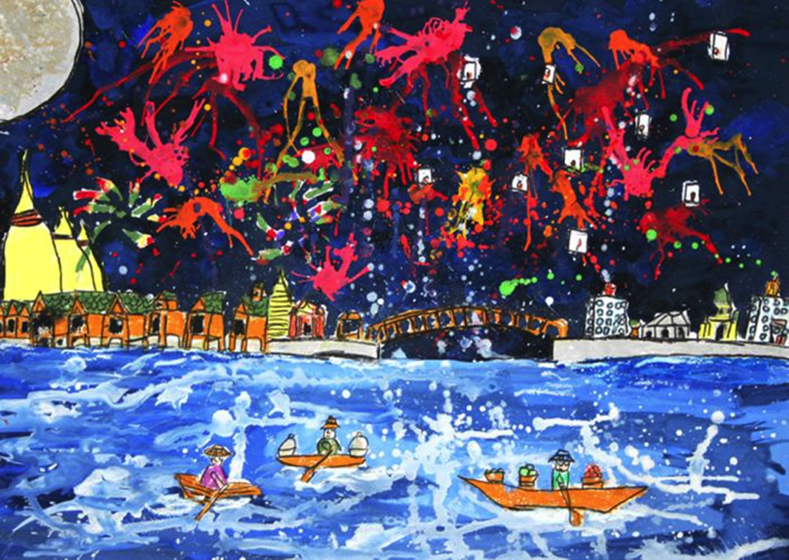
Teaching and Learning in Art Education, CHAPTER 12. Painting
Debrah C. Sickler-Voigt, Author & Presentation Developer ©
Notes:
Welcome to Teaching and Learning in Art Education, 2nd Edition, Chapter 12!
TLAE as a theoretically-based, practical textbook to prepare preservice educators for their teaching careers and to support in-service educators in improving their existing practices. Its timely second edition with its updated framework remains dedicated to assisting educators in all stages of their careers through effective curricular planning, instruction, assessment, and management to foster student learning and cultivate educators’ meaningful, creative, and rewarding careers.
This textbook and instructional resources resulted from the contributions of many individuals, including teachers, students, artists, organizations, family, mentors, and Routledge’s editorial/production team. Its teachings are based on the author’s research, communications, and professional interpretations of teachers, artists,’ and designers’ works with the aim of being respectful of diversified peoples and representing their teachings in a truthful and non-biased manner.
Book Cover Artwork: Paula Gale
Right Image: Tanrudee Kanokpol, 7 years old, Kolor Me Art School, Pakred, Thailand. 41st ICEFA Lidice.

Slide 2
Chapter 12 Topics
Understanding Painting in Context
Applying Paint Media in Context
Transformative Best Practices for Teaching Painting from Pre-K Through High School
Notes:
Spotlight on Student Art #12: Rejuvenation
Image: Tanrudee Kanokpol, 7 years old, Kolor Me Art School, Pakred, Thailand. 41st ICEFA Lidice.

Slide 3

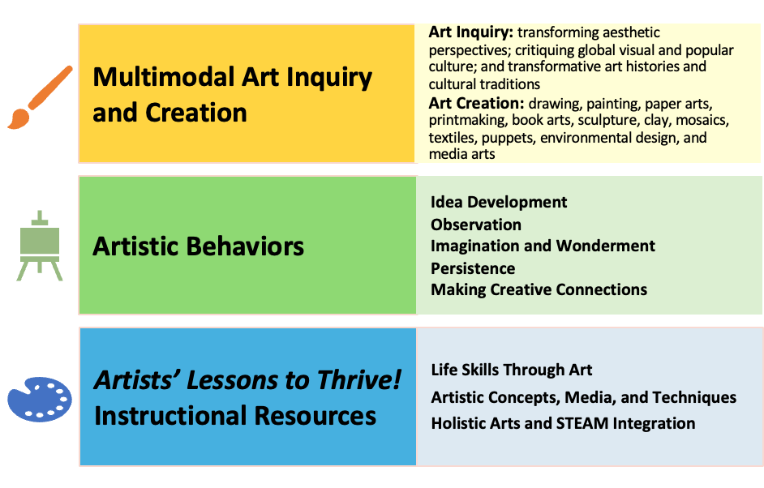
Link Chapter 12’s teachings with
TLAE’s Transformative
Art Education Framework
Notes:
Class instruction: Ask students to build on prior learning and personal experiences to make personal connections between this chapter’s teachings and TLAE’s Transformative Art Education framework.
Book Cover Artwork: Paula Gale

Slide 4

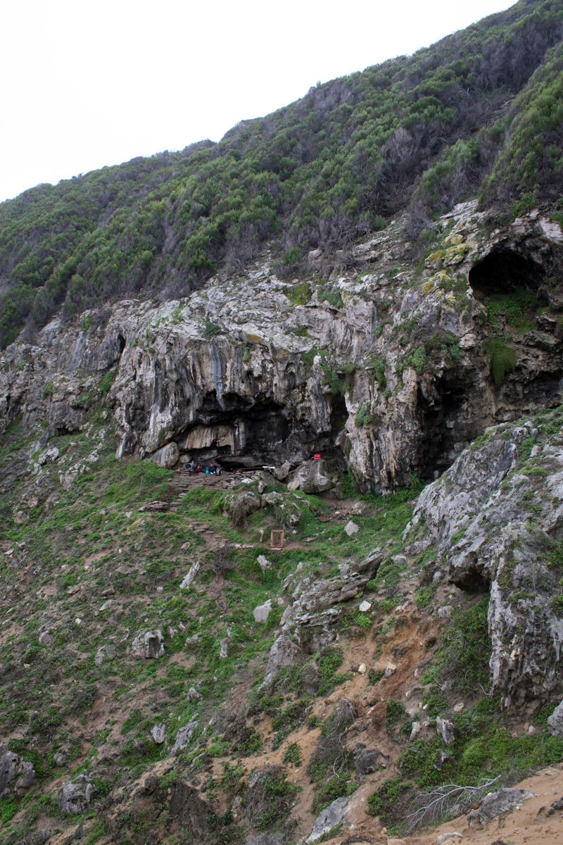
Understanding Painting in Context 1
The oldest evidence for human artmaking dates back 100,000 years at the Blombos Cave (South Africa’s Southern Cape), where humans developed the first paint manufactory, with pigments conceivably created for painting bodies, caves, and objects to clarify and communicate communal beliefs.
Notes:
Class instruction: Explain how prehistoric societies began spreading paint on natural surfaces including skin, rocks, leaves, tree barks, and animal hides.
Image: Vincent Mourre / Inrap, CC BY-SA 3.0 <https://creativecommons.org/licenses/by-sa/3.0>, via Wikimedia Commons. https://commons.wikimedia.org/wiki/File:Blombos.jpg
Reference:
Kelker, 2021

Slide 5

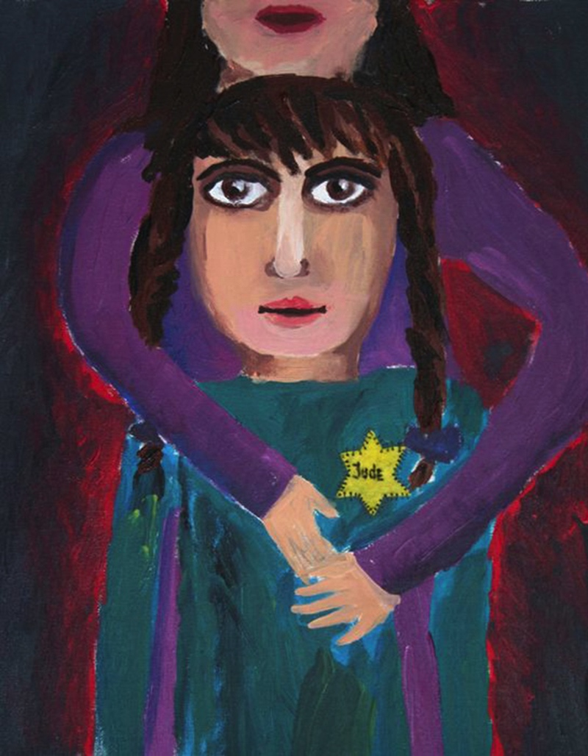
Understanding Painting in Context 2
Painting is the process artists use to apply layers of pigment from minerals and liquids, including water or oil, to two- or three-dimensional surfaces using mark making tools, such as paintbrushes, palette knives, fingers, sticks, and sponges.
Notes:
Image: Nicole Goryachy, 11 years old, Studio of Art - Ruta Kreitser, Jerusalem, Israel. 41st ICEFA Lidice.

Slide 6
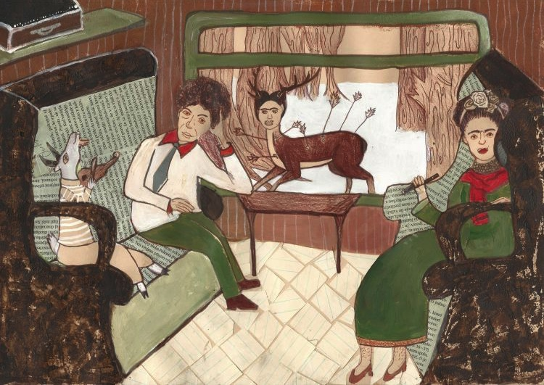
Understanding Painting in Context 3
The physical act of painting becomes a gateway to become acquainted with artists’ thought processes and feelings about subject matter.
Artists spend a lifetime refining their artistic knowledge of paint.
Notes:
Image: This artwork includes portraits of painters Frida Kahlo and Diego Rivera. Luisa Tichá, 13 years old, Občianske združenie art SLNEČNICE, o.z., Bratislava, Slovak Republic. 45th ICEFA Lidice.

Slide 7
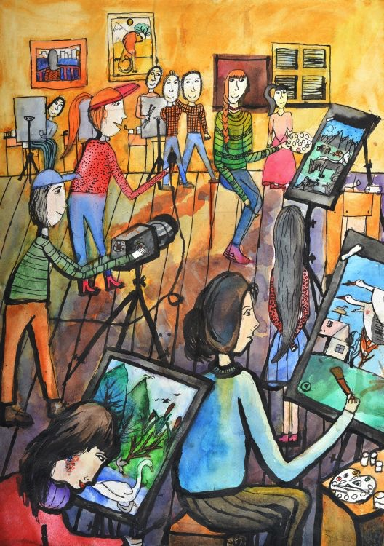
Understanding Painting in Context 4
Many of today’s painters utilize electronic media to produce their works.
They determine if evidence of technological inspirations will remain evident in their completed painted products, which may extend beyond the canvas, easel, and frames to include digital installations, displays, and performance pieces.
Digital technologies provide artists with supplemental opportunities to integrate context, social influences, and historical knowledge into their paintings.
Notes:
Class activity: Discuss contemporary painters’ use and disuse of technology, such as Josef Zedník, Katharina Grosse, and Carole Kirk.
Image: Anastasiia Shishkovskaia, 9 years old, GUO Lidskaia Detskaia Khudohzestvenaia Shkola Iskusstv, Lida, Belarus. 44th ICEFA Lidice.

Slide 8
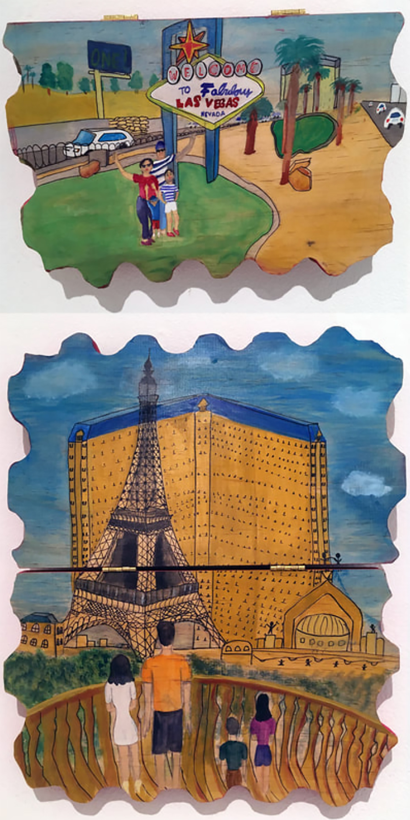
Applying Paint Media in Context 1
Water-soluble paints include tempera paints, watercolors, finger paints, and acrylics. They are the most common in schools.
Paintings reach beyond compositional qualities and the rudimental characteristics of liquid and pigment applied to surfaces.
Notes:
Image: Meghan Arora, 15-years-old, USA. Source Todd Johnson, teacher

Slide 9
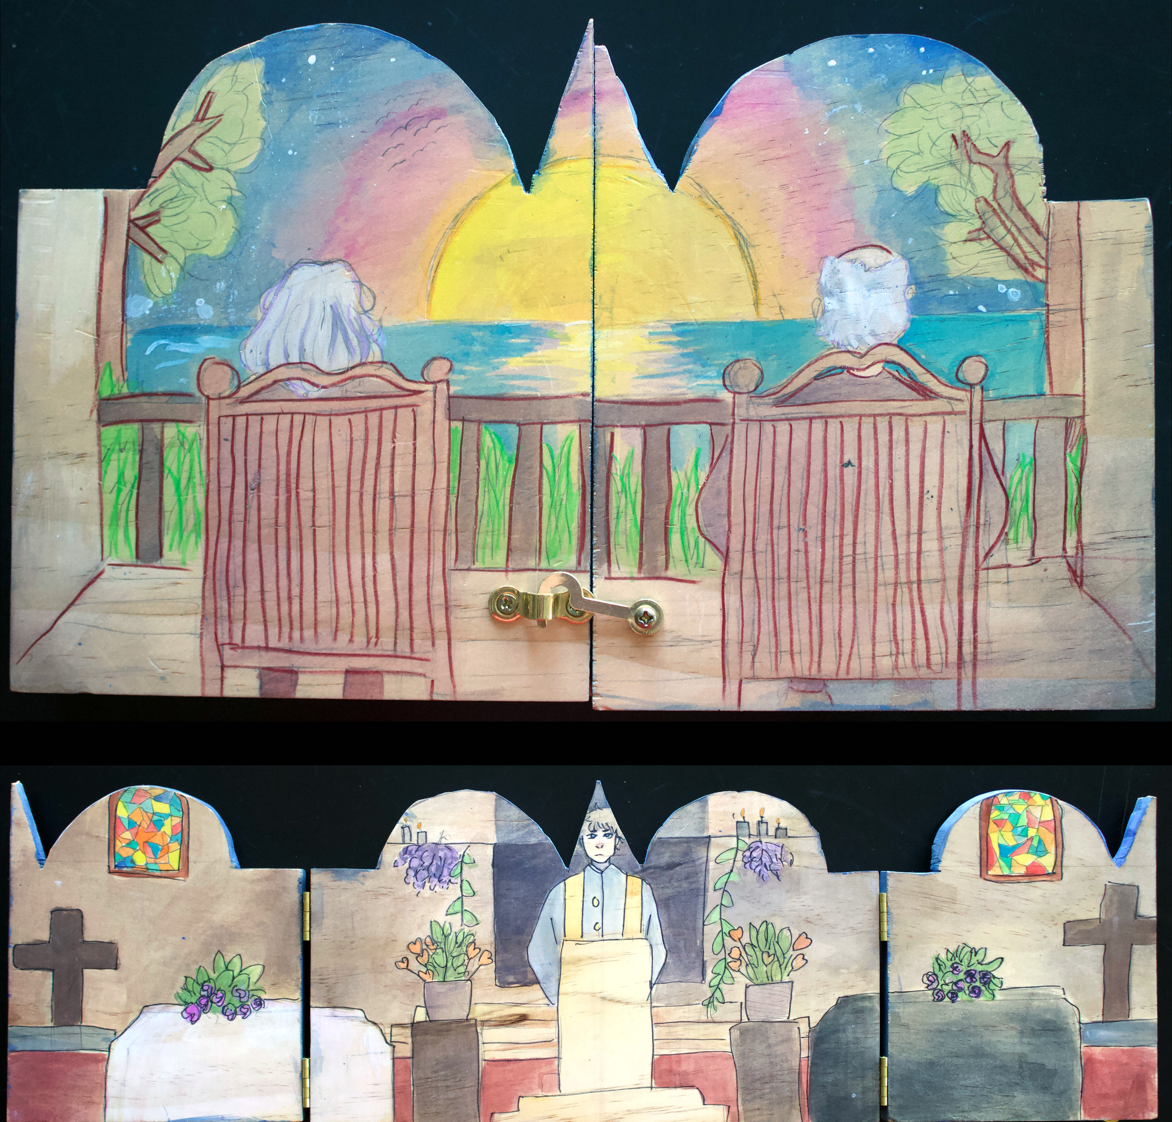
Applying Paint Media in Context 2
Polyptychs (including diptychs and triptychs) are paintings on multiple conjoined flat panels with distinct framed areas to depict multiple scenes within a picture plane.
Notes:
Image: Lucien Crane, 15-years-old, USA. Source Todd Johnson, teacher

Slide 10
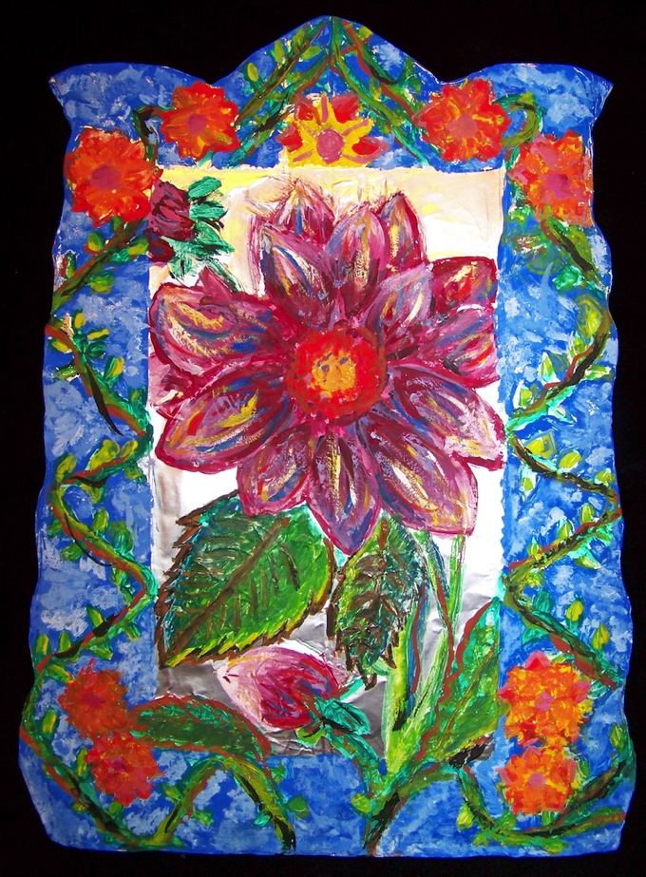
Applying Paint Media in Context 3
A retablo is a devotional painting on industrial iron covered with tin that became popularized by 19th century Mexican folk artists.
Its name retablo originates from the Latin phrase “behind the altar.”
Students can paint directly on prepared metal sheets with dull edges or cheaper tooling foil or heavy-duty aluminum foil.
Notes:
Image: Ailee Sickler, 6th Grade. USA. Author, teacher. Richard Sickler, photo.

Slide 11
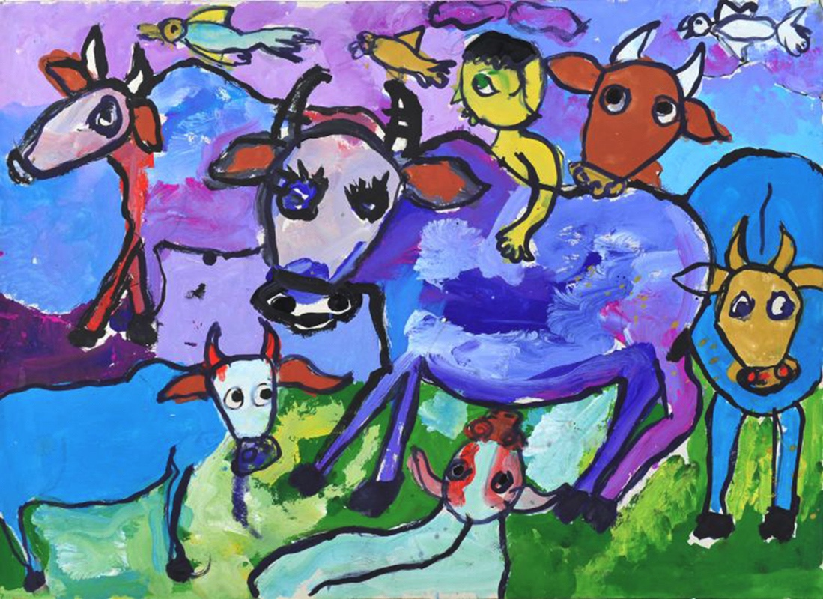
Tempera Paint 1
Tempera paint is an opaque paint also known as poster paint.
School grade tempera paints are colorful, versatile, and affordable.
Liquid Tempera
Powder Tempera
Tempera Cakes
Tempera Sticks
Notes:
Class instruction: Discuss how tempera paints adhere to papers, cardboard, and burlap. When applying layers, light colors may not conceal darker background colors. Have the class experiment with different types of tempera paint.
Image: Zarif Hasan Ayman, 6 years old, Children Painting Workshop, Dhaka, Uttara, Bangladesh. 42nd ICEFA Lidice.

Slide 12

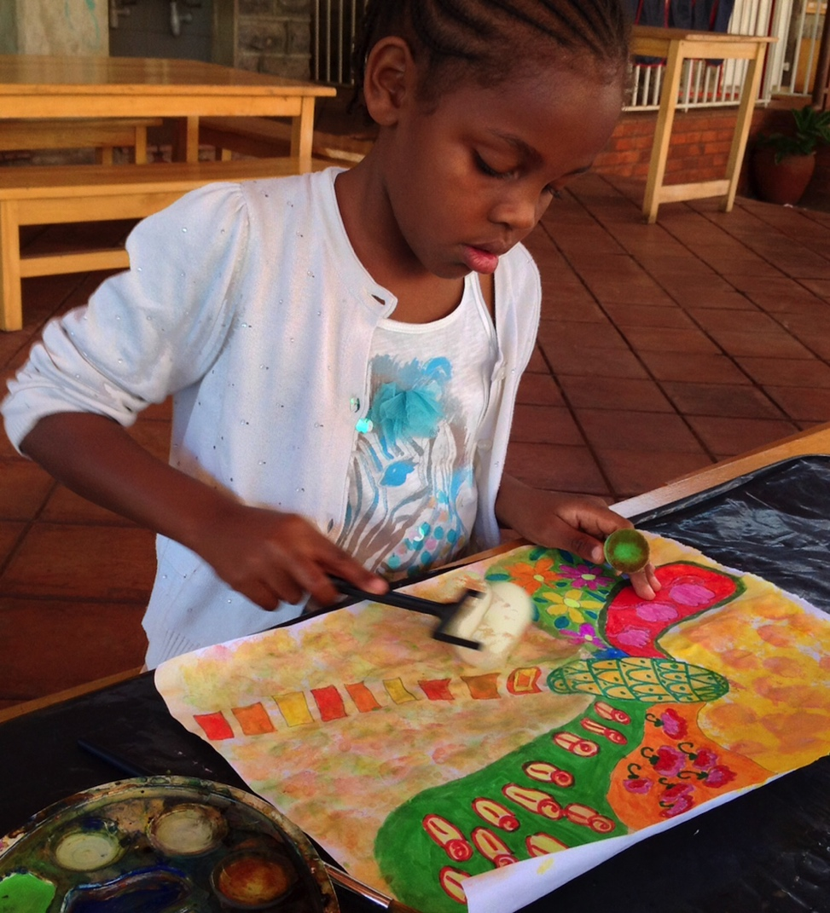
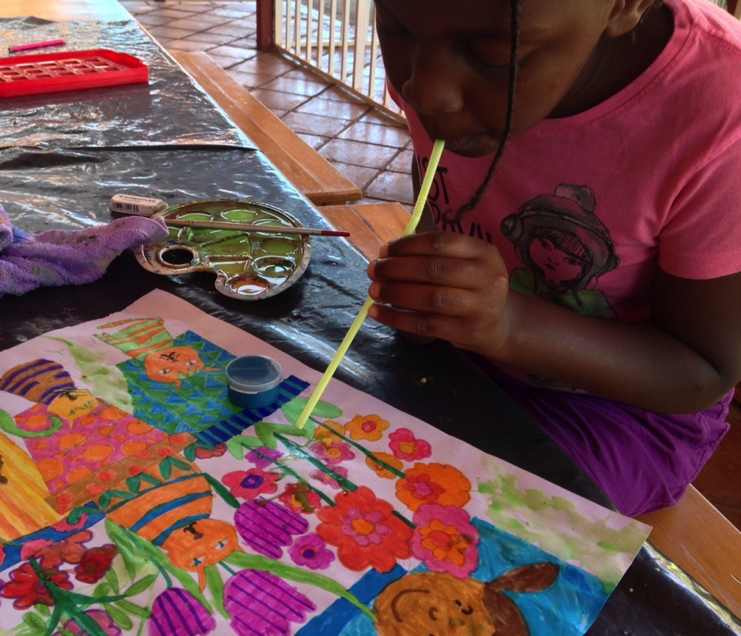
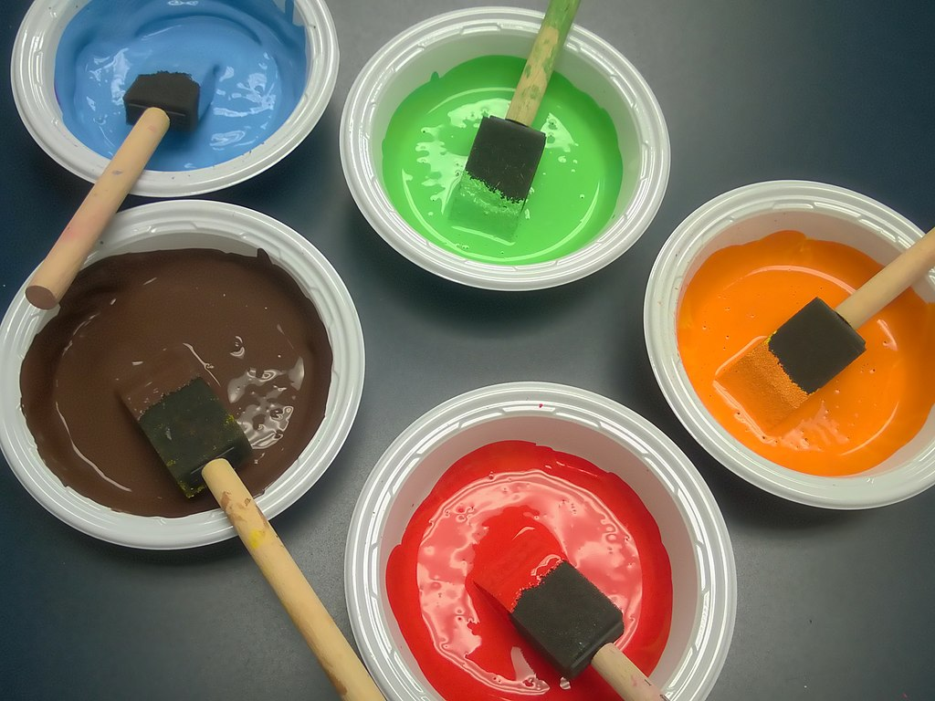
Tempera Paint 2
Try rollers, sponges, and found objects to create textures.
Notes:
Left Image: Siana Nyachae paints with a roller. Kenya. Lisa Wee, teacher.
Right Image: Mali Nyachae blows paint through a straw. Kenya. Lisa Wee, teacher.
https://commons.wikimedia.org/wiki/File:Multicolored_tempera_paints.jpg
Joyful spherical creature, CC BY-SA 4.0 <https://creativecommons.org/licenses/by-sa/4.0>, via Wikimedia Commons

Slide 13
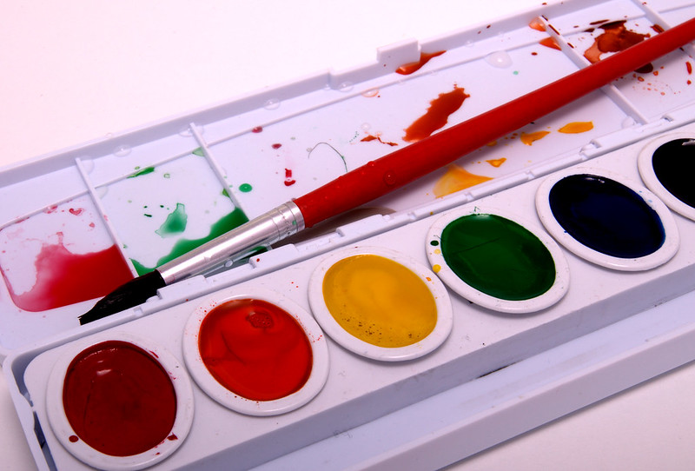
Watercolors 1
Watercolors are transparent, semi-moist paints comprised of pigment bound in a gum base.
Watercolor paper is white or light cream. It is measured in the amount of pounds of water pressure a sheet can hold.
Watercolor brushes come in a range of sizes and have soft, natural bristles that hold greater amounts of water.
Notes:
Class instruction: Watercolors come in tubes, pencils, or sets filled with pans of colors. The higher the number, the stronger the watercolor paper is and less likely it will warp. Ninety to 120 pounds are common school-grade weights. Have the class try different types of watercolors and watercolor papers.
Image: https://www.flickr.com/photos/ariels_photos/4196603186/
https://creativecommons.org/licenses/by-sa/2.0/

Slide 14
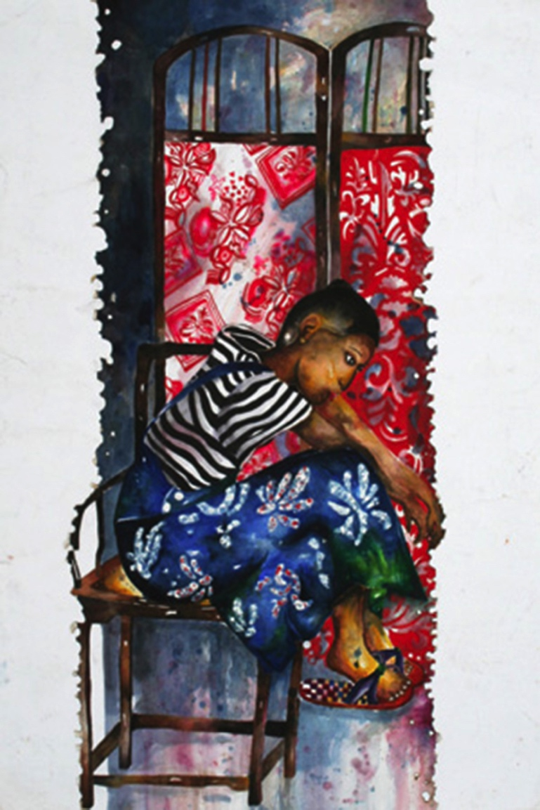
Watercolors 2
Create a wash, a watery base coat of paint that produces a light, pastel hue by dampening paper with a sopping paintbrush.
Design works that feature reflective lights and transparent layered textures.
Vary the amount of water on brushes to produce transparent visual effects.
Notes:
Class instruction: Explain that the more water a paintbrush has on it, the lighter in intensity the color will be.
Image: Lim Luen Gui, 16 years old, Yeow Chye Art Centre, Penang, Malaysia. 39th ICEFA Lidice.

Slide 15

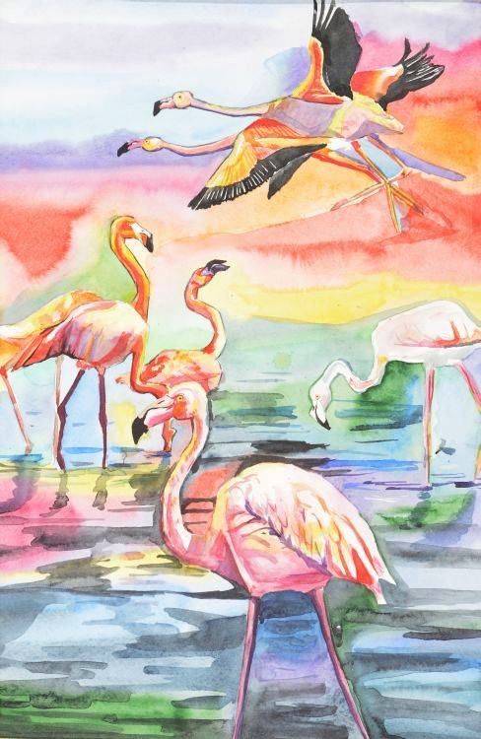
Watercolors 3
Leave sections of the paper unpainted for the white areas within a composition.
Use a knife to scratch away painted surfaces on watercolor paper to reveal fresh white areas.
Apply salt, cellophane, aluminum foil, or leaves to wet paintings to produce textures when dried.
Notes:
Image: Mahri Amanaliyeva, 14 years old, Children Arts School named after B. Nurali, Ashgabat, Turkmenistan. 46th ICEFA Lidice.

Slide 16
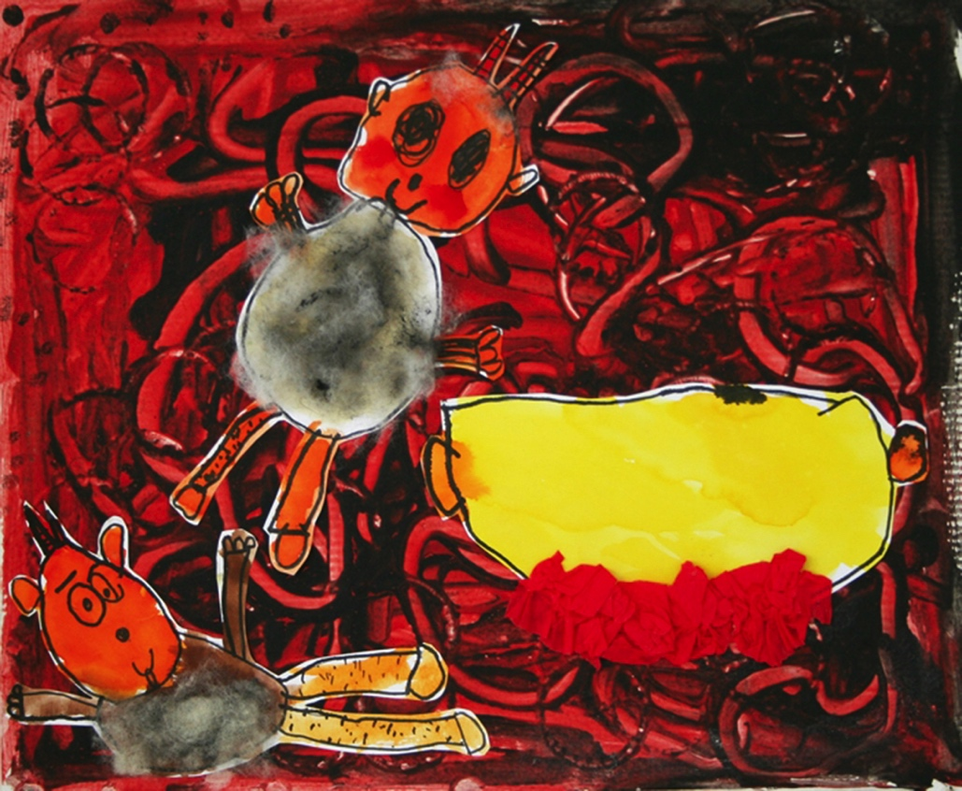
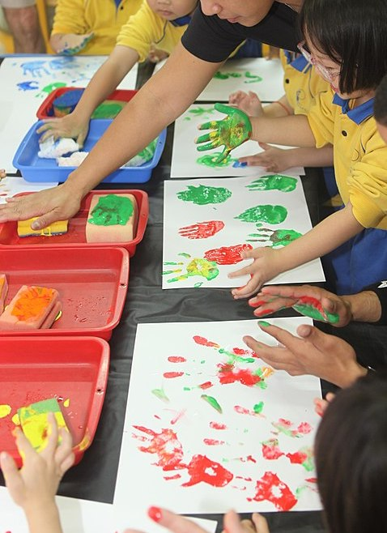
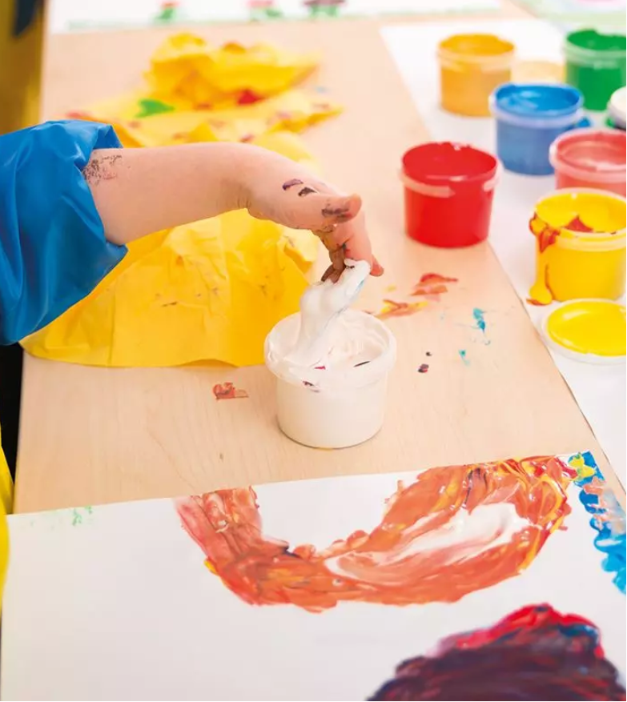
Finger Paint
In the 1920s, modern finger painting came to life through Ruth Faison Shaw.
Finger paint is a thick, tactile paint that children apply with their fingers onto finger painting paper.
Finger painting paper is a paper with a glossy surface and enough weight to hold in moisture and keep the painting intact.
Notes:
Class instruction: Explain how children can activate the force of their bodily motions to produce dynamic rhythms. They should reach outwards to paint all corners of their papers.
Image Left: US Marine Corp, Public domain, via Wikimedia Commons. https://commons.wikimedia.org/wiki/File:USMC-101119-M-4689B-009.jpg
Image Top Right: Natálie Hierschová, 4 years old, MŠ Zdraví, Ostrava – Zábřeh, Czech Republic. 40th ICEFA Lidice.
Image Bottom Right: Cyril Caskey, Flickr, https://creativecommons.org/licenses/by/2.0/ CC BY 2.0 Deed
References:
Marabel, D. (2006). Ruth Faison Shaw: First lady of finger painting. The World and I, 21(9), 22.
Shaw, R. F. (1947). Finger-painting and how I do it. New York: Leland-Brent.

Slide 17
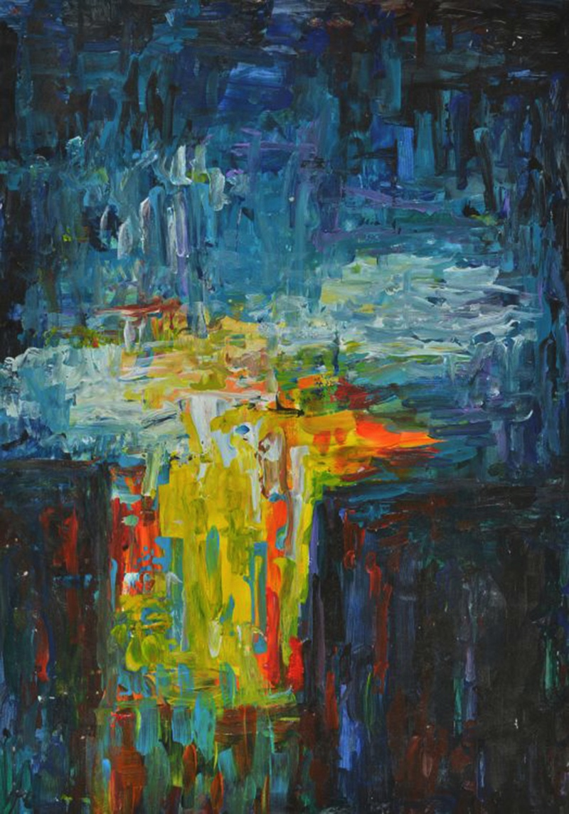
Acrylics 1
Acrylic paint is a permanent paint medium comprised of pigment and a polymer binder. Acrylic paint dries quickly, is odorless, and does not require harsh solvents to dilute.
Notes:
Image: Polina Rusakovich, 13 years old, CDODiM Mayak, Minsk, Belarus. 43rd ICEFA Lidice.

Slide 18
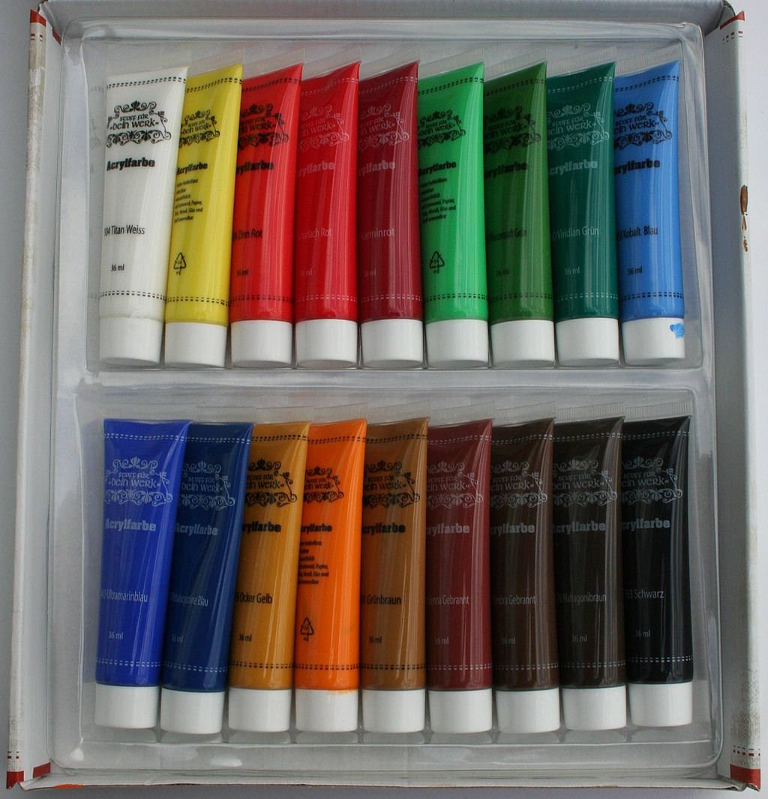
Acrylics 2
Acrylic paint has a smooth sheen and covers other colors better than tempera paints.
It adheres to nearly all surfaces including canvas, paper, wood, metal, stone, fabrics, and cardboard.
Dilute it with water. It can be used as a thin base coat. Mix with mediums for different qualities and consistencies.
Notes:
Image: Gmhofmann, CC BY-SA 3.0 <https://creativecommons.org/licenses/by-sa/3.0>, via Wikimedia Commons

Slide 19
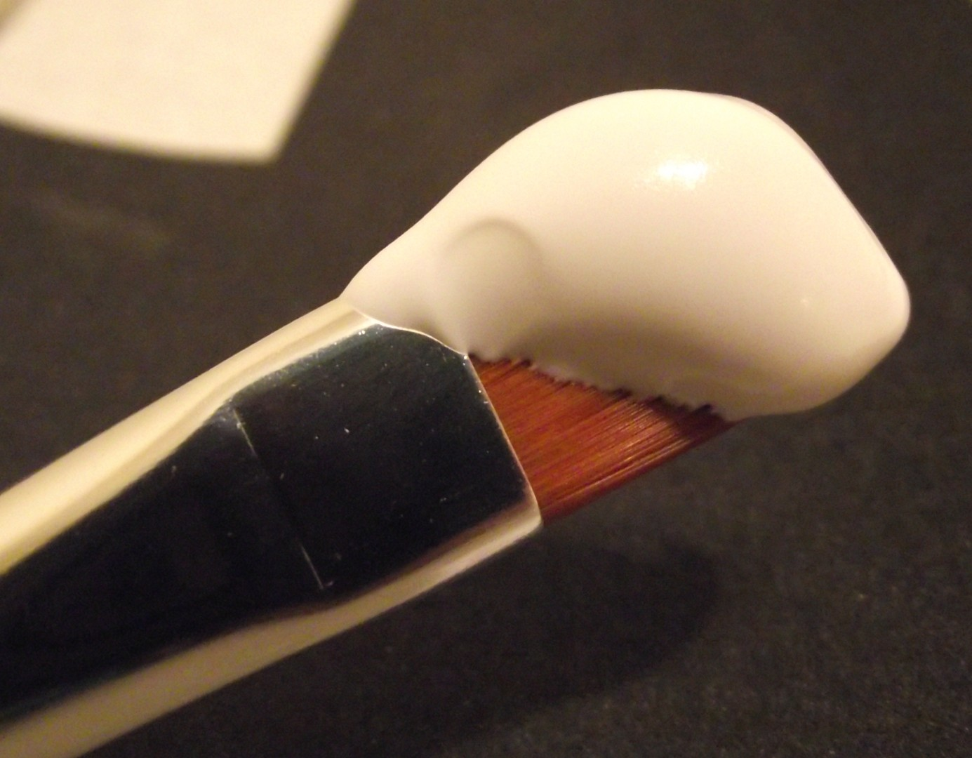
Gesso
Gesso is a thick priming material that artists apply by painting directly to a surface before painting.
Notes:
Image: Stickpen, Public domain, via Wikimedia Commons

Slide 20

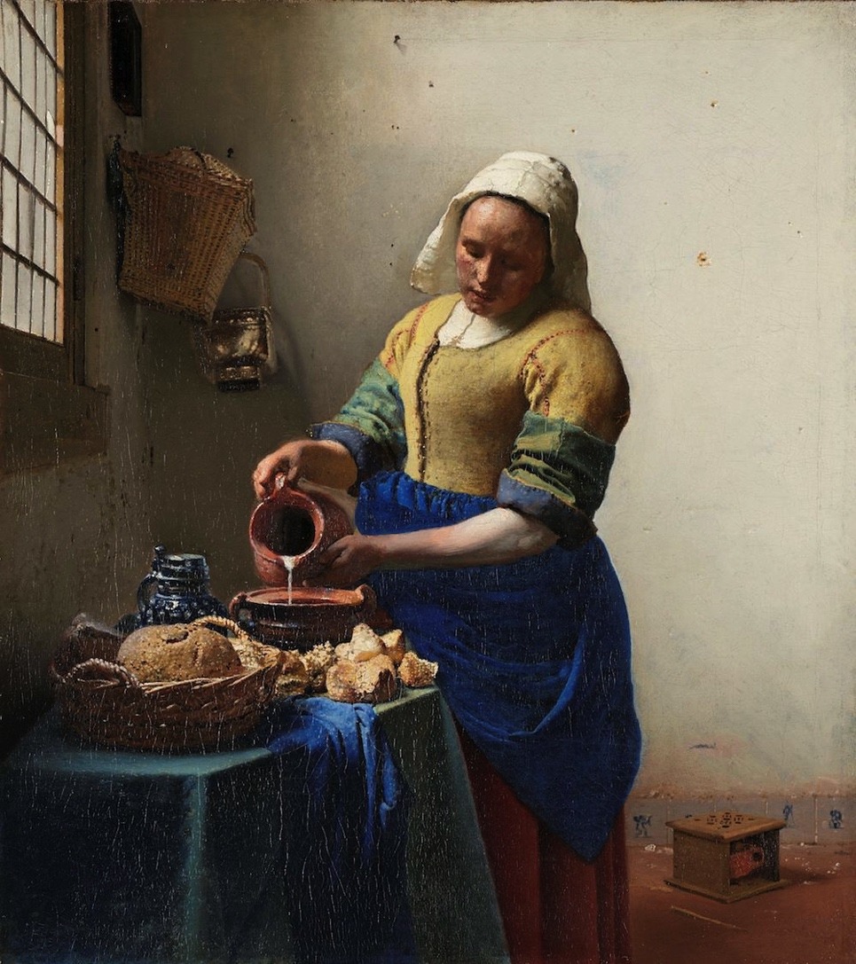
Oil Paint 1
Oil paint is a slow drying paint medium. Frequently used by professional artists, oil painting is less common in schools due to its expense, slow drying time, students’ ages or skill levels, and the potential for working with harsh solvents.
Notes:
Left Image: F. Weber Co. catalogue. AnonymousUnknown author, Public domain, via Wikimedia Commons
Right Image: The Milkmaid, Johannes Vermeer, c. 1660 oil on canvas, h 45.5cm × w 41cm. Public Domain: Rijksmuseum. http://hdl.handle.net/10934/RM0001.COLLECT.6417

Slide 21
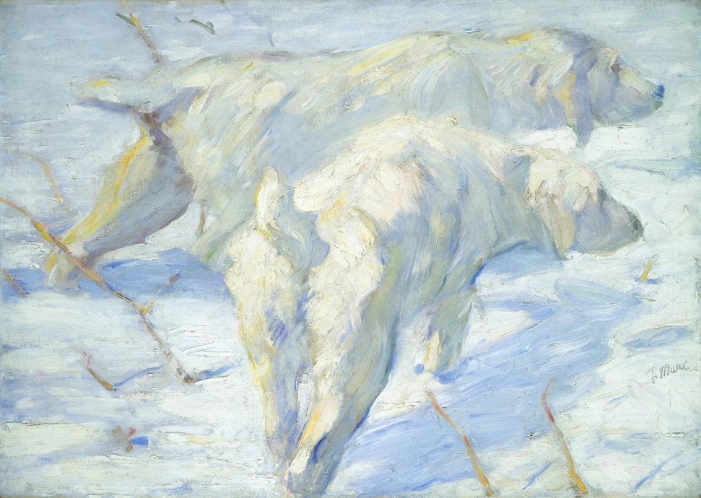
Oil Paint 2
Paint in well-ventilated areas with oil paints that have AP and/or CL safety seals.
Select walnut oil or other safe substitutes to thin paint and clean brushes as alternatives.
Gradually build up layers of oil paint with synthetic brushes, natural bristle brushes, and palette knives.
Notes:
Class instruction: Inform the class that in the 19th century, American painter John Rand invented the paint tube.
Image: Franz Marc, German, 1880 – 1916, Siberian Dogs in the Snow, 1909/1910 oil on canvas. overall: 80.5 x 114 cm (31 11/16 x 44 7/8 in.) framed: 97.8 x 131.4 cm (38 1/2 x 51 3/4 in.) Gift of Mr. and Mrs. Stephen M. Kellen. Open Access. Courtesy National Gallery of Art, Washington.

Slide 22
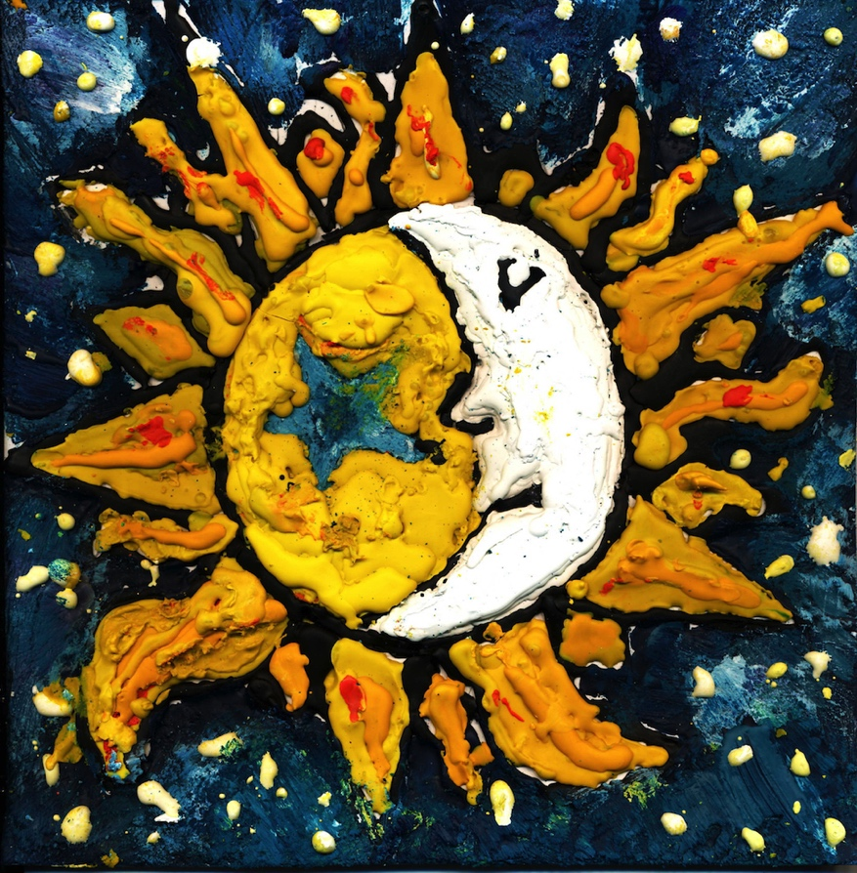
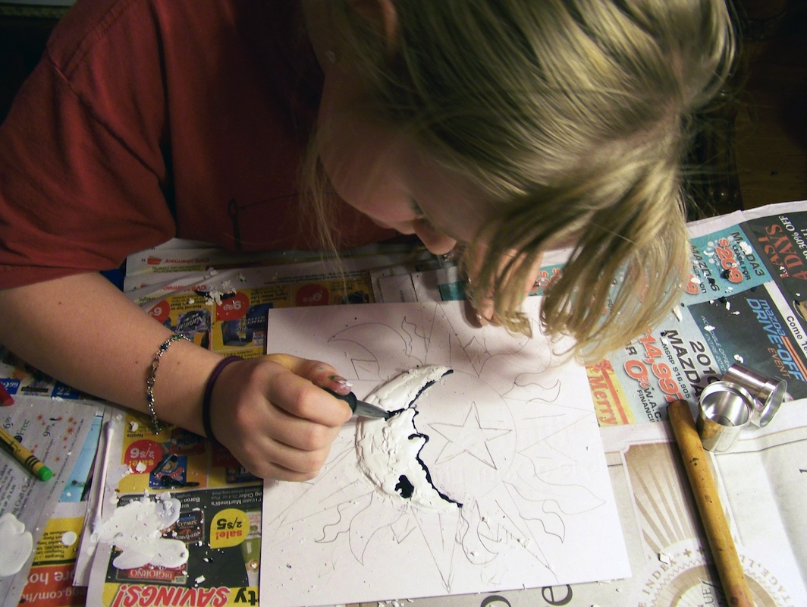
Encaustics
An encaustic is created by melting beeswax or synthetic wax with colored pigment and applying it to a surface.
Notes:
Class instruction: Inform the class that encaustic painting is an ancient art form that dates back 3,000 years when Greek shipbuilders used beeswax to seal ships (Mattera, 2001). It is best suited for responsible upper elementary and older students with teacher classroom management and safety procedures in place.
Left Image: Ailee Sickler, 6th Grade. USA. Author, teacher. Richard Sickler, photo.
Right Image: Ailee layers melted crayons with paintbrushes and a medicine dropper to create her encaustic. USA. Author, teacher. Richard Sickler, photo.
Reference:
Mattera, 2001

Slide 23
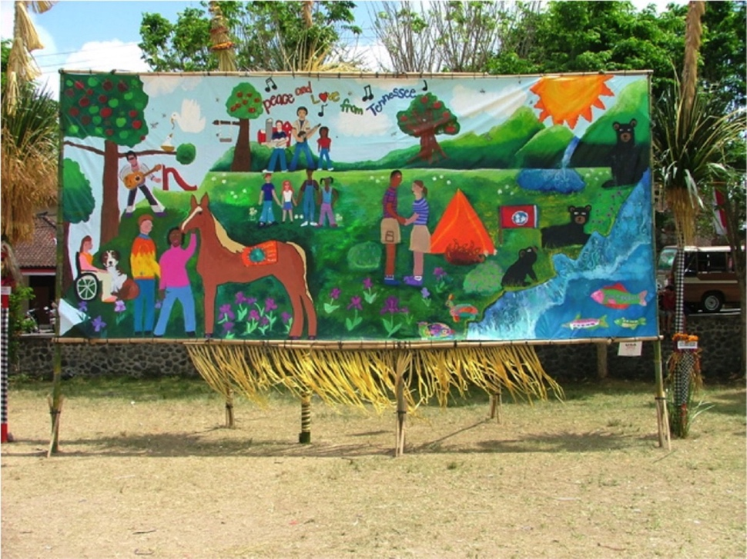
Murals
Murals are large public artworks painted on walls, panels, and canvas.
Historically their images communicate messages including community, sacred teachings, significant moments, and socio-political commentaries.
Student murals promote shared ownership. The best murals correlate with community sites and the populations they serve.
Notes:
Class instruction: Explain to the class that murals can also include frescos and some graffiti artworks. Mural paints can include latex paint for wall murals and tempera paint for paper murals on butcher paper.
Image: Elementary and middle school students’ peace mural displayed in Bali. USA. Author, teacher. Tom Anderson, photo.

Slide 24
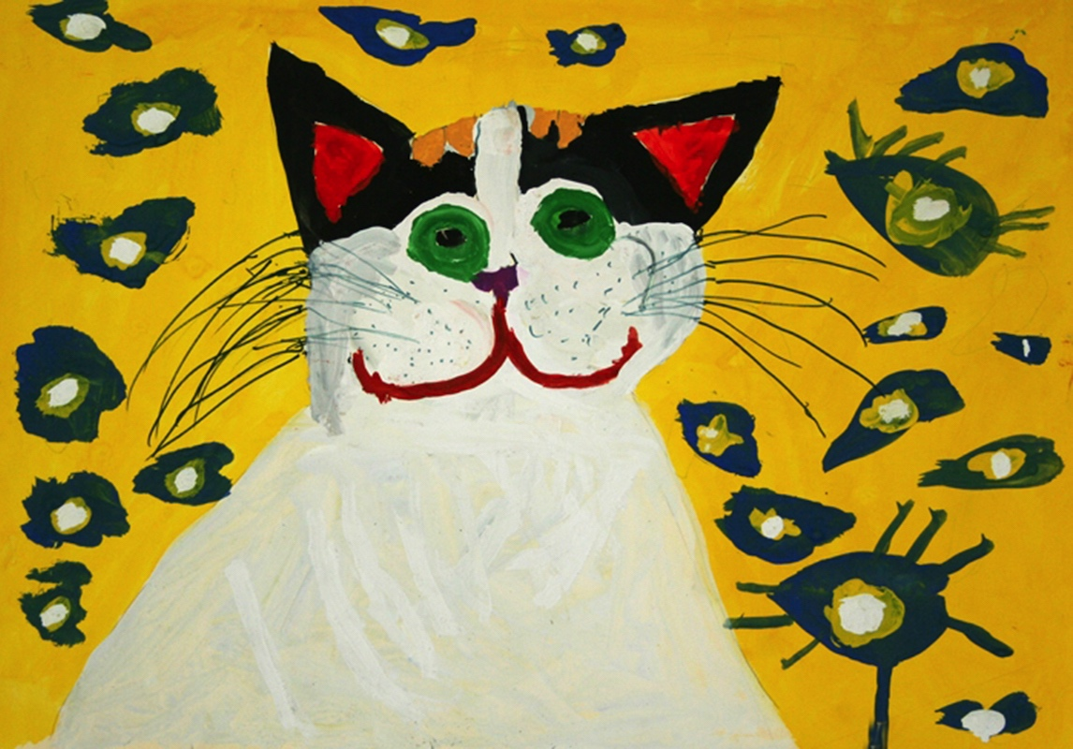
Transformative Best Practices for Teaching Painting from Pre-K Through High School 1
Study traditional and contemporary painting processes.
Learn how artists may incorporate mixed media methods and technologies to paint diverse surfaces.
Produce quick painted sketches and in-depth projects.
Notes:
Image: Anastasia Rusinova, 7 years old, Gorogskaia Shkola Iskusstv, Kharkiv, Ukraine. 40th ICEFA Lidice.

Slide 25
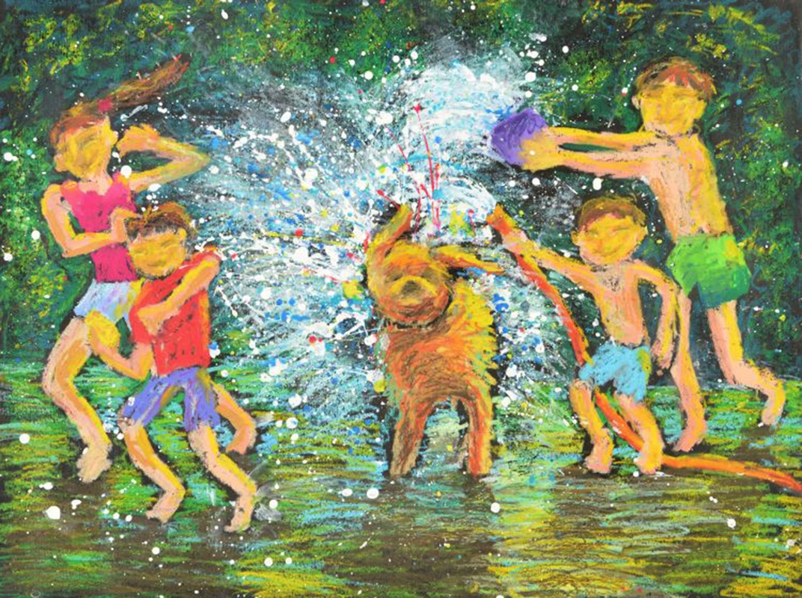
Transformative Best Practices for Teaching Painting from Pre-K Through High School 2
Organize paint into table sets and cover the paint palettes.
Place materials at students’ desks before instruction.
Pass out paintbrushes when students are ready to paint.
Notes:
Image: Kennard Alvaro Hadinata Hadinata, 9 years old, Nirvana Visual School, Surabaya, Indonesia. 46th ICEFA Lidice.

Slide 26
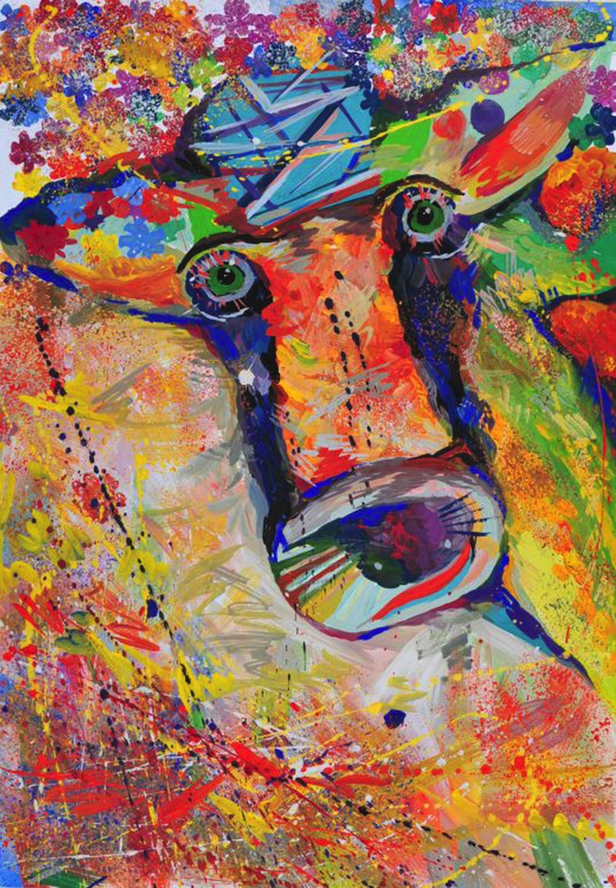
Transformative Best Practices for Teaching Painting from Pre-K Through High School 3
Have students write their names on the back of their paper/canvas before painting.
Teach students to respect brushes and painting materials. Demonstrate how to pour small amounts of a color at a time.
Establish paint distribution, refill, and cleanup rules. Teach how to mix light colors first and add small amounts of darker colors.
Notes:
Image: Iryna Firko, 13 years old, Shkola dekoratyvno-uzhytkovogo mystetstva, Sambir, Ukraine. 42nd ICEFA Lidice.

Slide 27
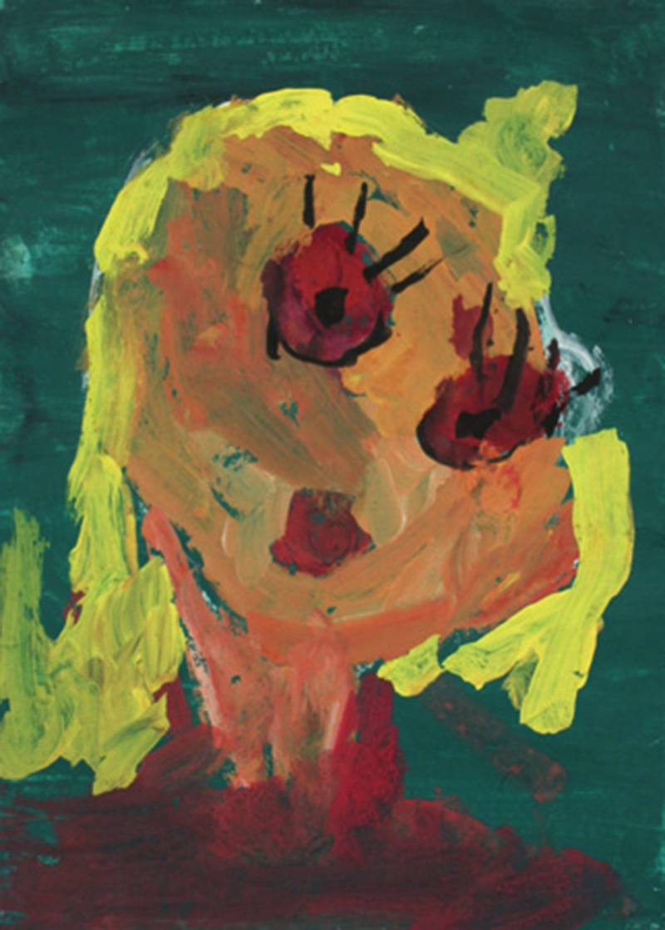
Transformative Best Practices for Teaching Painting from Pre-K Through High School: Early childhood 1
Learning to operate paintbrushes and dip their hands in finger paint to form more controlled marks.
Painting on large papers and mixing paint promote kinesthetic learning.
Notes:
Class instruction: Discuss how young students enjoy painting about events in their lives.
Image: Miruna Toba, 4 years old, Scoala Albestii de Arges, Arges, Romania. 39th ICEFA Lidice.

Slide 28
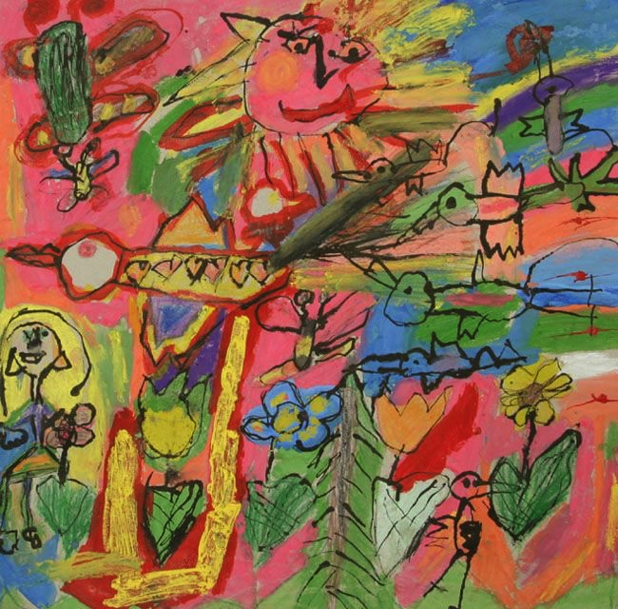
Transformative Best Practices for Teaching Painting from Pre-K Through High School:
Early Childhood 3
Students paint with imaginative color choices.
Limited color palettes can help students avoid mixing too many colors together.
Notes:
Image: Martinka Gallíková, 6 years old, Súkromná MŠ Stella, Poprad, Slovak Republic. 39th ICEFA Lidice.

Slide 29
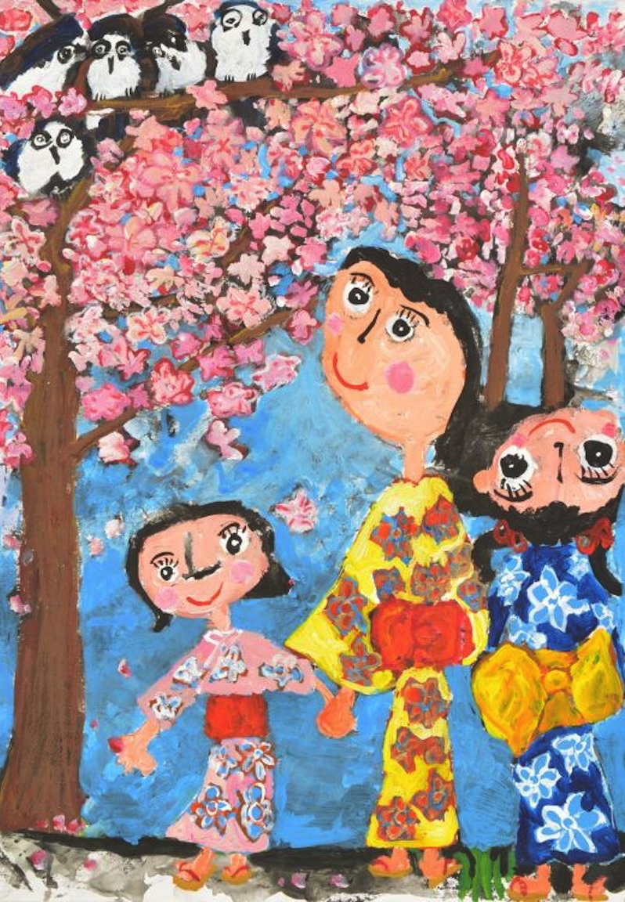
Transformative Best Practices for Teaching Painting from Pre-K Through High School:
Early Childhood 4
Young students enjoy painting about events in their lives including feelings, celebrations, transportation, and friends, family, and pets.
Learning painting vocabulary. Terms will become a regular part of their discussions and critiques.
Notes:
Image: Yeung Sze Nga, 7 years old, Kids Palette Creative Art Workshop, Hong Kong, China. 45th ICEFA Lidice.

Slide 30
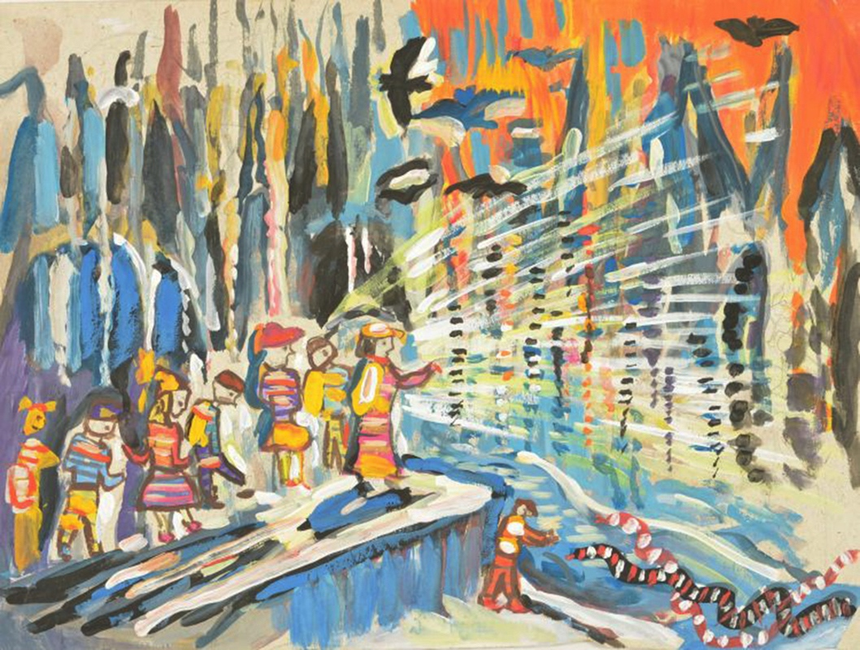
Transformative Best Practices for Teaching Painting from Pre-K Through High School:
Middle Childhood 1
Have increased manipulative skills to control a paintbrush better and can illustrate finer details in their paintings.
Learn how painters apply their intuitive knowledge to correct mistakes and produce dynamic results.
Notes:
Image: Lilia Margaryan, 10 years old, Art School studio Vardges Gulikyan, Yerevan, Armenia. 45th ICEFA Lidice.

Slide 31
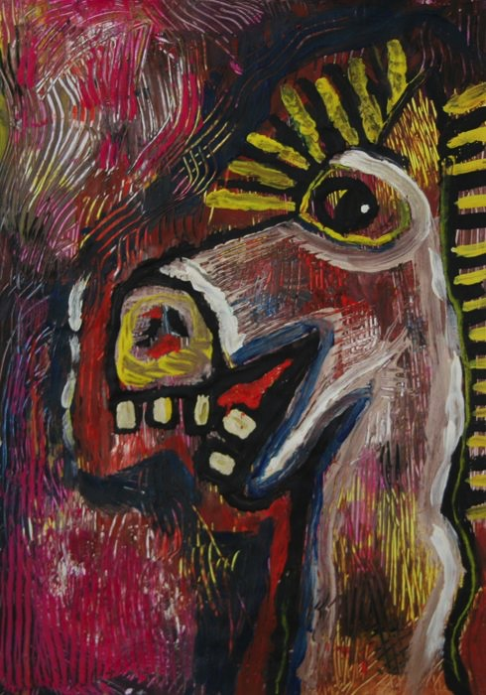
Transformative Best Practices for Teaching Painting from Pre-K Through High School:
Middle Childhood 2
Augment knowledge of painting vocabulary, painters, and painting materials, and processes.
Combine realism with abstractions.
Notes:
Image: Luisa Tichá, 9 years old, Súkromná ZUŠ, Bratislava, Slovak Republic. 41st ICEFA Lidice

Slide 32
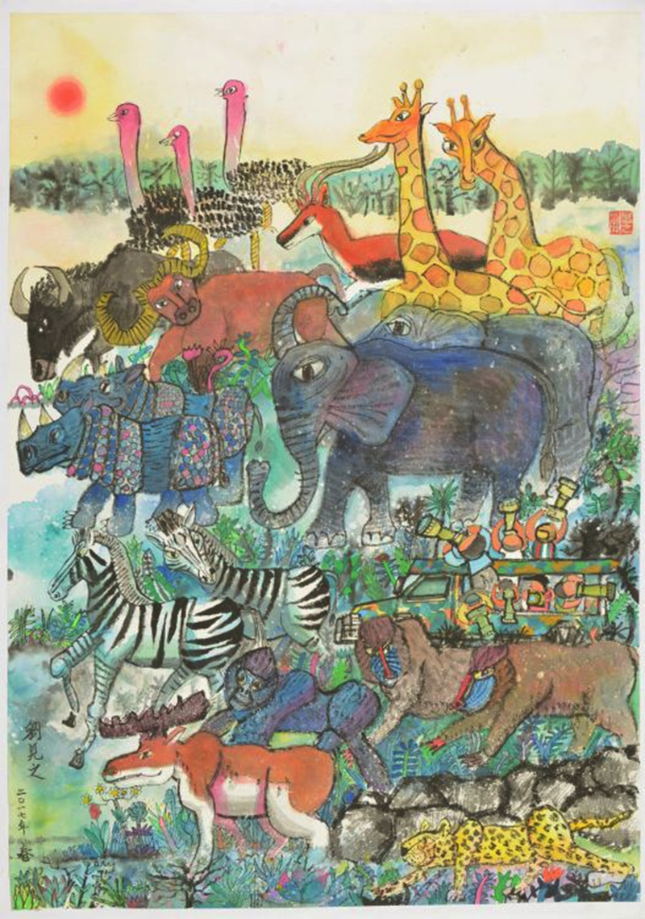
Transformative Best Practices for Teaching Painting from Pre-K Through High School:
Middle Childhood 3
Select from different brushes and brushstrokes to produce aesthetic marks.
Portray aerial perspective and depict details in a painting’s foreground, middle ground, and background.
Mix and layer colors to make paintings appear more three-dimensional.
Notes:
Image: Lau Kin Gi. 11 years old, Simply Art, Hong Kong, China. 45th ICEFA Lidice.

Slide 33
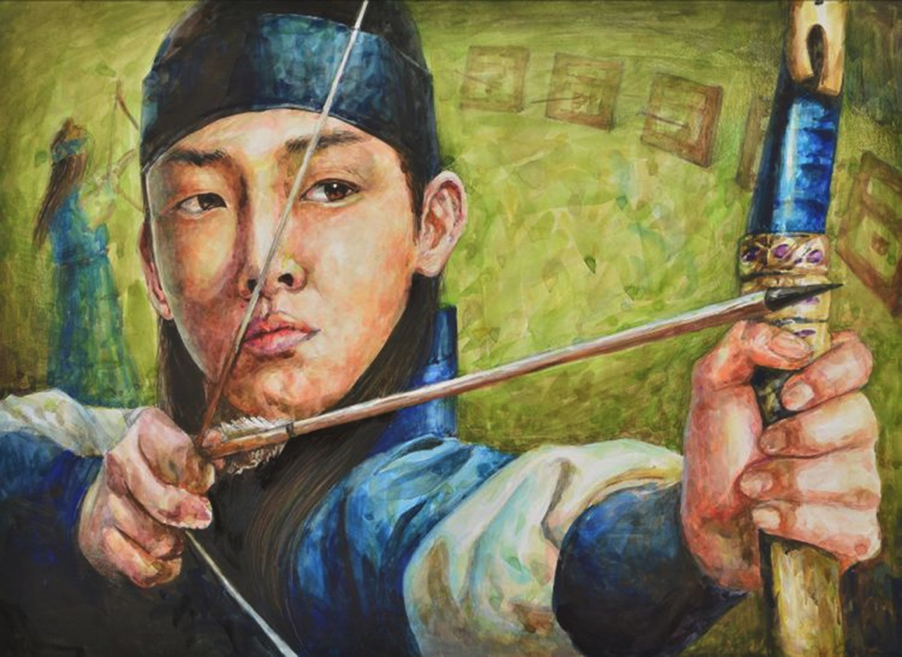
Transformative Best Practices for Teaching Painting from Pre-K Through High School:
Early Adolescence 1
Introduce advanced processes and media including acrylics, oils, and encaustics on various substrates.
Encourage creative risk-taking to build upon students’ existing repertoires and develop new skills.
Include lessons on experimental mark making and non-realistic expressive colors.
Students can produce subtle color changes to show greater value and depth.
Notes:
Class instruction: Try collaborative painting activities to promote a sense of belonging and group accomplishment.
Image: Lee Ji Hyeon, 13 years old, Busan Middle School of Arts, Busan, Korea, South. 44th ICEFA Lidice.

Slide 34
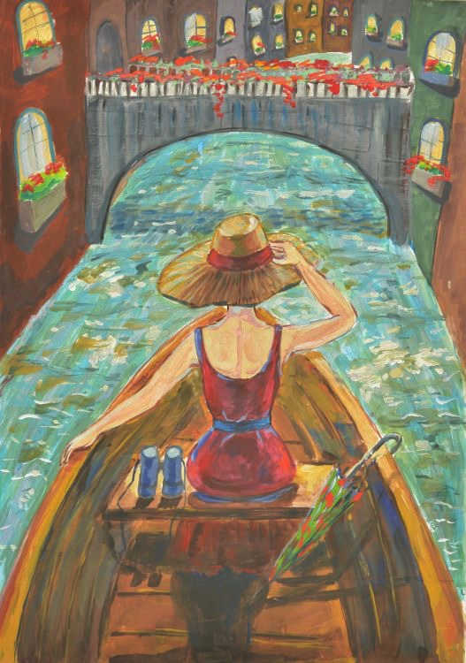
Transformative Best Practices for Teaching Painting from Pre-K Through High School:
Early Adolescence
Make revisions to paintings as necessary and augment current skills based on successful learning outcomes.
Analyze paintings’ meanings. Cite evidence to make convincing cases.
Notes:
Image: Lizi Murvanidze, 13 years old, Painting Art School No. 1 of Soliko Virsaladze, Tbilisi, Georgia. 45th ICEFA Lidice.

Slide 35
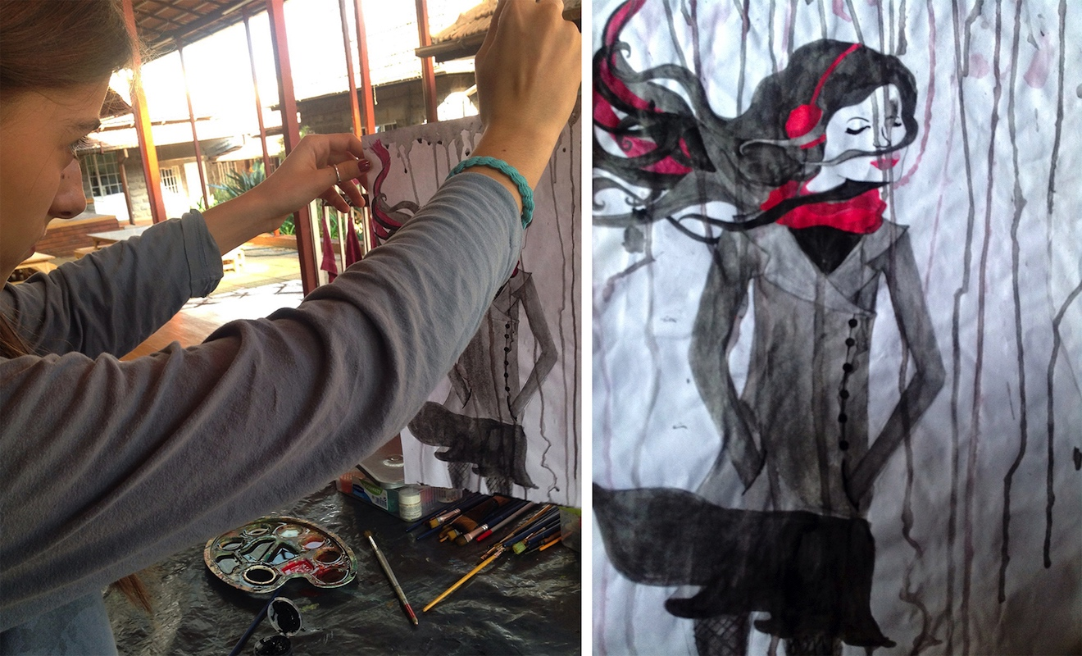
Transformative Best Practices for Teaching Painting from Pre-K Through High School:
Early Adolescence
Use video footage of their production methods and gather audience feedback to build on the meaning of the works they created.
Create journal entries and photographs to document the steps they took to produce finished painted designs.
Notes:
Image: Lorna Fida, early adolescence, drips paint. Kenya. Lisa Wee, teacher.

Slide 36
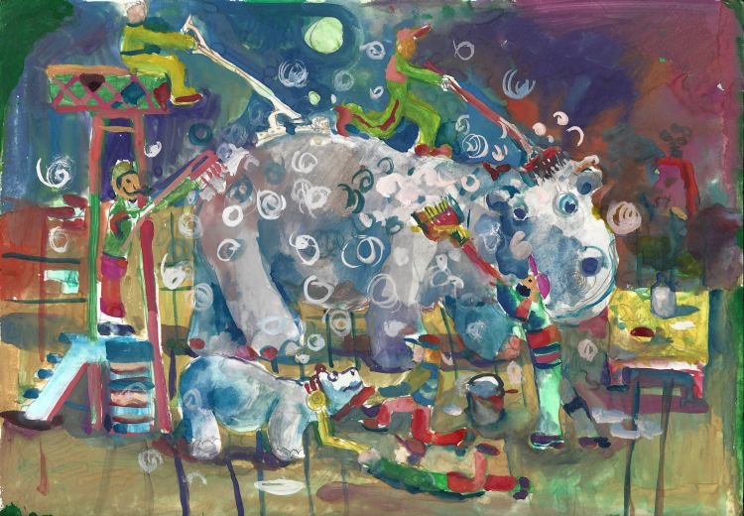
Transformative Best Practices for Teaching Painting from Pre-K Through High School:
Adolescence 1
Pre-assess students’ painting knowledge to develop learning targets that meet student’s personal needs.
Have students analyze the commonalities and dissimilarities that paintings share through art inquiry tasks.
Notes:
Image: Aren Asatrian, 14 years old, Detskaia khudozhestvennaia shkola O. Sharambeiana, Dilizhan, Armenia. 46th ICEFA Lidice.

Slide 37

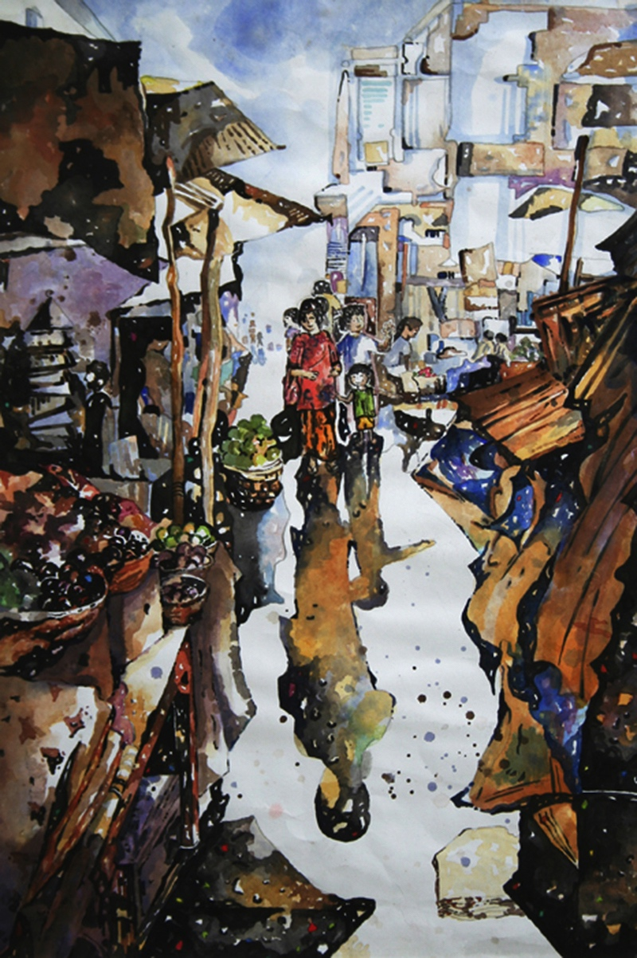
Transformative Best Practices for Teaching Painting from Pre-K Through High School:
Adolescence 2
Build strengths working with painting techniques, media, and styles. Try less familiar approaches and combine existing skills in new ways.
Benefit from using professional materials, including absorbent watercolor papers, canvas, professional-grade encaustic wax, and finer brushes.
Notes:
Class instruction: Discuss strategies to encourage student choice-based painting tasks.
Image: Liang Lim Yong, 16 years old, Yeow Chye Art Centre, Penang, Malaysia. 41st ICEFA Lidice.

Slide 38
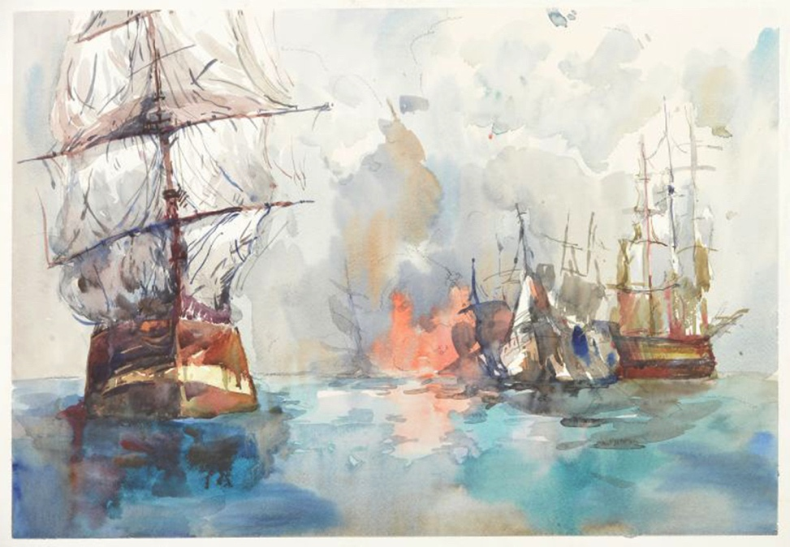
Transformative Best Practices for Teaching Painting from Pre-K Through High School:
Adolescence 3
Assess paintings in their portfolios to identify pathways to expand current ideas, make revisions, and produce future works.
Can study transformations in the environment and life through paint, as well as participate in outdoor plein aire painting.
Notes:
Image: Gordey Murashko, 14 years old, GBOU School No. 1955, Moscow, Russia. 46th ICEFA Lidice.

Slide 39
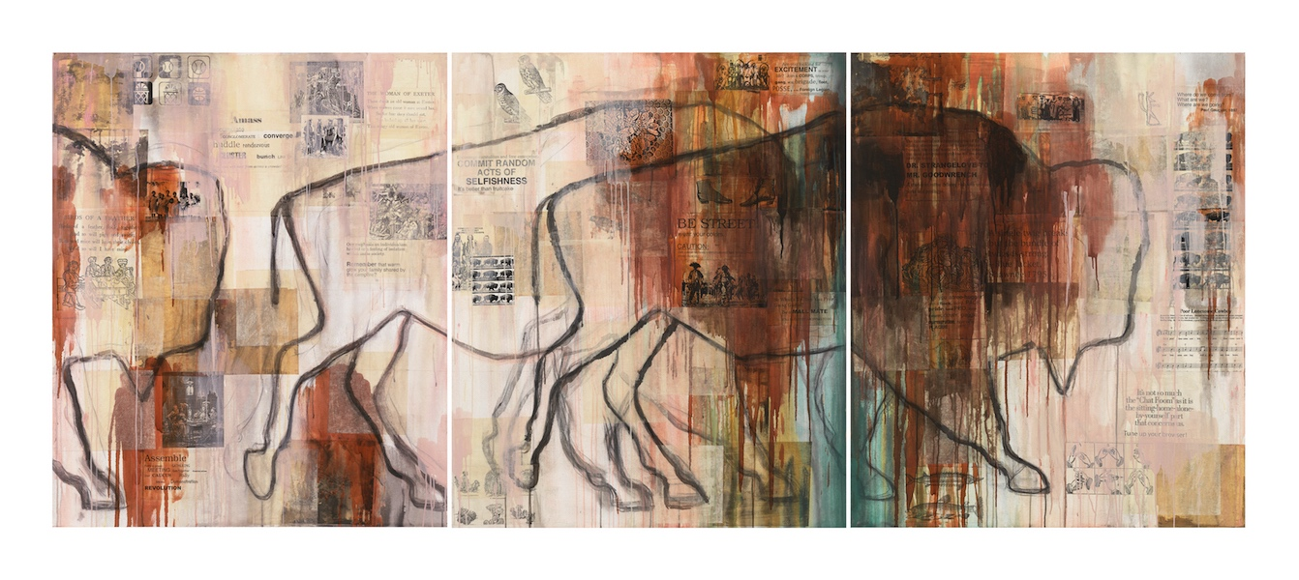
Jaune Quick-to-See Smith: Have You He(a)rd? Setting Higher Standards Through Art, Education, and Activism
Artists’ Lessons to Thrive! 12.1.
Painting
Big Idea: Higher Standards
Notes:
Class instruction: Have the class open the textbook to Artists’ Lessons to Thrive! 12.1. Participate in its learning targets.
Image: Jaune Quick-to-See Smith, I See Red: Herd, 1993 Mixed media on canvas 60 x 150 inches 152.4 x 381 cm Signed and dated, verso (Inv# QTSPT026) Courtesy the artist and Garth Greenan Gallery, New York.

Slide 40
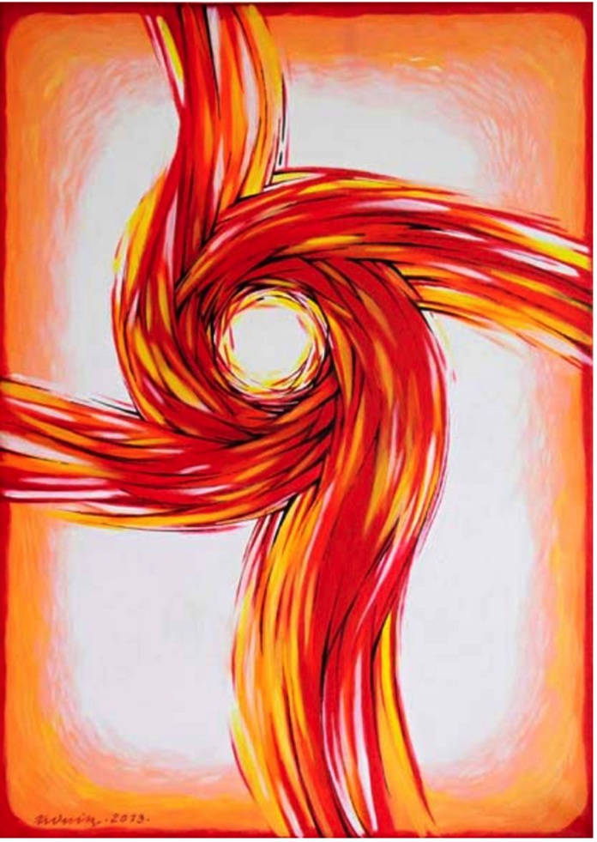
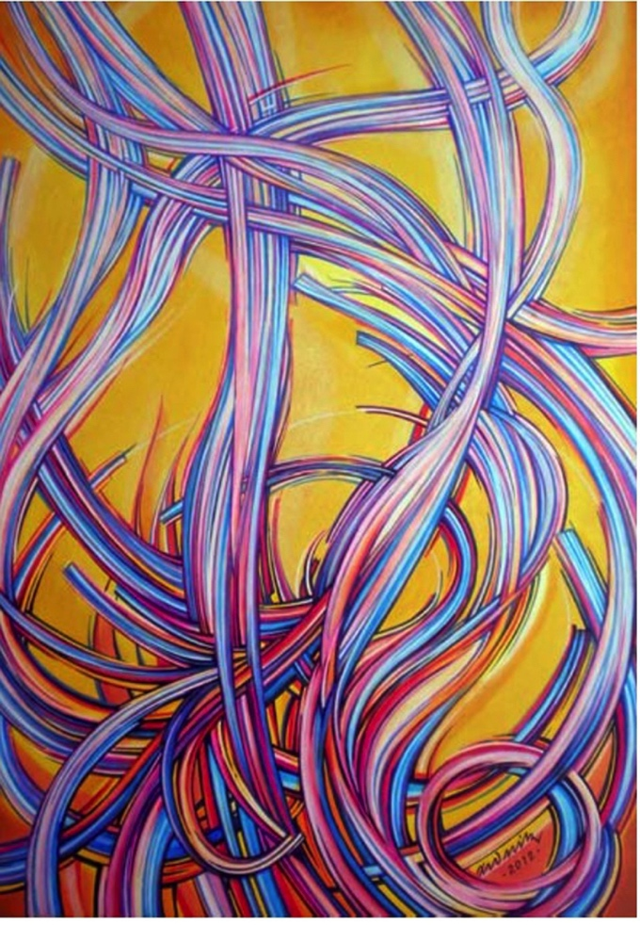
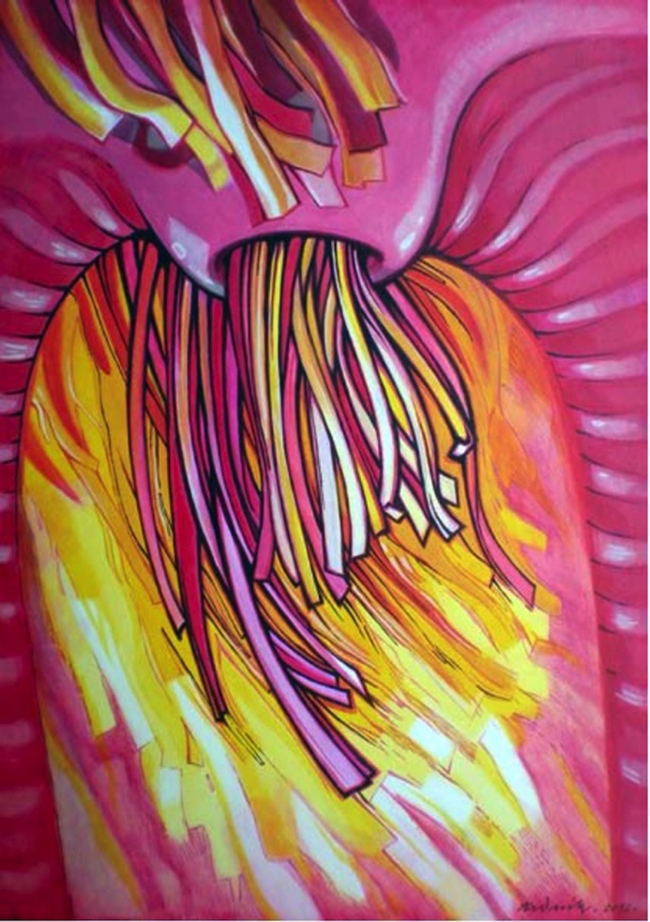
Josef Zedník: Living Transformations
Artists’ Lessons to Thrive! 12.2.
Painting
Big Idea: Higher Transformation
Notes:
Class instruction: Have the class open the textbook to Artists’ Lessons to Thrive! 12.2. Participate in its learning targets.
Left Image: Josef Zedník, Gateway to Power, 2013.
Center Image: Josef Zedník, Gateway to Pleasure, 2012.
Right Image: Josef Zedník, Gateway to Summer, 2012.

Slide 41
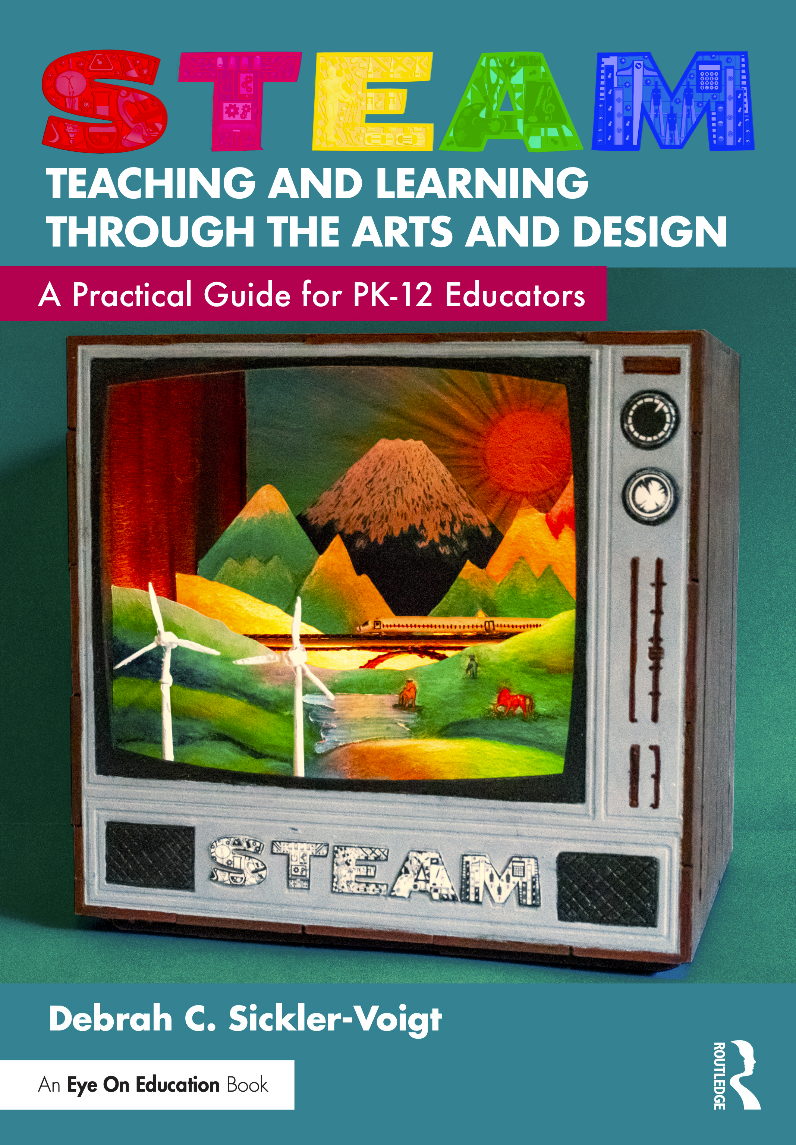
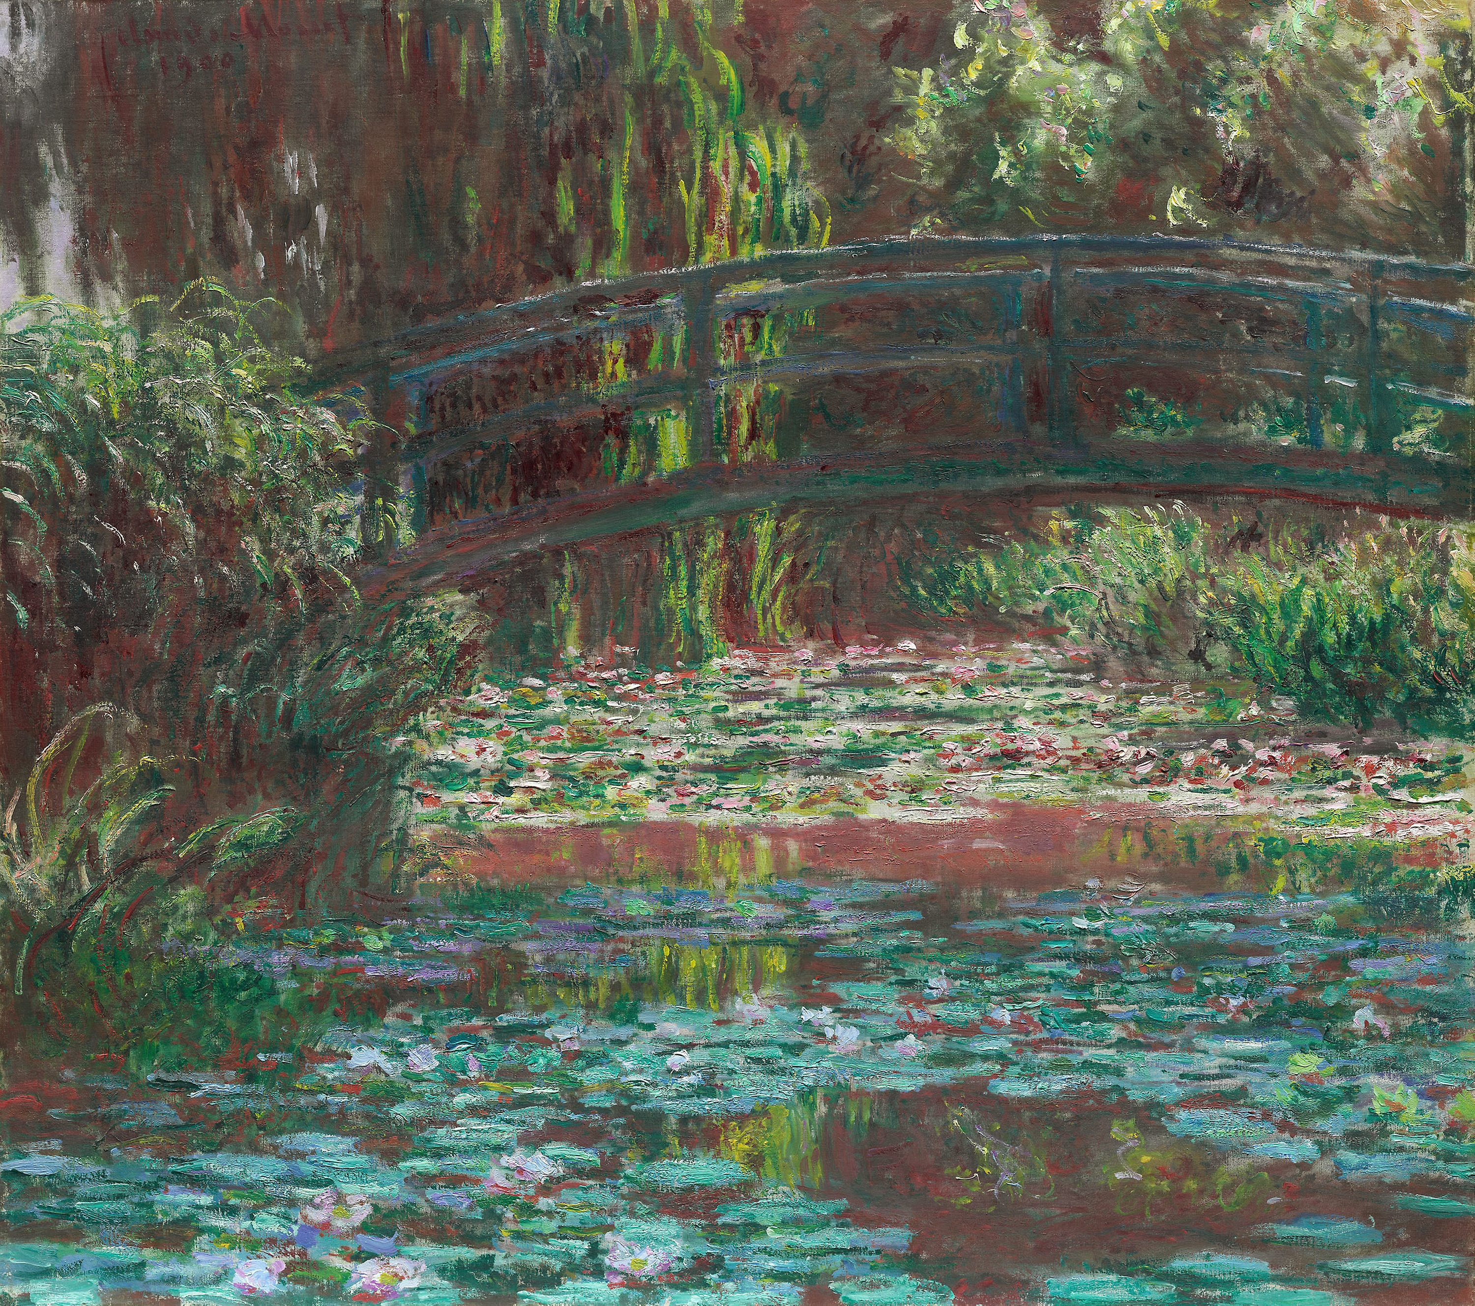
Claude Monet’s Water Garden
STEAM Artists’ Lessons to Thrive!
Zednick’s paintings can be explored as a unit plan with STEAM Teaching and Learning Through the Arts and Design’s (STLAD’s) Artists’ Lessons to Thrive! on Claude Monet and his infamous paintings of his tranquil water garden’s transformations according to the seasons and time of day.
Notes:
Image: Claude Monet, Water Lily Pond, 1900. Oil on canvas, 89.8 × 101 cm (35 3/8 × 39 3/4 in.). Art Institute of Chicago. (CC0) Public Domain
https://www.artic.edu/artworks/87088/water-lily-pond

Slide 42
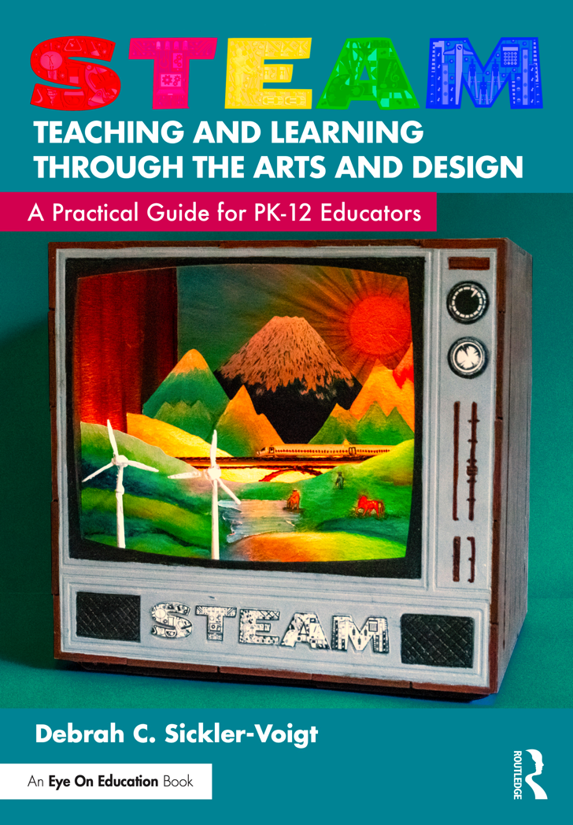


Alma Thomas:
Beyond a Shadow of a Doubt artists’ Lessons to Thrive!
Teach students about Alma Thomas’s painting methods and studies of the solar eclipse.
Notes:
Left Book Cover: © Debrah Sickler-Voigt
Left Image Tunnel Book: © Debrah Sickler-Voigt, Paige Brenner, and Richard Sickler. Photo: Richard Sickler
Middle Image: Alma Thomas, The Eclipse, 1970, acrylic on canvas. Source: Smithsonian American Art Museum, Gift of the artist.
Right Image: Alma Thomas, Snoopy—Early Sun Display on Earth, 1970, acrylic on canvas. Source: Smithsonian American Art Museum, Gift of Vincent Melzac.

Slide 43

Teaching Tips to Thrive! 12.1
Gerald Obregon
Transitioning From Pastels to Paint
I like to introduce students to painting by having them work in oil pastel first before moving on to acrylic paint. With both mediums, I limit the amount of colors they use to the primary colors plus white. This means that all secondary and tertiary colors have to be mixed. Brown has to be mixed as well. Black is off limits for quite a while to encourage students' experimentation and observational skills, helping them produce richer shades and tones while preventing muddy hues.
Notes:
Class instruction: Discuss Teaching Tips to Thrive #12.1 and Gerald Obregon’s methods for transitioning his students from creating with pastels to paint.
Top Image: Photo by Kai Tremblay on Unsplash https://unsplash.com/photos/assorted-color-coloring-pencils-in-box-jmb4HafBuS0
Bottom Image: Gmhofmann, CC BY-SA 3.0 <https://creativecommons.org/licenses/by-sa/3.0>, via Wikimedia Commons

Slide 44

Approaches to Teacher and Student Transformative Growth Charts
Teacher: Honor student voice and agency by co-creating a painting lesson that invites students to explore their identities, cultural backgrounds, and lived experiences using self-directed painting and mixed media techniques.
Student: Cultivate my skills to hone my intuitive painting practices, allowing myself to follow my creative instincts and spontaneity, exploring how my paintings evolve naturally.
Notes:
Class Activity: Open the textbook to Chapter 12’s Teacher and Student Transformative Growth Charts. Model 12.1 TLAE’s Overview of Approaches to Teacher Transformative Growth and Model 12.2 TLAE’s Overview of Approaches to Student Transformative Growth. Discuss the meanings of these transformative actions. Build on their list of actions.
Image: Midjourney AI, prompted by Netha Hussain, CC0, via Wikimedia Commons. https://commons.wikimedia.org/wiki/File:Quilling_pattern_of_a_mountain_02.png

Slide 45
Chapter 12 Topics
Understanding Painting in Context
Applying Paint Media in Context
Best Practices for Teaching Painting from Pre-K Through High School
Tempera Paint
Watercolors
Finger Paint
Acrylic and Oil Paints
Encaustics
Murals
Notes:
Thanks for participating in Teaching and Learning in Art Education’s 2nd Ed. Chapter 12!
Book Cover Artwork: Paula Gale
Chapter References
Bolt, B. (2004). Art beyond representation: The performative power of the image. I. B. Tauris.
Brommer, G. F. , & Kinne, N. K. (2003). Exploring painting (3rd ed.). Davis Publications.
Elkins, J. (2000). What painting is: How to think about oil painting, using the language of alchemy. Routledge.
Grant, D. (2010). More watercolor classes are needed in art schools. American Artist, 74 (811), 74–75.
Guarino, E. (2018). And the ship sails on: More of Jaune Quick-to-See Smith’s Trade Canoe series. https://kinggalleries.com/and-the-ship-sails-on-more-on-jaune-quick-tosee-smiths-trade-canoe-series/
Hurt, P. (2013). Never underestimate the power of a paint tube. Smithsonian. www.smithsonianmag.com/arts-culture/never-underestimate-the-power-of-a-paint-tube-36637764/#QTzQSRQ34rldaVgl.99
Kaneda, T. , & Fischer, H. (2010). The Kids’ Guernica Peace Mural Project: A vehicle for social justice. In T. Anderson , D. Gussak , K. Hallmark , & A. Paul (Eds.), Art education for social justice (pp. 195–200). National Art Education Association.
Kastner, C. (2013). Jaune Quick-to-See Smith: An American modernist. University of New Mexico Press.
Kelker, N. L. (2021). Art of the non-western world: Asia, Africa, Oceania, and the Americas. Oxford University Press.
Kirk, C. (2014). “Painting” as emergent knowledge: A practice-led case study of contemporary artistic labour. Journal of Visual Art Practice, 13(2), 114–129.
Mattera, J. (2001). The art of encaustic painting: Contemporary expression in the ancient medium of pigmented wax. Watson-Guptill.
Petersen, A. R. (2010). Painting spaces. In A. R. Petersen , M. Bogh , H. Dam Christensen , & P. N. Larsen (Eds.), Contemporary painting in context (pp. 123–138). Museum Tusculanum Press.
Reyner, N. (2007). Acrylic revolution: New tricks and techniques for working with the world’s most versatile medium. North Light Books.
Sawyer, D. (2018). Katharina Grosse rejects your idea that painting is archaic. www.documentjournal.com/2018/05/katharina-grosse-rejects-your-idea-that-painting-is-archaic/
Shaw, R. F. (1947). Finger-painting and how I do it. Leland-Brent.
Sickler-Voigt, D. C. (2006). From out of sight to “outta sight!”: Collaborative art projects that empower children with at-risk tendencies. Journal of Social Theory in Art Education, 26, 156–175.
Sickler-Voigt, D. C. (2023). STEAM teaching and learning through the arts and design: A practical guide for PK-12 educators. Routledge.
Weibel, P. (2010). Pittura/immedia: Painting in the nineties between mediated visuality and visuality in context. In A. R. Petersen , M. Bogh , H. D. Christensen , & P. N. Larsen (Eds.), Contemporary painting in context (pp. 49–66). Museum Tusculanum Press, University of Copenhagen.
Womack, L. , & Womack, W. (2008). Embracing encaustic: Learning to paint with beeswax. Hive.
Zarur, E. N. C. (2001). Introduction. In E. N. C. Zarur & C. M. Lovell (Eds.), Art and faith in Mexico: The nineteenth-century retablo tradition (pp. 17–29). University of New Mexico Press.

