Slide 1

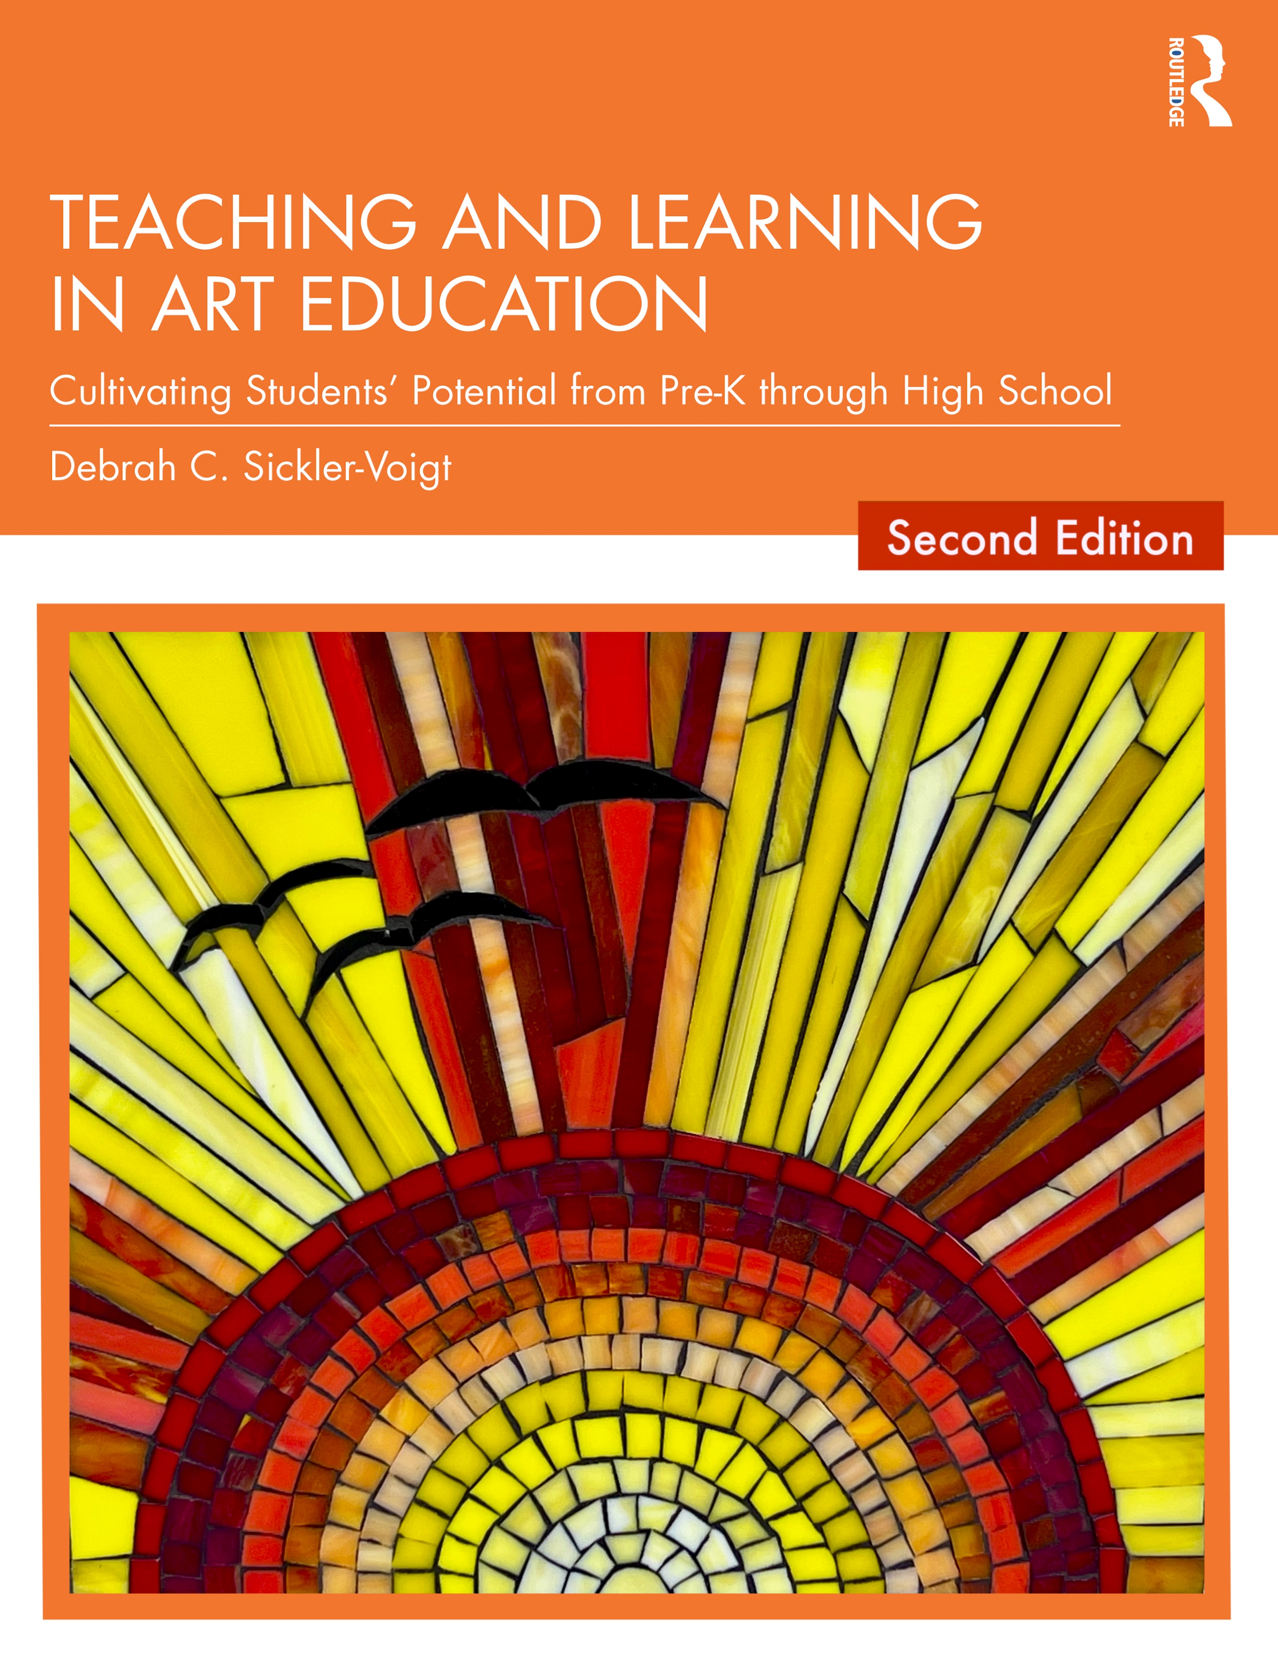
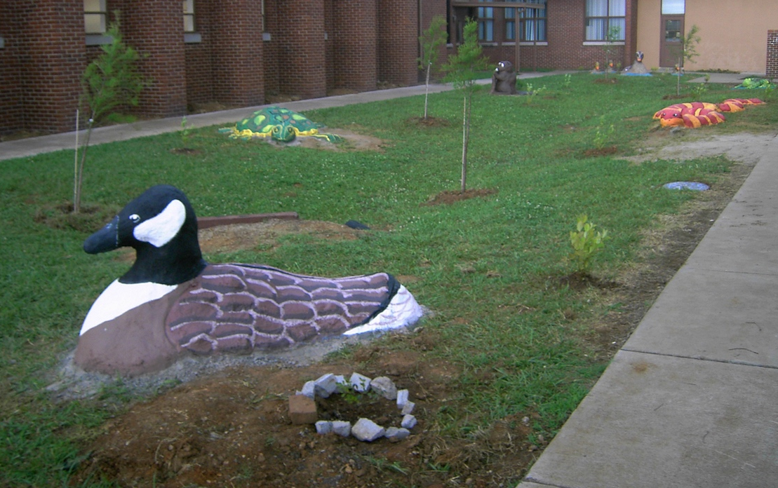
CHAPTER 14. Sculpture Teaching and Learning in Art Education, 2nd Ed.
Debrah C. Sickler-Voigt, Author & Presentation Developer ©
Notes:
Welcome to Teaching and Learning in Art Education, 2nd Edition, Chapter 14!
TLAE as a theoretically-based, practical textbook to prepare preservice educators for their teaching careers and to support in-service educators in improving their existing practices. Its timely second edition with its updated framework remains dedicated to assisting educators in all stages of their careers through effective curricular planning, instruction, assessment, and management to foster student learning and cultivate educators’ meaningful, creative, and rewarding careers.
This textbook and instructional resources resulted from the contributions of many individuals, including teachers, students, artists, organizations, family, mentors, and Routledge’s editorial/production team. Its teachings are based on the author’s research, communications, and professional interpretations of teachers, artists,’ and designers’ works with the aim of being respectful of diversified peoples and representing their teachings in a truthful and non-biased manner.
Book Cover Artwork: Paula Gale
Right Image: Wetland Garden Red-Eared Slider Turtle. Middle childhood students, USA, Author, teacher. MTSU Public Service Grant. Pamela McColly, photo.

Slide 2

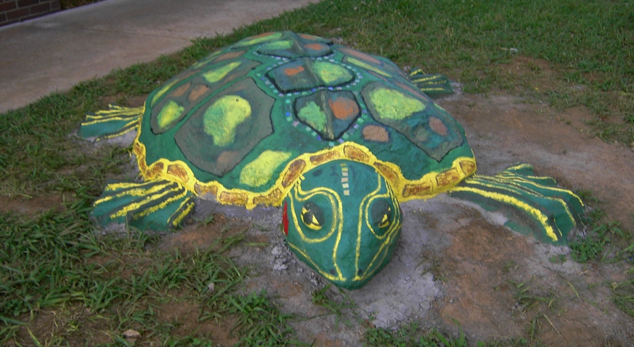
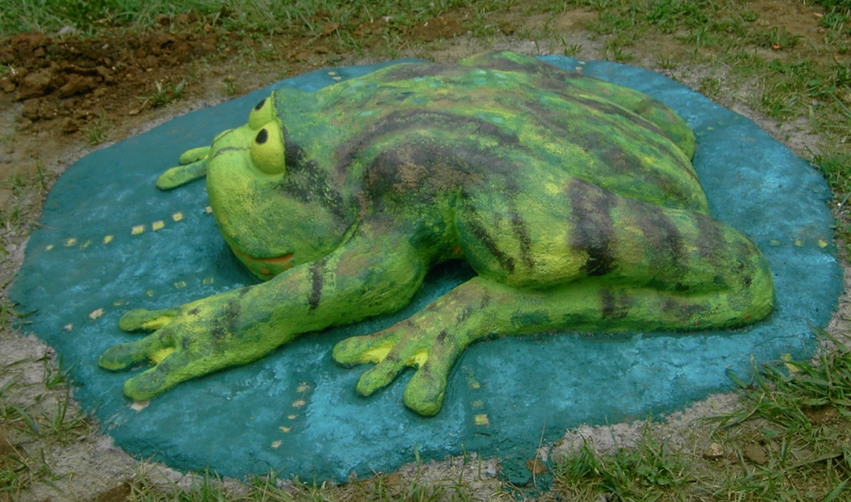
Chapter 14 Topics
Understanding Sculpture in Context
Applying Sculpture Methods in Context
Transformative Best Practices for Teaching Sculpture from Pre-K Through High School
Notes:
Spotlight on Student Art #14: Wetland Protection
Top Image: Wetland Garden Red-Eared Slider Turtle. Middle childhood students, USA, Author, teacher. MTSU Public Service Grant. Pamela McColly, photo.
Bottom Image: Wetland Garden Frog. Middle childhood students, USA, Author, teacher. MTSU Public Service Grant. Pamela McColly, photo.

Slide 3
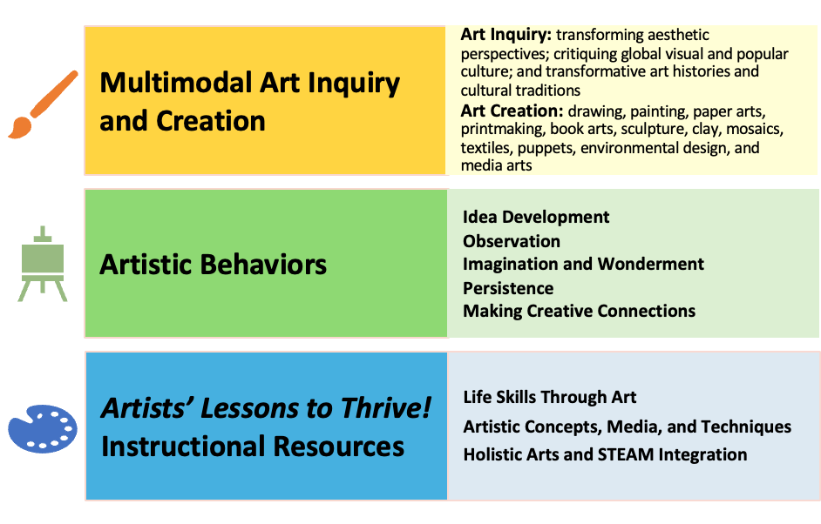
Link Chapter 14’s teachings with TLAE’s Transformative
Art Education Framework
Notes:
Class instruction: Ask students to build on prior learning and personal experiences to make personal connections between this chapter’s teachings and TLAE’s Transformative Art Education framework.
Book Cover Artwork: Paula Gale

Slide 4

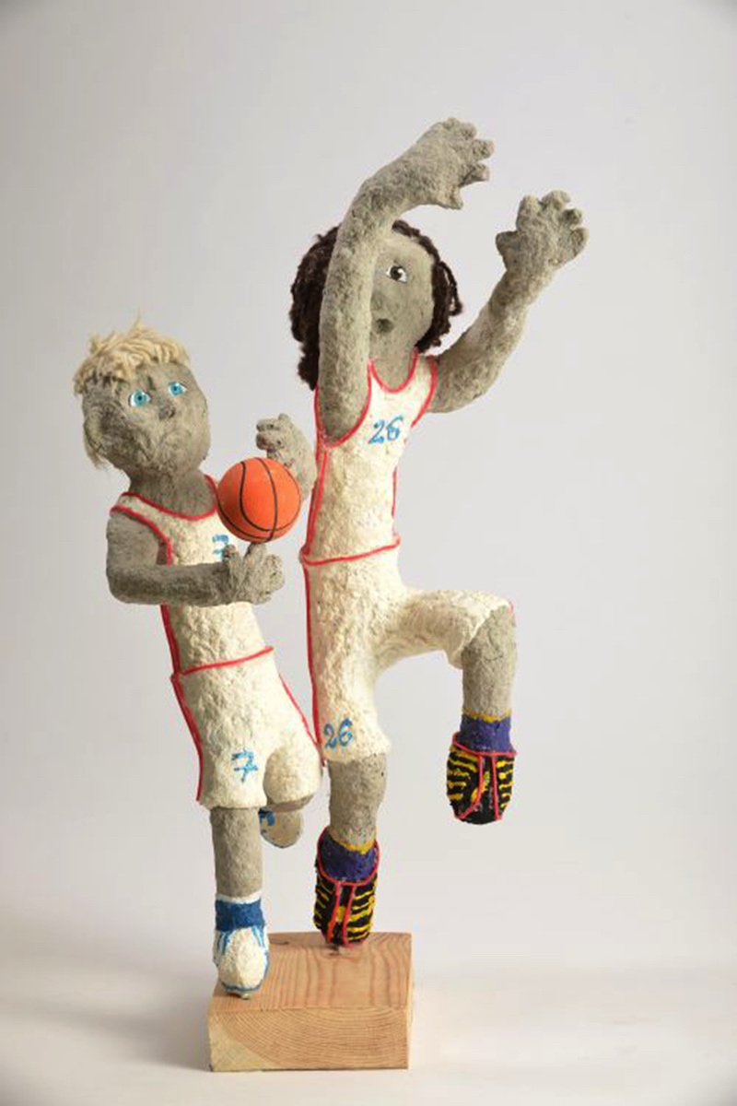
Understanding Sculpture in Context 1
A sculpture is a three-dimensional art form that has volume and mass.
Sculpting satisfies the human need to manipulate objects into something special.
Artists produce sculptures by carving, molding, and constructing materials.
Sculptures can be heavy, lightweight, static, and kinetic.
Notes:
Image: Džeina Gutaroviča, 12 years old, Una Laizāne old, 12 years, Inčukalna novada muzikas un makslas skola, Vangaži, Latvia. 44th ICEFA Lidice.

Slide 5
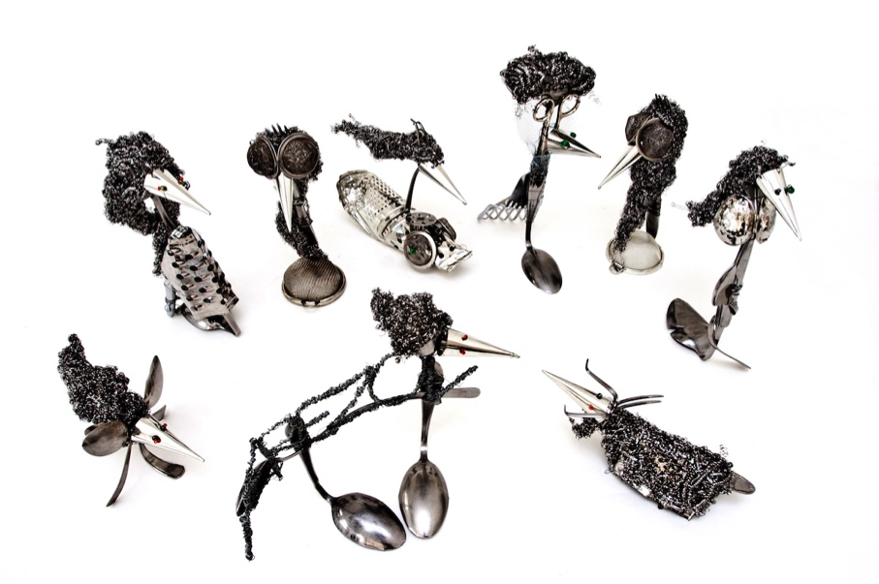
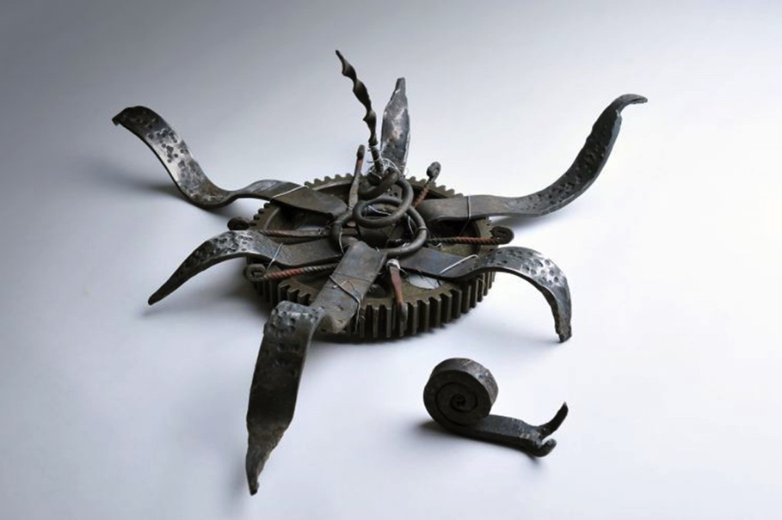
Understanding Sculpture in Context 2
Many early sculptures had utilitarian functions, including weapons, containers, and musical instruments. Some served religious and ceremonial purposes.
As the world became industrialized, contemporary artists began making sculptures out of found objects including tools.
Notes:
Top Image: Daniela Berezová, 13 years old, Michaela Chlachulová, 12 years old, Lucie Kolaříková, 14 years old, Dominika Laníková, 14 years old, Jakub Oulehla, 16 years old, ZUŠ Vladimíra Ambrose, Prostějov, Czech Republic. 40th ICEFA Lidice.
Bottom Image: Barbora Kulhánková, 13 years old, ZUŠ, Mšeno, Czech Republic. 42nd ICEFA Lidice.

Slide 6

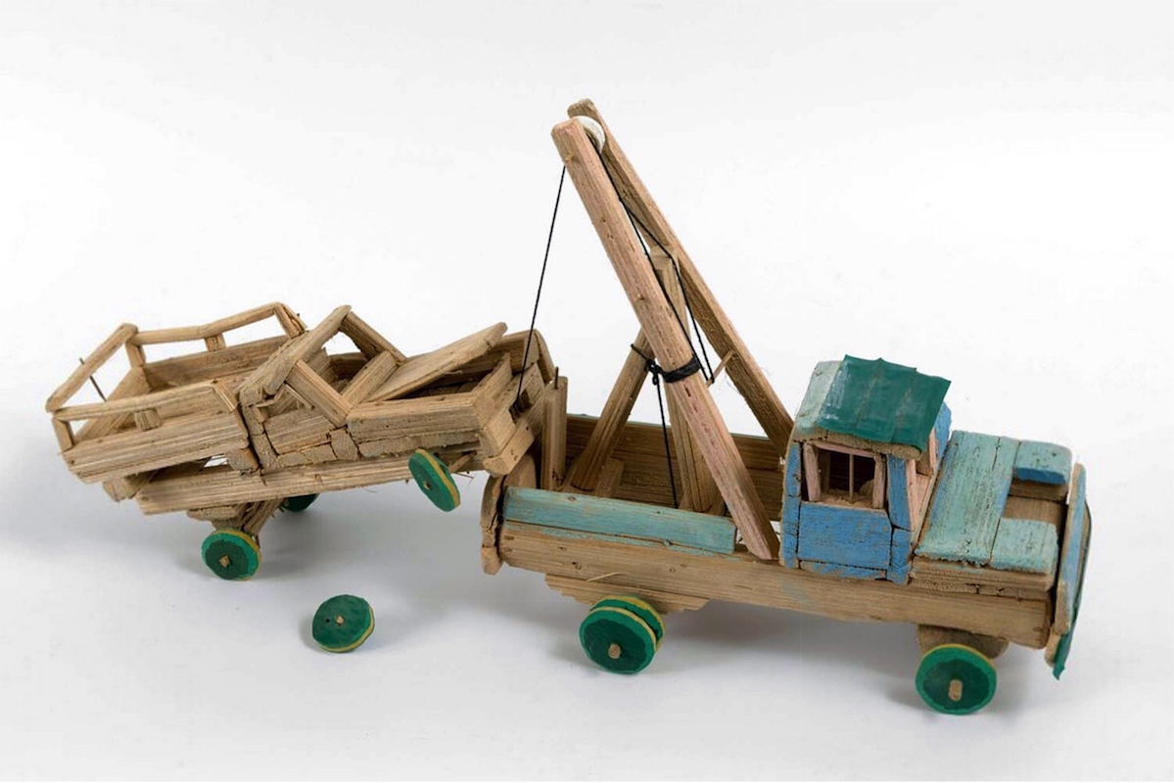
Understanding Sculpture in Context 3
Artists design most sculptures in the round, meaning that people can walk around a free standing sculpture and see it from all different angles.
Notes:
Image: Hassän Mwalago, 12 years old, Toy car. Kenya. Tropenmuseum, part of the National Museum of World Cultures. CC BY-SA 3.0 via Wikimedia Commons. https://creativecommons.org/licenses/by-sa/3.0/deed.en

Slide 7
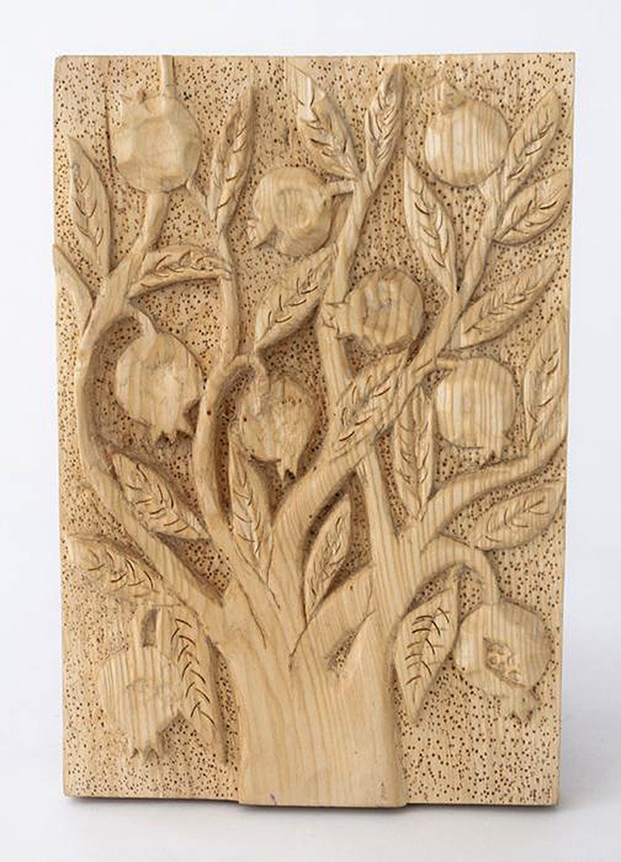
Understanding Sculpture in Context 4
A bas-relief sculpture has a low relief, just like the images on cast coins.
A high relief sculpture projects at least 50 percent of its form from the background.
A relief sculpture differs from a sculpture in the round. Viewers cannot see the backside of the images in relief.
Notes:
Class instruction: Explain to the class that reliefs vary by the amount of depth artists use to raise the figures from the background plane.
Image: Gagik Aleqsanyan, 7 years old, Kasakh, Armenia. 41st ICEFA Lidice.

Slide 8

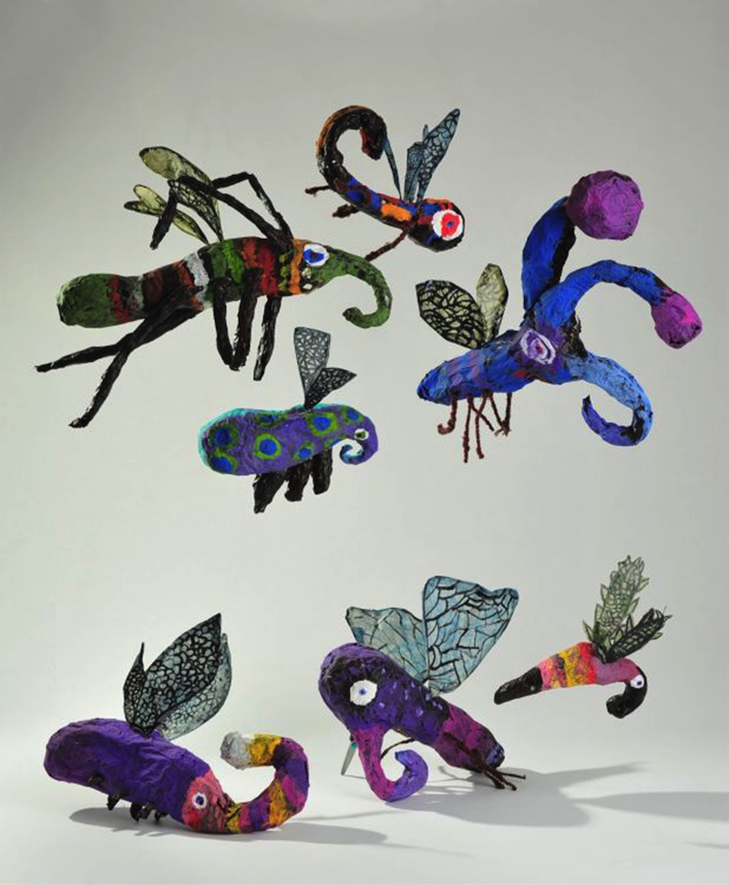
Understanding Sculpture in Context 5
Sculptors join different parts together to build an additive sculpture.
They may construct additive sculptures on an armature, a skeletal frame located at the core of a sculpture to support it.
Notes:
Image: Amálie Gajdová, 6 years old, Ema Gojtková, 8 years old, Jolana Juráňová, 6 years old, Magdaléna Kyšáková, 8 years old, Eliška Rozsypalová, 9 years old, Markéta Skalková, 8 years old, Jiří Vašenka, 8 years old, ZŠ Sedmikráska o.p.s., Rožnov pod Radhoštěm, Czech Republic. 42nd ICEFA Lidice.

Slide 9
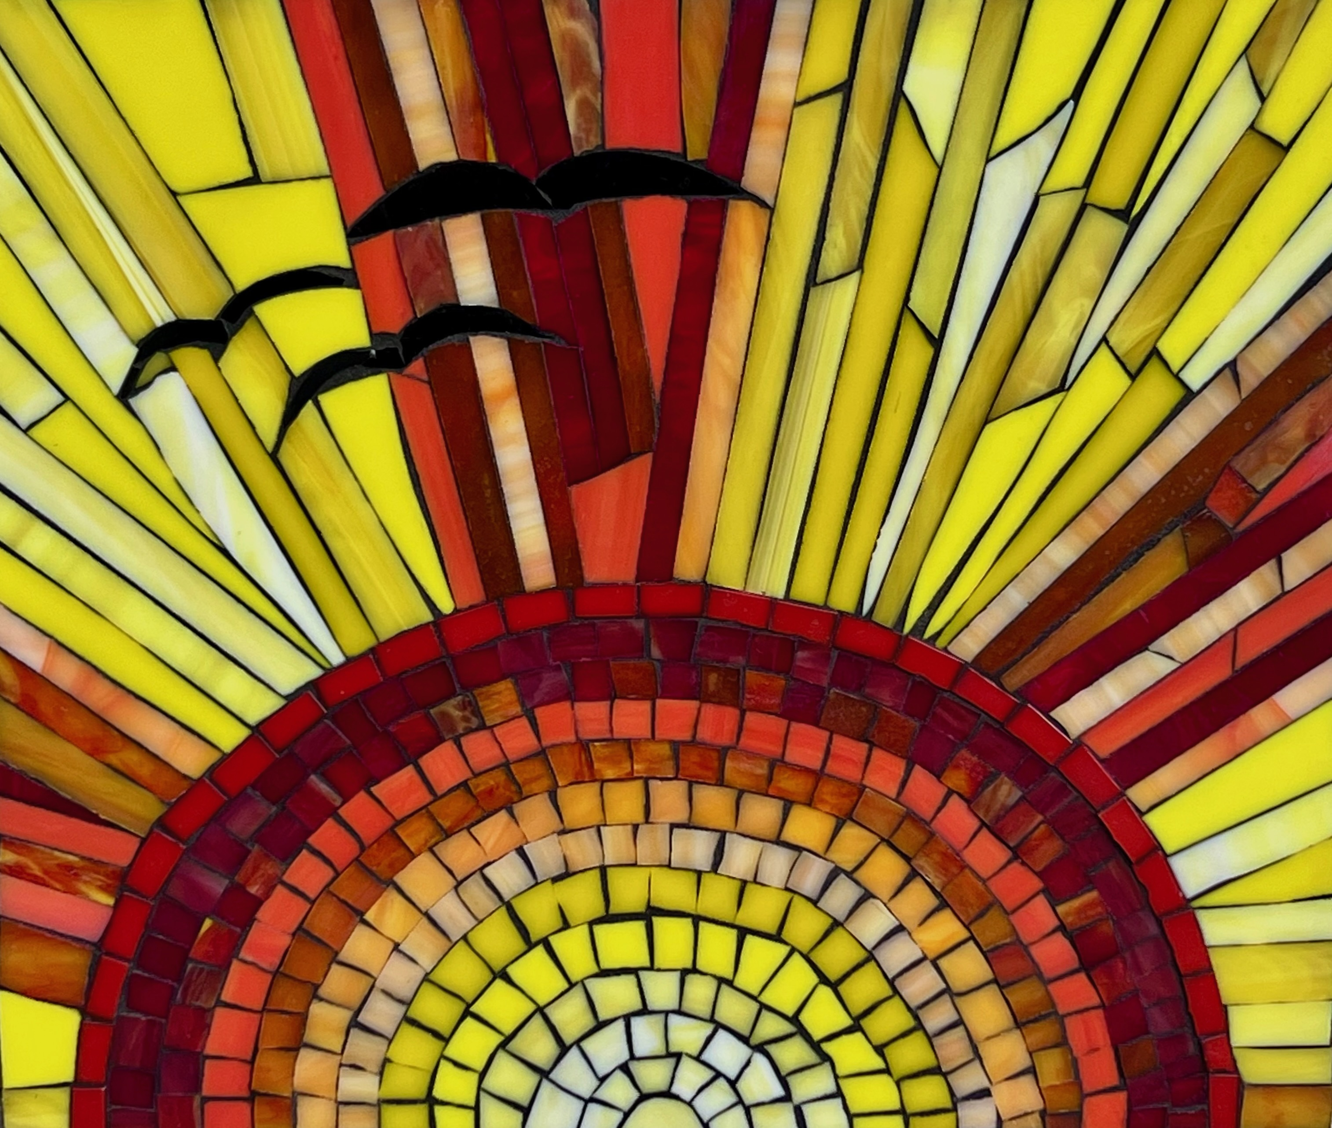
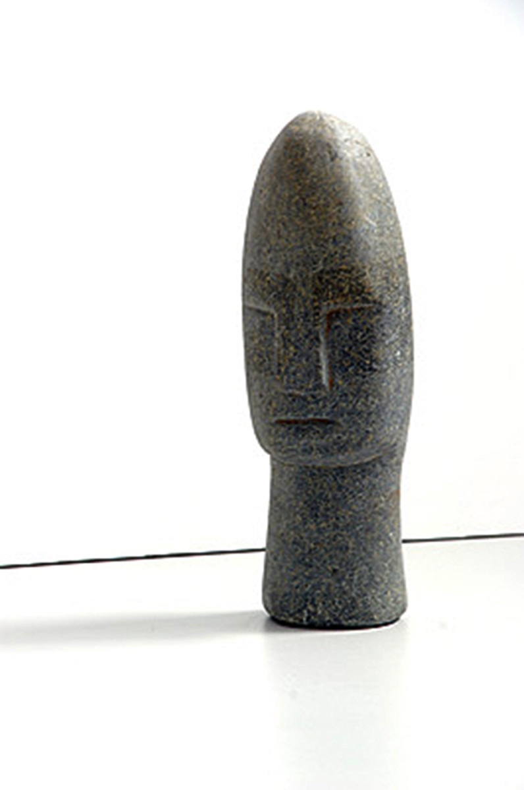
Understanding Sculpture in Context 6
To produce a subtractive sculpture, artists take away mass by cutting, scraping, carving, chiseling, and drilling into an object to reveal the sculptural form within it.
Notes:
Class instruction: Explain to the class that sculptors plan what their subtractive sculptures will look like before carving because once they remove mass from their carving blocks they cannot replace it.
Image: Josiah Laina,13 years old, Zimbabwe. 33rd ICEFA Lidice.

Slide 10
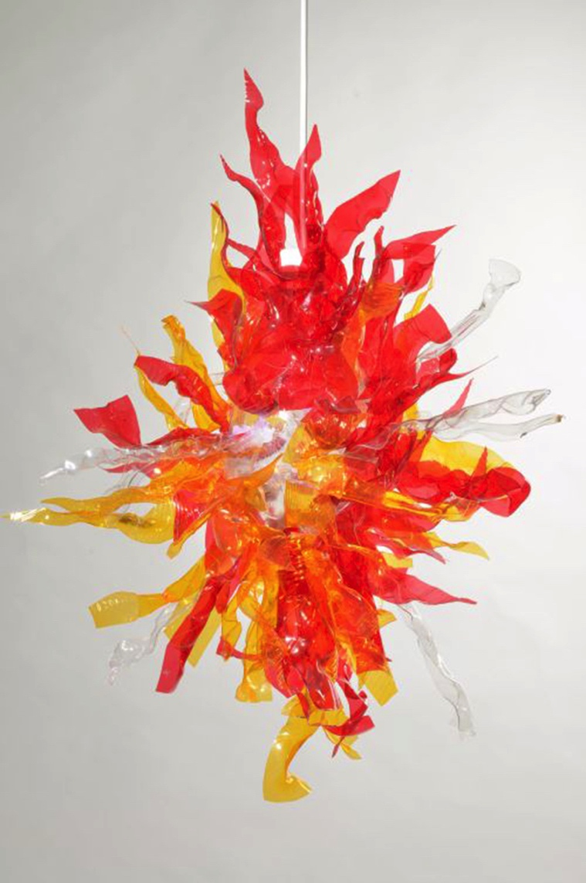
Sculpture and Technology
Technology plays an important role in contemporary sculpture design and production.
Artists may integrate digital screens and interactive computer devices within their sculpted forms and installations.
Some artists rely on a highly-accurate model making process called subtractive manufacturing.
Notes:
Image: Dominik Šimara, 15 years old, ZUŠ, Uničov, Czech Republic. 43rd ICEFA Lidice.

Slide 11
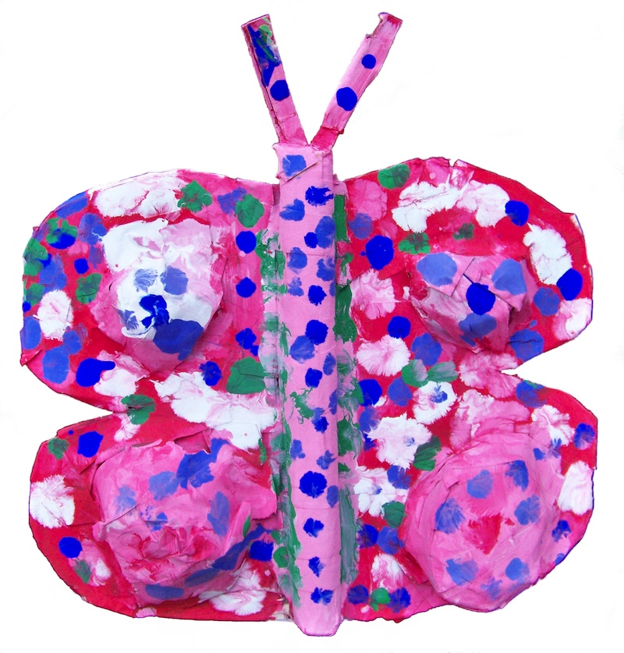
Applying Sculpture Methods in Context
TAE sculpture learning tasks provide students with creative means to communicate their ideas three-dimensionally.
Students’ sculpted designs can be realistic, abstracted, or combine realism and abstraction.
Students can create additive sculptures, subtractive sculptures, and molds. They will learn bending, folding, slicing, joining, pouring, constructing, and carving techniques.
Notes:
Image: Ailee Sickler, 5 years old. USA, Author, teacher. Richard Sickler, photo.

Slide 12

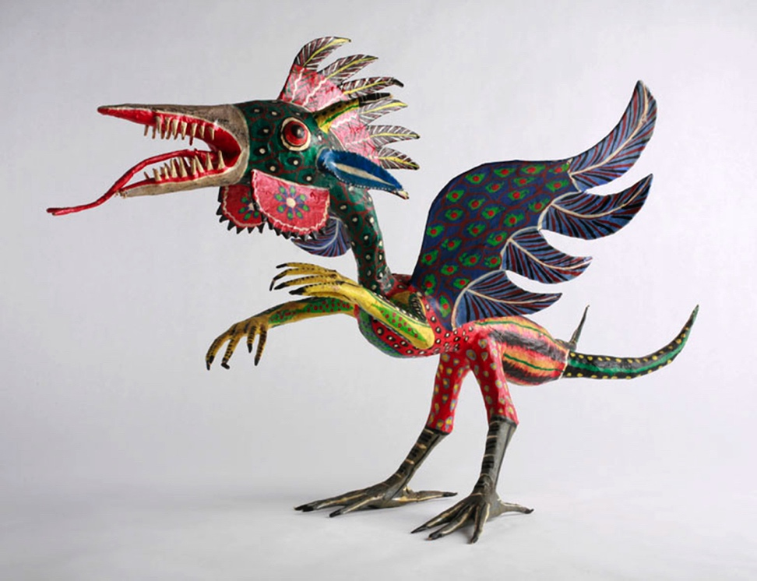
Papier-Mâché 1
Papier-mâché is an art form that artists create with torn, shredded, or pulped paper mixed with glue, flour, or starch.
The Chinese created the first papier-mâché products nearly 2,000 years ago.
Artists create figures, masks, furniture, jewelry, globes, decorations, parade floats, and more.
Notes:
Class activity: Introduce this textbook’s Model 14.1: Creating with Papier-Mâché. Explain that papier-mâché is an affordable art medium for learning tasks. Students can manipulate papier-mâché by cutting away parts. Papier-mâché is suited for individual and group projects. After the introduction, demonstrate how to create papier-mâché sculptures.
Image: Pedro Linares, “Alebrije" Paper Mache Sculpture, 1986, The Children's Museum of Indianapolis, Michelle Pemberton, photographer. CC BY-SA 3.0 via Wikimedia Commons. https://creativecommons.org/licenses/by-sa/3.0/deed.en

Slide 13
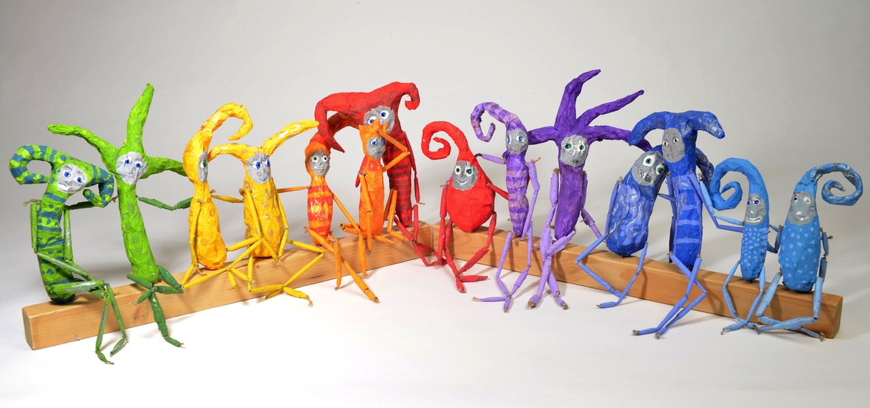
Papier-Mâché 2
Papier-mâché is an additive sculpture process.
Students build armatures as a base before layering it with cut paper dipped in a glue mixture.
Notes:
Image: Group project, 6-10 years old, ZŠ Sedmikráska o.p.s., Rožnov pod Radhoštěm, Czech Republic. 43rd ICEFA Lidice.

Slide 14
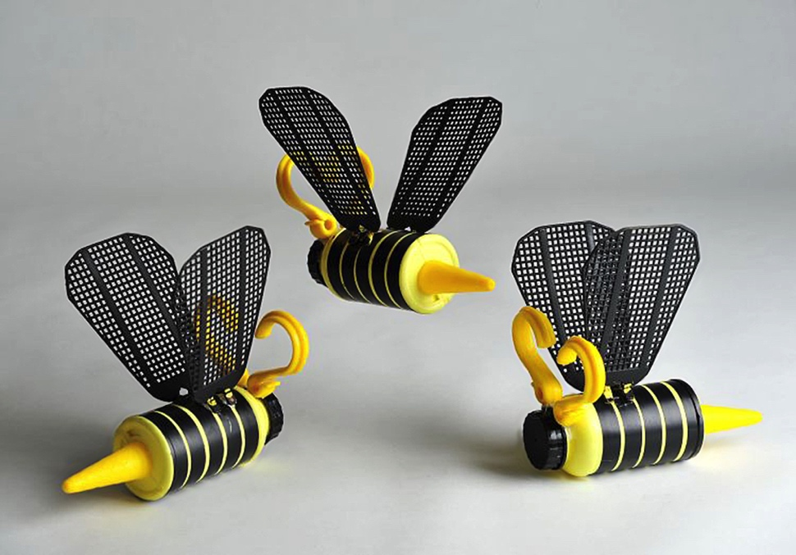
Assemblage 1
Sculptors create assemblages by arranging found objects in a pleasing design to produce three-dimensional, additive sculptures.
Students transform common household materials and found objects into art.
Students may choose to have original found objects remain visible in their completed designs.
Notes:
Image: Sabina Pilcová, 14 years old, ZUŠ Vladimíra Ambrose, Prostějov, Czech Republic. 42nd ICEFA Lidice.

Slide 15
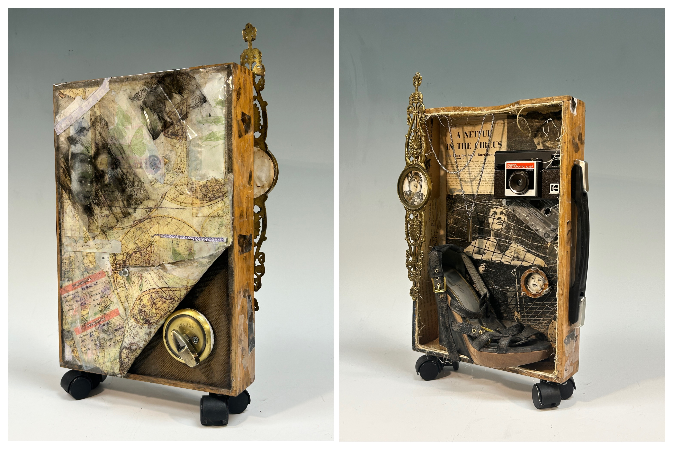
Assemblage 2
Assemblages vary according to artists’ styles and preferences for materials.
Examples include Yoruba sculptures, Ga fantasy coffins, Deborah Butterfield’s horses, Marisol Escobar’s portraits, and Joseph Cornell’s and Bette Saar’s shadow boxes.
Notes:
Image: Nicole Leandra Hernandez Montiel, 18-years-old, United States. Source: Efrain Montesino, teacher

Slide 16
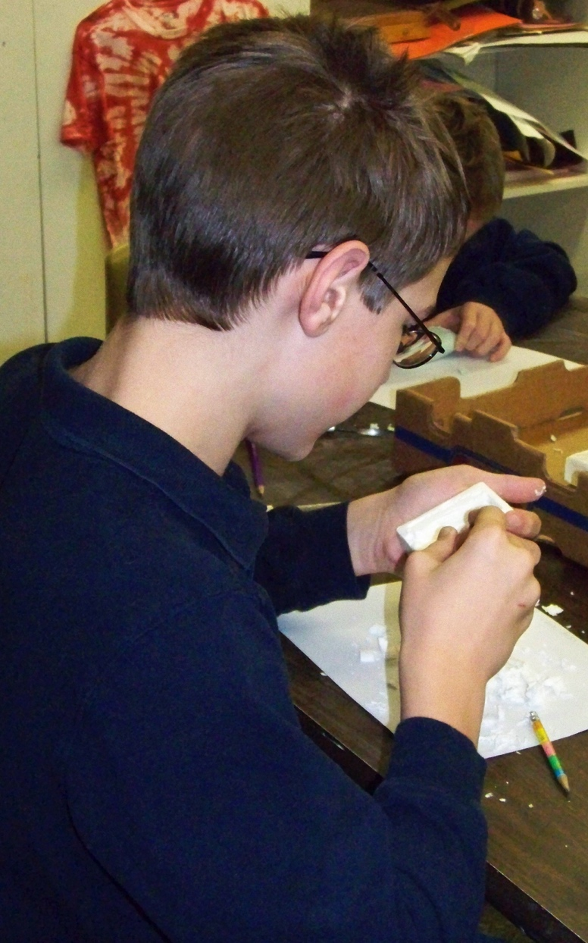
Carving 1
Students can carve into soft materials including soap, foam, and wood.
Students need clear instructions and careful supervision to promote safety while carving.
Notes:
Image: A middle school student is creating a soap carving. USA, Cara Harris, teacher.

Slide 17
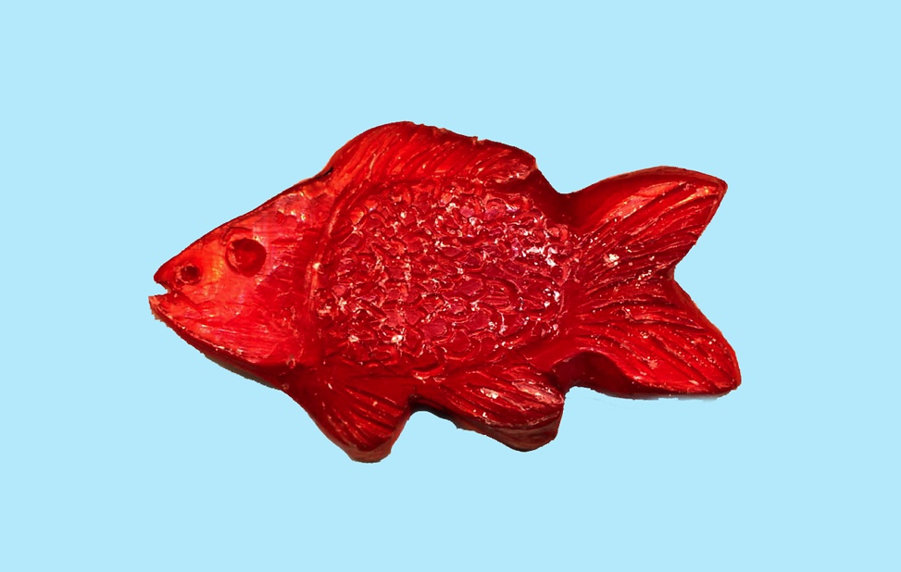
Carving 2
Soap carving originated in Thailand and is a popular art form in schools due to its soft density and affordability.
Inspirations may include Aztec jade carvings and Inuit bone carvings.
Teachers demonstrate how to transfer student sketches to soap bars using a toothpick or carving tool to prepare for deeper carvings.
Notes:
Image: Ailee Sickler, 10 years old, USA. Author, teacher. Richard Sickler, photo.

Slide 18
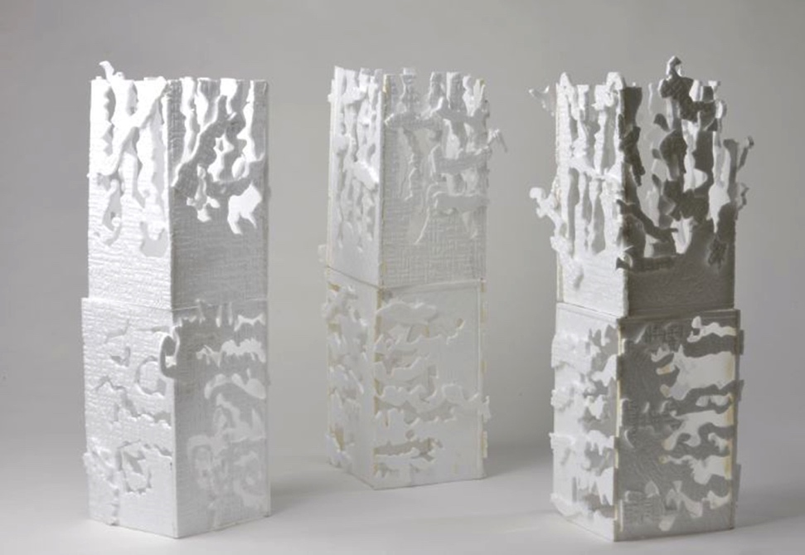
Carving 3
Manufactured plastic foams, Styrofoam®, and balsa foam have a softer consistency than wood.
Students can carve these products with plastic knives, stylus tools, and toothpicks.
They are a safer alternative for students’ developing manipulative skills.
An ecofriendly choice is to repurpose Styrofoam® packaging that comes in shipped boxes.
Notes:
Image: These Styrofoam® sculptures combine carving and additive sculpture methods. Štěpánka Jánošíková, 12 years old, Eliška Jarošová, 14 years old, Emma Líhová, 11 years old, Julie Marečková, 12 years old, Karolína Slavíková, 12 years old, Valerie Šulcová, 11 years old, ZUŠ, Mšeno, Czech Republic. 43rd ICEFA Lidice.

Slide 19
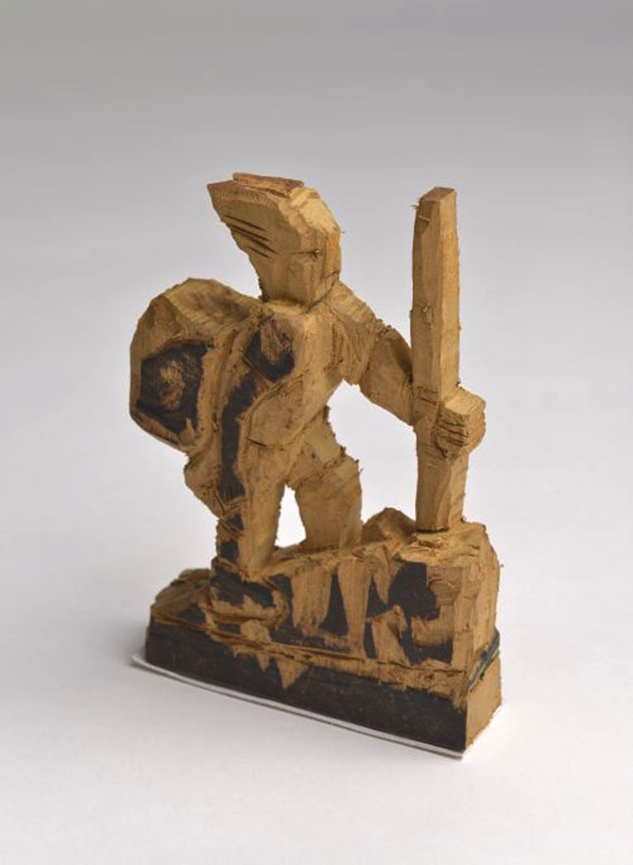
Carving 4
Woodcarving is a rewarding activity for responsible students who have control of their fine hand muscles. Lessons require direct teacher supervision.
Select soft balsa wood and white pine with a grain that moves in one direction. The wood needs enough moisture to prevent breakage.
Notes:
Class instruction: Explain to the class that societies around the world produce woodcarvings in different forms as contemporary and traditional works.
Image: Hasitha Gallella, 15 years old, Kandy, Sri Lanka. 45th ICEFA Lidice.
Reference:
Lubkemann, E. C. (2005) The little book of whittling: Passing time on the trail, on the porch, and under the stars. East Petersburg, PA: Fox Chapel.

Slide 20
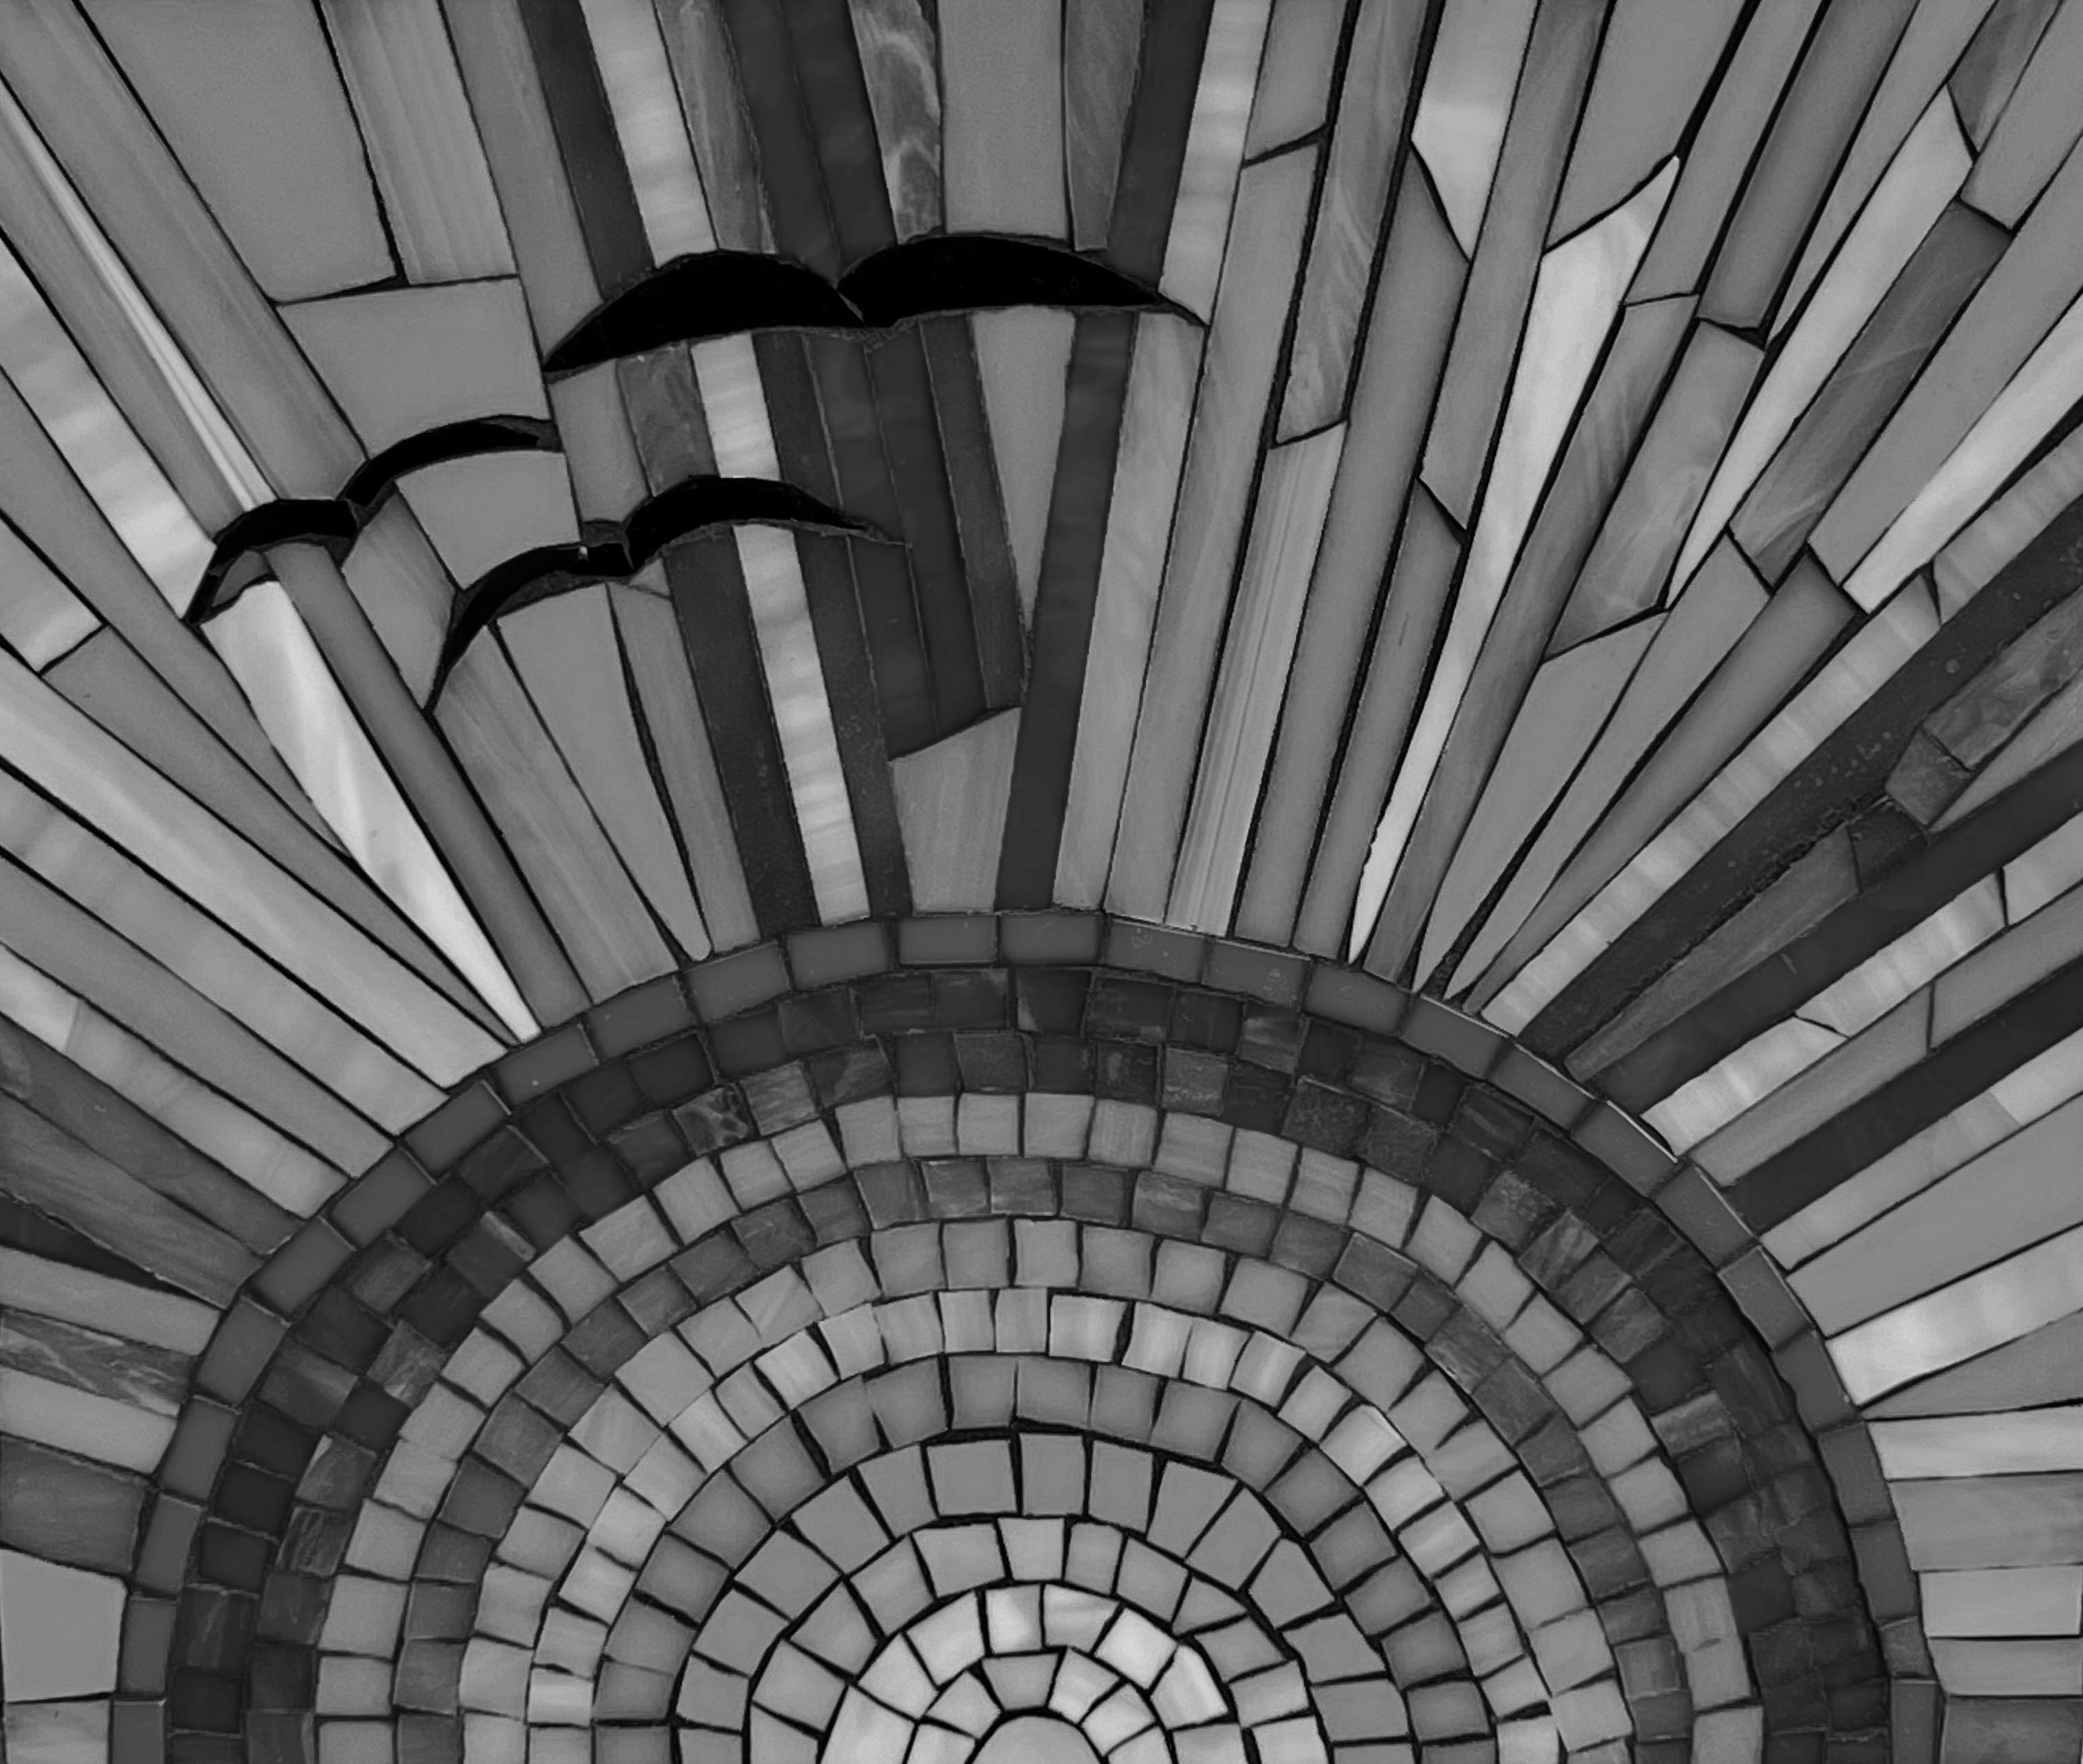
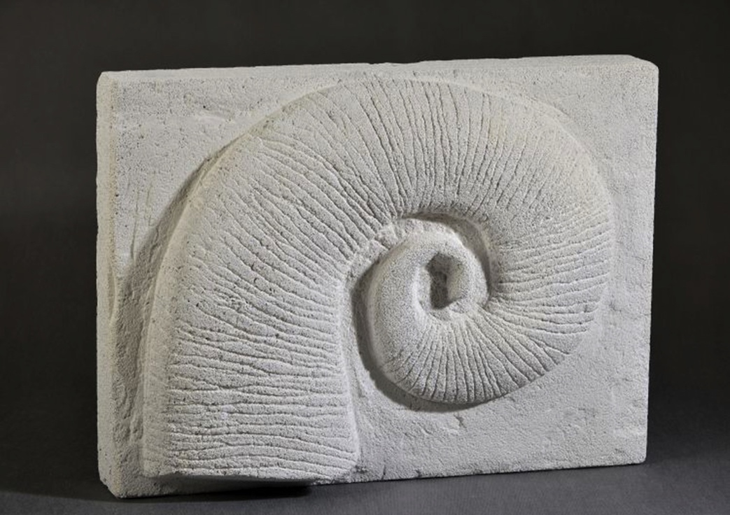
Molds 1
Artists produce a mold by filling a hallow vessel with damp materials including plaster and concrete or by lying damp materials that harden over a surface to reconstruct its sculpted form.
Students can combine mold making with carving by creating plaster molds.
Notes:
Image: Anna Ihmová, 12 years old, ZŠ, Praha 1, Czech Republic. 44th ICEFA Lidice.

Slide 21
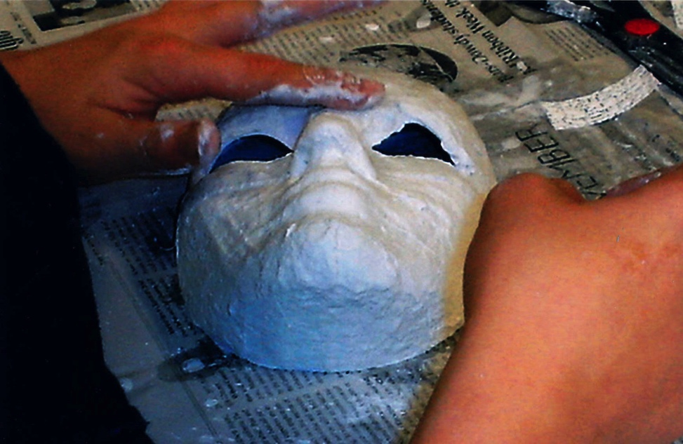
Molds 2
Plaster of Paris gauze is a plaster product that has a white, powdery texture that manufacturers apply to strips of gauze for mold making.
Plaster of Paris gauze is a more costly alternative to papier-mâché. It hardens quickly.
Notes:
Image: An early adolescent student creates a plaster of Paris gauze mold. USA. Cara Brown, teacher.

Slide 22
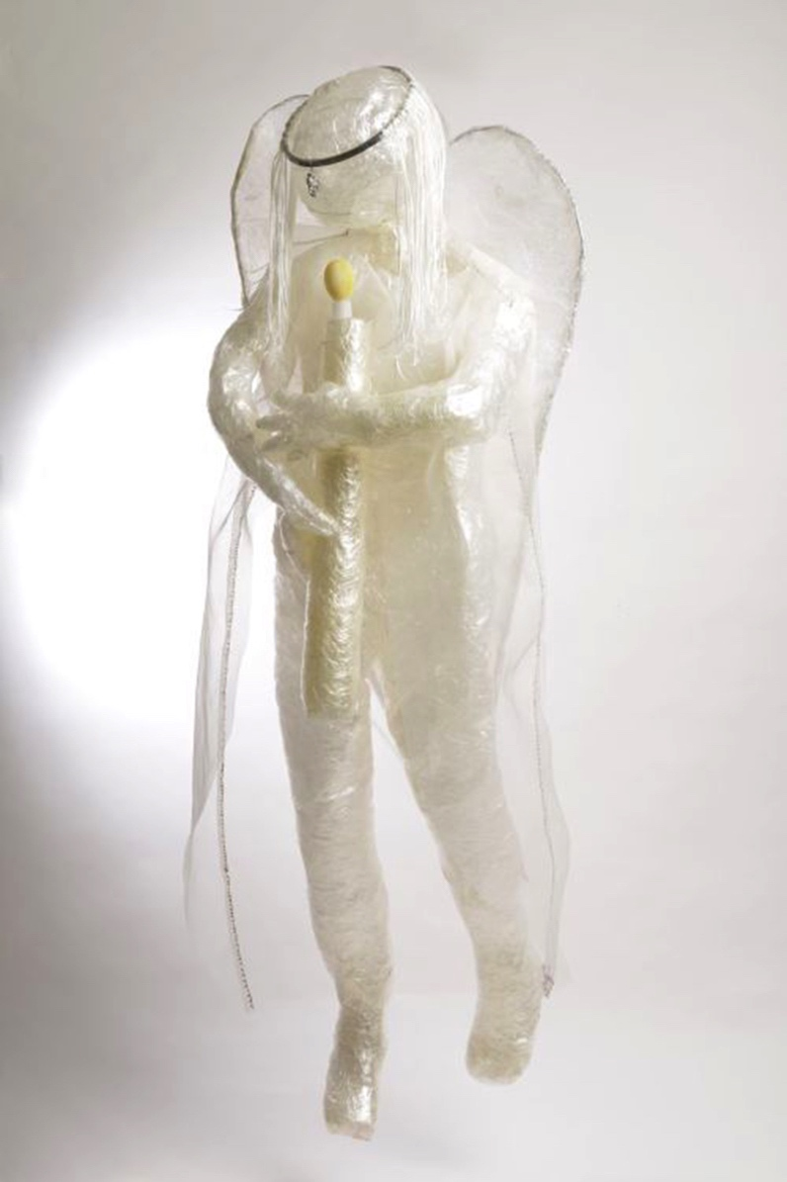
Molds 3
Students can make molds from clear packaging tape. They have a transparent hue and light feel.
Students can enhance tape and plaster of Paris molds with paint, yarns, wires, and raffia.
Notes:
Image: Anna Kraváčková, 15 years old, ZUŠ Vladimíra Ambrose, Prostějov, Czech Republic. 43rd ICEFA Lidice.

Slide 23
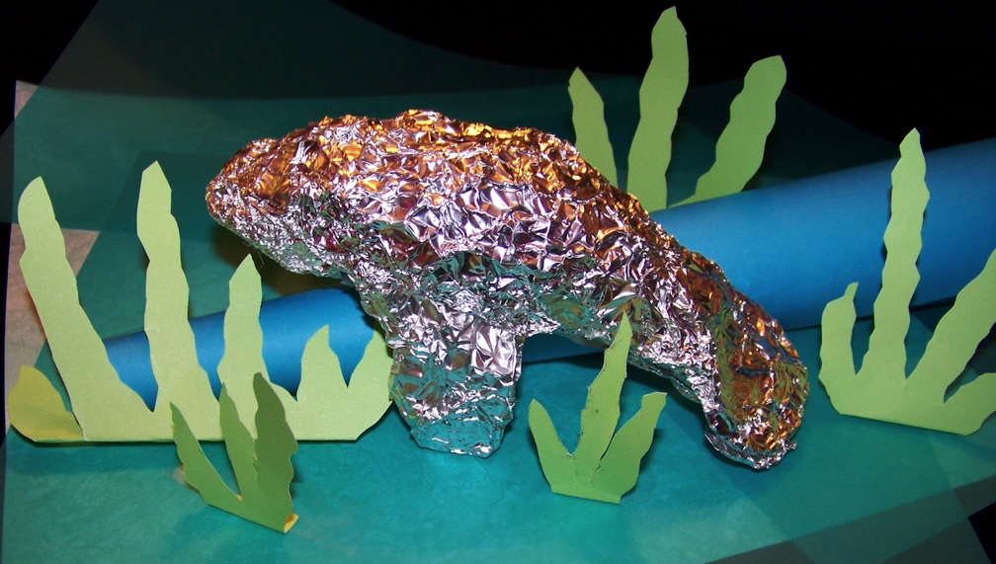
Wire and Aluminum 1
Artists use wires and foil to make static and kinetic sculptures.
Students can manipulate wire and aluminum foil by rolling, bending, coiling, twisting, folding, pinching, and cutting them.
Classroom foils and wires include aluminum foil, colorful plastic coated wire, pipe cleaners, metal hangers, and soft and flexible aluminum wire.
Notes:
Image: A. J. Sickler, 6th grade, raised her aluminum manatee sculpture by rolling up a piece of blue paper as a ledge and cutting out green paper to represent the sea grass that manatees eat. USA. Author, teacher. Richard Sickler, photo.

Slide 24

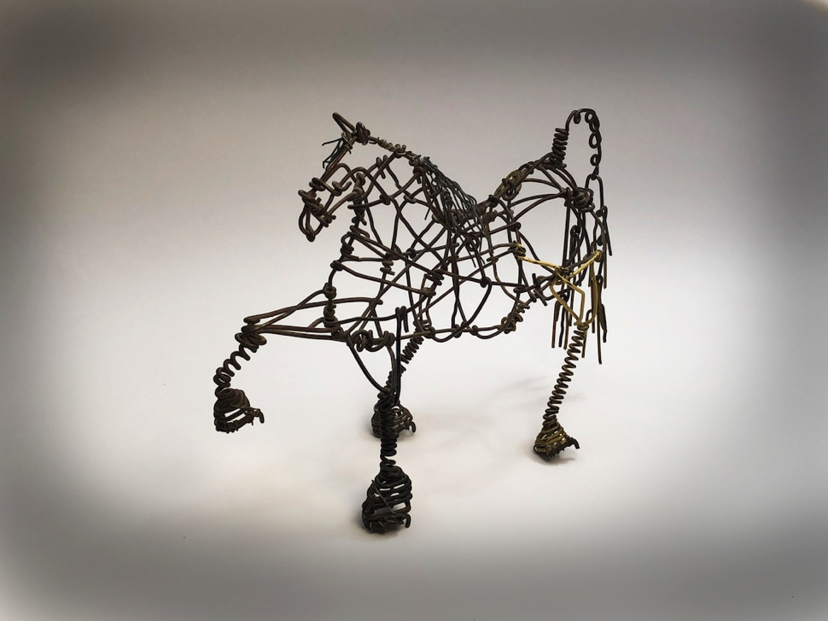
Wire and Aluminum 2
Manufacturers sell wires by their gauge, the thickness of a wire. The larger the gauge number is, the thinner the wire.
Wire is an effective medium for designing mobiles.
Vannoy Streeter’s wire sculptures focus on community and play.
Notes:
Image: Vannoy Streeter created Tennessee Walking Horses and other sculptures with ordinary wire coat hangers. (See Artists’ Lessons to Thrive! 2.1.). Jonathan Griffith, photo.

Slide 25
Transformative Best Practices for Teaching Sculpture from Pre-K Through High School 1
Students require ample time to practice and experiment with age-appropriate sculpting tools, equipment, and media to gain the confidence and skills needed to produce desired results before completing projects for summative grades.
Teachers can post signage to reinforce safety, procedures, and cleanup methods.
Notes:
Image: Group project, 9-15 years old, ZUŠ, Mšeno, Czech Republic. 44th ICEFA Lidice.

Slide 26
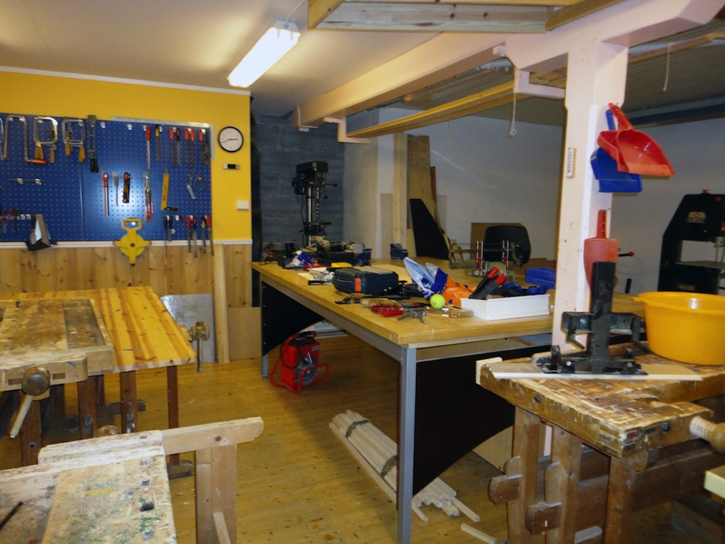
Transformative Best Practices for Teaching Sculpture from Pre-K Through High School 2
Students need to learn routines for working with sculpture equipment and tools.
Teachers can pre-assess students’ knowledge of sculpture safety procedures using informal and formal assessments.
Notes:
Image: Flåm Skule’s woodshop. Norway. Astrid Hassel, principal.

Slide 27
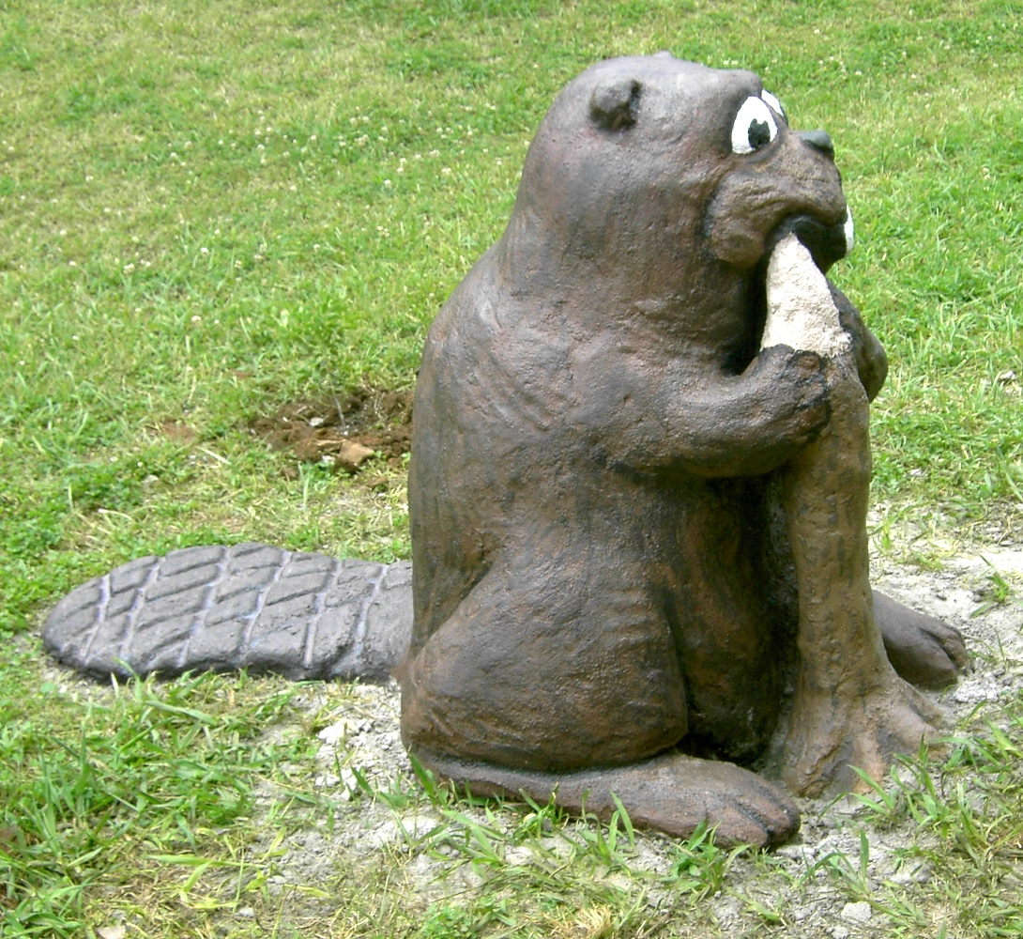
Transformative Best Practices for Teaching Sculpture from Pre-K Through High School 3
Include STEAM sculpture topics: space, balance, movement, and weight. Students will learn how their selection of size relationships, proportions, and materials impact the appearances, meanings, and functions of their sculptural designs.
Notes:
Image: Wetland Beaver. Middle childhood students, USA, Author, teacher. MTSU Public Service Grant. Pamela McColly, photo.

Slide 28
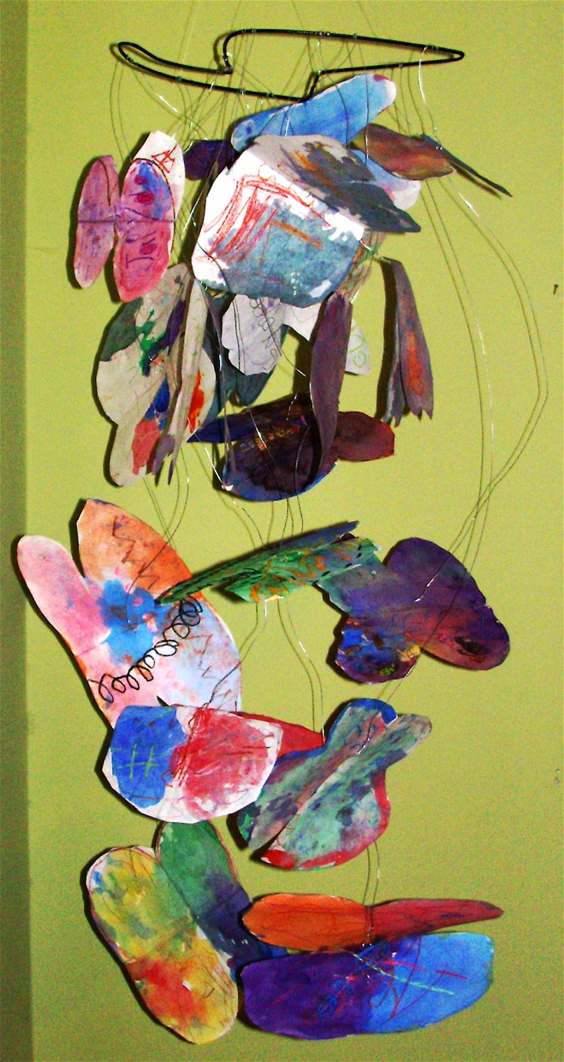
Transformative Best Practices for Teaching Sculpture from Pre-K Through High School: Early Childhood
Young children desire to manipulate their environment physically.
Students are learning how to bend, twist, coil, and shape soft wires to produce dynamic forms.
They can produce simple sculptures using papier-mâché and wire.
They can create environments with characters and props using sculpture media to explore TAE actions to facilitate group belonging.
Notes:
Image: Kindergarten group project. USA. J. Quinton Creasy and Janet Malone, teachers.

Slide 29
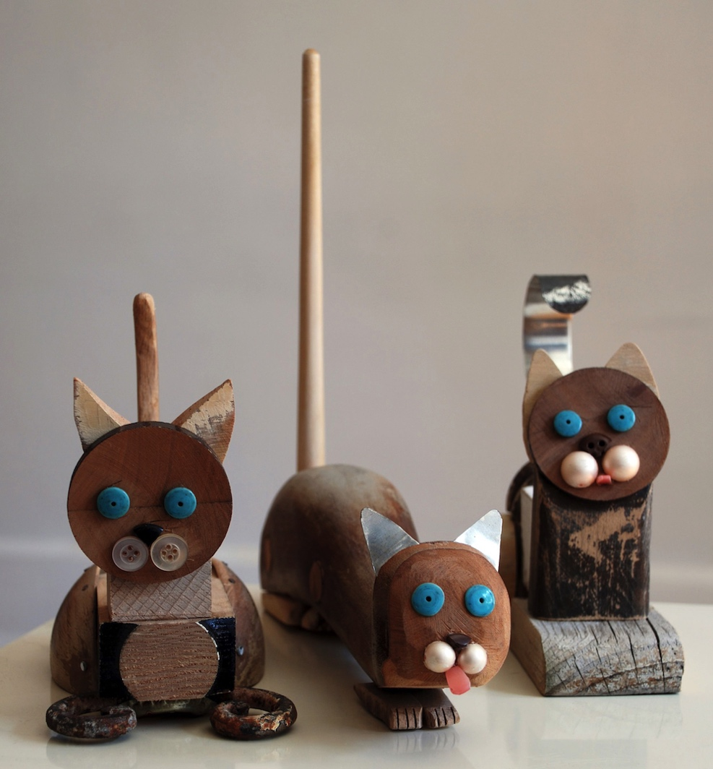
Transformative Best Practices for Teaching Sculpture from Pre-K Through High School: Middle Childhood
Students have acquired manipulative skills to produce more complex sculptures than they could in early childhood.
They can form assemblages, installations, and dioramas and can safely carve soft surfaces, including soap, foam, and clay.
They can address the TAE action of care for living beings and supportive relationships.
Notes:
Image: Pablo Cano. The Blue Ribbon Marionette Production, 2009. Jose Rodriguez, photograph.

Slide 30
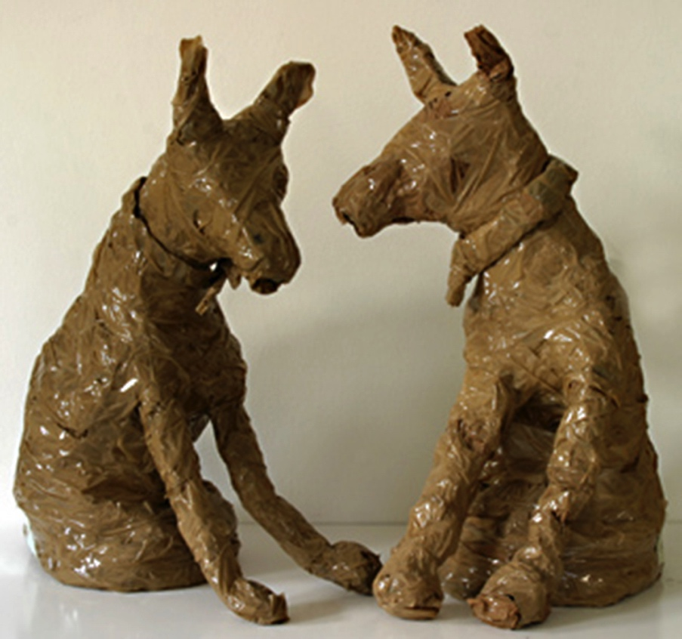
Transformative Best Practices for Teaching Sculpture from Pre-K Through High School: Early Adolescence
Students can produce sculptures with some of the same equipment and technologies that professional sculptors use.
Assemblage lessons challenge students as they work with tools and combine non-traditional art media to produce aesthetic forms.
They can address TAE issues including effective communication.
Notes:
Image: Group project, 10-12 years old, ZUŠ, Zlín - Malenovice, Czech Republic. 36th ICEFA Lidice.

Slide 31
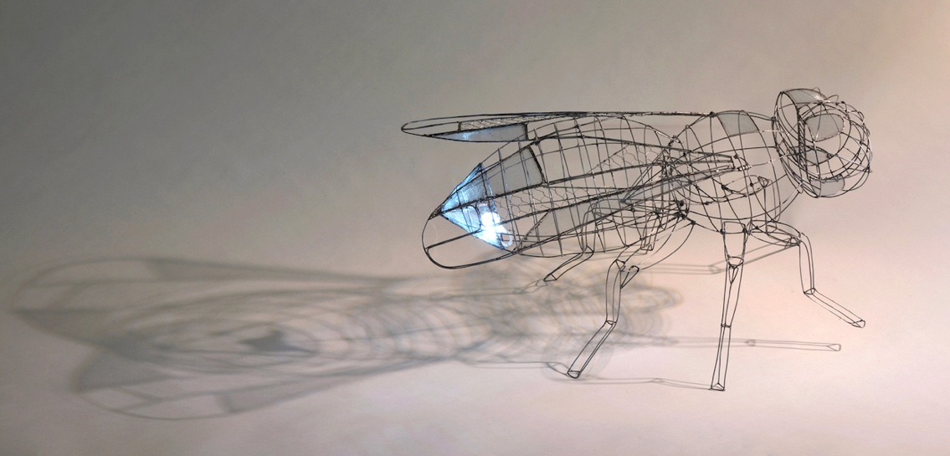
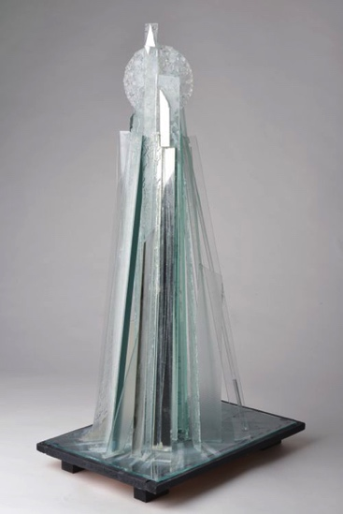
Transformative Best Practices for Teaching Sculpture from Pre-K Through High School: Adolescence
Teachers provide opportunities for students to work with specialized’ tools.
Students study sculptors’ works to analyze their designs.
They can identify the role of sculptures in private and public collections.
They can develop sculptures addressing concerns in their communities.
Notes:
Class instruction: Explain to the class that adolescents can produce more sophisticated sculptural forms. Class lessons can encourage them to refine existing skills and build new ones. Students can analyze the themes, materials, methods, and functions of artists’ works.
Left Image: Tomáš Mravec, 16 years old, ZUŠ Antonína Dvořáka, Lipník nad Bečvou, Czech Republic. 43rd ICEFA Lidice.
Right Image: Eduard Korbel, 15 years old, Pavel Neumann, 16 years old, Tomáš Toms, 16 years old, ZUŠ Fr. Kmocha, Kolín II, Czech Republic. 43rd ICEFA Lidice.

Slide 32
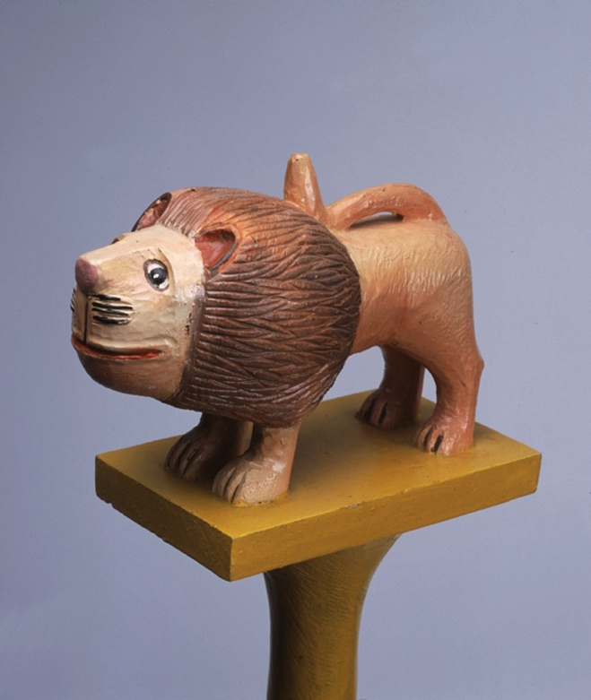
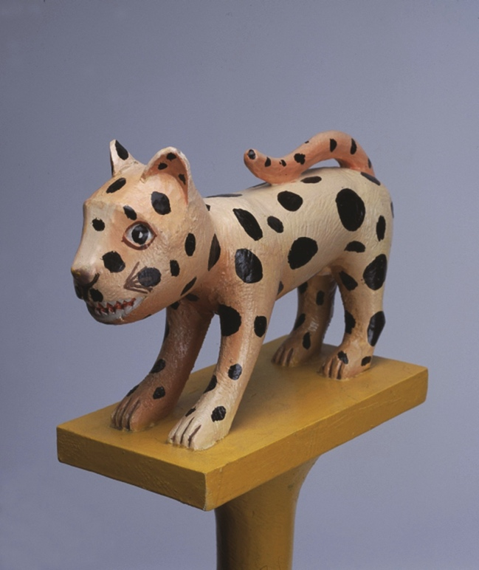
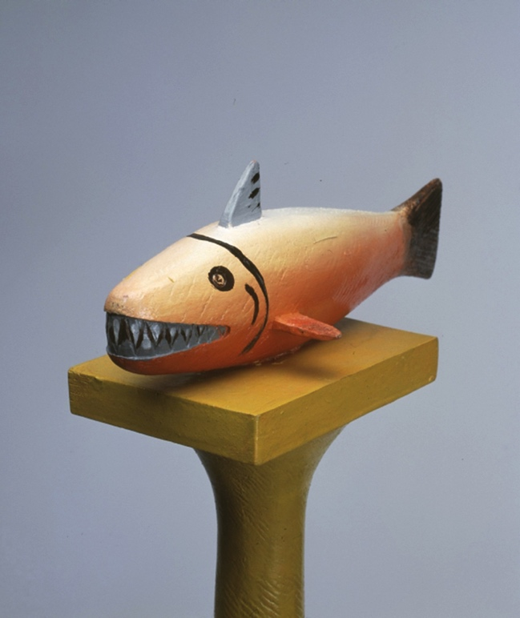
Kojo Bambil: Carving Strength in Numbers Artists’ Lessons to Thrive!: 14.1.
Big Idea: Strength in Numbers
Carving
Notes:
Class instruction: Have the class open the textbook to Artists’ Lessons to Thrive! 14.1. Participate in its learning targets.
Left Image: Kojo Bambil, Painted Wooden Clan Staff with a Lion as a Totem - Asakyire Abusua Poma, 1999-2000. 152,5 x 9 x 19,5cm (60 1/16 x 3 9/16 x 7 11/16in.). Tropenmuseum, part of the National Museum of World Cultures. CC BY-SA 3.0 via Wikimedia Commons. https://creativecommons.org/licenses/by-sa/3.0/deed.en
Center Image: Kojo Bambil, Painted Wooden Clan Staff with a Leopard as a Totem - Bretuo Abusua Poma, 1999-2000. 153 x 9 x 22cm (60 1/4 x 3 9/16 x 8 11/16in.). Tropenmuseum, part of the National Museum of World Cultures. CC BY-SA 3.0 via Wikimedia Commons. https://creativecommons.org/licenses/by-sa/3.0/deed.en
Right Image: Kojo Bambil, Painted Wooden Clan Staff with a Fish as a Totem - Asenie Abusua Poma, 1999-2000. 157 x 9 x 23cm (61 13/16 x 3 9/16 x 9 1/16in.). Tropenmuseum, part of the National Museum of World Cultures. CC BY-SA 3.0 via Wikimedia Commons. https://creativecommons.org/licenses/by-sa/3.0/deed.en

Slide 33
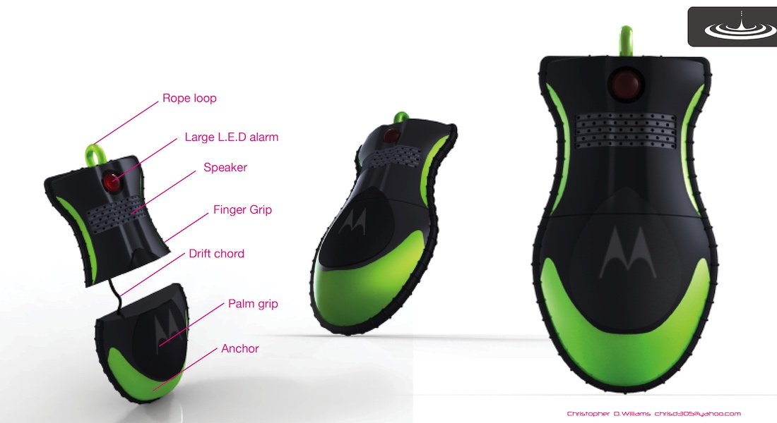
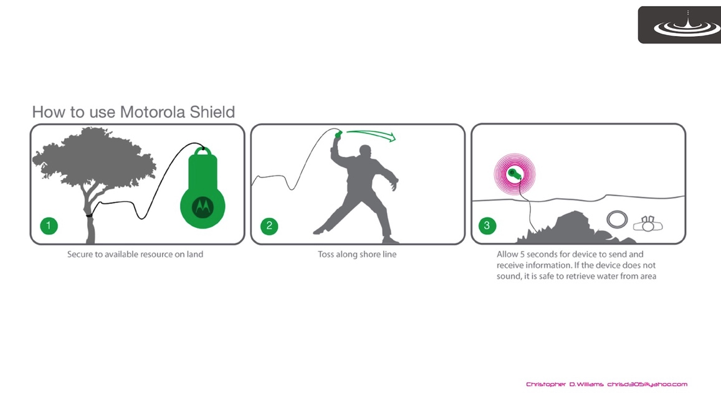
Christopher Williams: Designing Awareness Artists’ Lessons to Thrive! 14.2.
Big Idea: Awareness
Sculpture: 3D Printing
Notes:
Class instruction: Have the class open the textbook to Artists’ Lessons to Thrive! 14.2. Participate in its learning targets.
Left Image: Christopher Williams, Motorola Shield, 3-D Model. Project sponsored by Motorola.
Right Image: Christopher Williams, Motorola Shield Instructions. Project sponsored by Motorola.

Slide 34
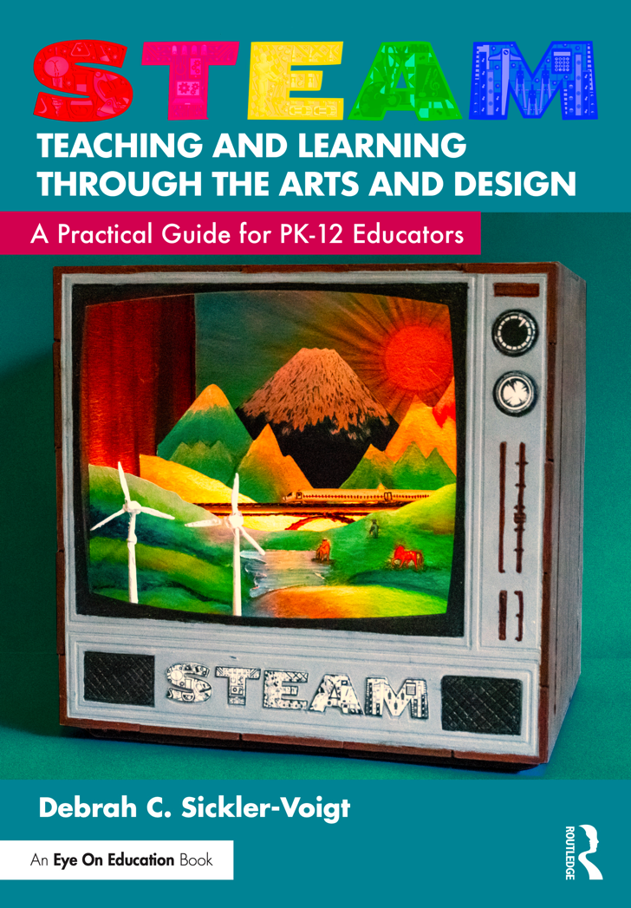
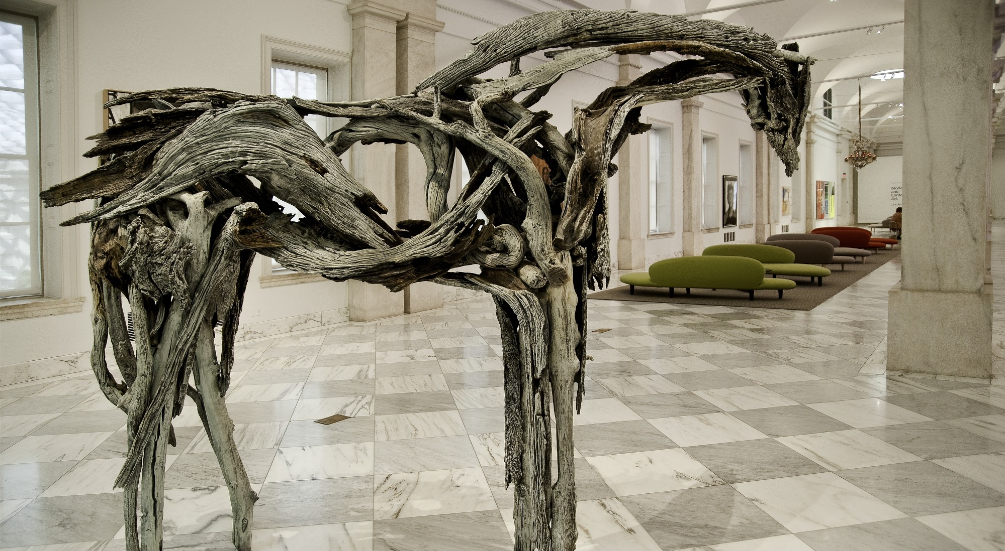
Deborah Butterfield: Horse Power Leading the Way artists’ Lessons to Thrive!
Notes:
Left Book Cover: © Debrah Sickler-Voigt
Left Image Tunnel Book: © Debrah Sickler-Voigt, Paige Brenner, and Richard Sickler. Photo: Richard Sickler
Right Image: Deborah Butterfield, Monekana, 2001, bronze, 96 × 129 ¹⁄₂ × 63 ¹⁄₂ in. (243.8 × 328.9 × 161.3 cm). Source: Smithsonian American Art Museum. © Deborah Butterfield.
🐴 Access photos of Butterfield working on Three Sorrows here: https://glasstire.com/2020/11/14/the-horse-as-witness-and-metaphor-a-chat-with-deborah-butterfield/
This book’s teachings are based on the author’s research, communications, and professional interpretations of artists’ and designers’ works with the aim of being respectful of diversified peoples and representing their teachings in a truthful and non-biased manner.

Slide 35
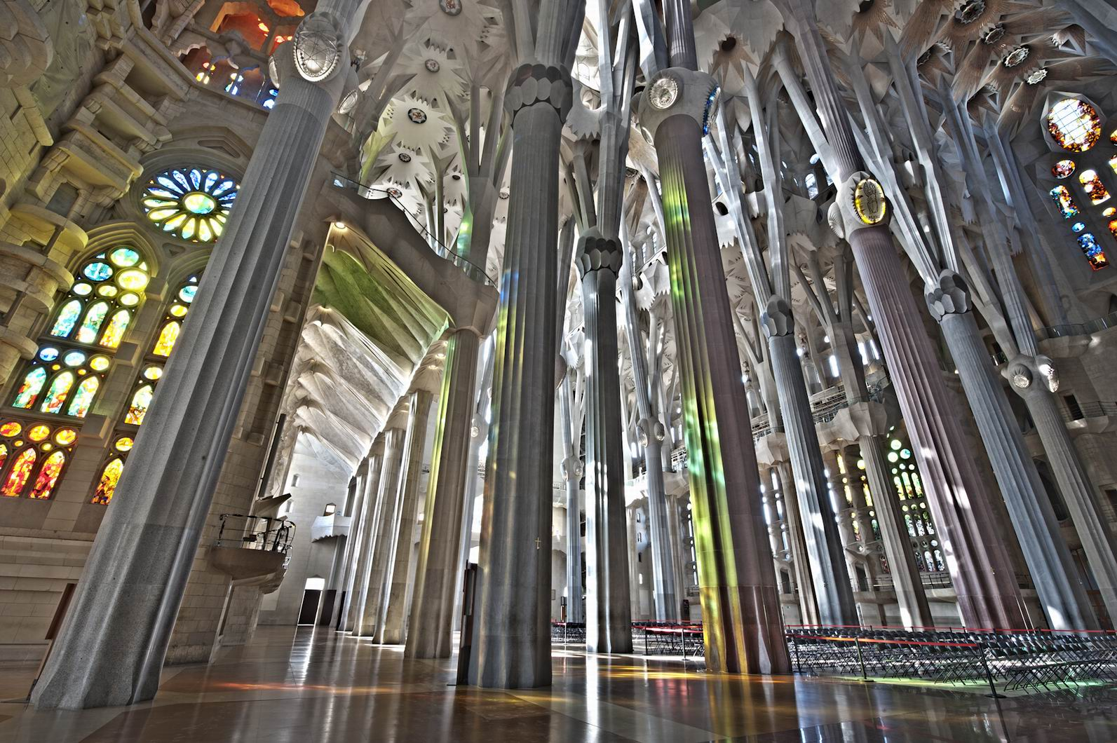
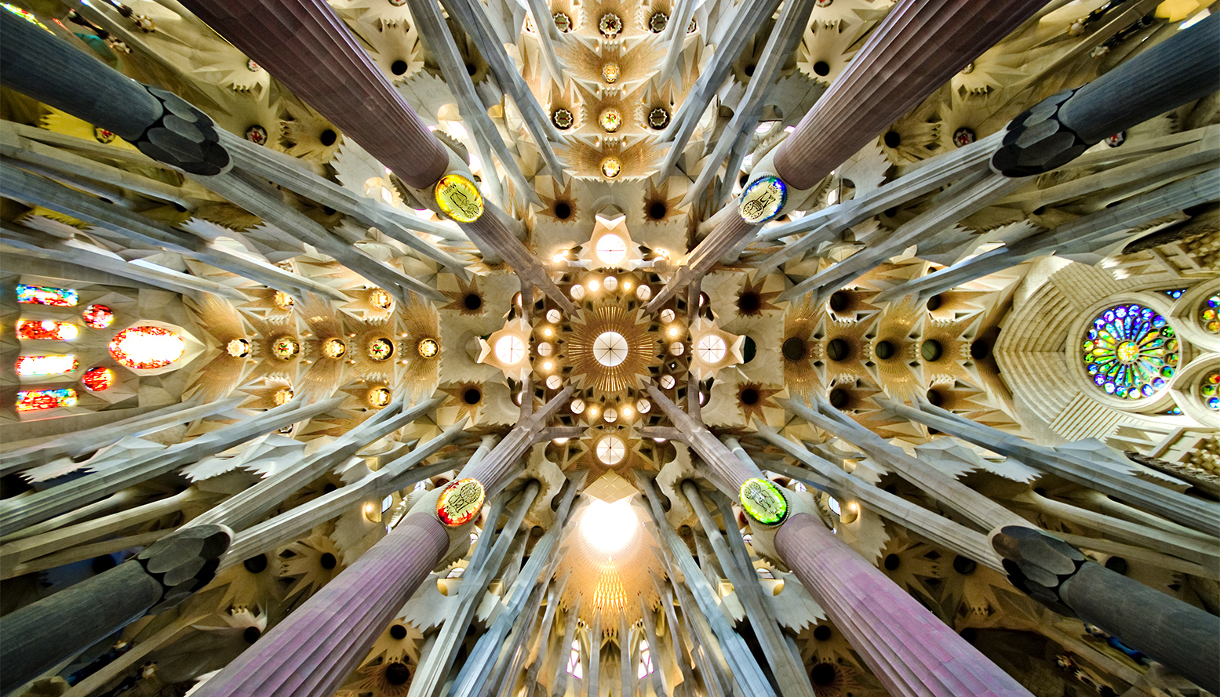
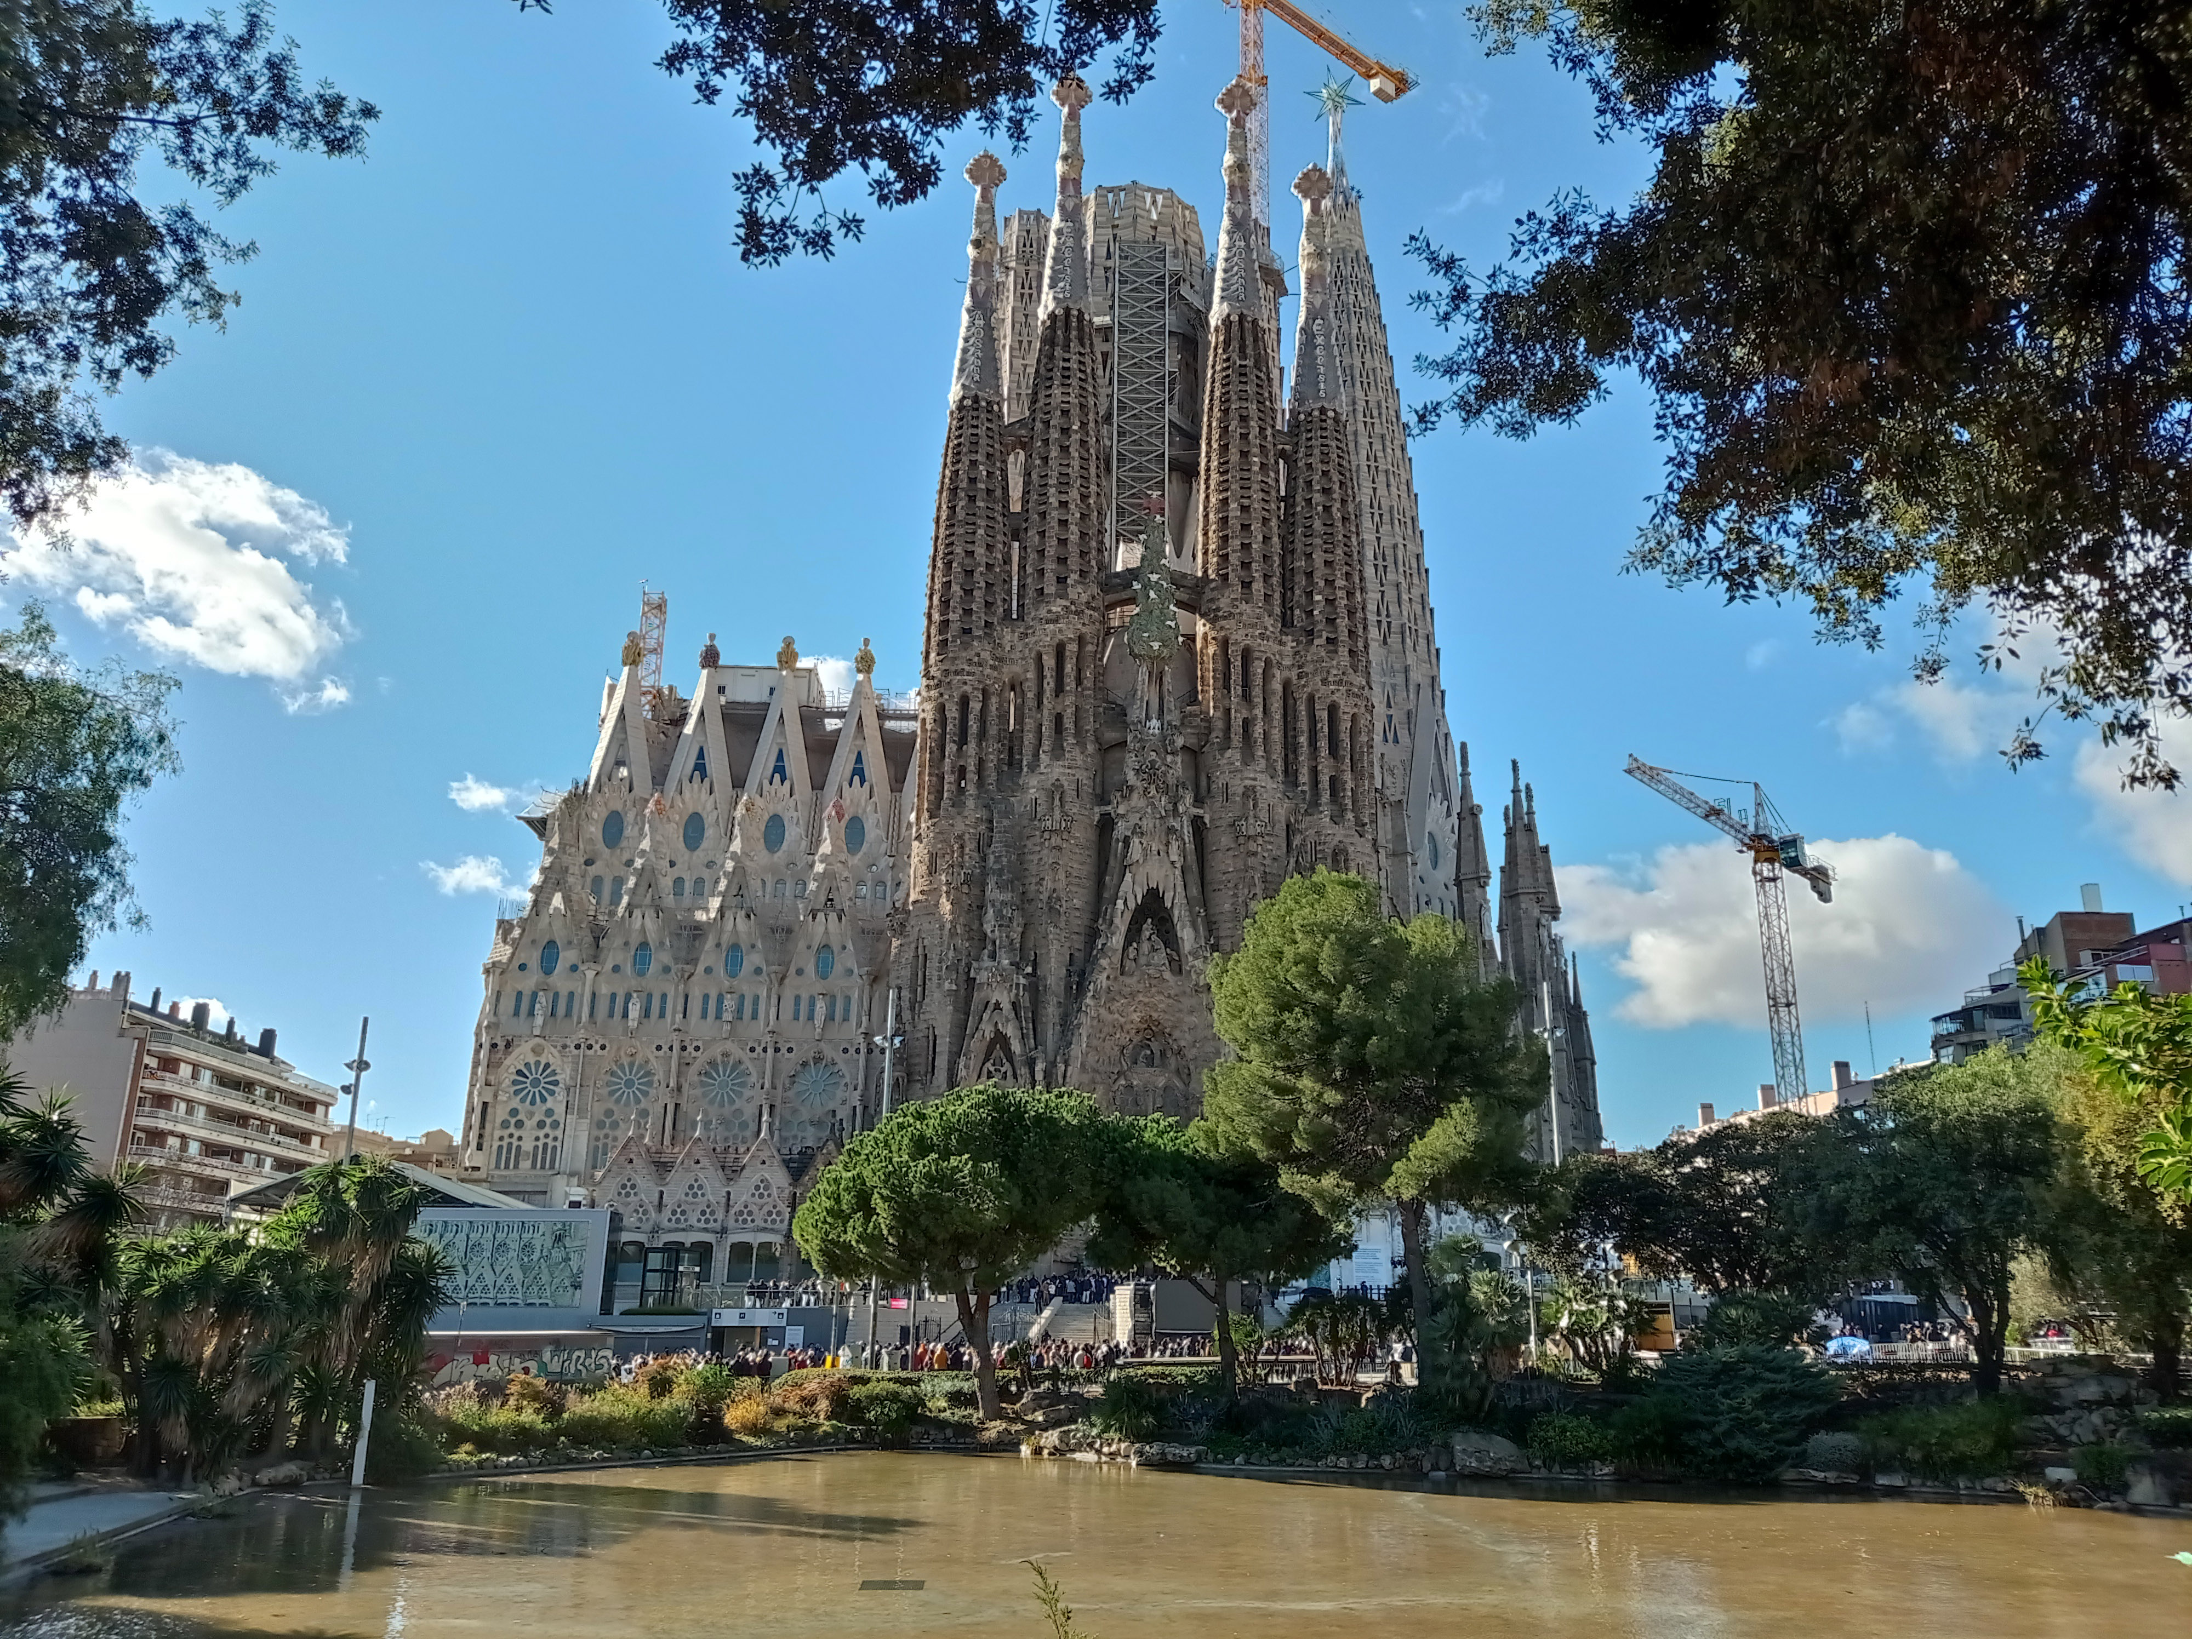
Antoni Gaudí Sagrada Familia & Modern Technologies artists’ Lessons to Thrive!
Sagrada Familia design team has utilized lidar scanning to produce accurate 3D models, 3D printers, and CNC (computer numerical control) milling machines for stone cutting.
Notes:
Class instruction: Gaudi’s Sagrada Familia is a basilica located in Barcelona. Its name means holy family. It is one of seven of Gaudi’s architectural structures listed on UNESCO’s World Heritage Site. Jordi Faulí has served as Sagrada Familia’s head architect. He exclaimed “Gaudí left us the path…. Sometimes, though, we’ve had to work hard to find it” (Abend, 2019). New technologies enabled Gaudi’s architectural designs to come into being.
Left Book Cover: © Debrah Sickler-Voigt
Left Image Tunnel Book: © Debrah Sickler-Voigt, Paige Brenner, and Richard Sickler. Photo: Richard Sickler
Top Middle Image:
Sagrada Família (oficial), CC BY-SA 3.0 <https://creativecommons.org/licenses/by-sa/3.0>, via Wikimedia Commons
https://commons.wikimedia.org/wiki/File:Sagrada_Fam%C3%ADlia._Obrador_(actualitat).jpg
Middle Left Bottom Image: Sagrada Familia’s columns and vaulting resemble a forest. Source: SBA73 from Sabadell, Catalunya, (CC BY-SA 2.0), Wikimedia Commons.
Middle Right Bottom Image
Sagrada Familia 2021
https://commons.wikimedia.org/wiki/File:Sagrada_Familia_8-12-21_(1).jpg
Canaan, CC BY-SA 4.0 <https://creativecommons.org/licenses/by-sa/4.0>, via Wikimedia Commons

Slide 36
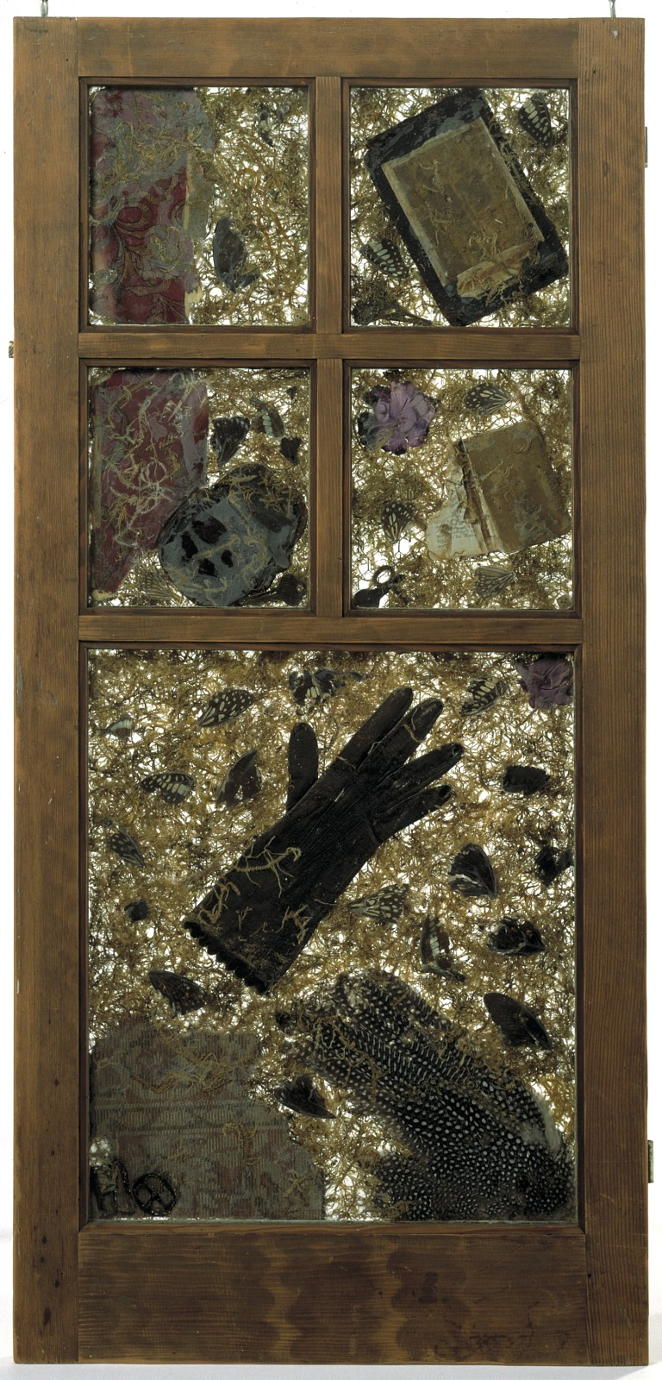
Betye Saar Let’s Go Places! artists’ Lessons to Thrive!
Notes:
Left Book Cover: © Debrah Sickler-Voigt
Left Image Tunnel Book: © Debrah Sickler-Voigt, Paige Brenner, and Richard Sickler. Photo: Richard Sickler
Middle and Right Images: Betye Saar, Wishing for Winter, 1989. Mixed media. 40 3⁄4 × 19 1⁄4 × 2 1⁄4 in. (103.6 × 48.9 × 5.8 cm.). Source: Smithsonian American Art Museum. © Betye Saar.
This book’s teachings are based on the author’s research, communications, and professional interpretations of artists’ and designers’ works with the aim of being respectful of diversified peoples and representing their teachings in a truthful and non-biased manner.
Chapter References
Create Whimsy. (n.d.) Spotlight: Susan Brandeis, textile artist. https://createwhimsy.com/projects/spotlight-susan-brandeis-textile-artist/
Jeck, D. (2005, September 8). Oral history interview with Patti Warashina, 2005 September 8. Archives of American Art, Smithsonian Institution. https://www.aaa.si.edu/collections/interviews/oral-history-interview-patti-warashina-12864-transcript
MoAD. [Museum of the African Diaspora]. (2018, November 27). Betye Saar: Lifetime achievement in the arts—MoAD Afropolitan Ball, 2017. [Video] YouTube. https://www.youtube.com/watch?v=2L3Yk3Jfga8
Smithsonian American Art Museum. (n.d.). Convertible Kiln Car. https://americanart.si.edu/artwork/convertible-car-kiln-33915
Women and Drones. (n.d.) About Women and Drones. https://womenanddrones.com/about/

Slide 37
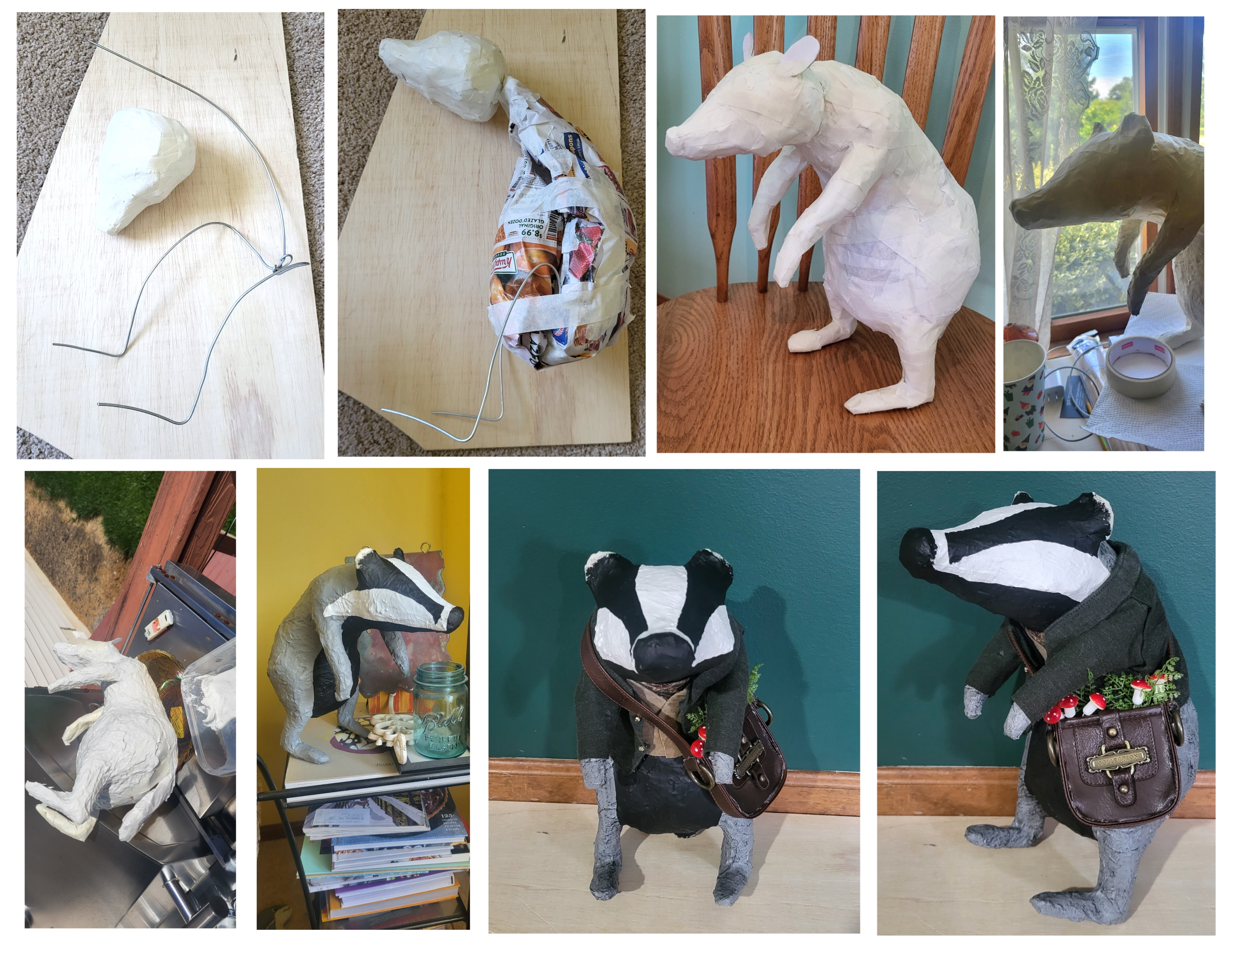
Teaching Tips to Thrive #14.1 Brianna Shetzler: Character Development Using Papier-Mâché Clay 1
For this lesson on character development using papier-mâché clay, I ask students to develop original animal characters and build from armatures to create their structure. Students are taught a variety of armature techniques, and the benefits of each are explored to determine a structural plan that is efficient for the intended sculpture. During this process, students discuss the ideas for their sculptural framework with their peers, taking into consideration desired mobility, strength, and the ability to balance.
Notes:
Class instruction: Discuss Teaching Tips to Thrive #14.1 and Brianna Shetzler’s methods for teaching character development using papier-mâché clay.

Slide 38
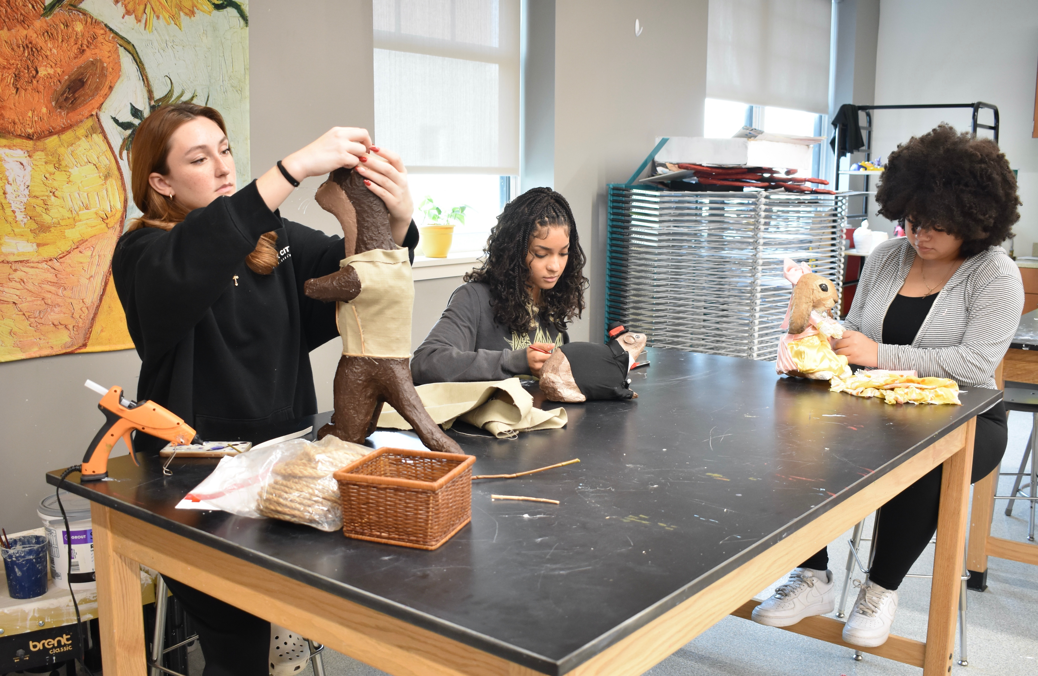
Teaching Tips to Thrive #14.1 Brianna Shetzler: Character Development Using Papier-Mâché Clay 2
Notes:
Class instruction: Discuss Teaching Tips to Thrive #14.1 and Brianna Shetzler’s methods for authentic teaching character development using papier-mâché clay.

Slide 39
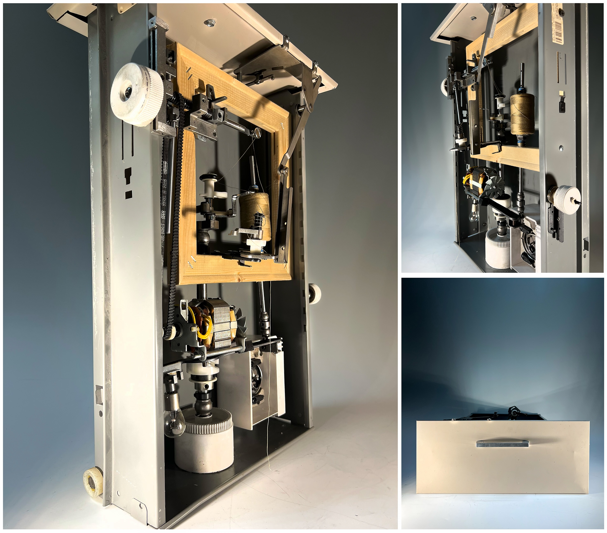
Teaching Tips to Thrive #14.2 Efrain Montesino: Sculpting with Boxes 1
Boxes can be used to create relief and in-the-round sculptures. They can be hung on walls or freestanding. Regardless of the approach, they are simple to work with because students generally work with a single side at a time.
Notes:
Class instruction: Discuss Teaching Tips to Thrive #14.2 and Efrain Montesino’s methods for teaching sculpting with boxes.

Slide 40


Teaching Tips to Thrive #14.2 Efrain Montesino: Sculpting with Boxes 1
Notes:
Class instruction: Discuss Teaching Tips to Thrive #14.2 and Efrain Montesino’s methods for teaching sculpting with boxes.

Slide 41

Approaches to Teacher and Student Transformative Growth Charts
Teacher: Integrate scaffolding techniques and provide multi-step sculpture demonstrations while referencing artists’ works to illustrate idea development and problem-solving strategies to build students’ confidence using sculptural concepts, materials, and processes in support of their creative and cognitive growth.
Student: Utilize my critical thinking and problem-solving skills to navigate potential sculptural challenges I may experience by setting clear artistic goals for myself, planning and sequencing construction stages, and making thoughtful revisions.
Notes:
Class Activity: Open the textbook to Chapter 14’s Teacher and Student Transformative Growth Charts. Model 14.2 TLAE’s Overview of Approaches to Teacher Transformative Growth and Model 14.3 TLAE’s Overview of Approaches to Student Transformative Growth. Discuss the meanings of these transformative actions. Build on their list of actions.
Image: Midjourney AI, prompted by Netha Hussain, CC0, via Wikimedia Commons. https://commons.wikimedia.org/wiki/File:Quilling_pattern_of_a_mountain_02.png

Slide 42
CHAPTER 14 Summary
Understanding Sculpture in Context
Applying Sculpture Methods in Context
Transformative Best Practices for Teaching Sculpture from Pre-K Through High School
Papier-Mâché
Assemblage
Carving
Molds
Wire and Aluminum Foil Sculptures
Notes:
Thanks for participating in Teaching and Learning in Art Education’s 2nd Ed. Chapter 14!
Book Cover Artwork: Paula Gale
Chapter References
Brew, C. A. (2004). The big heads: Sculptures that know it all. Arts and Activities, 135(4), 18–19.
Congdon, K. G. , & Hallmark, K. K. (2002). Artists from Latin American cultures: A biographical dictionary. Greenwood Press.
Congdon, K. G. , & Hallmark, K. K. (2012). U.S. folk artists of the twentieth century. ABC-CLIO.
Good, J. (2024). My favorite new paper mache clay recipe. https://www.ultimatepapermache.com/my-favorite-paper-mache-clay-recipe
Lubkemann, E. C. (2005). The little book of whittling: Passing time on the trail, on the porch, and under the stars. Fox Chapel.
MASS MoCA (2017, February 27). Nick Cave: Until. Monumental exhibition is home to performance art and community events. https://massmoca.org/wp-content/uploads/2017/10/Nick-Cave-Community-Events.pdf
Noble, D. (2022, Oct 21). Nick Cave’s colossal crystal cloudscape at Carriageworks imparts a vital message. Wallpaper. https://www.wallpaper.com/art/nick-cave-until-carriageworks
Park, S. (2021). Gucci. https://www.seungmopark.com/?wix-vod-video-id=7b4401d5270a4f54af37f84b38d14e59&wix-vod-comp-id=comp-kt2kkxzs
Sickler-Voigt, D. C. (2003). Out of the woods and into the light: O. L. Samuels on mentoring children with at-risk tendencies through personal history and carving lessons. Journal of Cultural Research in Art Education, 21(1), 60–67.
Sickler-Voigt, D. C. (2006). Carving for the soul: Life lessons from self-taught artist O. L. Samuels. Journal of Art Education, 59(3), 25–35.
Sickler-Voigt, D. C. (2023). STEAM teaching and learning through the arts and design: A practical guide for PK-12 educators. Routledge.
Simon, E. (2013). Soap sculptures. www.landscapesmag.com/teachers/lessonplans/Aboriginal%20lesson%20plans/Soap%20Sculptures.pdf
Tropenmuseum . (2018). Kojo Bambil. https://collectie.wereldculturen.nl/#/query/b96bee93-467b-41dc-ab09-03d01124c850
van der Reyden, D. , & Williams, D. (2006). The history, technology, and care of papier-mache: Case study of the conservation treatment of a Victorian “Japan ware” chair. www.si.edu/mci/downloads/RELACT/papier_mache.pdf

