Slide 1
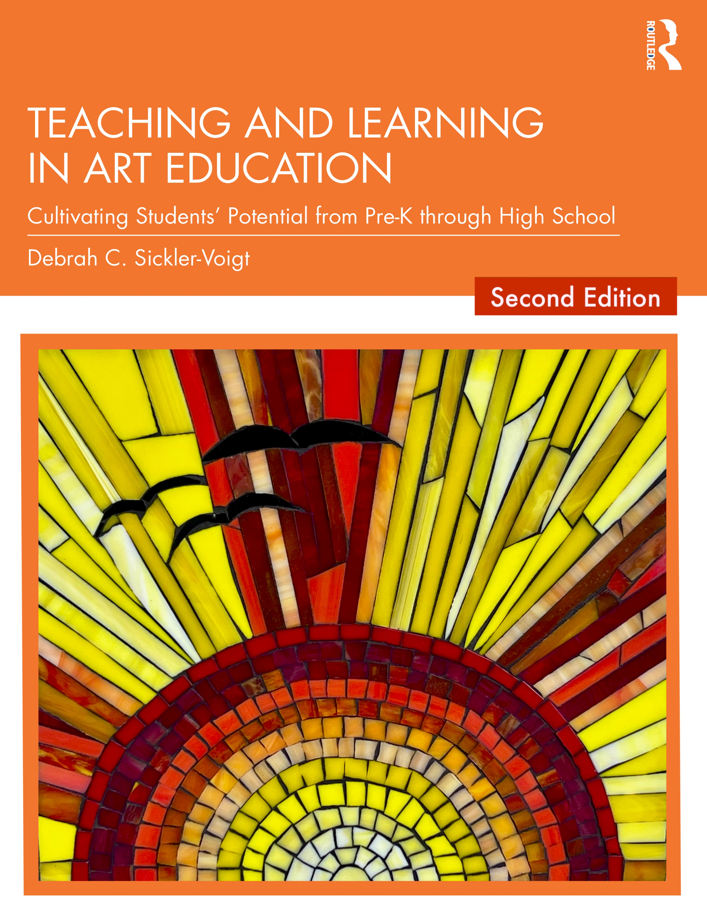
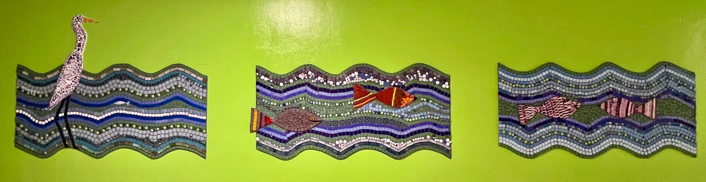
CHAPTER 19. Arts Advocacy
Teaching and Learning in Art Education, 2nd Ed.
Debrah C. Sickler-Voigt, Author & Presentation Developer ©
Notes:
Welcome to Teaching and Learning in Art Education, 2nd Edition, Chapter 19!
TLAE as a theoretically-based, practical textbook to prepare preservice educators for their teaching careers and to support in-service educators in improving their existing practices. Its timely second edition with its updated framework remains dedicated to assisting educators in all stages of their careers through effective curricular planning, instruction, assessment, and management to foster student learning and cultivate educators’ meaningful, creative, and rewarding careers.
This textbook and instructional resources resulted from the contributions of many individuals, including teachers, students, artists, organizations, family, mentors, and Routledge’s editorial/production team. Its teachings are based on the author’s research, communications, and professional interpretations of teachers, artists,’ and designers’ works with the aim of being respectful of diversified peoples and representing their teachings in a truthful and non-biased manner.
Book Cover Artwork: Paula Gale
Right Image: K-8 school mural installation. Source: Paula Gale, teacher

Slide 2
Chapter 19 Topics
Arts Advocacy and Teacher Leadership
Building an Arts Advocacy Campaign
Advocacy and Visual Arts Funding
Notes:
Spotlight on Student Art #19: Arts Advocacy
Image: K-8 school mural installation. Source: Paula Gale, teacher

Slide 3

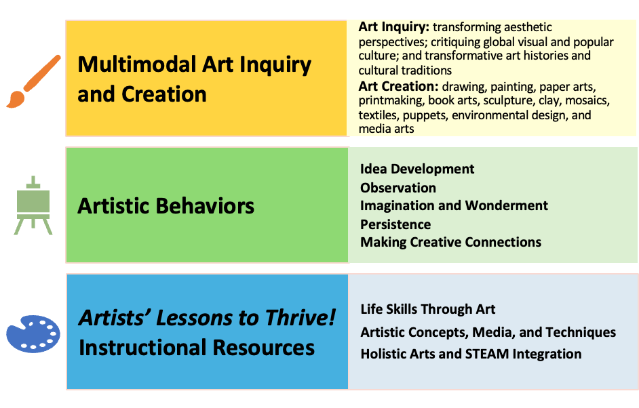
Link Chapter 19’s teachings with
TLAE’s Transformative
Art Education Framework
Notes:
Class instruction: Ask students to build on prior learning and personal experiences to make personal connections between this chapter’s teachings and TLAE’s Transformative Art Education framework.
Book Cover Artwork: Paula Gale

Slide 4

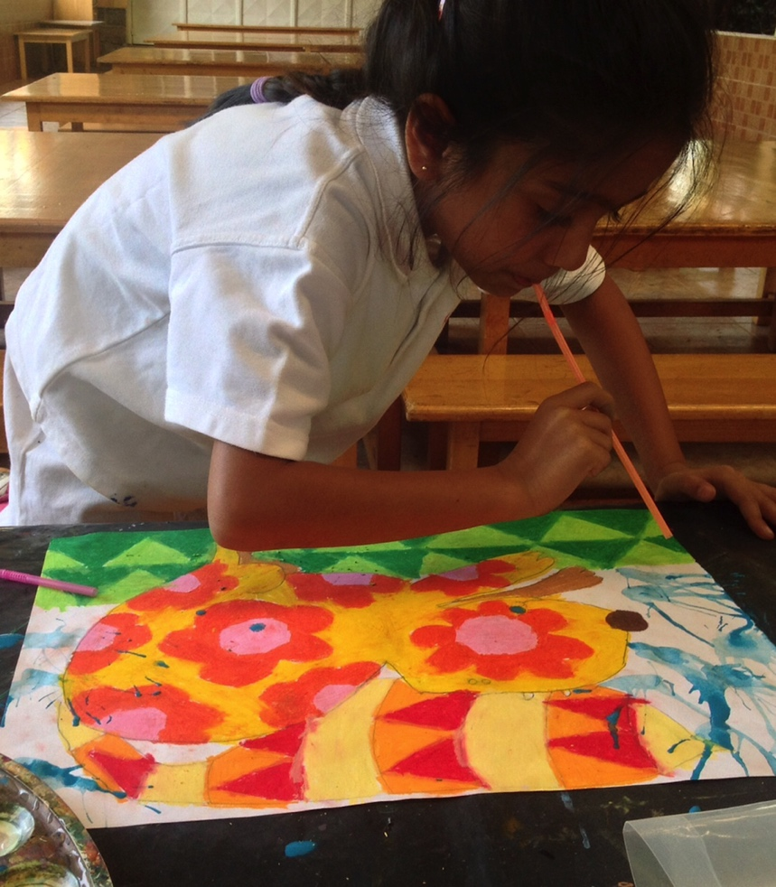
Arts Advocacy
Arts advocacy is the act of informing others about the value of the visual arts and arts professionals to provide students and society members with exemplary learning experiences.
An art education advocacy campaign articulates why students need the visual arts in schools and in the non-school hours.
Notes:
Class instruction: Discuss methods to develop an arts advocacy campaign with the class.
Image: Keiya Sumaria, 6 years old, experiences the joys of creating art. Kenya. Lisa Wee, teacher.

Slide 5
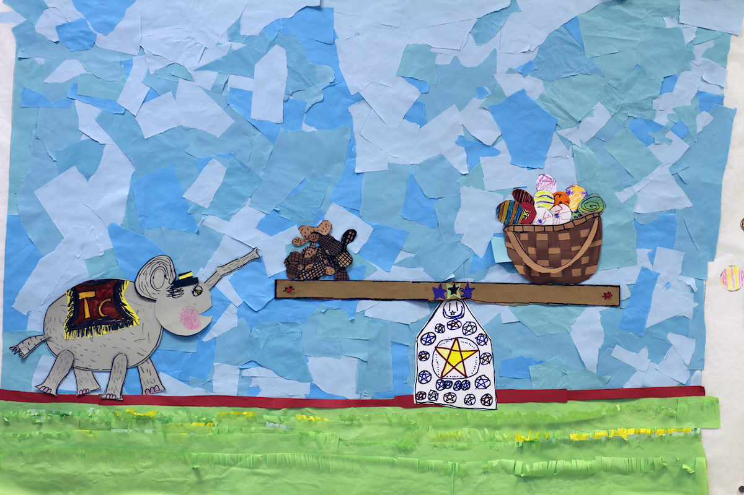
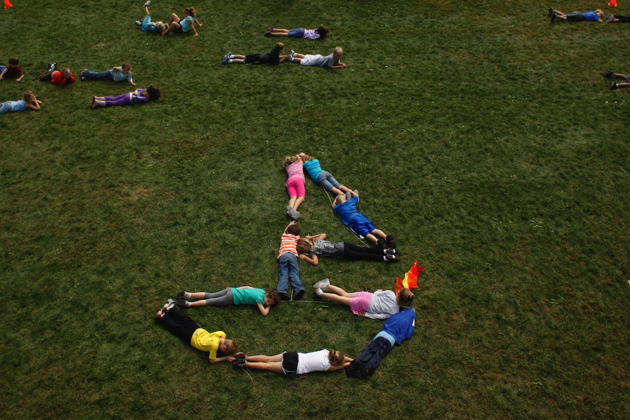
Advocacy and Teacher Leadership 1
Teachers who are arts advocates apply leadership skills to generate quality learning outcomes for all students.
They teach about significant issues through enthusiastic tones, quality visuals, and descriptions of their meanings.
Arts advocates know their audience and speak to them directly.
Notes:
Top Image: Tiny Circus, Elephant Trap. USA. Tiny Circus, artists-in-residence. Sarah Fitzgerald, teacher.
Bottom Image: Elephant Trap still. Students manipulate their bodies into the form of a sailboat. Tiny Circus, artists-in-residence. Sarah Fitzgerald, teacher.

Slide 6
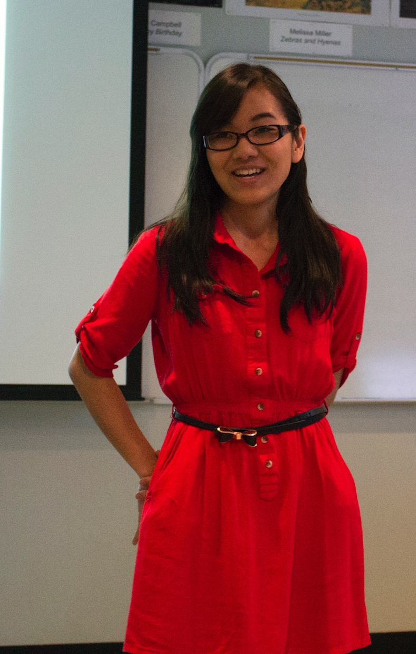
Advocacy and Teacher Leadership 2
Demonstrate teacher professionalism and deep-knowledge of the visual arts.
Have enthusiasm for subject matter that inspires others and show genuine care for students.
Augment teaching methodologies to develop meaningful arts experiences.
Notes:
Image: Beginning her teaching career, Natsumi Kajisa, demonstrates professionalism and enthusiasm for teaching. In this image she is teaching a lesson to students from a state school for the blind.

Slide 7
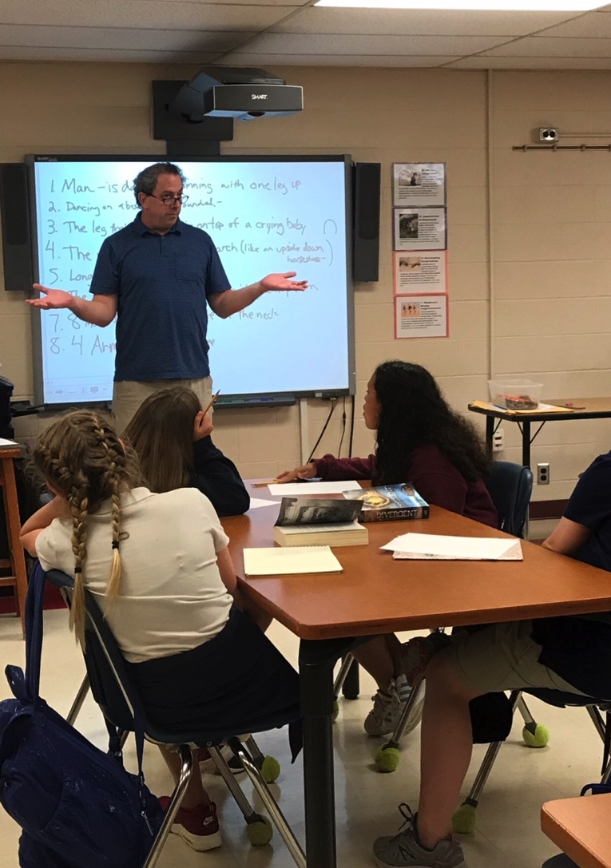
Advocacy and Teacher Leadership 3
Take steps to secure sustainable program funding.
Inform administrators and the public about student achievements and teacher accomplishments.
Seek support and form community partnerships.
Notes:
Image: Mike Muller continuously advocates for his students and art program. In this picture he is teaching an I spy art lesson to his middle school students.

Slide 8

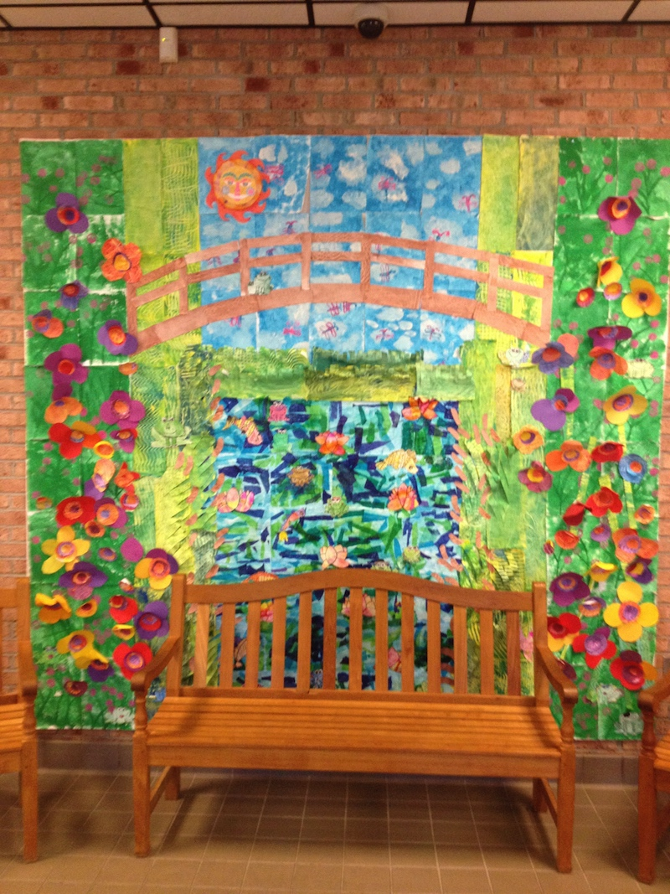
Communications
Inform parents, administrators, and policy makers, about achievements.
Use communications to highlight student and program achievements, raise awareness, and gain support.
Display student works at school, online, and within the community. Write press releases.
Notes:
Image: This paper mural and bench welcome elementary school visitors. USA. Cassie Stephens, teacher.

Slide 9
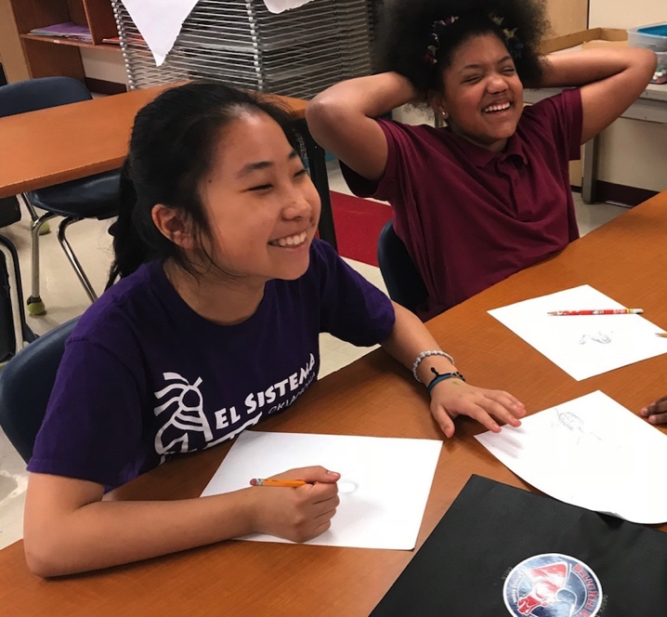
Everyday and Special Events 1
Recognize the importance of daily events that establish the routines of what is to be expected as normative quality practices.
Organize and participate in art centered special events including Youth Art Month (YAM) that increase program visibility and align with arts advocacy practices.
Notes:
Class activity: Brainstorm everyday classroom and special events that align with arts advocacy.
Image: Middle school students talk with their teacher about their work. USA. Mike Muller, teacher.

Slide 10
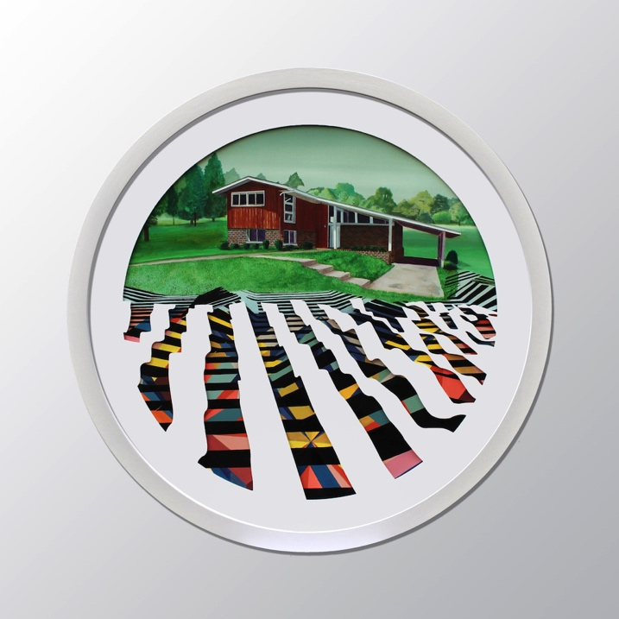
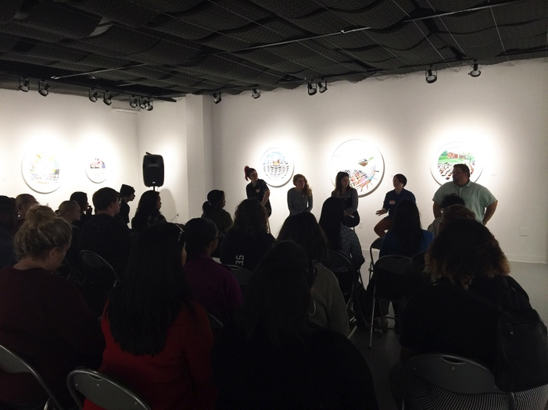
Everyday and Special Events 2
Develop exhibitions, performances, seminars, and panel discussions.
Write grants to bring artists-in-residents to learning sites.
Participate in a school-wide career day to teach about visual arts professions.
Sponsor an art club or National Art Honors Society.
Notes:
Top Image: Nick Peña, From Sea to Shining Sea, 2018, 30" (76.2 cm) diameter, watercolor, acrylic, sintra mat
Bottom Image: Pre-service art educators give a panel discussion on arts advocacy surrounded by original artworks by Nick Peña.

Slide 11
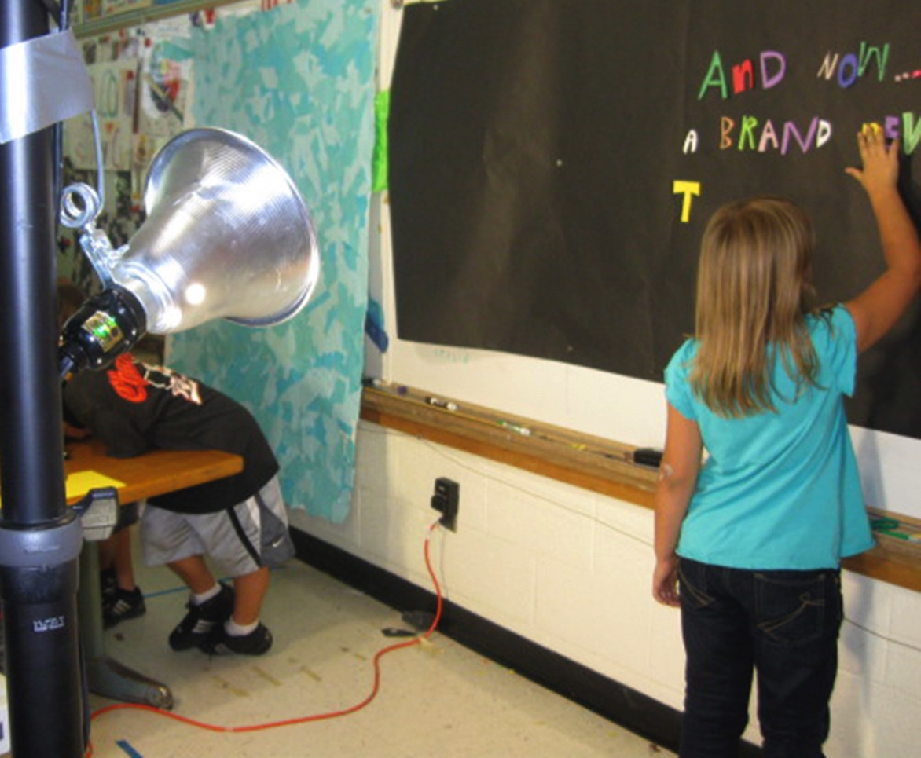
Community Art Education 1
Community art education is the practice of developing extraordinary projects and events with community partners that extend beyond regular classroom learning experiences.
Teachers take advantage of existing partnerships and establish new ones to implement community art projects.
Notes:
Image: Students developing Elephant Trap. Tiny Circus, artists-in-residence. Sarah Fitzgerald, teacher.

Slide 12
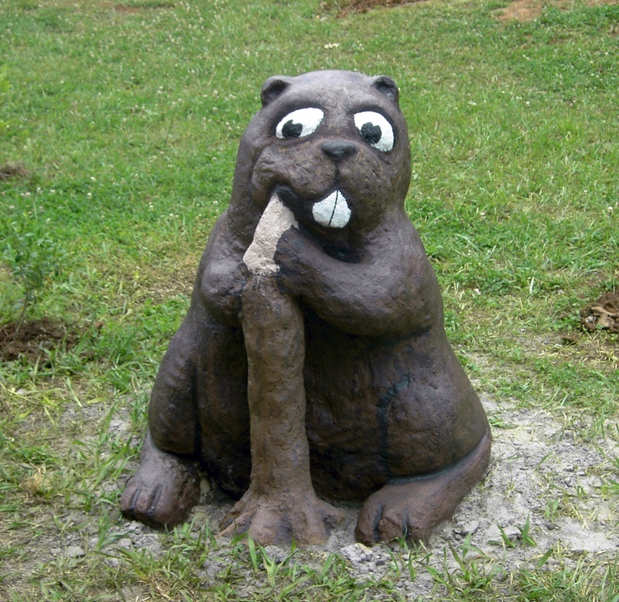
Community Art Education 2
Community art education puts students in touch with people with whom they may not normally have contact.
Community partners apply their diversified life experiences to inspire and teach students.
Notes:
Classroom activity: Brainstorm how to invited diversified and intergenerational community partners into community art projects.
Image: Students and intergenerational participants formed concrete sculptures for a wetland themed art garden. USA. Author and Suzanne St. John, teachers. Funded by MTSU Public Service Grant. Pamela McColly, photo.

Slide 13
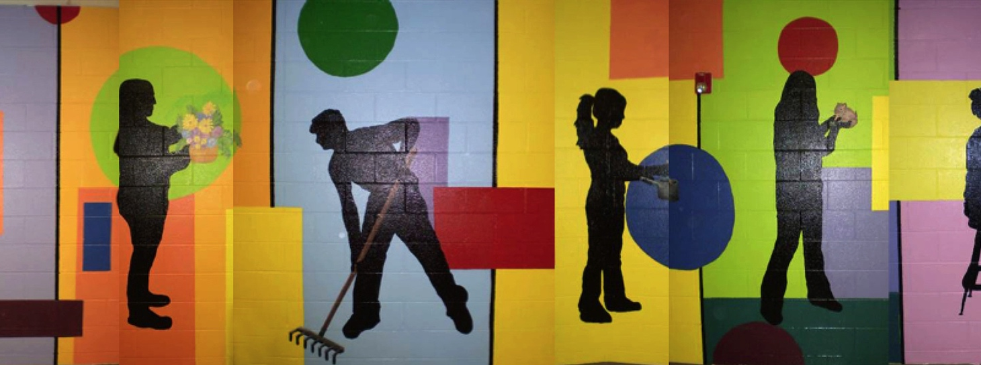
Community Art Education 3
Teachers and students should assess what they have learned and plan strategies to move forward.
Notes:
Image: Careers for Careers Mural. High School Students. USA. MTSU Public Service Grant. Author, Michael McGoffin, and Stephanie Roberts, teachers.

Slide 14
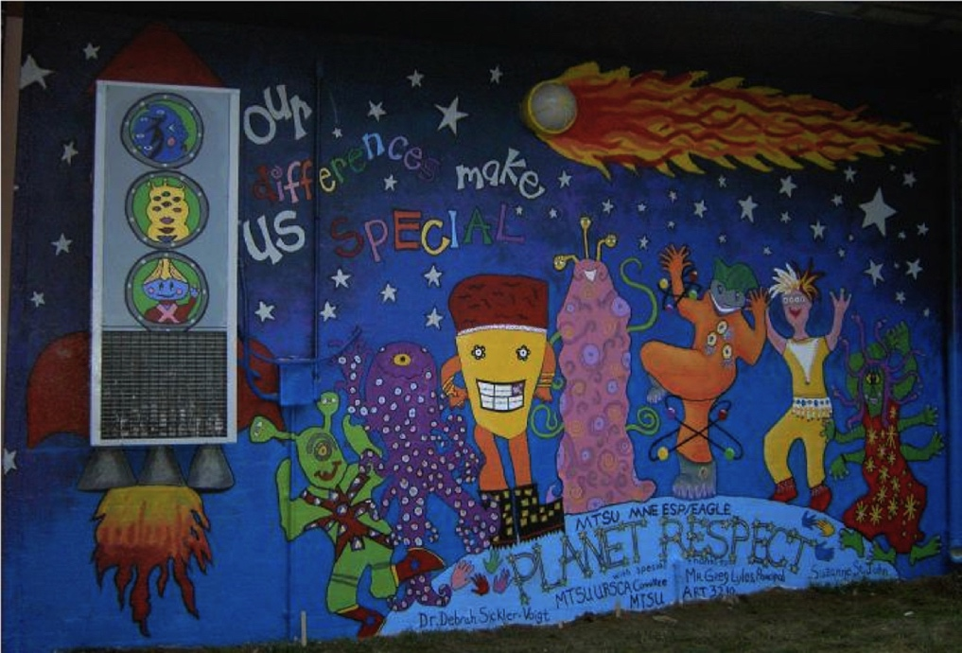
Teacher Research 1
Teachers present research findings through publications, blogs, and conferences to share knowledge.
They ask “what if” and “why” questions to know more about their teaching methodologies, students, and programs.
Teachers and students work as agents of positive change. They take actions and feel empowered as they make positive changes.
Notes:
Image: Planet Respect. Elementary students. USA. Author and Suzanne St. John, teachers. Funded by MTSU Public Service Grant. Pamela McColly, photo.

Slide 15
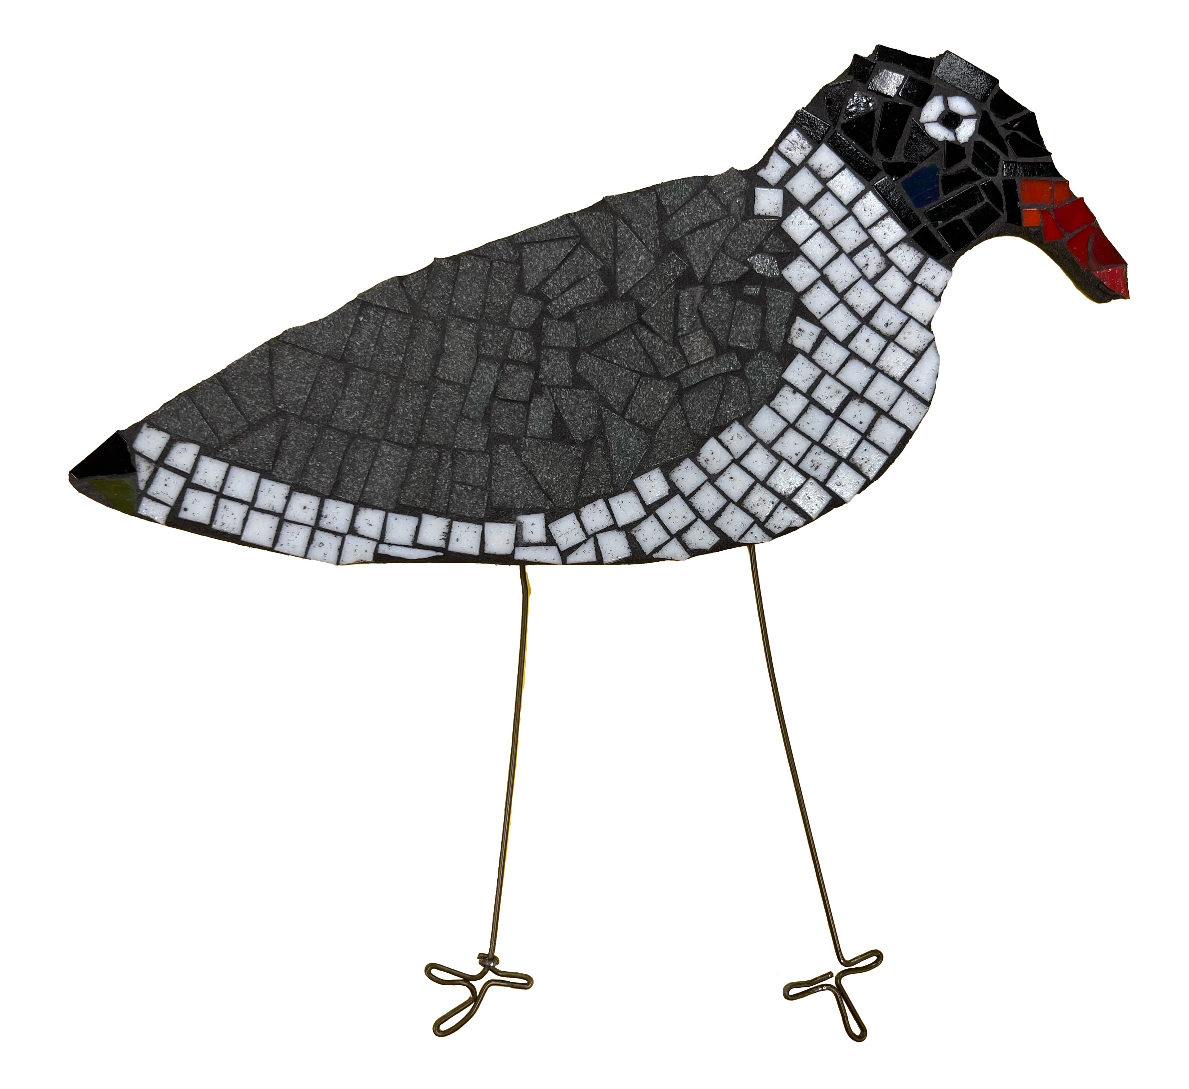
Teacher Research 2
The NAEA Research Commission assists educators in answering critical questions to strengthen teaching and learning practices in the visual arts and advocate to stake holders (NAEA, 2024b):
What are the opportunities for sharing inquiry, curiosities, and dialogue around research?
How do we build on inquiry by bringing ideas together and taking them further?
How do we create relevant resources and opportunities through the ever-changing research needs of our communities?
How do we begin to move research toward a more equitable and inclusive vision? (para 3-6).
Notes:
Image: K-8 laughing gull mosaic, USA. Source: Paula Gale, teacher

Slide 16

Teacher Research 3
Art-based research describes the practice of utilizing artistic processes and behaviors to ask questions, generate ideas, contemplate solutions to complex problems through the reflective practices of producing individual and community artworks.
Combining art-based research with Mezirow’s (1991) transformative learning theory encourages our reflective practices in making personally-driven discoveries to shape our professional practices and facilitate teacher and student agency.
It offers creative pathways to promote healthy discourse and dispositions by addressing the issues at hand and making necessary improvements.
Notes:
Class instruction: Clarify how transformative, art-based research practices are never forced, but rather driven by our desires to cultivate substantive changes.
We learn to take actions and feel empowered as we make positive changes. We benefit our profession by disseminating the results of our research findings in publications and professional developments, like conference presentations, to assist fellow educators and their students who face similar challenges.
Image: https://openclipart.org/download/116953/1296777772.svg
References:
Smilan et al., 2025

Slide 17
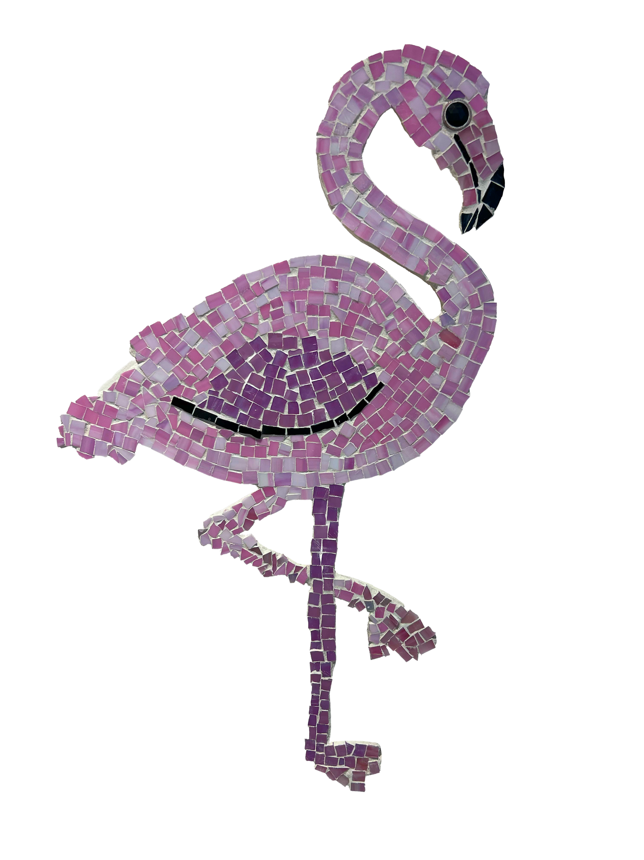
Teacher Research 4
Transformative, art-based research practices are never forced, but rather driven by our desires to cultivate substantive changes. We learn to take actions and feel empowered as we make positive changes.
We benefit our profession by disseminating the results of our research findings in publications and professional developments, like conference presentations, to assist fellow educators and their students who face similar challenges.
Notes:
Image: Figure 19.2 K-8 flamingo mosaic, USA. Source: Paula Gale, teacher
Reference:
Smilan et al., 2025

Slide 18
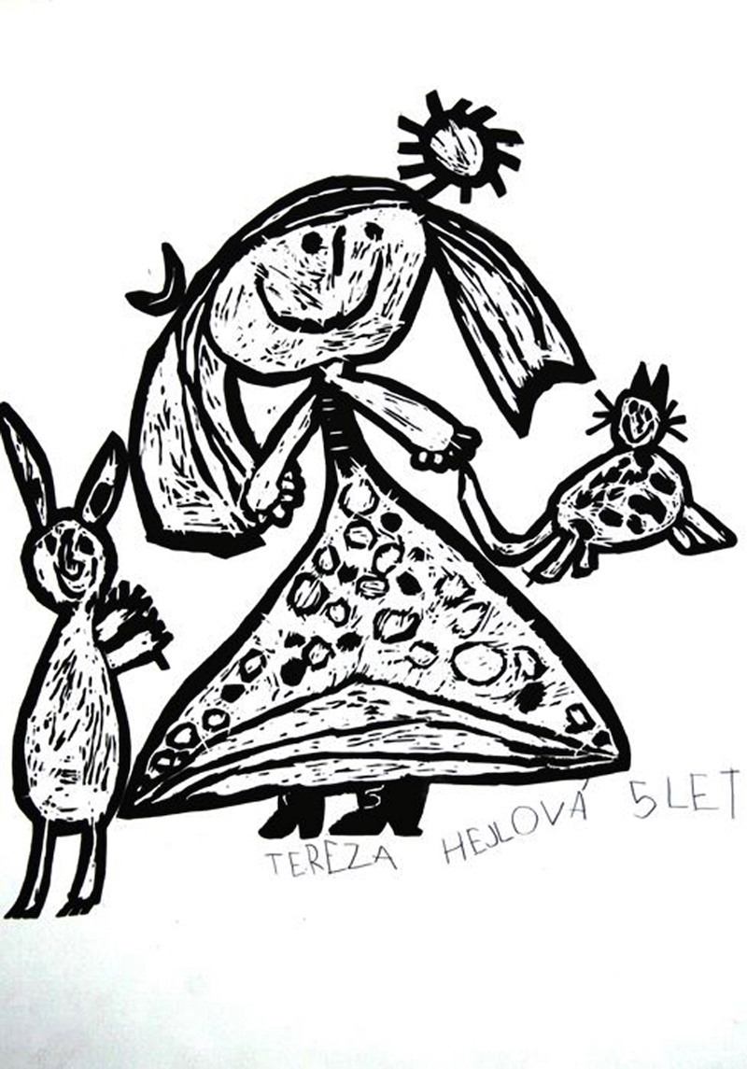
Building an Arts Advocacy Campaign
Arts advocacy must remain ongoing to stay current in people’s minds. Advocates form lasting partnerships with people who will take actions to support learning in the visual arts.
Advocates meet with administrators and elected officials. They make phone calls, form letter writing campaigns, and send postcards and artworks.
Notes:
Class instruction: Explain how the National Art Education Association (2016) emphasized the importance of being visible and knowledgeable when advocating for the visual arts. To stay current and relevant, art educators redesign standards, policy, curricula, and assessments as necessary. They recognize the people and policy makers that have supported their cause.
Image: Tereza Hejlová, 5 years old, ZUŠ, Plzeň, Czech Republic. 41st ICEFA Lidice.
Reference:
National Art Education Association, 2016

Slide 19
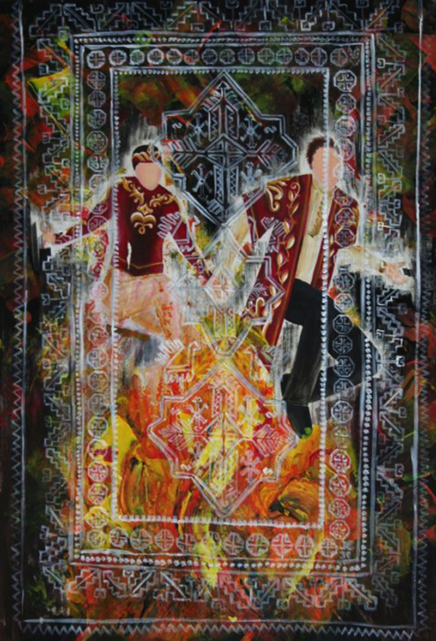
Advocacy and Visual Arts Funding 1
Arts advocacy can have a direct impact on resources for teaching art because principals and other administrators control art budgets, class facilities, and scheduling.
Notes:
Image: Nare Vartanovna Arutiunian, 14 years old, National Children´s Library after Khnko-Aper, Yerevan, Armenia. 41st ICEFA Lidice.

Slide 20
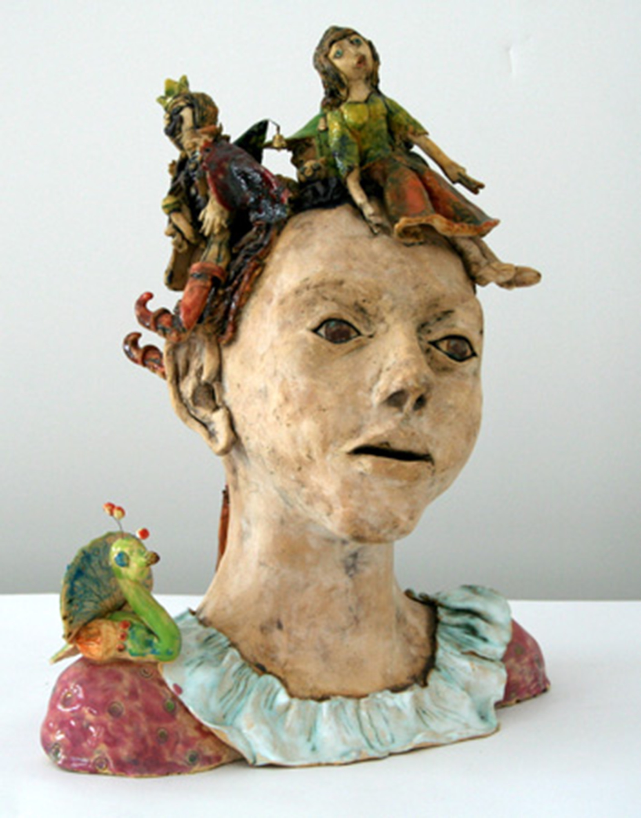
Advocacy and Visual Arts Funding 2
Most art supplies are consumable. Teachers must replenish the majority of class products and teach with specialized equipment.
Notes:
Image: Barbora Římalová, 10 years old, Dům dětí a mládeže Praha 3 - Ulita, Praha 3 - Žižkov, Czech Republic. 39th ICEFA Lidice.

Slide 21
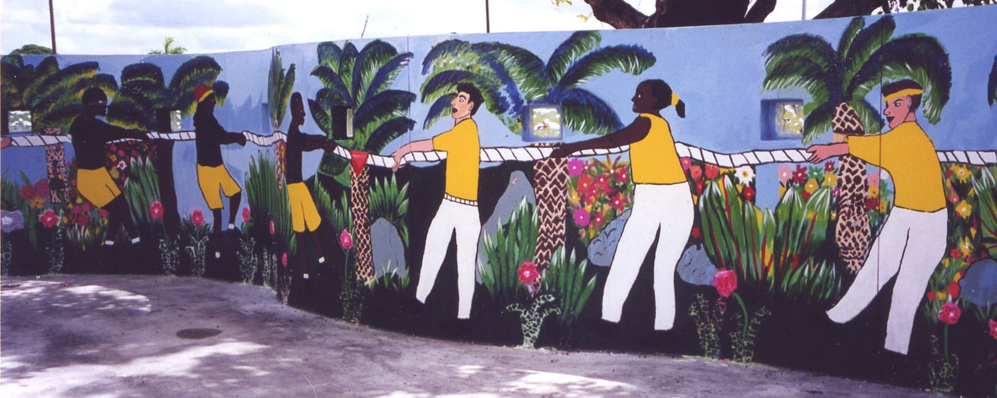
Art Budget Planning 1
Administrators allocate a financial amount to fund the visual arts each school year. Programs receive varying funding amounts based on available resources and/or administrators’/policy makers’ commitment to the arts.
Notes:
Image: Elementary students. USA. Author, teacher. Funded by Arts for a Complete Education/Florida Alliance for Arts Education. Pamela McColly photo.

Slide 22
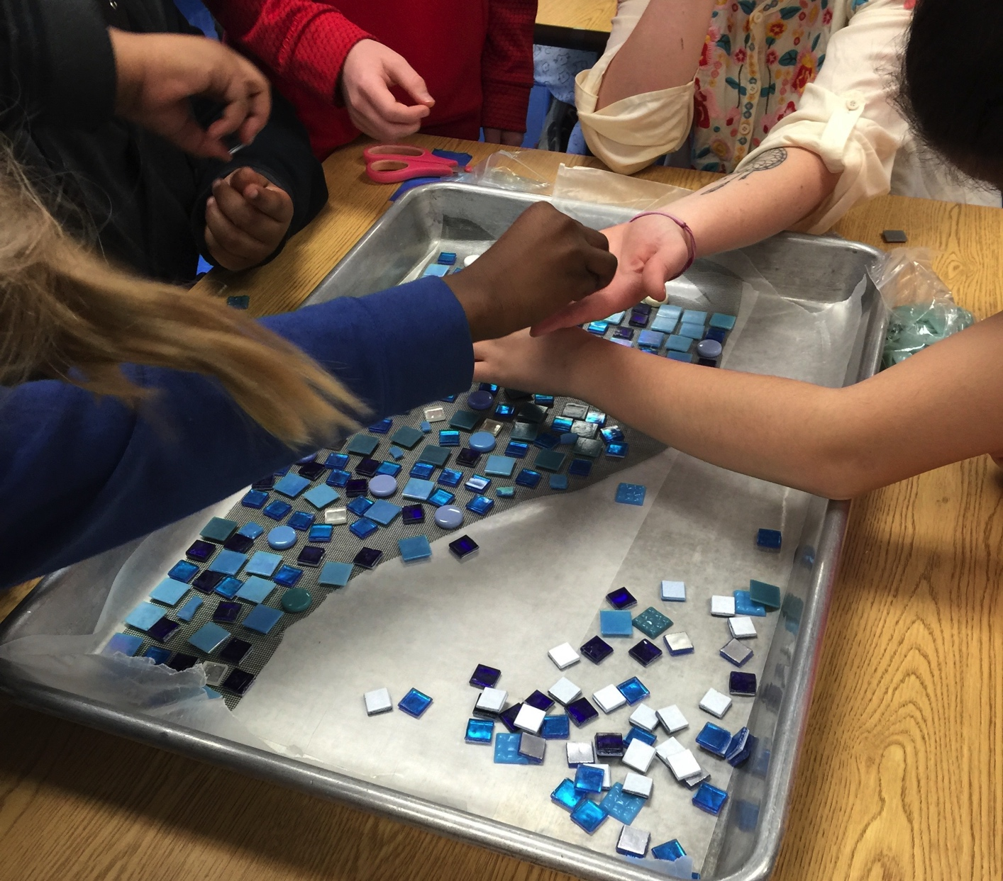
Art Budget Planning 2
When supplies cost more than allocated budgets, meet with administration to explain how the program requires specific art media and equipment.
Ask administrators for guidance in finding alternative sources when the school does not have the necessary funding.
Notes:
Class activity: Teach the class how to develop an art budget for classroom supplies.
Image: Students are forming a mosaic design for a mural. USA. Author and Abbey Logan, teachers.

Slide 23

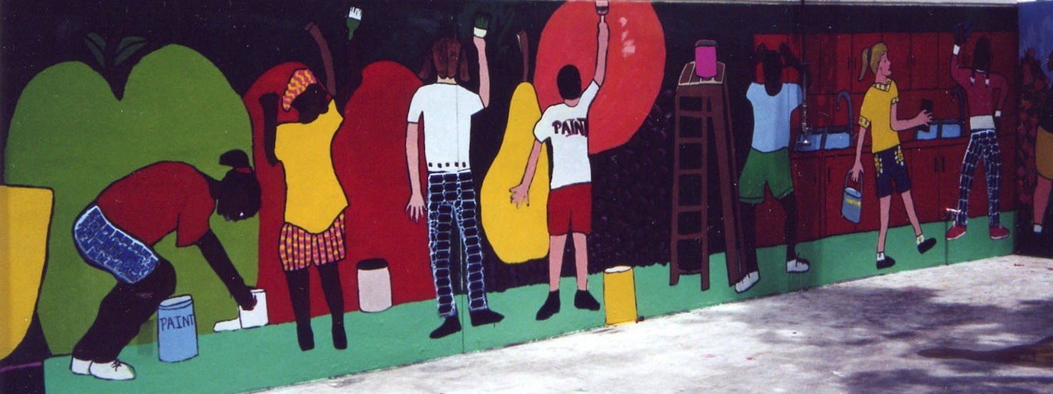
Fundraising 1
Fundraising is the act of soliciting monetary or material contributions through organized events designed to support a program, project, or event. Many teachers participate in fundraising activities to supplement their budgets. The best fundraisers involve many supportive individuals.
Notes:
Image: Elementary students. USA. Author, teacher. Funded by Arts for a Complete Education/Florida Alliance for Arts Education. Pamela McColly photo.

Slide 24
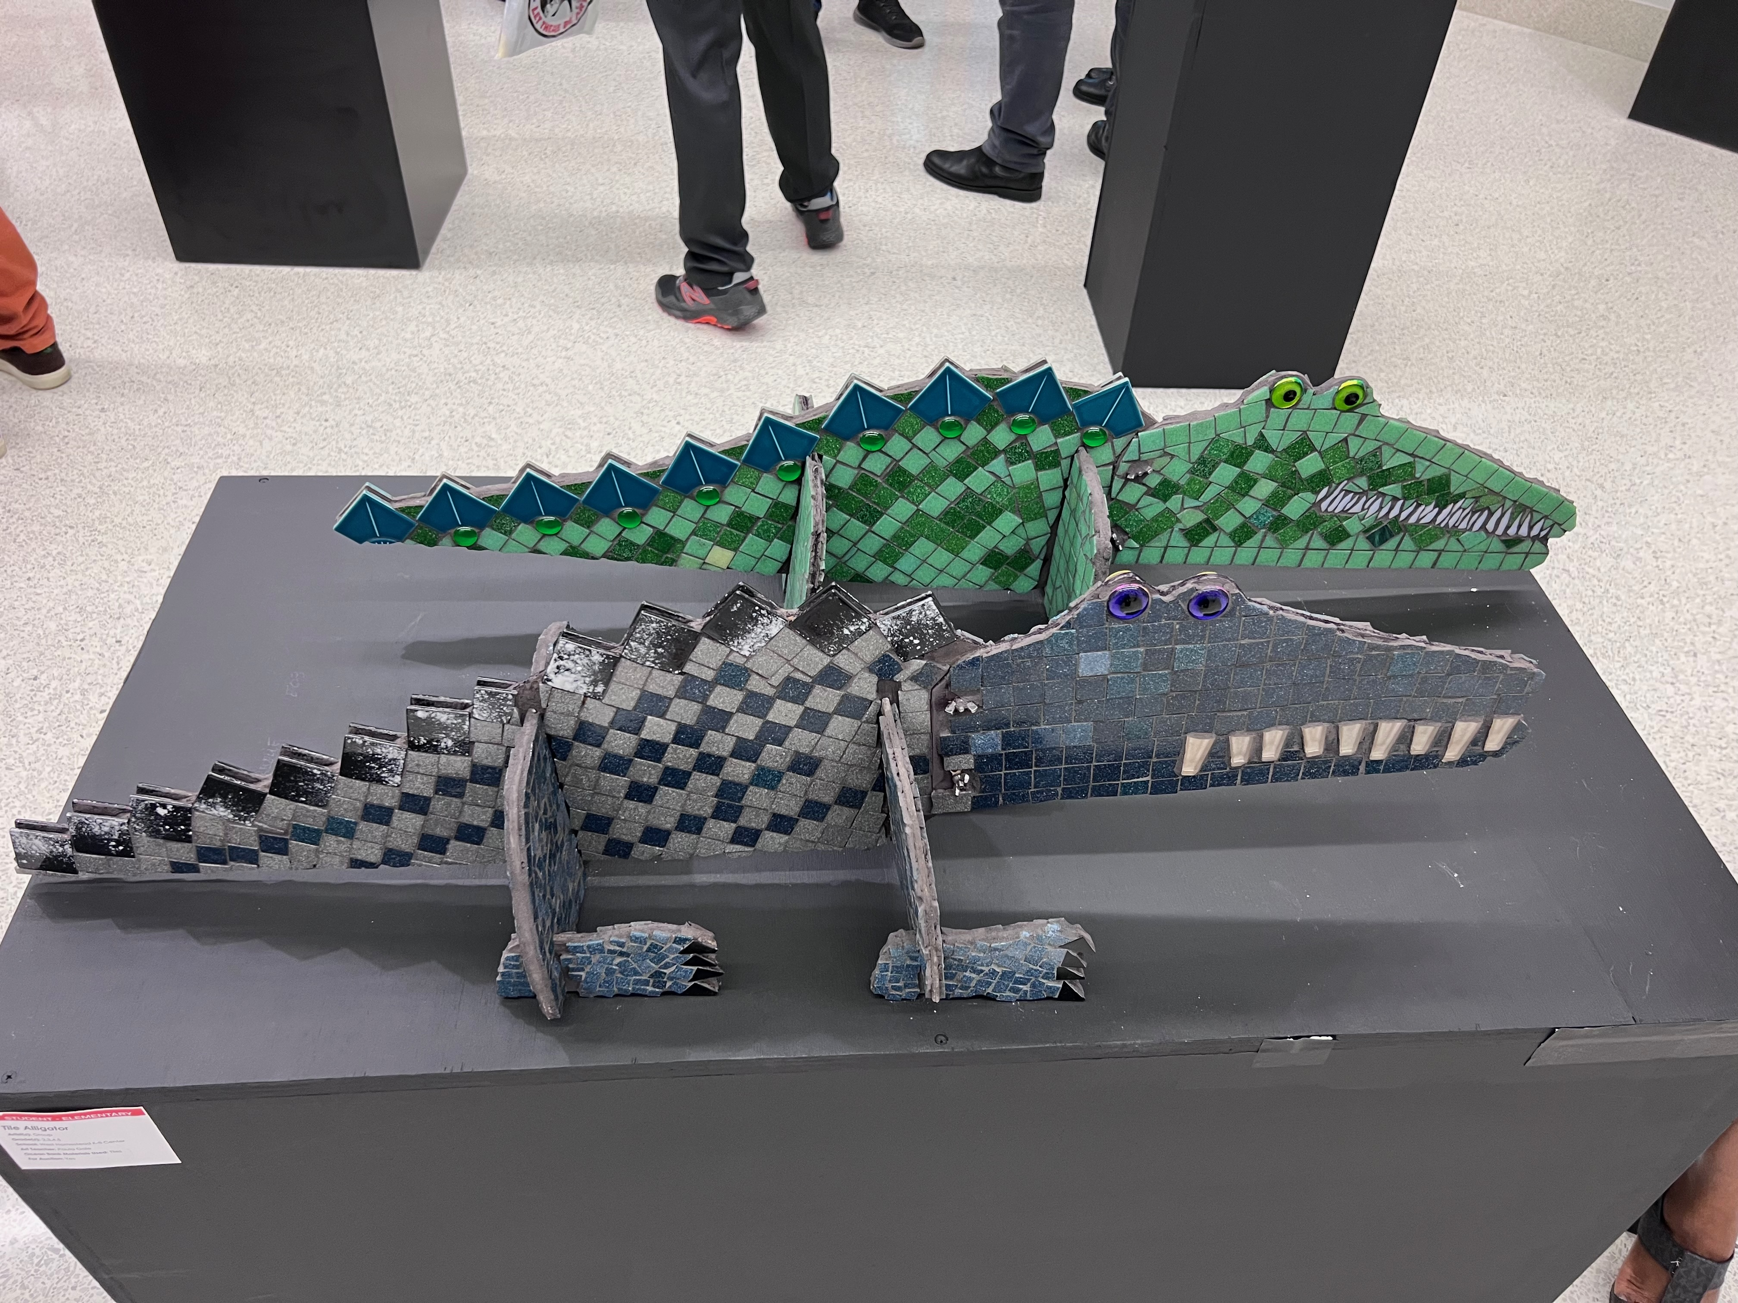
Fundraising 2
Large-scale schoolwide fundraising has become common in public schools and has placed unequal burdens at under-resourced schools compared to affluent ones.
They have fewer resources to secure funding and require more time to acquire funds. Policies implemented to ensure equitable funding distribution would reduce this hardship.
Notes:
Image: K-8 crocodile and alligator mosaics, USA. Source: Paula Gale, teacher
Reference:
Yoon et al., 2024

Slide 25
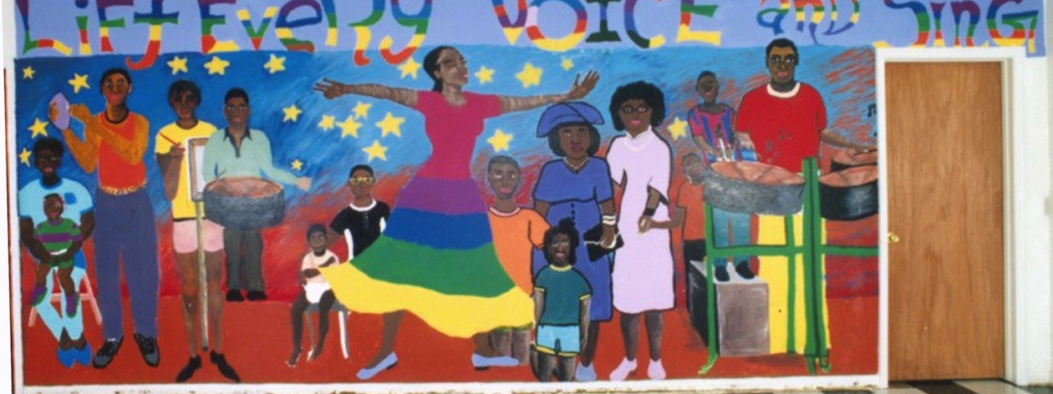
Grant
Writing 1
Grants are financial awards that government agencies, businesses, and foundations offer to support specific purposes. Grantors support educational and nonprofit organizations because of their tax-free status and their ability to perform projects that benefit society.
Notes:
Class activity: Have the class open their textbooks and introduce Model 19.1. Teacher Mini-Grant. Teach the class how to write a grant.
Image: Lift Every Voice and Sing. Early childhood through adolescence. USA. Jill Harper, Director.

Slide 26
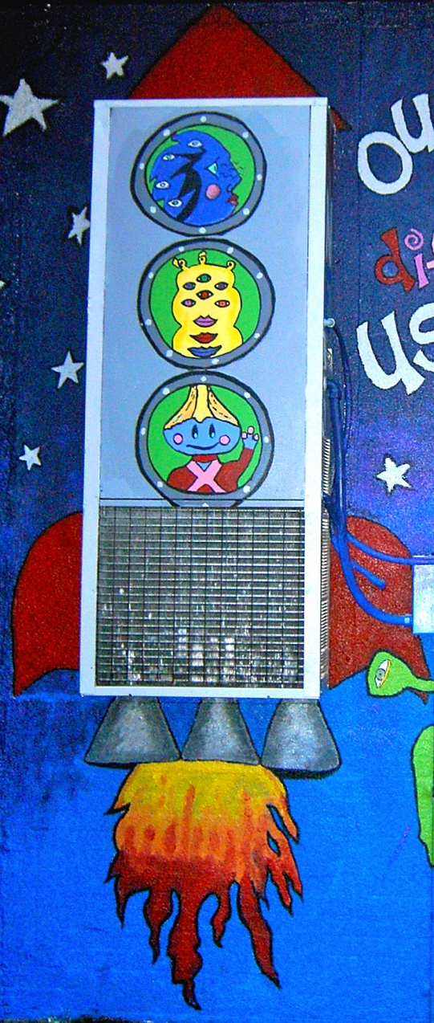
Grant Writing 2
Allow adequate time to plan and write grants. Follow all directions carefully and structure projects around a need.
Design proposals that are well written, professional, personable, and logical. Explain terminology and avoid jargon.
Explain how the project connects to the funder’s goals and the school’s/program’s mission.
Notes:
Image: Planet Respect. Elementary students. USA. Author and Suzanne St. John, teachers. Funded by MTSU Public Service Grant. Pamela McColly, photo.

Slide 27

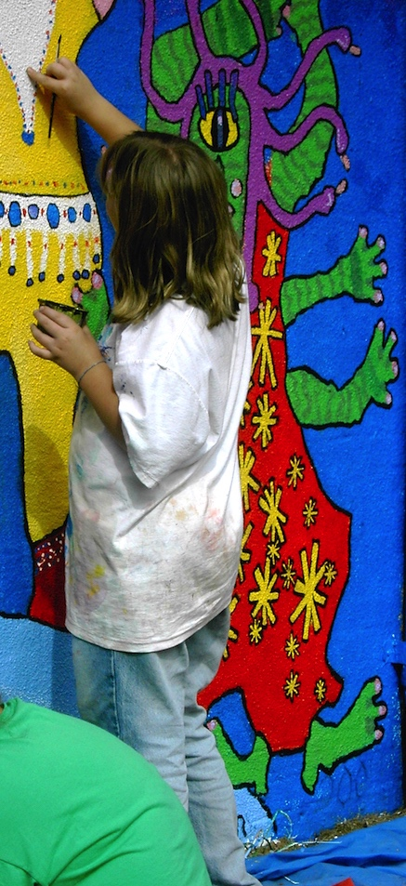
Grant Writing 3
Identify project participants and goals. Incorporate relevant research and statistics to support the cause.
Define the project’s objectives using measureable actions. Identify evaluation methods.
Communicate with funding agencies and proofread the grant.
Notes:
Image: Planet Respect. Elementary students. USA. Author and Suzanne St. John, teachers. Funded by MTSU Public Service Grant. Pamela McColly, photo.

Slide 28
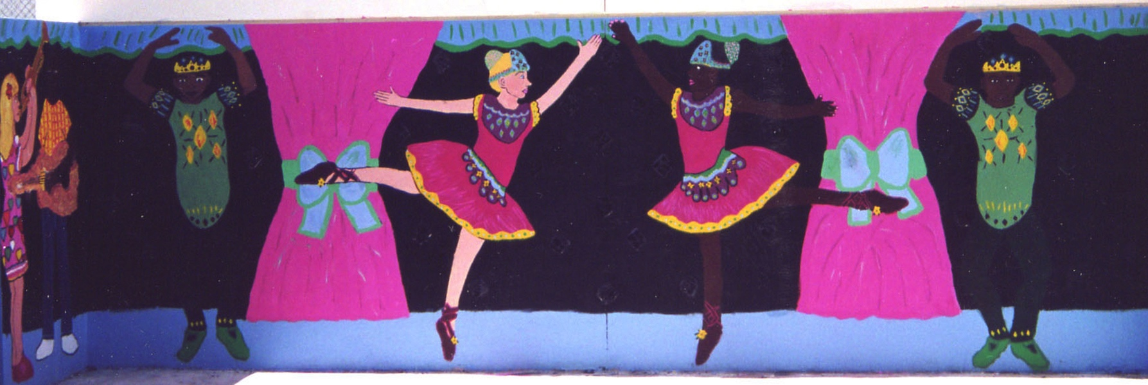
Grant Writing 4
A grant is based on a need.
Introduction
Objectives
Methods
Evaluation
Timeline
Budget
Notes:
Image: Elementary students. USA. Author, teacher. Funded by Arts for a Complete Education/Florida Alliance for Arts Education. Pamela McColly photo.

Slide 29
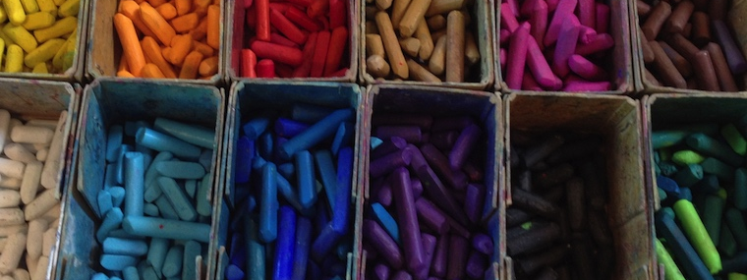
Grant Writing 5
Matching funds necessitate that grantwriters obtain equal amounts in cash from another source to match the funds the grantor will award.
An in-kind contribution includes non-cash goods and services from other sources.
Notes:
Class instruction: Ask the class to brainstorm examples of in-kind contributions, like donated materials, existing class/school materials, instructional resources, equipment, and volunteer support.
Image: A box of pastels. Author, photo.

Slide 30

Tiny Circus: Creativity
Artists’ Lessons to Thrive! 19.1.
Big Idea: Creativity
Stop Motion Animation
Notes:
Class instruction: Have the class open the textbook to Artists’ Lessons to Thrive! 19.1. Participate in its learning targets.
Image: Tiny Circus, Creativity, 2012. http://www.tinycircus.org

Slide 31
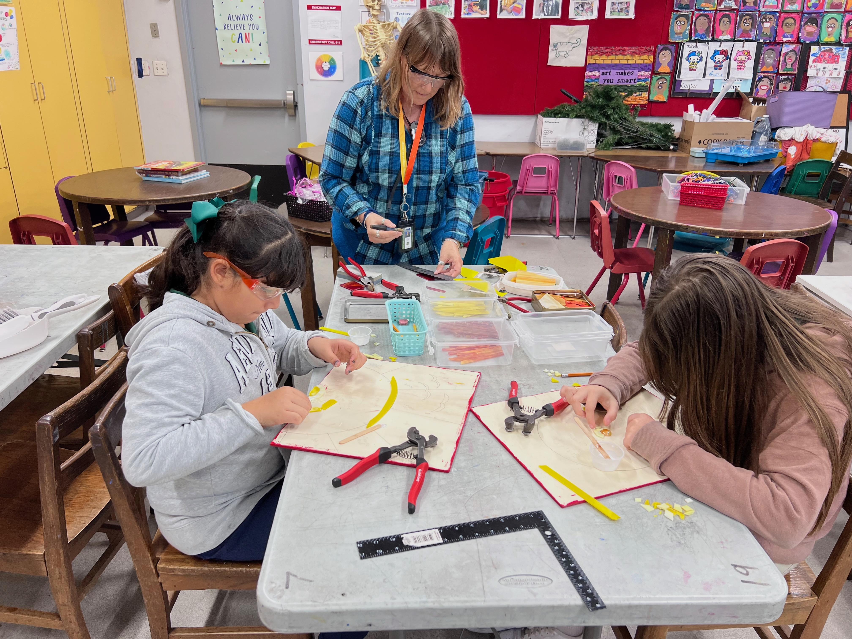
Teaching Tips to Thrive! 19.1
Paula Gale: Arts Advocacy Through
Large-Scale Group Mosaics
I feel the most important thing I can do in advocating for my students is to provide a safe, enriching, and nurturing environment where they can be free to explore their own ideas, interests and potentials. Having a positive relationship with students also helps them feel part of the classroom, and the school community which in turn fosters self-esteem and also kindness toward fellow students. Providing novel materials and interesting activities, like working on large-scale, group mosaics projects, engages even the most reluctant artists
Notes:
Class instruction: Discuss Teaching Tips to Thrive #4.1 and Amber Buck’s methods for authentic teaching and classroom management.
Top Image: Mosaic, USA. Source: Paula Gale, teacher
Bottom Image: Students create sun mosaic designs, USA. Source: Paula Gale, teacher.

Slide 32
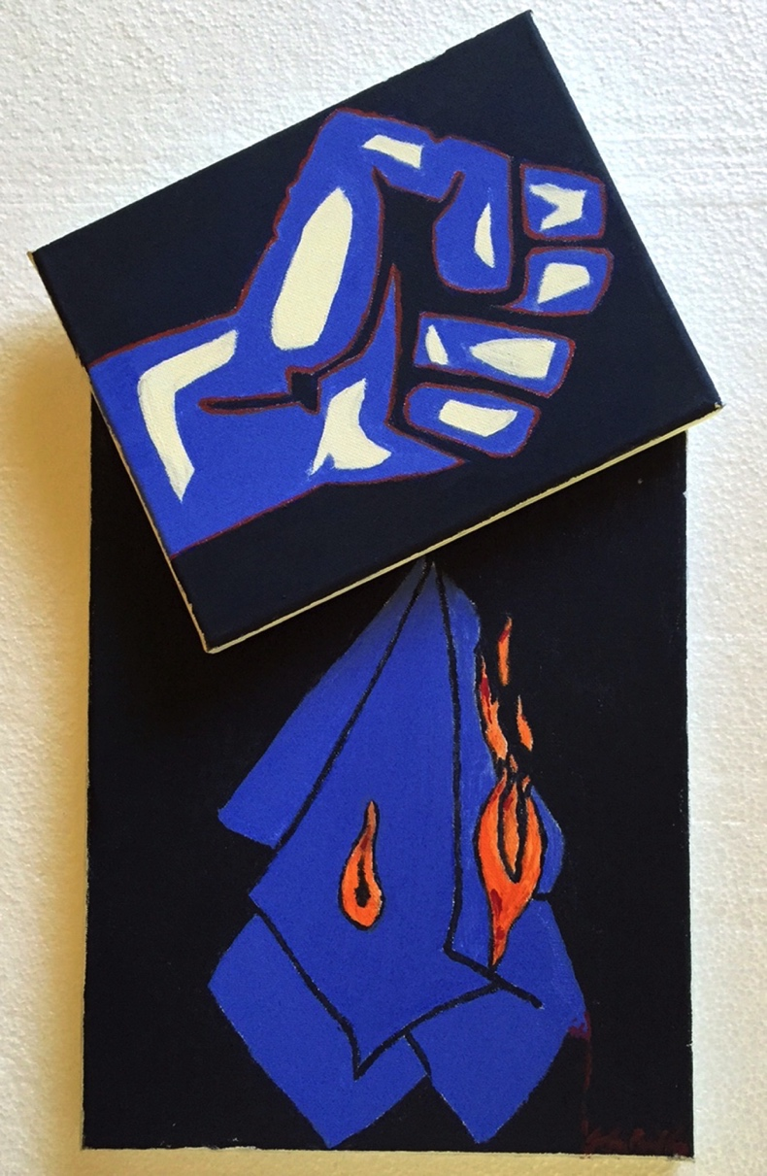
Teaching Tips to Thrive! 19.2
Dr. Yichien Cooper:
Embracing Community through Arts
My growing passion for integrating the arts into public life and municipal development eventually led me to serve as an arts commission board member in Richland, Washington State. In this role, I worked closely with city council and city management to incorporate art and aesthetic design into municipal projects. During my term, I contributed to various city planning initiatives, including the development of public art installations, which reinforced my belief that “arts and culture are creative agents that sustain, secure, and support a city's identity” (Cooper, 2018, p. 54).
Notes:
Class instruction: Discuss Teaching Tips to Thrive #19.1 and Dr. Yichien Cooper’s methods for embracing community through arts.
Image: John Paul Custodio, 13 years. Yichien's art studio. USA. Dr. Yichien Cooper, teacher.

Slide 33

Approaches to Teacher and Student Transformative Growth Charts
Teacher: Deepen my understandings of arts advocacy by creating a personally driven arts advocacy plan that uses innovative strategies to enrich my professional practices and enhance student learning.
Student: See myself as a visually literate advocate for the arts, who applies my creativity, voice, and lived experiences to educate others about the vital role the visual arts play in my education and life.
Notes:
Class Activity: Open the textbook to Chapter 19’s Teacher and Student Transformative Growth Charts. Model 19.2 TLAE’s Overview of Approaches to Teacher Transformative Growth and Model 19.3 TLAE’s Overview of Approaches to Student Transformative Growth. Discuss the meanings of these transformative actions. Build on their list of actions.
Image: Midjourney AI, prompted by Netha Hussain, CC0, via Wikimedia Commons. https://commons.wikimedia.org/wiki/File:Quilling_pattern_of_a_mountain_02.png

Slide 34
CHAPTER 19 Summary
Arts Advocacy and Teacher Leadership
Building an Arts Advocacy Campaign
Advocacy and Visual Arts Funding
Communications
Everyday and Special Events
Community Art Education
Teacher Research
Art Budget Planning
Fundraising
Grant Writing
Notes:
Thanks for participating in Teaching and Learning in Art Education’s 2nd Ed. Chapter 19!
Book Cover Artwork: Paula Gale
References
Americans for the Arts. (2023). Arts and economic prosperity 6: The economic & social impact study of nonprofit arts & culture organizations & their audiences. https://aep6.americansforthearts.org/resources/media/user/1696872054-AEP6_National_Findings_Full_Report-Proof_final-web.pdf
Buffington, M. L. , & McKay, S. W. (2013). T(Res)ea(r)cher. In M. L. Buffington & S. Wilson McKay (Eds.), Practice theory: Seeing the power of art teacher researchers (pp. 1–8). National Art Education Association.
Carpenter, B. S. , Taylor, P. G. , & Cho, M. (2010). Making a (visual/visible) difference because people matter: Responsible artists and artistic responses to community. In T. Anderson , D. Gussak , K. K. Hallmark & A. Paul (Eds.), Art education for social justice (pp. 60–66). National Art Education Association.
Cooper, Y. (2018). In the folds: Transforming a city's identity through art and social purpose. The Journal of Social Theory in Art Education, 38, 46-57. https://scholarscompass.vcu.edu/cgi/viewcontent.cgi?article=1526&context=jstae
Council for Art Education . (2015). How to submit a press release. http://councilforarteducation.org/wp-content/uploads/2015/10/How-to-Write-a-Press-Release.pdf
Council for Art Education . (2024). Youth art month. http://councilforarteducation.org/youth-art-month/
Freedman, K. (2011). Leadership in art education: Taking action in schools and communities. Journal of Art Education, 64 (2), 40–45.
Luehrman, M. (2002). Art education and attitude toward art education: A descriptive study of Missouri public school principals. Studies in Art Education, 43 (3), 197–218.
Mezirow, J. (1991). Transformative dimensions of adult learning. Jossey-Bass.
National Art Education Association . (2016). Advocacy made simple. https://www.arteducators.org/advocacy-policy/articles/51-advocacy-made-simple
National Art Education Association . (2024a). National Art Honor Society: National Junior Art Honor Society: 2024–2025 chapter handbook and resource catalog for new chapters. https://www.arteducators.org/national-art-honor-societies/chapter-downloads-and-resources
National Art Education Association. (2024b). NAEA Research Commission. https://www.arteducators.org/research/naea-research-commission
National Coalition for Core Arts Standards . (2014). National Core Arts Standards: A conceptual framework for arts learning. https://www.nationalartsstandards.org/sites/default/files/NCCAS%20%20Conceptual%20Framework_0.pdf
Rademaker, L. L. (2003). Community involvement in arts education: A case study. Arts Education Policy Review, 105 (1), 13–24.
Rolling, J. H. (2011). Art education as a network for curriculum innovation and adaptable learning. https://www.arteducators.org/advocacy-policy/advocacy-white-papers-for-art-education
Shin, R. (2012). The business of art education: Friend or foe? Art Education, 65 (2), 33–39.
Sickler-Voigt, D. C. (2023). STEAM teaching and learning through the arts and design: A practical guide for PK-12 educators. Routledge.
Sickler-Voigt, D. C. (2010). Unsung heroes: Making a positive difference through intergenerational learning. In T. Anderson , D. Gussak , K. K. Hallmark , & A. Paul (Eds.), Art education for social justice (pp. 84–90). National Art Education Association.
Smilan, C., Sickler-Voigt, D. C., & Shetzler, B. (2025, July). Shifting curricular territories through transformative art practice [Conference presentation]. INSEA 2025World Congress, Olomouc, Czech Republic.
Stankiewicz, M. A. (2001). Community/school partnership for the arts: Collaboration, politics, and policy. Arts Education Policy Review, 102 (6), 3–10.
Tollefson-Hall, K. , & Wightman, W. (2013). Enhancing teacher preparation through intergenerational-based service learning. Journal of Art for Life, 4 (1).
Trafi-Prats, L. , & Woywod, C. (2013). We love our public schools: Art teachers’ life histories in a time of loss, accountability, and new commonalities. Studies in Art Education, 55 (1), 7–17.
Wason, S. D. (2004). Webster’s New World® grant writing handbook. Wiley.
Yoon, E.-S., Livingston, E., & Young, J. (2024). A donor wall vs. a big jar: critical space analysis of two school fundraising campaigns. Journal of Educational Administration and History. https://doi.org/10.1080/00220620.2024.2368772

