Slide 1

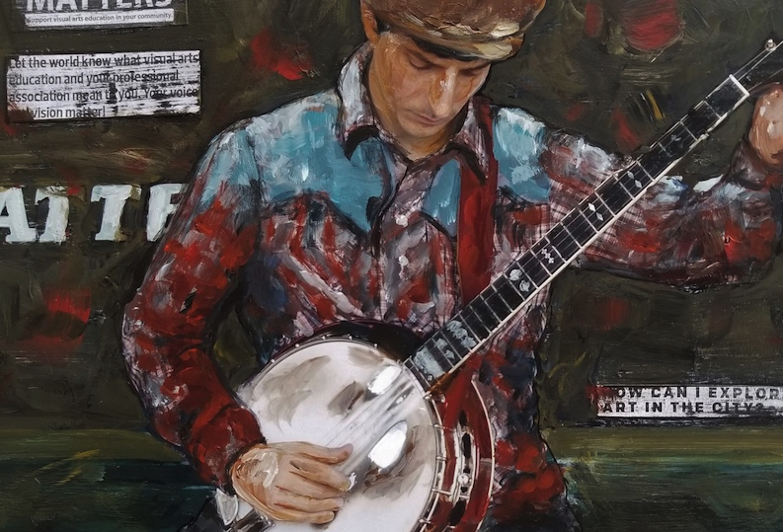
CHAPTER 20. Making the Most of Your Teaching Career Teaching and Learning in Art Education, 2nd Ed.
Debrah C. Sickler-Voigt, Author & Presentation Developer ©
Notes:
Welcome to Teaching and Learning in Art Education, 2nd Edition, Chapter 20!
TLAE as a theoretically-based, practical textbook to prepare preservice educators for their teaching careers and to support in-service educators in improving their existing practices. Its timely second edition with its updated framework remains dedicated to assisting educators in all stages of their careers through effective curricular planning, instruction, assessment, and management to foster student learning and cultivate educators’ meaningful, creative, and rewarding careers.
This textbook and instructional resources resulted from the contributions of many individuals, including teachers, students, artists, organizations, family, mentors, and Routledge’s editorial/production team. Its teachings are based on the author’s research, communications, and professional interpretations of teachers, artists,’ and designers’ works with the aim of being respectful of diversified peoples and representing their teachings in a truthful and non-biased manner.
Book Cover Artwork: Paula Gale
Right Image: Lorinne Lee, Bluegrass Banjo, 2018. (Cropped Detail)

Slide 2

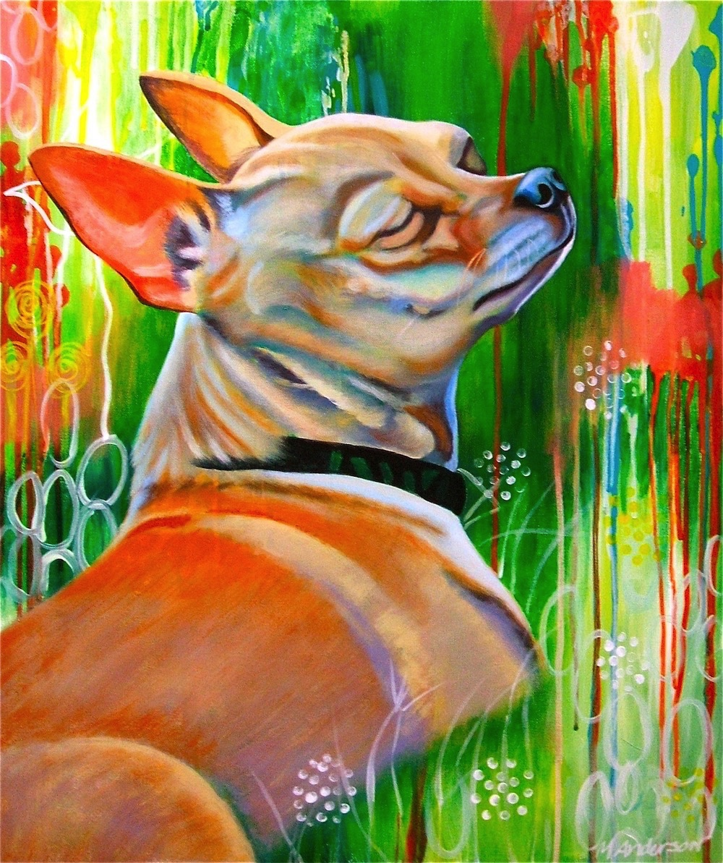
Chapter 20 Topics
Making the Most of Your Teaching Career
Teacher Creativity and Critical Thinking
Lifelong Learning
Securing the Right Teaching Job
Notes:
Image: Art educator Melanie Anderson paints dog portraits. This one is titled Bask. www.melanieanderson.net

Slide 3

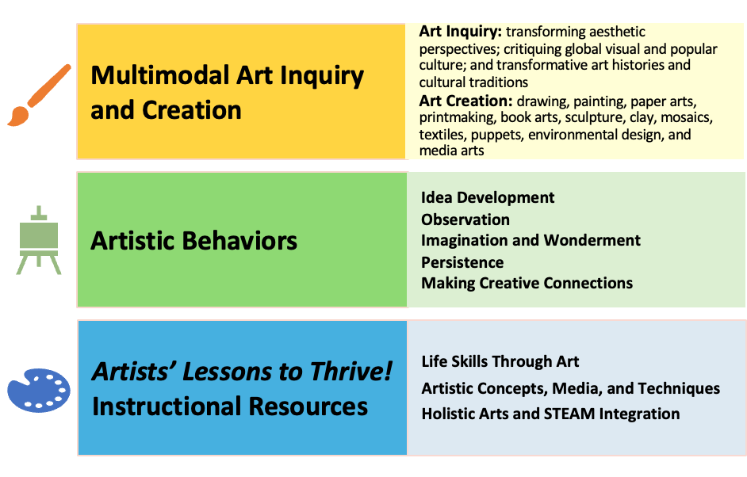
Link Chapter 20’s teachings with TLAE’s Transformative
Art Education Framework
Notes:
Class instruction: Ask students to build on prior learning and personal experiences to make personal connections between this chapter’s teachings and TLAE’s Transformative Art Education framework.
Book Cover Artwork: Paula Gale

Slide 4

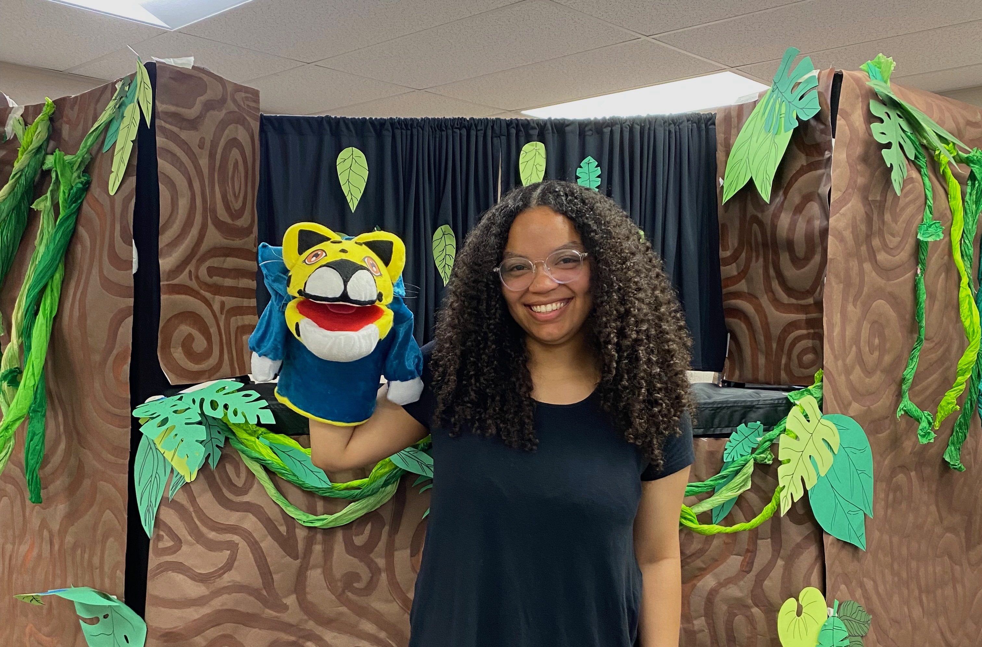
Making the Most of Your Teaching Career 1
Great teachers exude positivity and enthusiasm. They continuously improve their teaching and advocate for students and best educational policies.
They take steps to maintain personal and professional well-being at all stages of their careers.
Notes:
Image: Ava Manning is on her way to becoming a great teacher. She is proud of her class 2nd grade puppet production. Source: Author, teacher.

Slide 5
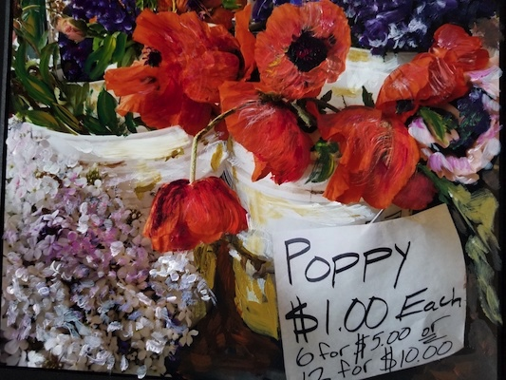
Making the Most of Your Teaching Career 2
Great educators understand that the teaching profession has rewards and challenges.
They reduce personal stress when challenges arise and use productive means to make the most of their teaching careers.
Notes:
Image: Lorinne Lee exhibited Pike Place Market in “Artistic Voices,” a 2018 Teachers as Artists Art exhibition.

Slide 6

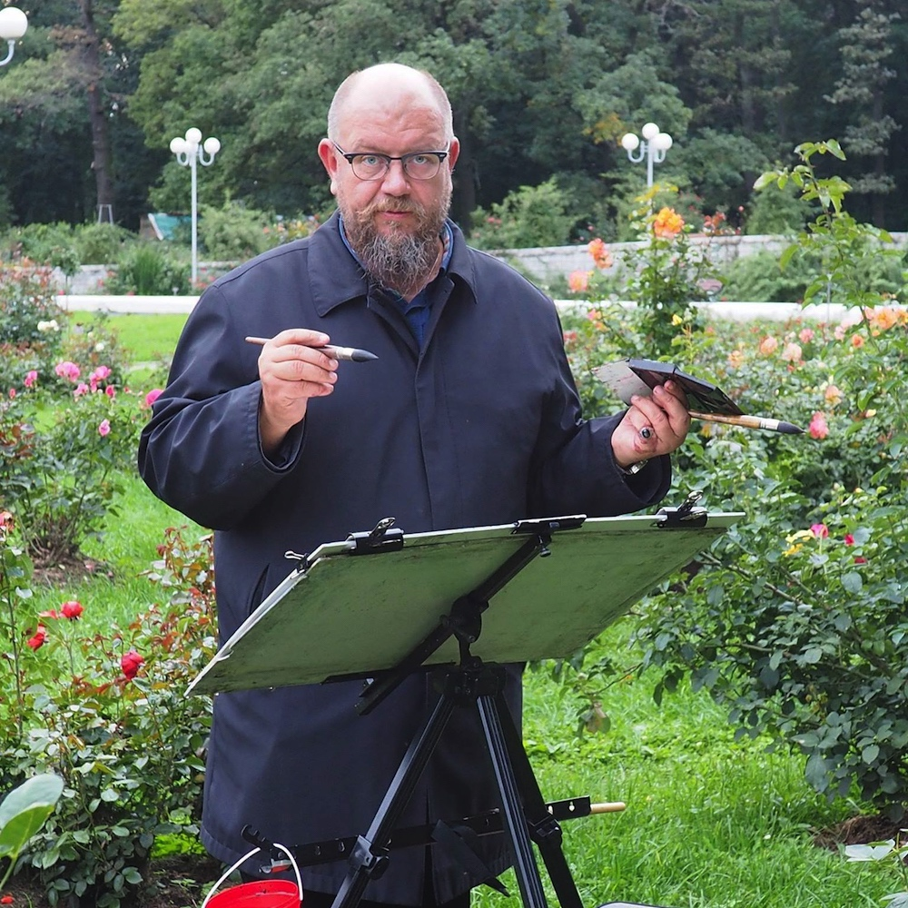
Teacher Creativity and Critical Thinking 1
Teacher creativity comes in many forms.
Highly qualified, licensed educators who teach in schools and create art are called Artists/Teachers/Critical Thinkers.
Their teaching influences their art and their art making practices inspire their teaching.
Notes:
Class activity. The class will discuss multiple forms of teacher creativity. Teacher creativity might center on designing original instructional resources, lesson plans, and assessments. Some teachers study their own professional practices and may publish their findings in journals and/or share their creations on social media. Teachers’ artistic creations may focus on a particular concept, medium, or process.
Image: Vsevolod Romankov is a great teacher who creates and exhibits his plein-air paintings internationally.

Slide 7
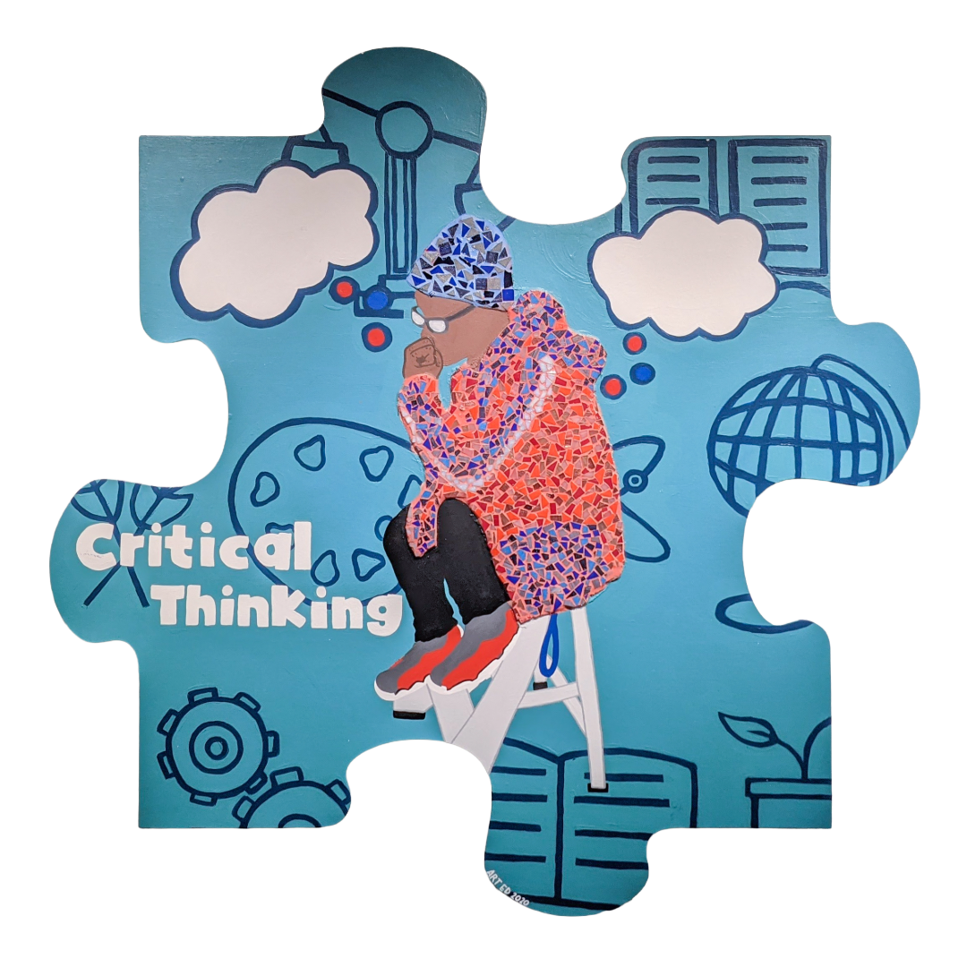

Teacher Creativity and Critical Thinking 2
Critical thinking skills bind artistic and pedagogical practices as they call upon educators to apply the artistic behaviors, ask questions, utilize symbols to communicate meaning, and conceptualize aesthetic knowledge by perceiving diverse perspectives on what constitutes art, beauty, and creative expression.
Notes:
Image: These are preservice teacher and community artworks in the form of puzzle pieces that teach about creativity and critical thinking skills.
MTSU’s Arts and Sciences Majors Showcase’s Be the Missing Piece murals (5′ × 5′ each) feature the 2020 World Economic Forum’s soft skills. They include complex problem-solving, critical thinking, creativity, people management, coordinating with others, emotional intelligence, judgment and decision-making, service orientation, negotiation, and cognitive flexibility. Source: Author, professor and Lucy Langworthy, coordinator. MTSU’s MT Engage Grant. Author, photo.

Slide 8
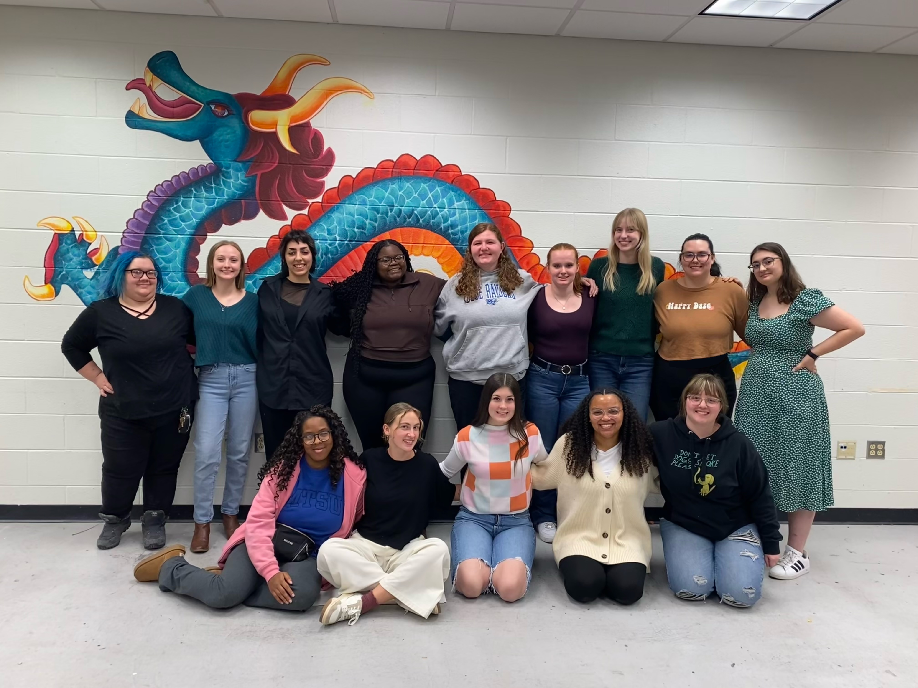
Teacher Creativity and Critical Thinking 3
By applying metacognition, they continuously reflect on their teaching practices, ensuring they can effectively communicate with students to impart their knowledge, understand students’ perspectives, and make accommodations to meet students’ individualized learning needs.
Notes:
Image: Preservice teachers created a mural and displays to enhance their classroom and documented their achievements in their portfolios. United States. Source: Author, teacher. Top-left-to bottom-right: Breanna Caldwell; Taylor Garrett-Pourchot; Zoe Saldana; Lingalireni Moyo; Daisy Taylor; Maggie Hazelton; Tracy Olsen; Megan Whitehouse; Auria Schenk; Alexandria Williams; Katherine Shanks; Emmaleigh Mackin; Ava Manning; Rowan Mosley

Slide 9
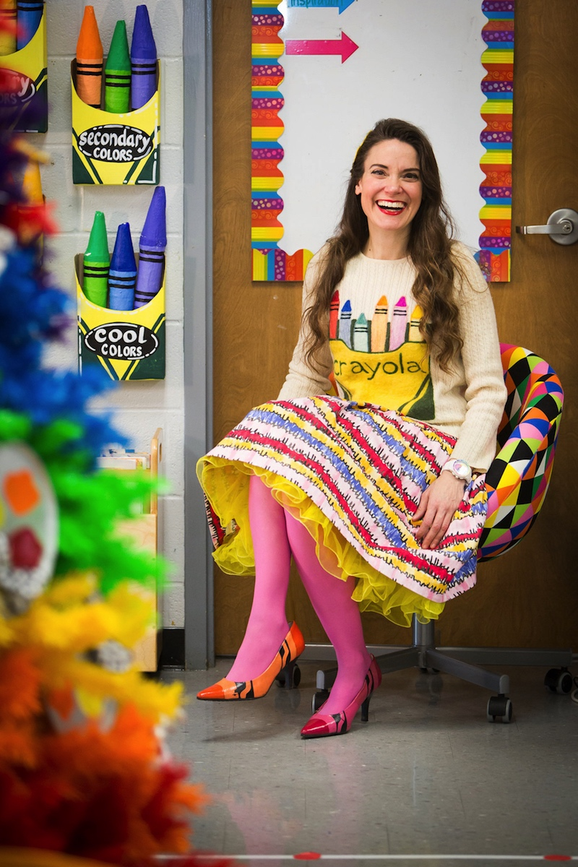
Cassie Stephens: Making Magic Happen in the Classroom and Beyond
Stephens’ social media postings address best teaching practices and present the creative fashions that she produces from scratch and repurposed thrift store finds.
Retiring after 25 years of classroom teaching, Stephens’ thriving career continues through her social media postings, professional developments, and creative products.
Notes:
Image: Cassie Stephens’ handmade crayon inspired outfit matches her classroom. Stella Blue Photography.

Slide 10
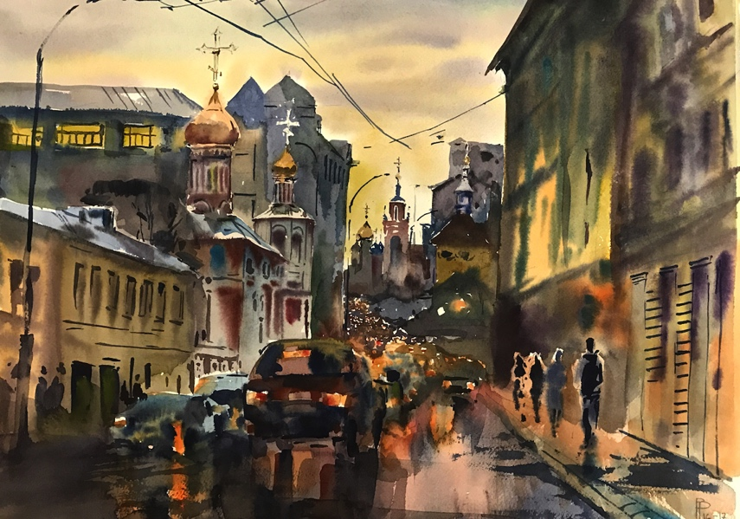
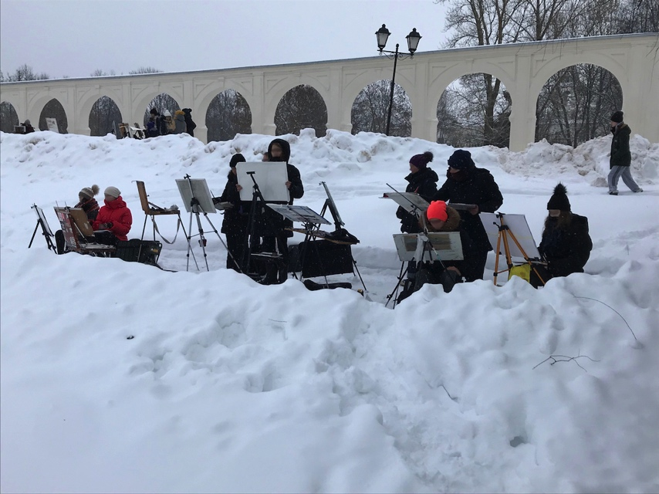
Vsevolod Romankov: Building Mutual Trust as Artists and Travelers
Romakov is an internationally acclaimed teaching artist recognized for his exceptional plein-air paintings.
His instructional methods encourage students’ creative choices and are designed to dissolve communication barriers.
Notes:
Top Image: Vsevolod Romankov, Evening in Moscow, watercolor, 23.62 × 31.49 in. (60 × 80 cm.)
Bottom Image: Weather is rarely a prohibiting factor. Romankov and his students paint on cold winter days. Russia. Vsevolod Romankov, teacher.

Slide 11
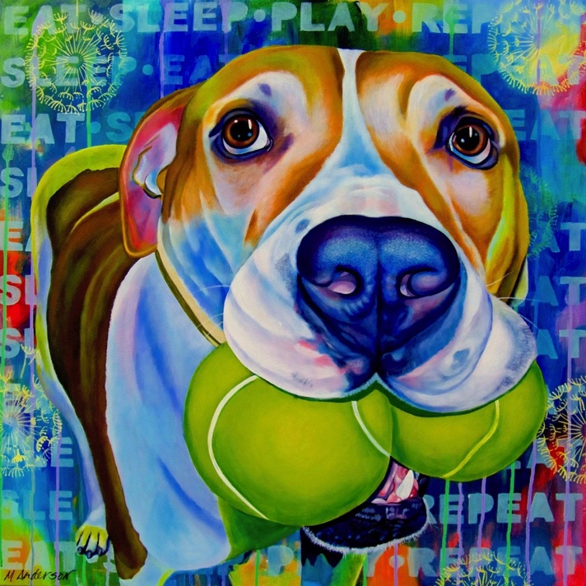
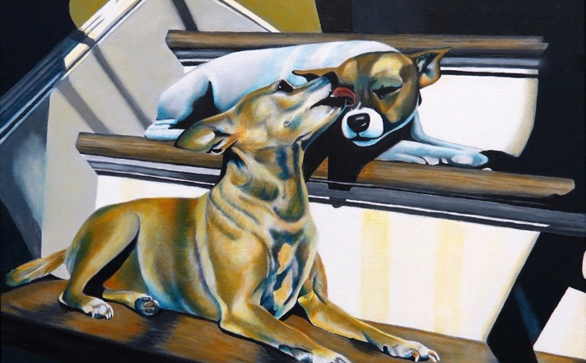
Melanie Anderson: Stepping Out of One’s Comfort Zone
Anderson has painted an impressive collection of commissioned dog portraits. Her vivid artworks reinforce her belief that dogs “brightly color our world.”
She painted The Sunbathers in preparation for teaching a grisaille lesson to understand the potential difficulties her high school students might encounter.
Notes:
Classroom activity: Describe how Anderson stepped out of her comfort zone to paint The Sunbathers. Compare it with her painting Eat, Sleep, Play, Repeat. Students will participate in a class discussion on why teachers like Anderson take extra steps to prepare for their lessons.
Top Image: Melanie Anderson, Eat, Sleep, Play, Repeat. www.melanieanderson.net
Bottom Image: Melanie Anderson, The Sunbathers. www.melanieanderson.net

Slide 12
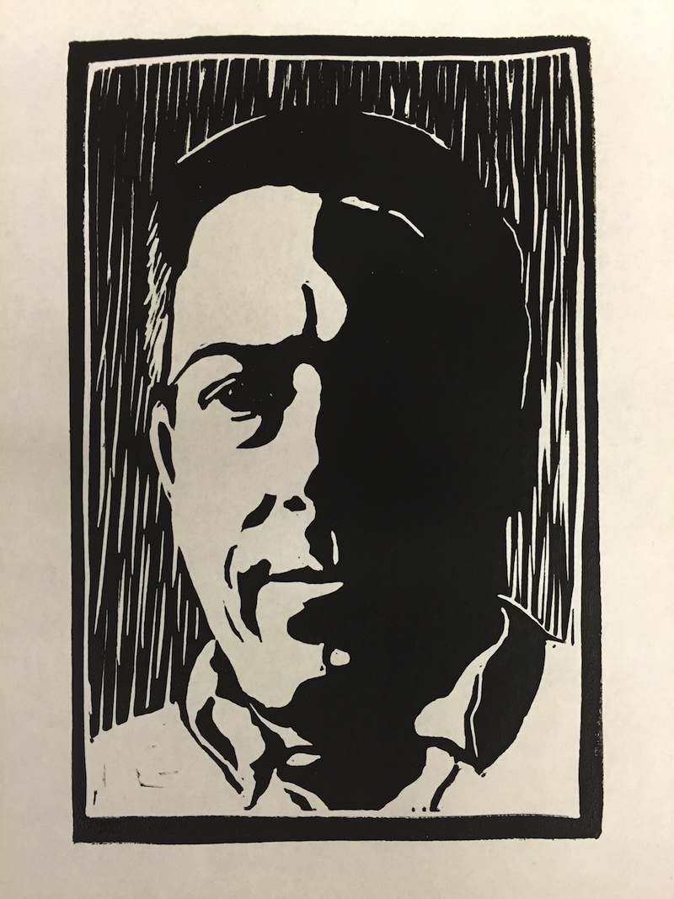
Mike Muller: Delivering One-to-One Instruction
Muller creates artworks in his middle school classroom that align with his lessons. He simultaneously produces videos to document his procedures.
His students review class tutorial videos as needed, giving Muller and his students increased time for one-to-one instruction.
Notes:
Image: Mike Muller, Self-Portrait.

Slide 13
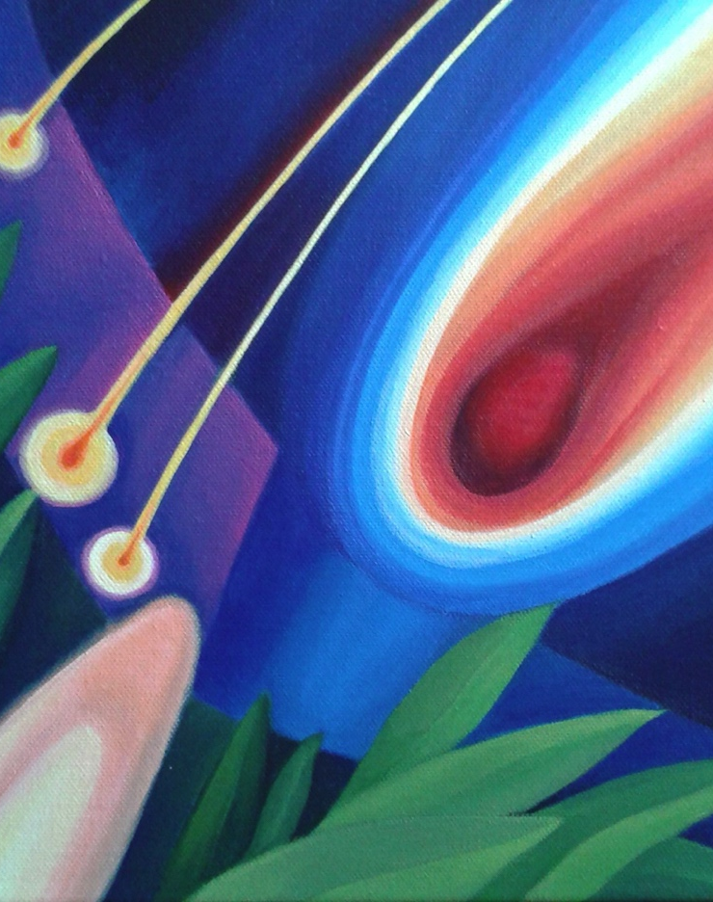
Romana Štajerová: We Learn Together
Štajerová views students as creative partners and promotes equality. Students recognize her love and enthusiasm for teaching.
Her students (ages 5-20) produce exceptional results without feeling pressure to be perfect. She encourages them to relax to enjoy their creative practices.
Notes:
Image: Romana Štajerová, Perseids.

Slide 14

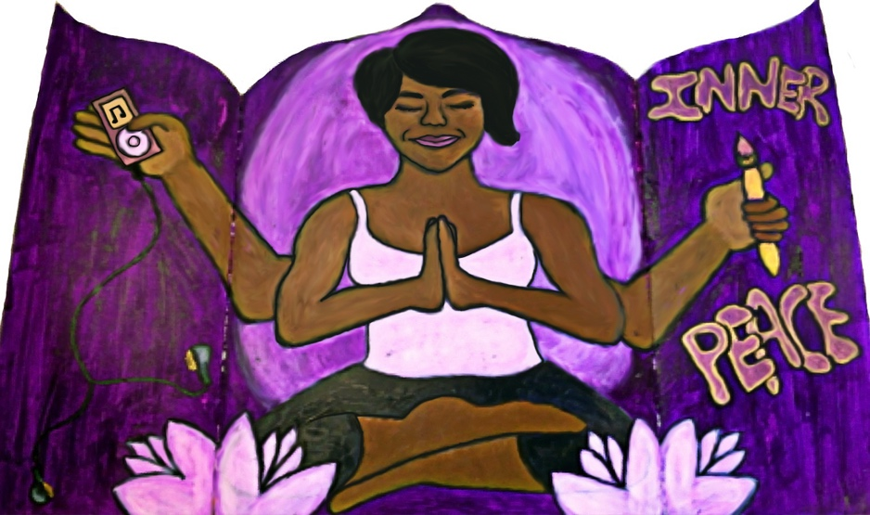
Nichole Rich: Cultivating a Positive, Self-Reflective Mindset
Rich begins each day with meditation and exercise to generate positive thoughts about teaching and learning.
She emphasizes that educators need to be self-reflective: “You have to do a lot of reflection. It is not just about you. The students make up the class.”
Notes:
Image: Nichole Dawson Rich, Inner Peace.

Slide 15
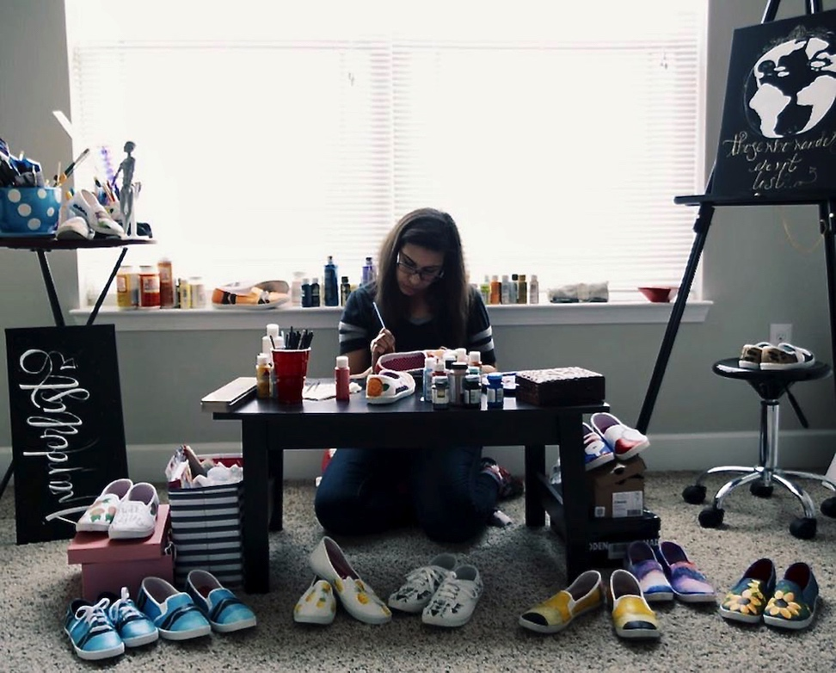
Sasha Burnette: Yes I Can, Overcoming Obstacles Through Art
Burnette designs painted shoes called shoescapes. She decorates them with motivational statements and aesthetic designs.
Prior to painting shoescapes, she felt hesitant to share her work publicly. Overcoming her fear of exhibiting her art demonstrates resiliency to her elementary students.
Notes:
Image: Sasha Burnette is painting shoescapes.

Slide 16
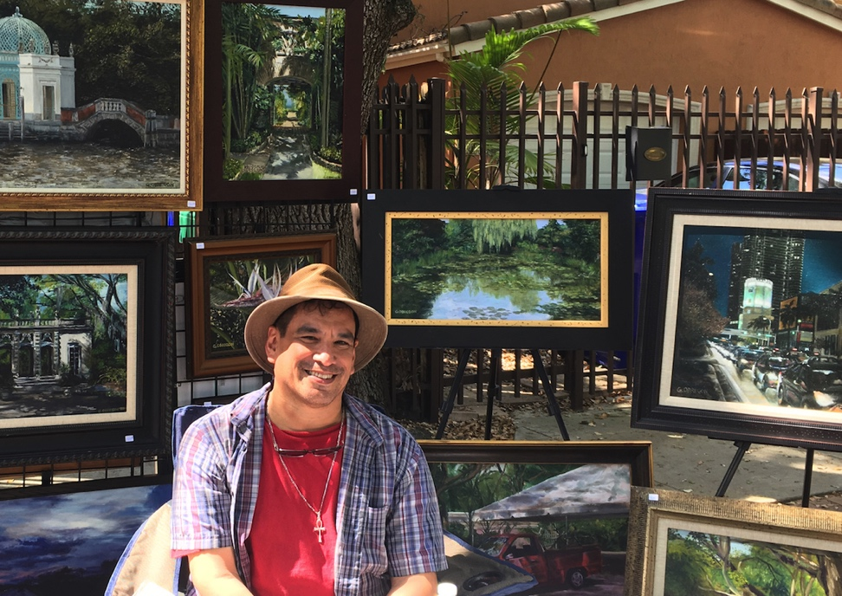
Gerald Obregon: Opening Doors to Possibilities
Obregon is a voice of reason and encouragement when students feel parental resistance to pursuing the visual arts as a profession. “I tell them that it is a career choice and legitimate.”
Participating in a study abroad experience made him even more passionate about his teaching and painting practices. He eagerly imparts what he has learned with students and fellow teachers.
Notes:
Image: Gerald Obregon participates in an art festival.

Slide 17
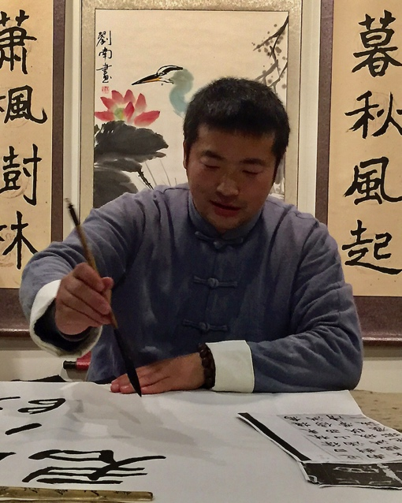
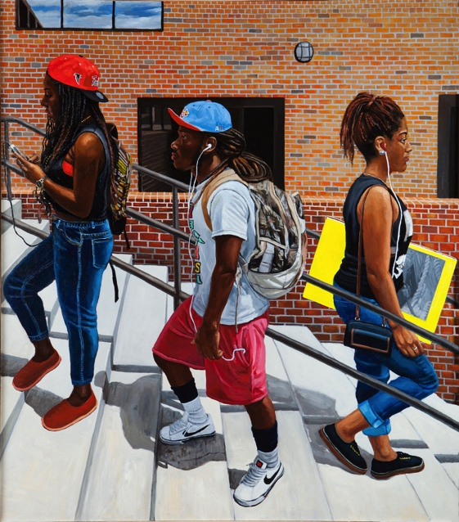
Nan Liu: Researching and Teaching Diversified Artistic Practices
Liu shares his knowledge about eastern and western painting methodologies with his students and the broader community.
His body of works demonstrates how teachers can combine familiar cultural norms with the exchange of diversified ideas to augment their teaching practices.
Notes:
Top Image: Nan Liu demonstrates traditional Chinese art techniques.
Bottom Image: Nan Liu, Climbing Up, 2014, 68 × 60 in. (152.4 × 152.4 cm) oil on canvas.

Slide 18
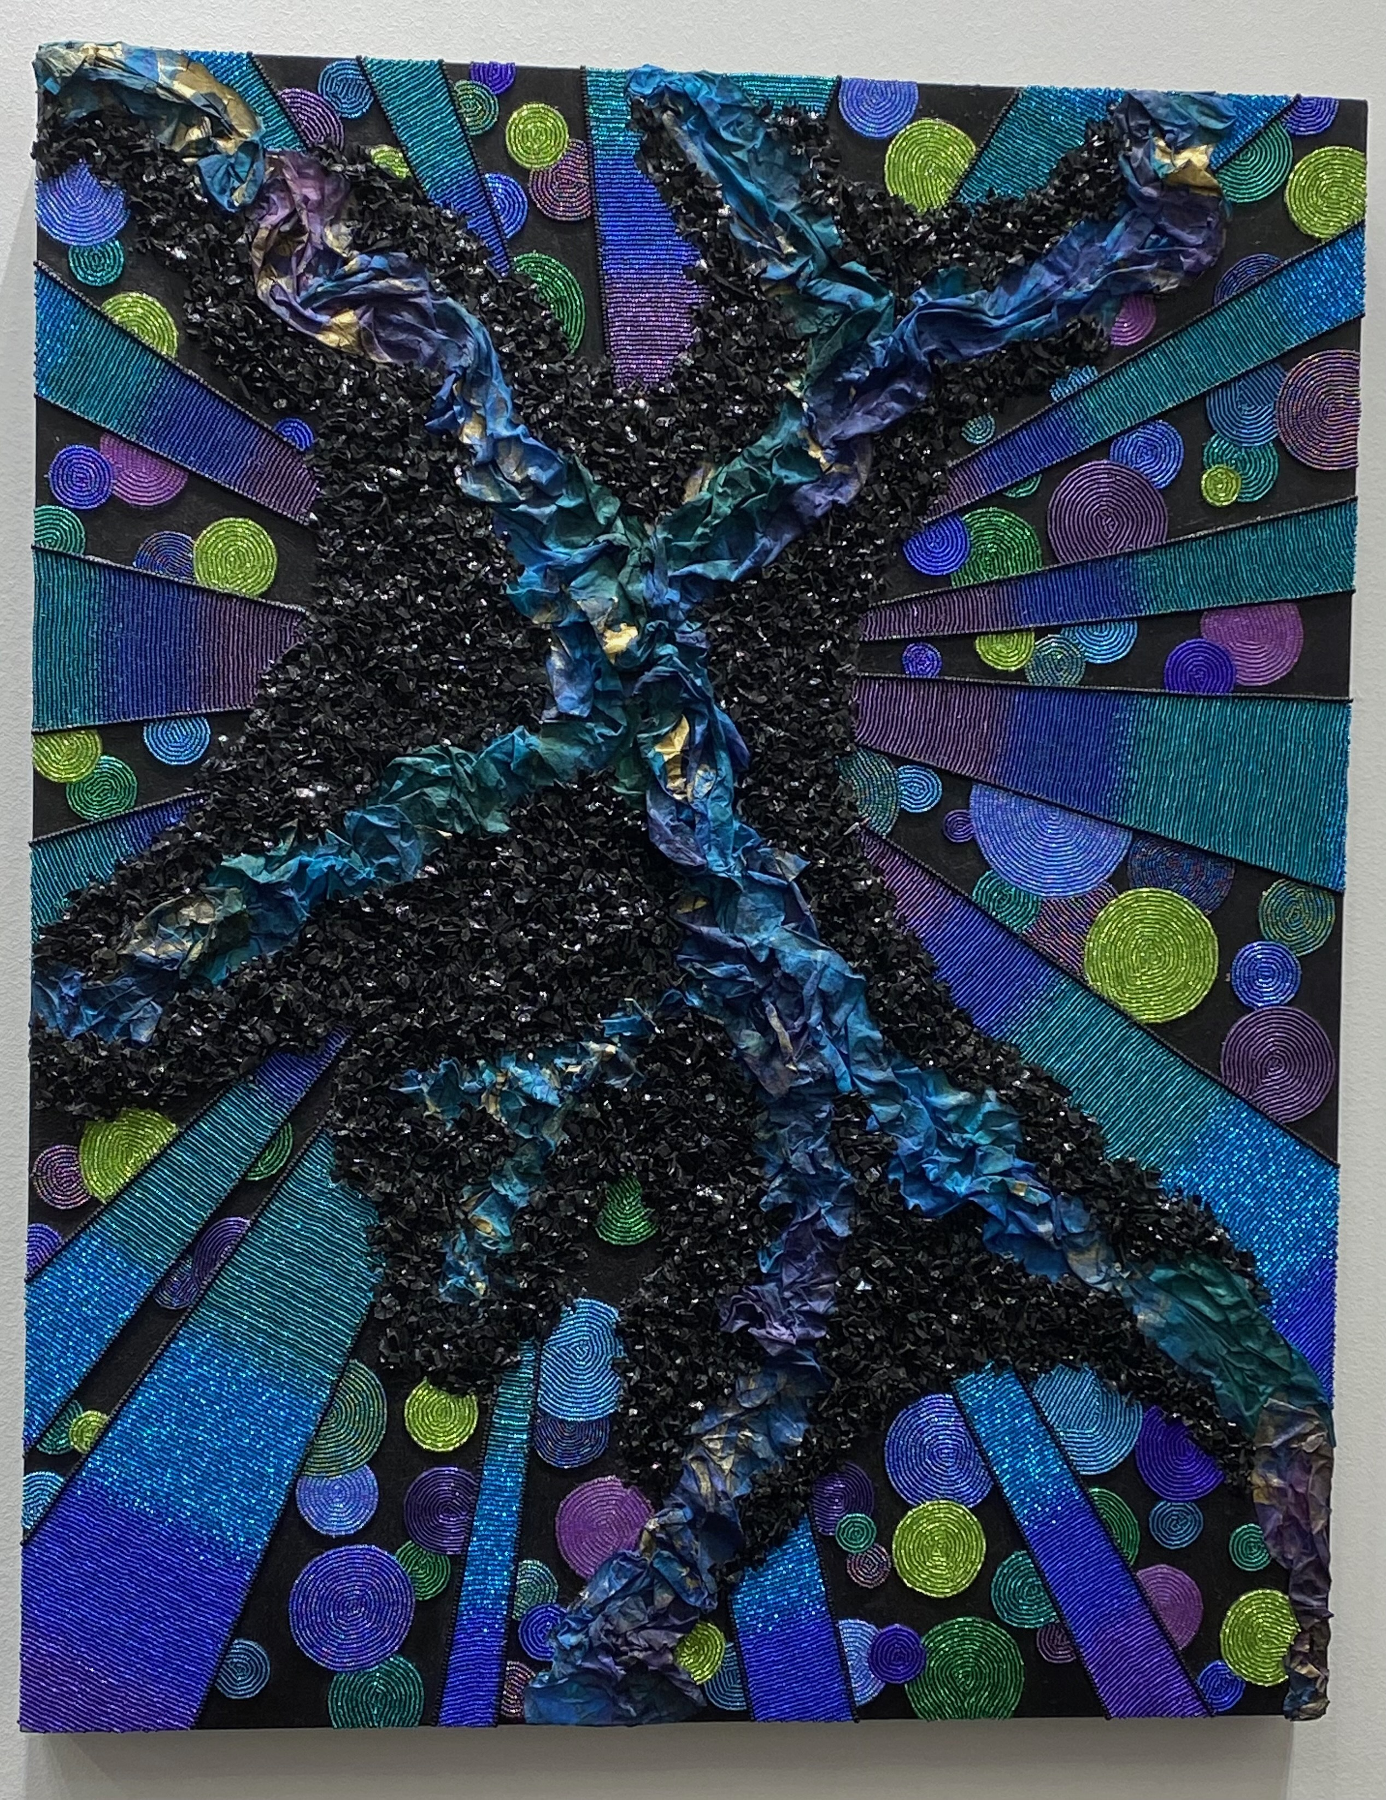
Janet Malone: Let’s Get Involved
Malone advises teachers: “Don’t be afraid to get involved in your school.” She takes on special projects that showcase students’ achievements and her professionalism.
She teaches elementary students how to develop artistic behaviors to create detailed artworks. Students learn to concentrate, tune others out, and persevere to achieve quality results.
Notes:
Image: Janet Malone, beaded canvas

Slide 19
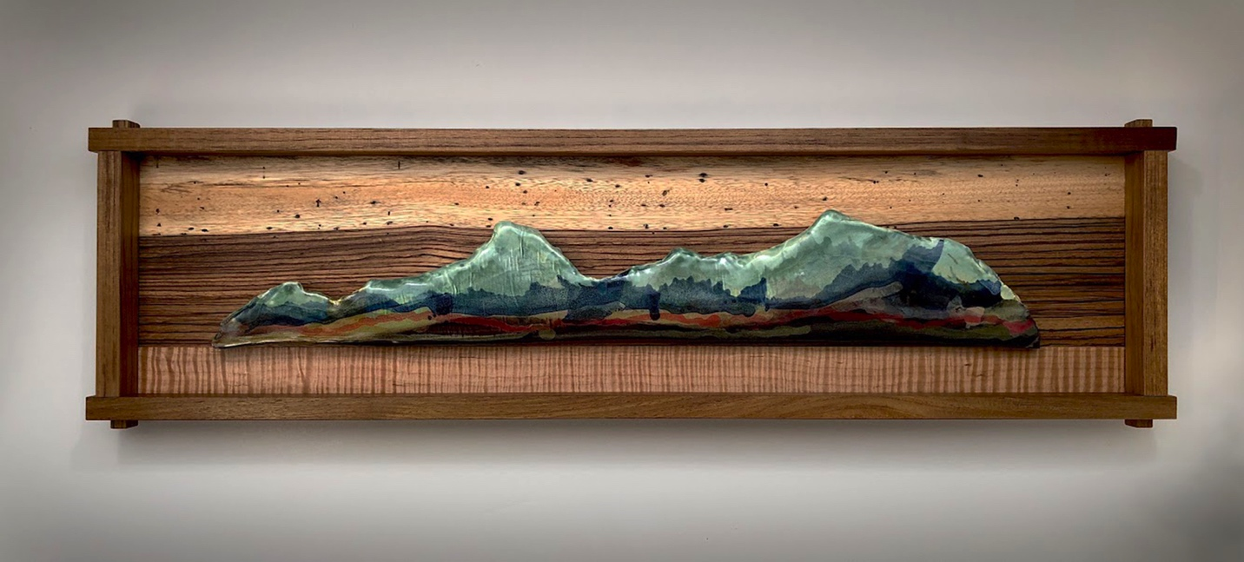
Jonathan Griffith: Honing Students’ Creative and Professional Skills
Griffith organizes annual studio art tours and live demonstrations of artists’ techniques. They result from his interactions with community artists with whom he exhibits at juried craft fairs.
He applies his expert knowledge to teach high school students the differences between exceptional and poor craftspersonship.
Notes:
Image: Jonathan Griffith, Mirage, 2018, 31 × 9 × 2 in. (78.74 × 22.86 × 5 cm), Clay/Teak/zebra-wood/tiger-maple.

Slide 20
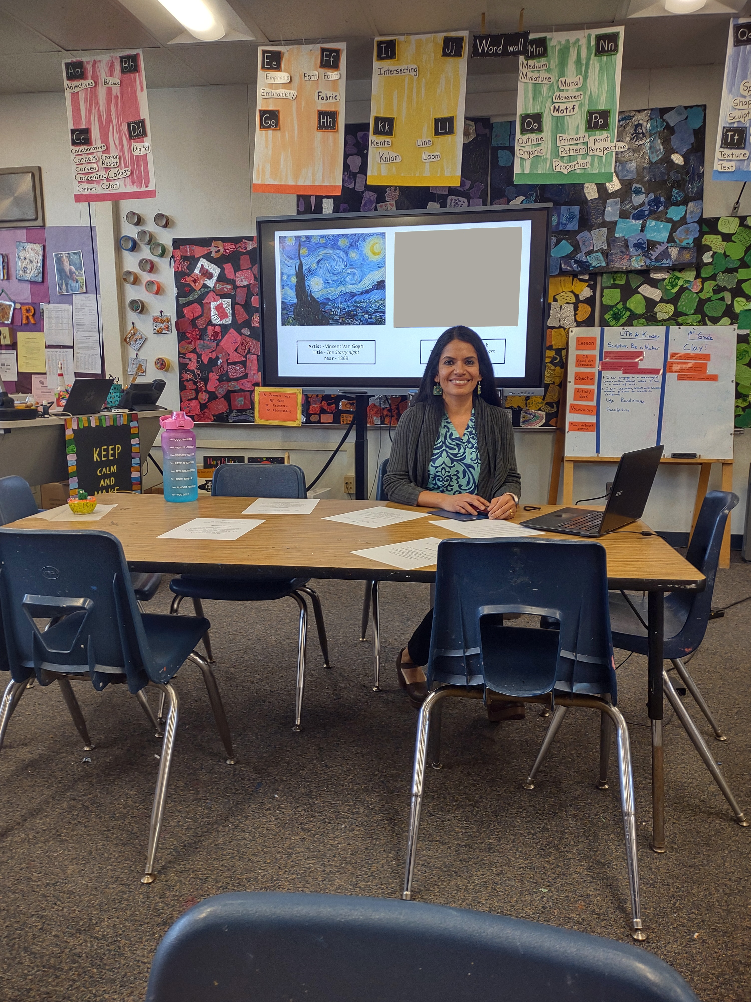
Lifelong Learning
Lifelong learning is the ongoing pursuit of knowledge and skills. Teachers:
Exchange ideas with others to add intrinsic value to teaching and learning practices.
Are self-motivated and inquisitive. They look to inspirational people who are excellent at what they do.
Build on their existing proficiencies in formal and informal environments.
Self-reflect on their planning, instruction, management, and assessment.
Notes:
Image: Meera Ramanathan is sitting at a table in her classroom. A computer screen is behind her.

Slide 21
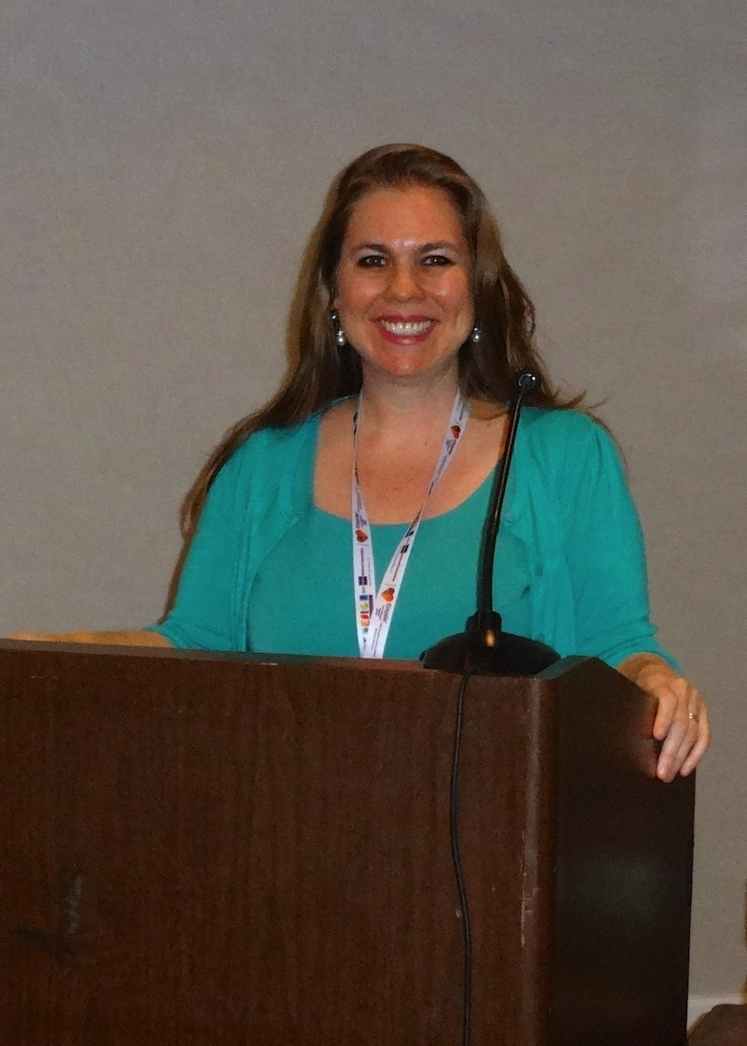
Lifelong Learning: Professional Development
Teachers’ professional developments and specialized trainings are designed to improve knowledge and skills about art, education, and other topics.
They include seminars, presentations, workshops, courses, and professional learning communities. Teachers earn credentials, recertification, and advanced degrees.
Notes:
Image: The author is giving a professional development presentation at a National Art Education Association Convention.

Slide 22
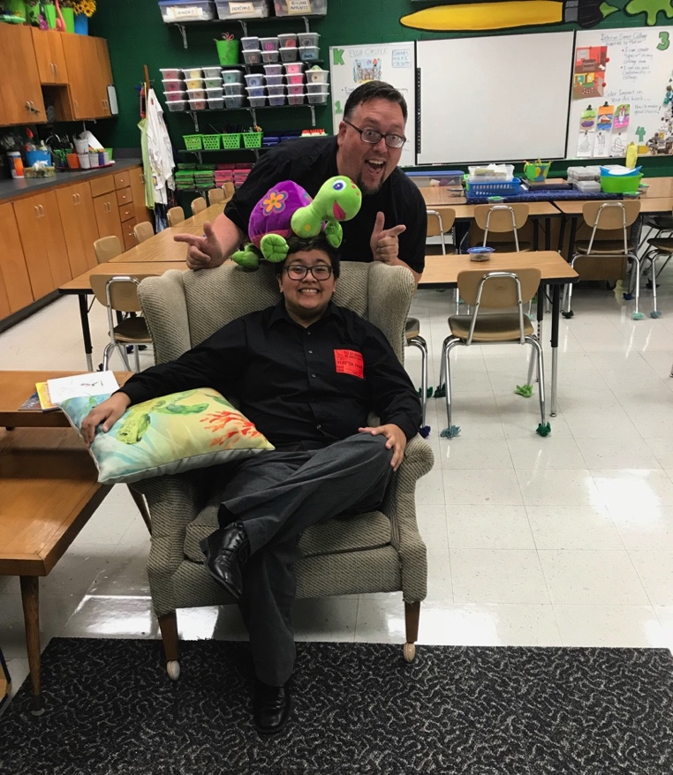
Lifelong Learning: Mentoring
Teacher mentors impart their skills, knowledge, and care to help others achieve.
“I don’t know where I would have been without that support.” Janet Malone
“My past and present art education experiences and collaborative teamwork made me realize how important it is that we continue to be role models for the next generation of art educators.” Lorinne Lee
“Taking on university students allows me to feel more fulfilled in my profession. I love teaching children. However, I also love teaching young adults the "craft" of art education.” Mr. E.
Notes:
Image: Ted Edinger, Mr. E., and his practicum student Kayla Wilson pose for a fun classroom picture.

Slide 23
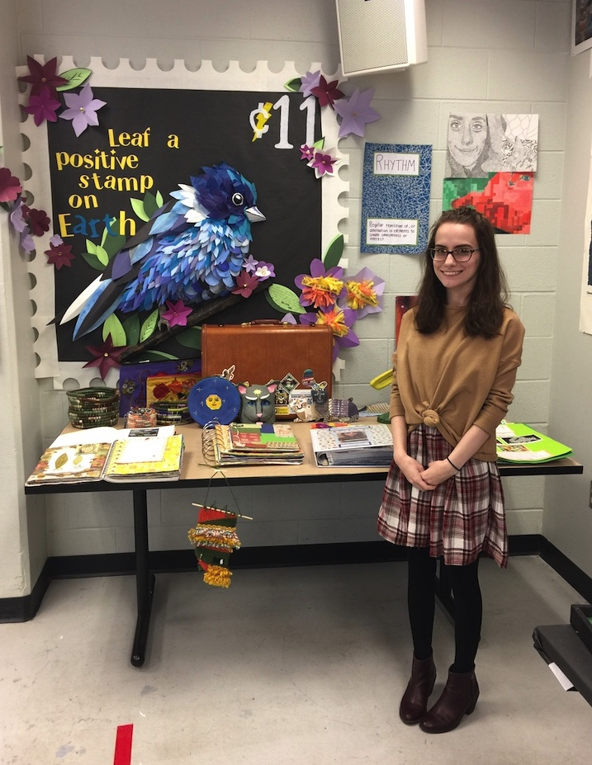
Securing the Right Teaching Job
Teacher job candidates must convince employers that they are the best person for the position given their qualifications.
Employers want to see winning dispositions that align with their school or organization’s needs.
Notes:
Image: Pre-service teacher Emily Armstrong practices presenting her teaching portfolio.

Slide 24
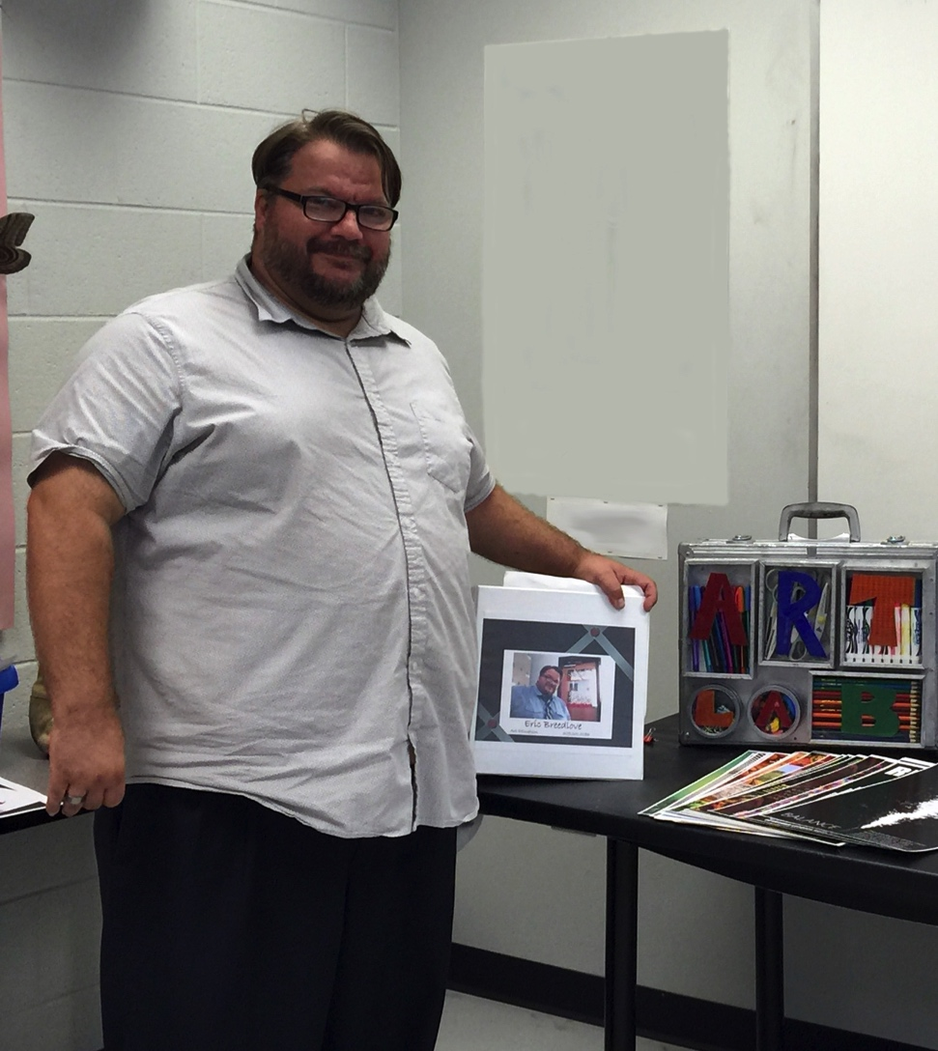
Securing the Right Teaching Job: Teaching Portfolio 1
A teaching portfolio is a collection of artifacts that represent an educator’s planning, teaching, and assessment abilities.
Pre-service teachers can integrate content developed for performance assessments and university courses into their portfolios.
Notes:
Image: Eric Breedlove created a professional website, binder portfolio, and artist case portfolio to showcase his abilities as an educator. USA. Pamela Catania, photo.

Slide 25
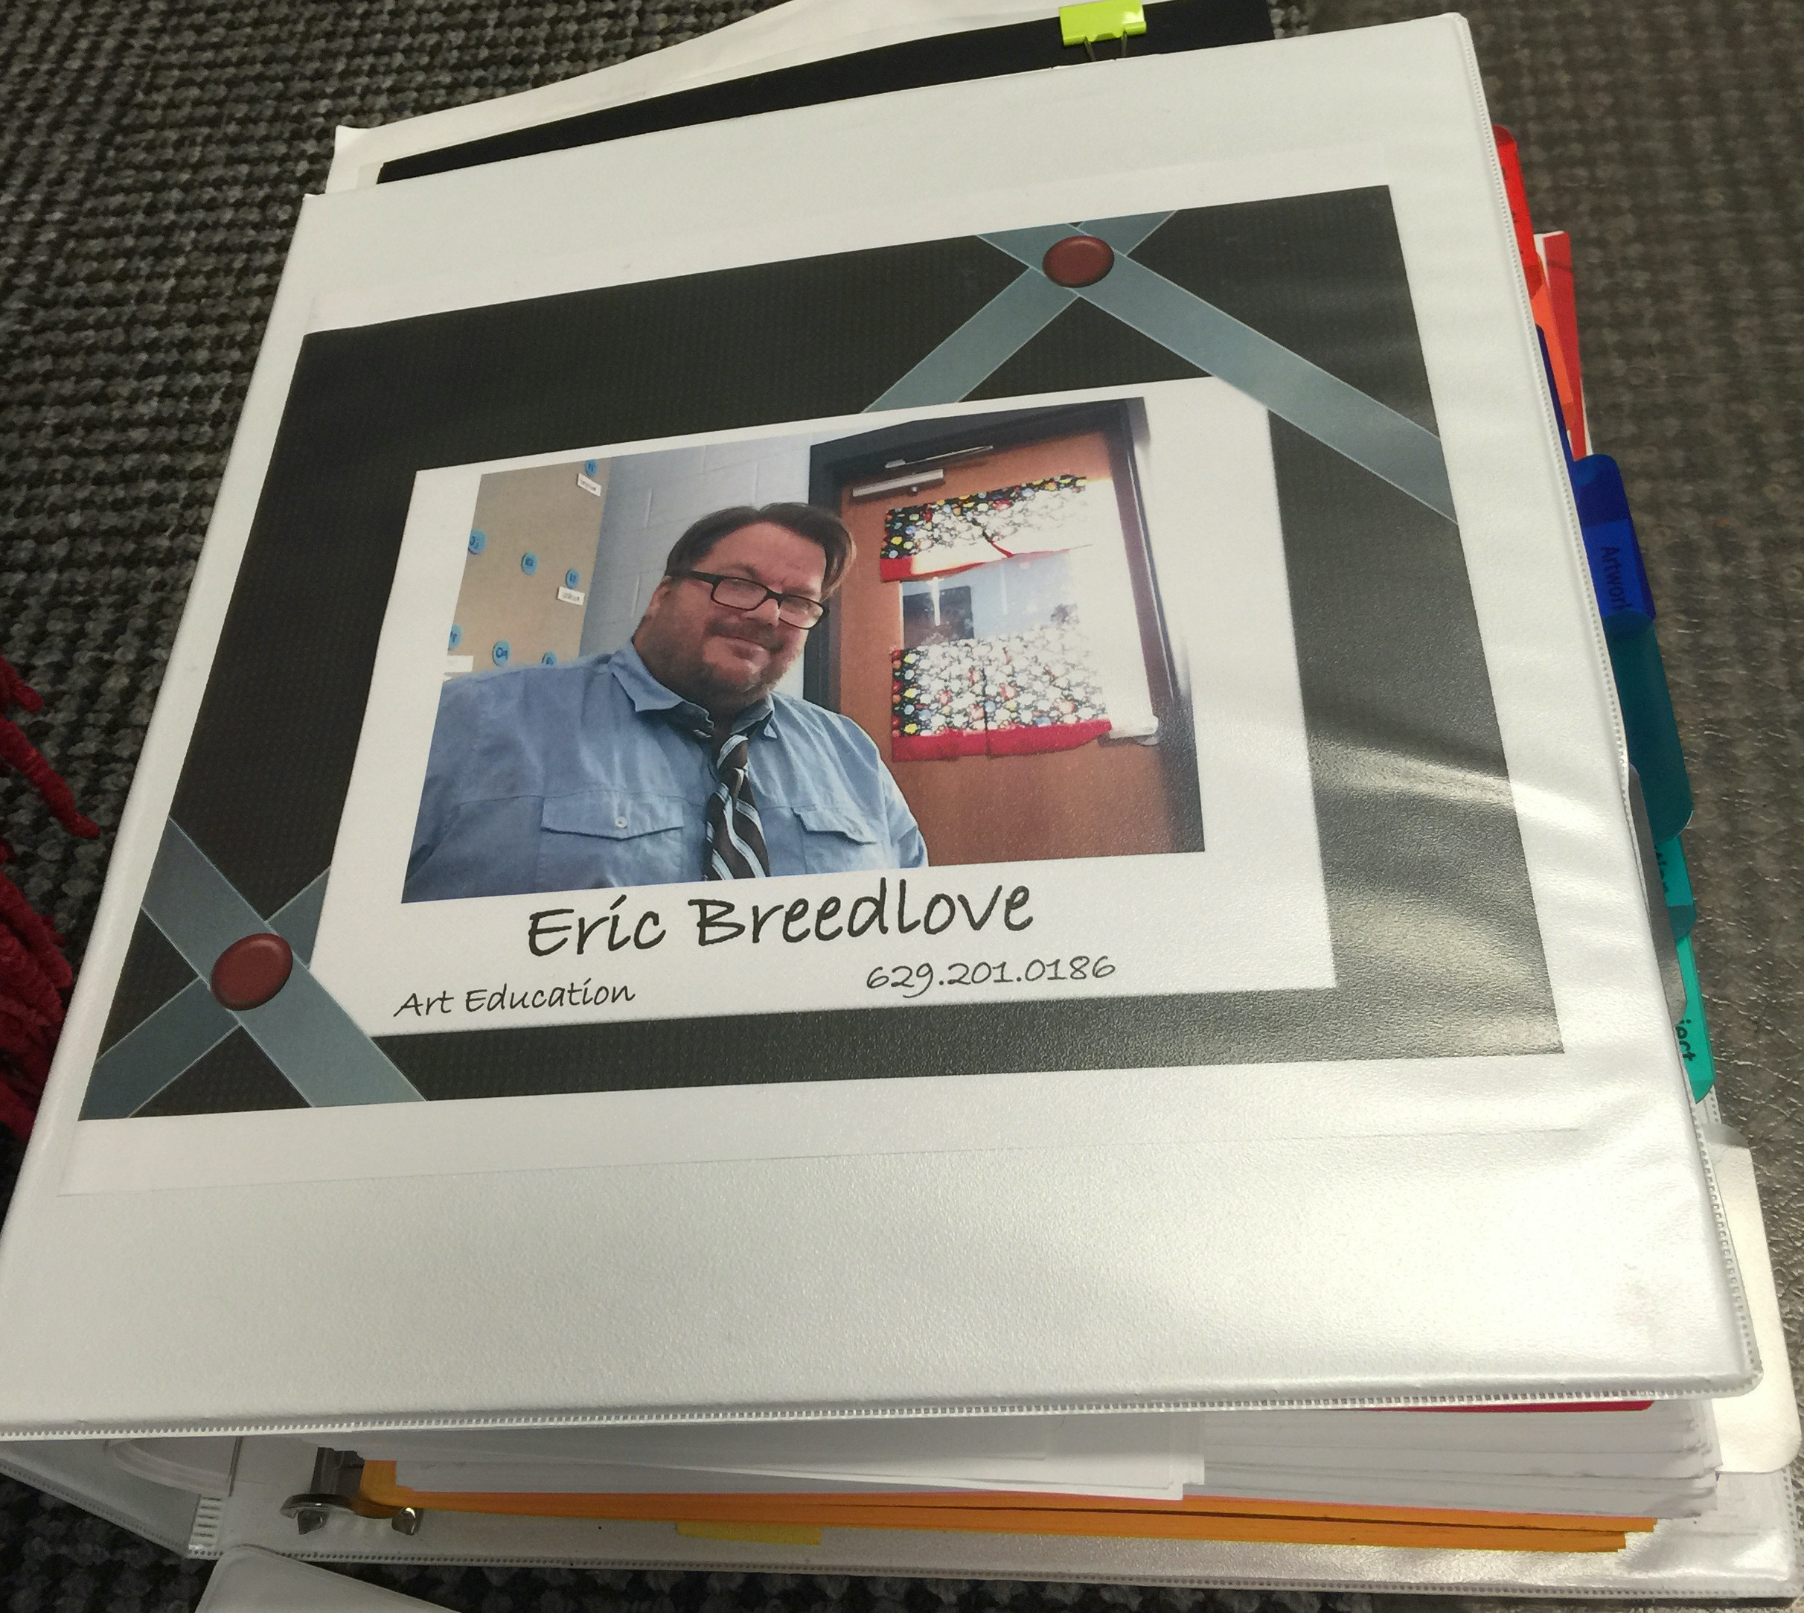
Securing the Right Teaching Job: Teaching Portfolio 2
Visual arts teaching portfolios in traditional and online formats are neat, organized, and professional. Parts are labeled with headers and brief descriptions to make navigation easier.
Original Instructional Resources, Lessons, and Assessments
Images Documenting Pre-K-12 Teaching
Quality Student Artworks and Photographs of Displays/Exhibitions
Letters of Recommendation and Certificates
Effective Teaching Video Clips
Evidence of Professional Accomplishments
Notes:
Image: This is the cover of Eric Breedlove’s portfolio. USA. Pamela Catania, photo.

Slide 26
Teaching Philosophy 1
Teacher and Student Performances
A teaching philosophy articulates teachers’ beliefs about teaching and learning in essay form. It is typically a one-page, single-spaced document with an introduction, body, and a summary that includes rich, descriptive language with active verbs and concrete examples to articulate their professional strengths and knowledge.
Leadership Skills and Dispositions
Anticipated Goals and Advocacy Methods
Teaching Methods and Successful Outcomes
Jargon-Free Terminology
Notes:
Class activity: Have the class open the textbook and introduce Model 20.1. Guiding Questions for Developing a Teaching Philosophy and Model 20.2. Teaching Philosophy. Guide the class in developing a teaching philosophy.

Slide 27
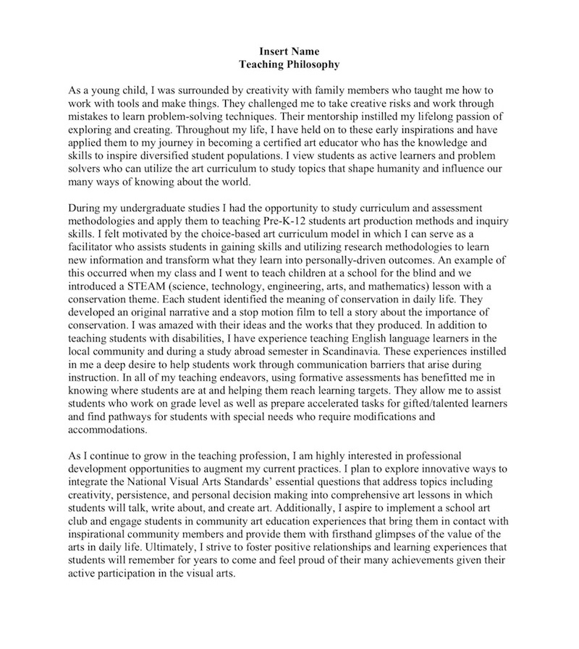
Teaching Philosophy 2
A well-written teaching philosophy leaves readers with the impression that they know who teachers are and what they value.
Notes:
Image: This is a graphic of a teaching philosophy.

Slide 28
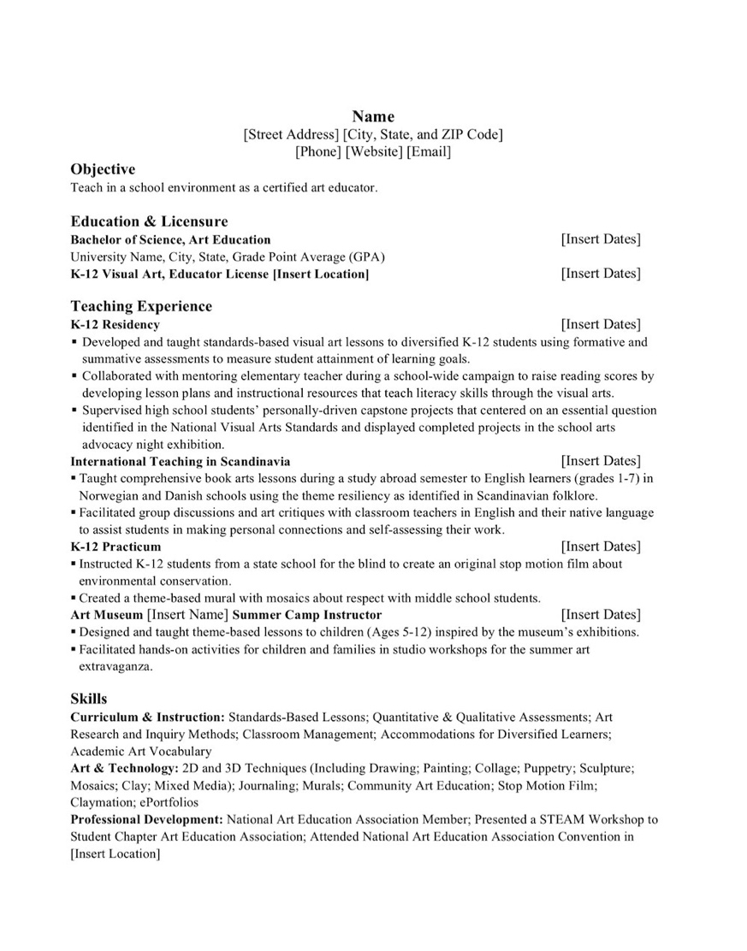
Securing the Right Teaching Job: Résumés 1
Résumés highlight teachers’ significant work experiences, educational background, and professional qualifications.
They provide an overview of teachers’ skills and help determine if teachers will be invited to interview.
Notes:
Class instruction: Explain how pre-service teachers can emphasize teaching experiences including practicum and residency placements, teaching internships, tutoring, volunteer work, and employment at summer camps and extended school programs. Guide the class in developing a teacher résumé.
Image: This is a graphic of a teacher résumé.

Slide 29
Securing the Right Teaching Job: Résumés 2
A résumé is usually one-page long and contains appropriate headers, wording, and content to showcase teaching proficiencies. It includes strong action verbs written in past tense to identify experiences.
Its information represents actual professional experiences. It highlights proficiencies in curriculum development, assessment, art production methods, and classroom management.
Notes:
Image: This is a graphic of a teacher résumé.

Slide 30

Securing the Right Teaching Job: Interviewing
Successful candidates are well-prepared for job interviews.
Research Principal Interview Questions.
Practice Personally-Driven Responses to Interview Questions.
Project Confident Body Language that Is Not Arrogant.
Wear Professional Clothing.
Smile as Appropriate and Provide A Firm Welcoming Handshake.
Make Proper Eye Contact.
Listen to What Employers Have to Say.
Come Prepared to Ask Important Questions.
Notes:
Class instruction: One common interview question is “Why should we hire you?” Ask students to answer this question.
Image: https://openclipart.org/detail/152155/mirror-frame
Reference:
Fredericks, 2016, p.160

Slide 31
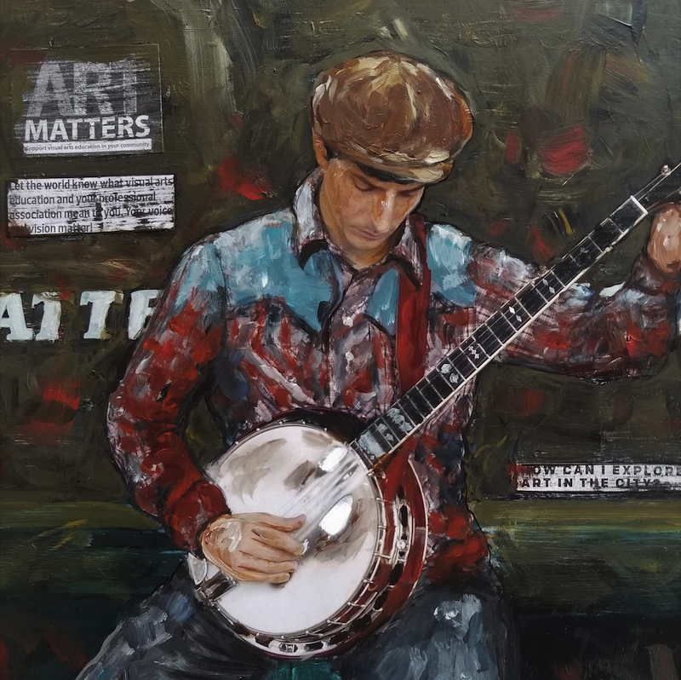
Lorinne Lee: Setting the Stage for Leadership in the Visual Arts Artists’ Lessons to Thrive! 20.1.
Big Idea: Leadership
Painting
Notes:
Class instruction: Have the class open the textbook to Artists’ Lessons to Thrive! 20.1. Participate in its learning targets.
Image: Lorinne Lee, Bluegrass Banjo, 2018.

Slide 32
Our Journey to Thrive Continues: Making the Most of Your Teaching Career
Maintaining positive dispositions and professional behaviors, even in challenging times, makes teaching and learning genuinely rewarding.
What strategies will you take to make the most of your teaching career and cultivate students’ full potential?
Reflect on what you have learned in textbook and your overall teaching and learning experiences to answer this question.
Notes:
Class instruction: Use the content on this slide to guide class discussions about what they have learned by participating in Teaching and Learning in Art Education’s learning tasks.
Image: https://openclipart.org/detail/152155/mirror-frame

Slide 33
Teaching Tips to Thrive! 20.1 Ted Edinger (Mr. E): Mentoring Preservice and Beginning Teachers
There are many reasons I believe it is imperative to welcome preservice and beginning educators into my classroom. It is my responsibility to build into the next generation of art educators. Many wonderful people took the time to build into me, expand my vision for the field, challenge my thoughts and reasoning, and refine my teaching skills. The difference that made impacts my teaching to this day. I desire to do the same. By positively influencing future art educators, I'm also impacting the students, faculty, and communities they will be serving. This expands the reach I’m able to have through art education.
Notes:
Class instruction: Discuss Teaching Tips to Thrive #20.1 and Ted Edinger’s experiences with mentoring preservice and beginning teachers.

Slide 34
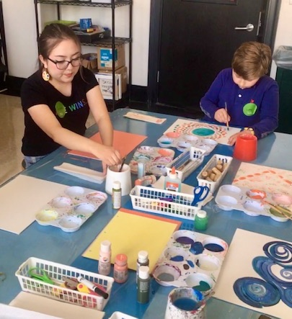
Teaching Tips to Thrive! #20.2 Dr. Paige M. Medlock: Supervising Preservice Student Teachers
Meeting with student teachers prior to their first day of placement, I cover important topics. First, I address the logistics they need to accomplish: communicate with the mentor teacher/s, meet the principals and staff, learn names, policies, dress code, and where to make copies and have lunch. Then, I cover presence, including professional behaviors in person and online. We discuss attendance, punctuality, demeanor, rapport, and holistic well-being. I ask them to:
Recall what brings you joy;
Identify your supports;
Access your resources;
Implement plans for hygiene, school-life balance, time management, and setting boundaries;
Evaluate your overall health: physical, emotional, mental, social/relational, financial, spiritual, and occupational; and,
Reinforce yourself.
Notes:
Class instruction: Discuss Teaching Tips to Thrive #20.2 and Paige Medock’s advice for supervising preservice student teachers.
Image: Courtesy of Paige Medlock

Slide 35
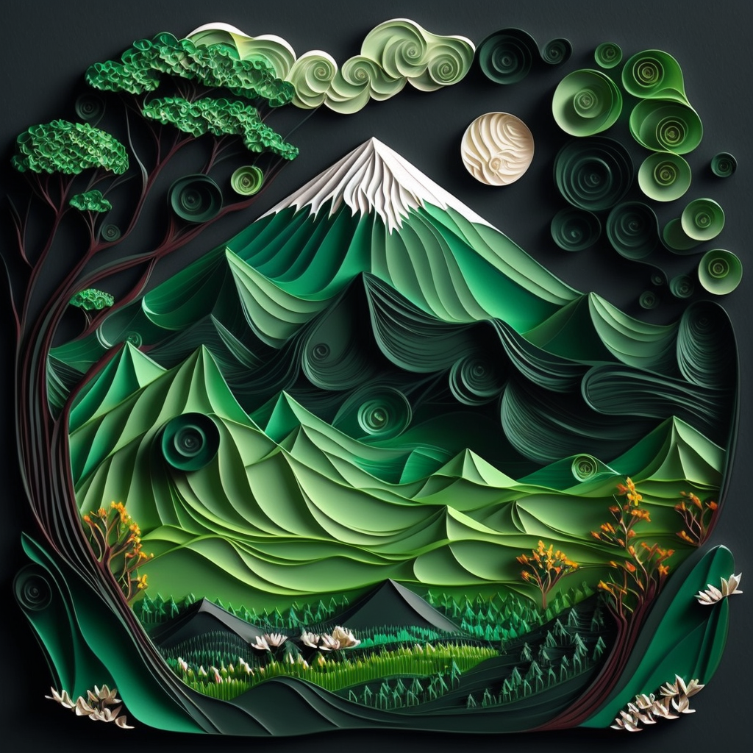
Approaches to Teacher Growth Charts: Making the Most of My Career from Preservice/Beginning to Practicing Educator
Participate in Pre-K–12 classrooms observations to learn how teachers organize their learning environments, identifying the key qualities of well-designed classrooms, including effective visuals and signage, thoughtfully arranged furnishings and materials, and dedicated spaces for storing student artwork.
Commit to deepening my impact as an educator by continuously evolving my practice to meet the needs of all learners.
Notes:
Class Activity: Open the textbook to Chapter 20’s Teacher Transformative Growth Chart. Model 20.4. Discuss the meanings of these transformative actions. Build on their list of actions.
Image: Midjourney AI, prompted by Netha Hussain, CC0, via Wikimedia Commons. https://commons.wikimedia.org/wiki/File:Quilling_pattern_of_a_mountain_02.png

Slide 36
CHAPTER 20. Summary
Making the Most of Your Teaching Career
Teacher Creativity and Critical Thinking
Lifelong Learning
Securing the Right Teaching Job
Cassie Stephens
Teaching Portfolio
Vsevolod Romakov
Melanie Anderson
Mike Muller
Romana Štajerová
Nichole Rich
Sasha Burnette
Gerald Obregon
Nan Liu
Janet Malone
Jonathan Griffith
Teaching Philosophy
Professional Teacher Résumé
Notes:
Thanks for participating in Teaching and Learning in Art Education’s 2nd Ed. Chapter 20!
Book Cover Artwork: Paula Gale
Chapter References
Fredericks, A. D. (2016). Ace your teacher interview: 149 fantastic answers to tough interview questions (2nd ed.). Blue River Press.
Fredericks, A. D. (2017). Ace your teacher résumé (and cover letter). Blue River Press.
Graham, M. A. , & Zwirn, S. G. (2010). How being a teaching artist can influence K–12 art education. Studies in Art Education, 51 (3), 219–232.
Hausman, J. J. (1959). Editorial. Studies in Art Education, 1(1), 3–8. https://doi.org/10.2307/1319946
Liu, N. (2019). Art education in the United States. Hu Nan Fine Arts Publishing House.
Sickler-Voigt, D. C. (2018). Changing mindsets about edTPA: From test anxiety to demonstrating teacher competencies through authentic teaching and assessment practices. https://www.arteducators.org/learn-tools/assessment-papers-for-art-education
Sickler-Voigt, D. C. (2023). STEAM teaching and learning through the arts and design: A practical guide for PK-12 educators. Routledge.
Smilan, C. (2016). Developing visual creative literacies through integrating art-based inquiry. Clearing House, 89 (4/5), 167–178.

