Slide 1

Rotoscoping Infographic
by © Amber Buck

Slide 2
ANIMATION
Understanding Basic Approaches
Definition
Categories
Concepts
01
Animation can be defined as manipulating a series of images, drawings, or models to create an illusion of movement.
02
Animation can consist of different categories including:
2-D Animation: implied movement through manipulation of flat objects and backgrounds.
3-D Animation: implied movement through manipulation of objects using an x, y, and z axis.
03
Basic animation terms can include:
Frames: capture a series of movements and a single frame captures one motion in the sequence.
Key Frames: mark when movement starts and ends within a series.
Frame Rate: determines how quickly and smoothly frames progress (typically 24 frames per one second of movement).

Slide 3
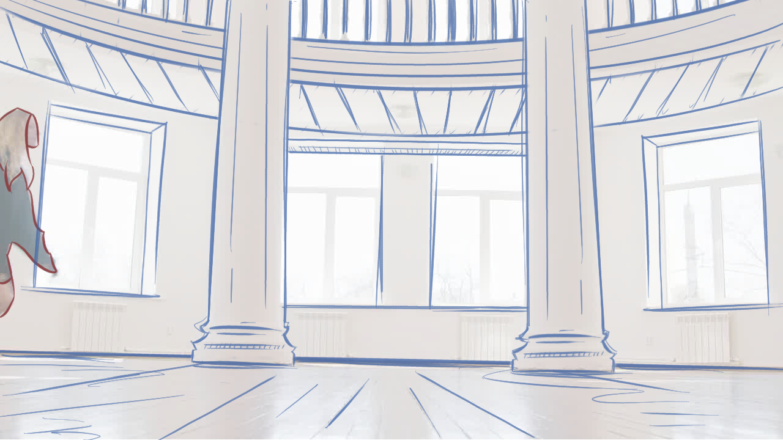
ANIMATION
Understanding Rotoscope Techniques
Definition
Categories
Concepts
01
Rotoscoping can be defined as tracing over sequential motion pictures, frame by frame, to produce realistic movement.
02
Rotoscoping can include 2-D Animation processes in which motion picture frames are traced using flat perspectives.
A basic approach to creating rotoscope films can include:
03
Converting videos into sequential motion pictures & tracing each image frame by frame until the complete sequence is formed.
*Frame 1

Slide 4
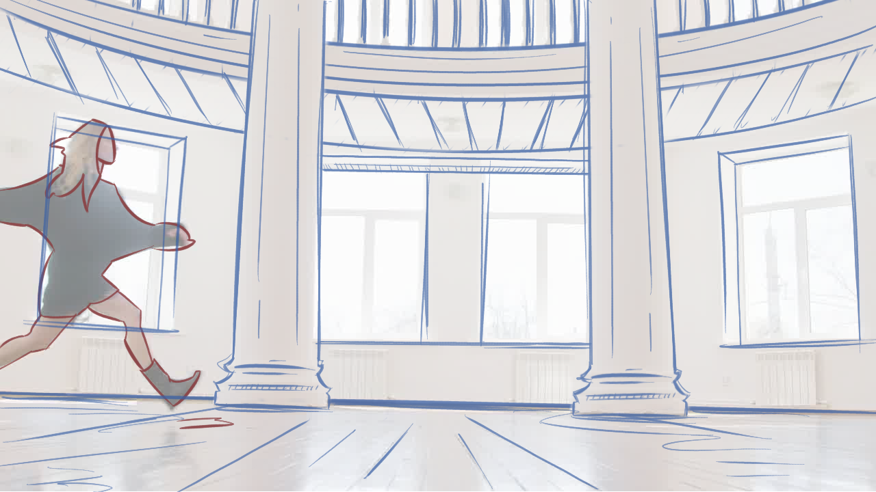
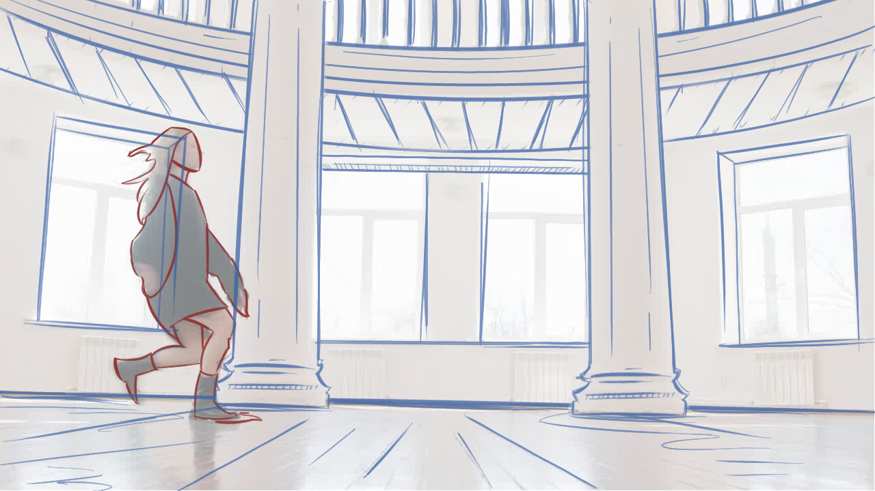
ANIMATION
Understanding Rotoscope Techniques
Definition
Categories
Concepts
03
*Frame 2
*Frame 3

Slide 5
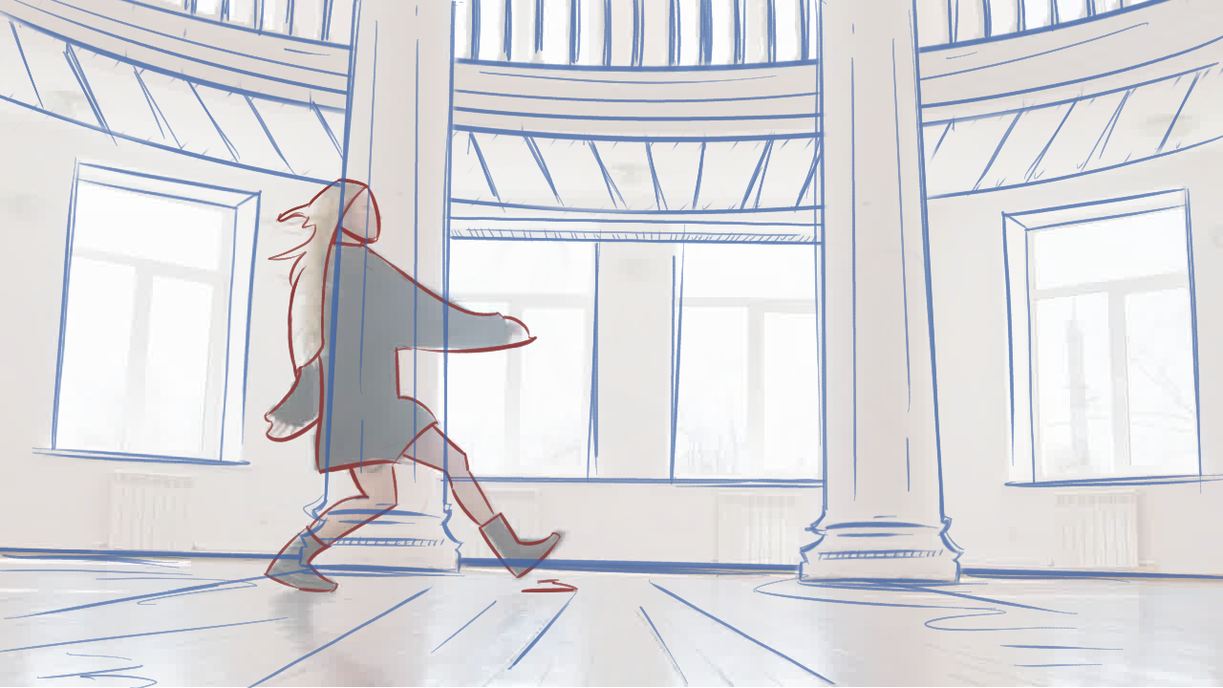
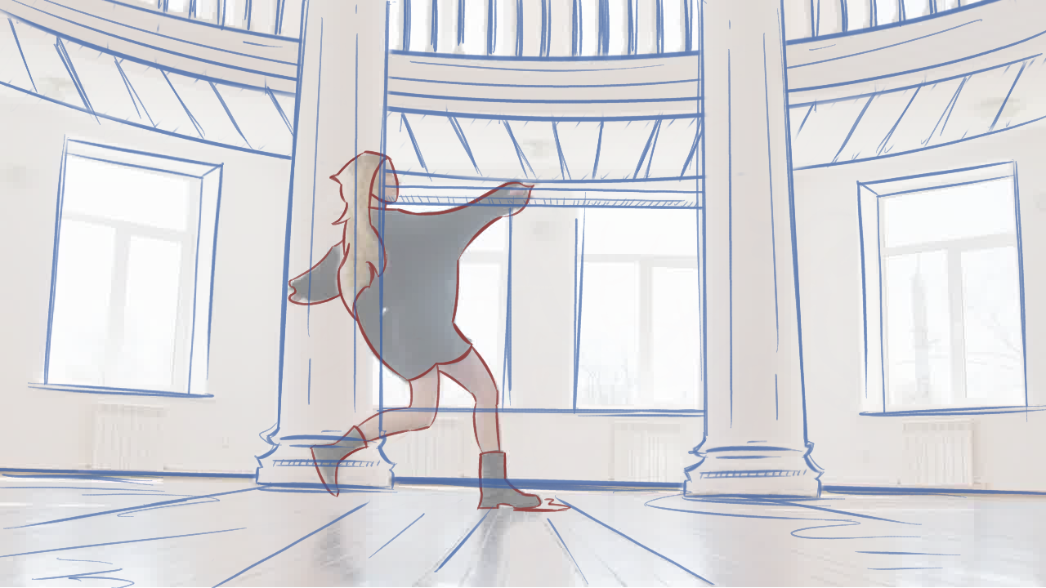
ANIMATION
Understanding Rotoscope Techniques
Definition
Categories
Concepts
03
*Frame 4
*Frame 5

Slide 6
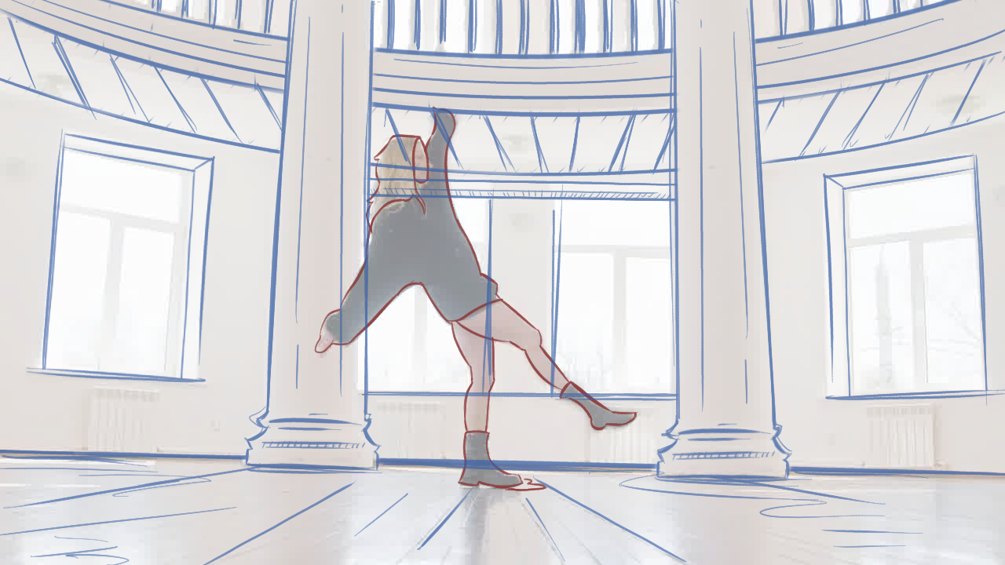
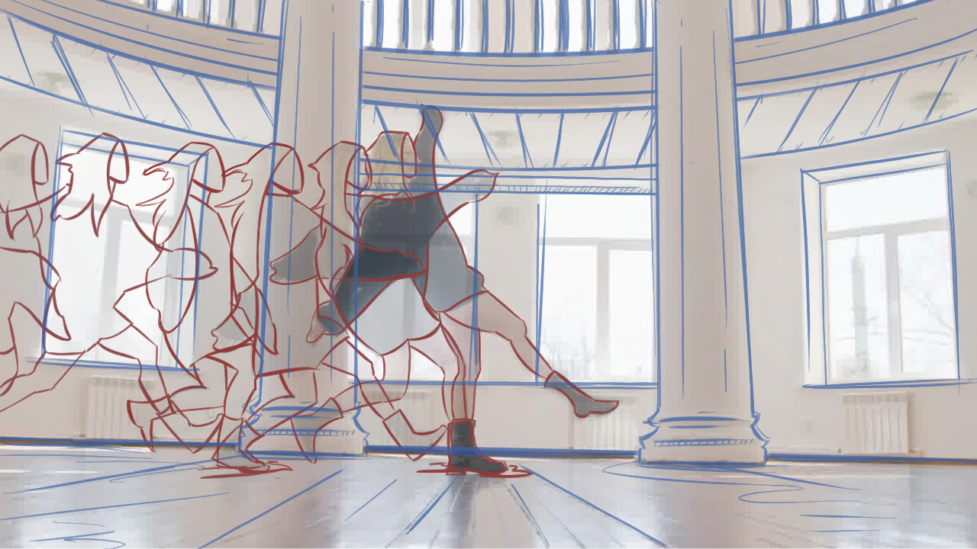
ANIMATION
Understanding Rotoscope Techniques
Definition
Categories
Concepts
03
*Frame 6
*Sequential Frames

Slide 7
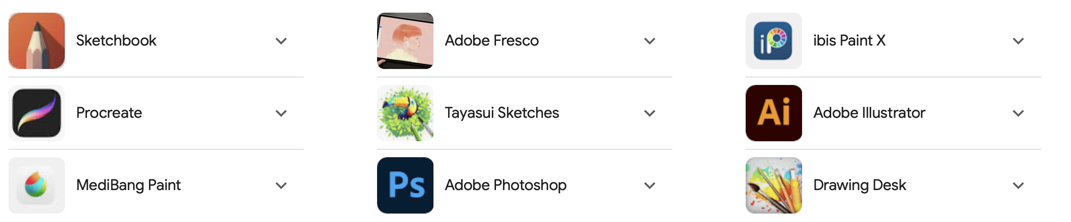
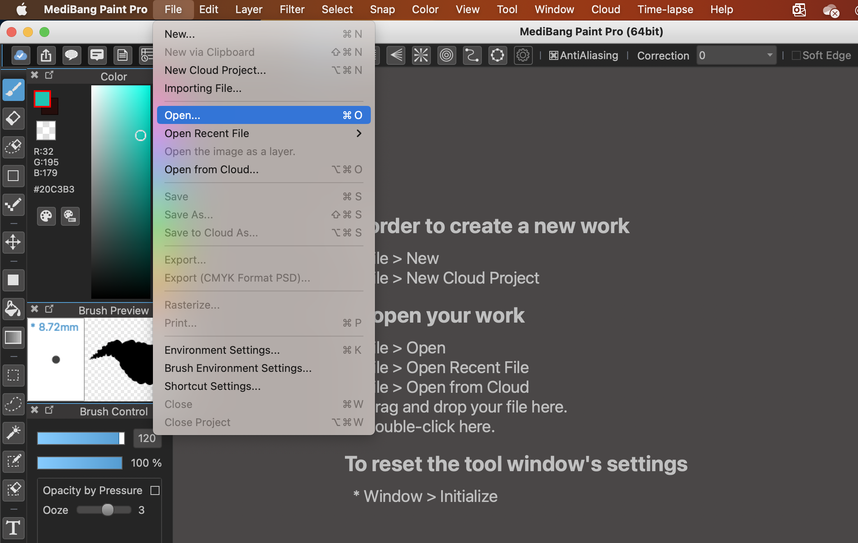
ANIMATION
Understanding Rotoscope Techniques
Resources
Processes
04
Developing rotoscope frames can be completed using some of the apps and general steps below:
*
More apps include Ibis Paint or Corel Painter Essentials (*free apps).
*
05
In most drawing apps, users can open or import digital files and motion pictures (pngs or jpgs).

Slide 8
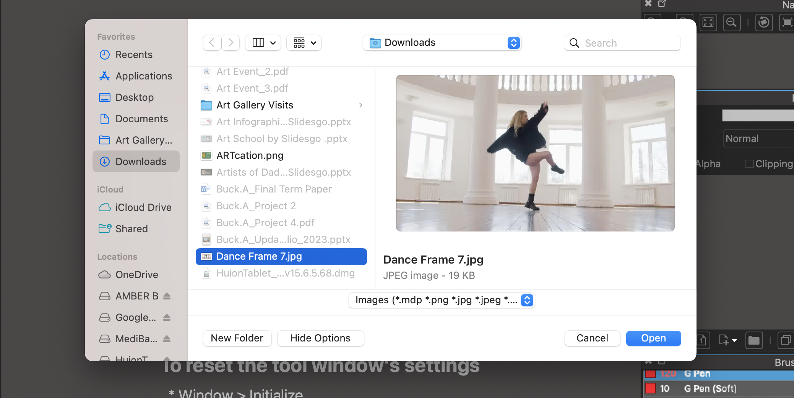
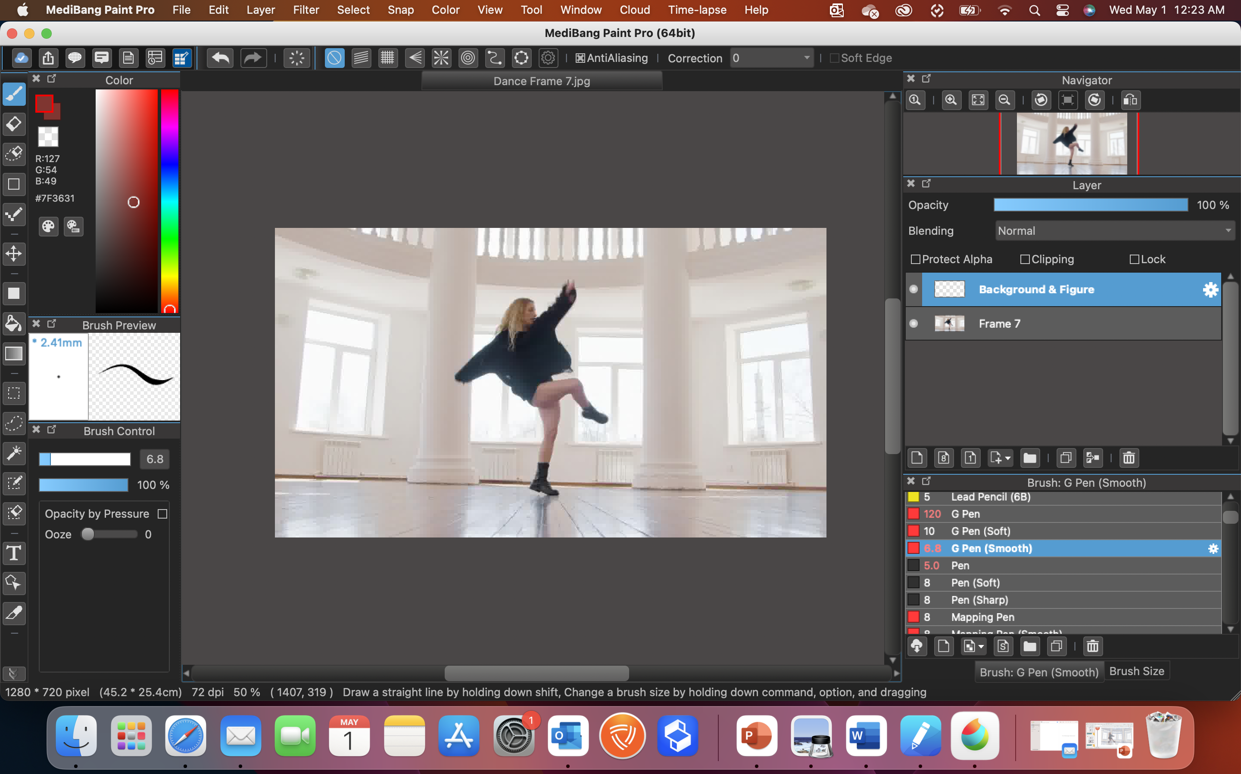
ANIMATION
Understanding Rotoscope Techniques
Resources
Processes
04
Locate the image which will be rotoscoped and select open. This will place the motion picture directly in the drawing app.
05

Slide 9
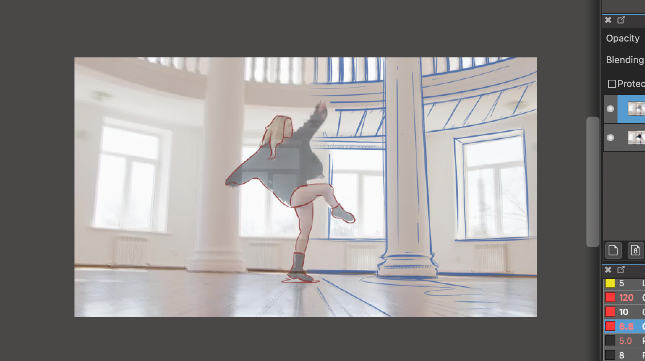
ANIMATION
Understanding Rotoscope Techniques
Resources
Processes
04
Users can then add layers to sketch on, select digital brushes, and begin rotoscoping on top of the stop motion picture.
05
Added Layer
Brushes
Add Layer

Slide 10
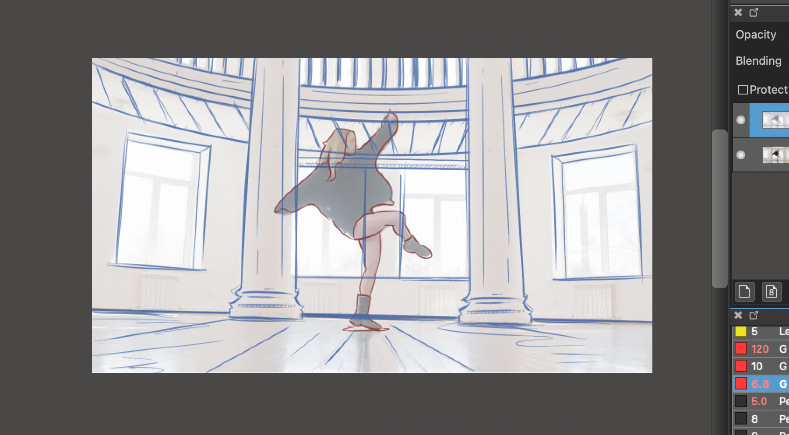
ANIMATION
Understanding Rotoscope Techniques
Resources
Processes
04
Once the complete stop motion picture has been stylistically rotoscoped, the process should be repeated for all frames in a sequence.
05

Slide 11
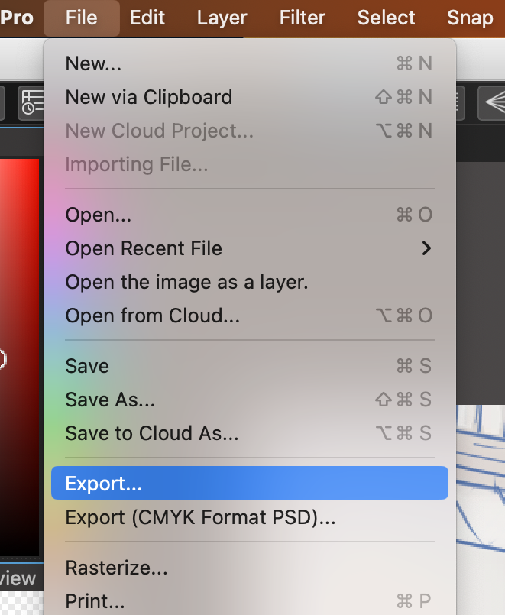
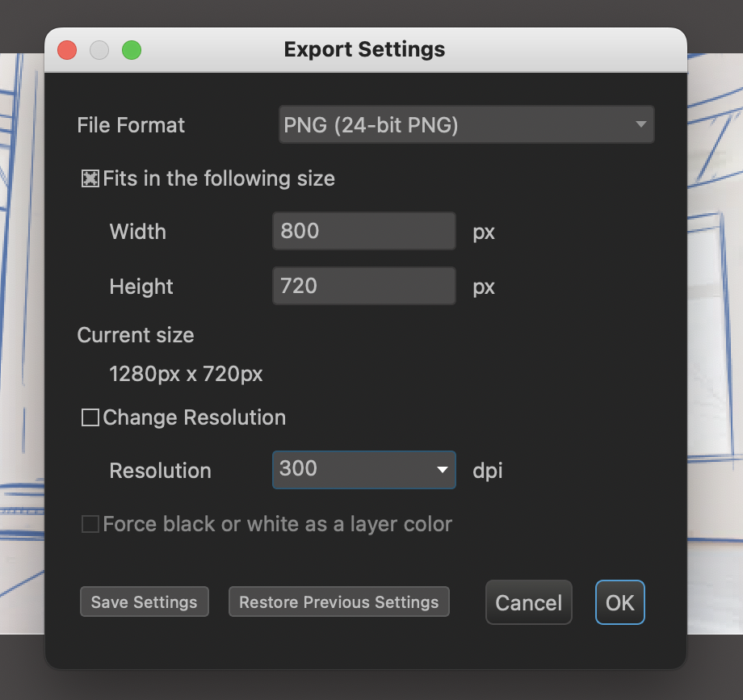
ANIMATION
Understanding Rotoscope Techniques
Resources
Processes
04
Once a full sequence is completely rotoscoped, all individual frames need to be exported as jpgs or png files.
05

Slide 12
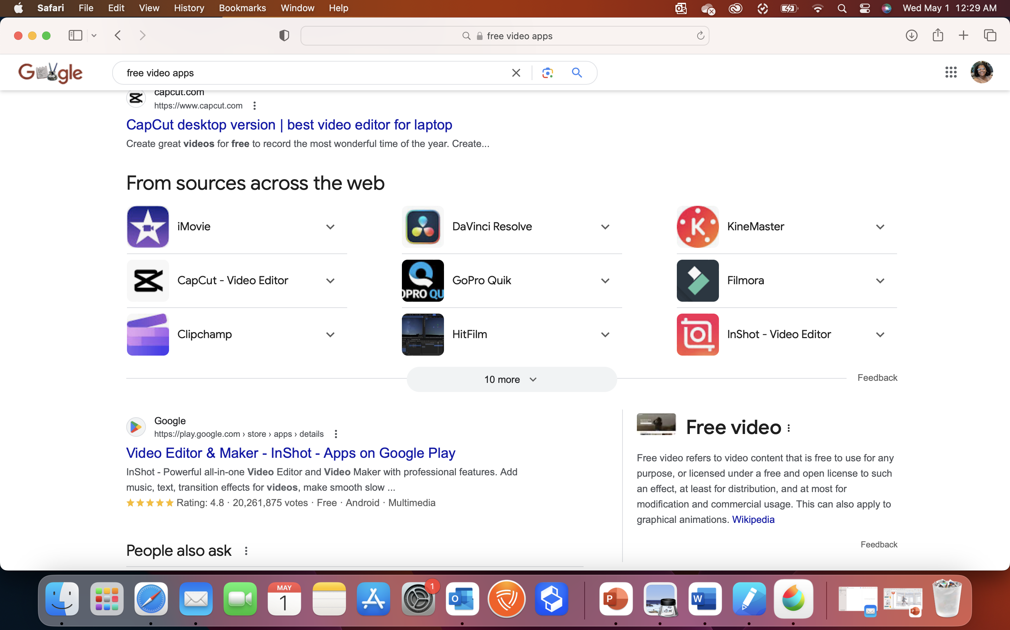
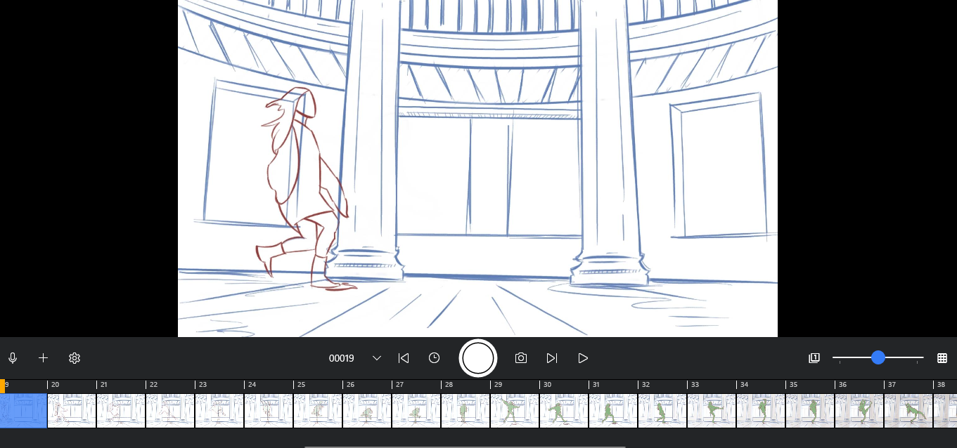
ANIMATION
Understanding Rotoscope Techniques
Resources
Processes
04
All exported jpgs or png files should then be merged into an animation using video creation apps which can include the below options:
05
*
*
*
More apps include Inshot, Flipaclip, or Stop Motion Studio (*free apps).
*
*

