Slide 1

Sample Art Classrooms
Conduct classroom observations to document the diverse resources available to teachers, including furnishings, cabinets, closets, storage areas, sinks, and natural and artificial lighting. Observe how teachers and students engage with and utilize these elements within the classroom environment. Note how teachers personalize their spaces and how students are represented within them. Identify which components and organizational strategies appear to be most effective or in need of improvement.
Debrah C. Sickler-Voigt, Author & Presentation Developer ©
Notes:
Book Cover Artwork: Paula Gale

Slide 2


Early Childhood
All4Ed
Documented Classroom
Notes:
Image: Photo by Allison Shelley/The Verbatim Agency for EDUimages. (CC BY-NC 4.0).

Slide 3
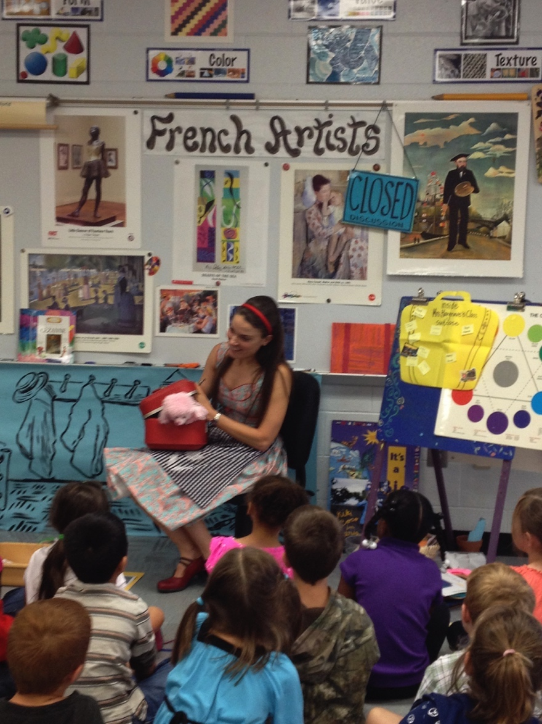
Cassie Stephens’ Elementary Art Classroom
Notes:
Image: Cassie Stephens’ classroom. Pamela McColly, photo.

Slide 4
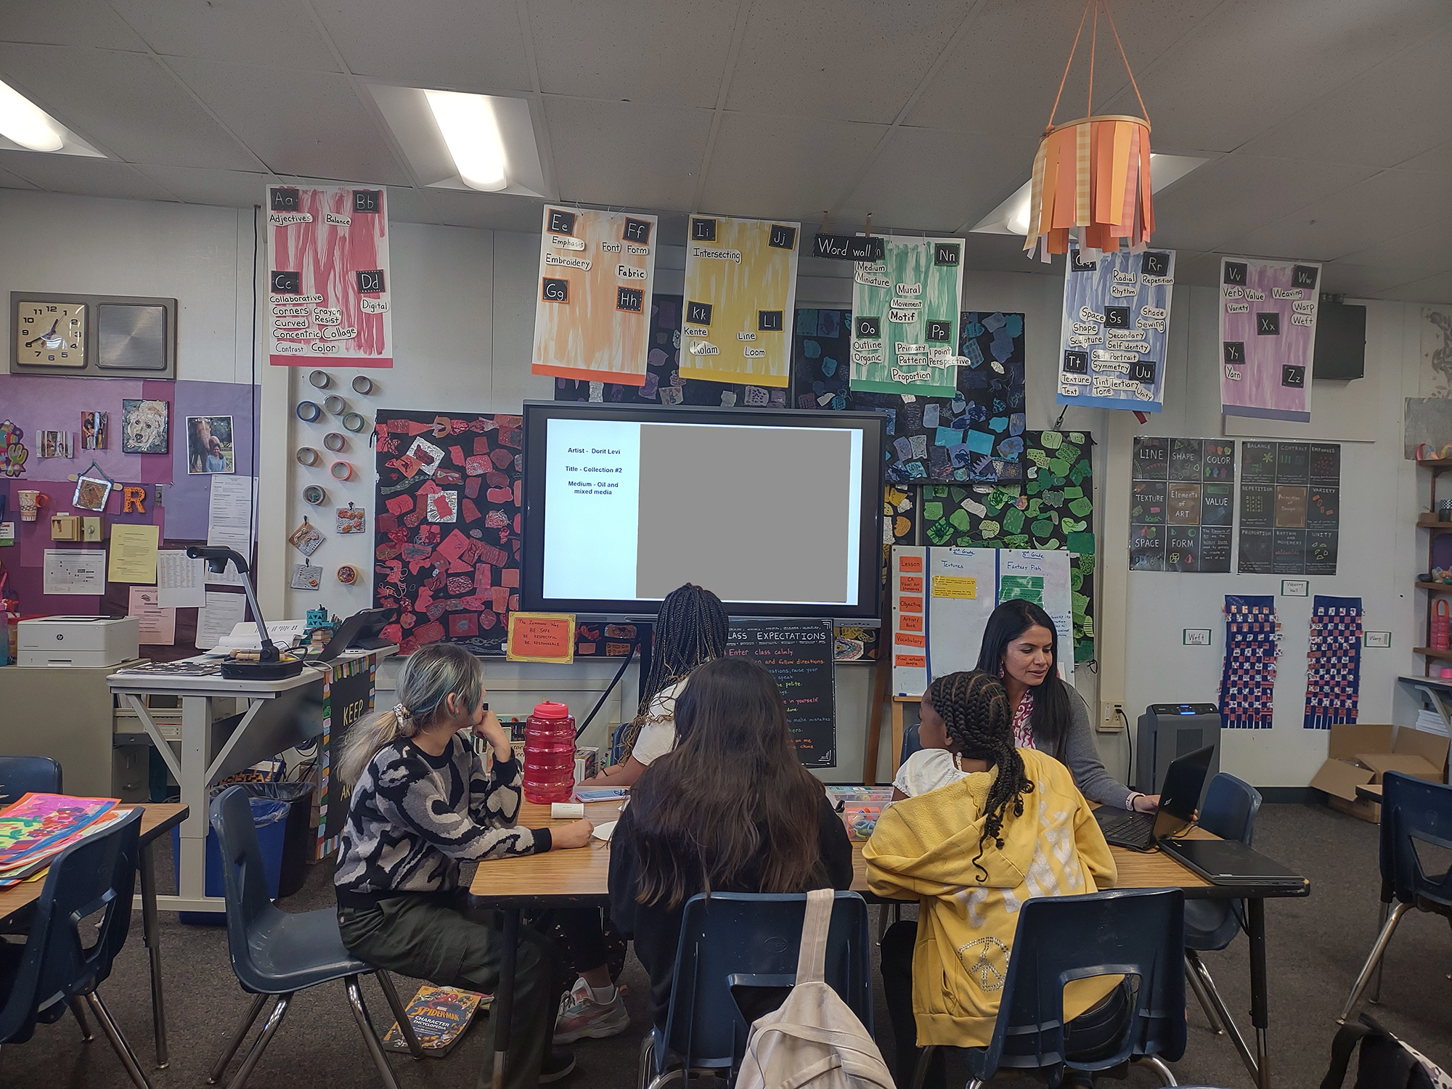
Meera Ramanathan’s Elementary Art Classroom
Notes:
Image: Courtesy of Meera Ramanathan.

Slide 5

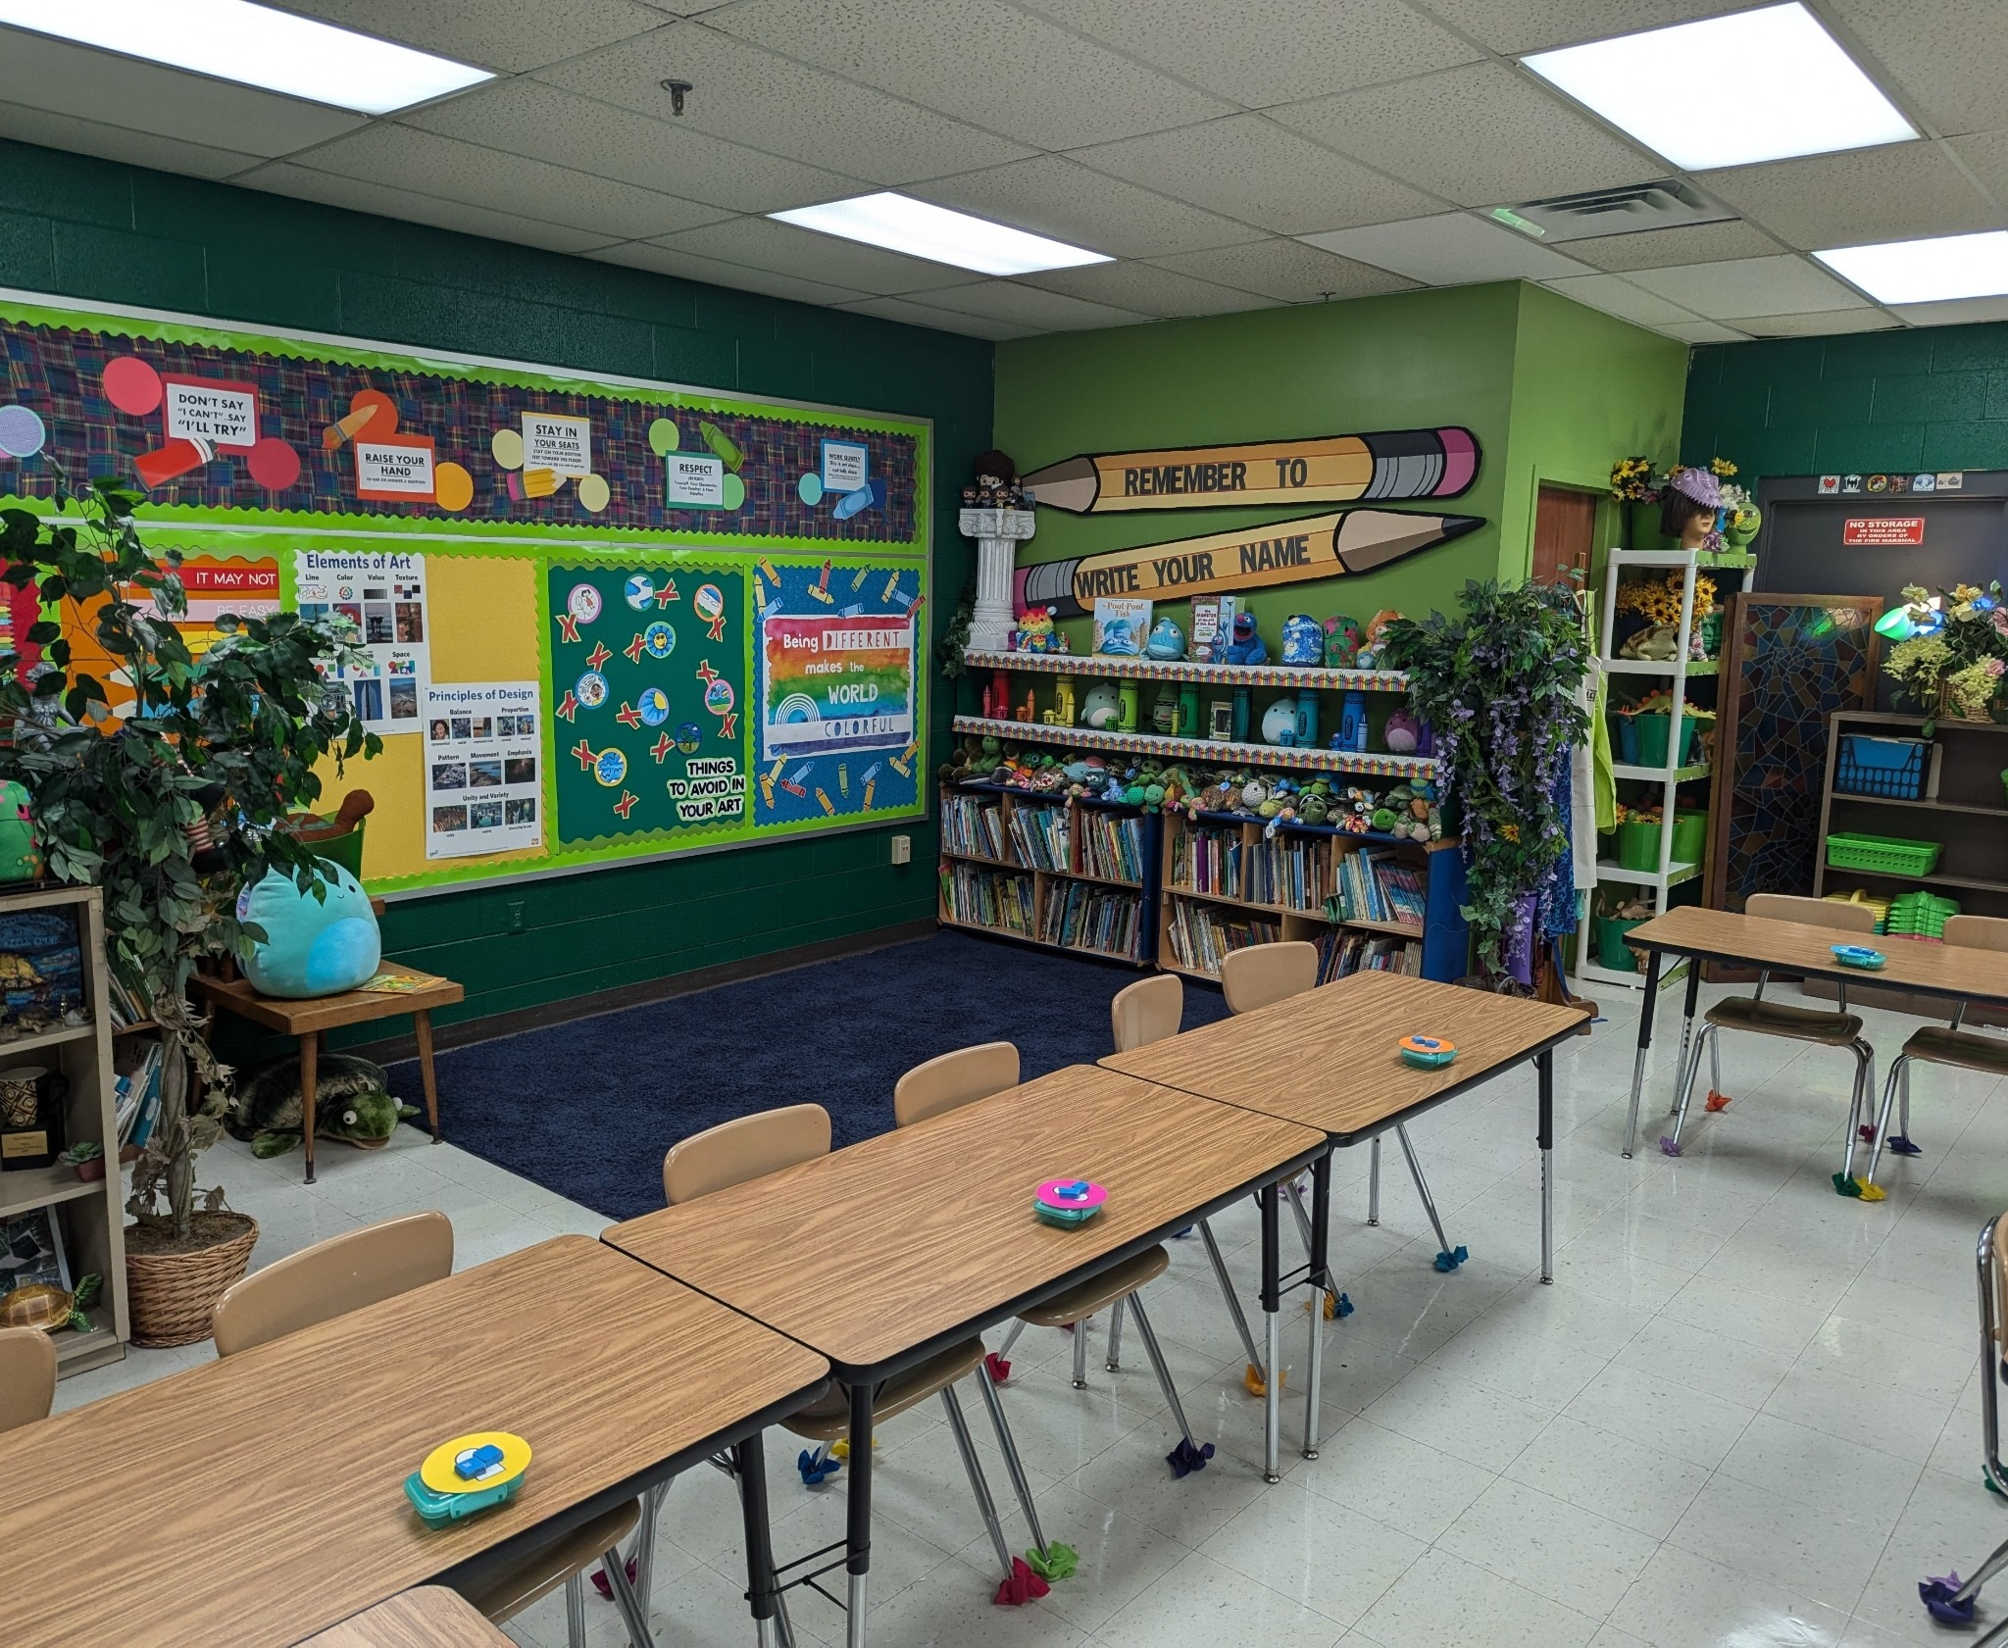
Ted Edinger’s
Former Elementary Art Classroom
Notes:
Image: Ted Edinger’s, Mr. E’s classroom. Pamela McColly, photo.

Slide 6

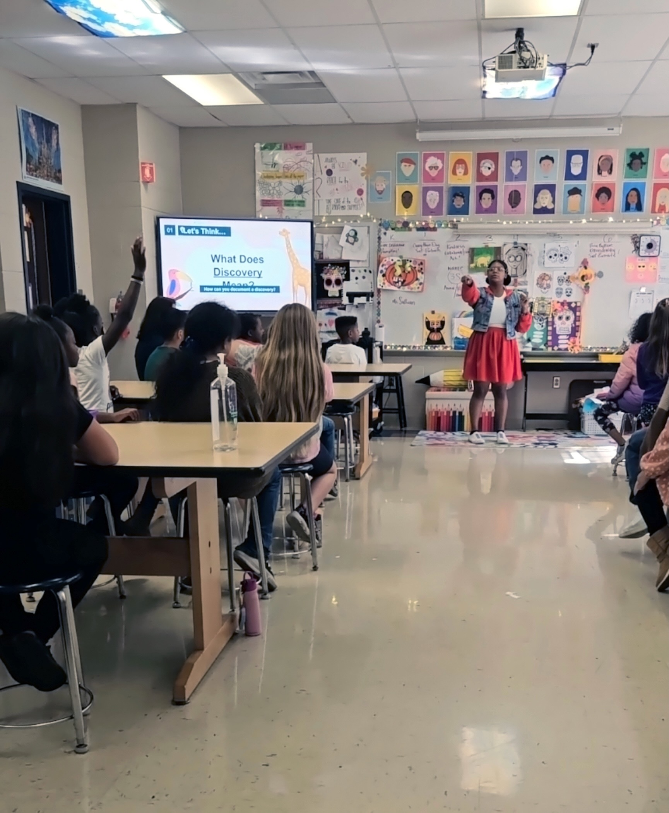
Sasha Burnette’s Elementary Art Classroom
Notes:
Left Image: Courtesy of Sasha Burnette.
Right Image: Courtesy of Amber Buck.

Slide 7
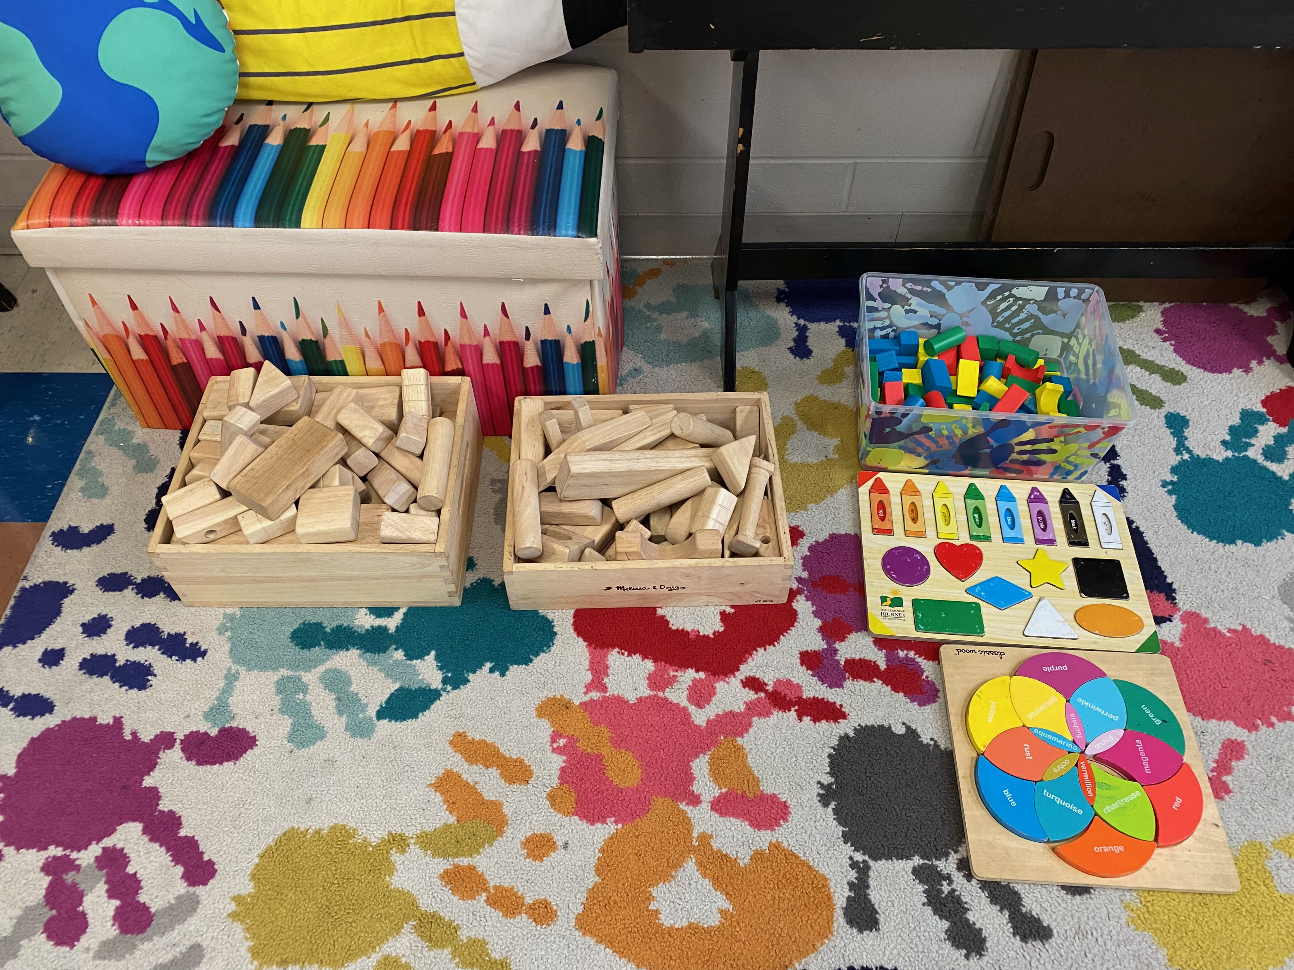
Sasha Burnette’s Elementary Art Classroom
Notes:
Image: Sasha Burnette’s classroom. Pamela McColly, photo.

Slide 8
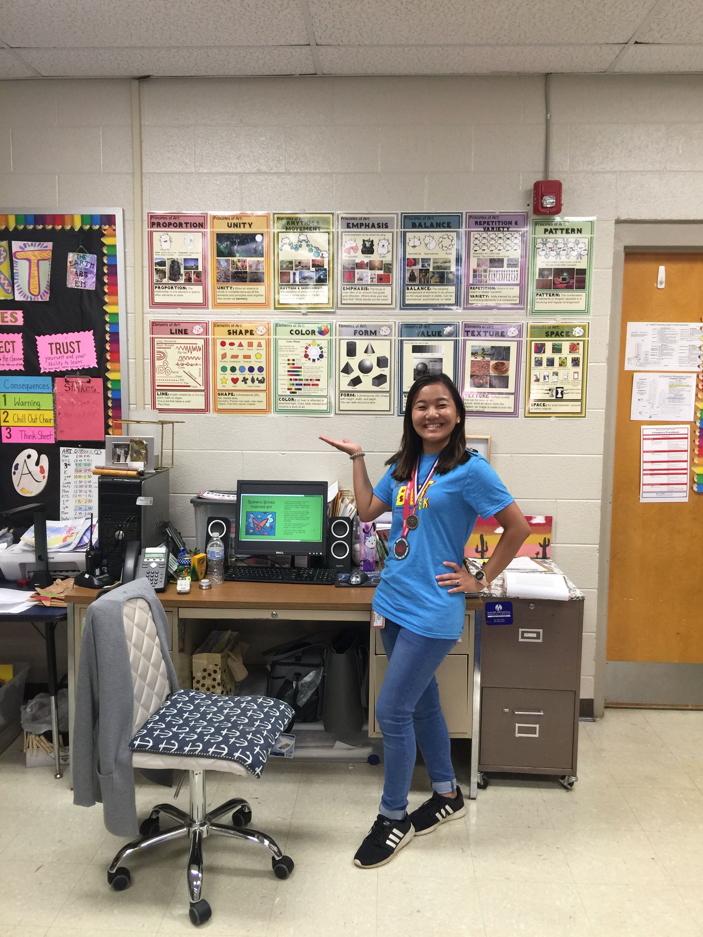
Natsumi Kajisa Gregory’ Elementary Art Classroom
Notes:
Image: Natsumi Kajisa Gregory’s classroom. Pamela McColly, photo.

Slide 9
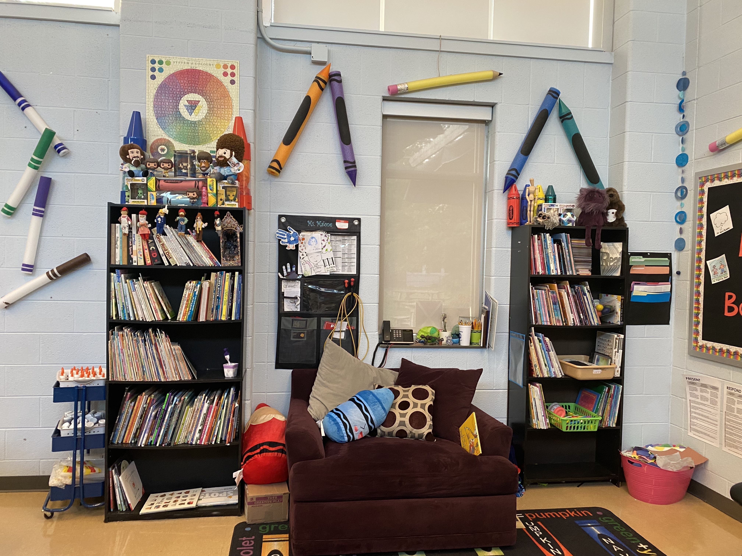
Janet Malone’s Elementary Art Classroom
Notes:
Image: Janet Malone’s classroom. Pamela McColly, photo.
`

Slide 10
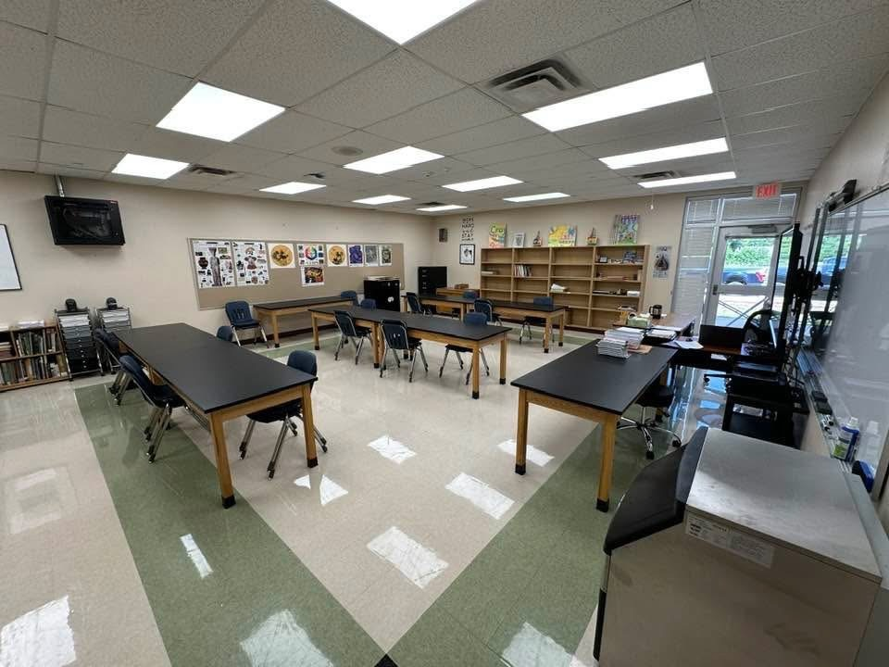
Mike Muller’s Middle School Classroom
Notes:
Image: Courtesy of Mike Muller.

Slide 11
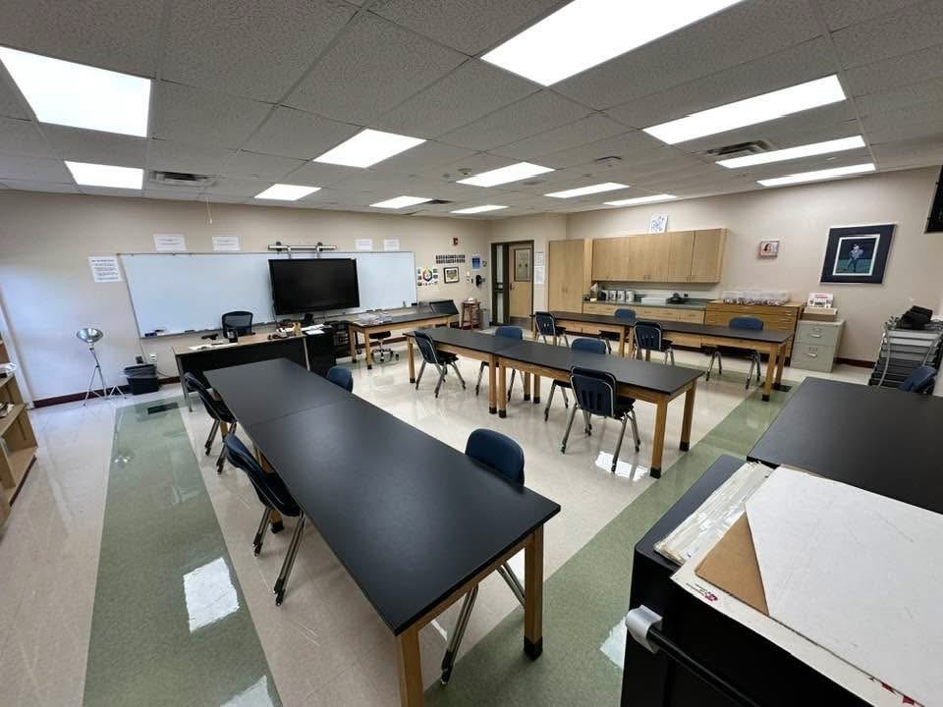
Mike Muller’s Middle School Classroom
Notes:
Image: Courtesy of Mike Muller.

Slide 12
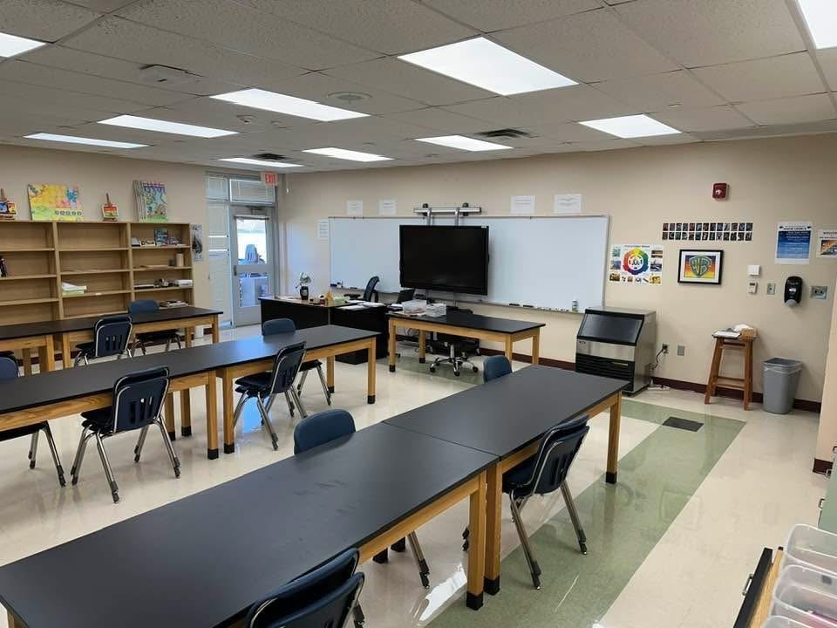
Mike Muller’s Middle School Classroom
Notes:
Image: Courtesy of Mike Muller.

Slide 13
Mike Muller’s Middle School Classroom
Notes:
Image: Courtesy of Mike Muller.

Slide 14
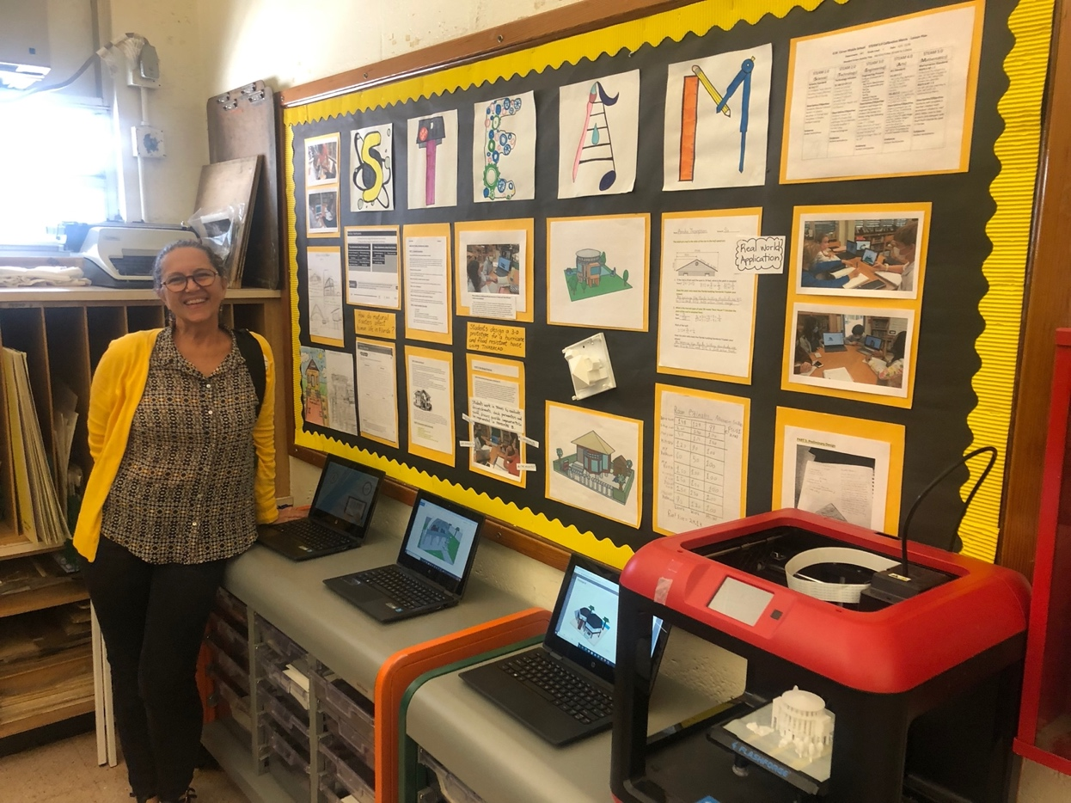
Jenny Llewellyn-Jones’s Middle School Art Classroom
Notes:
Image: Courtesy of Jenny Llewellyn-Jones.

Slide 15
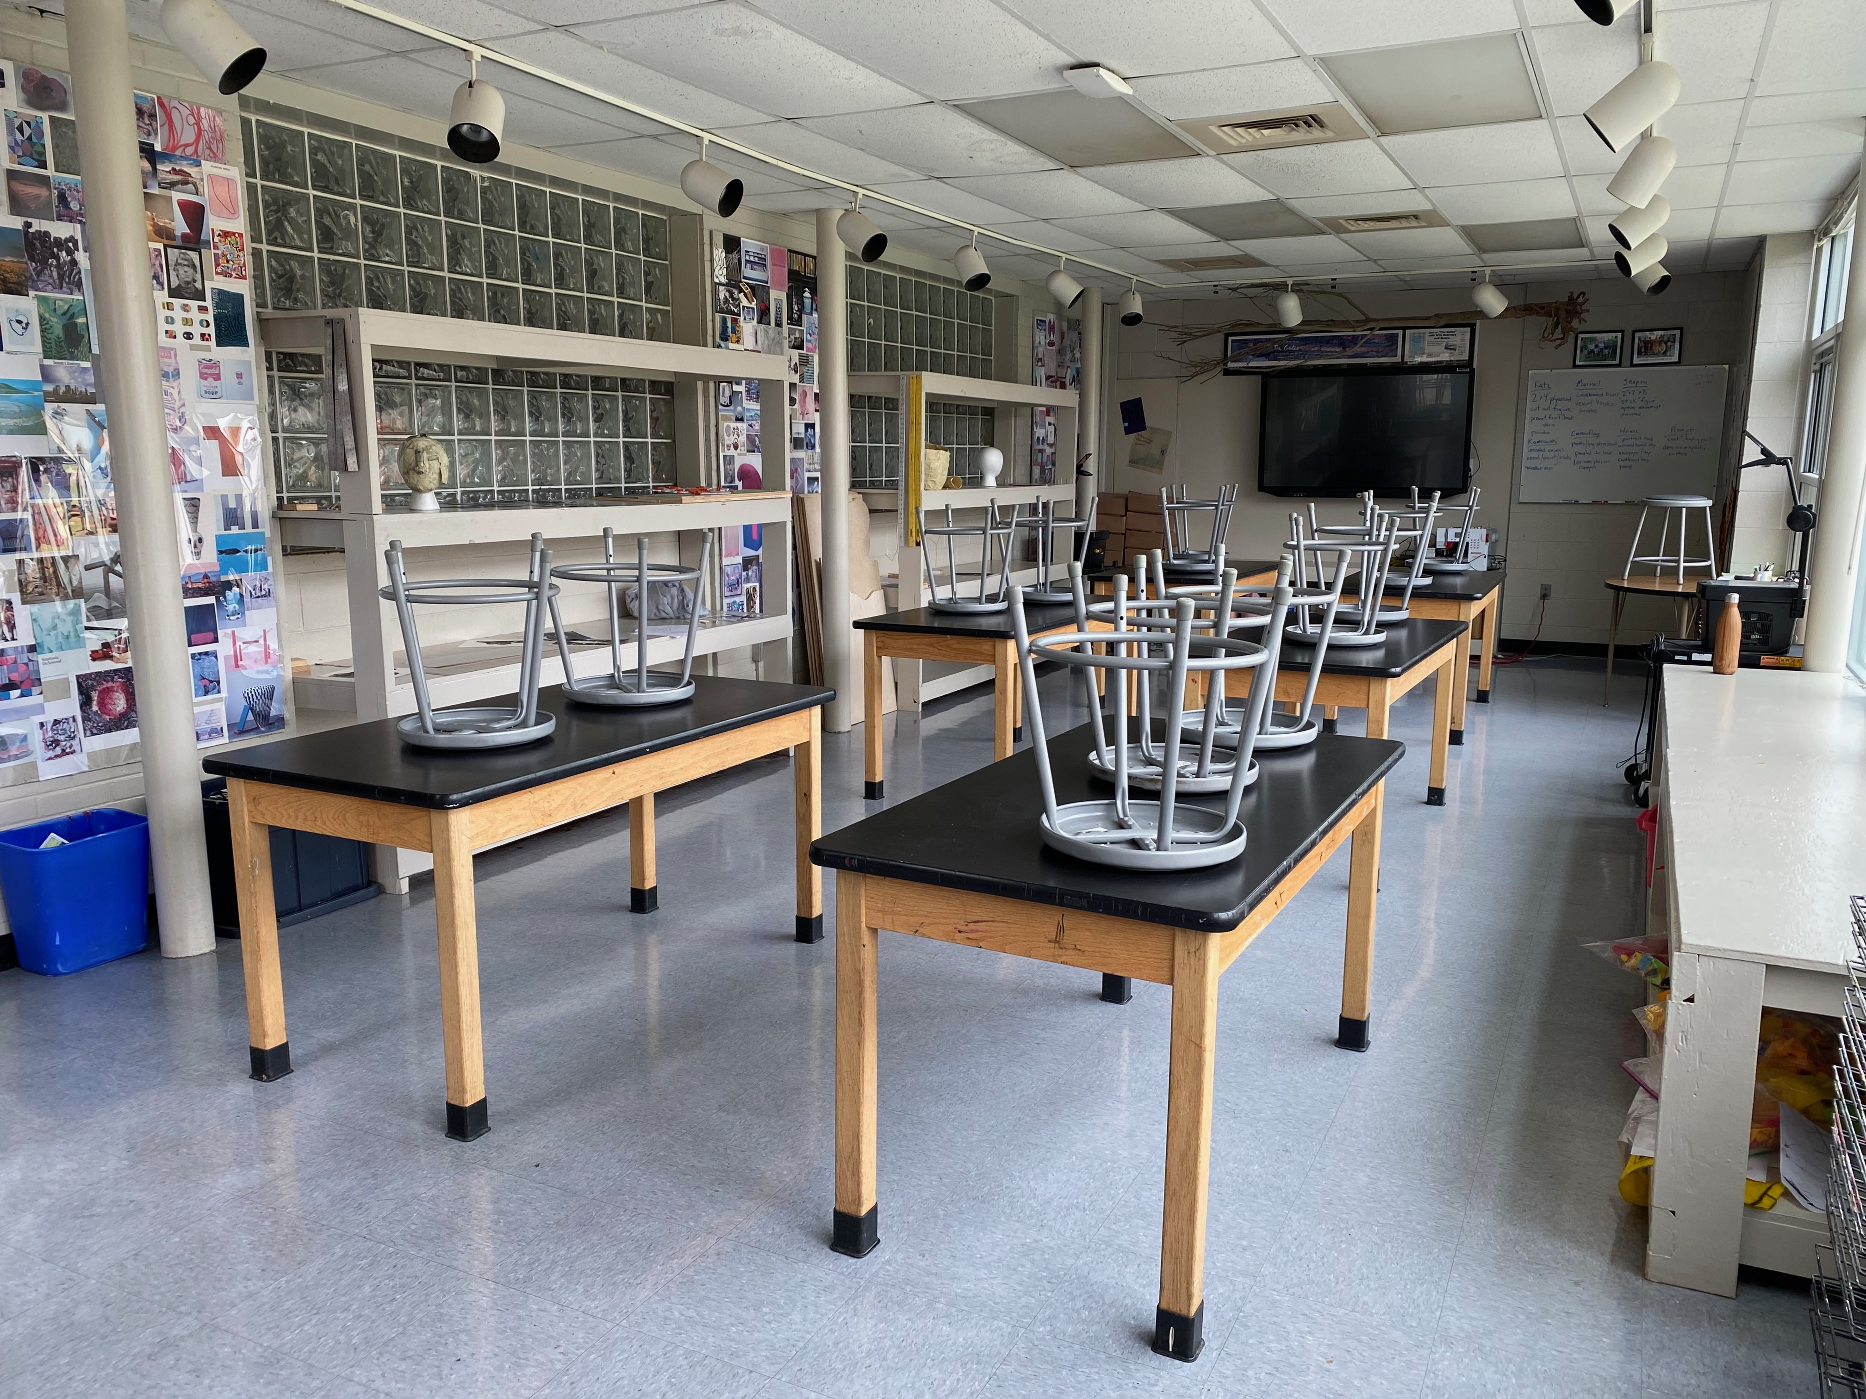
Todd Johnson’s Middle School Art Classroom
Notes:
Image: Todd Johnson’s classroom. Pamela McColly, photo.

Slide 16
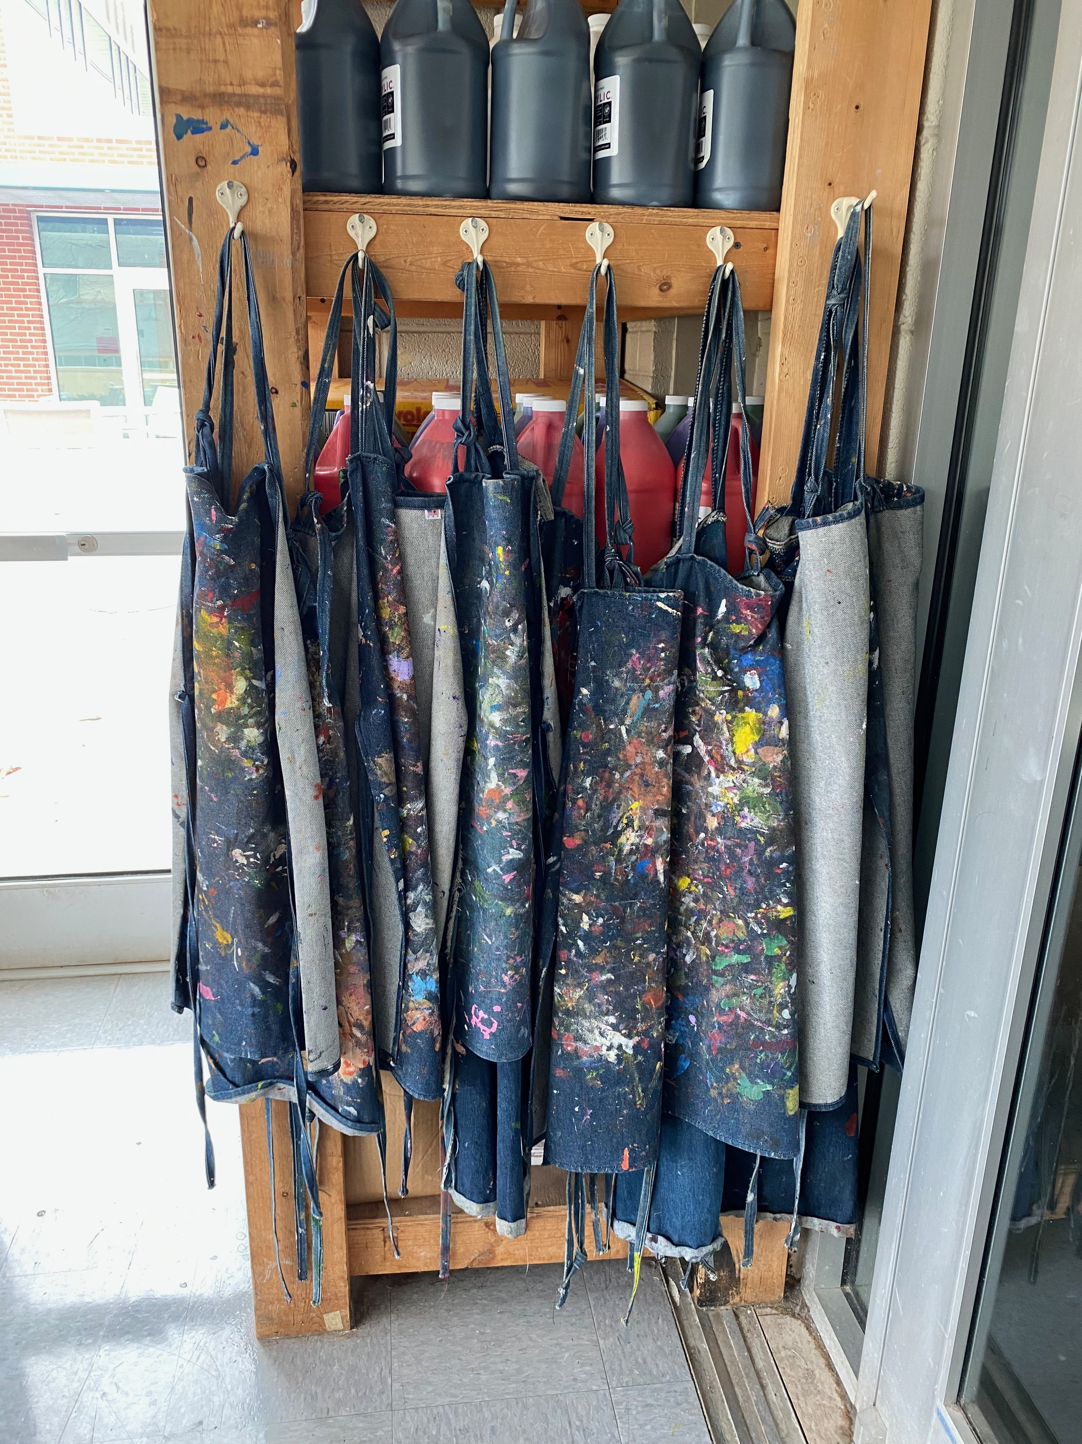
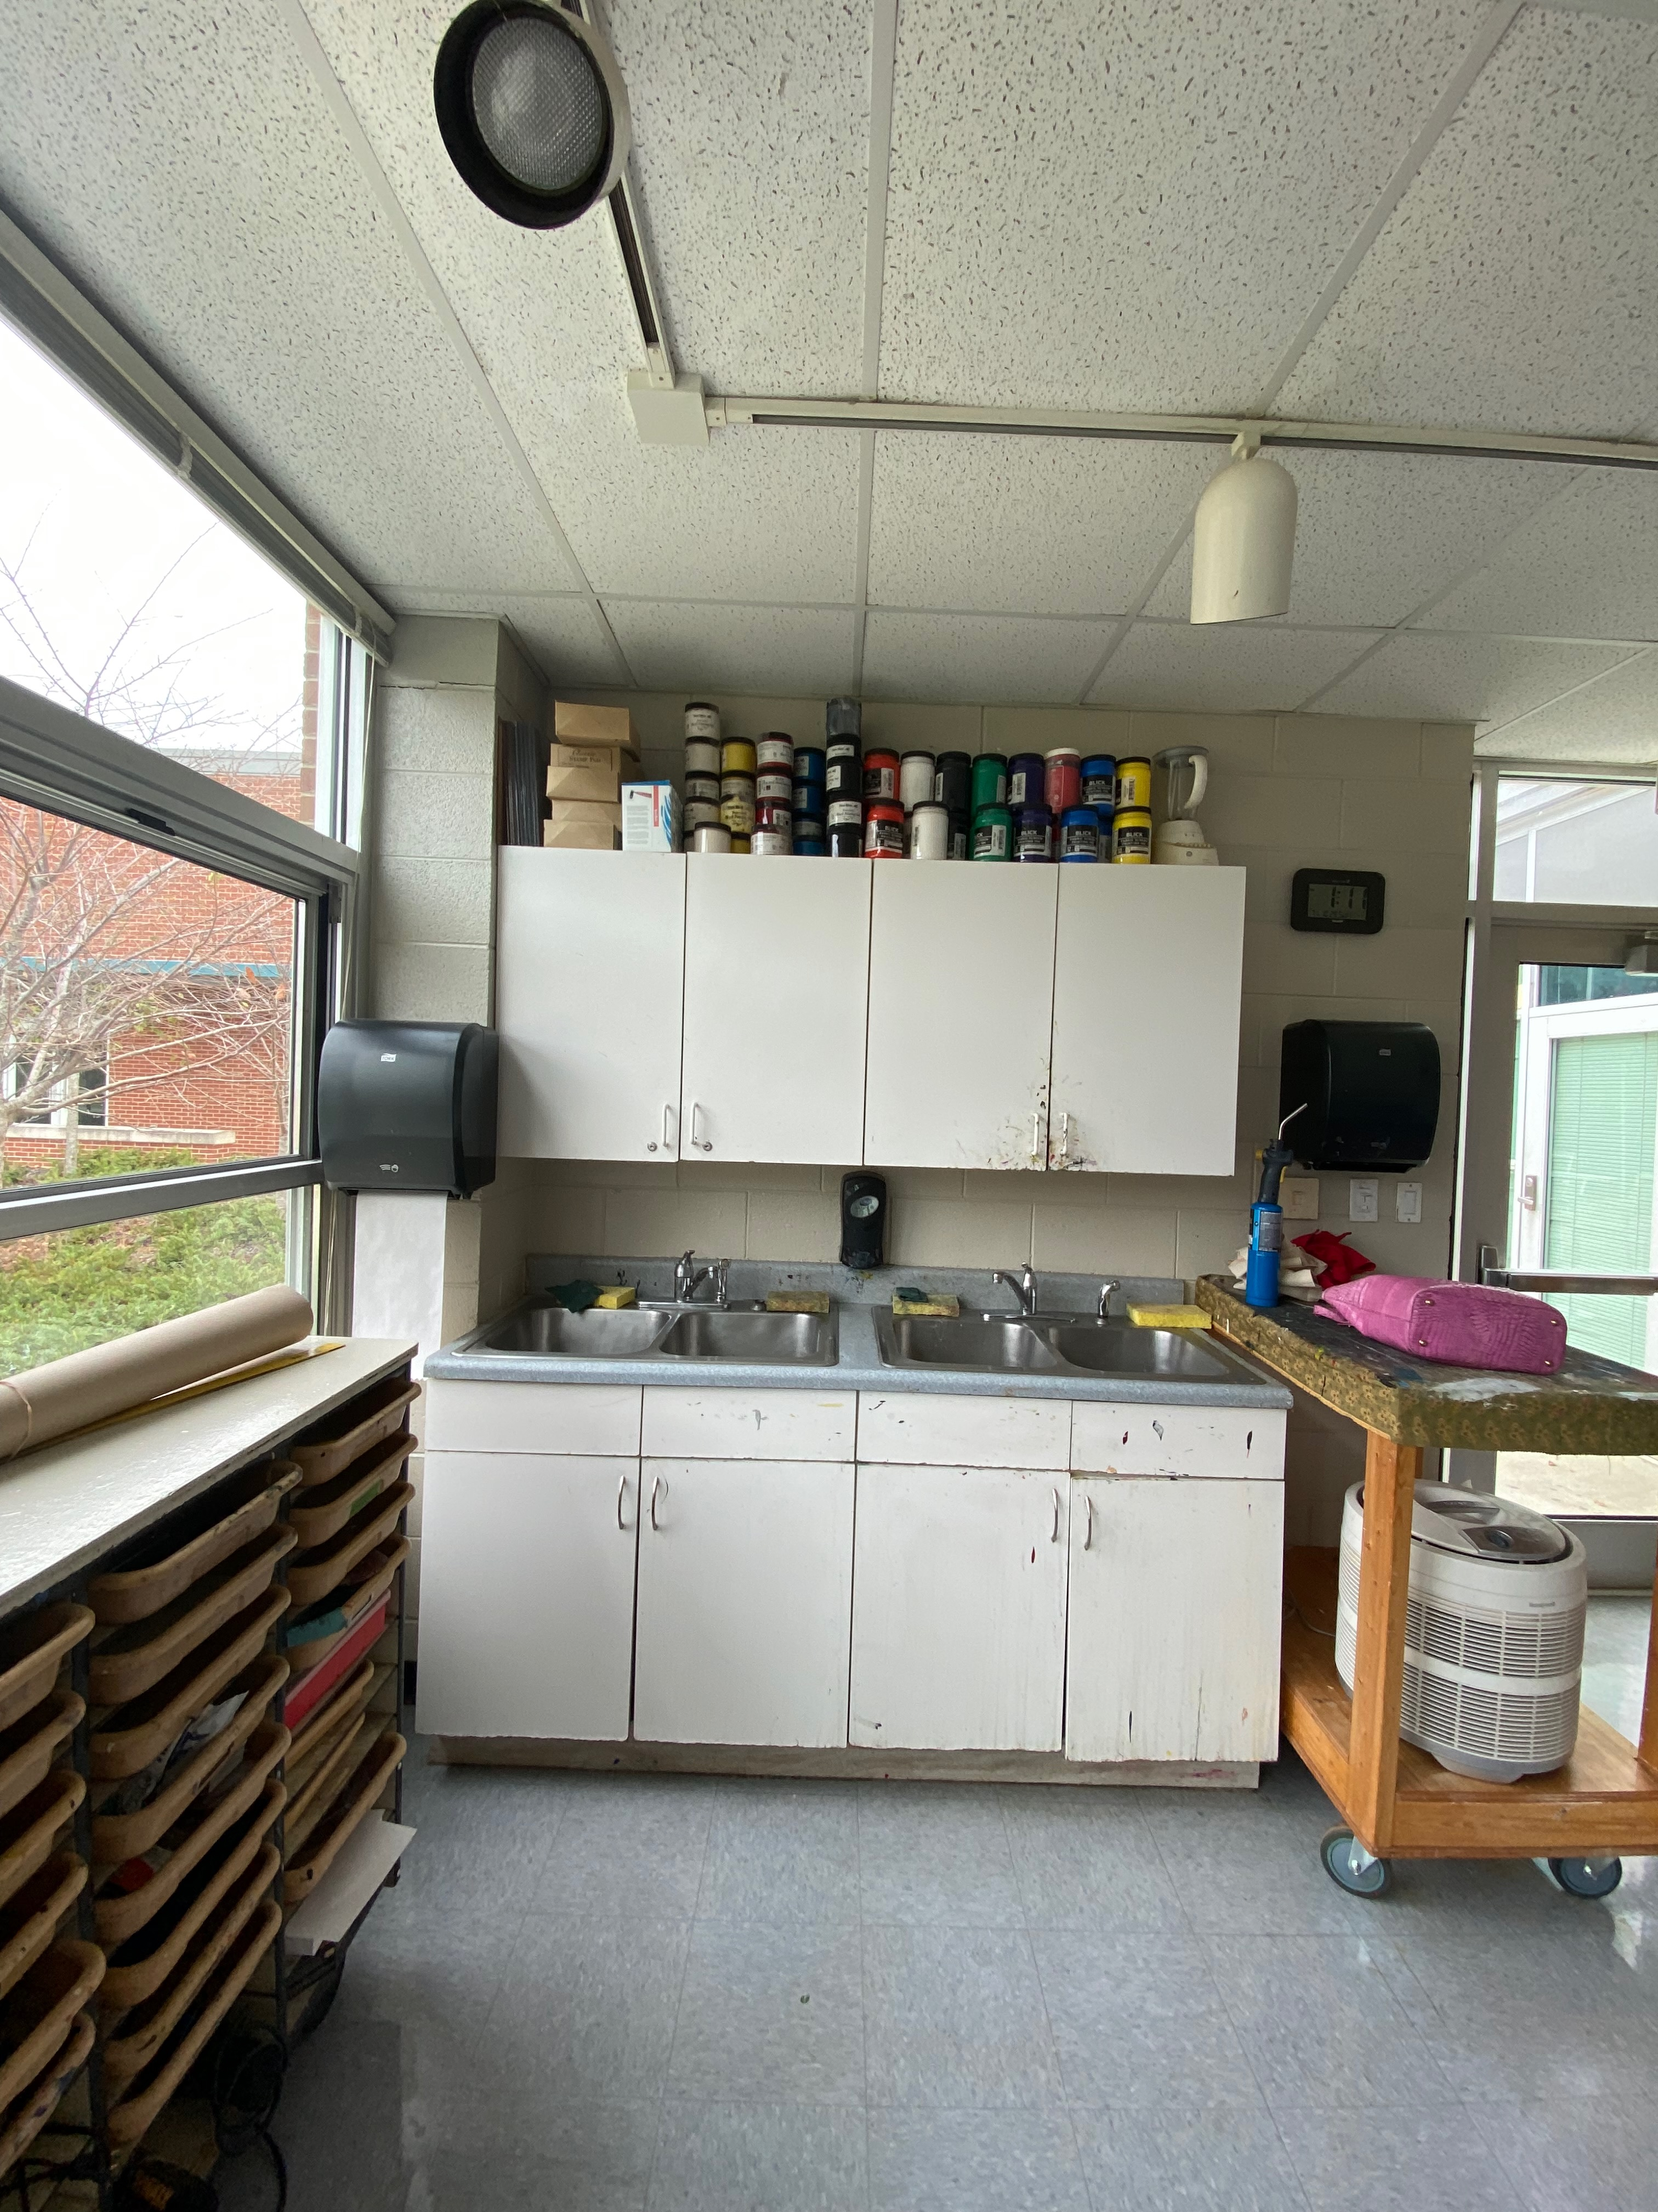
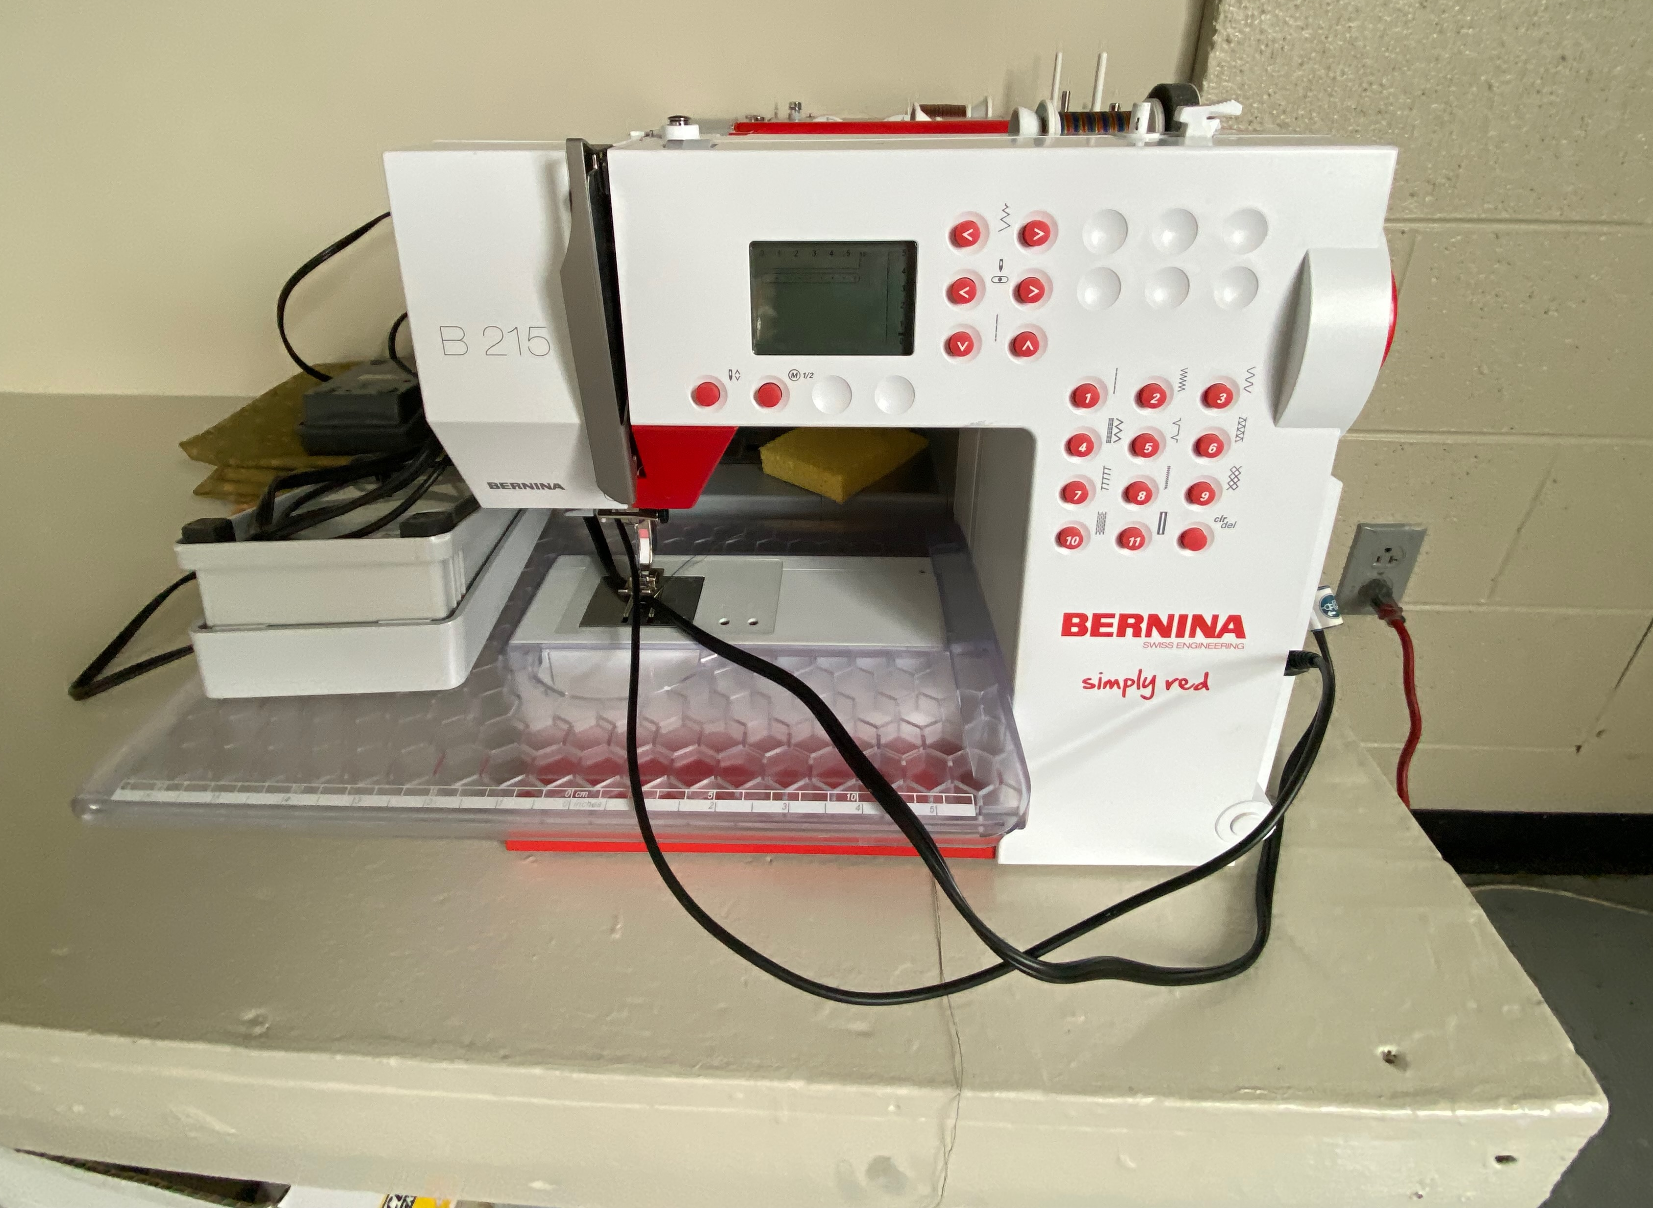
Todd Johnson’s Middle School Art Classroom
Notes:
Image: Todd Johnson’s classroom. Pamela McColly, photos.

Slide 17
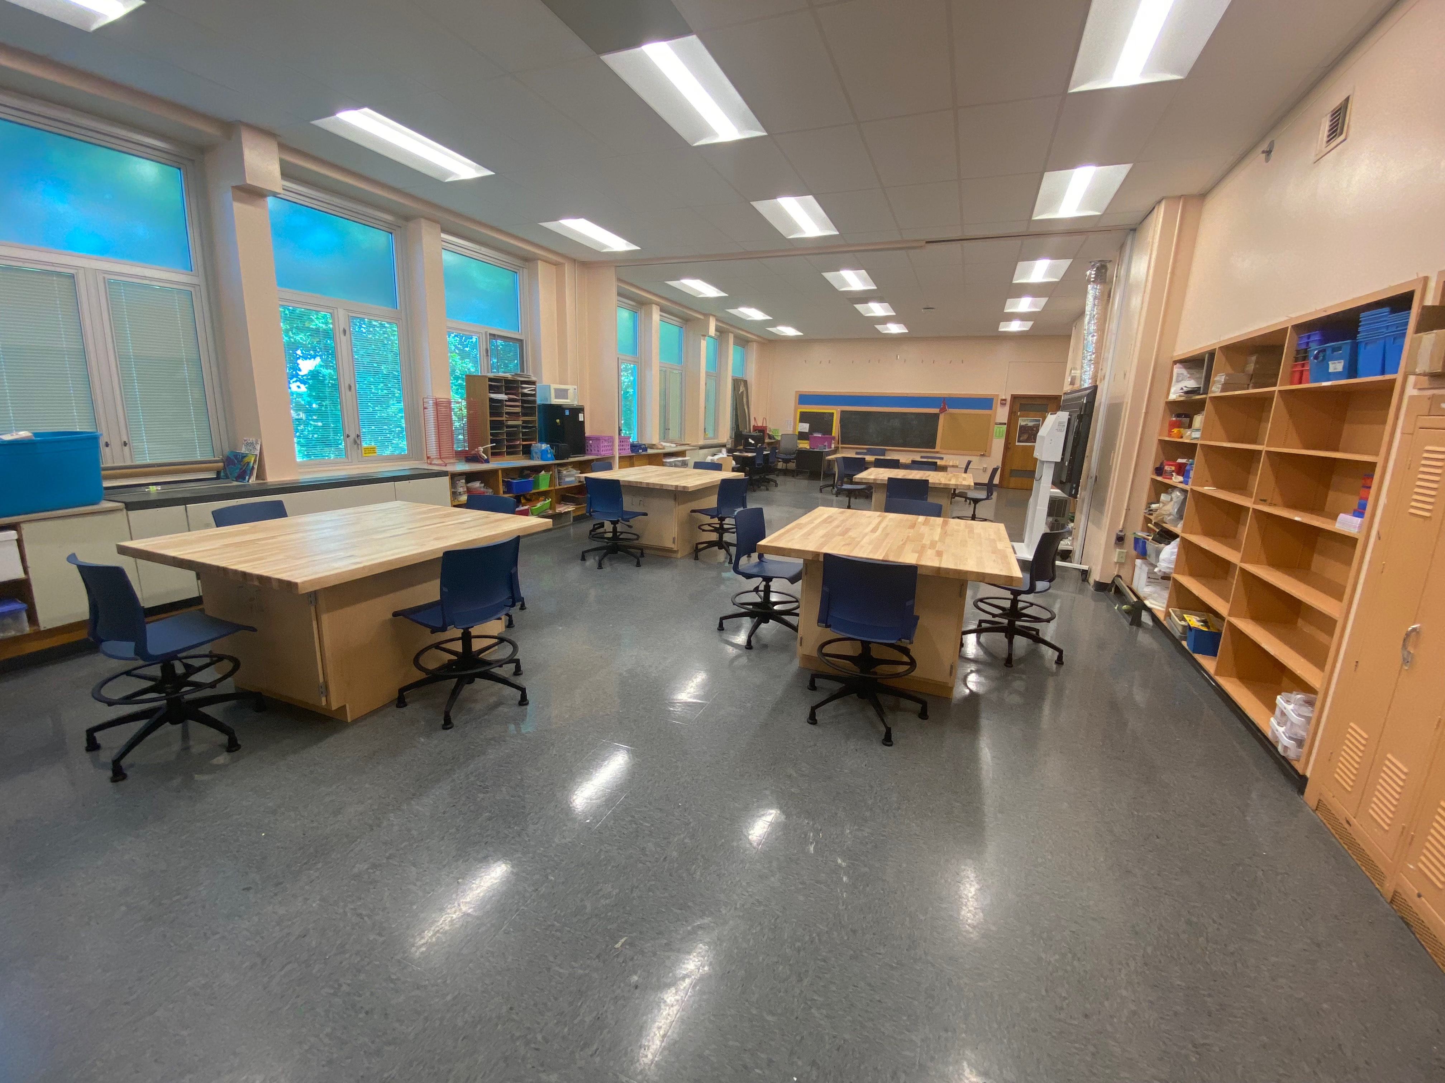
Monica Leister’s Elementary- High School Art Classroom
Notes:
Image: Courtesy of Monica Leister.

Slide 18
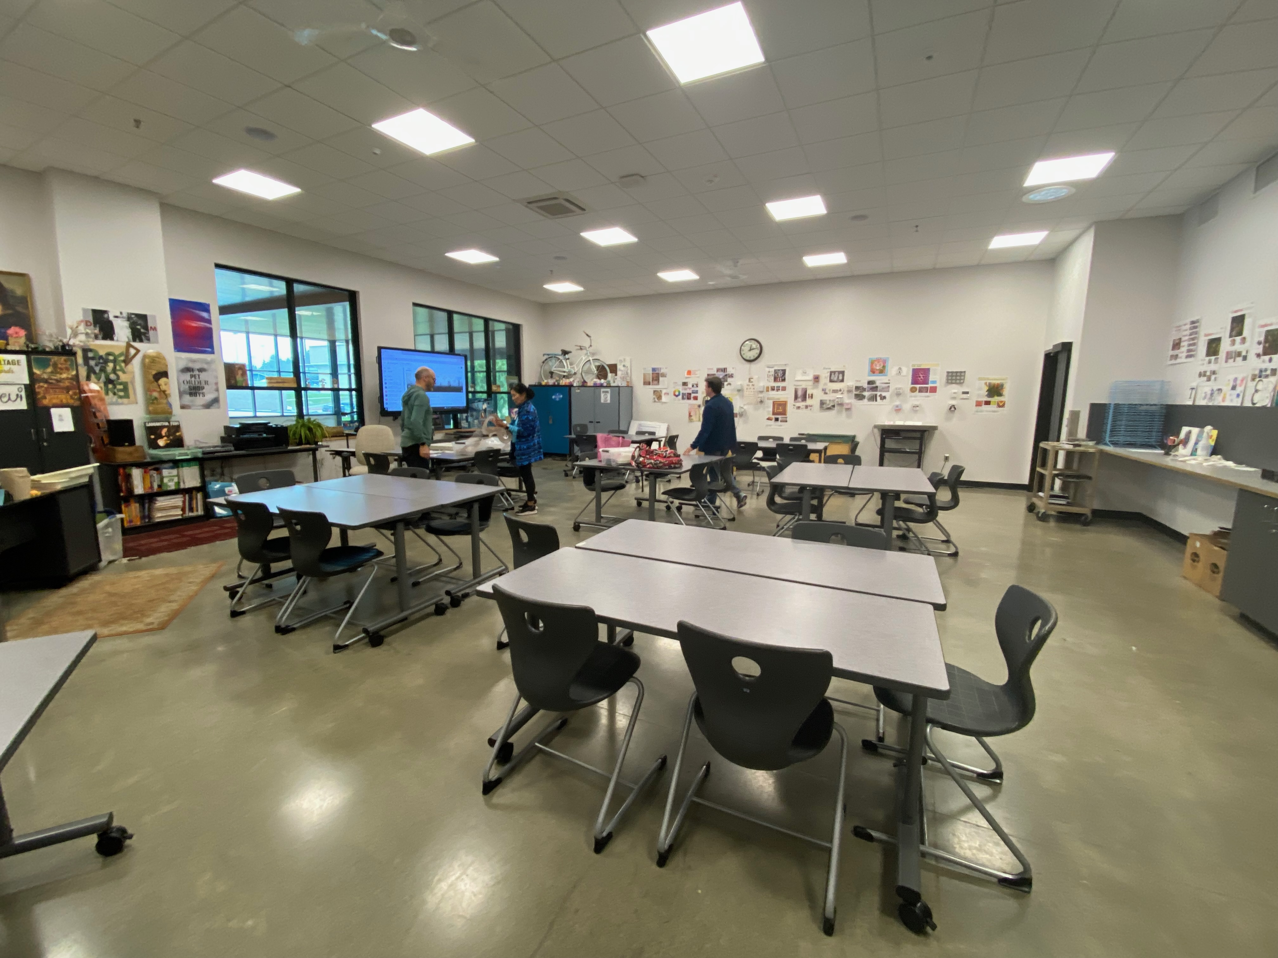
David Cassel’s High School Art Classroom
Notes:
Image: David Cassel’s classroom. Norbert Voigt, photo.

Slide 19
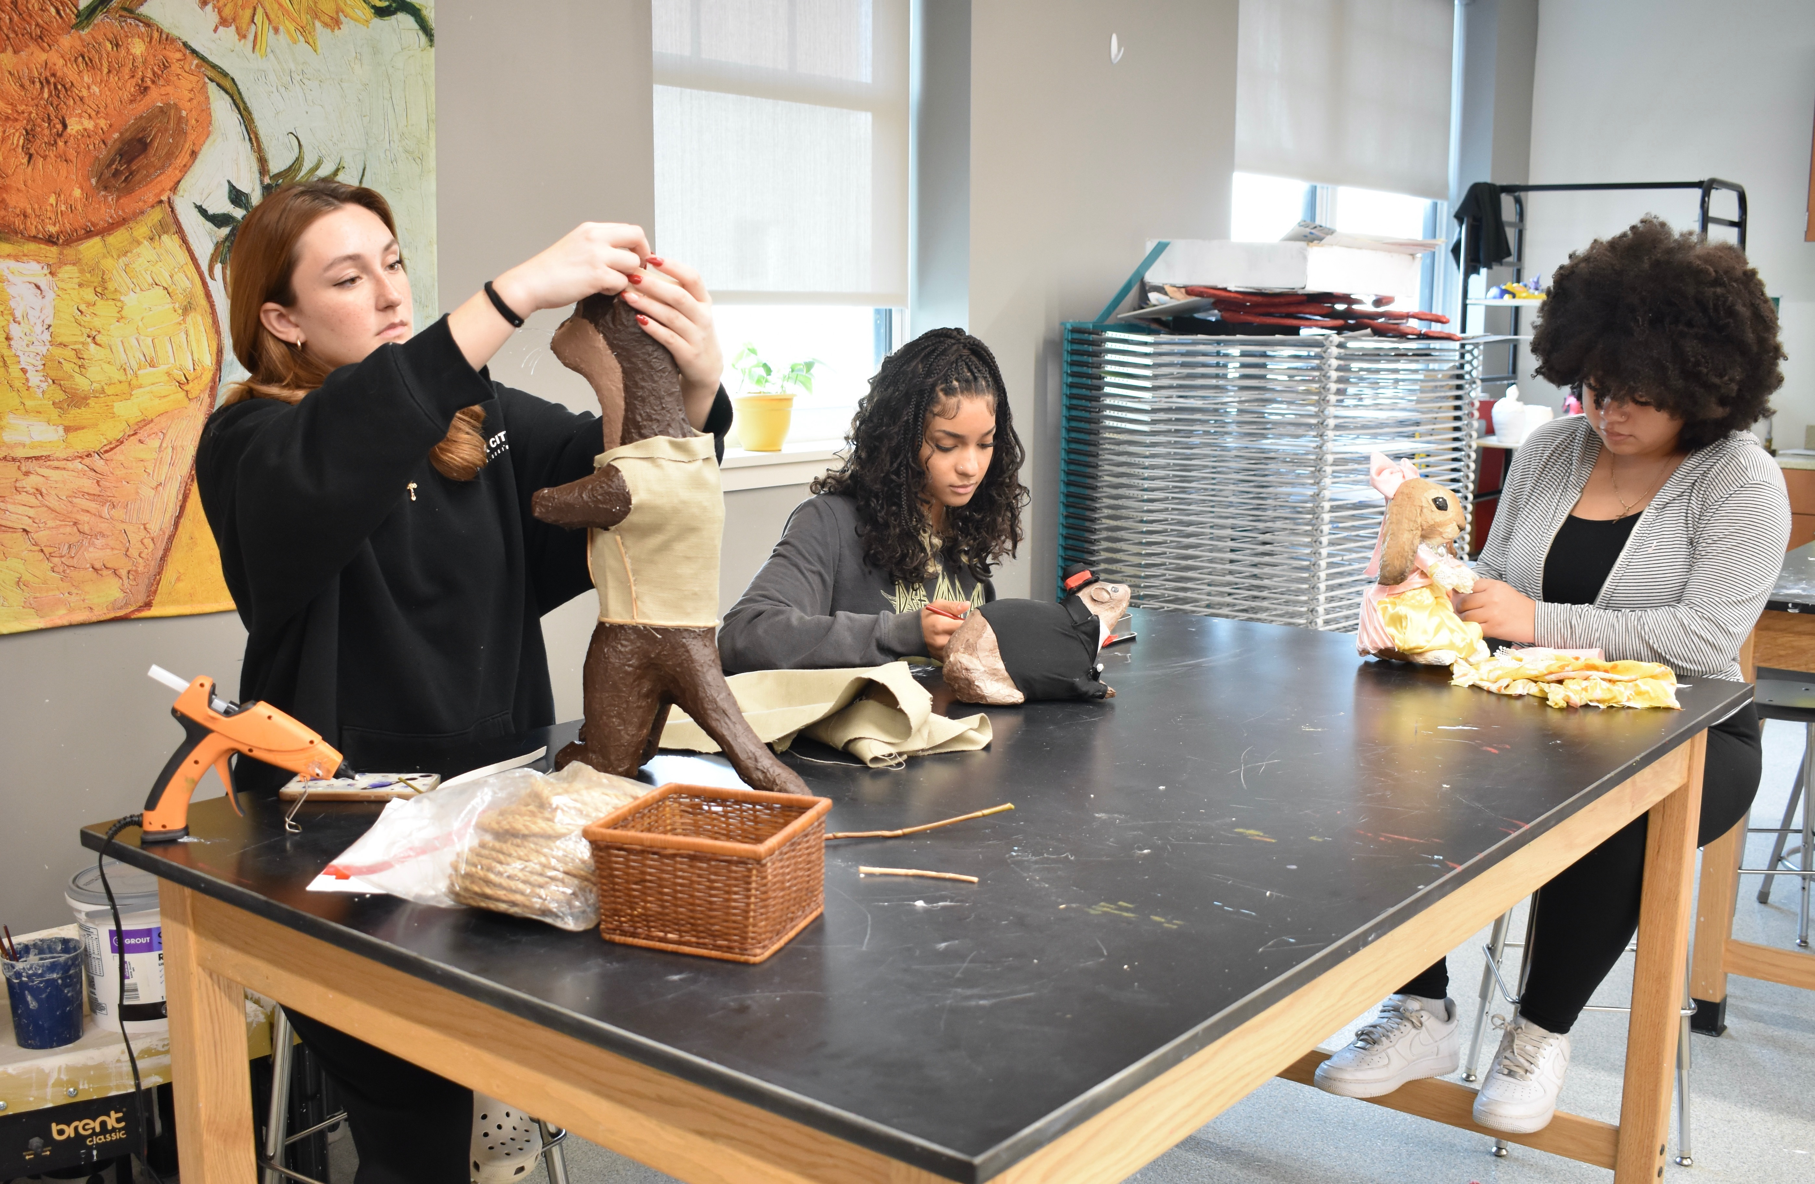
Brianna Shetzler’s High School Classroom
Notes:
Image: Courtesy of Brianna Shetzler.

Slide 20
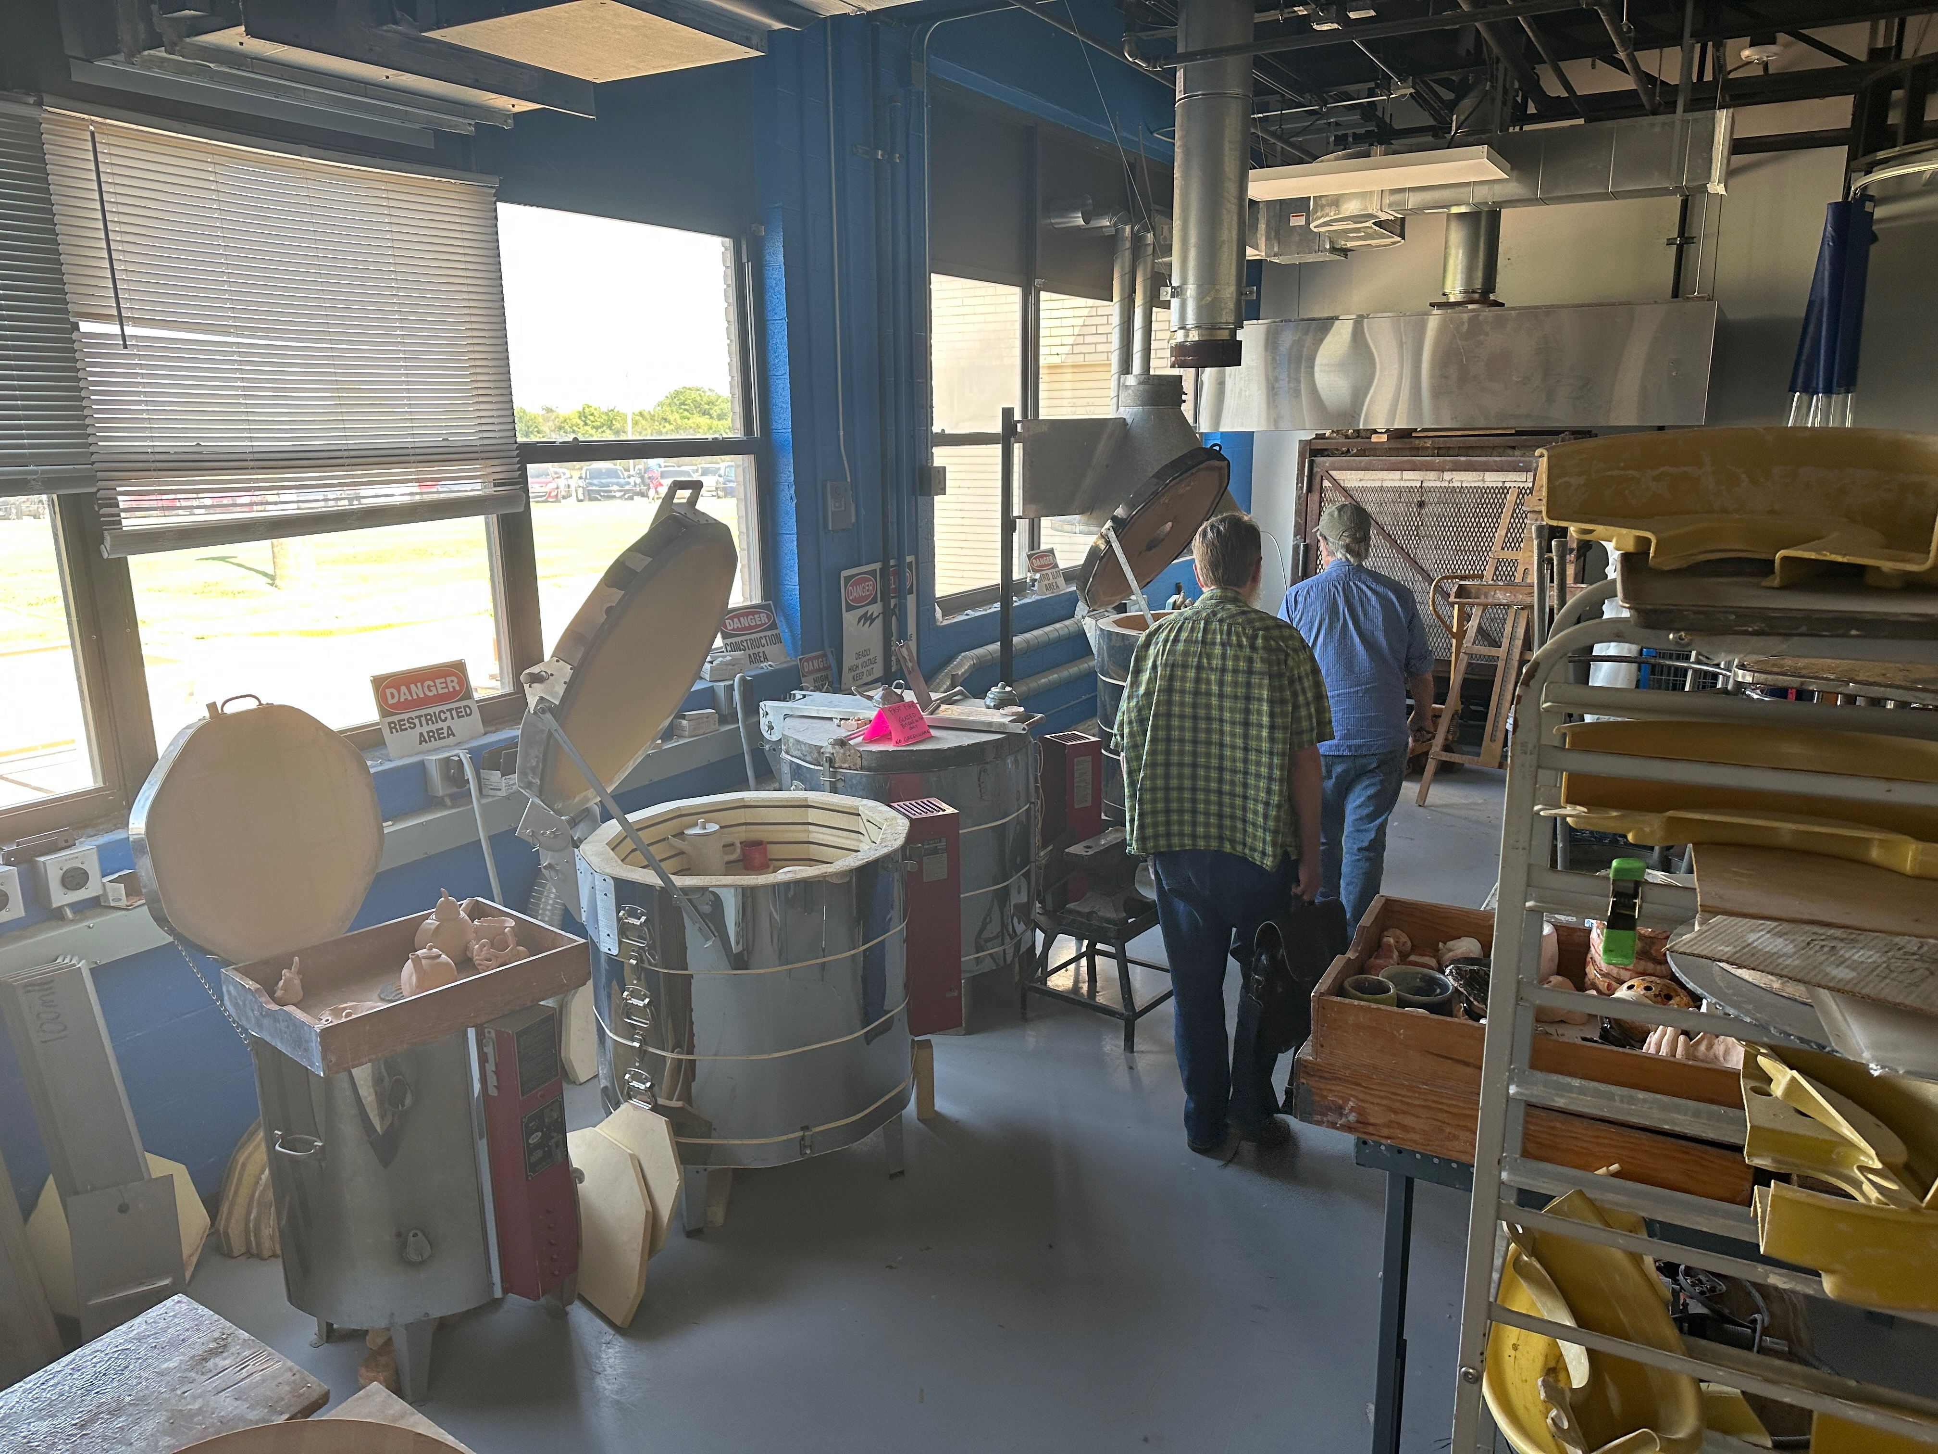
Paul Sweeney’s AP
High Art School Classroom
Notes:
Image: Courtesy of Mike Muller.

Slide 21
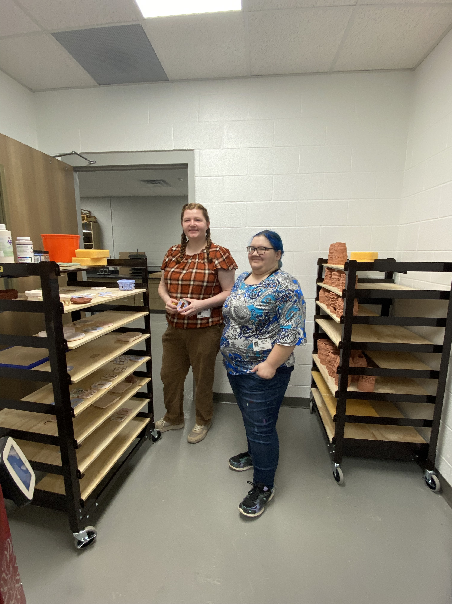
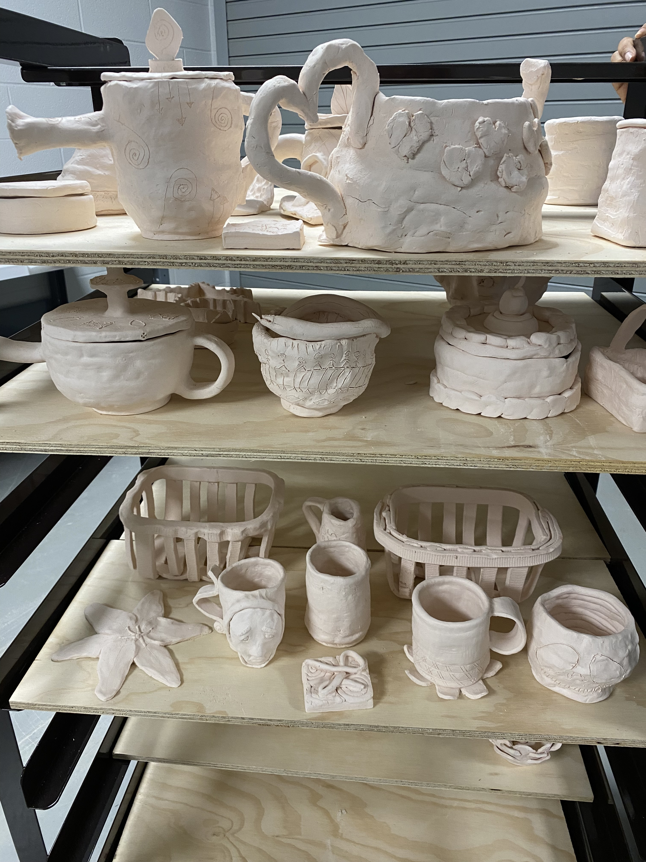
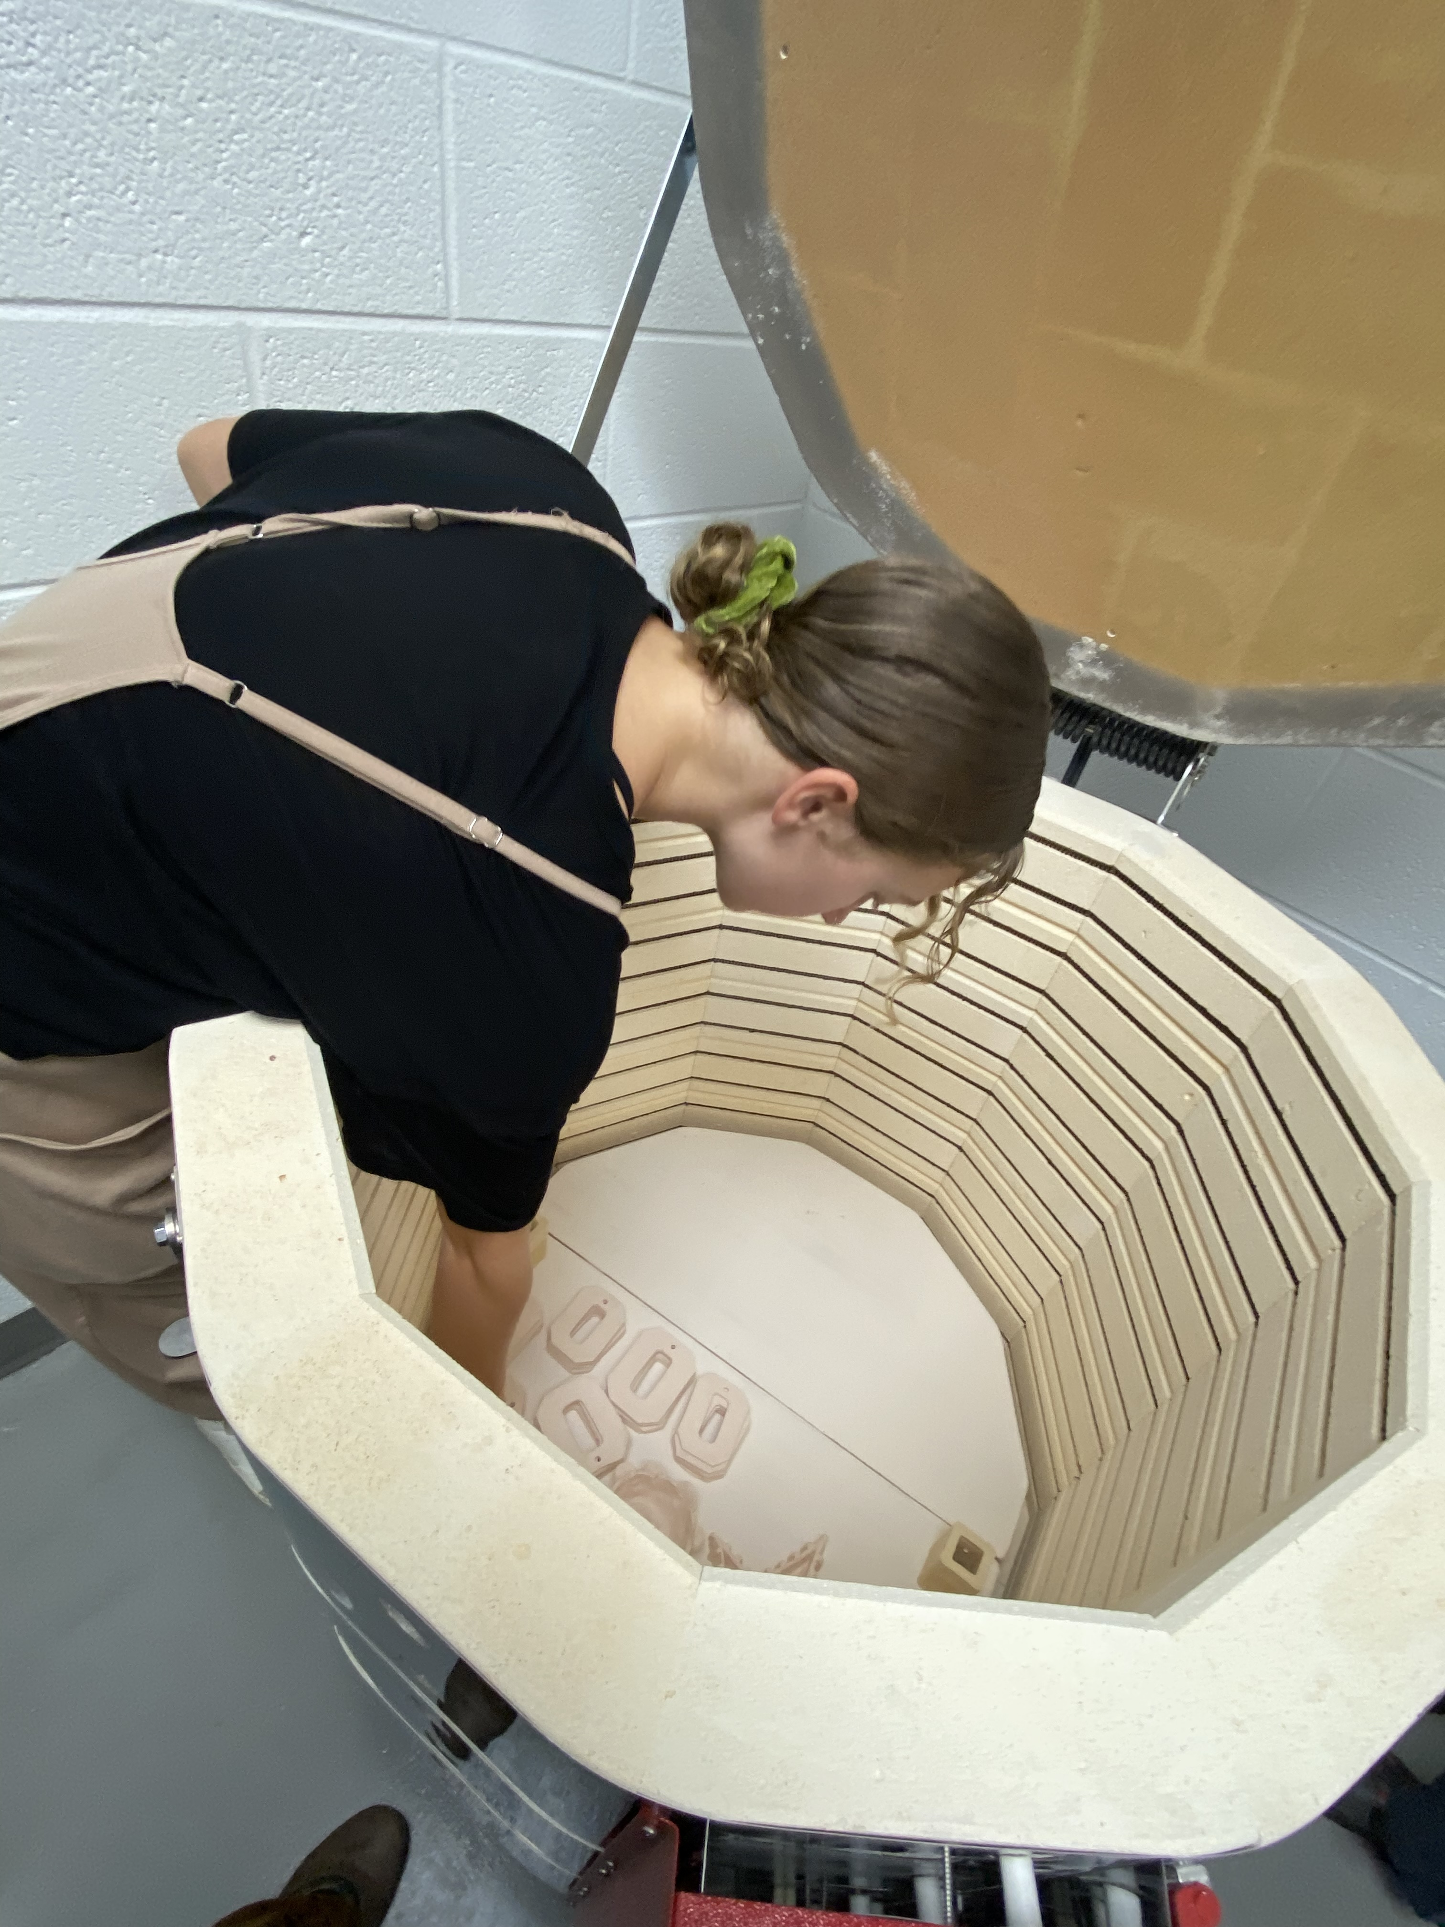
Jonathan Griffith and Frank Baugh
High Art School Ceramics
Notes:
Images: Jonathan Griffith and Frank Baugh’s ceramic areas. Author, photos.

Slide 22
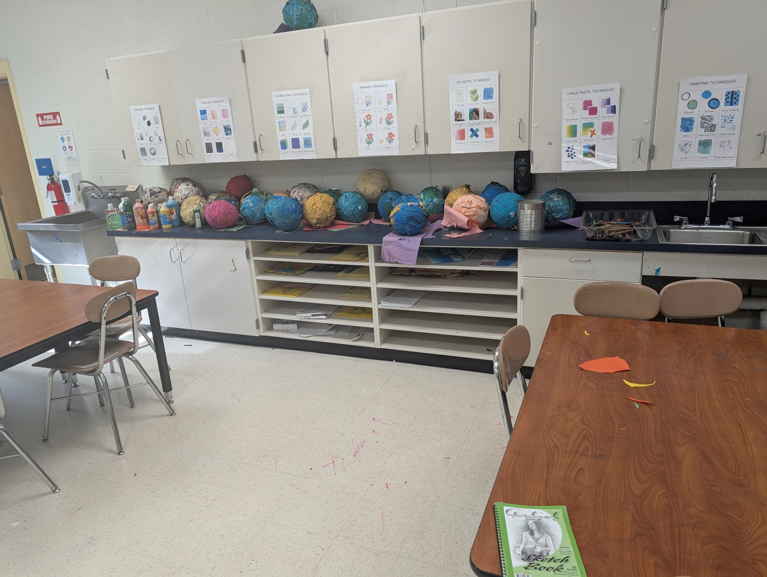
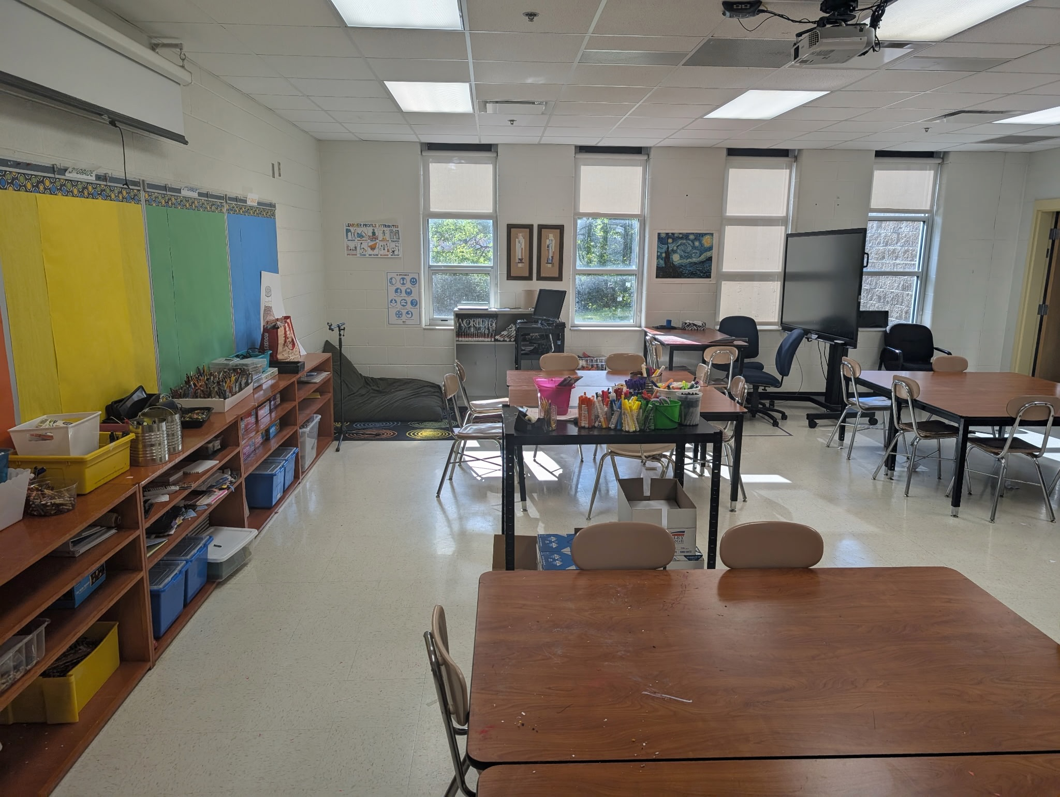
Ted Edinger’s Classroom
Before Its Transformation
Notes:
Images: Courtesy of Ted Edinger, Mr. E.

Slide 23
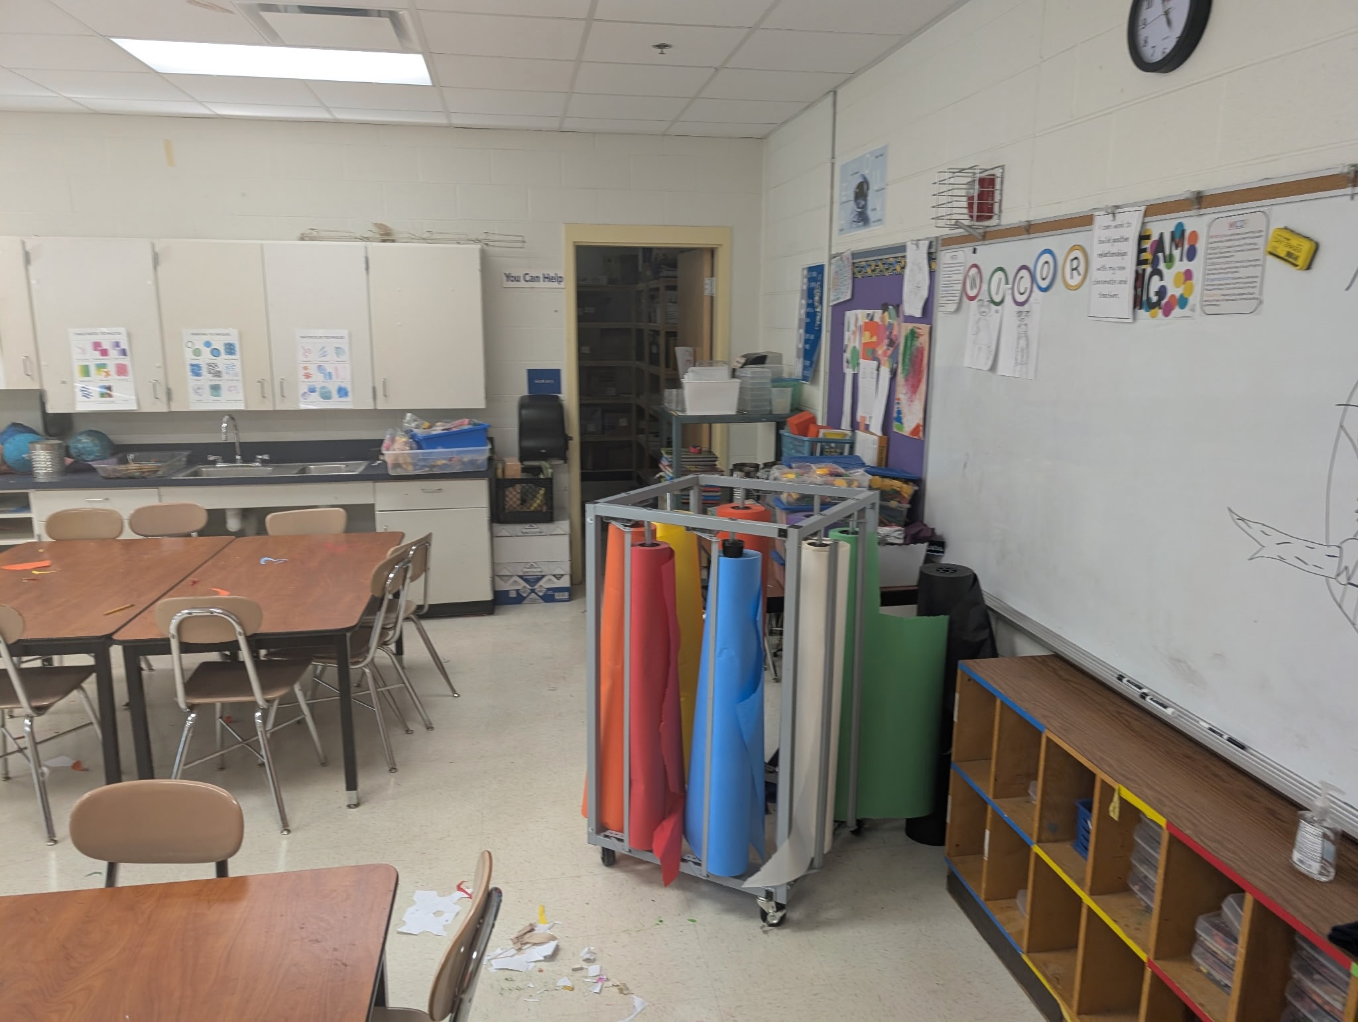
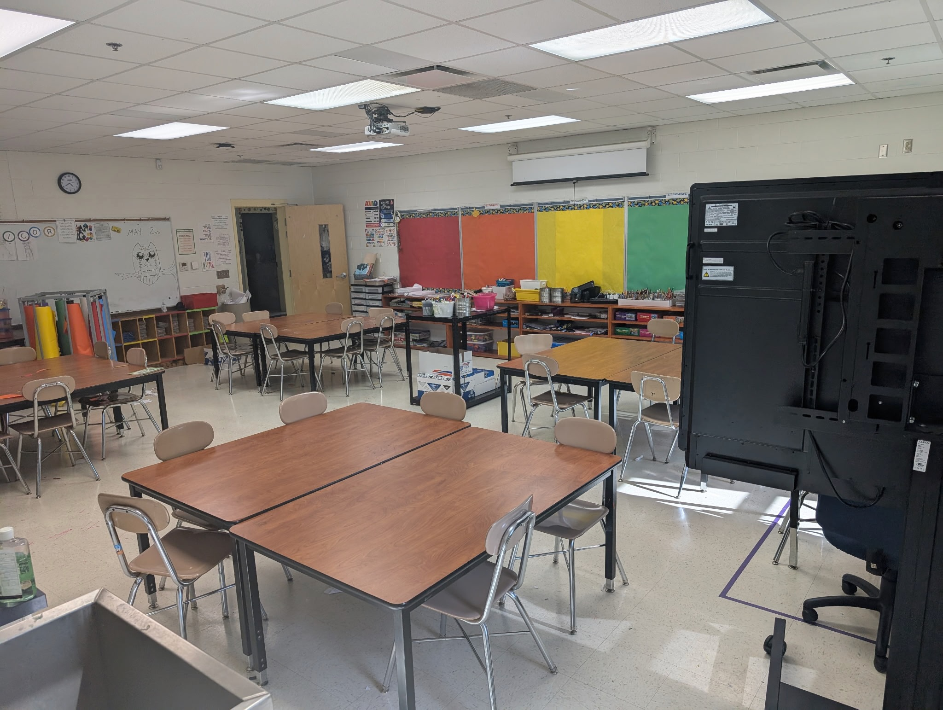
Ted Edinger’s Classroom
Before Its Transformation
Notes:
Images: Courtesy of Ted Edinger, Mr. E.

Slide 24
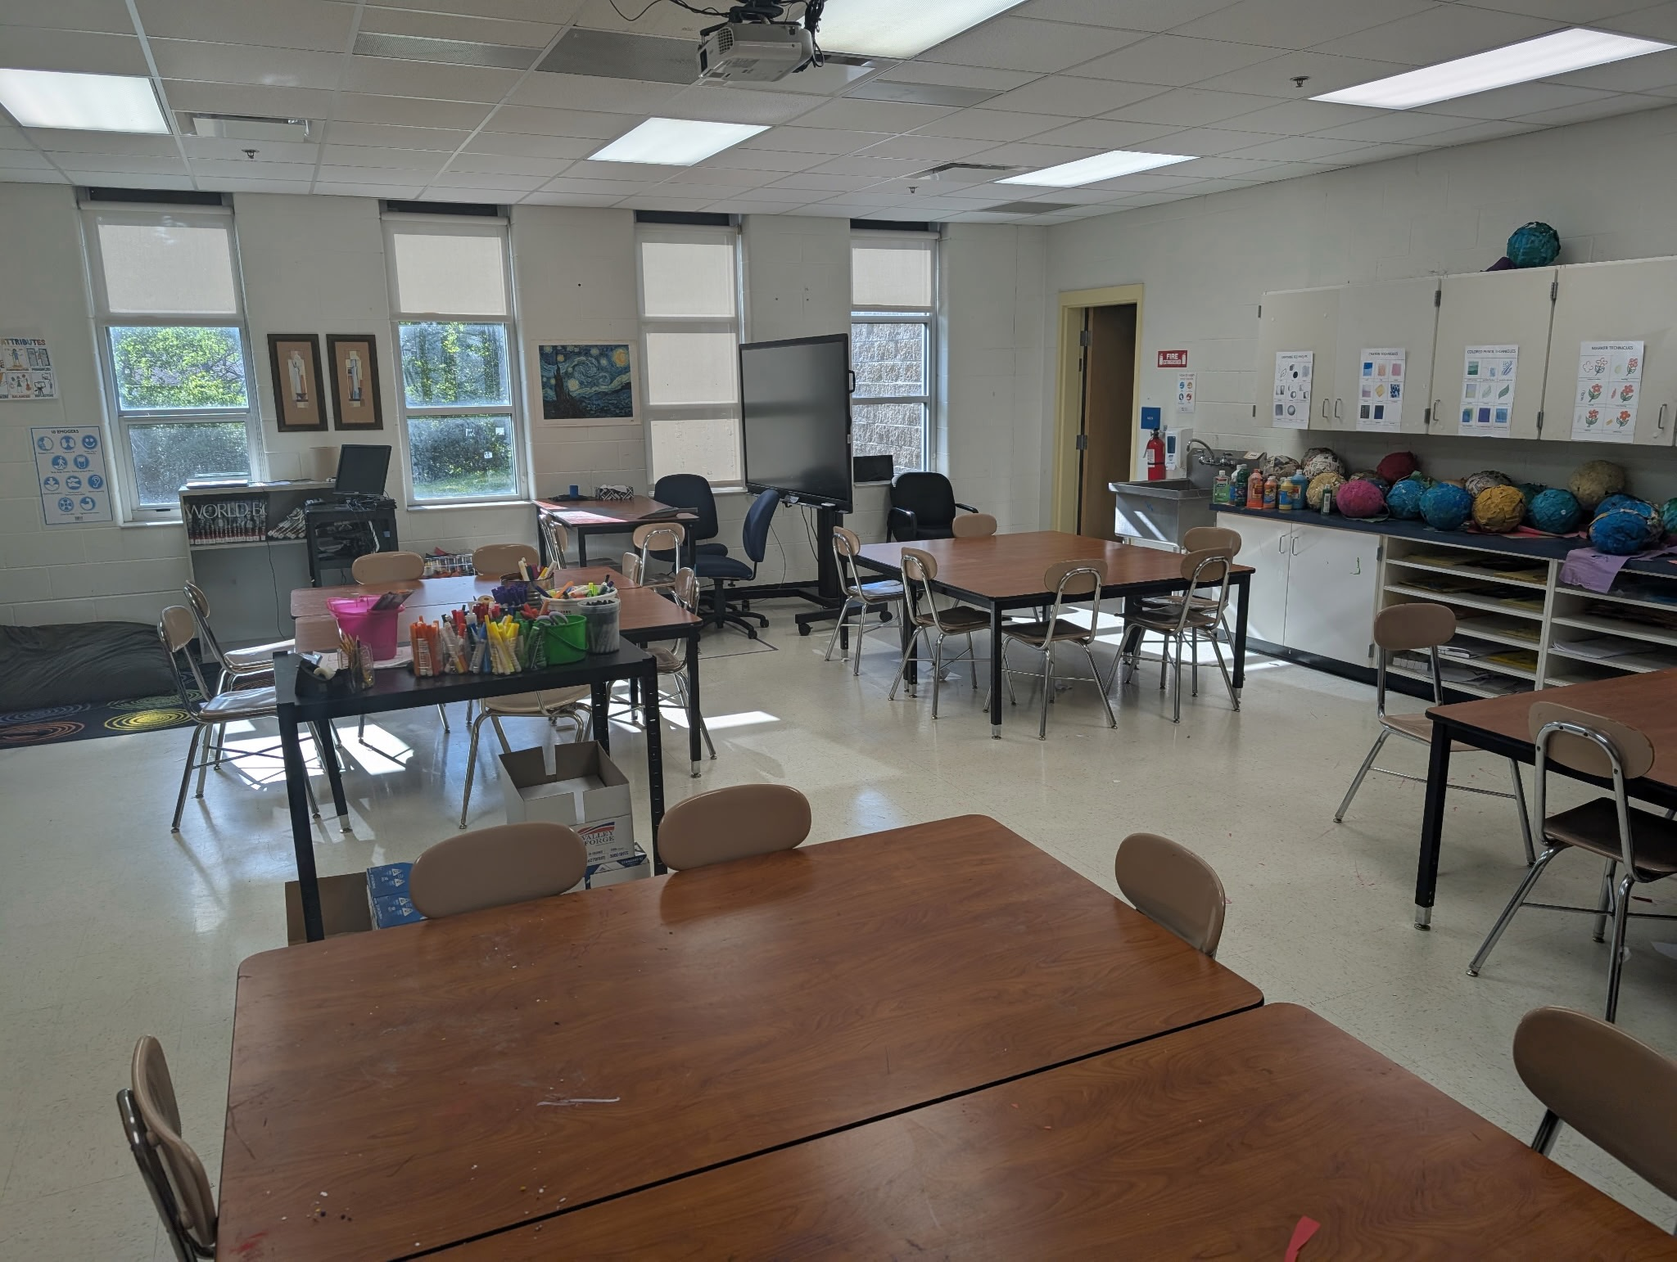
Ted Edinger’s Classroom
Before
Its Transform-ation
Notes:
Image: Courtesy of Ted Edinger, Mr. E.

Slide 25
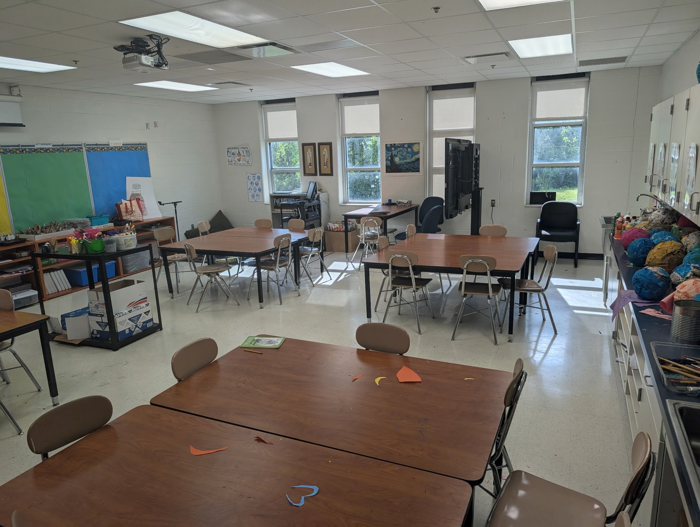
Ted Edinger’s Classroom
Before
Its Transform-ation
Notes:
Image: Courtesy of Ted Edinger, Mr. E.

Slide 26
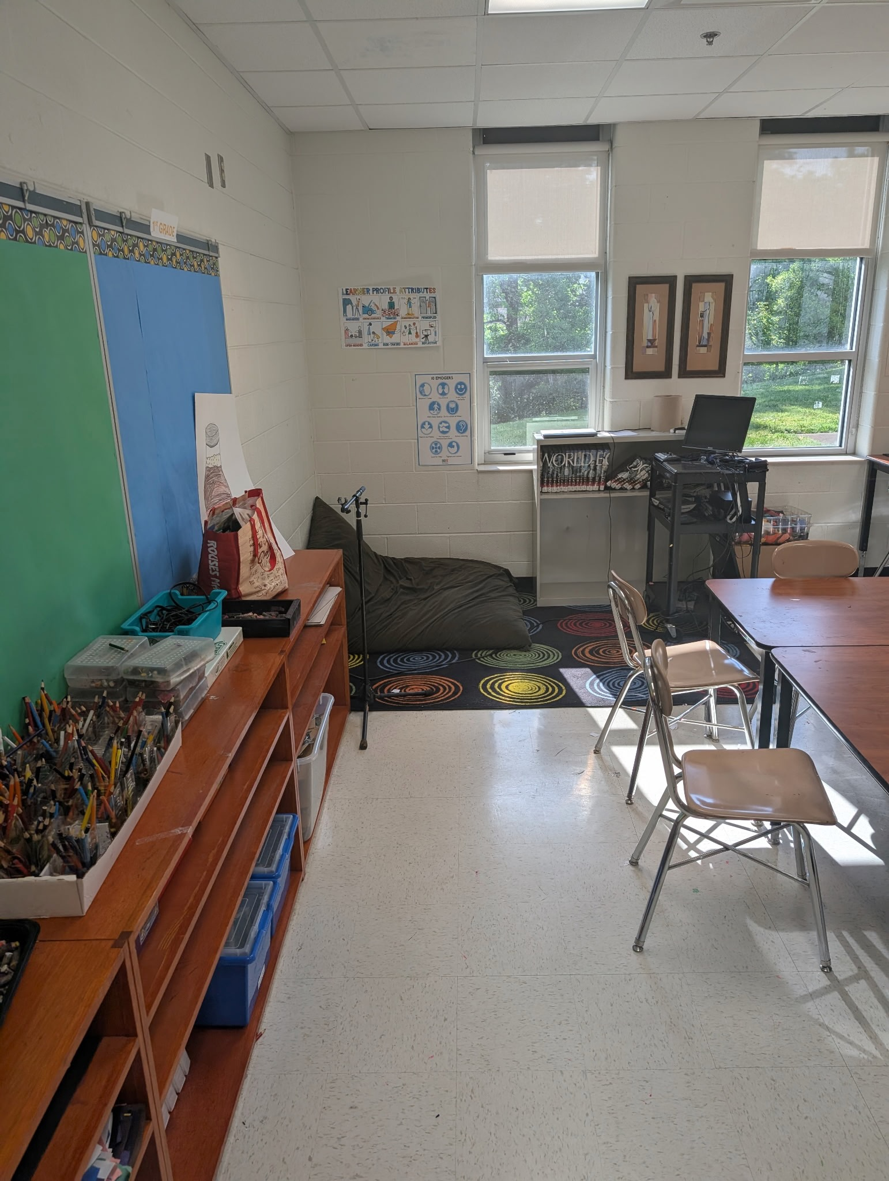
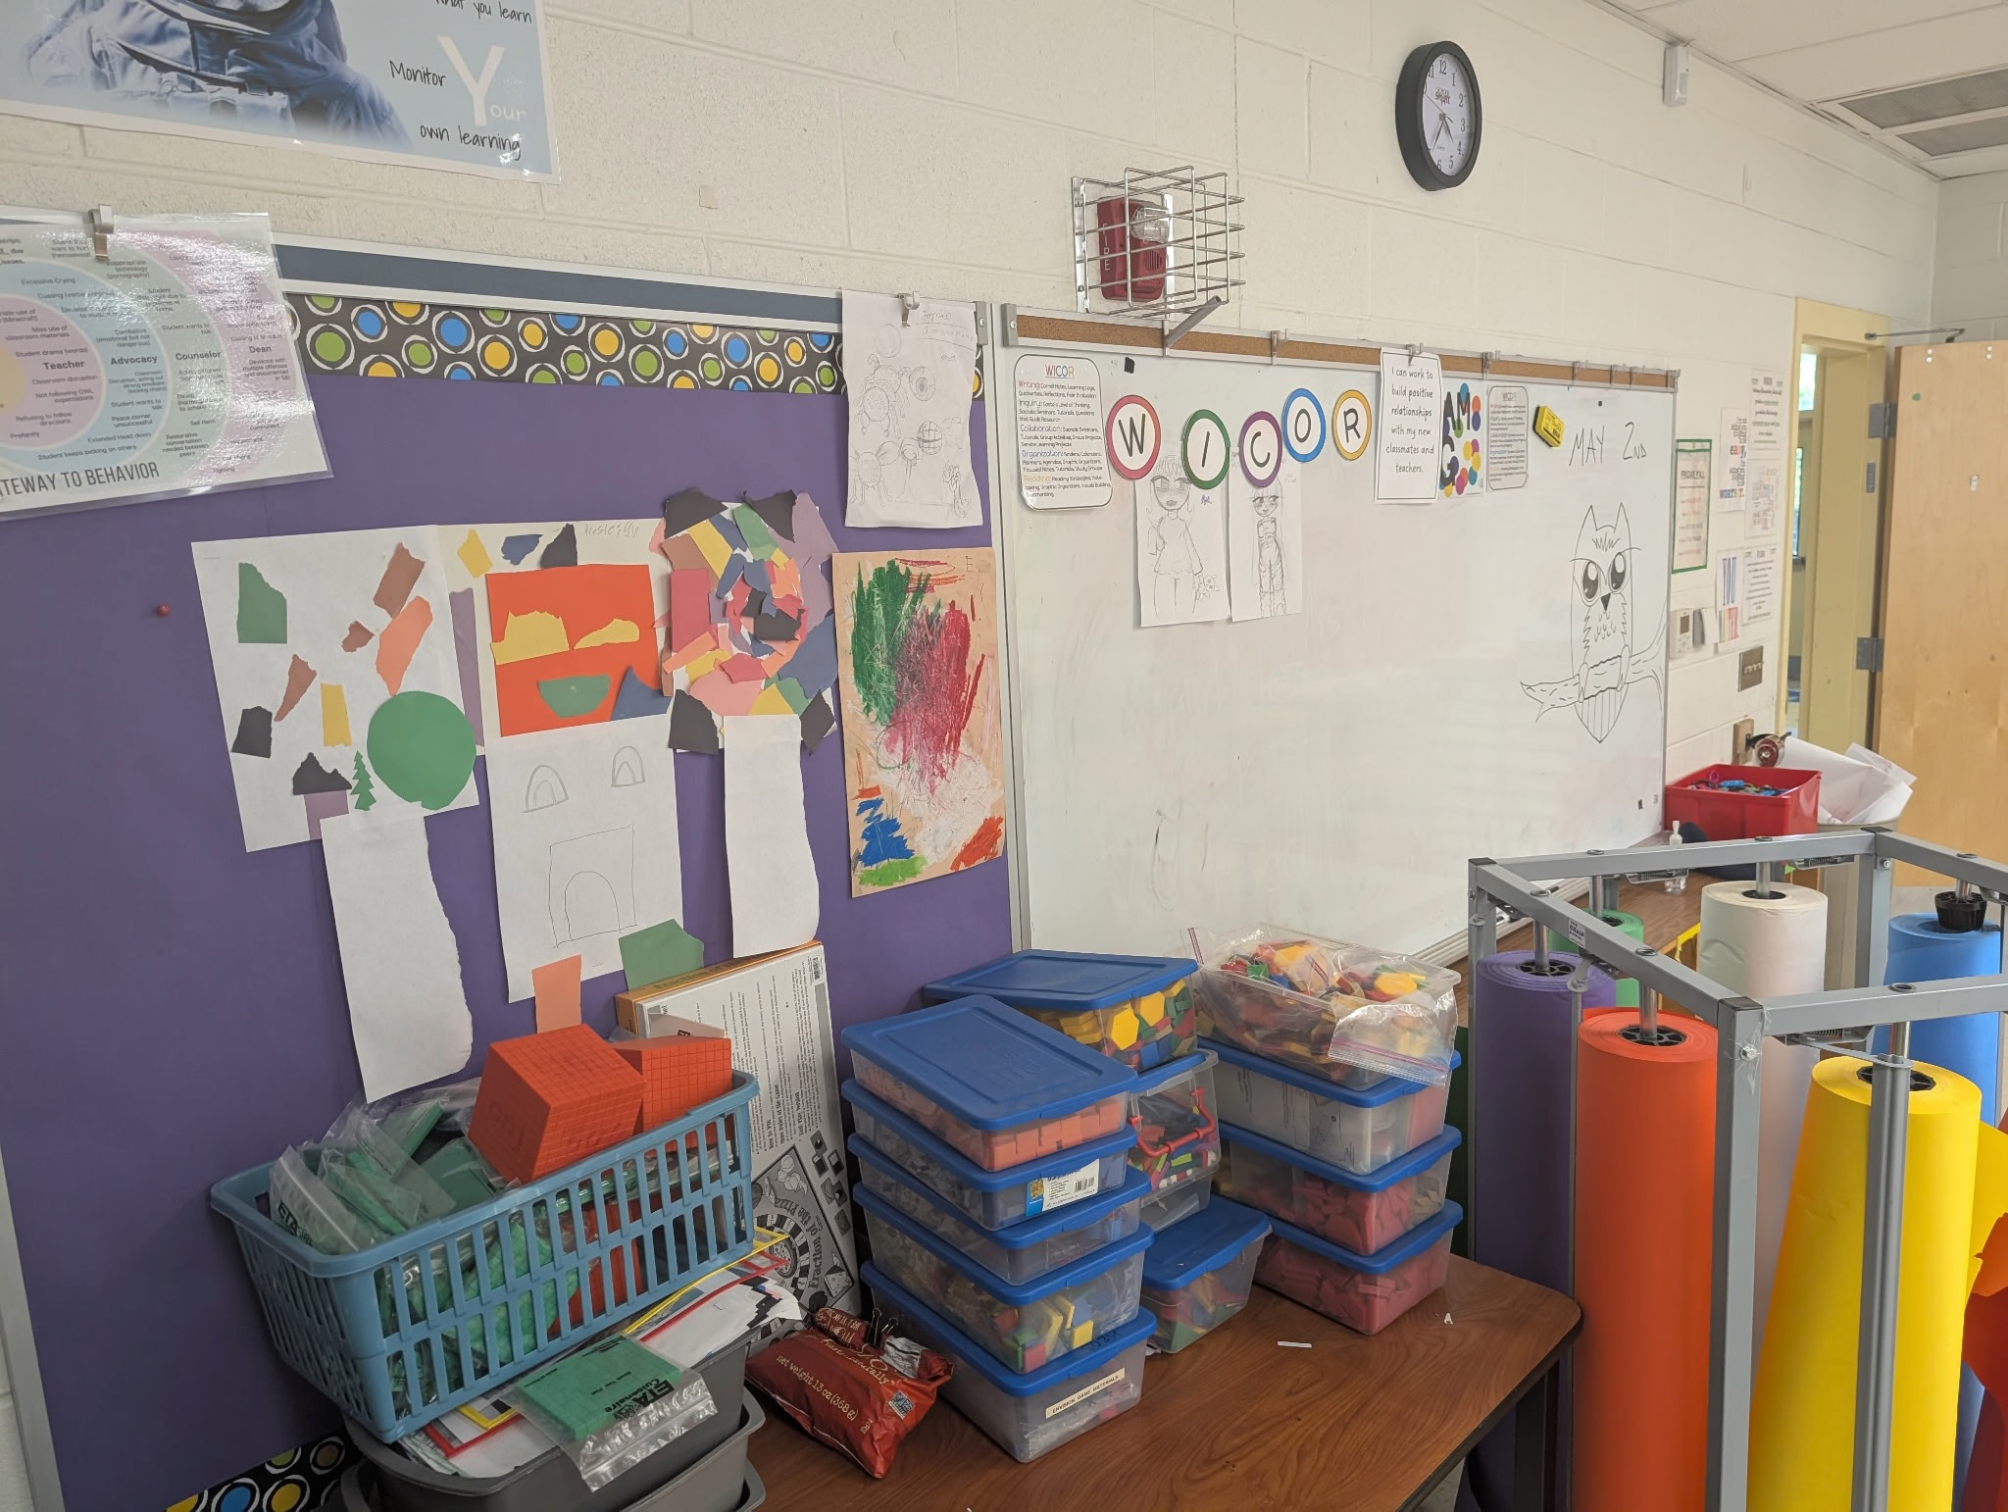
Ted Edinger’s Classroom
Before Its Transformation
Notes:
Images: Courtesy of Ted Edinger, Mr. E.

Slide 27
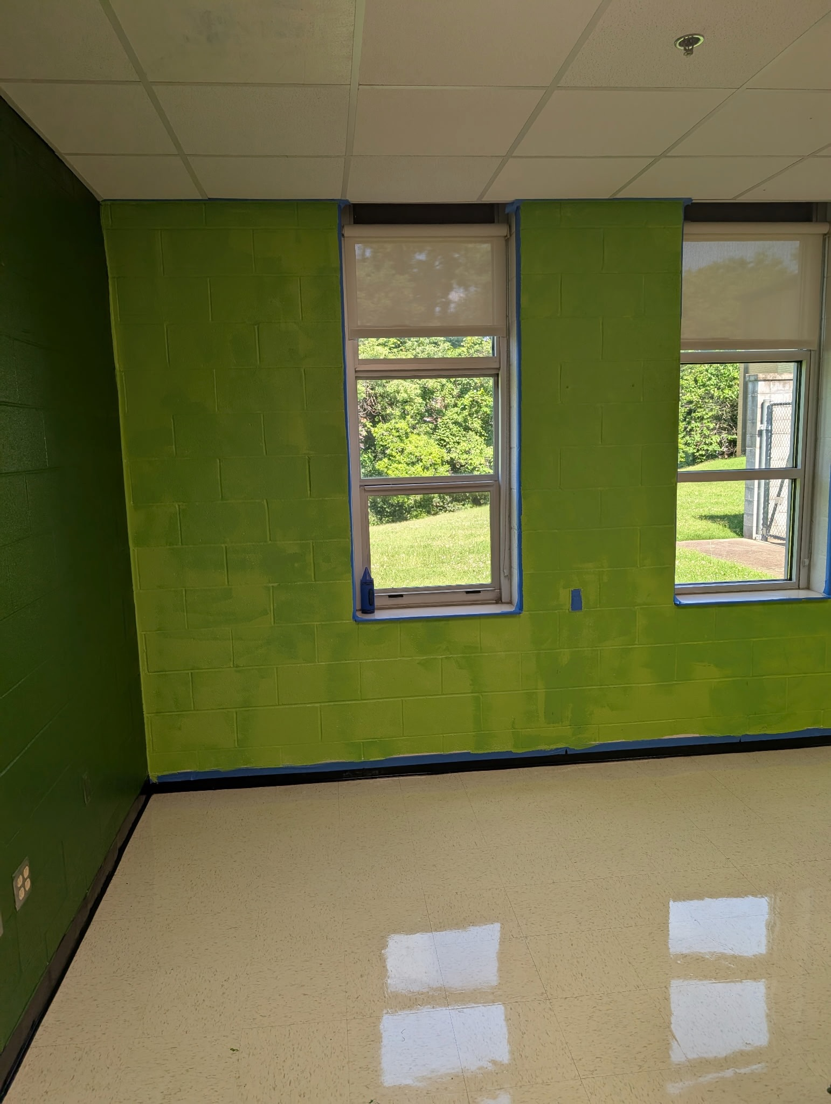
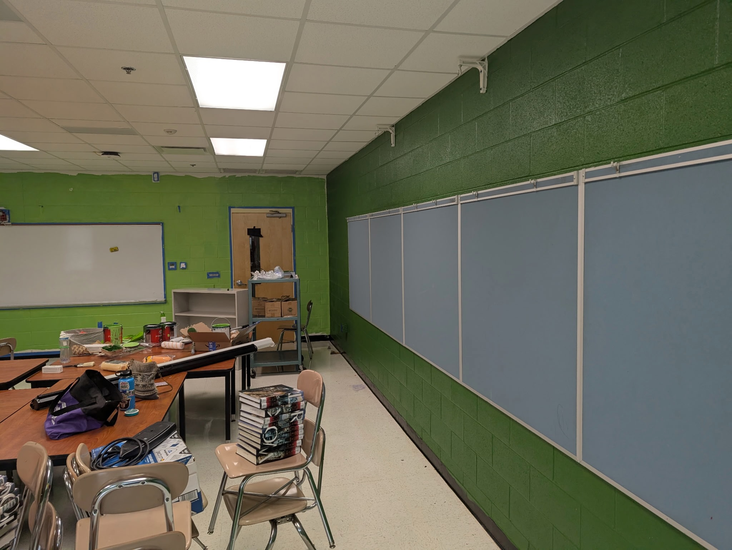
Ted Edinger’s Classroom
During Its Transformation
Notes:
Note: The store gave Mr. E two different colors of what was supposed to be the same light green color of paint. He had to repaint the walls so they would have only one light green hue.
Images: Courtesy of Ted Edinger, Mr. E.

Slide 28
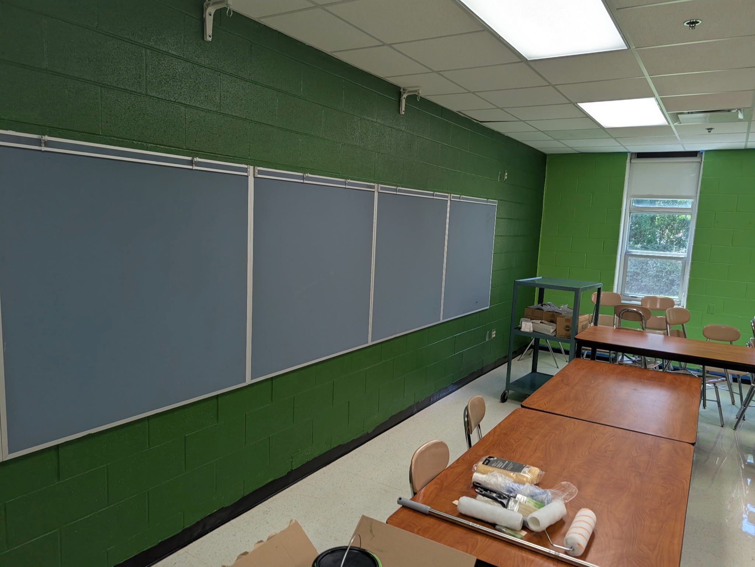
Ted Edinger’s Classroom
Before
Its Transform-ation
Notes:
Image: Courtesy of Ted Edinger, Mr. E.

Slide 29
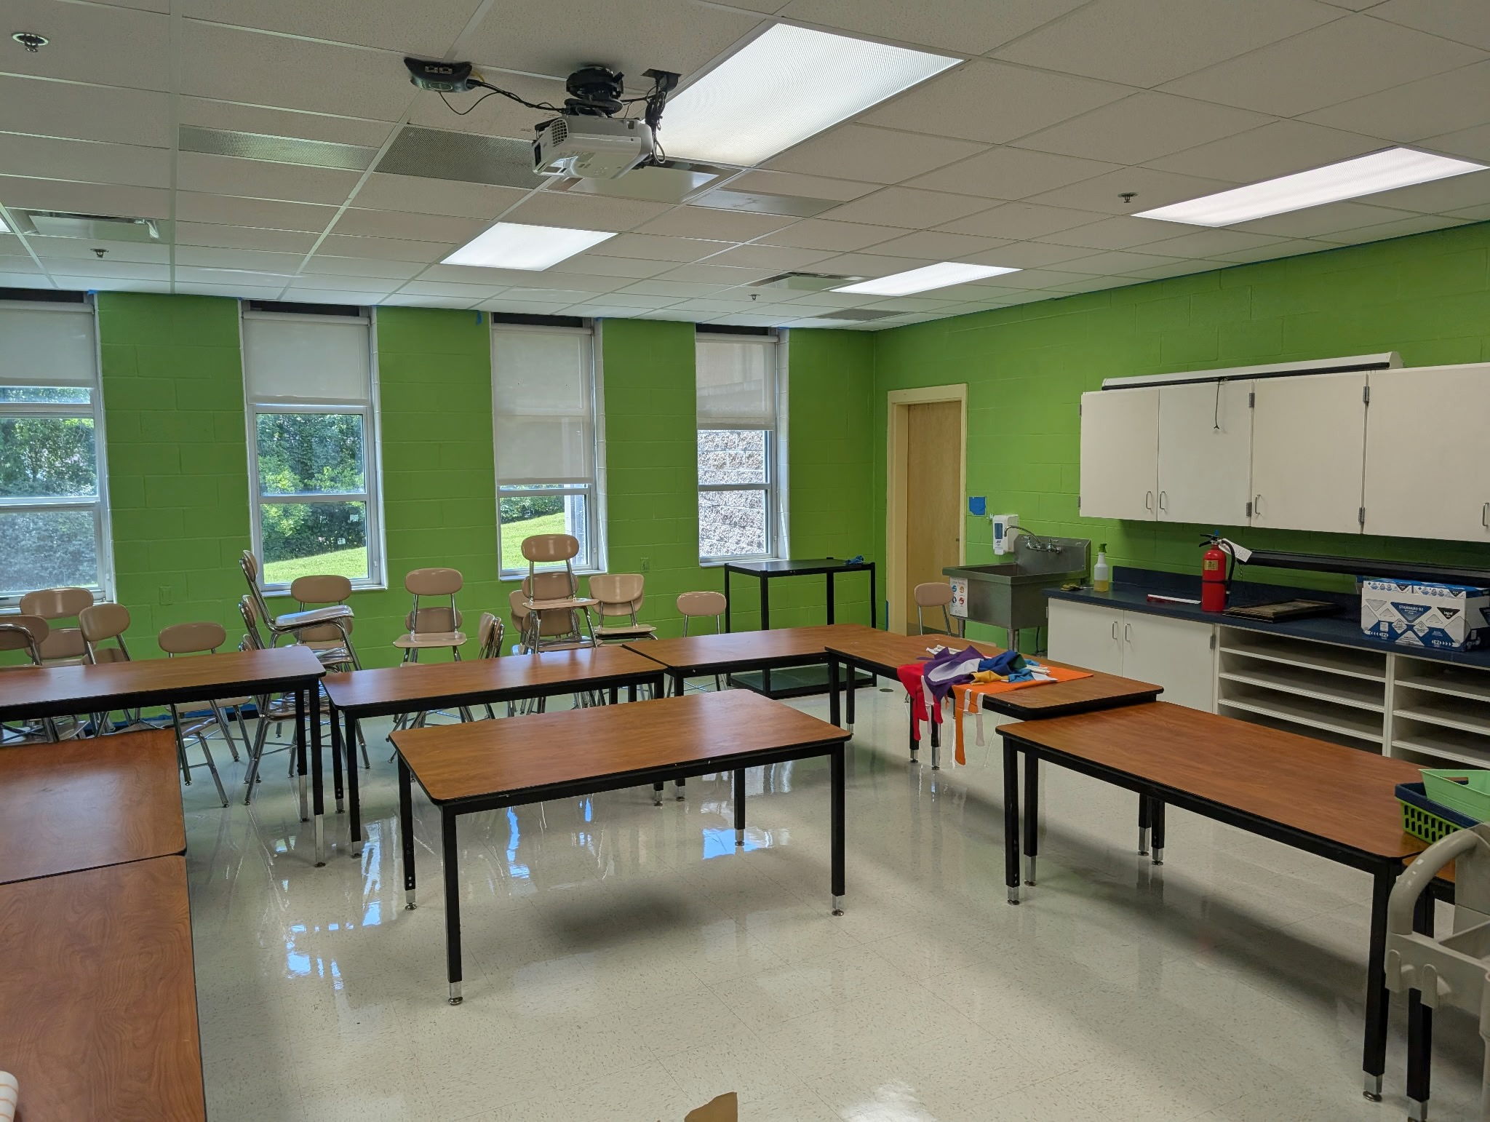
Ted Edinger’s Classroom
Comparison
Notes:
Images: Courtesy of Ted Edinger, Mr. E.

Slide 30
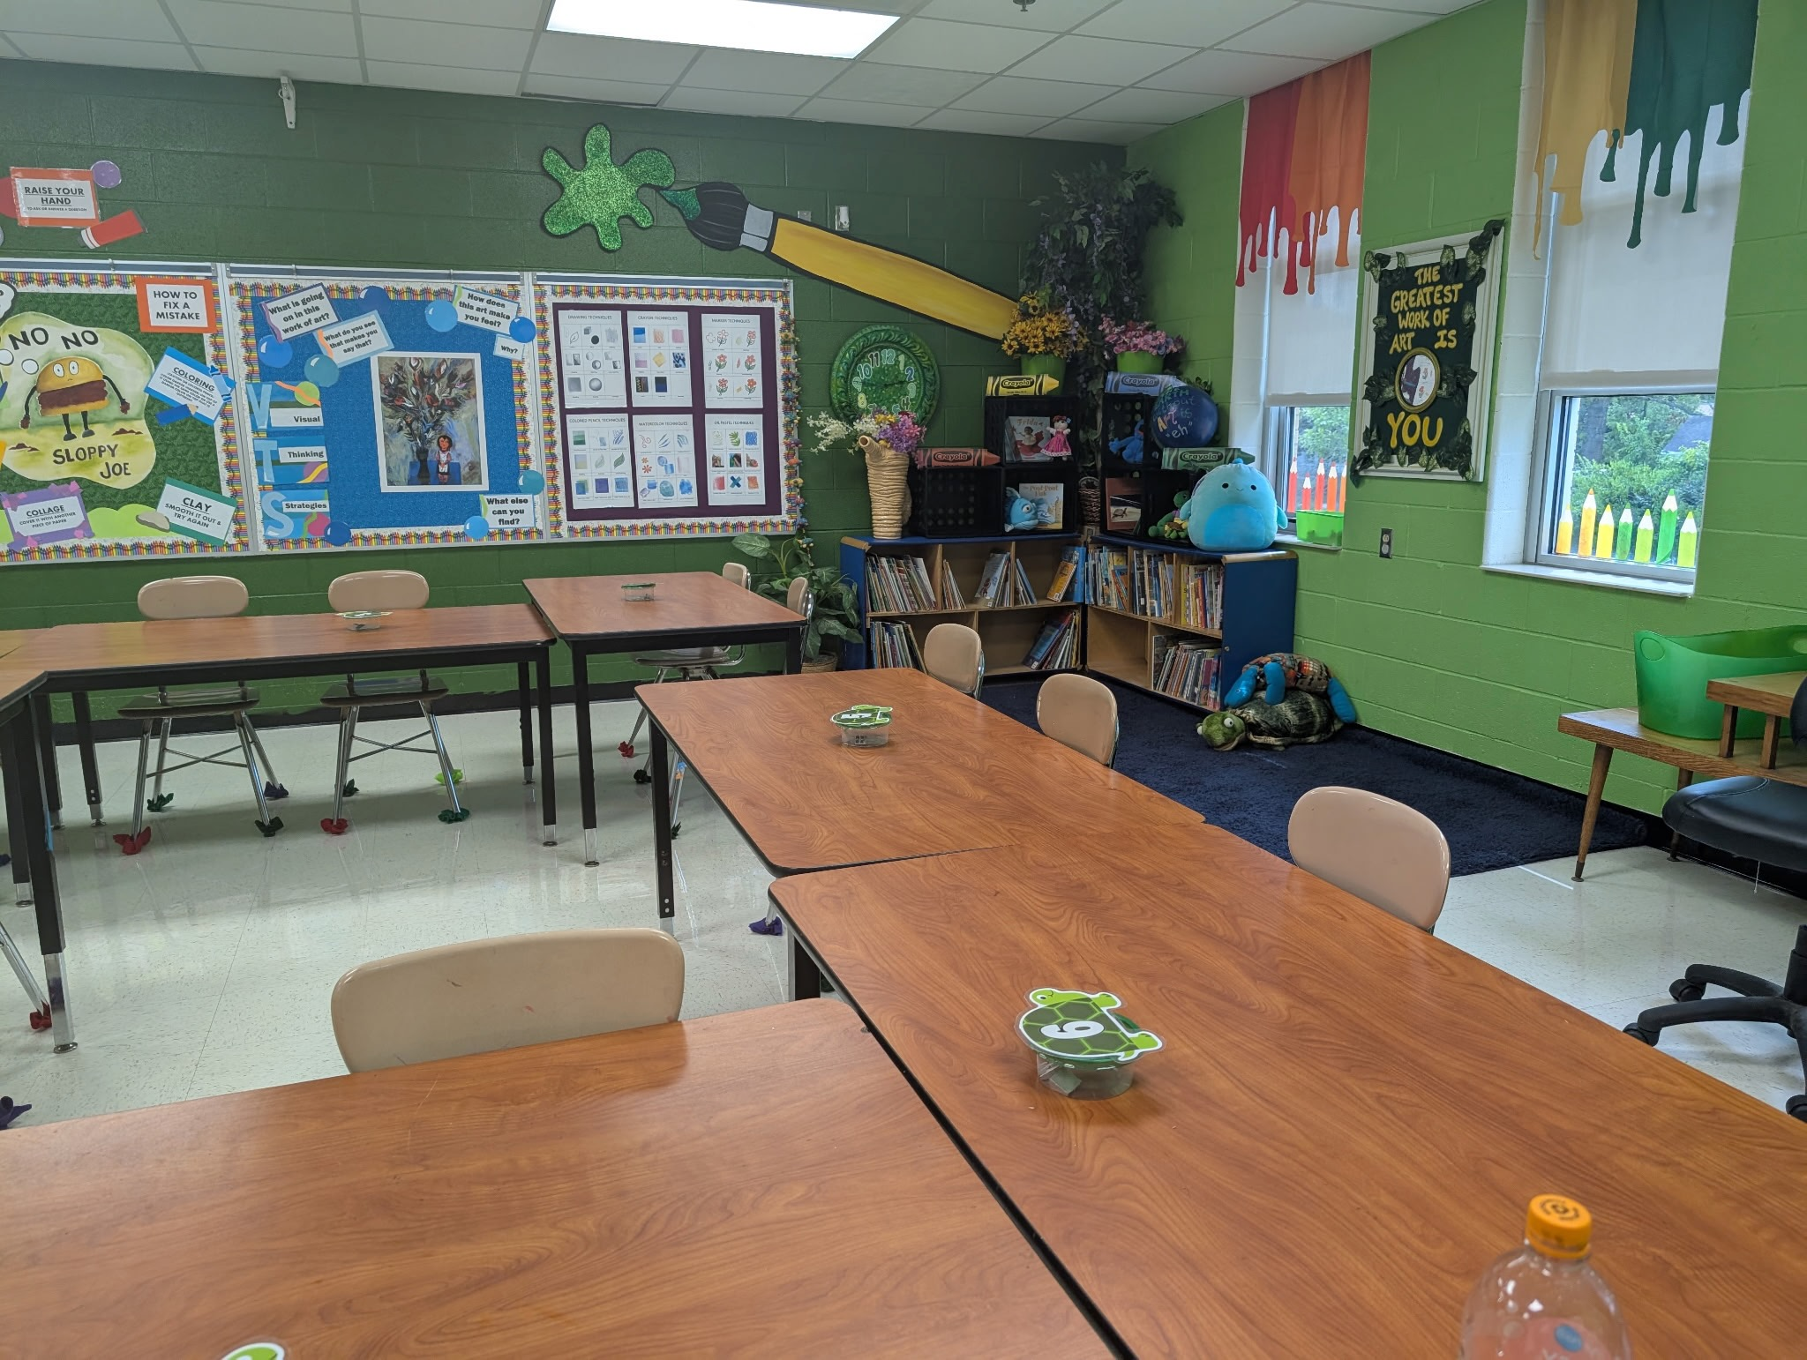
Ted Edinger’s Classroom
Completed Transform-ation
Notes:
Image: Courtesy of Ted Edinger, Mr. E.

Slide 31
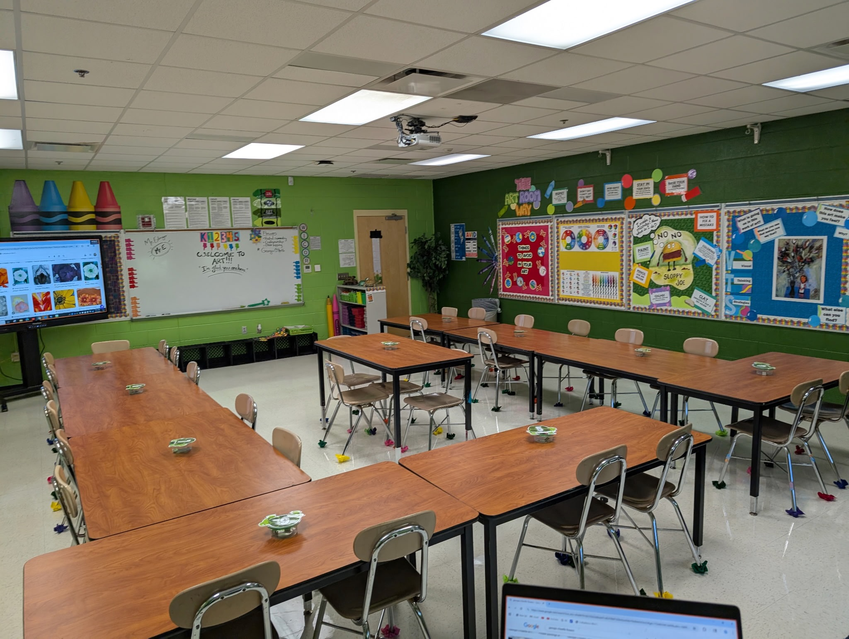
Ted Edinger’s Classroom
Completed Transform-ation
Notes:
Image: Courtesy of Ted Edinger, Mr. E.

Slide 32
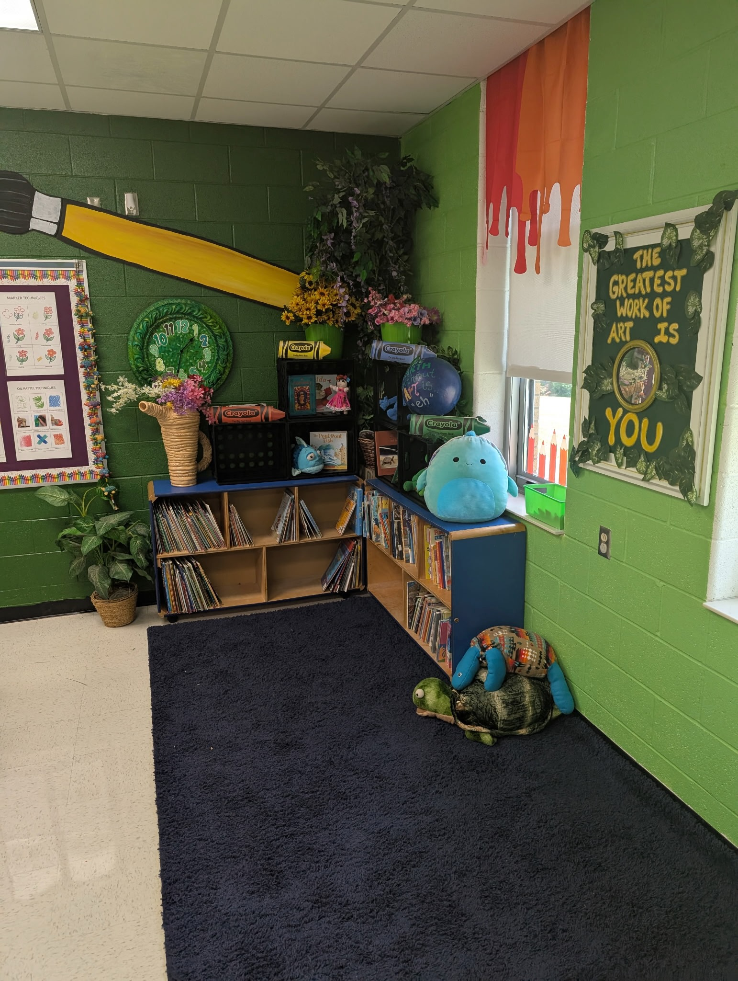
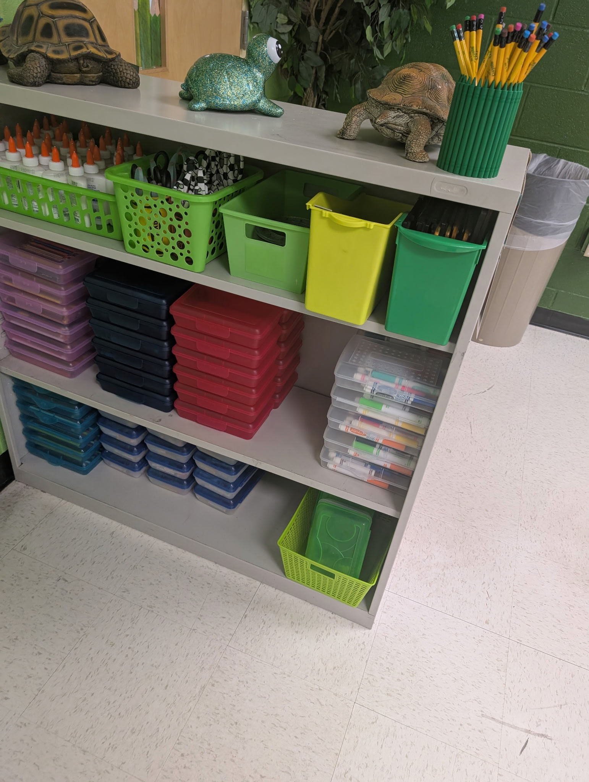
Ted Edinger’s Classroom
Completed Trans-formation
Notes:
Images: Courtesy of Ted Edinger, Mr. E.

Slide 33
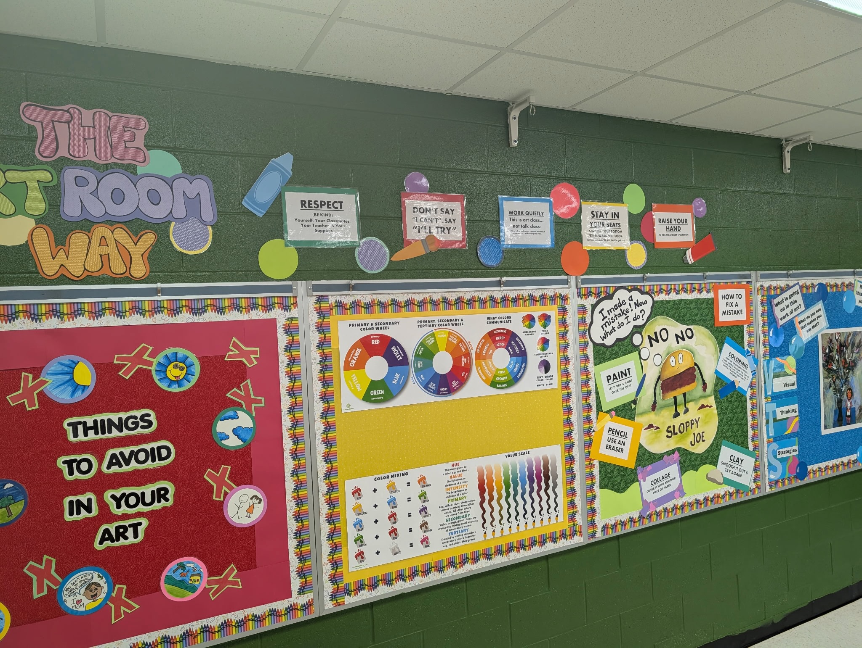
Ted Edinger’s Classroom
Completed Transform-ation
Notes:
Image: Courtesy of Ted Edinger, Mr. E.

Slide 34
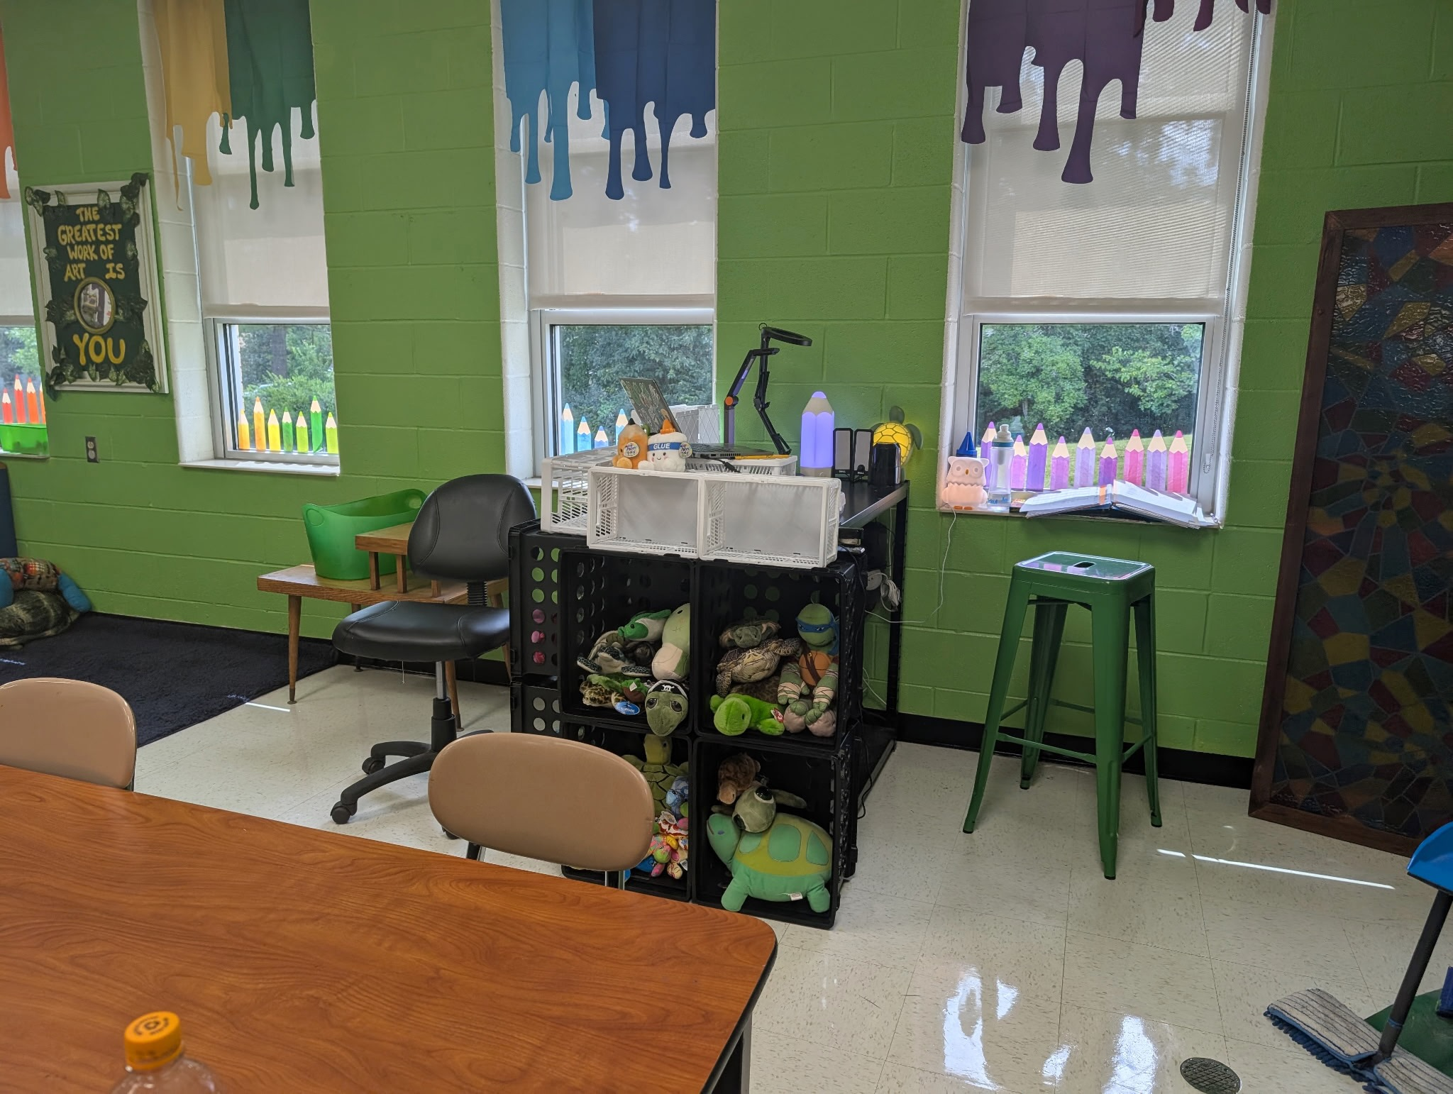
Ted Edinger’s Classroom
Completed Transform-ation
Notes:
Image: Courtesy of Ted Edinger, Mr. E.

Slide 35
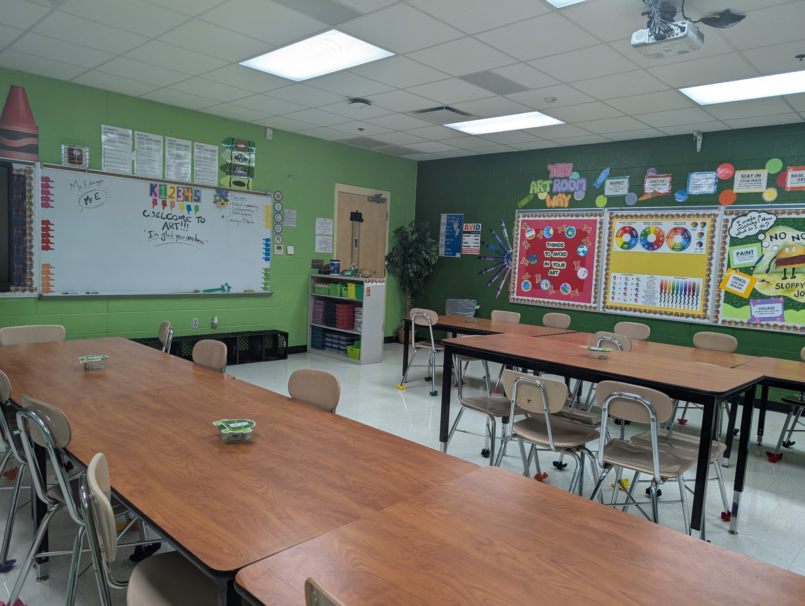
Ted Edinger’s Classroom
Completed Transform-ation
Notes:
Image: Courtesy of Ted Edinger, Mr. E.

