Slide 1


Sample Children’s Development Journal Pages
Debrah C. Sickler-Voigt, Author & Presentation Developer ©
Notes:
Book Cover Artwork: Paula Gale
Right Image: Photo by Jan Kahánek onUnsplash

Slide 2
Children’s Development Journal Pages
The following examples showcase preservice teacher journal pages that document children’s artworks and apply children’s artistic development theories. Through this multimodal process, students gain personalized insights into children’s artistic growth by interweaving research, artwork analysis, and personal reflection. The artworks and visual designs are of their choosing.
Note: The preservice teachers’ writings are unedited and some additional written segments are concealed in the journals’ pockets and flaps.
Notes:
Book Cover Artwork: Paula Gale
Right Image: Photo by Jan Kahánek onUnsplash

Slide 3

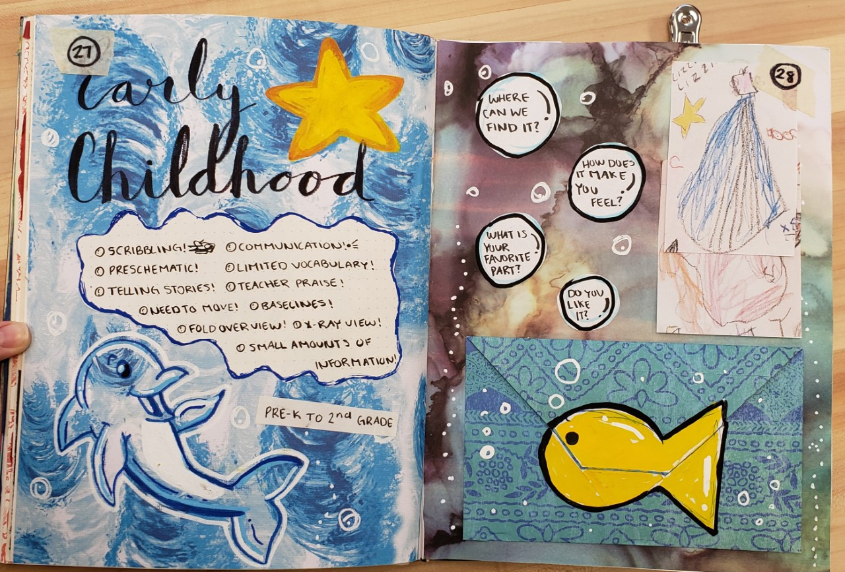
Early Child-hood
Lizzie Stefaniak
Notes:
Credit: Lizzie Stefaniak

Slide 4
Early Childhood
In this stage of a child’s physical development, the bodies grow quickly. From PreK to 2nd grade, they are developing basic motor and speech skills. Their large muscles are developing. Since they have a limited vocabulary and cannot understand abstract symbols or shapes, it is important to learn how to communicate with children of this age. At this age, they learn how to control their muscle and nerve movements. Also, they need to move around often and get their bodies going. During this age, children have a limited attention span, so you need to take that into account when teaching. They also begin the processes of assimilation and multiple intelligences. These processes progress a child's way of thinking and make them identify things and start their learning process. Even though these children are young, they are still soaking up this information and it is just as important to show them new things. The social interaction children have played a significant role in their emotional development. As a teacher, it is important to give your students that outlet to discuss, play, create artwork, and write. This lets them express their emotions in other ways besides verbally. When this young, expressing emotions can be hard so they can create symbols and tell stories. It is also important to give praise to kids. When this is done it makes them feel good and want to keep going. Children are capable of so much at an early age. Their artistic development starts with disordered scribbles from 12 to 18 months (about 1 and a half years) and uses a fist to hold the utensil. As they grow older, they learn how to draw a mandala to create preschematic symbols. Around age 3 or 4 they begin to use 4 fingers to hold a pencil and around 5 they use three fingers, called a tripod grip. Also, younger students design pieces using nonrepresental space and use either one baseline or multiple baselines in their artwork. They do not understand perspective, so they can use methods such as x-ray and fold over views. Lizzie Stefaniak
Notes:
Credit: Lizzie Stefaniak

Slide 5
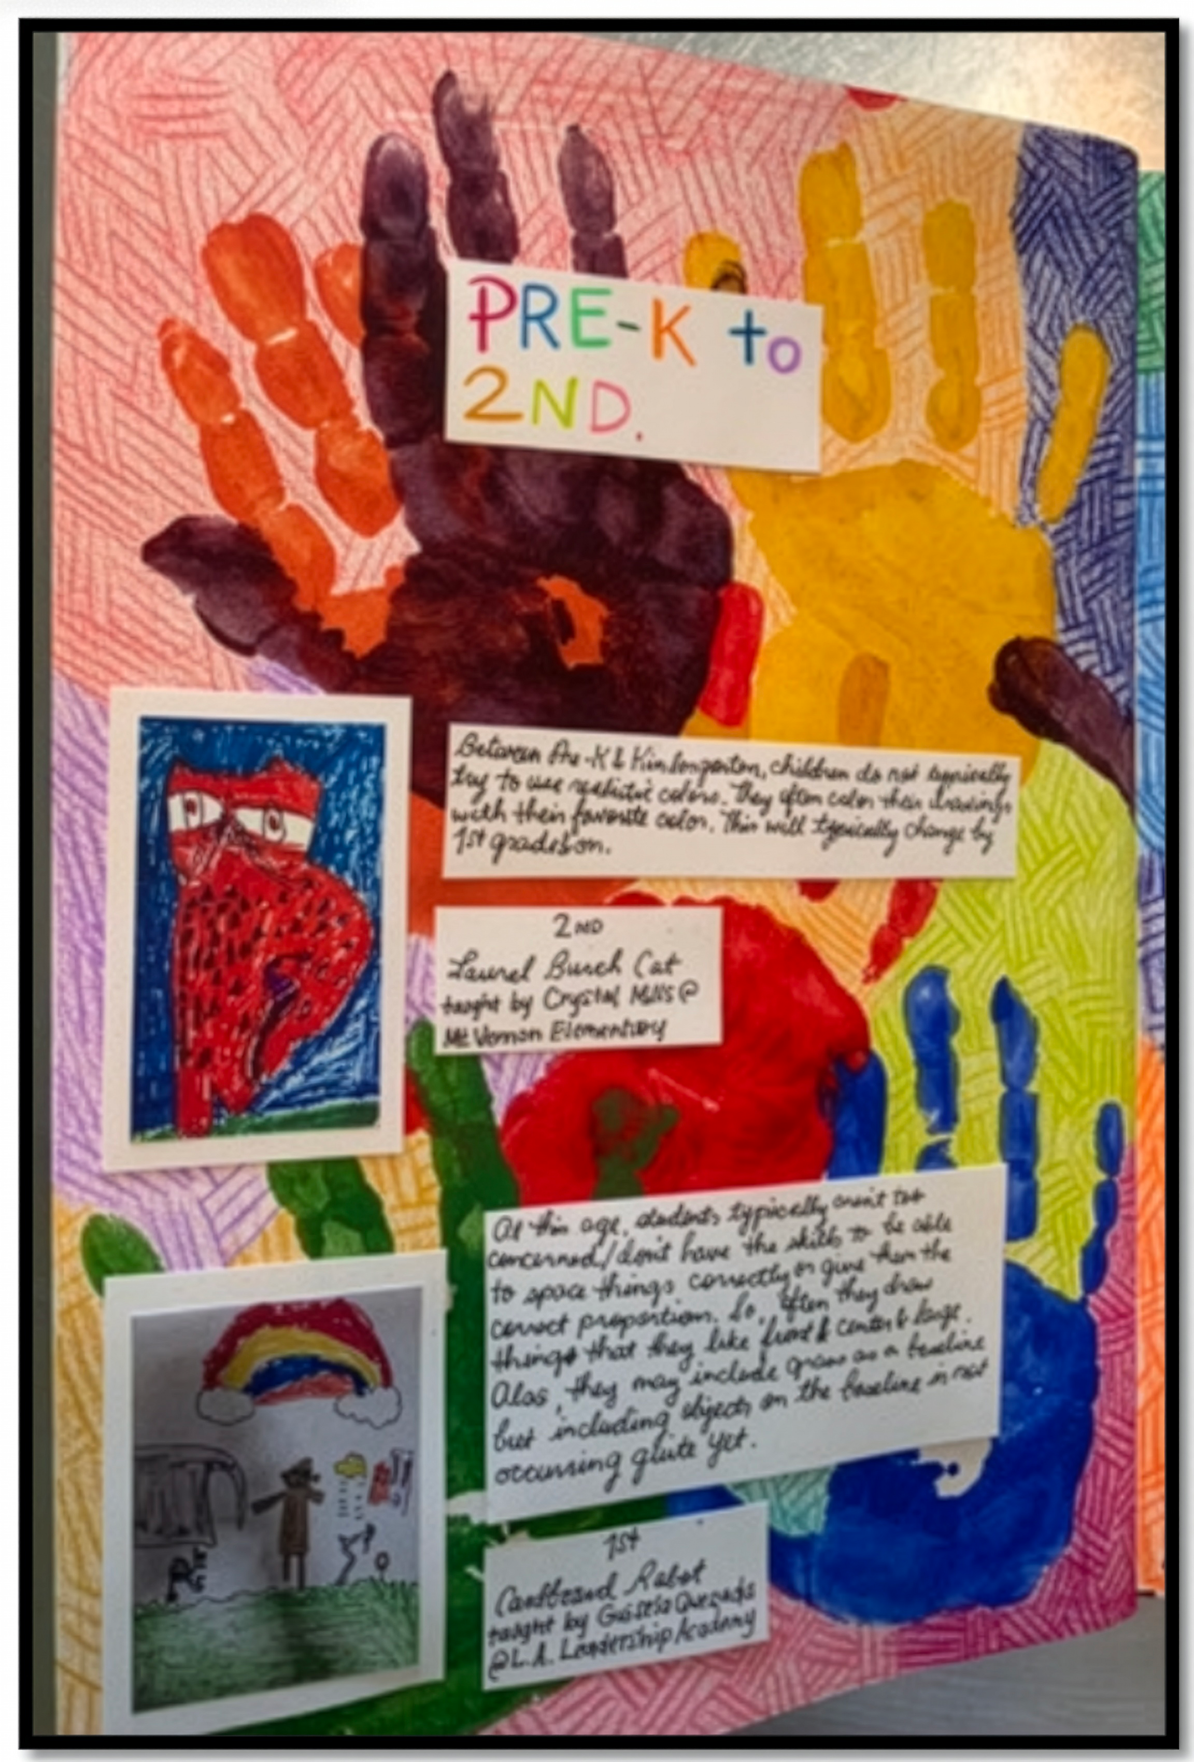
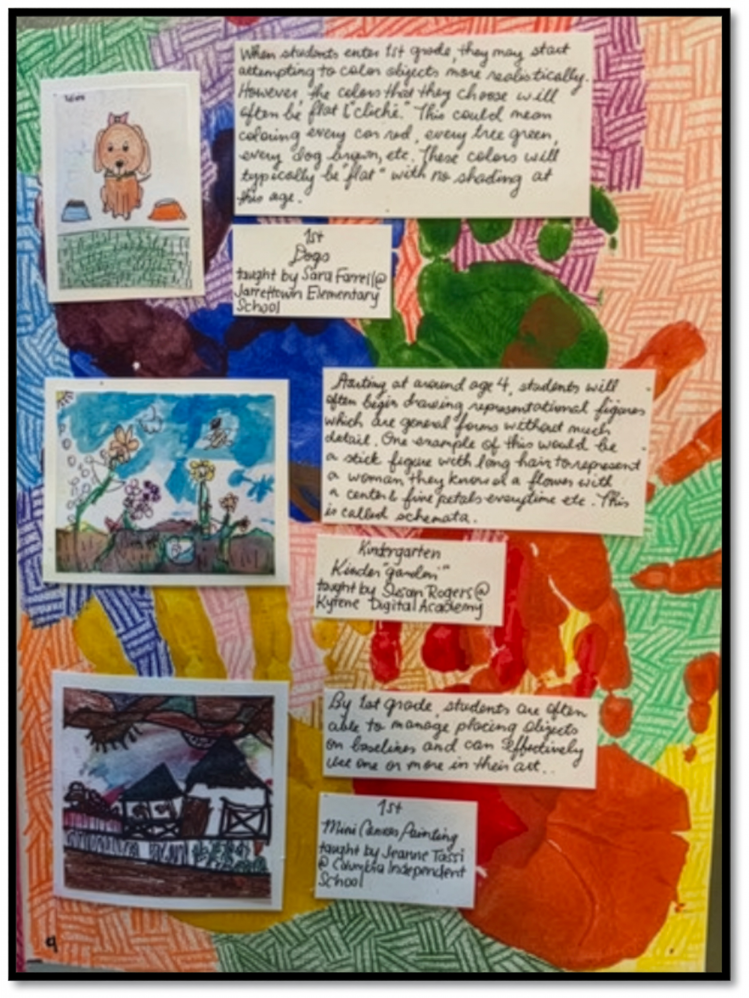
Early Child-hood
Paige Brenner
Notes:
Credit: Paige Brenner

Slide 6
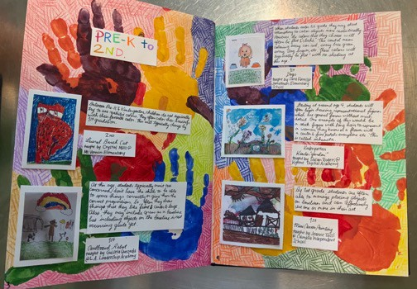
Early Childhood
These are my ‘Early Childhood’ pages from my journal which showcase multiple art pieces from students aged pre-k to second grade. There are also explanations of children’s development specifically in reference to “creating” that coincide with the artworks that are being presented. My four-year-old nephew who is in Pre-K lent his hands to the background of the pages. Paige Brenner
Notes:
Credit: Paige Brenner

Slide 7
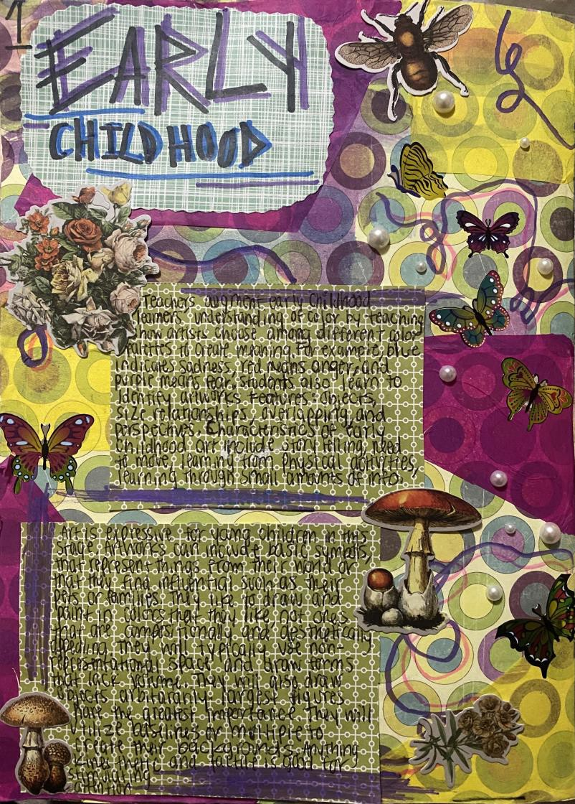
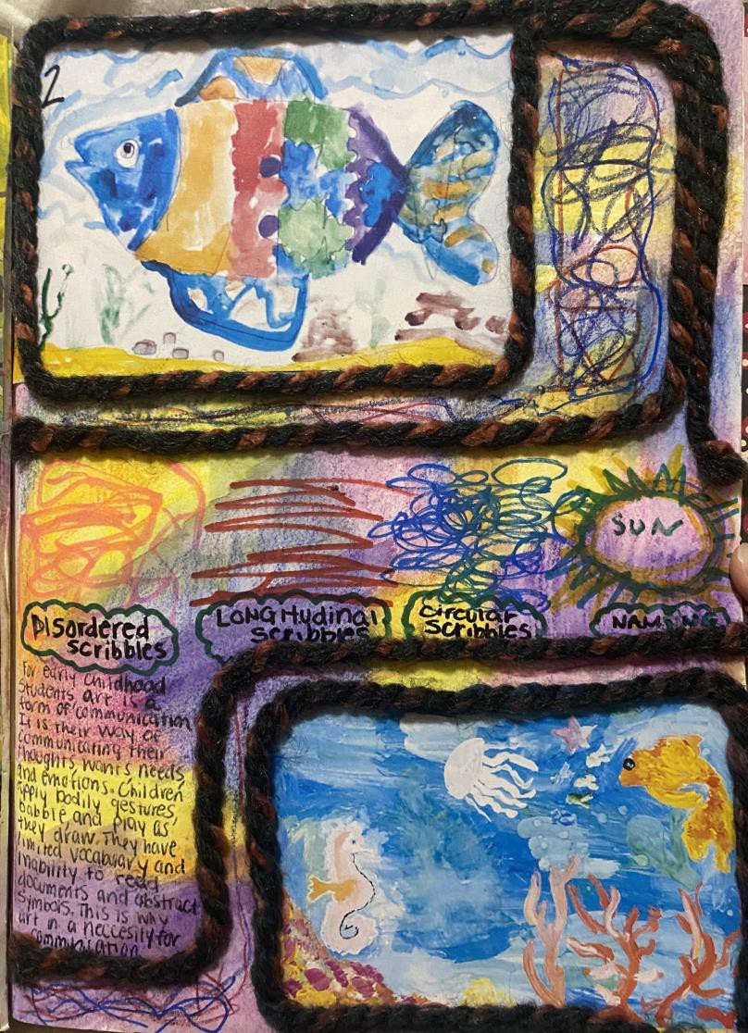
Early Child-hood
Kiersten Maddox
Notes:
Credit: Kiersten Maddox

Slide 8
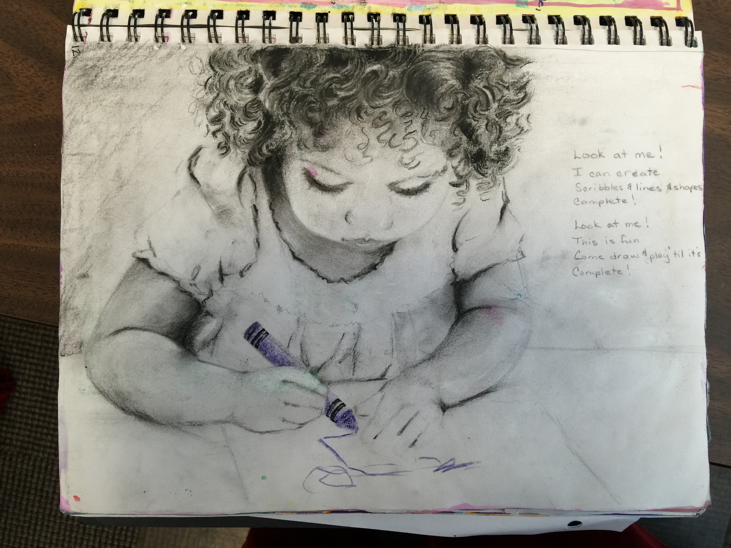
Early Child-hood
Becky
Fraser
Notes:
Credit: Becky Fraser

Slide 9
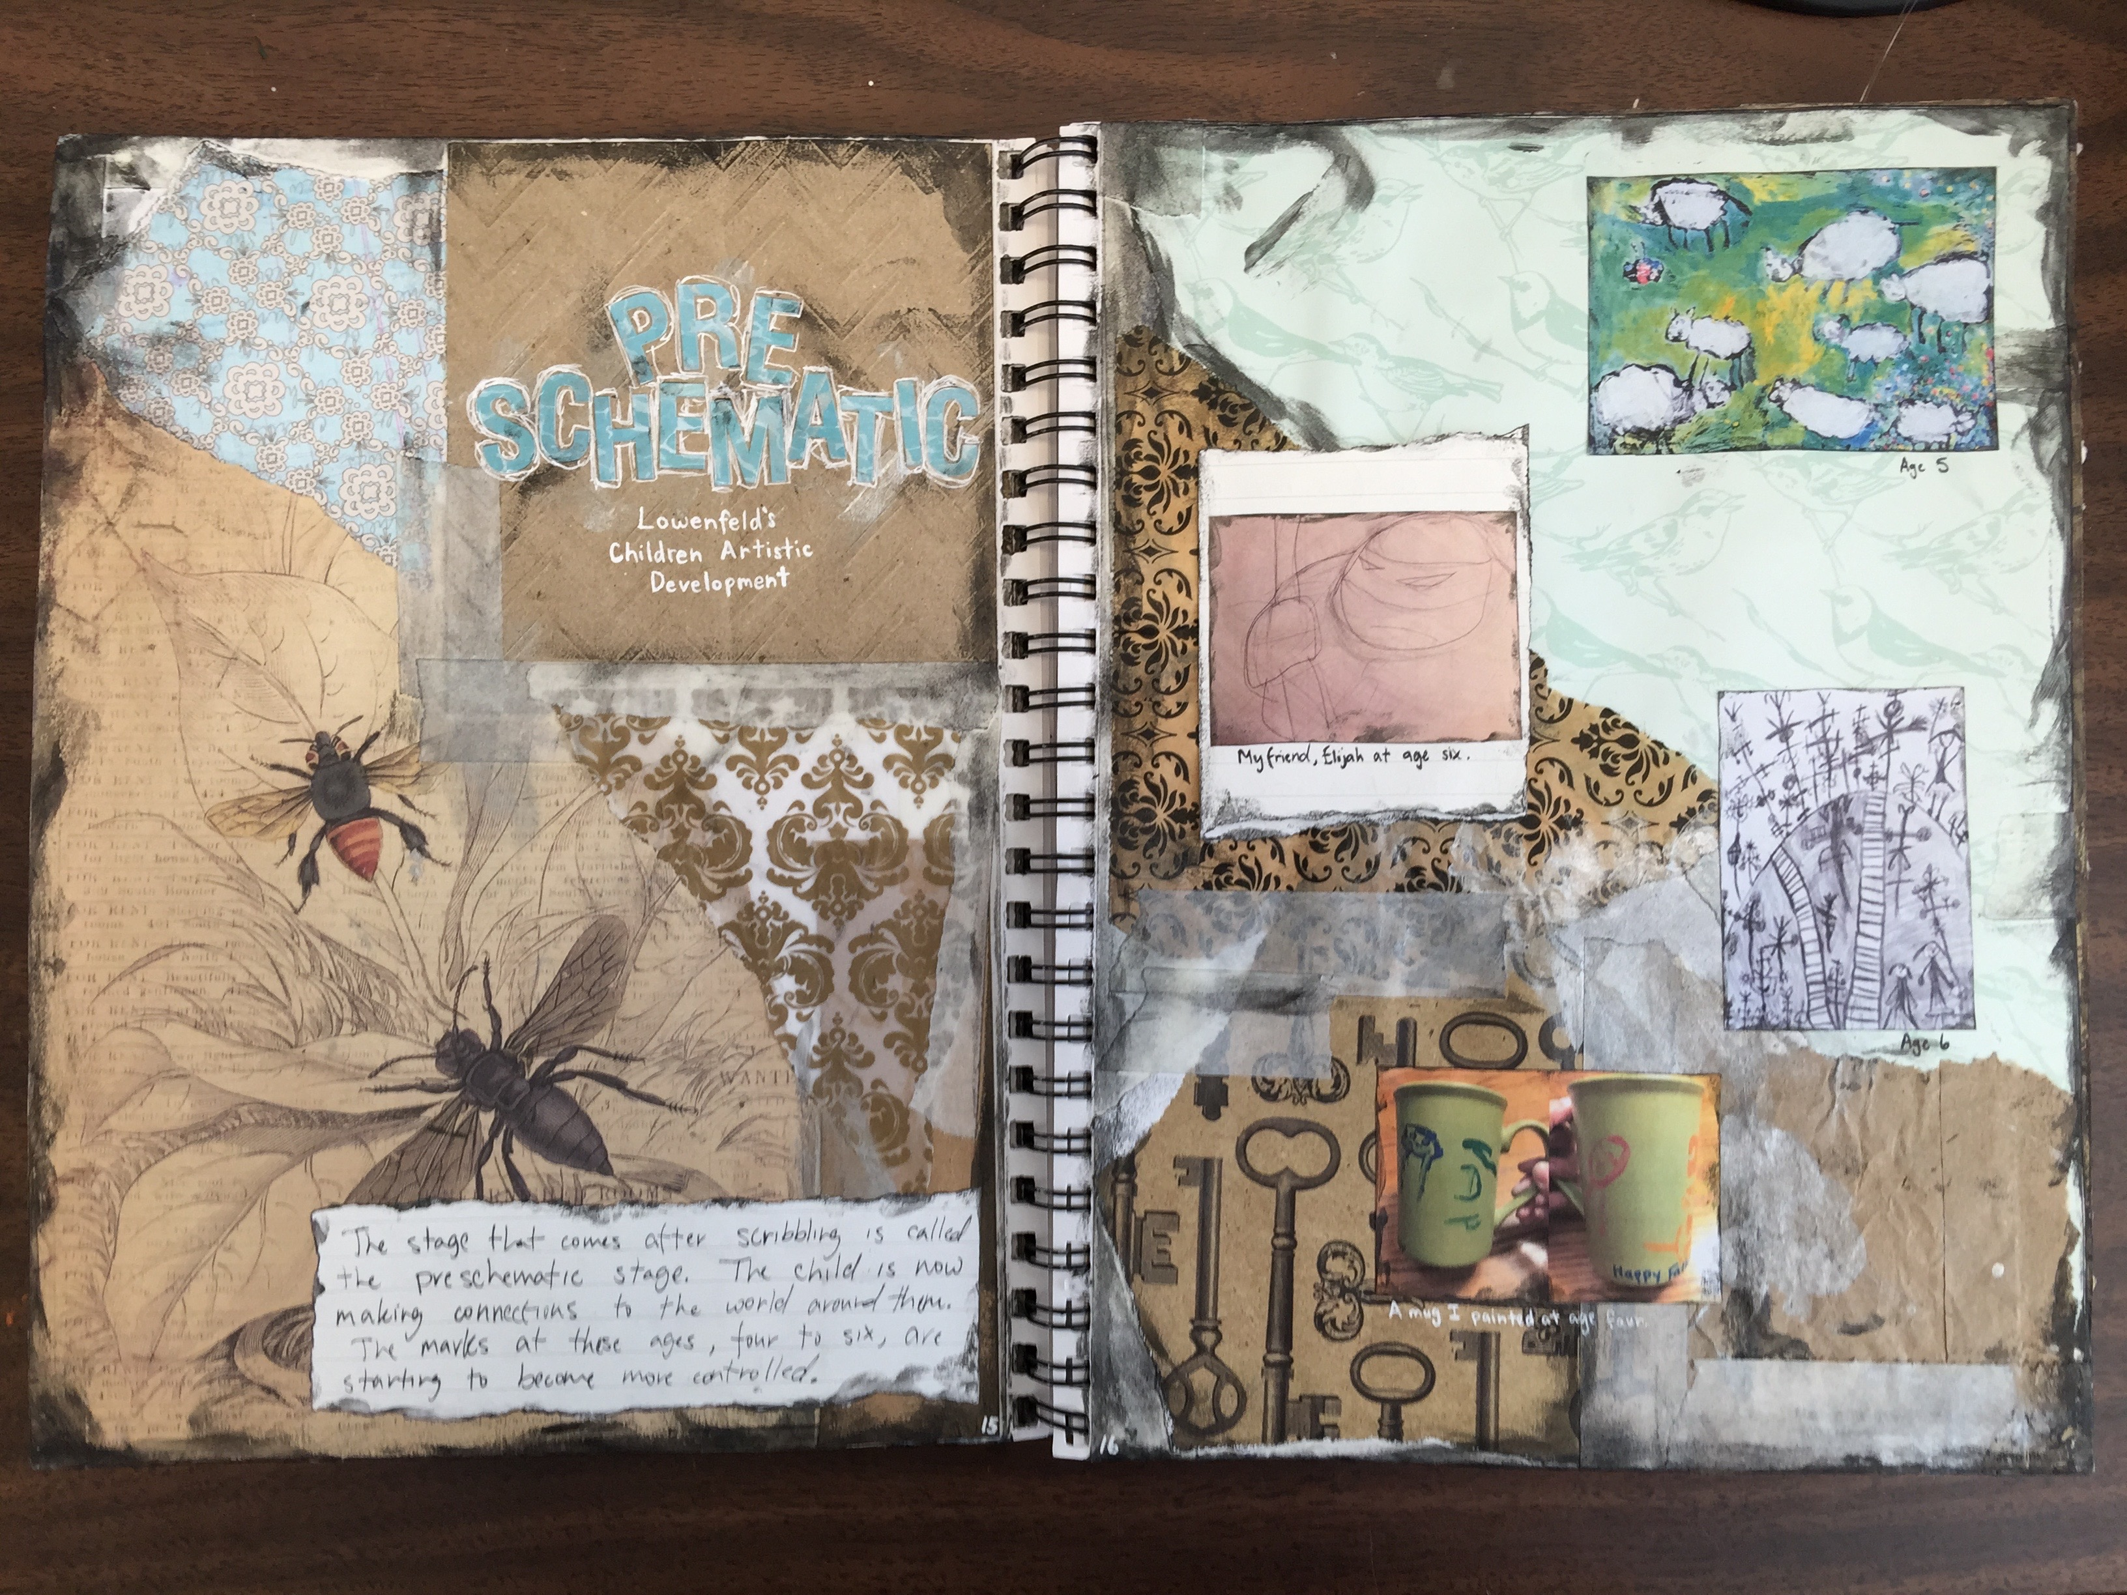
Early Childhood
Bobby Shuey
Notes:
Credit: Bobby Shuey

Slide 10
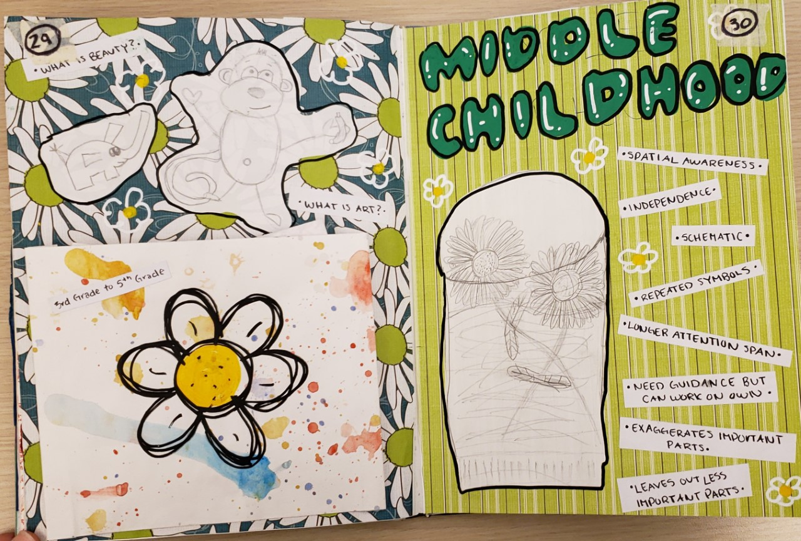
Middle Child-hood
Lizzie Stefaniak
Notes:
Credit: Lizzie Stefaniak

Slide 11
Middle Childhood
As children reach third through fifth grade, they feel more independent and have advanced their communication skills. They gain vocabulary and concrete reasoning skills. They are more social and establish a network of friends at this age, as well as work with others. They make speculations and begin to realize connections and how they relate to things in the world. A child’s thinking skills progress at this age. They can understand deeper topics and have greater inquiry skills. They can also understand international and social cultural concerns. Furthermore. The students can write artist statements and defend their decisions about art. In third and fourth grade, students can absorb small chunks of data, but in fifth grade students can comprehend multiple concepts at once. As they grow older, children use visual art less to express their emotions and instead can use verbal and written communication skills. Also, they become proud of their artwork and begin to feel enthusiastic about creating art, so they require practice time. They can feel frustrated and discouraged when they are not grasping innovative ideas, so positive reinforcement can help them to keep going. And finally, they can get frustrated if their observational drawings are not realistic enough and do not look like the real thing. Students can hold a pencil like an adult by third grade, allowing them to add finer details in their artwork. As they get older, they begin to decrease the use of flat planes of color and begin to explore layering and mixing colors. The imagery created becomes more proportional than before and is refined. Also, Teachers can teach the children observational drawing and how to draw from real life, instead of just from their heads. Lizzie Stefaniak
Notes:
Credit: Lizzie Stefaniak

Slide 12
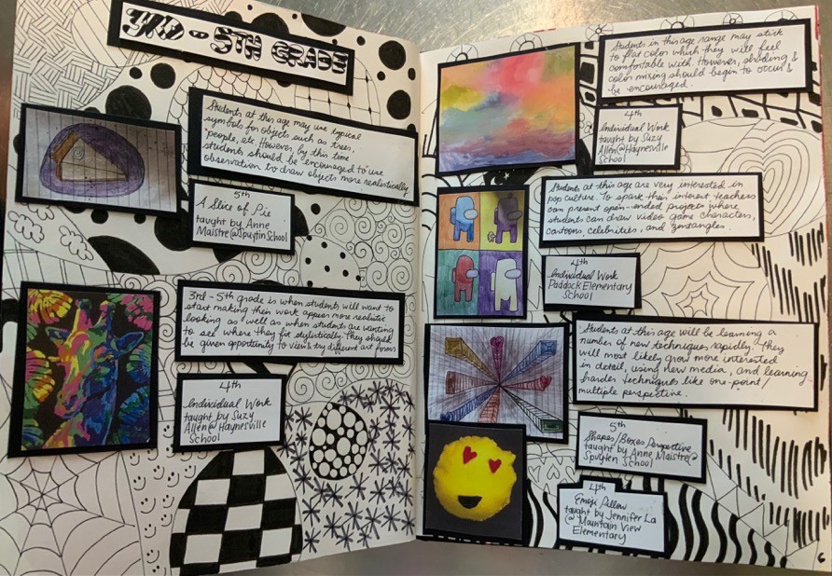
Middle Child-hood
Paige Brenner
Notes:
Credit: Paige Brenner

Slide 13
Middle Childhood
These pages represent ‘Middle Childhood’ art and art development. I created a “zentangle” in the background as 3rd through 5th grade is when I created many zentangles and in looking through the works for these pages, I saw this was still popular. I included many other facts about student’s art development for this specific age group and I was amazed at how advanced the art pieces were within this age range. Paige Brenner
Notes:
Credit: Paige Brenner

Slide 14
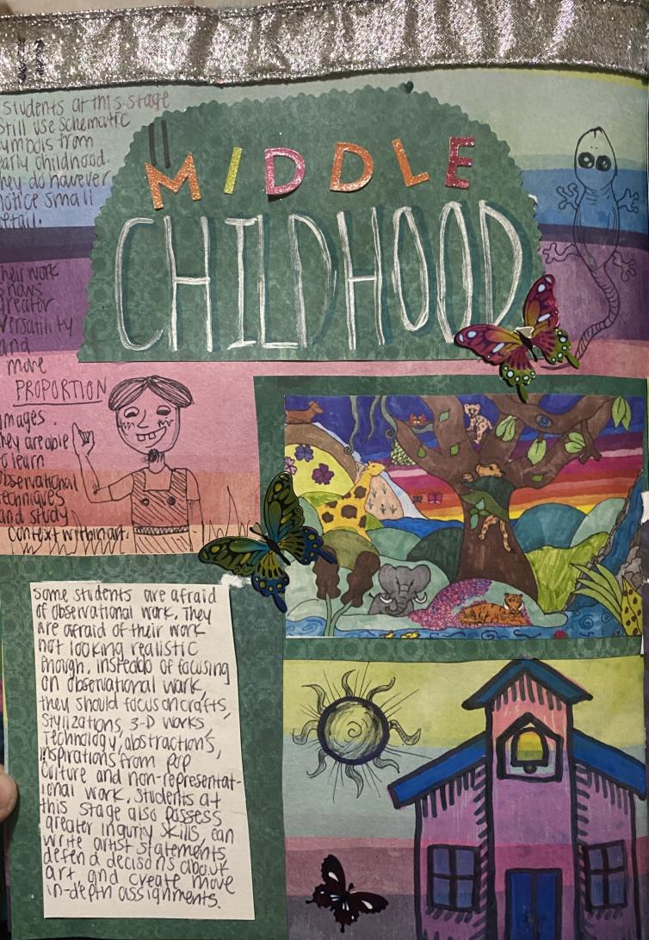
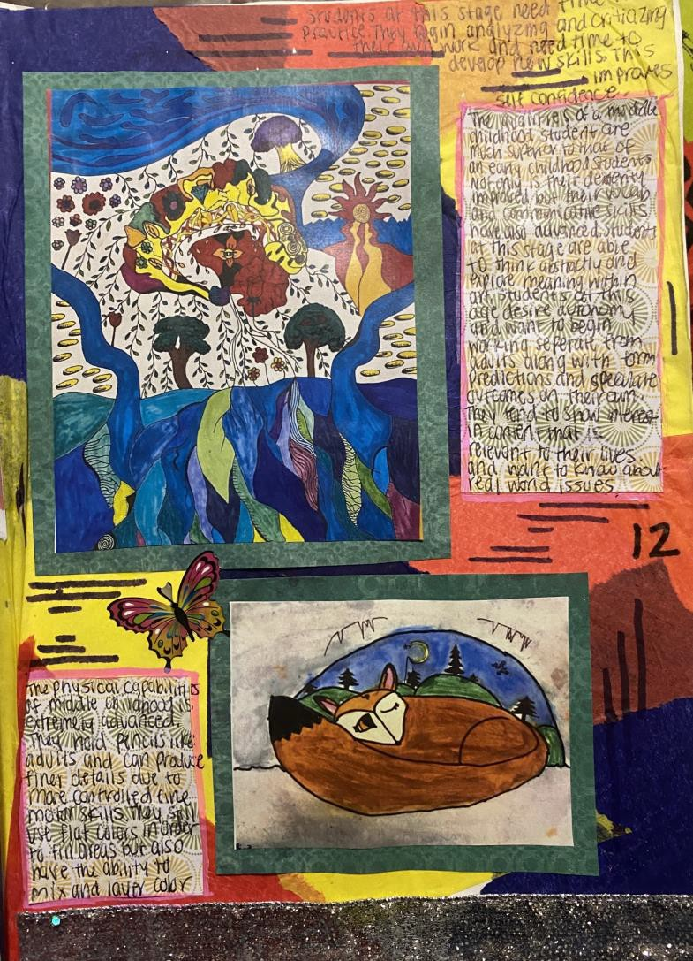
Middle Child-hood
Kiersten Maddox
Notes:
Credit: Kiersten Maddox

Slide 15
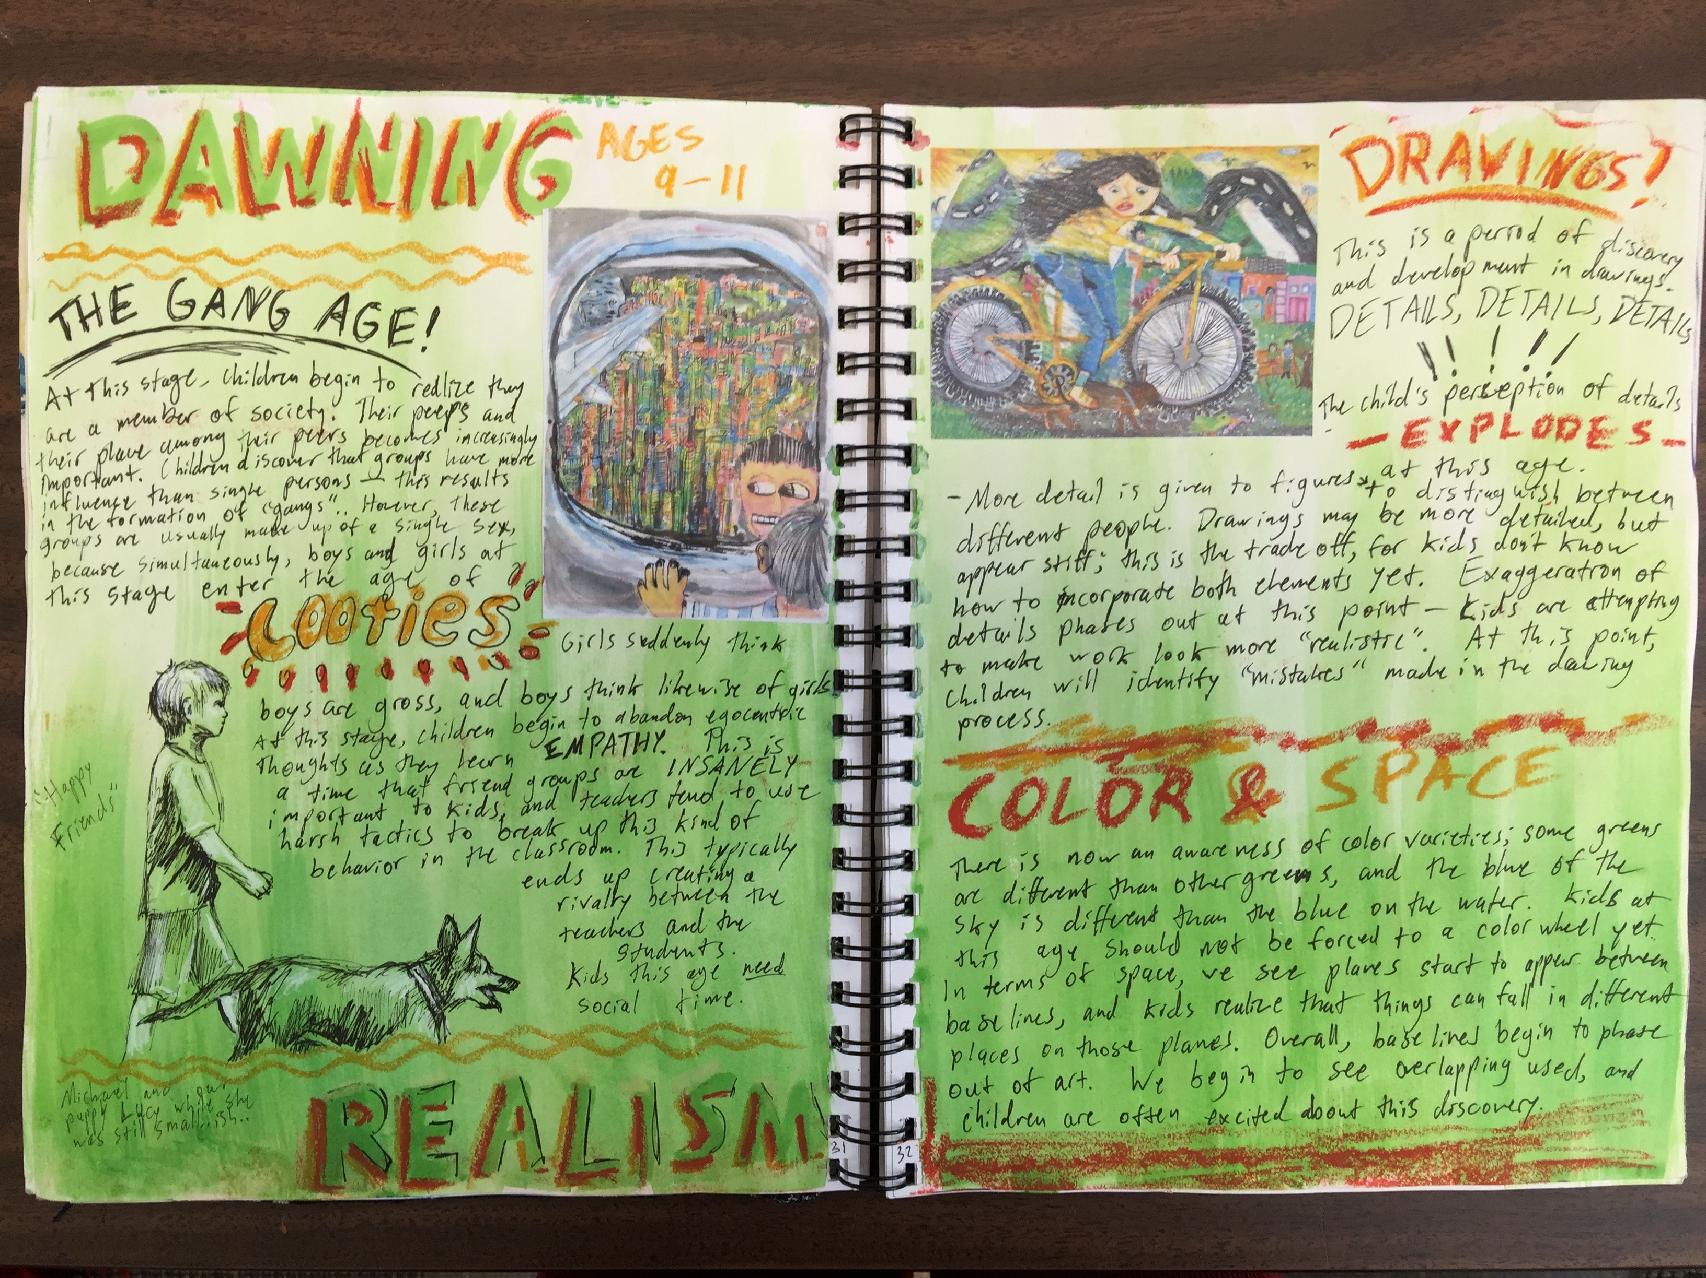
Middle Child-hood
Emily
James
Notes:
Image:

Slide 16
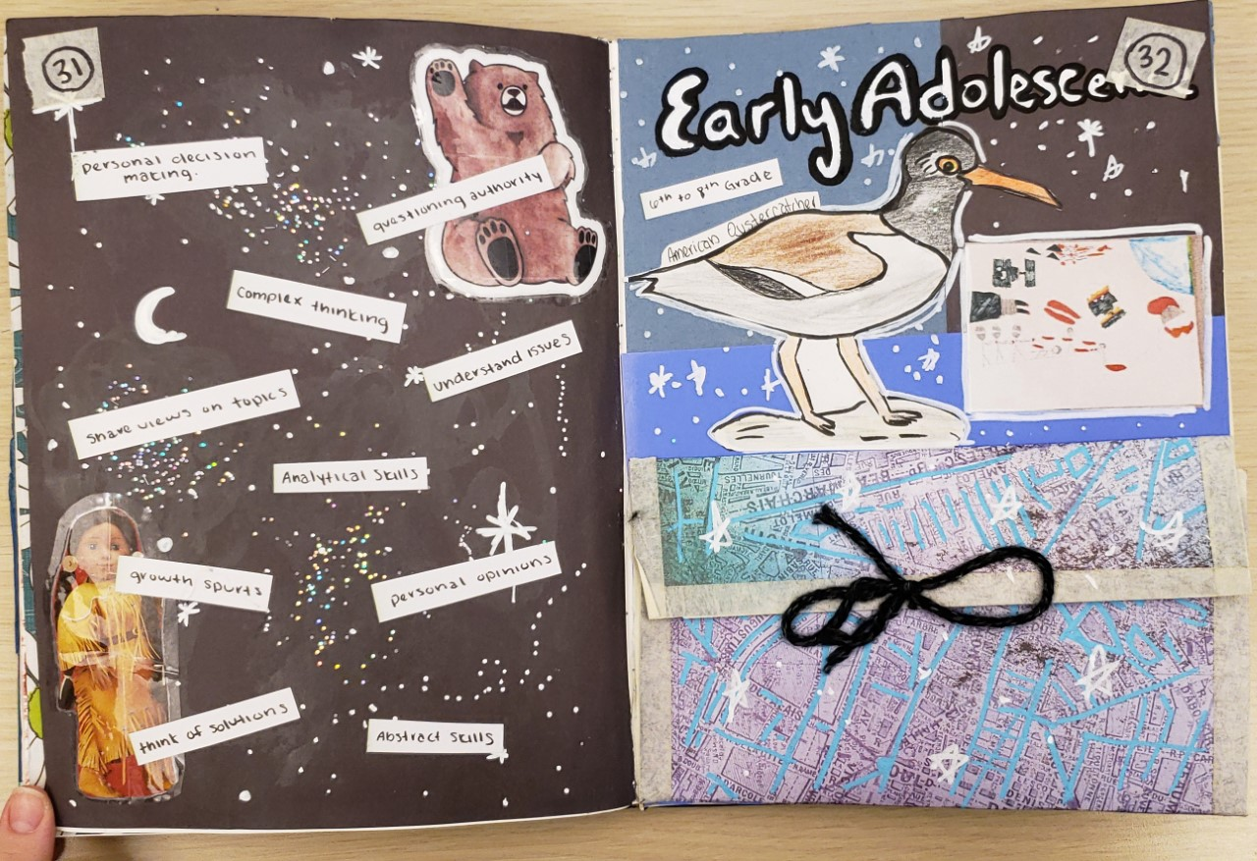
Early Adole-scence
Lizzie Stefaniak
Notes:
Credit: Lizzie Stefaniak

Slide 17
Early Adolescence
During this beginning transition from childhood to adulthood, children experience rapid skeletal growth, muscle development, and hormonal changes. With these physical changes, puberty comes along as well. Girls begin puberty in middle school, rapidly changing their bodies faster than they think. On the other hand, boys start to begin puberty towards the end of the 8th grade. Both boys and girls are now dealing with these physical changes, which can become apparent in the classroom. They also experience sleep deprivation, which can then affect their performance in the classroom from being too tired. At this age, children do a lot of thinking. Along with the changes happening in their body, they also are having changes in their thoughts. They begin to compare themselves to their peers. This could be comparing their artwork, but also their bodies, mannerisms, and things they decide to do. These changes play into their decision making and how they decide right from wrong. This can be brought into the classroom, so if negative behavior is happening, it must be taken care of quickly. During this period of a child’s life, they are experiencing several new emotions and levels of those emotions. They experience peer pressure and just want to feel like they belong with their peers. This can lead to unwise decision making, so we need to teach them smart decision making. Also, during early adolescence, children may sense sexual urges being induced by hormonal changes. They may want to act out adult behaviors and activities because of puberty. It is important to implement classroom management skills to help control any aggressive behaviors. In early adolescence, students will start to develop their own artistic style. They will stick with what they know well and practice it until it comes out perfect. On the other hand, they will shy away from things they are not familiar with. Also, they will start to communicate their personal interests and topics they like, in their artwork. By this age, they are aware of events going on in the world and may implement these into their artwork.
Notes:
Credit: Lizzie Stefaniak

Slide 18
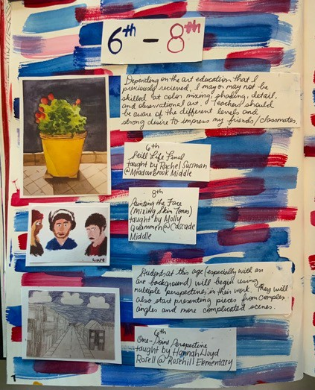
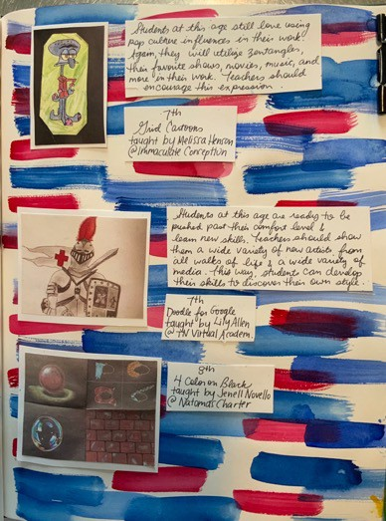
Early Adole-scence
Paige Brenner
Notes:
Credit: Paige Brenner

Slide 19
Early Adolescence
These pages from my journal represent “Early Adolescence.” This is the age group that I think I would enjoy teaching the most so it was really fun for me to look through all of the artworks associated with this age range. Children at this age are getting into more advanced techniques and abstract thought. These artworks were extremely impressive to look at and learning about this age group deepened my desire to work within this age range. Paige Brenner
Notes:
Credit: Paige Brenner

Slide 20
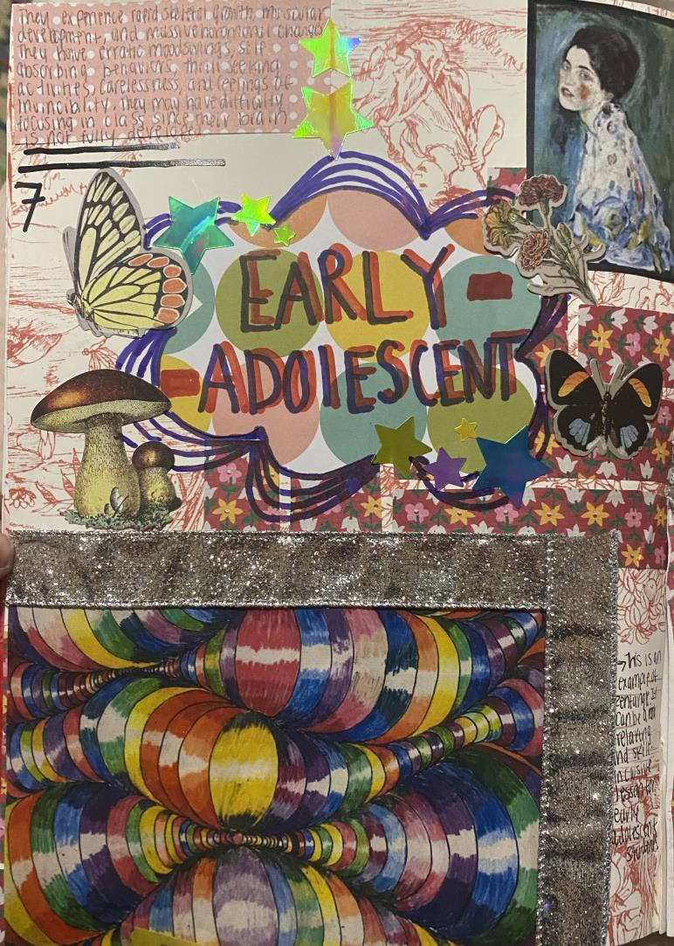
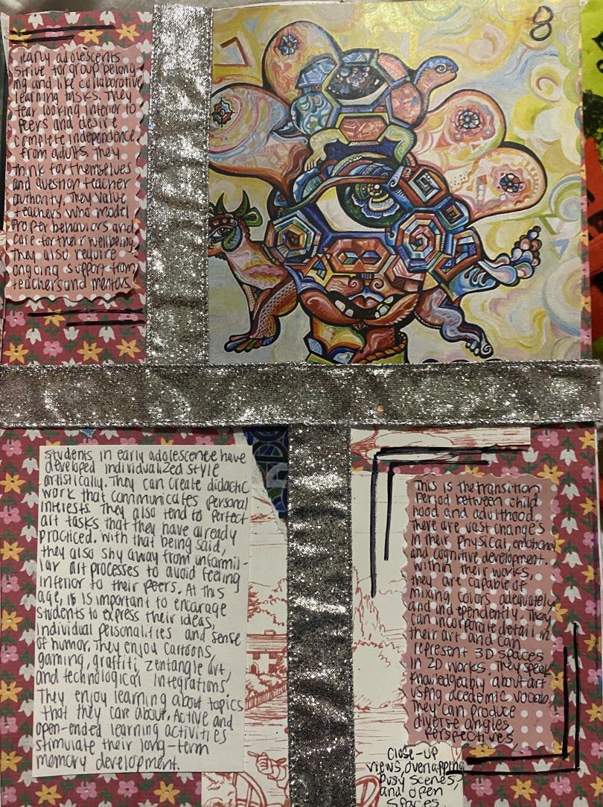
Early Adole-scence
Kiersten Maddox
Notes:
Credit: Kiersten Maddox

Slide 21
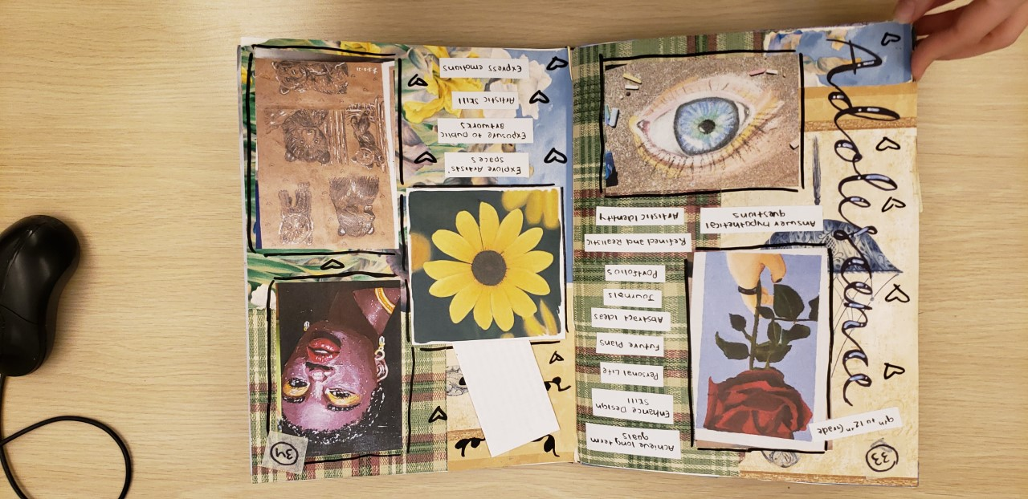
Adolescence
As children enter and go through high school, they are facing some of the same physical changes as they did in early adolescence. However, by the end, they will be nearing their physical growth. By this time, girls have completed going through puberty. Also, on the other hand, boys are now at the end of puberty. Due to the increase of hormones and physical changes, they may experience more sexual urges. They spend a larger amount of time paying attention to how they look and may be interested in exercise or dieting. And finally, they may not get enough sleep to function properly. Children at this age are now maturing in their cognitive function. They can answer hypothetical questions, explore abstract ideas, and achieve long term goals. They can take the things they learn in the classroom and now apply them to the real world. In addition to that, they can take ideas from their lives (and social events for example) and apply them to their work. They begin thinking about the future past high school, and now investigate an adult pathway. At this age, students are gaining more control over their emotions and reactions. They seek independence from adults but need guidance on how to obtain independence. It is important to be supportive and set parameters, but to not be too controlling towards the student. Students become more aware of the things going on around them such as: peers' exploration of drinking, drug use, sexual activity, and knowing the difference between right and wrong. At this age they are just trying to figure out how they belong and want to strive forward. At this point in a student’s artistic development, they can build upon their past art foundations (if applicable) and enhance their design skills. They can implement their personal life into their artwork and express their emotions through their work. They can also participate in community projects. Also, they create artworks to build their portfolios and journals for college applications. And finally, they can explore other artists’ space and artworks at museums to gain inspiration and further expand their exposure to public artworks. Lizzie Stefaniak
Notes:
Credit: Lizzie Stefaniak

Slide 22
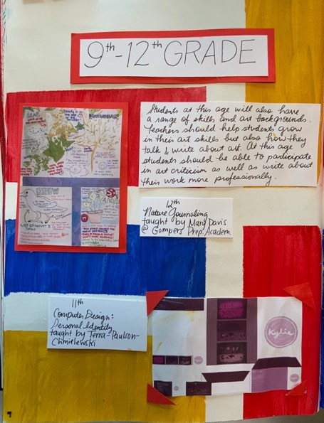
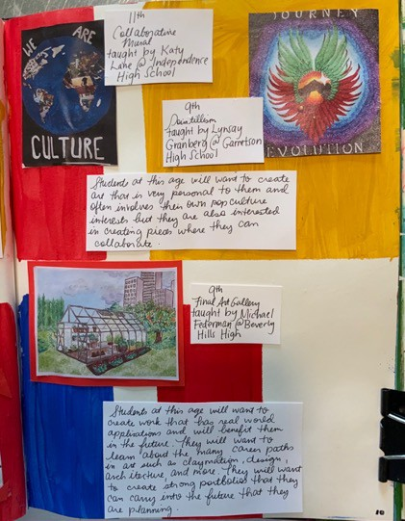
Adole-scence
Paige Brenner
Notes:
Credit: Paige Brenner

Slide 23
Adolescence
These are the the pages in my journal that represent “Adolescent” art. This was an interesting age group to learn about and another that I would be excited to teach. There were a number of fascinating art techniques that were popular within this age range from what I saw including digital art, in depth portfolios, and students eager to create professional looking art that they can bring with them into the future. Paige Brenner
Notes:
Credit: Paige Brenner

Slide 24
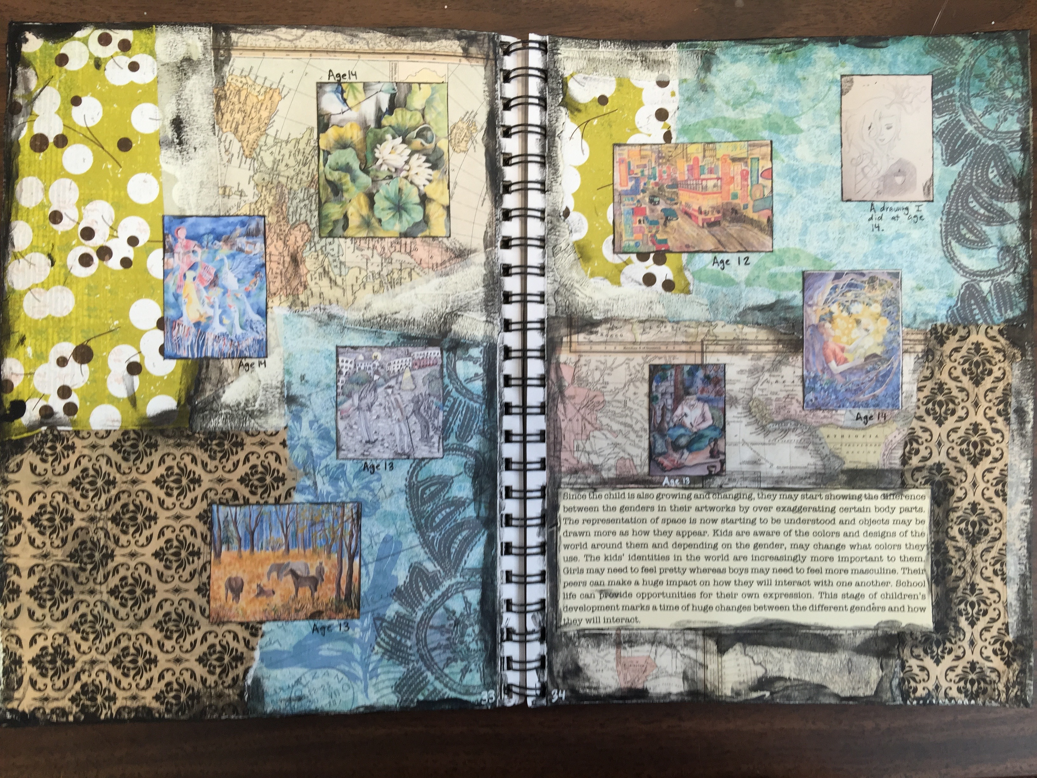
Adole-scence
Bobby Shuey
Notes:
Image: Bobby Shuey

