Slide 1
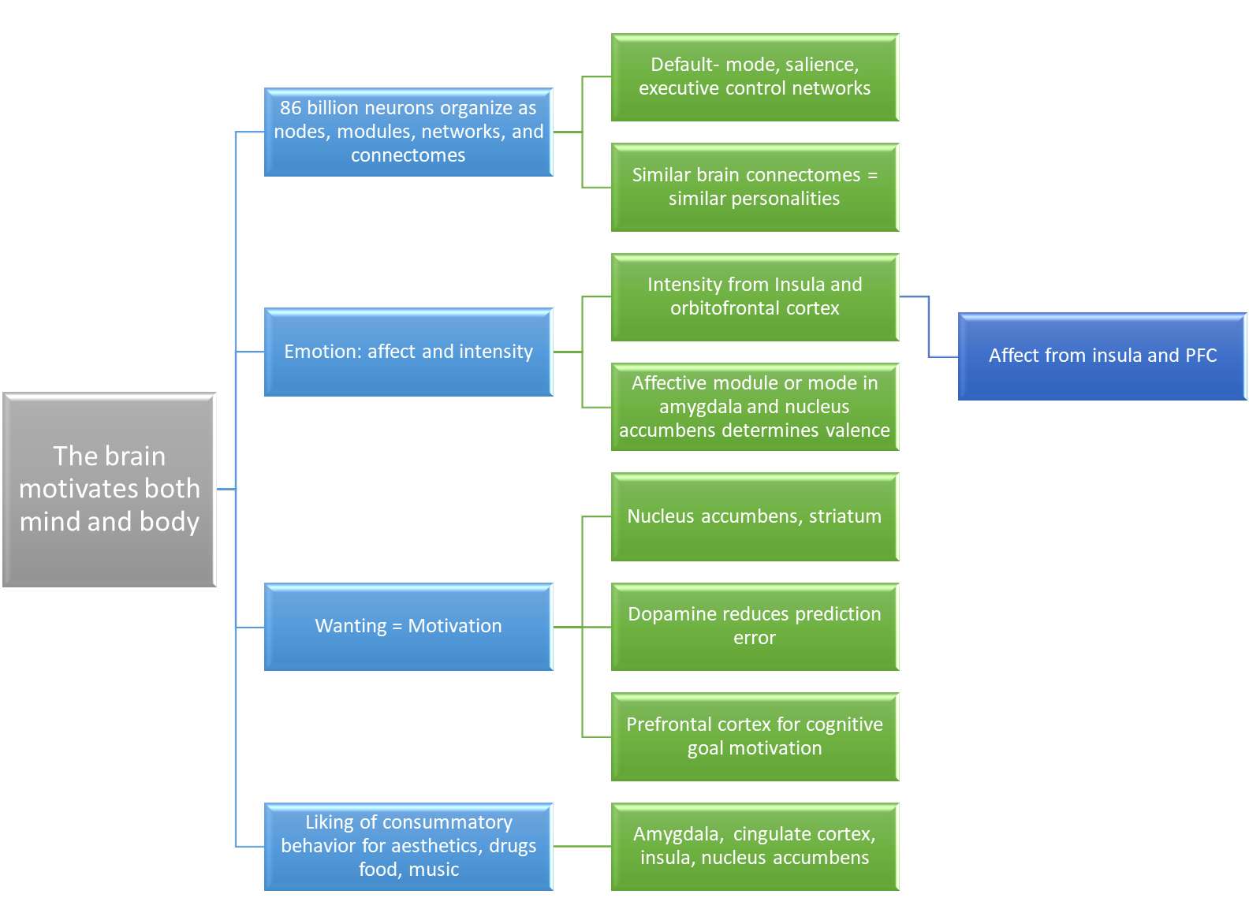
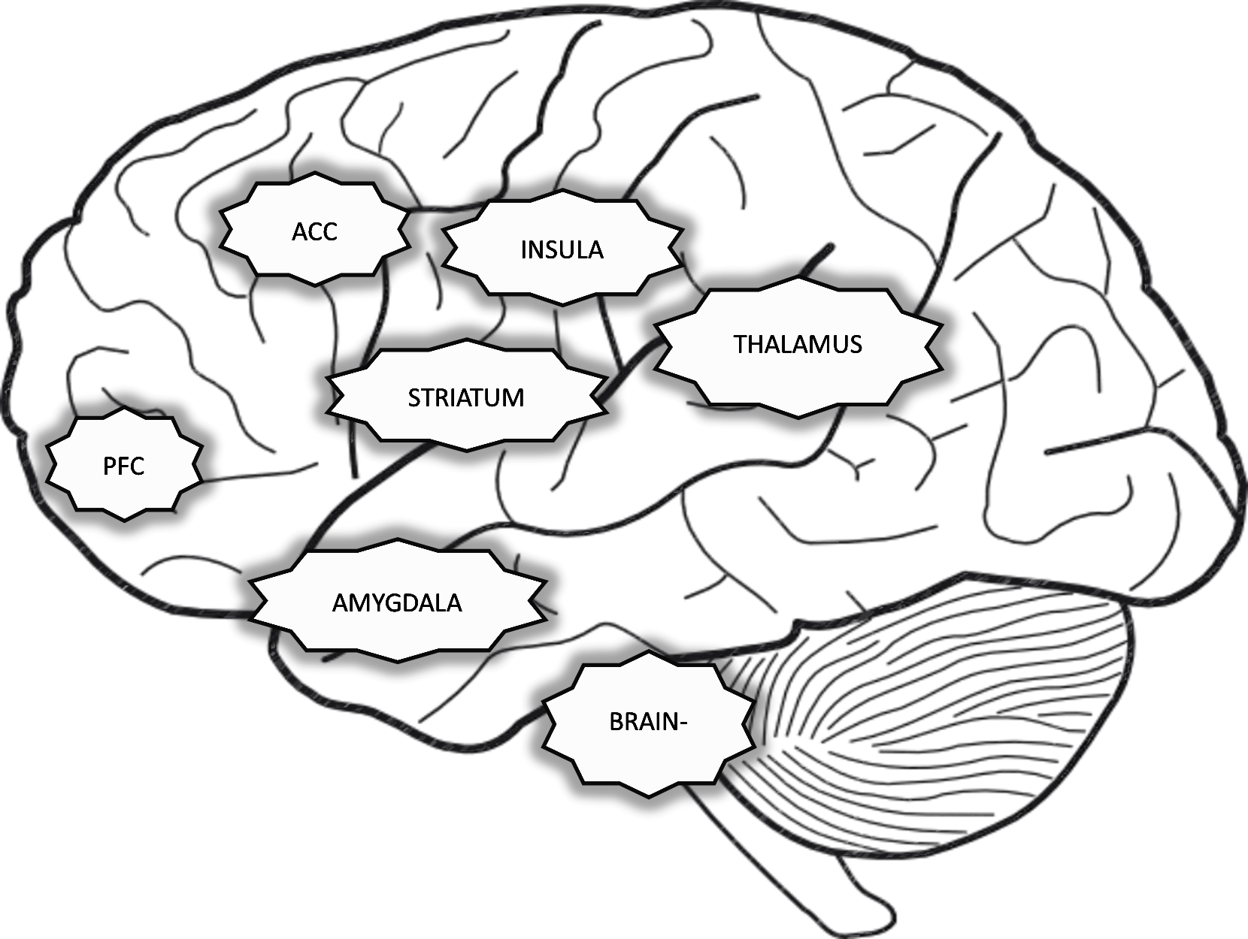
Chapter 4: Concept Map
The Brain in Motivation & Emotion

