Slide 1

Leases and Leasing Strategy
Commercial property leases are fundamental to real estate investment. They create the operating cash flow that determines property value. A lease is a long-term contract between a property rights holder (lessor/landlord) and a user (lessee/tenant).
Leasing has become the dominant way commercial space is occupied in the US, especially for larger, more valuable properties in the institutional real estate investment industry.

Slide 2
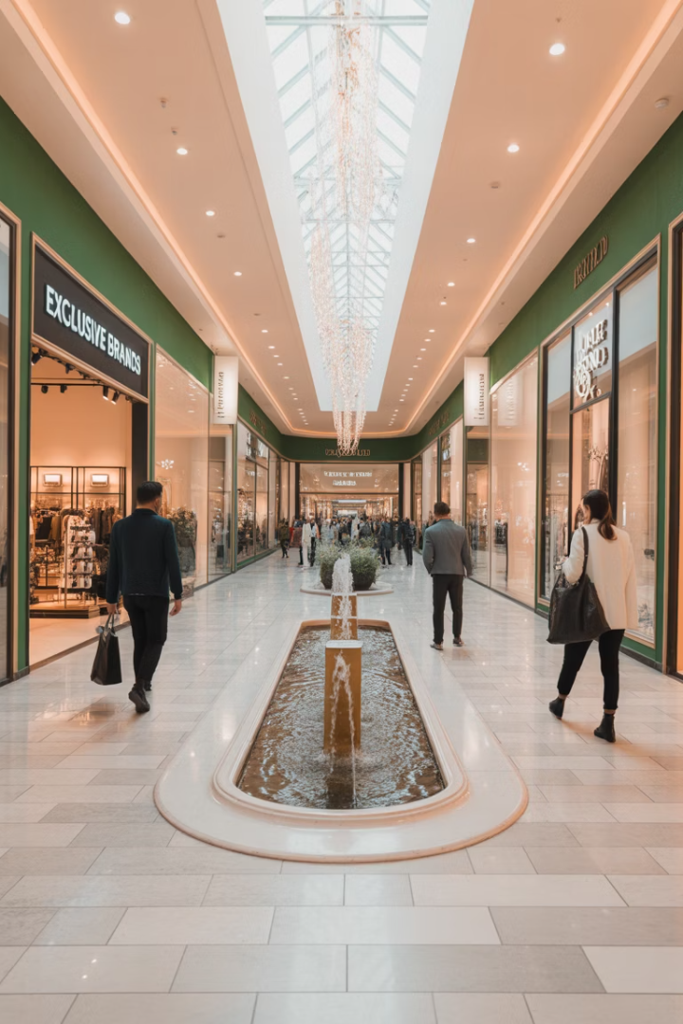
Why Leasing Exists
Tax Advantages
Income tax circumstances of tenants and landlords create potential for tax arbitrage, saving taxes across property investors and tenants.
Specialized Expertise
Development and management of built space have become specialized industries with economies of scale.
Centralized Control
Single landlord ownership enables optimization of property functioning as a whole, especially in retail centers.
Risk Management and Capital Retention for Tenant
Leasing addresses heterogeneity in market knowledge, credit access, and preferences for real estate risk exposure. Note also Capital Retention: For many companies, the return on capital from investing in their own business is higher than the return on capital if they owned real estate.
.

Slide 3
Basic Lease Typology: Expense Responsibility
Gross Lease
Net Lease
Hybrid Lease
Landlord pays all operating expenses. Also called full-service lease. Most popular for office properties.
Tenant responsible for operating expenses. In triple net (NNN), tenant pays nearly all expenses including property taxes and insurance.
Tenant and landlord share operating expenses. Common in apartments where some utilities are separately metered.
Landlord provides services like electricity, heat, water, cleaning, maintenance, and security.
Popular for single-tenant retail and industrial properties where expenses are easily attributed.
May include expense stops, where tenant pays expenses above a specified level.

Slide 4





Types of Rent Changes in Leases
Flat Rent
Fixed, constant rent throughout the lease term. Common in short-term leases and during low inflation periods.
Graduated Rent
Specified step-ups in rent at predetermined times. Example: $15/SF with $1/SF increase every two years.
Revaluated Rent
Professional appraiser determines rent adjustments at specified times. Common in very long-term leases.
Indexed Rent
Rent adjusted according to public index like CPI or PPI. Example: 75% of CPI increase applied annually.
Percentage Rent
Used in retail spaces. Rent includes base amount plus percentage of tenant's sales revenue.

Slide 5

Lease Characteristics Affecting Value
The Space
The Tenant
Location, physical qualities, size, shape, and configuration determine usefulness and rent. Rent per square foot is typically minimized for most commonly demanded space sizes.
Credit quality, prestige, synergy with other tenants, and parking use intensity affect desirability. High-profile tenants may bring particular benefits to landlords.
Lease Terms
Length of lease, timing of signing and expiration, rent levels, concessions, covenants, and options all impact value to landlord and tenant.

Slide 6
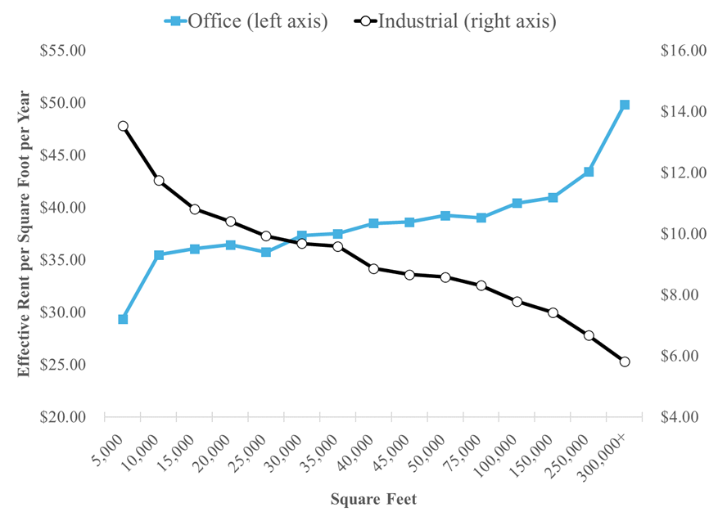
Rent Variation by Space Size for Office Rent
Office rents typically increase with space size as larger spaces are often custom-built and have fewer options in the market. Industrial properties show the opposite pattern, with rents decreasing as size increases.
Industrial properties are typically built on city outskirts where space isn't limited, while office buildings have structural constraints that make larger spaces more expensive to construct. Thus, industrial rents are more linear with size.

Slide 7





Lease Options
Renewal Option
Cancellation Option
Expansion Option
Tenant can renew at end of lease at specified or market rent. Similar to right of first refusal when at market rate.
Allows option holder to cancel lease before term end with specified notice. May benefit either landlord or tenant.
Gives tenant right to take additional space, either as first refusal on adjacent space or at specified rent during time window.
Sublease Rights
Tenant's ability to sublet space unless explicitly limited. Provides flexibility but landlord may want control over new occupants.

Slide 8
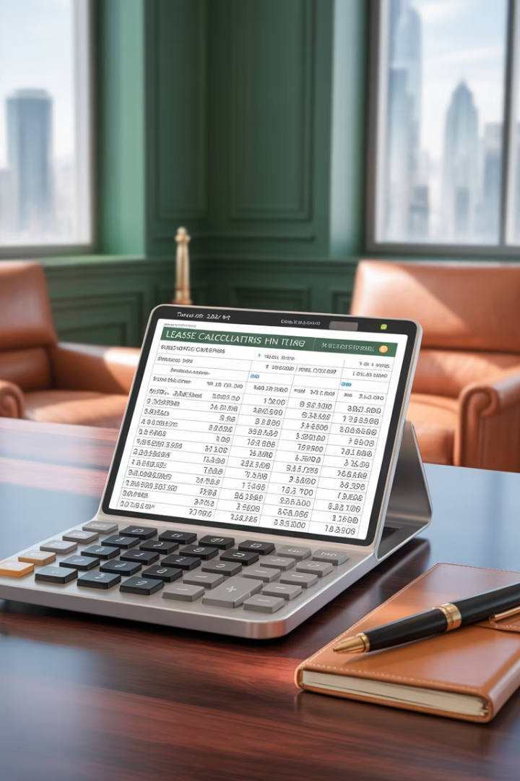
Effective Rent Calculations
Calculate Lease Present Value (LPV)
Sum the discounted cash flows over lease term. First payment often undiscounted as leases typically pay in advance.
LPV = CF₁ + CF₂/(1+k) + CF₃/(1+k)² + ... + CFₜ/(1+k)^(T-1)
Determine Annualized Value
Calculate equivalent level annuity payment of the LPV. This creates the Annuitized Lease Value (ALV).
Effective Rent = (LPV) × k(1+k)/[1-1/(1+k)ᵀ]
Choose Appropriate Discount Rate
For rigorous calculation, use tenant's credit rating and bond market yield curve rather than conventional 10% rule of thumb.

Slide 9

ALV Numerical Example
Lease A
Lease B
5-year term
6-year term
$20/SF net rent
$24/SF net rent
1-year free rent upfront
2-years free rent upfront
Landlord ALV: $15.44/SF
Landlord ALV: $14.90/SF
Tenant ALV: $25.74/SF
Tenant ALV: $25.21/SF
Using a 7% discount rate for landlord and 8% for tenant, Lease A is preferable for the landlord while Lease B is better for the tenant. The final agreement depends on negotiation success and market conditions.
ALV calculations help compare lease alternatives but don't capture all strategic considerations that might make a seemingly less favorable lease the better choice.

Slide 10








Broader Leasing Strategy: Term Length
Releasing Costs
Market Expectations
Vacancy, search costs, and tenant moving expenses create deadweight costs that generally push both parties toward longer leases.
Expectations about future rent trends affect opportunity costs. Rising rent expectations require higher ALVs for longer leases.
Expiration Timing
Flexibility Value
Landlords may prefer staggered expirations to reduce exposure to market conditions at any single point in time.
Shorter leases provide flexibility to adapt to changing market conditions or space needs, valuable under uncertainty.

Slide 11
Typical Lease Terms by Property Type
Hotel: 1 day-1 week
Lowest releasing costs and highest flexibility needs.
Apartment: 1 year
Low releasing costs and high flexibility value.
Small Retail: 2-5 years
Moderate releasing costs and flexibility needs.
Office: 3-10 years
Moderate to high releasing costs.
Anchor Retail: 5-15 years
High releasing costs, lower flexibility needs.
Industrial: 5-20 years
Highest releasing costs, lowest flexibility value.
Unique Corporate Space: 20+ years
Extremely high releasing costs or owner-occupancy.

Slide 12
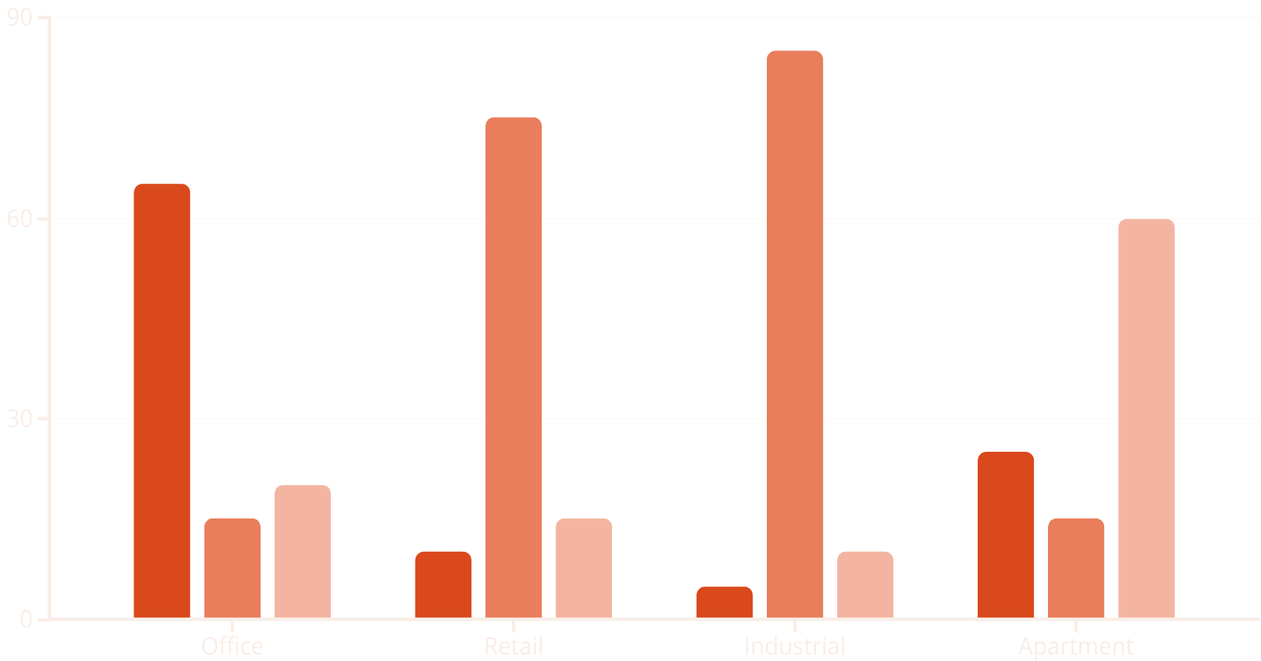
Lease Distribution by Property Type
Office properties predominantly use gross leases due to difficulty attributing expenses in multi-tenant buildings. Retail and industrial properties favor net leases, especially with single tenants. Apartments typically use hybrid leases with some utilities separately metered.
Gross Lease %
Net Lease %
Hybrid Lease %

Slide 13





Renewal Options at Market Rent
Not Just a Right of First Refusal
Even "at market" renewal options have value to tenants and cost to landlords beyond simple right of first refusal.
Tenant Holdup Problem
Landlords might exploit tenants with high moving costs by demanding above-market rent at renewal without this protection.
Landlord Holdup Problem
Tenants can block redevelopment plans by exercising renewal options, potentially costing landlords significant value.
Market Equilibrium
The value and cost of renewal options are typically reflected in agreed rent and other lease terms.

Slide 14






Micro-spatial Trade-Offs and Synergies
Tenant Mix Optimization
Strategic combination of tenants creates value beyond individual rents.
Anchor Tenant Benefits
Anchors draw customers and add prestige, creating positive externalities.
Optimal Space Configuration
Archetypical space sizes balance efficiency and market demand.
Clever mixing of tenants and space configurations can significantly enhance property value. Landlords may rationally offer lower ALV to tenants that create positive externalities for other tenants.
Anchor tenants often receive favorable terms because they generate value for the entire property. This explains why shopping centers may use short leases with options to continuously optimize tenant mix.

Slide 15
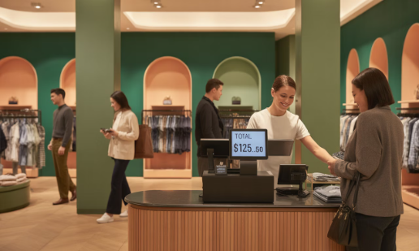
Why Percentage Rents in Retail?
Incentive Compatibility
Risk Reduction
Percentage rents give landlords direct incentive to help maximize store revenues through optimal tenant mix and center management.
Small retail businesses are sensitive to fixed rent leverage. Percentage rent reduces this effect by making rent proportional to revenue.
Without this alignment, landlords might not optimize for tenant success.
Landlord becomes like an equity partner, sharing in tenant's operating risk and growth.
The balance between fixed base rent and percentage components can be adjusted based on tenant financial strength and potential for positive externalities.

Slide 16
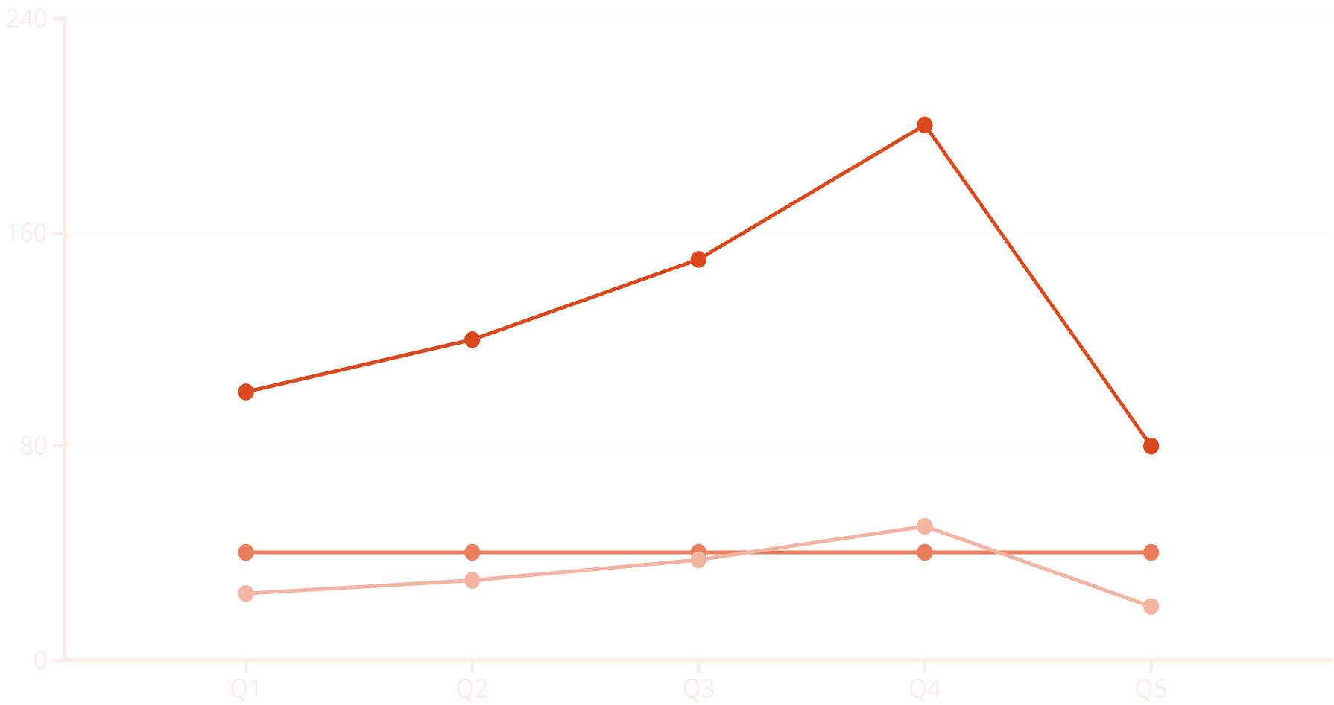
Percentage Rent Impact on Volatility
With fixed rent, tenant's net income fluctuates dramatically with revenue changes.
Percentage rent (shown as 25% of gross revenue) reduces this volatility by making rent costs
move in proportion to revenue.
Gross Revenue
Fixed Rent
Percentage Rent
This arrangement benefits financially vulnerable tenants by reducing operating leverage while allowing landlords to share in upside potential during strong sales periods.

Slide 17

Why Concessions Instead of Lower Rent?
Tenant Cash Flow Timing
Strategic Cash Flow Timing
Up-front concessions ease tenant moving or start-up expenses, matching rental expenses with revenue generation timing.
Higher future cash flows may facilitate building sale or loan refinancing if these events are likely in the future.
Information Privacy Value
Market Perception
Concessions are more private than quoted rent, concealing from other tenants and competitors exactly how low the effective rent is.
Maintaining higher quoted rents preserves perceived property value even when effective rents are lower due to concessions.

Slide 18





Optimal Landlord Search for Tenants
Set Asking Rent
Establish initial asking rent above expected transaction rent to allow negotiation room.
Evaluate Tenant Quality
Consider credit quality, business stability, and potential synergies with existing tenants.
Negotiate Terms
Balance rent level with concessions, term length, and options based on tenant quality.
Adjust Strategy
Modify asking rent or concessions based on market response and vacancy duration.
Landlords must balance the cost of continued vacancy against the benefit of waiting for a better tenant or higher rent. This optimal search problem involves weighing immediate income against long-term property value.

Slide 19








Expectations and Lease Term Structure
Market Rent Expectations
Releasing Cost vs. Flexibility
Rising rent expectations create upward-sloping term structure; falling expectations create downward slope.
Optimal lease term balances costs of finding new tenants against value of flexibility.
Expectation Alignment
Market Sector Norms
Complementary expectations facilitate agreement; conflicting expectations may require shorter terms.
Specific submarkets develop characteristic lease terms based on these trade-offs.

Slide 20

Key Leasing Strategy Takeaways
3
5
4
7+
Major Lease Types
Rent Change Methods
Term Length Factors
Typical Lease Durations
Gross, net, and hybrid leases distribute operating expenses differently between parties.
Flat, graduated, revaluated, indexed, and percentage rents serve different strategic purposes.
Releasing costs, market expectations, flexibility value, and expiration timing drive optimal terms.
From daily hotel stays to 20+ year industrial leases, each property type has characteristic terms.
Understanding lease structures and strategies is fundamental to real estate investment and property management. The optimal approach balances financial considerations with strategic property positioning.
Effective leasing strategies must consider both immediate financial impacts and long-term property value implications.

