Slide 1

Micro-Level Real Estate Investment and Finance
This presentation completes our exploration of micro-level real estate investment analysis. We'll build on financial and urban economics principles to examine property valuation, cost of capital, leverage effects, and tax implications.

Slide 2

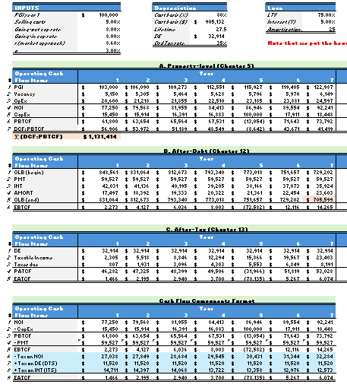
DCF Valuation: Numerators and Denominators
Numerators
Cash flow projections reflecting the space market dynamics.
Denominators
Discount rates reflecting the asset market and opportunity cost of capital.
Property-Before-Tax Level
Analysis at property asset level, not considering debt or taxes.

Slide 3
Capital Markets Overview
Public Markets
Private Markets
Homogeneous units traded on exchanges with many participants. High liquidity and price transparency.
Assets traded in private transactions between individual buyers and sellers. Lower liquidity and transparency.

Slide 4
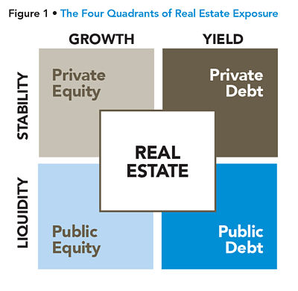
Capital Market Quadrants
Public
Private
Equity
Stocks, REITs, Mutual funds
Real estate, Equity funds
Debt
Bonds, MBS, Money instruments
Bank loans, Mortgages, Venture capital

Slide 5




Opportunity Cost of Capital (OCC)
Risk-Free Rate
Based on government securities yields.
Risk Premium
Additional return for taking investment risk.
Total Return
Expected return investors require for similar-risk investments.

Slide 6

Computing the Risk-Free Rate
Result: Long-Term Risk-Free Rate
Subtract Yield Curve Effect
Start with 10-Year Government Bond Yield
Typically, 1.5% to account for interest rate risk premium.
Represents expected average future short-term yields.
Reflects long-term investment horizon of real estate.

Slide 7

Method #1: Structural Approach to OCC
3%
4.5%
7.5%
Risk-Free Rate
Risk Premium
Total OCC
10-year bond yield minus 1.5% yield curve effect
Historical premium for institutional real estate
Expected return for typical commercial property

Slide 8
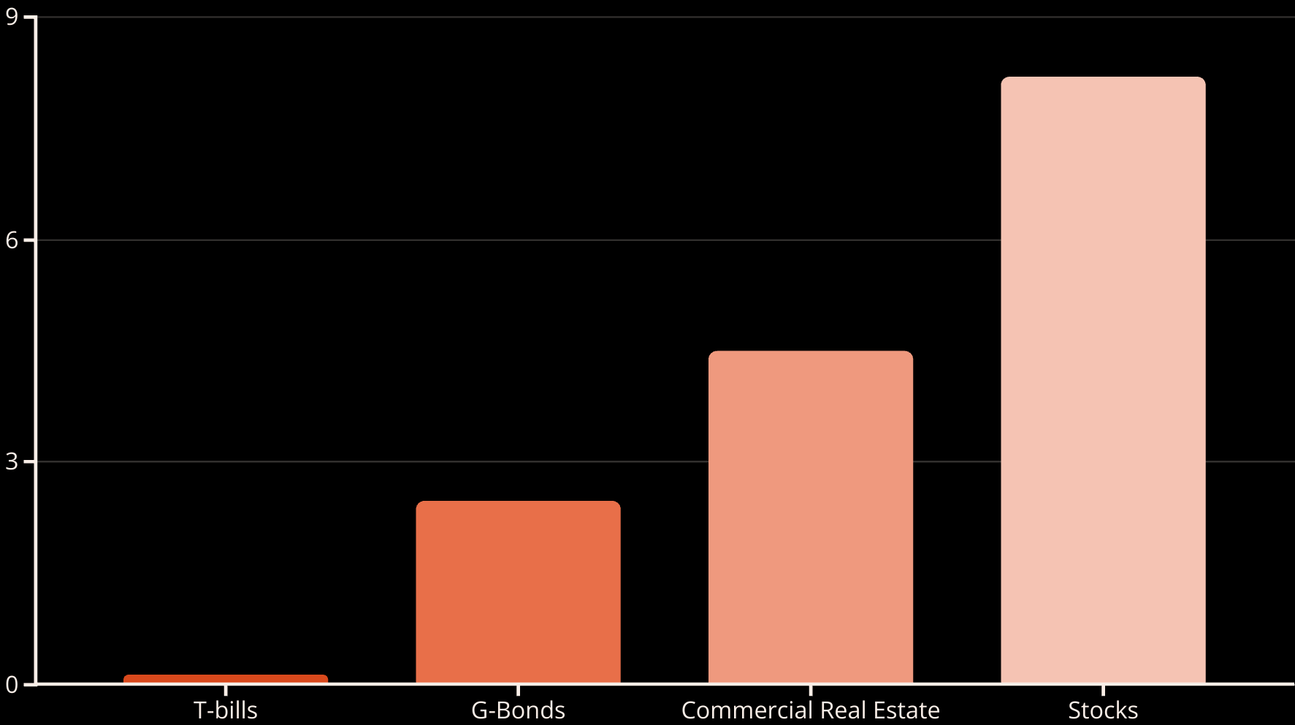
Historical Risk Premiums (1970-2022)
Risk premiums represent excess returns over T-bills. Commercial real estate has historically offered a premium between government bonds and stocks.

Slide 9








Method #2: Market Approach to OCC
Observe Cap Rates
Adjust for CapEx
Current transaction cap rates in relevant market
Multiply by 0.7 to reflect actual cash flow yield
Add Growth Rate
Calculate OCC
Expected rental growth minus depreciation
E[r] ≈ 0.7 × (Cap rate) + E[g]

Slide 10

Comparable Cap Rate Analysis
Find Similar Properties
Identify 3-10 comparable properties that recently sold in your target market.
Adjust for Differences
Account for variations in location, size, age, and market timing.
Calculate Average
Determine weighted average cap rate based on similarity to target property.
Apply Formula
Use adjusted cap rate in the market approach formula to find OCC.

Slide 11
Double-Checking OCC Estimates
Structural Approach
Market Approach
Risk-free rate + Risk premium
Adjusted cap rate + Growth rate
Reflects what OCC "should be" based on fundamental theory
Reflects current market conditions and property specifics
When approaches disagree, it may signal market overvaluation or undervaluation. This can provide valuable investment timing insights.

Slide 12




Alternative OCC Estimation Methods
Investor Surveys
Direct feedback on expected returns from market participants.
Corporate Bond Yields
Useful for valuing long-term leases with corporate tenants.
Historical Performance
Long-term actual returns for similar properties.

Slide 13



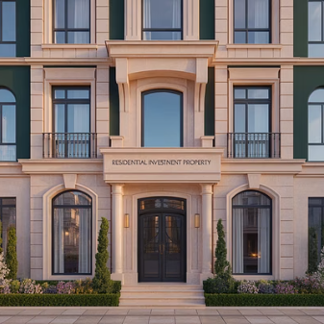

Property Type Risk Variations
Risk premiums vary by property type, size, and operational status. For example, hotels and specialty properties typically command higher risk premiums than core property types.

Slide 14








Institutional vs. Non-Institutional Properties
Trophy Assets
Lowest risk premium
Institutional Core
Moderate risk premium
Value-Add Properties
Higher risk premium
Development Projects
Highest risk premium

Slide 15



Going-Out Cap Rate Considerations
Property Age
Younger properties experience more cap rate creep.
Growth Expectations
Changes in rental growth projections affect exit cap rate.
Risk Premium Changes
Older properties typically have higher risk premiums.

Slide 16
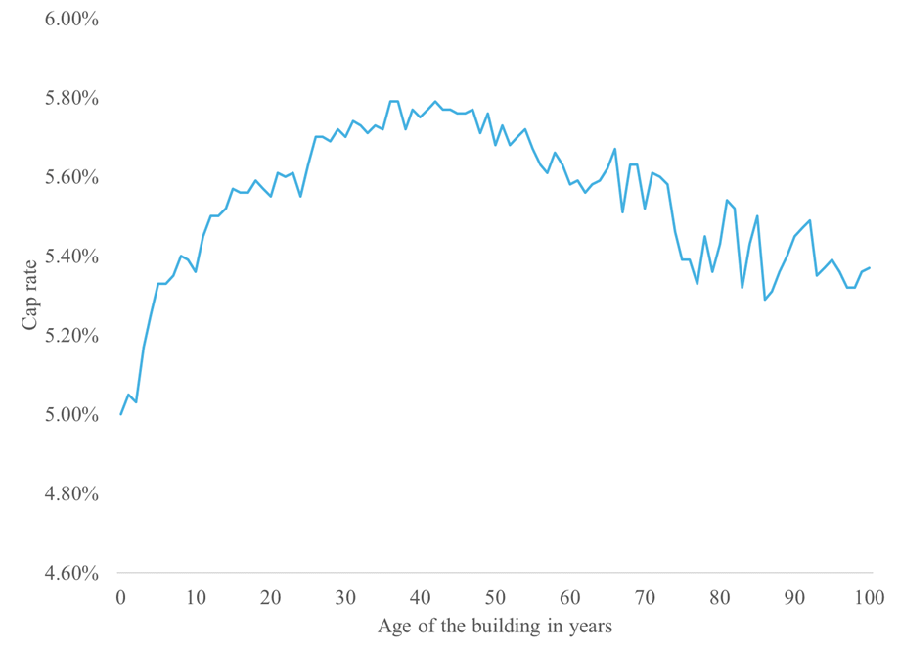
Cap Rate Age Profile: In general cap rates increase with building age except for
Some classic or iconic buildings in prime locations.
Cap rates typically increase in the first decade (cap rate creep), then stabilize and may decrease in older properties (cap rate compression).

Slide 17
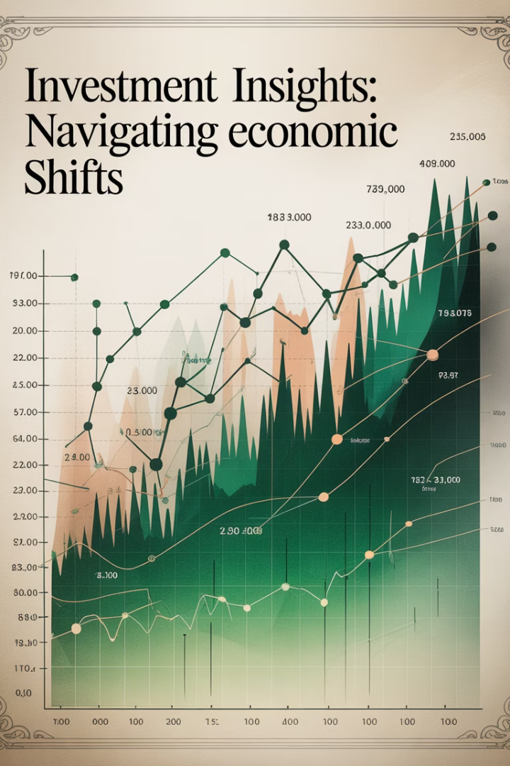




Inflation Impact on Discount Rates
Nominal Risk-Free Rate
Increases with inflation (real rate + inflation)
Risk Premium
May decrease slightly as real estate hedges inflation
Rental Growth
Often increases with inflation, offsetting discount rate changes
Cap Rates
Remain relatively stable as inflation effects mostly cancel out

Slide 18

Common DCF Mistakes: GIGO Problems
1
Intentionally Misleading Assumptions
2
Excessive Laziness
Using unrealistic inputs to make a property look more valuable.
Relying on conventional wisdom rather than property-specific analysis.
3
Ignoring Market Cycles
4
Misapplying Underwriting Haircuts
Failing to consider cyclical tendencies in space and asset markets.
Using conservative assumptions inconsistently or inappropriately.

Slide 19
Underwriting Haircuts vs. GIGO
Underwriting Haircuts
GIGO Problems
Deliberate conservative assumptions to protect against downside risk.
Poor quality inputs that lead to unreliable or misleading valuations.
Intentionally conservative
Unrealistic assumptions
Risk management tool
Lack of rigor
Common in lending
Often self-deceptive

Slide 20








Key Takeaways
Multiple Methods
Property Specifics
Use both structural and market approaches to estimate OCC.
Adjust for property type, age, and market conditions.
Quality Inputs
Market Cycles
Ensure realistic, unbiased assumptions in all DCF components.
Consider where we are in space and asset market cycles.

