Slide 1

The Effect of Leverage in Real Estate Investment
Leverage is a powerful tool in real estate investment that allows investors to control larger assets with less equity. This presentation explores how debt financing impacts risk and return in real estate investments.

Slide 2

Understanding Leverage: The Basics
Definition
Widespread Use
Leverage allows equity investors to magnify the amount of underlying physical capital they control.
Over $4 trillion in commercial mortgage loans outstanding in the early 2020s in the US.
Key Metrics
Industry Standard
Leverage Ratio (LR) = Total Asset Value/Equity Value
Loan-to-Value (LTV) = Loan Amount/Property Value

Slide 3
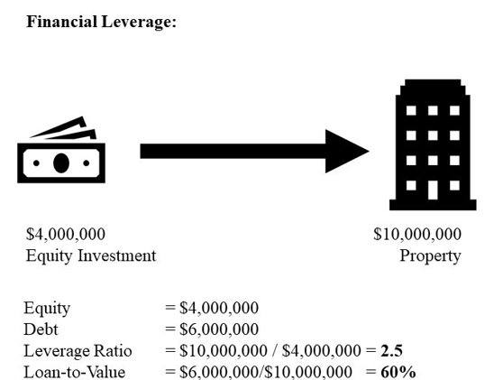
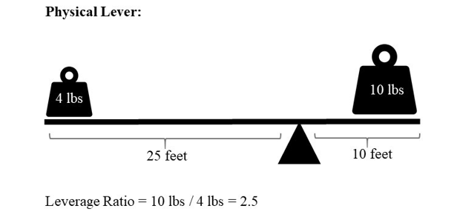
The Physical Lever Analogy
Physical Leverage
Financial Leverage
An investor purchases a $10 million property using $4 million equity and $6 million borrowed money.
A 4-pound weight can balance a 10-pound weight by standing at the end of an arm 2.5 times longer.
The leverage ratio is 2.5, allowing control of an asset 2.5 times greater than the equity invested.
The weight ratio equals the inverse of the arm length ratio.

Slide 4

Impact on Expected Returns
Unlevered Property
Levered Equity (60% LTV)
10% total return: 8% income return + 2% appreciation return
13% total return: 8% income return + 5% appreciation return
Key Insight
Leverage increases expected return when borrowing at an interest rate lower than the property's expected return.

Slide 5



The Risk Trade-off
Unlevered Property
±11% range in total return between optimistic and pessimistic scenarios
Levered Equity (60% LTV)
±27.5% range in total return between scenarios
Risk Magnification
Risk is magnified by a factor equal to the leverage ratio (2.5x)

Slide 6
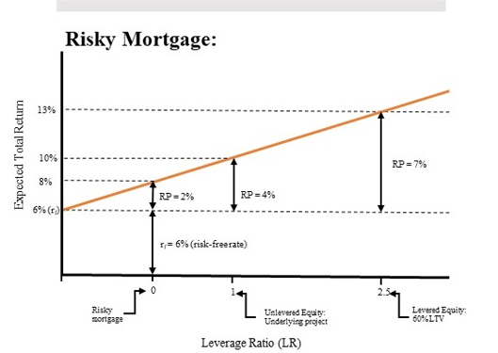

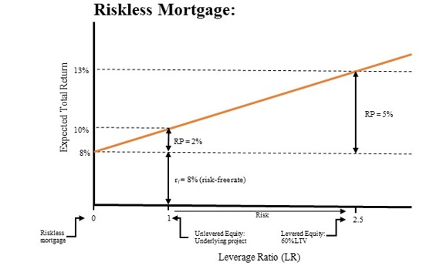




The Security Market Line
Risk-Free Rate
Mortgage Return
Base return with zero risk (e.g., 6% T-bills)
Includes risk premium (e.g., 8% return = 6% risk-free + 2% premium)
Unlevered Property
Levered Equity
Higher risk premium (e.g., 10% return = 6% risk-free + 4% premium)
Highest risk premium (e.g., 13% return = 6% risk-free + 7% premium)

Slide 7
The Weighted Average Cost of Capital
Where:
rP is the return on the underlying property
rD is the return to the property's debt
rE is the return to the levered equity
LTV is the loan-to-value ratio

Slide 8

Solving for Equity Return
Example: If property return is 10%, debt costs 8%, and LTV is 60%:

Slide 9
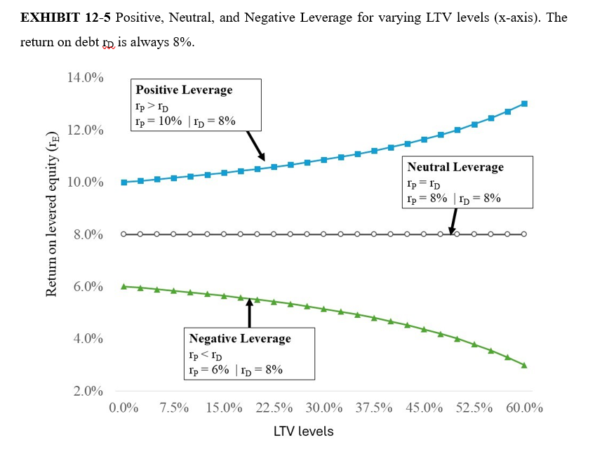
Positive vs. Negative Leverage
LTV
Positive (rP=10%, rD=8%)
Neutral (rP=8%, rD=8%)
Negative (rP=6%, rD=8%)
Positive leverage occurs when property return exceeds debt cost. Negative leverage occurs when debt cost exceeds property return.

Slide 10








Impact on Return Components
Debt Return
Property Return
8% interest - 1% amortization = 7% total
8% income + 2% growth = 10% total
Key Insight
Equity Return
Leverage shifts return from income toward appreciation
9.5% income + 6.5% growth = 16% total

Slide 11
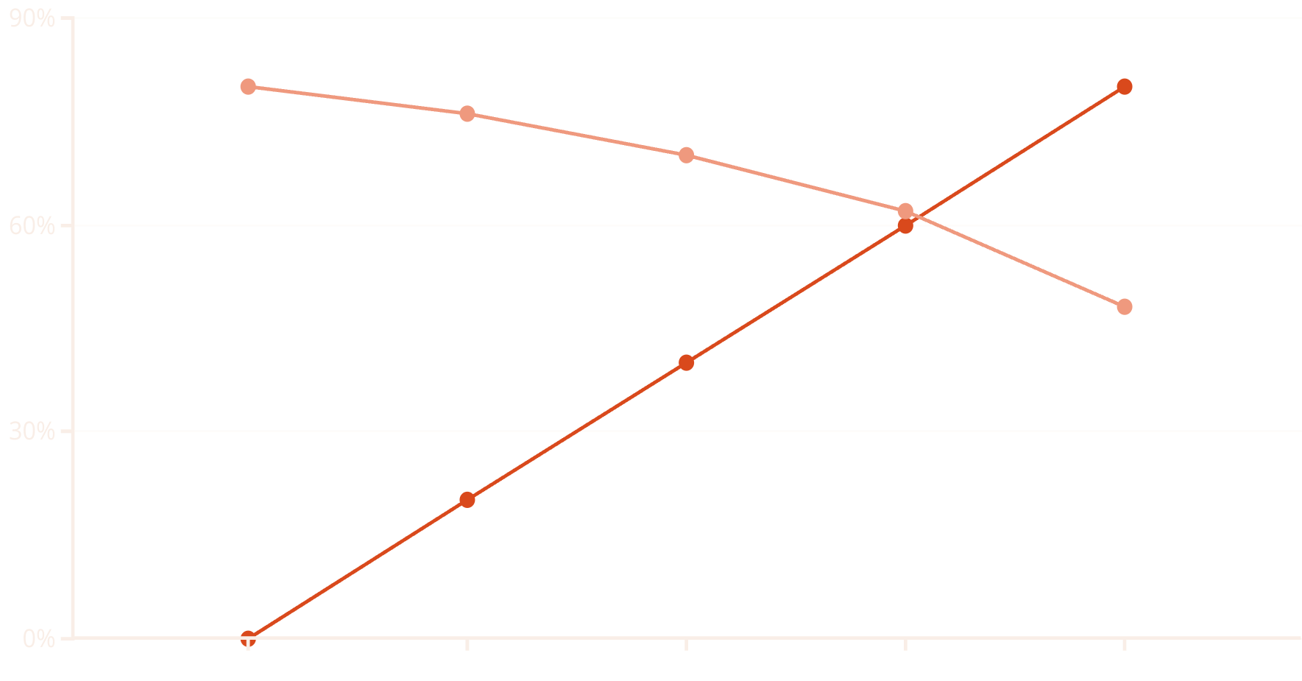
Income vs. Growth Component: More leverage means less income return
of the total return.
LTV
Income % of Total Return
As leverage increases, the proportion of total return coming from income decreases, while the proportion from appreciation increases.

Slide 12




Real-World Commercial Mortgages
Common Terms
1/7, 2/8, or 3/10 structures with 25-year amortization
Adjustable Rates
Interest rates may adjust based on indexes like LIBOR
Balloon Payments
Large final payment when loan matures before full amortization

Slide 13
Calculating Mortgage Payments
Where:
PMT is the monthly payment
OLBt-1 is the outstanding loan balance
rt is the monthly interest rate
Nt is the remaining months to maturity

Slide 14
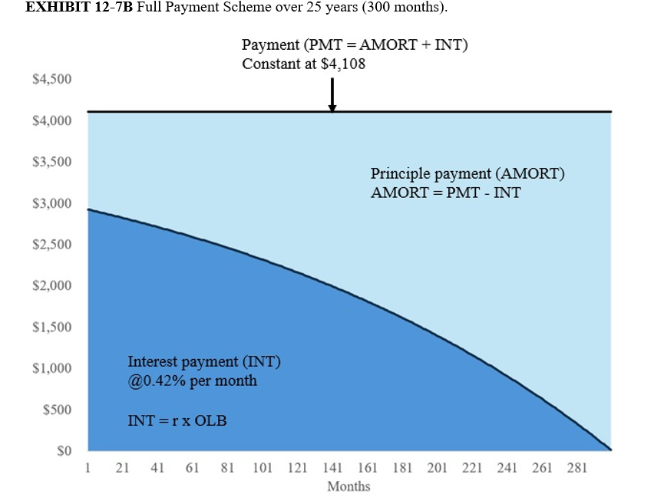
Mortgage Payment Components
Over time, the composition of mortgage payments shifts from mostly interest to mostly principal, while the total payment remains constant.

Slide 15
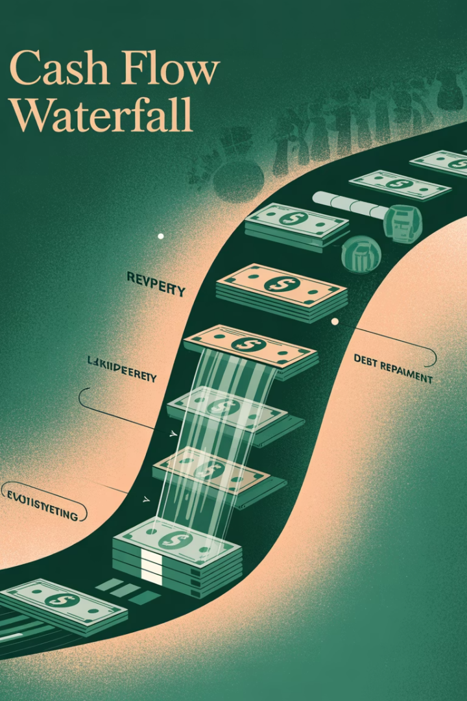
Calculating Equity Cash Flow
Property Before-Tax Cash Flow (PBTCF)
Net operating income minus capital expenditures
Debt Service
Annual mortgage payments (principal + interest)
Equity Before-Tax Cash Flow (EBTCF)
PBTCF minus debt service

Slide 16

Impact on Equity IRR
8.60%
15.03%
6.43%
Unlevered IRR
Levered IRR
IRR Increase
Return on property with no debt
Return on equity with 75% LTV
Difference due to leverage effect

Slide 17
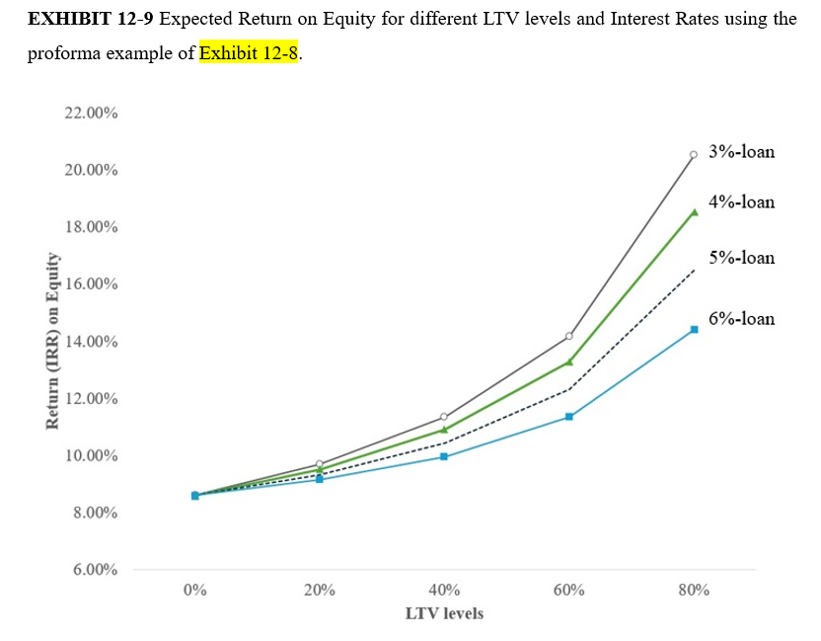
Leverage and Interest Rate Impact
LT
3% Interest
4.5% Interest
Higher leverage amplifies the impact of interest rate differences on equity returns.

Slide 18








The Temptation and Danger of Leverage
Bankruptcy Risk
Excessive leverage is the leading cause of investment failure
Systemic Risk
Interconnected debt can propagate failures through the system
Market Crashes
Commercial property markets crash every few decades
Prudent Use
Moderate leverage can enhance returns while managing risk

Slide 19





Key Takeaways
Risk-Return Tradeoff
Leverage increases both expected return and risk, typically in proportion.
Return Composition
Leverage shifts returns from current income toward appreciation.
Careful Analysis
Proper debt structuring requires understanding payment mechanics and cash flow impacts.
Prudent Management
Successful investors balance leverage benefits against increased vulnerability.

