Slide 1

After-Tax Real Estate Investment Analysis
This presentation explores how income tax obligations affect real estate investment cash flows at the after-tax level. We'll examine the interaction between tax effects and debt financing on equity investor returns.

Slide 2





Key Learning Objectives
Calculate After-Tax Cash Flow
Learn to estimate annual after-tax cash flows for property investments.
Understand Taxable Income
Master the calculation of annual taxable income for real estate investments.
Analyze Tax Effects
Understand how depreciation postpones taxation and how resale gains are taxed.
Evaluate Leverage Impact
Utilize proformas to analyze how debt affects after-tax returns.

Slide 3




Cash Flow Levels: From Property to Equity
Property-Level Before-Tax Cash Flow (PBTCF)
The cash flow generated by the property before considering debt or taxes.
Equity-Before-Tax Cash Flow (EBTCF)
The cash flow to the equity investor after debt service but before taxes.
Equity-After-Tax Cash Flow (EATCF)
The bottom-line cash flow to the investor after both debt service and taxes.

Slide 4
Accrual vs. Cash Flow Accounting
Accrual Accounting
Cash Flow Accounting
Records income and expenses when legally owed, not when cash changes hands.
Records actual cash inflows and outflows when they occur.
Used to determine taxable income for the property owner.
What investors ultimately care about for investment decisions.
Income taxes are based on accrual accounting, but they affect the investor's cash flow. Net income can diverge significantly from net cash flow.

Slide 5

Key Differences: Cash Flow vs. Taxable Income
Depreciation Expense
Capital Expenditures
Not a cash outflow but reduces taxable income. Property structure value can be depreciated over time, providing a tax shield.
Immediate cash outflows but capitalized and depreciated gradually for tax purposes. Limited immediate tax benefit.
Debt Amortization
Principal payments reduce cash flow but aren't tax-deductible expenses. Only interest portion reduces taxable income.

Slide 6

Calculating Depreciation Expense
Determine Depreciable Cost Basis
Subtract land value from acquisition price. Only building structure, equipment, and fixtures can be depreciated.
Apply Appropriate Lifetime
Use 27.5 years for residential structures and 39 years for non-residential property (US rules).
Calculate Annual Expense
Divide depreciable cost basis by the permitted lifetime to find yearly depreciation expense.

Slide 7

Depreciation Example
$1M
$800K
$29,091
Property Purchase
Depreciable Basis
Annual Depreciation
After subtracting $200K land value
Total acquisition price
For residential property ($800K ÷ 27.5 years)
The depreciation clock resets for new owners whenever the property is sold, regardless of building age.

Slide 8








Calculating After-Tax Operating Cash Flow
Start with NOI
Calculate Taxable Income
Net Operating Income after all operating expenses
NOI - Interest - Depreciation Expense
Compute EATCF
Determine Tax Obligation
EBTCF - Tax Obligation
Taxable Income × Tax Rate

Slide 9
Tax Shields and Shelters
What Are Tax Shields?
Historical Context
When a property generates negative taxable income, these losses can offset other income sources, reducing overall tax liability.
In the 1980s, generous tax shields and easy credit created a real estate boom followed by crisis.
The 1986 tax reform removed many special real estate tax incentives, causing a decade-long recovery in prices.
This creates "negative taxes" in the property's proforma, generating additional cash flow.

Slide 10

Cash Flow Components Format
NOI
$77,250
- CapEx
$15,450
PBTCF
$61,800
- Debt Service
$49,293
EBTCF
$12,507
- Tax on NOI
$27,038
+ Depreciation Tax Shield
$9,539
+ Interest Tax Shield
$12,182
EATCF
$7,190
This format highlights tax shield components separately, making it easier to analyze cash flows with different risk characteristics.

Slide 11





Capital Gains Tax: Key Definitions
Net Sales Proceeds (NSP)
Gross Book Value (GBV)
Adjusted Basis (AB)
GBV minus accumulated depreciation. Also called Net Book Value.
Sales price minus selling costs. Also called PBTCF at reversion.
Purchase price plus all capital expenditures. Represents total gross investment.
Capital Gain/Loss
Capital gain occurs when NSP > AB. Capital loss when NSP < AB.

Slide 12



Capital Gains Tax Components
Total Capital Gains Tax
1
Sum of "pure" capital gains tax and depreciation recapture tax
"Pure" Capital Gains
2
15% tax on (NSP - GBV) when NSP > GBV
Depreciation Recapture
3
25% tax on recovered depreciation
When NSP > GBV, all accumulated depreciation is taxed at 25%. When GBV > NSP > AB, only the portion (NSP - AB) is taxed at 25%.

Slide 13
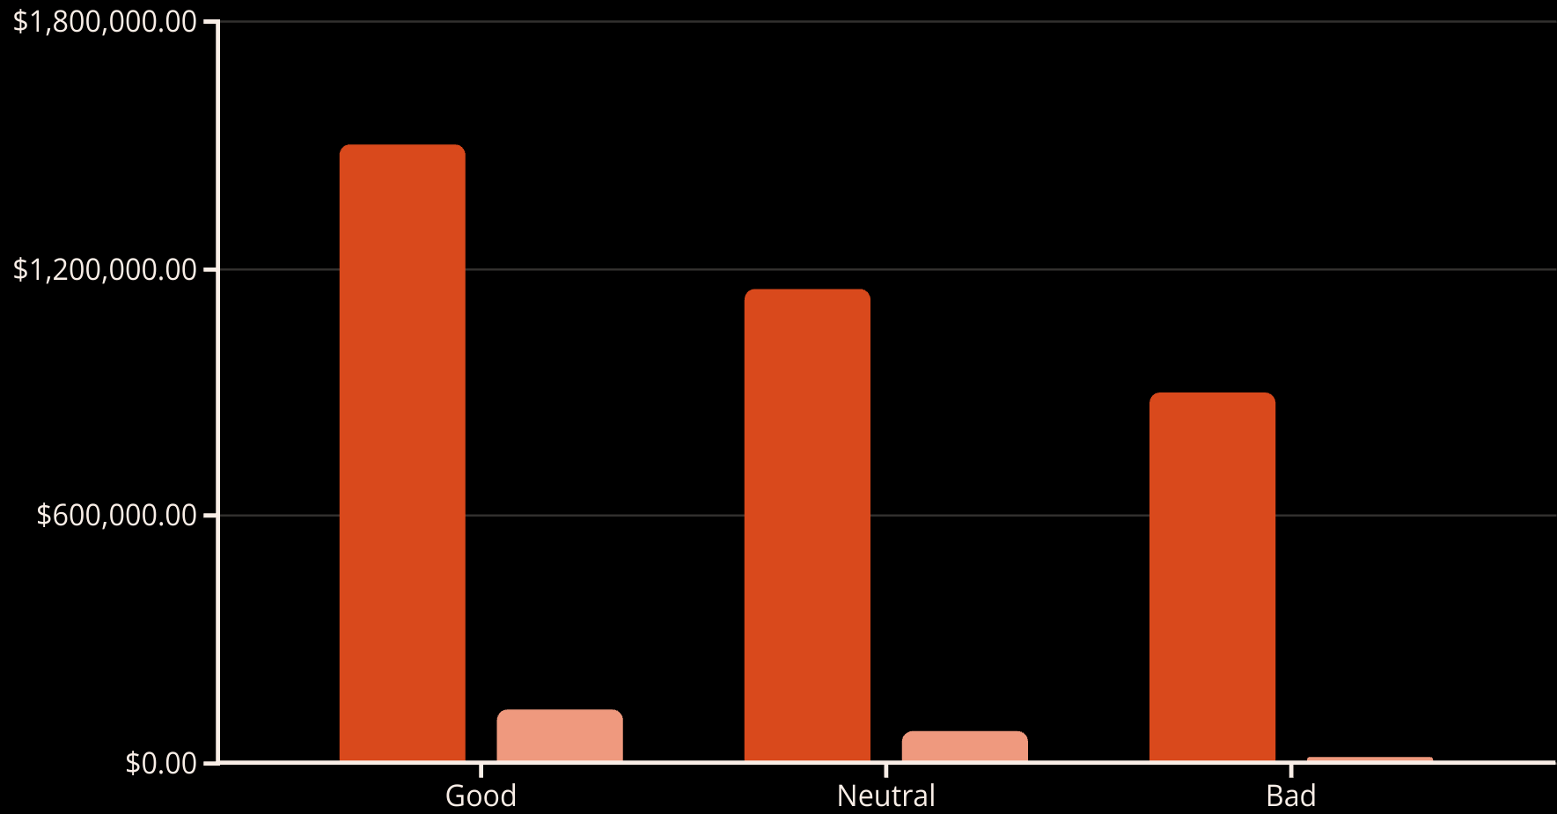
Capital Gains Tax Scenarios
Net Sales Price
Capital Gains Tax
Even in the "bad" scenario with a sale price below purchase price, capital gains tax may still be owed due to depreciation recapture if NSP > AB.

Slide 14





Like-Kind Exchanges (Section 1031)
Tax Deferral Opportunity
Capital gains tax can be deferred (not exempted) by reinvesting in "like-kind" real estate.
Time Constraints
45 days to identify replacement property and 180 days to close the exchange.
Value Requirements
New investment value must equal or exceed the old investment value.
Third-Party Facilitator
Required to hold proceeds and ensure IRS compliance.

Slide 15
Cash Flow Components Analysis
Separating investment cash flows into components highlights different sources and risk levels.
Lower-risk cash flows generally present lower expected returns.

Slide 16




Calculating Investment Returns
Property-Level Before-Tax IRR
Apply IRR function to PBTCF stream
Property-Level After-Tax IRR
Apply IRR function to PATCF stream
Equity-Level Before-Tax IRR
Apply IRR function to EBTCF stream
Equity-Level After-Tax IRR
Apply IRR function to EATCF stream

Slide 17

Example IRR Calculations
8.60%
6.05%
15.03%
11.17%
Property Before-Tax IRR
Property After-Tax IRR
Equity Before-Tax IRR
Equity After-Tax IRR
Unlevered return after income taxes
Levered return before considering taxes
Levered return after income taxes
Unlevered return before considering taxes

Slide 18
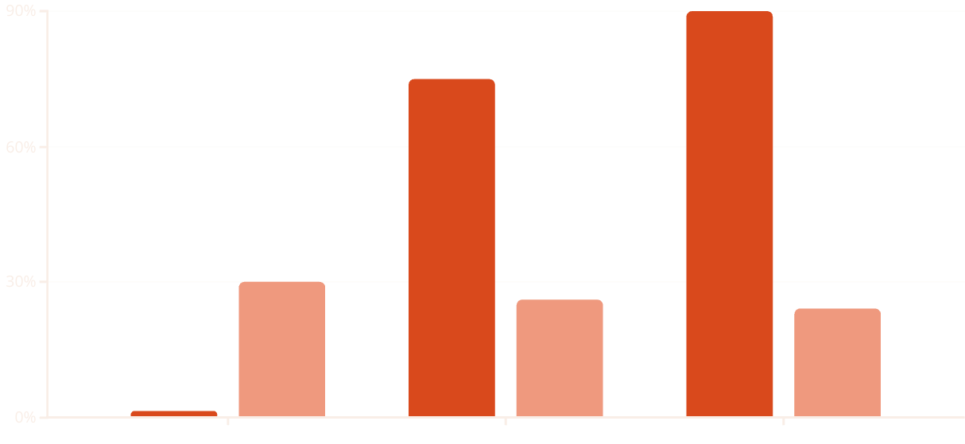
Leverage and Effective Tax Rate
LTV Ratio
Effective Tax Rate
Leverage reduces the effective tax rate by shifting returns toward capital gains and magnifying depreciation tax shields. However, leverage also increases investment risk.

Slide 19








Discount Rate Considerations
Consistency Rule
Market-Based OCC
Discount equity-after-tax cash flows at the appropriate equity-after-tax discount rate.
Opportunity cost of capital comes from the market, not individual investors.
Tax Effect Challenges
Property-Level Approach
Difficult to quantify tax effects on required returns across different investors.
Often easier to observe property-level returns than after-tax equity returns.

Slide 20


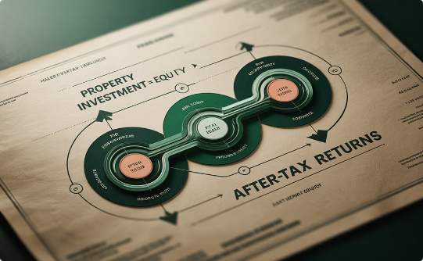
Key Takeaways
Tax Shield Benefits
Leverage Effects
Cash Flow Analysis
Depreciation and interest expenses create valuable tax shields that enhance after-tax returns.
Debt financing amplifies returns but also increases risk. It can reduce effective tax rates on equity returns.
The Cash Flow Components format helps analyze different risk characteristics in investment returns.

