Slide 1

Investment Value in Property Investment and Debt Financing
This presentation explores the advanced concepts of investment value and debt financing in real estate. We'll examine how sophisticated investors can leverage unique market positions and tax advantages to create positive NPV opportunities.

Slide 2
Market Value vs. Investment Value
Market Value (MV)
Investment Value (IV)
The expected price at which an asset would sell in the current property market without pressure or distress.
A property's value to a particular owner who plans to operate the asset long-term.
Reflects opportunity cost of the investment.
Can differ between investors for the same asset.

Slide 3

Key Differences: MV vs. IV
Market Value
Investment Value
Objective value exogenous to any one party.
Private or subjective valuation of a specific party.
Same for a given asset for all investors at a given point in time.
Based on unique investor circumstances and capabilities.
Relationship
When IV > MV, buying makes sense.
When IV < MV, selling makes sense.

Slide 4





When IV Exceeds MV: Examples
Expansion Needs
A retailer values adjacent lots higher than market for expansion space and to block competitors.
Market Power
An investor owning most apartments in an area values additional properties higher to strengthen market position.
Synergy Effects
A property owner sees unique synergies between existing and potential new properties.
Entrepreneurial Innovation
An investor develops a new property concept that meets latent market demand.

Slide 5





Measuring Investment Value
Use Multiperiod DCF
Project long-term cash flows specific to the particular owner/user.
Include Synergy Effects
Account for spillover benefits with owner's other assets and operations.
Apply Market Discount Rates
Use opportunity cost of capital based on capital markets.
Focus on Cash Flow Numerators
Differences in IV typically come from cash flow projections, not discount rates.

Slide 6
Boston Real Estate Example
Current Situation
1
BRE owns apartment complex (Plot A) generating $100,000 yearly.
Opportunity
2
Adjacent Plot B available with two development options: apartment or retail.
Synergy Effect
3
Retail on Plot B would increase Plot A's value by $400,000 through spillover benefits.

Slide 7



Decision Making with IV and MV
Maximize NPV
1
Choose alternatives with highest NPV
Consider Both Perspectives
2
Calculate NPV using both MV and IV
Evaluate Unique Situations
3
When NPVIV > 0 > NPVMV or NPVMV > 0 > NPVIV

Slide 8
Negotiation Philosophies
Conservative Philosophy
Liberal Philosophy
Never pay more than MV for something, even if your IV is higher.
Make the deal as long as it meets investment criteria on NPVIV basis.
Bargain seller down to MV or walk away from the deal.
Bargain for best price, but accept positive NPV from your IV perspective.

Slide 9








Setting Your Reservation Price
Search Costs
Asset Necessity
Consider how costly it is to continue searching for alternative assets.
How desperately you want or need this specific asset affects your price ceiling.
MV Certainty
Risk Tolerance
The more certain you are about MV, the closer to that MV you'll set your reservation price.
Lower risk tolerance suggests setting a more conservative reservation price.

Slide 10

Marginal vs. Intramarginal Investors
Marginal Investors
Those for whom IV = MV, indifferent between buying and selling at market price.
Intramarginal Investors
Those for whom IV ≠ MV, can achieve positive NPV deals by trading at market prices.
Market Equilibrium
MV is determined by the IV of marginal participants in the asset market.

Slide 11








Investment Value Through Debt Financing
Tax Effects
Value Additivity
Debt's impact varies based on investor's tax situation.
Property value equals sum of all cash flow component values.
Market Equilibrium
Adjusted Present Value
Competition drives typical APV to zero for marginal investors.
APV = NPV(Property) + NPV(Financing)

Slide 12

After-Tax Valuation of Debt Example
4%
3%
25%
Market Mortgage Rate
Tax-Exempt Rate
Implied Tax Rate
Municipal bond rate for tax-free investments
Marginal tax rate of typical debt market investors
Prevailing interest rate for typical mortgage loans

Slide 13

Investor Tax Scenarios
Investor Type
Tax Rate
Debt NPV Impact
Marginal (Mary)
25%
Zero NPV
Tax-Advantaged (Abner)
20%
Negative NPV
Tax-Disadvantaged (Clarence)
30%
Positive NPV

Slide 14
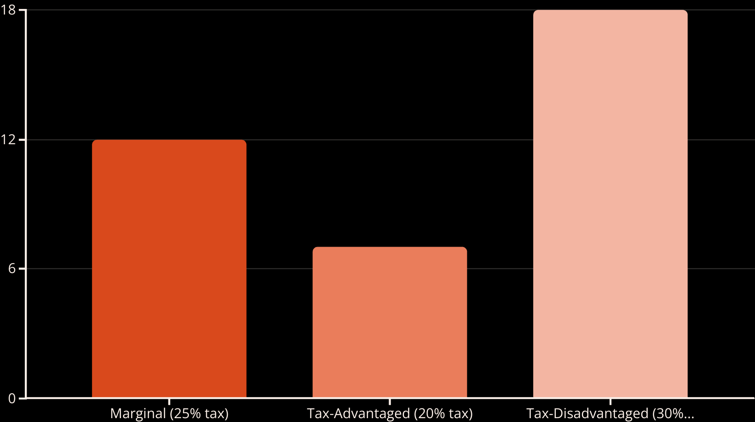
Subsidized Loan Analysis
NPV of borrowing $100 with a subsidized 3.5% loan (market rate: 4%)

Slide 15





Debt and Taxes in Property Market
Higher Tax Investors
Gain positive NPV from borrowing
Market Competition
Drives property prices higher
Equilibrium Reached
When APV = 0 for marginal investors
Price Premium
Property prices include tax advantage value

Slide 16



Apartment Property Example
Property Details
Financing
Tax Situation
Market value: $937,000
Loan amount: $702,670
Investor tax rate: 35%
NOI: $77,250 in year 1
Interest rate: 5%
Debt market marginal tax rate: 15%

Slide 17





Valuation by Components
Calculate After-Tax OCC of Debt
(1-0.15) × 5% = 4.25%
Discount Loan Cash Flows
Present value of loan obligation: $649,767
Calculate NPV(Financing)
$702,670 - $649,767 = +$52,903
Determine NPV(Property)
For APV = 0, NPV(Property) = -$52,903

Slide 18

Corporate Real Estate: Own vs. Rent
Key Principles
Typical Outcome
Discount after-tax cash flows at after-tax discount rates.
For profitable taxed corporations, leasing often makes more sense from a tax perspective.
Include both corporate and personal taxation levels.
Value impact is typically small when considering debt capacity effects.
Discount cash flow components at risk-appropriate OCC rates.
Other Considerations
Duration of space usage, depreciation allowances, price/rent multiples, and expected capital gains.
Non-financial factors may outweigh tax considerations.

Slide 19




Key Takeaways: Investment Value
IV vs. MV Framework
Tax Advantages
Understanding both perspectives enables better investment decisions.
Debt financing can create positive NPV for high-tax-bracket investors.

Slide 20





Next Steps for Sophisticated Investors
Identify Unique Advantages
Analyze Tax Situation
Apply APV Framework
Develop Negotiation Strategy
Look for situations where your IV exceeds MV due to synergies or capabilities.
Understand how your tax position affects debt financing value.
Evaluate investments by separating property and financing components.
Set reservation prices based on your IV and market knowledge.

