Slide 1

Advanced Topics in Capital Structure
This presentation explores the role of debt in real estate equity investment, examining both the strategic reasons different investors use debt and the mechanics of project-level capital structure in institutional real estate investment.

Slide 2

Understanding Capital Structure
Definition
Micro-Level Focus
The relative use of debt versus equity financing in real estate investments.
Real estate investment often occurs at the individual deal or project level.
Unique Considerations
Complex Structures
Physical assets are relatively easy for outsiders to observe and evaluate.
Various investor types can be combined to allocate risk, return, and control.

Slide 3





Debt with Equity Capital Constraints
Breaking Through Constraints
Debt financing allows investors to expand beyond their equity capital limits.
Capturing Positive NPV
Enables investors to pursue opportunities requiring more capital than available equity.
Enabling Diversification
Allows spreading equity across multiple properties rather than concentrating in few assets.
Maintaining Control
Preserves management control compared to bringing in additional equity partners.

Slide 4
Leveraging Human Capital
What Is Human Capital?
How Debt Enhances Human Capital
The productive abilities, skills, and expertise that individuals acquire to generate income.
Allows investors to acquire larger properties or more properties than possible with equity alone.
For real estate investors, this includes property management skills, development abilities, and market knowledge.
Creates more opportunities to apply specialized skills and expertise across a larger portfolio.
Enables investors to perform more property management or development services.

Slide 5

Diversification Through Debt
The "Lumpiness" Problem
Real estate requires purchasing whole assets, making diversification difficult with limited equity.
Debt Solution
With 75% LTV debt, $10M equity can buy eight $5M properties instead of just two.
The "Free Lunch"
Diversification uniquely allows investors to reduce risk without reducing expected return.
Important Caveat
Don't "borrow to lend" - diversification should be into risky assets, not bonds.

Slide 6








Limitations on Equity Constraints
Alternative Vehicles
Track Record Impact
REITs, partnerships, and syndications provide equity access without debt.
Successful investors can more easily attract equity partners.
Information Sharing
Control Concerns
Reluctance to reveal proprietary information to potential equity partners.
Some investors avoid equity partners to maintain management control.

Slide 7



Debt as Management Incentive
Magnifying Risk and Reward
Debt increases both risk and potential return for property managers.
Heightening Attention to Detail
Small improvements become more noticeable with leverage.
Driving Innovation
Thinner margins encourage creativity and experimentation.
With 75% LTV debt, a 1% improvement in property performance becomes a 4% impact on equity returns, making managers more attentive to opportunities and threats.

Slide 8





Debt and Liquidity
Reduced Flexibility
Strategic Timing
Market Cycles
Cash-Out Option
Lower debt preserves capacity to act when market opportunities arise.
Liquidity helps avoid forced sales during market downturns.
High leverage limits ability to quickly convert assets to cash without loss.
Debt allows partial liquefaction of gains without selling the property.

Slide 9






Costs of Financial Distress
Agency Costs
Conflicts between equity and debt holders at high leverage
Legal Expenses
Costs of default, foreclosure, and bankruptcy proceedings
Property Neglect
Reduced incentive for long-term maintenance at high LTV
These costs are factored into loan terms ex-ante, affecting interest rates and fees charged to borrowers. Real estate can typically support higher LTV ratios (up to 75%) than corporations (around 50%) before these costs become significant.

Slide 10

Debt and Inflation
Scenario
Low Inflation (0%)
Expected (2%)
High Inflation (4%)
Property Growth
-1.0%
1.0%
3.0%
Unlevered Real Return
-1.0%
-1.0%
-1.0%
Levered Equity Growth
-2.5%
2.5%
7.5%
Levered Real Return
-2.5%
0.5%
3.5%
Only unexpected inflation benefits borrowers. Expected inflation is priced into interest rates. Fixed-rate debt magnifies the inflation-hedging quality of real estate, making it a positive risk factor in levered equity.

Slide 11





Project-Level Capital Structure
First-Lien Mortgage
Senior debt secured directly by the property with first claim on assets.
Mezzanine Debt
Subordinated to senior debt but senior to equity, often secured by ownership interests.
Preferred Equity
Contractual dividend/yield with priority over common equity but subordinate to debt.
Common (Residual) Equity
Ownership entity with operational control receiving residual cash flow after other obligations.

Slide 12

Enriching the Capital Structure
Multiple-Note Mortgages
Single mortgage split into separate notes, either horizontally (equal priority) or vertically (A/B notes with different priorities).
Mezzanine Debt Features
Higher interest rates than first mortgages, with interest often accruing if not paid currently.
Preferred Equity Characteristics
Returns primarily through dividends rather than appreciation, typically placed before and paid after mezzanine debt.
Differentiated Equity Partners
Joint ventures with different classes of partners based on contributions and objectives.

Slide 13
Joint Venture Equity Structures
General Partner (GP)
Limited Partner (LP)
Typically contributes:
Typically contributes:
Operational management
Majority of equity capital
Deal sourcing
Institutional backing
Development expertise
Receives:
Smaller equity portion
Preferred return
Receives:
Capital protection
Management fees
Major decision rights
Promote above hurdle
Operational control

Slide 14





Cash Flow Waterfall Structure
First Mortgage Payments
Senior debt service has first priority on property cash flow.
Preferred Returns
LP receives contractual preferred return (e.g., 5.5% on invested capital).
Residual Split
Remaining cash flow split between partners (e.g., 50/50).
Promote Mechanism
GP receives disproportionate share after hitting return hurdles.

Slide 15

Apartment Investment Example
$937K
75%
90%
5.5%
Property Value
LTV Ratio
LP Equity Share
Preferred Return
Total acquisition price
First-lien mortgage at 5% interest
$211K of $234K total equity
Annual return to LP on invested capital
The GP contributes 10% of equity ($23K) but receives 50% of cash flow after the LP's preferred return, creating strong performance incentives.

Slide 16
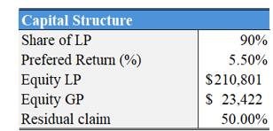
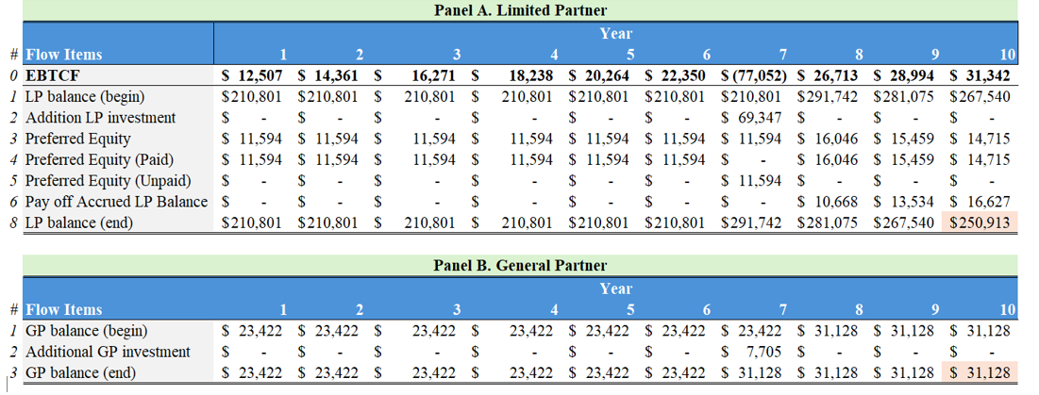
Capital Account Tracking
Capital accounts track each partner's investment basis, including initial contributions, additional investments, and unpaid preferred returns. The spike in year 7 reflects capital expenditure requirements.

Slide 17





Expected Returns by Position
Unlevered Property
First Mortgage
8.6% IRR
5.0% IRR
2
1
Moderate risk, no leverage
Lowest risk, senior position
Limited Partner
11.8% IRR
3
Preferred position in equity
General Partner
5
29.3% IRR
Entity Level Equity
4
15.0% IRR
Highest risk, junior position
Combined equity return
Returns increase with risk position in the capital structure. The GP achieves the highest return due to the promote structure and junior position.

Slide 18
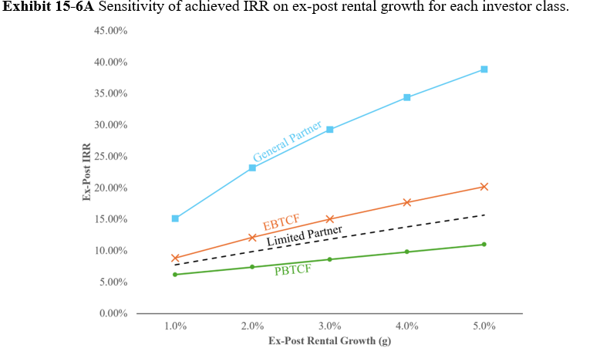
Sensitivity Analysis
GP returns are highly sensitive to changes in rental growth rates, ranging from negative to extremely positive.
Rental Growth Impact

Slide 19
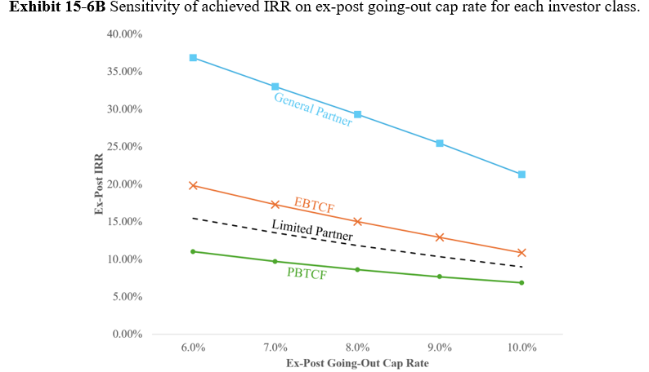
Sensitivity Analysis
Lower exit cap rates dramatically improve GP returns while modestly improving LP returns.
Exit Cap Rate Impact
Combined Scenarios
In worst case (1% growth, 10% cap rate), LP gets 4.7% while GP faces -22% IRR. In best case, LP gets 19% while GP achieves 45%.

Slide 20
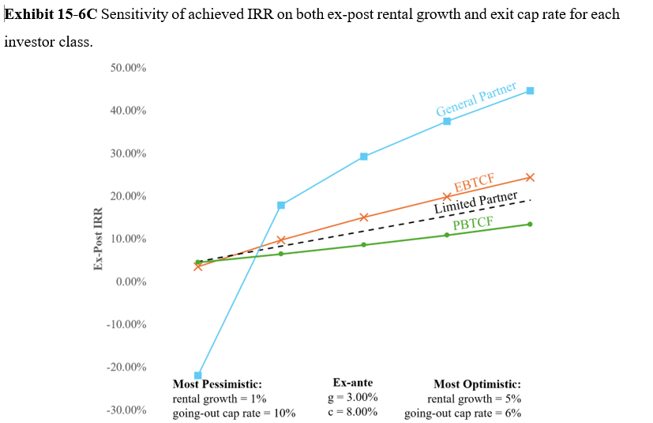
Evaluating Capital Structure Fairness Under Various Scenarios
Fair capital structures should provide risk-adjusted returns (Treynor ratios) that are approximately equal across positions. In our example, the LP's ratio (0.55) exceeds the GP's (0.38), suggesting the GP may be undercompensated for risk.

Slide 21
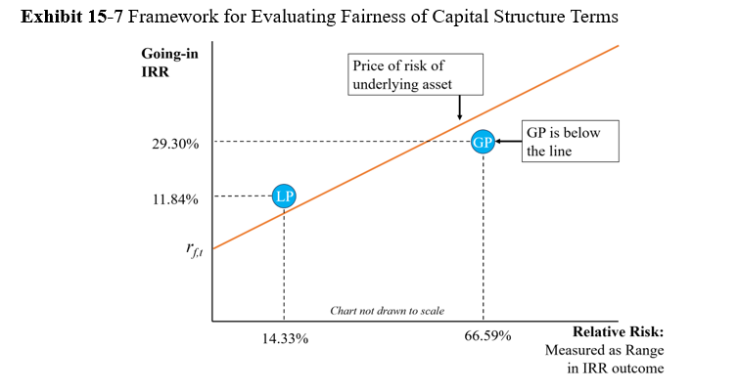
Evaluating Capital Structure Fairness In Risk Framework
Fair capital structures should provide risk-adjusted returns (Treynor ratios) that are approximately equal across positions. In our example, the LP's ratio (0.55) exceeds the GP's (0.38), suggesting the GP may be undercompensated for risk.

Slide 22





Key Takeaways
No Single "Correct" Structure
Optimal capital structure varies by investor type, property, and market conditions.
Risk-Return Tradeoffs
Each position in the capital stack offers different risk and return profiles.
Real Estate Advantage
Stable, transparent assets can support higher leverage than more complex investments.
Caution Required
Excessive debt is the most common cause of real estate investment failure.

