Slide 1

Real Options and Land Value
Land value is the most fundamental topic in real estate development. It's the pivotal link between asset and space markets in the development process. This presentation explores option valuation theory (OVT) and real options as tools to understand land value and development timing decisions.

Slide 2

Understanding Options
Definition
An option is a right without obligation to obtain something of value upon payment of something else of value.
Key Components
Options have an underlying asset, exercise price, and can be American (exercise anytime) or European (exercise only at expiration).
Real Options
These are options whose underlying assets are real assets (physical capital) rather than financial assets.

Slide 3
The Call Option Model of Land Value
Land as an Option
Irreversibility
Land obtains its value through the option it gives its owner to develop a structure on the land.
The exercise of the option is essentially irreversible; the option is given up through its exercise.
The landowner can obtain a valuable rent-paying asset upon paying the construction cost necessary to build.
Most applicable to vacant land or land in transition zones where highest and best use is changing.

Slide 4
Simple Numerical Example
$100M
$88.24M
$11.76M
Building Value Today
Construction Cost
Immediate Profit
Current value of potential building
Cost to build today
If developed today
But what if we wait? Future uncertainty creates an option premium that may make waiting more valuable than immediate development.

Slide 5





Future Uncertainty Creates Value
Wait One Year
Development option doesn't expire today
Market Changes
70% chance value rises to $113.21M; 30% chance falls to $78.62M
Construction Costs Rise
Costs increase by 2% to $90M next year
Flexibility Advantage
Only develop if market improves; avoid downside risk

Slide 6

Calculating Option Value
Expected Value Next Year
Present Value Challenge
Traditional Approach
If market improves (70%): $113.21M - $90M = $23.21M profit
Must account for time and risk differences between immediate development ($11.76M) and waiting ($16.25M next year).
Using 20% discount rate: $16.25M/1.20 = $13.54M
If market declines (30%): Don't build = $0
Option premium = $13.54M - $11.76M = $1.78M
Expected value = (0.7)($23.21M) + (0.3)($0) = $16.25M
Need appropriate discount rate - the opportunity cost of capital (OCC).

Slide 7








The NPV Rule and Option Value
Timing Matters
Traditional NPV Rule
Building today versus building next year are mutually exclusive alternatives.
Invest to maximize NPV among mutually exclusive alternatives.
Land Market
Option Premium
In well-functioning land markets, development option premium should be included in current market value of land.
Include current value of option premium as part of cost incurred by exercising development option.

Slide 8




A Rigorous Model of Option Value
The Challenge
We need to know the opportunity cost of capital (OCC) of the option to wait.
Two Approaches
The arbitrage argument and the certainty-equivalence valuation procedure.
Key Insight
These approaches are equivalent and solve the problem of determining the true OCC.

Slide 9

The Arbitrage Perspective
Complete Markets Assumption
Investors can buy or sell without trading costs in three markets: land, built properties, and bonds.
Create a Replicating Portfolio
Construct a portfolio that will have exactly the same value as the option next year, no matter what scenario unfolds.
Calculate Present Value
The option to wait and develop must be worth exactly the same as the replicating portfolio today: $12.09M.

Slide 10

Replicating Portfolio Construction
Portfolio Component
Today
Next Year (Up)
Next Year (Down)
67% share in future building
$63.29M
$75.95M
$52.74M
Borrowed at 3% interest
-$51.21M
-$52.74M
-$52.74M
Net Portfolio Value
$12.09M
$23.21M
$0
Development Option Value
?
$23.21M
$0
Since the portfolio exactly replicates the option's future values, the option must be worth $12.09M today.

Slide 11






Certainty-Equivalence Approach
Same Result: $12.09M
Arrives at identical valuation as arbitrage approach
Risk Premium Proportionality
Based on the principle that risk premium is proportional to risk
Certainty Equivalent Value
Expected value minus risk discount, then discounted at risk-free rate

Slide 12
True Option Return Rate
34.42%
9%
3%
5.24x
Option OCC
Built Property OCC
Risk-Free Rate
Risk Premium Ratio
True opportunity cost of capital for the development option
Opportunity cost for completed buildings
Return on riskless bonds
Option risk premium vs. built property risk premium

Slide 13








How the Option Valuation Model Works
Market Equilibrium
Cross-Market Balance
Same expected return risk premium per unit of risk across investments
Equilibrium across markets for built property and land
Risk Measurement
Normative Tool
Risk measured by spread in possible investment return outcomes
Model tells what land "should" be worth for fair returns

Slide 14
The Binomial Model of Option Value
Building Block Approach
Extending to Reality
The one-period binomial world is a simplification that can be extended to create more realistic models.
By stitching individual binomial outcomes together sequentially, we can span longer timeframes.
Think of an individual binomial scenario as a financial economic "molecule" containing one unit of time and risk.
Making each period shorter approaches continuous time and continuous pricing realistically.

Slide 15
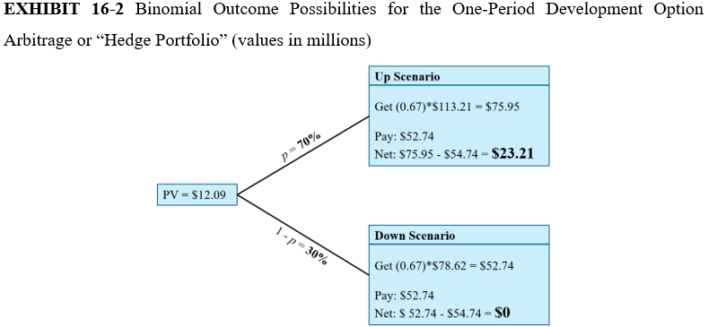

Binomial Value Tree
The binomial model can create a realistic probability distribution of future property values, making it useful for practical land valuation and development timing decisions.

Slide 16
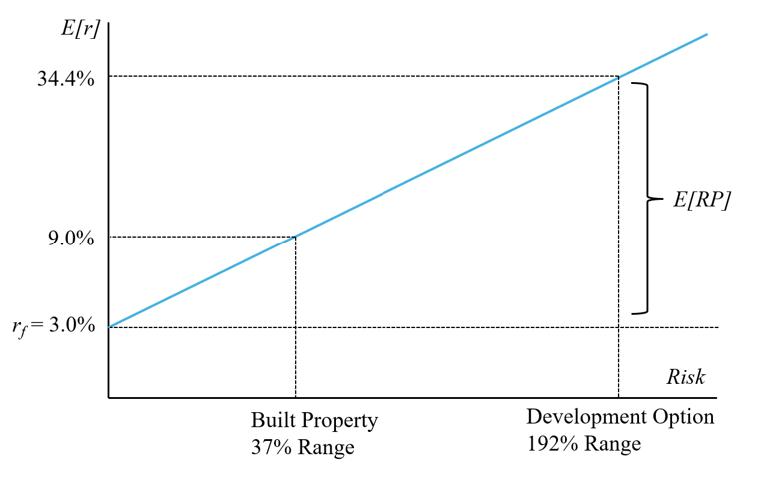
Development Option and Risk Premium Illustrated
The curved line shows land value based on the Samuelson-McKean formula. The straight line shows NPV of immediate development. Development is optimal at the intersection point ($121.69M).

Slide 17




The Perpetual Model in Continuous Time
Perpetual Rights
Samuelson-McKean Formula
Nobel Prize-Winning
Fee simple land ownership rights are perpetual, and the right to build an as-of-right development never expires.
Provides exact models of perpetual options in continuous time without artificial discretization.
Developed by economist Paul Samuelson and mathematician Henry McKean in 1965.

Slide 18

The Samuelson-McKean Formula
Required Inputs
Option Elasticity
Hurdle Value
Built property's current cash yield rate, volatility in built property value, and construction cost yield.
Measures percentage change in land value associated with 1% change in built property values.
Identifies the critical value of developed property above which immediate development is optimal.

Slide 19
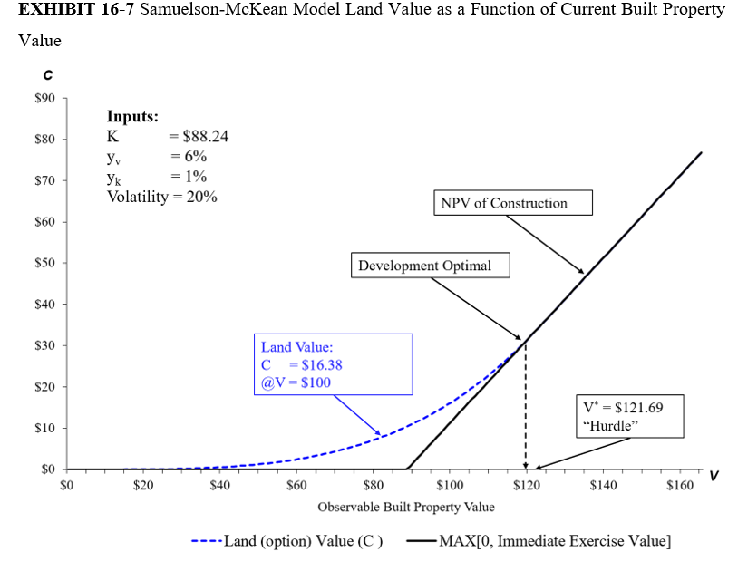

Slide 20



Implications for Development Timing
Higher Volatility
Greater market risk increases land value but raises development hurdle
Urban Configuration
Cities with volatile economies tend to have smaller, denser spatial configurations
Investment Returns
Land speculation requires higher returns to compensate for greater risk

Slide 21




Key Takeaways
Development Threshold
Completed development value must exceed costs by a sufficient margin to induce development.
Option Value
The call option concept explains land value and why delaying development can be beneficial.
Valuation Models
Binomial models and the Samuelson-McKean formula provide practical tools for land valuation.
Investment Insights
Option theory illuminates' development timing, land speculation, and opportunity costs.

