Slide 1
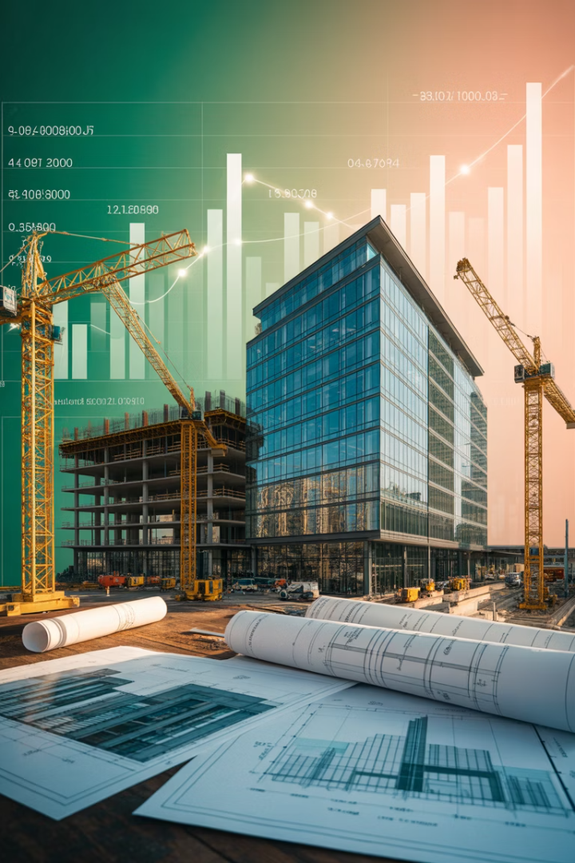
Investment Analysis of Real Estate Development Projects
Real estate development is a make-or-break activity for entrepreneurs and firms with tremendous social consequences. Investment analysis is crucial - projects that pass financial screens get built, those that don't remain dreams.

Slide 2








The Development Decision-Making Process
Physical Analysis
Urban Economics
Architectural and engineering disciplines shape the physical design
Analysis of the real estate space market and demand factors
Financial Economics
Legal/Political
Capital market and real estate asset market analysis
Regulatory approvals and entitlements process

Slide 3
Two Development Approaches
Site Looking for a Use
Use Looking for a Site
The site is already controlled by the developer. Analysis is essentially a highest and best use study.
The developer knows what to build but needs the right location.
Common when developers "inventory" land
Common for large development firms
Typical for local public sector authorities
Typical for retail firms like McDonald's
Requires market analysis to determine optimal use
Focuses on underserved locations
Often involves "build-to-suit" projects

Slide 4
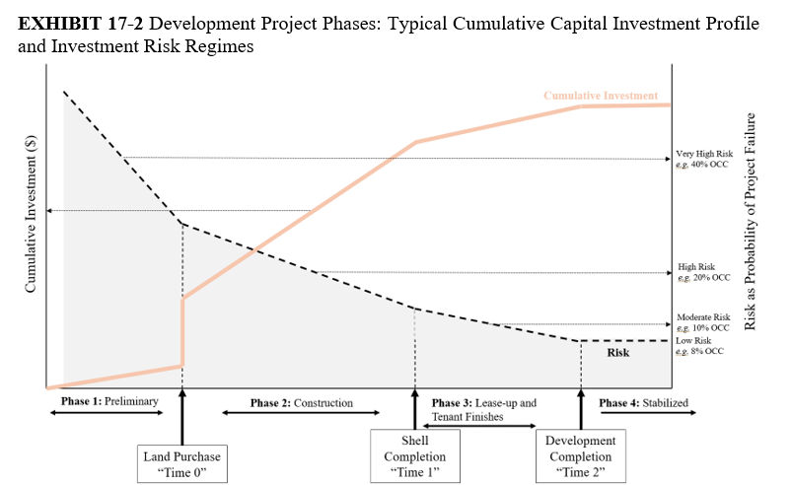





Development Project Phases
Preliminary Phase
Most creative and entrepreneurial phase. Involves land assembly, permits, and project design.
Construction Phase
Bulk of financial expenditures occur here, paying for building construction.
Lease-up & Tenant Finishes
After shell completion, spaces are customized for tenants who will occupy them.
Stabilized Operation
Project is fully leased and operating at long-run steady-state profitability.

Slide 5
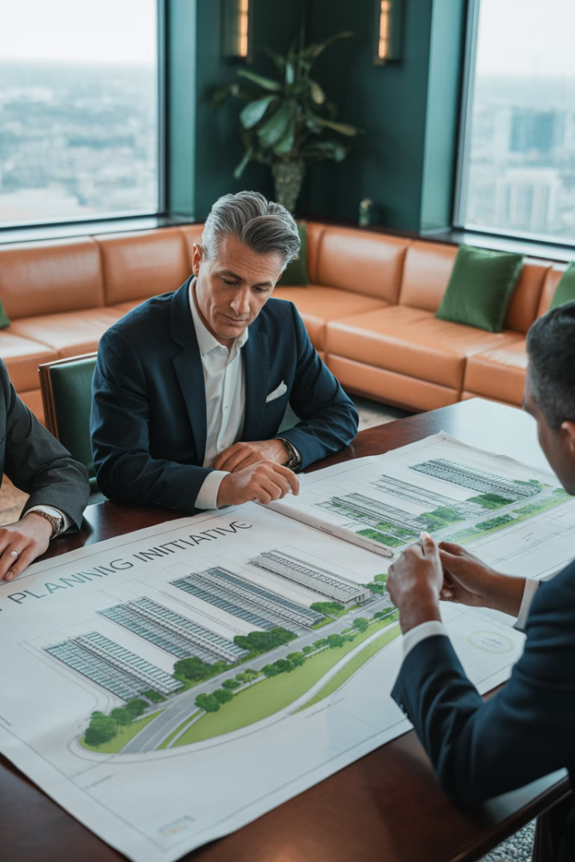
The Preliminary Phase
1
High Risk, High Creativity
This phase may take months to years and involves the most entrepreneurial work.
2
Land Assembly
Often involves optioning and assembling separate land parcels.
3
Entitlements
Obtaining necessary permits, sometimes including variances or special provisions.
4
Project Design
Includes highest and best use analysis and determining optimal density (FAR).

Slide 6






Construction Phase Risk
Operational Leverage
High fixed costs relative to variable revenues
Lease-up Risk
Uncertainty about occupancy rates and timing
Cost Commitment
Construction costs must be paid regardless of project outcome
Even with no financial leverage and fully preleased projects, development investments contain inherent operational leverage. This creates risk that requires high expected returns, often around 20% per annum.

Slide 7
Construction Phase Risk
Operational Leverage
High fixed costs relative to variable revenues
Lease-up Risk
Uncertainty about occupancy rates and timing
Cost Commitment
Construction costs must be paid regardless of project outcome
Even with no financial leverage and fully preleased projects, development investments contain inherent operational leverage. This creates risk that requires high expected returns, often around 20% per annum.

Slide 8
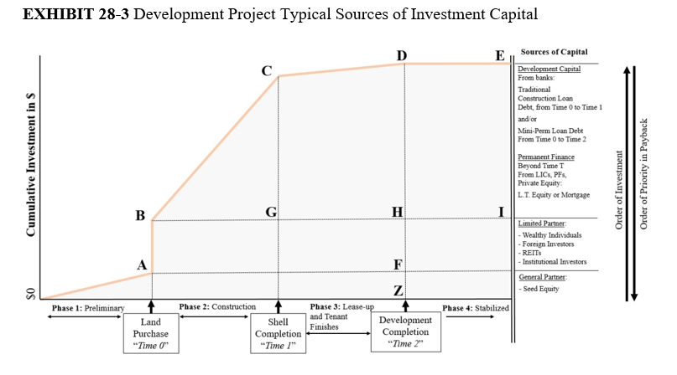
Sources of Capital During Development
The order of investor payback seniority is typically the reverse of the order of investment. Riskier investments get paid back last but receive higher potential returns.

Slide 9
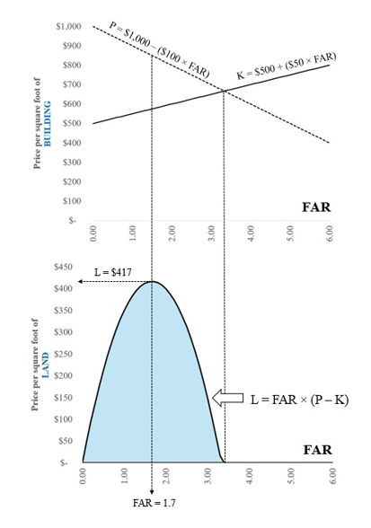
Determining Optimal
Floor Area Ratio (FAR)
To understand what maximizes land value, note that, as a general rule, as you increase the FAR, the price you can get for the property tends to decrease, even as the costs of development tend to increase, in both cases per building square foot. There are various reasons for this, related to construction costs, building efficiency (net rentable floor area divided by gross building floor area), and the value per square foot tenants are willing to pay in rent. However, this cost of density is offset by the obvious economic advantage of density, which is the greater productivity of the land. The more rentable square feet per land square foot (greater FAR), the greater the value of the land site, other things equal. To a point, FAR can be increased without increasing building height by increasing the proportion of the land site covered by the building footprint. But while this may not increase construction cost per built square foot, it will often reduce the rent per square foot that tenants are willing to pay.
Building codes will dictate the change in construction costs as the height increases, starting with wood for shorter structures and steel for most larger structures except for the use of mass timber and flexible building codes.
As FAR increases, property value per square foot decreases while costs increase. The optimal FAR maximizes land value by balancing these opposing forces. In this example, the maximum land value of $417/SF occurs at FAR 1.70.

Slide 10




Construction Loan Mechanics
Loan Commitment
Bank provides specified maximum amount based on construction budget and schedule.
Draw-Down Process
Funds are drawn as needed to pay for construction. Lender verifies physical progress.
Interest Accrual
Interest accrues on drawn funds and compounds over time, adding to loan balance.
Take-Out Financing
Construction loan is paid off at completion with permanent financing or sale.

Slide 11
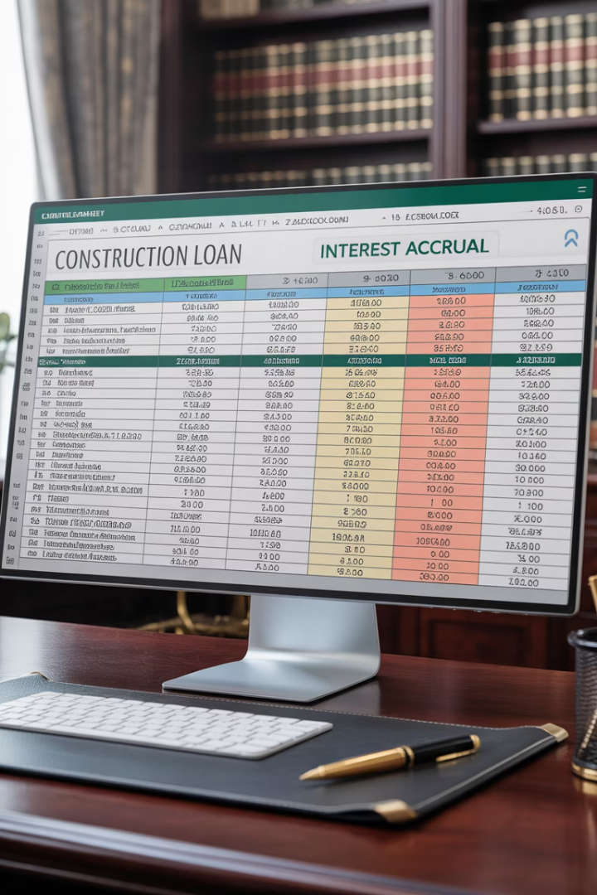
Construction Loan Interest Accrual Example
Month
New Draw
Current Interest
New Loan Balance
1
$500,000
$3,333
$503,333
2
$750,000
$8,356
$1,261,689
3
$1,500,000
$18,411
$2,780,100
This example shows how interest compounds during construction. The loan balance ($2,780,100) exceeds direct costs ($2,750,000) due to accrued interest. This financing cost is a separate item in the construction budget.

Slide 12
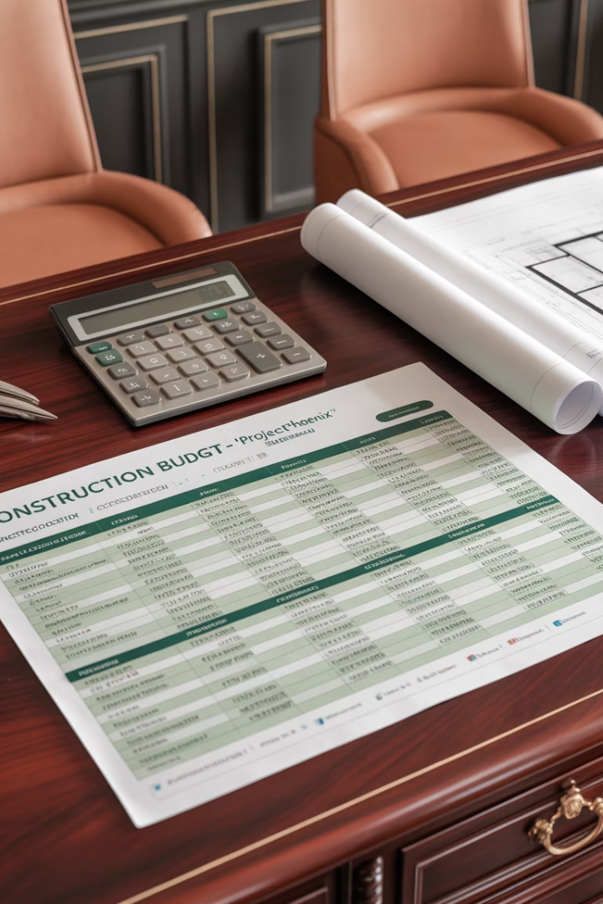
Construction and Absorption Budget Components
Hard Costs
Soft Costs
Land acquisition
Loan fees
Site preparation
Construction interest
Building materials
Legal fees
Labor costs
Architectural fees
Equipment rental
Engineering fees
Tenant finish
Marketing costs
Lease-up Costs
Leasing commissions
Tenant improvements
Working capital
Marketing expenses
Operating deficits

Slide 13
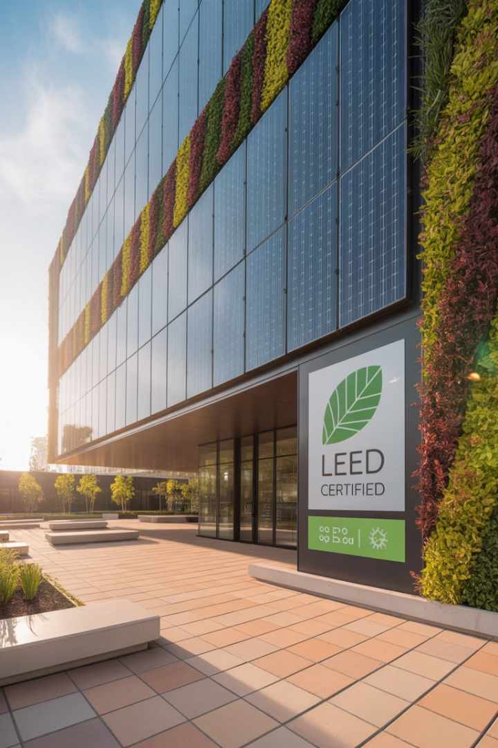




The Trend Toward Greener Development
Energy Efficiency
Renewable Energy
Water Conservation
LED lighting, occupancy sensors, and reduced plug loads through monitoring
Solar panels, wind turbines, and natural gas fuel cells
Reduced flow features, rainwater capture, and gray water recycling
Sustainable Materials
Local and recycled materials, renewable wood, and non-toxic products
Sustainable development promotes environmental and social improvement. Today's market standards require higher energy and water efficiency, with many tenants insisting on these features.

Slide 14

Simple Financial Feasibility Analysis (SFFA)
Front-Door Analysis
Starts with land and construction costs to determine required minimum rent. Used for site-looking-for-a-use projects.
Back-Door Analysis
Starts with expected market rents to determine affordable site acquisition cost. Used for use-looking-for-a-site projects.
Borrow-to-the-Hilt Assumption
Assumes developer will take out maximum permanent loan the completed project will support.
SFFA is widely used in practice but only assesses feasibility, not investment desirability. It relies on mortgage market information rather than complete capital market analysis.

Slide 15
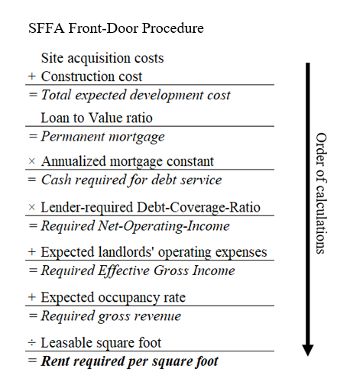

Slide 16
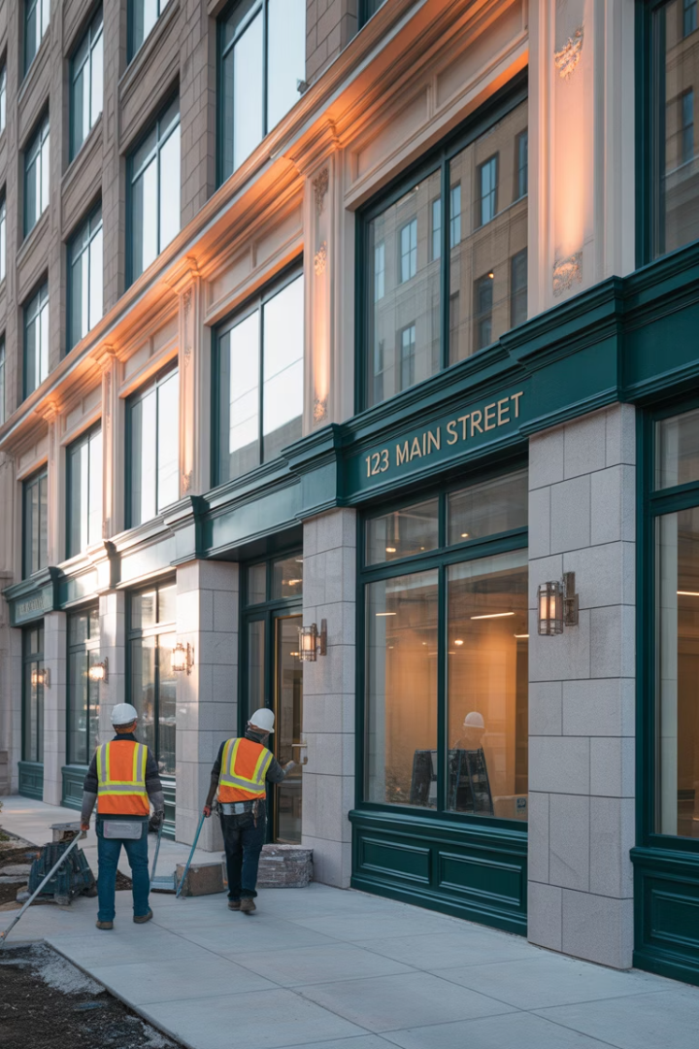
Front-Door SFFA Example: Office Rehab
$1.24M
$992K
$152K
Total Costs
Mortgage Amount
Required NOI
Site, shell, and rehab costs
At 80% LTV ratio
With 1.2x debt coverage
$10.27
Required Rent/SF
To achieve feasibility
With market rents around $10/SF, this rehab project appears feasible. The analysis used conservative assumptions for vacancy and operating expenses.

Slide 17
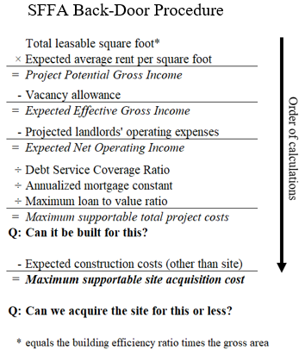

Slide 18
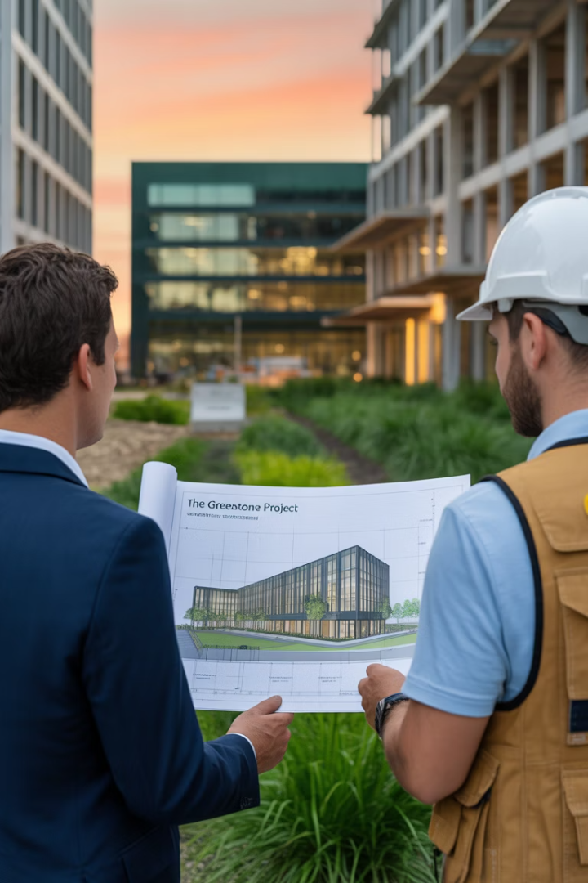




Back-Door SFFA Example: New Office Building
Market Rent
$12/SF with 8% vacancy
NOI Calculation
$265,440 after expenses
Mortgage Analysis
$2,048,735 supportable with 9% interest
Land Value
$591,647 supportable for site acquisition
With the seller asking $500,000 for the site and supportable land value of $591,647, this project appears financially feasible.

Slide 19

Other Development Evaluation Methods
Profit Margin Ratio
Enhanced Cap Rate on Cost
Expected project value divided by total costs. Developers often target 20% margin.
Applies higher cap rate to development costs to account for extra risk.
Blended Long-Run IRR
Net Present Value (NPV)
Calculates single IRR over development and 5-10 year operational phase.
Most rigorous approach but rarely used explicitly in practice.

Slide 20
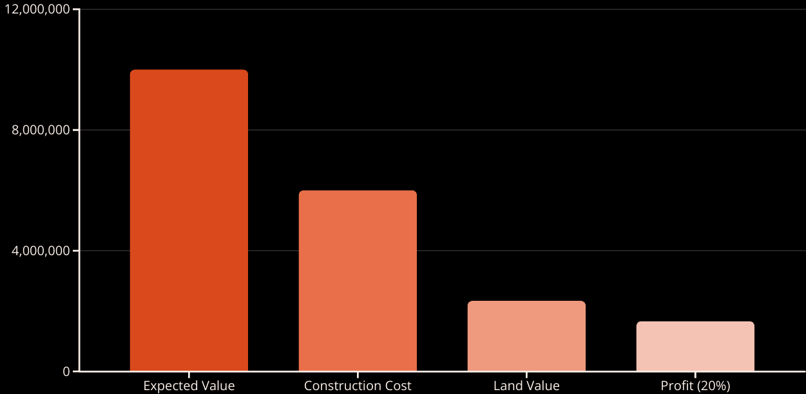
Other criteria for Feasibility: Profit Margin Method Example
With an expected property value of $10M, construction costs of $6M, and a target 20% profit margin, the supportable land value is $2.33M. This method ignores time value of money and risk adjustments.

Slide 21








Problems with Ad Hoc Approaches
Ignores Time Value
Blends Risk Profiles
Most methods don't properly account for present value discounting
Mixes different investment phases with different risk characteristics
Overrelies on Debt
Lacks Opportunity Cost
SFFA assumes maximum debt financing, unrealistic for larger developers
Fails to quantify the opportunity cost of capital rigorously
These ad hoc procedures have practical utility but don't provide complete or correct financial economic evaluation of development projects.

Slide 22
Why NPV Should Be Used
Wealth Maximization
Market Relevance
NPV rule is grounded in the principle of wealth maximization. It ensures developers cover their cost of capital.
As Wall Street and institutional investors become more involved in real estate, rigorous methods consistent with corporate finance become necessary.
Successful developers implicitly apply NPV principles even if they don't explicitly use the formula.
NPV allows proper comparison with other investment opportunities in a portfolio context.

Slide 23
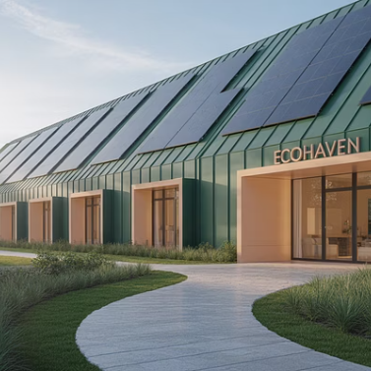

Key Takeaways
Real estate development is a complex, iterative process requiring expertise across multiple disciplines. While current practice relies on simplified feasibility methods, rigorous NPV analysis provides the most accurate evaluation. Development projects contain unique risks requiring higher returns, and sustainable building practices are increasingly important.

