Slide 1
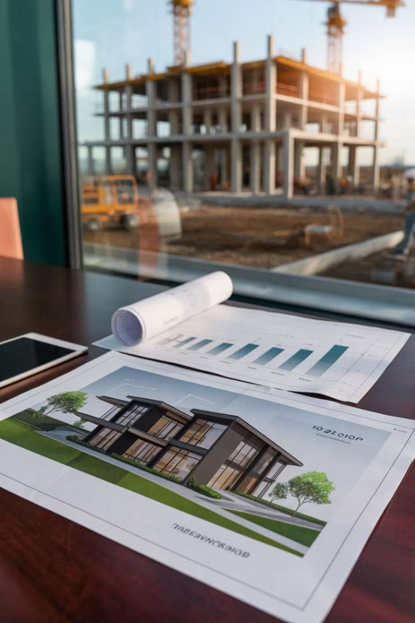
Investment Analysis of Real Estate Development Projects
This presentation explores the economic analysis of real estate development projects, focusing on rigorous NPV-based approaches that improve upon traditional feasibility tools.

Slide 2

Beyond Traditional Feasibility Analysis
Current Limitations
Traditional feasibility tools are often ad hoc and not grounded in rigorous economic frameworks.
Market Equilibrium
Current methods often fail to fully consider basic economic principles of market equilibrium and opportunity cost.
Communication Gap
Traditional approaches make it difficult to communicate with mainstream finance and investment worlds.
Limited Creativity
Without rigorous frameworks, analysts lack deep understanding that facilitates innovation in project conceptualization.

Slide 3
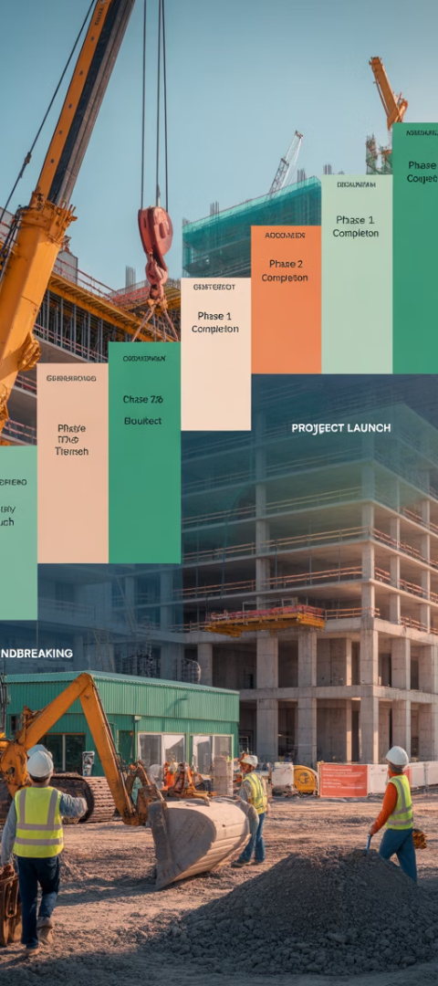



Unique Features of Development Projects
Time-to-Build
Investment cash outflow is spread out in time instead of occurring all at once upfront.
Construction Loans
Debt financing is almost universal in construction phase, typically covering all construction costs.
Phased Risk Regimes
Development involves different levels of investment risk between construction, absorption, and stabilized phases.

Slide 4





Applying NPV to Development Projects
Identify Benefits and Costs
Forecast magnitudes and timings of benefits (completed buildings) and costs (construction).
Apply Appropriate Discount Rates
Use OCC discount rates appropriate to each type of projected cash flow.
Calculate Present Values
Discount projected values back to present using appropriate rates.
Determine NPV = V-P Costs
Calculate difference between present value of benefits and costs.

Slide 5
The FutureSpace Center Example
Project Details
Key Calculations
Two office buildings with construction costs of $1.5M paid quarterly over 12 months.
Present value of benefits (V₀): $9.352M
Present value of construction costs (K₀): $5.889M
First building completed at 6 months, second at 12 months.
Net economic value: $3.463M
Each building expected to produce $37,500 monthly cash flow in perpetuity.

Slide 6






Operational Leverage in Development
Higher Risk & Return
Development investments have higher risk and expected returns
Operational Leverage
Future costs not perfectly correlated with future benefits
Stabilized Properties
No operational leverage as investment occurs entirely at time 0

Slide 7
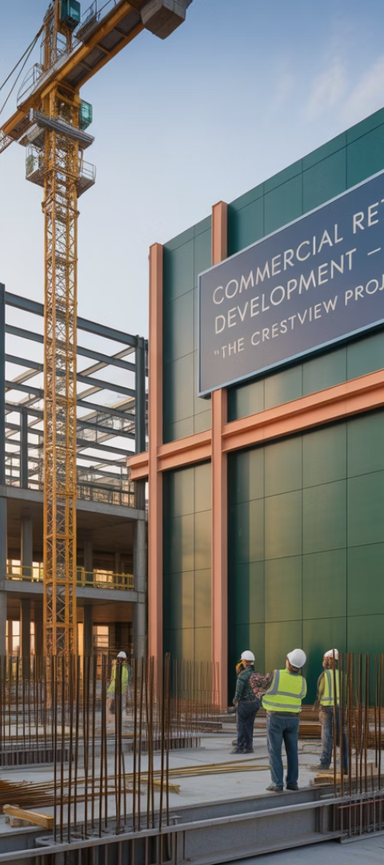
Risk Comparison: Development vs. Stabilized
9.38%
16.59%
2.14x
Stabilized Property IRR
Development Project IRR
Risk Premium Ratio
Development risk premium vs. stabilized property
Expected return for Hereandnow Place
Expected return for FutureSpace Center

Slide 8
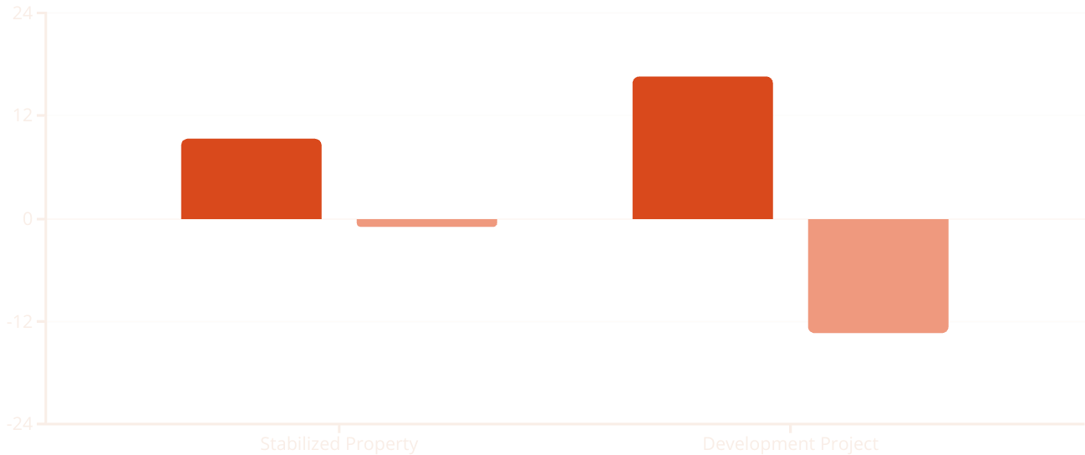
Impact of Negative Market Shifts
Expected Return
Actual Return After 10% Val...
When asset values drop 10%, the development investment suffers a much larger percentage
decline in returns due to operational leverage.

Slide 9

The Canonical Formula for Development OCC
A standardized approach to measuring development project OCC:
Equilibrium Condition
Balances markets for developable land, built property, and contractually fixed cash flows.
Standardized Timing
All cash flows occur at two points: time 0 (land cost) and time T (construction completion).
Practical Application
Allows for consistent comparison across different development projects.

Slide 10
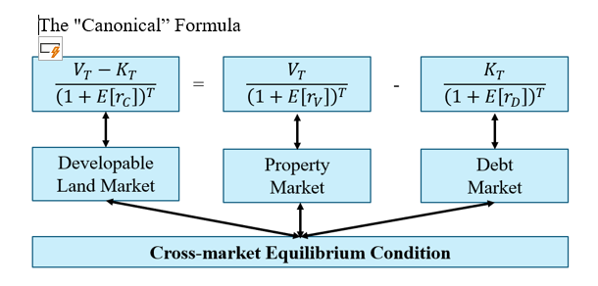

Slide 11








Development Risk Ratio (DRR)
Measurement
Calculated as ratio of risk premium in development project OCC divided by risk premium in stabilized asset OCC.
Diagnostic Tool
Can help flag particularly risky development projects or those not fully using site value.
Definition
Location Impact
Ratio of investment risk in development project to risk in unlevered investment in identical stabilized property.
Higher land values typically associated with lower DRRs due to less operational leverage.

Slide 12
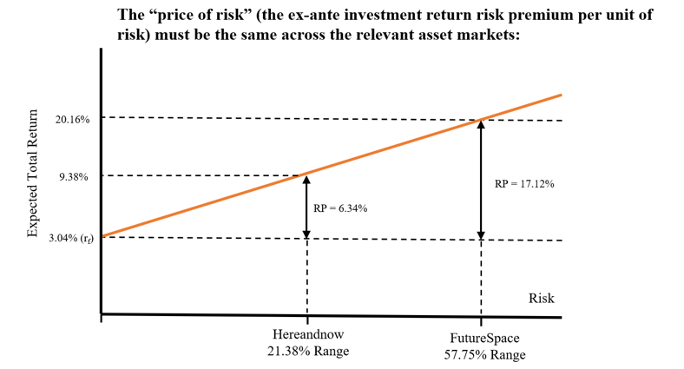

Slide 13
Relationship to Real Options Model
Land as Option
Risk Premium Ratio
Development project valuation is consistent with real options model of land value.
Equals option elasticity at moment of optimal development.
1
2
3
4
Option Exercise
Land Value Fraction
Development represents optimal exercise of the real option to develop.
Inverse of option elasticity, affected by market volatility and cap rates.

Slide 14



Capital Structure for Development
Joint Venture Structure
Most developments organized as joint ventures between GPs and LPs
General Partner Role
Local, entrepreneurial investor handling preliminary phase and operations
Limited Partner Role
Institutional investors providing capital while retaining control over major decisions

Slide 15
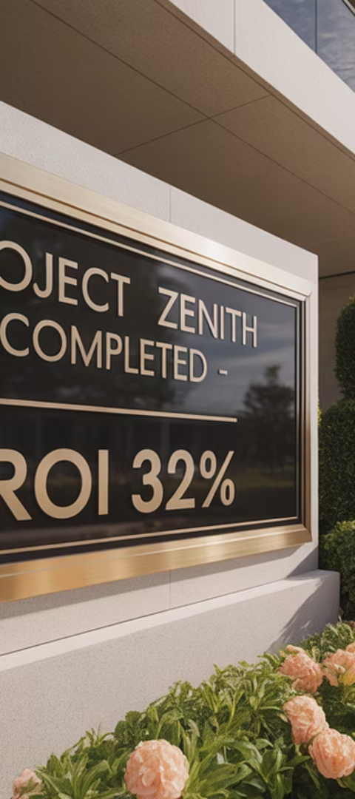
Example Joint Venture Structure
Investment Split
LP invests 90% of costs ($1.8M), GP invests 10% ($200K)
Return Structure
LP receives 5.5% preferred return, then remaining profits split 50/50
Construction Financing
$8M construction loan covers all construction costs
Permanent Financing
Interest-only permanent loan at 4% replaces construction loan upon completion

Slide 16
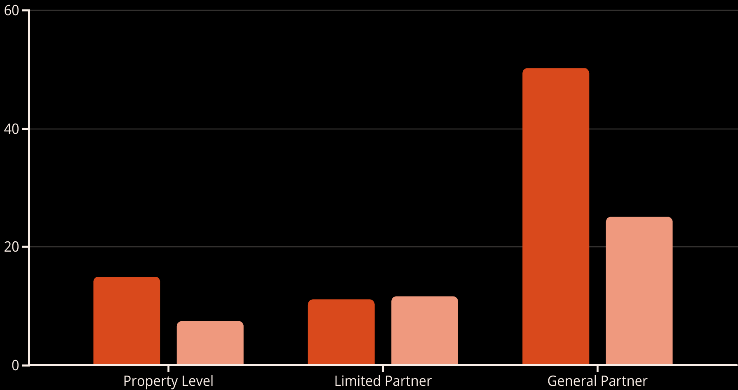
Partner Returns Across Project Phases
Construction Phase IRR
Full Project IRR
The GP faces higher risk but potentially much higher returns, especially during the construction phase where returns can exceed 50%.

Slide 17

"Unblending" the Blended IRR
Phase-Specific Analysis
Each development phase has different risk/return profiles and should be evaluated separately.
Backing Out True OCCs
Use typical developer rules of thumb to extract market's true OCC rates for each phase.
Comparing Across Phases
Determine IRRs implied specifically within each phase based on cash flows and stated long-run IRRs.

Slide 18
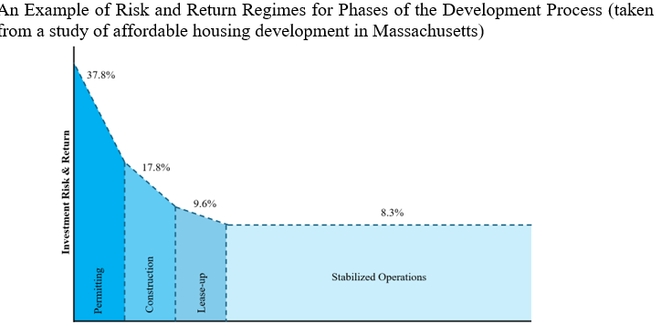
Risk and Return Across Development Phases
37.8%
17.8%
9.6%
8.3%
Preliminary Phase
Construction Phase
Lease-up Phase
Stabilized Phase
Going-in IRR for land assembly and permitting
Going-in IRR for construction phase investment
Going-in IRR for lease-up phase investment
Going-in IRR for stabilized property investment

Slide 19
Construction Cost OCC vs. Project OCC
Lower Construction Cost OCC
Higher Development Project OCC
Construction costs are relatively stable
Operational leverage increases overall risk
Supply of construction services is elastic
Similar to financial leverage effect
Risks are mostly idiosyncratic and diversifiable
Greater expected return required to compensate
Contractors may provide guarantees
Follows fundamental equilibrium theory

Slide 20








Implications for Urban Development
Higher Volatility Markets
Lower Cap Rate Markets
Greater land value fractions and higher density development
Higher land values and less propensity to build
Higher Appreciation
Denser Cities
Lower real depreciation rates as land value doesn't depreciate
Higher rents and greater irreversibility premium

Slide 21

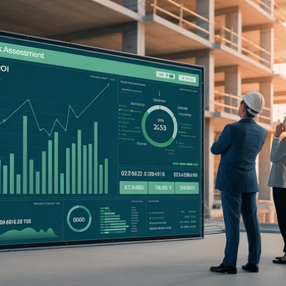


Using DRR as a Diagnostic Tool
The Development Risk Ratio can help flag projects that may not be optimal for their location, either by being too risky or by underutilizing valuable land.

Slide 22





Key Takeaways
NPV-Based Evaluation
Economic Principles
Use rigorous NPV-based financial evaluation for development projects.
Base analysis on opportunity cost, market equilibrium, and wealth maximization.
Phase-Specific Analysis
Practical Application
Evaluate each development phase separately with appropriate OCC rates.
These methods require no more information than traditional rules of thumb.

