Slide 1

Mortgages from an Investment Perspective
Real estate debt creates two investment products: levered property equity and debt secured by property. Each appeals to different investors based on risk tolerance and income needs.

Slide 2
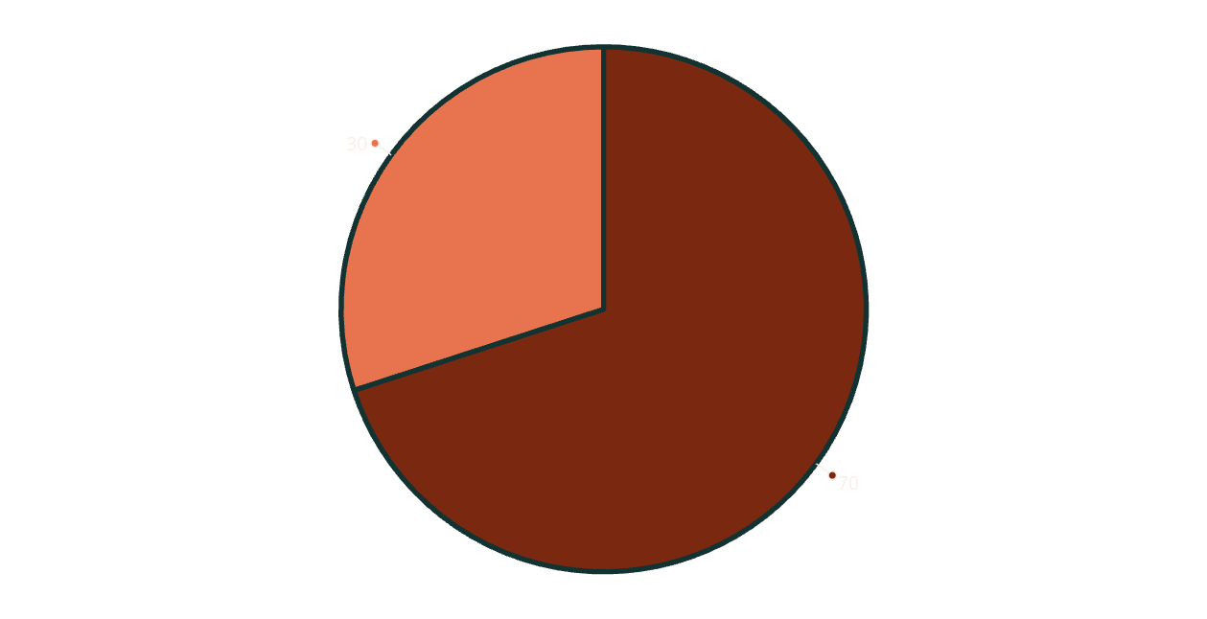
The Debt Market Landscape as of 2023
Residential
Commercial
The U.S. debt market exceeds $53.3 trillion, with about 30% based on mortgages. During COVID-19, mortgage-backed securities briefly surpassed Treasury securities as the largest fixed-income issuance.

Slide 3

U.S. Mortgage Debt Overview
$19.8T
$5.9T
$2.1T
Total Mortgage Debt
Commercial Mortgages
Multifamily Mortgages
Outstanding in the U.S. as of 2023
Funding income-producing properties
A significant portion of commercial debt

Slide 4
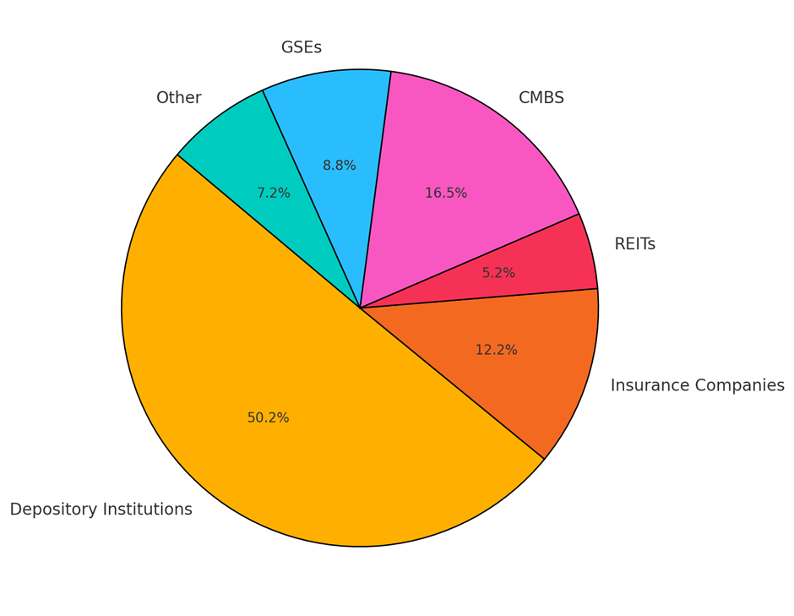








Commercial Mortgage Capital Sources
Depository Institutions
Life Insurance Companies
Local and regional banks provide most commercial mortgage capital
Major source for larger properties and longer-term loans
CMBS
GSEs
Over $960 billion in securities backed by commercial mortgage pools
Significant role in multifamily housing finance

Slide 5

Multifamily Mortgage Funding
GSE Funding
CMBS Funding
Other Sources
Government Sponsored Enterprises fund approximately 24% of multifamily development
Commercial Mortgage-Backed Securities provide about 25% of multifamily funding
Banks, life insurance companies, and other lenders provide the remaining 51%

Slide 6

Cyclical Nature of Commercial Mortgages
1980s Boom
2008 Crash
Significant flow of mortgage capital into commercial real estate
Negative flow as lenders retrenched and reduced exposure
1
2
3
4
2000s Peak
COVID-19 Impact
Capital flowing at $300B annually, with $100B through CMBS
Unprecedented challenges with office vacancies and remote work

Slide 7
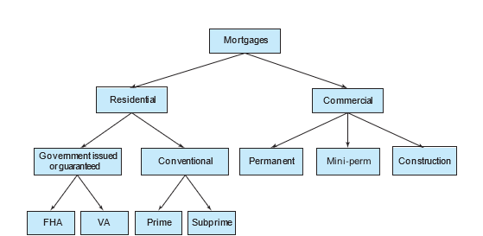
Residential Mortgages
Commercial Mortgages
Smaller individual loans but more numerous
Larger individual loans but fewer in number
No income from property
Property generates income to service debt
Borrowers are typically non-professionals
Borrowers are often financial professionals
Properties are relatively homogeneous
Properties tend to be unique
More government involvement
Less government involvement
Residential vs. Commercial Mortgages

Slide 8



Permanent vs. Construction Loans
Construction Loans
Short-term financing for building projects (1-3 years)
Bridge Financing
"Mini-perm" loans bridging construction and permanent financing
Permanent Loans
Long-term financing for completed properties (5-10+ years)

Slide 9




Legal Structure of Mortgages
Promissory Note
Establishes the debt obligation between borrower and lender
Mortgage Deed
Secures the debt by conveying potential ownership of collateral
Recording
Establishes priority claim to the collateral property

Slide 10
Mortgage Legal Theories
Lien Theory States
Title Theory States
Lender holds a lien on property, giving right to force foreclosure sale if borrower defaults
Lender holds ownership title until loan is paid off
Borrower only retains right of use and possession while meeting obligations
Borrower retains title to property until foreclosure
Allows lender to take possession more quickly in default

Slide 11
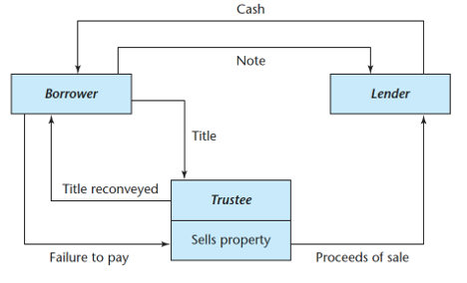
Deed of Trust Structure
Loan Origination
During Loan Term
Borrower receives funds and gives title to trustee
Trustee holds title for lender's benefit
Default Scenario
Loan Repayment
Trustee can sell property on lender's behalf
Trustee returns title to borrower when loan is paid

Slide 12








Priority of Claims in Foreclosure
Property Tax Liens
Always first position regardless of recording date
Mechanics' Liens
Can take priority within specific time windows
First Mortgage
Most senior debt position among mortgages
Junior Mortgages
Second, third mortgages paid after senior claims

Slide 13





Common Mortgage Covenants
Promise to Pay
Good Repair Clause
Borrower's commitment to repay principal, interest, and penalties
Requirement to maintain property in good condition
Acceleration Clause
Due-on-Sale Clause
Allows lender to demand full loan balance immediately under certain conditions
Enables loan acceleration when property is sold

Slide 14

Additional Mortgage Provisions
Prepayment Clause
Subordination Clause
Exculpatory Clause
Grants borrower right to pay off loan before maturity, often with penalties in commercial loans
Makes loan subordinate to other loans, even if recorded earlier
Creates non-recourse loan where lender can only claim the collateral property

Slide 15





Default and Foreclosure Process
Default Occurs
Borrower violates mortgage agreement, typically by missing payments
Forbearance Option
Lender may delay action, allowing borrower time to resolve issues
Litigious Actions
Court proceedings that may lead to foreclosure sale
Non-litigious Resolution
Alternatives like loan modification or deed in lieu of foreclosure

Slide 16





Costs of Foreclosure
Legal Expenses
Property Deterioration
Time Costs
Typically around 10% of loan balance but can be higher
Lost revenue and interest during lengthy process (typically 1+ year)
Maintenance issues and tenant problems during foreclosure
Reputation Effects
Negative impact on both borrower and lender reputations

Slide 17



Non-litigious Resolutions
Lenders prefer to resolve problems without litigation. Options include loan transfers to new borrowers, short sales where property sells below mortgage balance, and deed in lieu of foreclosure arrangements.

Slide 18

Workout Strategies
Loan Rescheduling
Extending loan term or providing temporary payment holidays
Debt Forgiveness
Reducing principal in exchange for equity participation or higher future yield
New Partners
Bringing in additional equity or debt partners to strengthen the deal
Specialized Mediation
Using workout specialists as advisors, brokers, and mediators

Slide 19
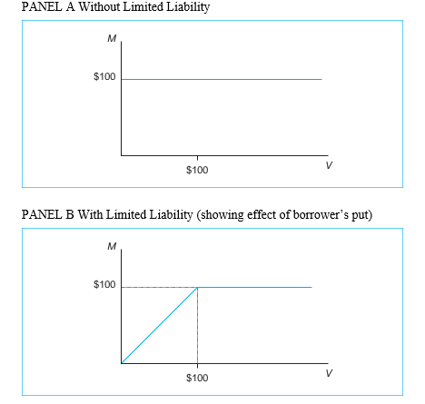
The Borrower's Put Option
A put option gives its holder the right without obligation to sell a specified underlying asset at a specified price. In the context of a nonrecourse mortgage, the underlying asset is the collateral property, and the borrower’s ability to default on the loan effectively gives him the ability to sell the property to the lender at a price equal to the outstanding loan balance.
By defaulting on the loan, the borrower is said to “put” the property to the lender, thereby ridding himself of a liability equal, at least in book value, to the outstanding loan balance.
Property Value ($M)
Lender Value with Limited L...
Lender Value without Limite...
In non-recourse loans, borrowers effectively have a put option to "sell" the property to the lender at a price equal to the outstanding loan balance by defaulting.

Slide 20



Strategic Default Considerations
Underwater Loans
Negotiation Leverage
Reputation Effects
When property value falls below loan balance, rational default becomes likely
Foreclosure costs give borrowers leverage to force workout deals
Both sides consider long-term reputation impacts in default decisions

