Slide 1

Commercial Real Estate Investment
This presentation explores the foundations of commercial real estate investment, examining its unique characteristics as an asset class and how it compares to other investment options.
NM

Slide 2

What is Commercial Real Estate?
Definition
Property Rights
Investment Focus
Land and all things permanently attached to it, including buildings and structures.
Rights to control, occupy, develop, improve, exploit, pledge, lease, and sell.
Investable property with the purpose of creating cash flow, unlike owner-occupied housing.

Slide 3

Commercial Real Estate Market Size
$18T
97B
33%
Market Value
Square Feet
Asset Share
Total value of investable commercial real estate in the US (2020)
Total amount of investable commercial real estate space
Combined real estate debt and equity as percentage of all US assets

Slide 4










Major Property Types
Industrial
Apartments
28% of square footage but only 15% of dollar value
Income-producing rental units, not owner-occupied housing
Retail
20% of square footage and 18% of dollar value
Healthcare
Only 3% of square footage but 16% of dollar value
Office
Traditional workspace properties

Slide 5
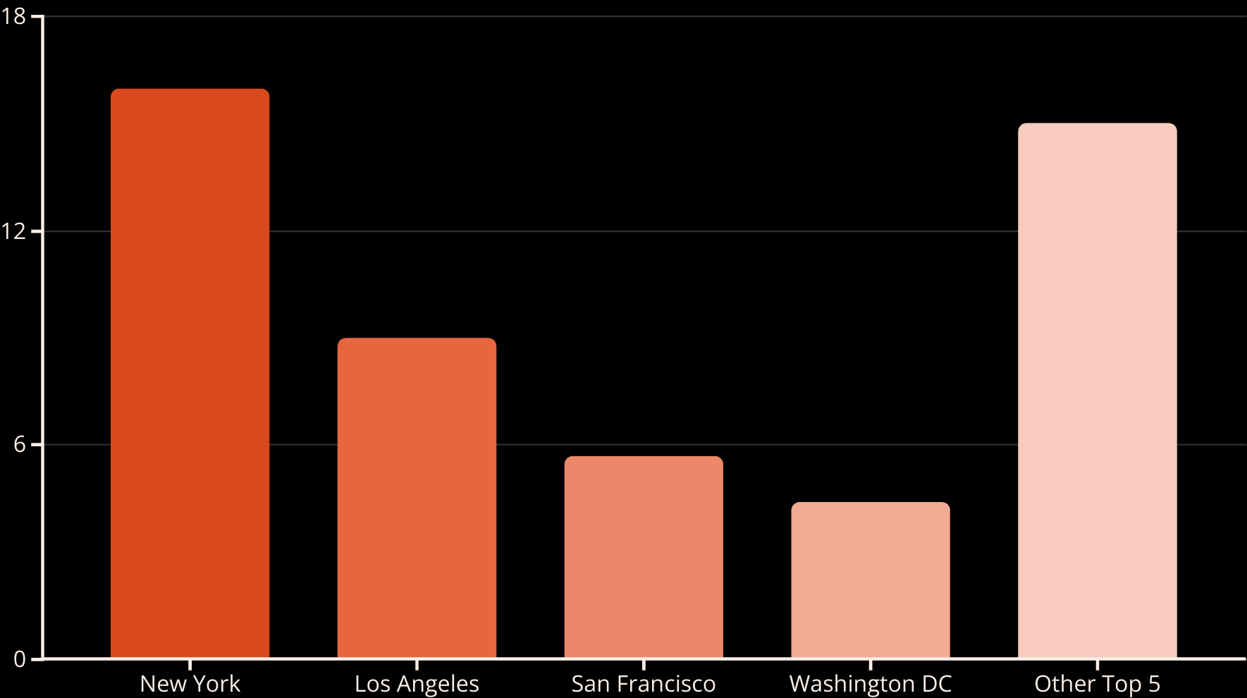
Geographic Concentration
The top 9 metro areas (out of 150) contain 50% of all commercial real estate value in the US, following Zipf's law distribution pattern.

Slide 6
Why Invest in Real Estate?
Advantages
Challenges
Long-lived assets with perpetual land value
Low liquidity compared to stocks and bonds
Moderate returns with lower volatility than stocks
High transaction costs (2-10% of purchase price)
Good inflation protection
Significant management burden
Portfolio diversification benefits
Large capital requirements for direct investment
Direct control over investment decisions
Complex valuation due to heterogeneity

Slide 7




Investment Approaches
Direct Investment
Owning physical property directly, with full control but high management burden
Listed REITs
Publicly traded companies that own and operate income-producing real estate
Real Estate Debt
Investing in mortgages or mortgage-backed securities

Slide 8

Direct Real Estate Investment
Full Control
Direct decision-making authority over property management, improvements, and tenant selection.
Management Burden
Responsibility for hiring brokers, making repairs, paying taxes, and maintaining the property.
Capital Intensive
Requires substantial financial resources, typically millions of dollars for commercial properties.
Low Liquidity
Average deal takes 8 months to complete, with properties selling only once every 5-10 years.

Slide 9





Real Estate Investment Trusts (REITs)
Public Trading
Market Size
Volatility
Listed on stock exchanges with high liquidity and ease of transaction
Over $1 trillion in real estate holdings in the US market
More short-term price fluctuations than direct real estate
Accessibility
Available to small investors with minimal capital requirements

Slide 10





Real Estate Debt Investment
Mortgage-Backed Securities (MBS)
Primarily for multi-family rental apartment properties, often with government guarantees
Commercial Mortgage-Backed Securities (CMBS)
Securities based on non-residential properties without government guarantees
Bank Balance Sheet Loans
37% of all loan originations, with local banks playing a significant role
Mortgage REITs (mREITs)
Publicly traded companies that invest in real estate debt instead of equity

Slide 11








Investment Risk Categories
Opportunistic
15-20%+ returns, highest risk, substantial rehabilitation needed
Value-Added
12-18% returns, improved asset management to raise value
Core Plus
8-12% returns, mix of income and growth
Core
6-9% returns, lowest risk, income-focused, prime properties

Slide 12

Major Investment Asset Classes
Asset Class
Return
Risk
Liquidity
Income %
Stocks
High
High
High
Low
Real Estate
Moderate
Moderate
Low
Moderate
Long-Term Bonds
Moderate-Low
Moderate-Low
Moderate
High
Cash (T-bills)
Low
Low
High
None

Slide 13
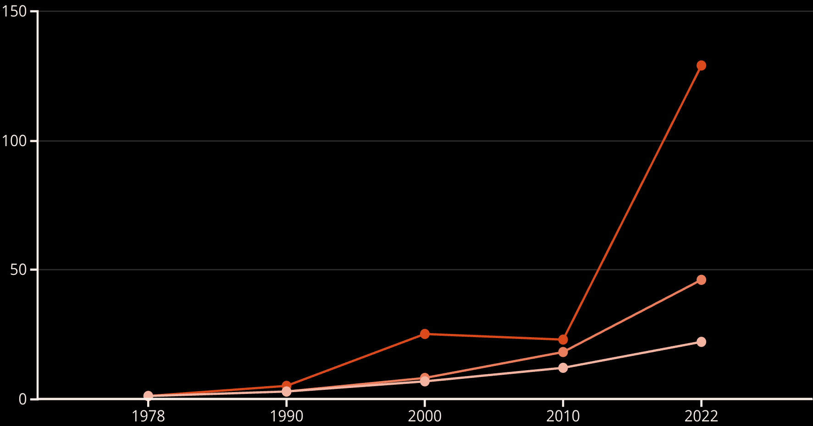
Historical Cumulative Investment Performance
Stocks
Real Estate
Bonds
Growth of $1 invested in 1978 across major asset classes. All four asset classes beat inflation, which would have required $4 in 2022 to match 1978 purchasing power.

Slide 14
Performance Statistics (1978-2022)
13.02%
9.32%
16.46%
6.99%
Stocks
Real Estate
Stocks
Real Estate
Average annual return
Average annual return
Standard deviation
Standard deviation
7.30%
3.16%
Bonds
Bonds
Average annual return
Standard deviation

Slide 15
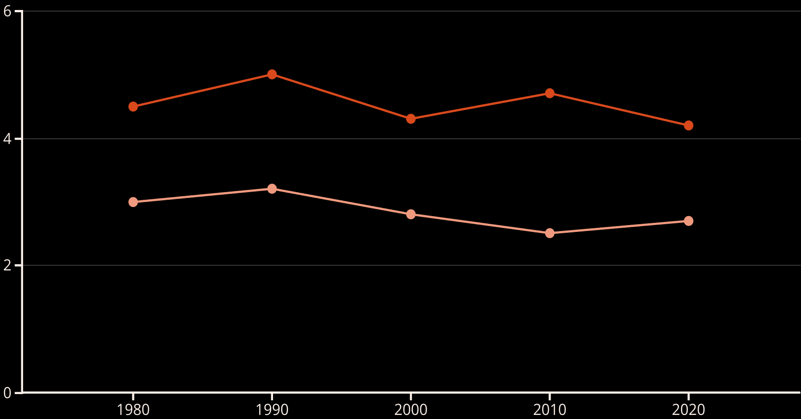
Average Income Yield % Comparison
Real Estate
Stocks
Commercial real estate has consistently provided higher income yields (4.5% average) compared to stocks (3% average) between 1978-2022.

Slide 16







Real Estate Market Cycles
Recovery
Expansion
Increasing occupancy, modest rent growth, limited new construction
Low vacancy, strong rent growth, increasing new construction
2
Recession
Oversupply
High vacancy, declining rents, minimal new construction
Rising vacancy, slowing rent growth, excessive new construction

Slide 17





Historical Market Disruptions
1980s Building Boom
Tax incentives led to overbuilding, especially in office, retail, and hotels
1986 Tax Reform
Removed special tax incentives for real estate investment
Early 1990s Crash
Property values fell 30-50% in major markets
2007-2009 Financial Crisis
Commercial property prices dropped 35% from 2006 to 2009
COVID-19 Pandemic
Shifted demand patterns between property types and locations

Slide 18



Investor Objectives and Constraints
Growth Objective
Income Objective
Key Constraints
Long-term horizon with no immediate need for cash. Typical of young to middle-aged individuals and growing pension funds.
Need for current cash flow. Typical of retired individuals and mature pension funds with more retirees than contributors.
Risk tolerance, liquidity needs, time horizon, expertise level, and capital availability all influence investment decisions.

Slide 19

Investor Heterogeneity
Different Objectives
Investors have varying goals based on life stage, wealth level, and institutional requirements.
Varying Constraints
Risk tolerance, liquidity needs, and expertise levels differ significantly among investors.
Market Creation
This heterogeneity creates markets as different investors want to buy when others want to sell.
Product Development
Investment products are tailored to various objectives and constraints to serve diverse investor needs.

Slide 20



Key Takeaways
Unique Asset Class
Multiple Investment Approaches
Real estate offers distinct risk-return characteristics compared to stocks and bonds.
Direct ownership, REITs, and debt instruments provide various entry points.
Historical Performance
Market Cycles
Moderate returns with lower volatility than stocks and higher income yield.
Understanding historical patterns helps anticipate future opportunities and risks.

