Slide 1

Mortgage Basics II: Payments, Yields, and Values
This presentation builds on the legal structure of mortgages introduced previously, focusing on the quantitative aspects of mortgage analysis. We'll explore how to calculate loan payments, values, and yields, enabling you to design and structure loans effectively and analyze debt investments with confidence.
While the material is technical, modern financial calculators and spreadsheets have eliminated much of the formula memorization and number crunching, allowing us to focus on the underlying economics. These practical skills are essential for borrowers, lenders, and investors alike.

Slide 2
Abbreviations for Calculating Loan Payments
L = Initial contract principal amount (the loan amount)
r_{t} = Contract simple interest rate applicable for payment in period t
INT_{t} = Interest owed in period t
AMORT_{t} = Principal paid down in the period t payment
OLB_{t} = Outstanding principal balance after the period t payment has been made
PMT_{t} = Amount of the loan payment in period t

Slide 3
Four Basic Rules for Calculating Loan Payments
1
Interest Calculation
The interest owed in each payment equals the applicable interest rate times the outstanding principal balance at the end of the previous period: INTt = (OLBt-1) rt.
2
Principal Amortization
The principal amortized (paid down) in each payment equals the total payment (net of expenses and penalties) minus the interest owed: AMORTt = PMTt - INTt.
3
Balance Update
The outstanding principal balance after each payment equals the previous outstanding principal balance minus the principal paid down in the payment: OLBt = OLBt-1 - AMORTt.
4
Initial Balance
The initial outstanding principal balance equals the initial contract principal specified in the loan agreement: OLB0 = L.

Slide 4
Interest-Only Loans: The Simplest Structure
Key Characteristics
Advantages & Disadvantages
Interest-Only mortgages represent the oldest and most basic pattern of mortgage payments. There is no amortization of principal; the outstanding loan balance remains constant throughout the life of the loan.
Lower regular payments than amortizing loans
Entire regular payment is tax-deductible
Maximizes total interest paid over loan life
Creates repayment spike at maturity
The entire original principal is repaid in a single lump-sum "bullet" payment at the loan's maturity date, while regular payments consist purely of interest.
Forces refinancing or property sale at maturity

Slide 5




Constant-Amortization Mortgage (CAM)
Equal Principal Payments
A constant amount of principal is paid down in each loan payment (AMORTt = L/N).
Declining Payment Pattern
As the loan balance is reduced by a constant amount each period, the interest owed falls by a constant amount as well.
Historical Context
CAMs were used in the 1930s when interest-only loans caused havoc during the Great Depression and persistent deflation resulted in declining rents and land values. Rarely used today.
Practical Limitations
The declining payment pattern can be undesirable for both borrowers (high initial payments) and investors (constant reinvestment of capital).

Slide 6








Constant-Payment Mortgage (CPM): The Classic Solution
Consistent Payments
Fixed monthly payments simplify budgeting
Increasing Amortization
Principal portion grows over time
Flexible Structure
Can include balloon payment options
Mathematical Foundation
Based on annuity formula
The CPM solves many problems associated with interest-only loans and CAMs. Its consistent payments simplify budgeting for both borrowers and lenders, and it better matches typical rent growth patterns in income properties. The CPM offers flexibility in balancing payment levels, amortization rates, and maturity periods.

Slide 7
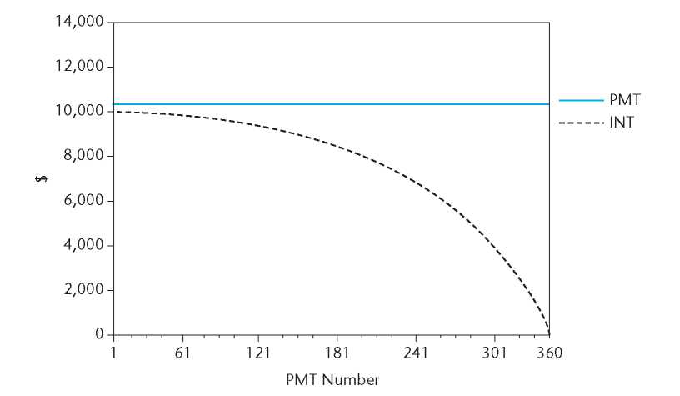
Inside the CPM: Slow Initial Principal Reduction
Interest portion of payment
Loan payoff is very slow at first and accelerates over time, but this keeps initial payments much lower than in the case of the constant amortization mortgage.
Interest (Year 1)
Principal (Year 1)
CPMs are characterized by an increasing amortization schedule. In our $1 million, 12%, 30-year example, after 15 years (180 payments), the remaining loan balance is still $857,057, with less than 15% of the principal repaid during the first half of the loan's term.
This slow reduction in the loan balance early on occurs because most of the payment is allocated to interest. In this example, more than half of the monthly payments are devoted to interest costs, with principal repayment becoming more substantial only after the 291st payment (24 years into the loan term).
As the interest component diminishes over time, the tax deductibility of the debt service is likewise reduced.

Slide 8
Adjustable Rate Mortgage (ARM): Sharing Interest Rate Risk
Periodic Rate Adjustments
Index + Margin Structure
Yield Curve Advantage
The contract interest rate adjusts periodically to changes in prevailing debt market rates, reducing interest rate risk for the lender and potentially lowering initial rates for the borrower.
ARMs are typically based on a publicly observable index (like U.S. Treasury bonds) plus a constant margin to reflect greater default risk. The index must not be subject to manipulation by the lender.
ARMs offer particular advantages when a steeply upward-sloping yield curve prevails in the bond market, allowing borrowers to access rates based on the short-term end of the yield curve.

Slide 9




ARM Payment Calculation Process
Initial Rate Setting
The ARM begins with an initial interest rate, which may be a "teaser rate" below the fully indexed rate to attract borrowers.
Adjustment Interval
At predetermined intervals (often annually), the rate adjusts based on the current value of the index plus the margin.
Payment Recalculation
The new payment is calculated using the updated rate, remaining loan balance, and remaining amortization period.
Ongoing Adjustments
This process repeats throughout the loan term, creating a payment pattern that reflects market interest rate movements.

Slide 10
ARM vs. Fixed Rate: Risk and Return Tradeoffs
ARM Advantages
ARM Disadvantages
Lower initial interest rate and payment
Payment uncertainty makes budgeting difficult
Rate decreases automatically when market rates fall
Payments can increase substantially if rates rise
May be appropriate when planning to sell/refinance before first adjustment
Applicable rate may exceed fixed rate at some point
Prepayment option less valuable than in FRMs
Can benefit from falling interest rate environments

Slide 11








Customized Loan Structures
Creative Design
Negotiation Opportunity
With spreadsheets and the four basic rules, you can develop your own loan and payment patterns.
Commercial mortgage business is less standardized and often allows more customization.
Special Situations
Financial Engineering
Particularly useful for unique properties or investment circumstances like developments and turnarounds.
Combine elements of different loan types to meet specific needs.

Slide 12




Understanding Mortgage Yields
Yield-to-Maturity (YTM)
Contract Rate vs. YTM
Market Value Impact
In the secondary market, YTM reflects the market value regardless of par value or contractual interest rate.
The internal rate of return (IRR) computed over the full remaining potential life of the loan, assuming no prepayment.
The YTM will differ from the contract interest rate whenever the cash flow differs from the outstanding loan balance.

Slide 13
Computing Mortgage Yields
Secondary Market Effects
Impact of Origination Fees
If market yields drop and the loan sells for $1,025,000 in the secondary market, the buyer's YTM would be 7.74%, reflecting the premium paid over the par value.
Basic YTM Calculation
With a 1% origination fee (or discount point), the lender disburses only $990,000 on a $1 million loan. This increases the YTM to 8.11%, or 11 basis points over the stated contract rate.
For a standard loan with no fees, the YTM equals the contract interest rate. For example, a $1 million, 30-year CPM with an 8% annual interest rate would have monthly payments of $7,337.65, and its YTM would be 8%.

Slide 14









Factors Affecting Effective Yield
Origination Fees
Contract Rate
Points and fees paid upfront
The stated interest rate in the loan agreement
1
Prepayment Horizon
Expected time until loan is paid off
Default Risk
Probability of borrower non-payment
Prepayment Penalties
Fees for early loan repayment

Slide 15
The Impact of Prepayment on Loan Yield
Prepayment Horizon (yrs.)
1
2
3
5
10
20
30
0% fee, 0 penalty
8.00%
8.00%
8.00%
8.00%
8.00%
8.00%
8.00%
1% fee, 0 penalty
9.05%
8.55%
8.38%
8.25%
8.15%
8.11%
8.11%
2% fee, 0 penalty
10.12%
9.11%
8.77%
8.50%
8.31%
8.23%
8.21%
1% fee, 1% penalty
10.01%
9.01%
8.67%
8.41%
8.21%
8.13%
8.11%
The shorter the prepayment horizon, the greater the effect of disbursement discounts on the realistic yield of the mortgage. The effect is hyperbolic, not linear, with much greater impact on yield the shorter the prepayment horizon.
For example, with one point of disbursement discount, the yield would be 8.25% over a five-year horizon, or 8.55% over a two-year horizon. Prepayment penalties cause a similar (though slightly smaller) effect.

Slide 16
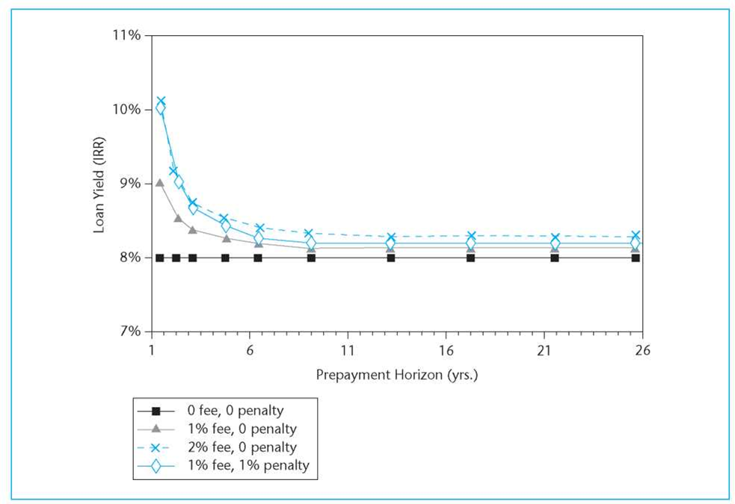
The Impact of Prepayment on Loan Yield
The shorter the prepayment horizon, the greater the effect of disbursement discounts on the realistic yield of the mortgage. The effect is hyperbolic, not linear, with much greater impact on yield the shorter the prepayment horizon.
8.00%
8.00%
8.00%
8.00%
For example, with one point of disbursement discount, the yield would be 8.25% over a five-year horizon, or 8.55% over a two-year horizon. Prepayment penalties cause a similar (though slightly smaller) effect.
9.05%
8.55%
8.38%
8.25%
10.12%
9.11%
8.77%
8.50%
10.01%
9.01%
8.67%
8.41%

Slide 17

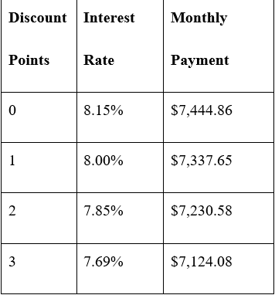



Why Points and Fees Exist
These choices below all provide the same 10- year 8.15% yield to the lender.
Broker Compensation
In the commercial mortgage industry, origination fees often compensate mortgage brokers who find and filter loan applications for financial institutions.
Administrative Cost Recovery
Loan originators face overhead and administrative costs that differ from the opportunity cost of capital. While capital costs accrue over the loan life, administrative costs are sunk at origination.
Prepayment Disincentive
Up-front fees provide some disincentive against early prepayment of the loan by the borrower due to the hyperbolic relation between yield and prepayment horizon.
Payment Level Trade-off
Greater origination fees and discount points allow lower regular loan payments for the same yield, creating the familiar mortgage menu offered by lenders.

Slide 18



Using Yields to Value Mortgages
Identify Market Yield
Determine the appropriate yield for similar loans in the current market
Apply DCF Valuation
Discount the loan's cash flows using the market yield
Determine Market Value
The resulting present value represents the loan's market worth
For a given loan with specified contractual future cash flows, a given yield will correspond to a certain price, and vice versa. Yields become a convenient way to measure and quote mortgage prices in the debt market. By applying the relevant market yield to a given mortgage, you can determine its market value.

Slide 19
Mortgage Valuation Example
$1M
8%
7.5%
Loan Amount
Contract Rate
Market Yield
30-year amortization, 10-year maturity
Fixed interest rate
Current required return
$1.03M
Market Value
Premium over par value
This example shows how a $1 million, 8% loan with monthly payments of $7,337.65 would be valued at $1,033,509 if the market yield at that time is 7.5%. This premium reflects the fact that the loan's contract rate exceeds the current market yield.
Conversely, if the market yield were 8.5%, the loan would be worth only $967,888, requiring 3.2112 points of prepaid interest or origination fees to make up the difference.

Slide 20





The Refinancing Decision
Evaluate Current Loan
Calculate remaining payments and outstanding balance
Determine Market Rate
Find current yield for comparable new loans
Calculate NPV
Compare value of old liability to cost of paying it off
Make Decision
Refinance if NPV is significant and positive after transaction costs

Slide 21
Traditional Refinancing Calculation
Step 1: Calculate Liquidating Payment
Step 3: Calculate Present Value
Determine the outstanding balance plus any prepayment penalty required to pay off the existing loan.
Compute the present value of the old loan's remaining cash flows using the opportunity cost as the discount rate.
Step 2: Determine Opportunity Cost
Step 4: Compute NPV
Calculate the yield on a new loan over the remaining maturity of the old loan, including any origination fees.
Subtract the liquidating payment from the present value of the old loan, then deduct transaction costs.
This approach views refinancing fundamentally as a decision about whether to exercise the old loan's prepayment option. It doesn't matter whether the old loan would be paid off with capital from a new loan, additional equity, or some combination - the analysis focuses on comparing the current liability value with the cash required to pay it off.

Slide 22
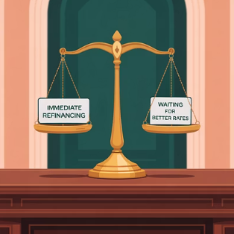
Prepayment Option Value: What Traditional Analysis Misses
Traditional refinancing analysis ignores the value of the prepayment option in the existing loan. This option has positive value to the borrower and is extinguished when exercised. The loss of this option is therefore a cost that should be considered.
In practice, a simple rule of thumb is that when yields on new loans get to around 200 basis points below the interest rate on the old loan, prepayment likely makes sense. However, with little remaining maturity or expectations of further rate decreases, it may still be better to wait. Conversely, with long remaining maturity or if rates are likely at their bottom, refinancing may make sense even with less than a 200 basis point differential.

