Slide 1

Commercial Mortgage Analysis and Underwriting
Commercial mortgages represent a significant investment vehicle in real estate finance. Understanding how to analyze default risk and apply proper underwriting procedures is essential for both lenders and borrowers in this market.
This presentation explores the quantitative aspects of default risk in commercial mortgages and examines the traditional underwriting procedures used by lenders. We'll investigate how expected returns differ from stated yields, analyze the impact of default timing, and review the key metrics used in commercial mortgage underwriting.

Slide 2
Expected Returns vs. Stated Yields
Contract Yield (YTM)
Expected Return (E[r])
Based on contractual cash flow terms of the mortgage
Recognizes realistic probability of default and foreclosure
Assumes all payments will be made according to schedule
Accounts for potential credit losses
This is what lenders typically quote to borrowers
More fundamental measure for investment decisions
The difference between stated yield and expected return quantifies the impact of default risk on the ex ante return that lenders care about. This difference is known as yield degradation.

Slide 3

Understanding Yield Degradation
Credit Losses
Shortfalls to the lender resulting from default and foreclosure
Yield Degradation
The effect of credit losses on realized yield compared to contractual yield
Recovery Rate
Percentage of outstanding loan balance recovered after default (e.g., 70%)
Loss Severity
Percentage of outstanding loan balance lost after default (e.g., 30%)

Slide 4





Timing of Default Matters
Earlier Default
Higher Loss
Greater yield degradation
Less time to collect interest payments
Property Value
Recovery Rate
May have declined significantly
Critical to final loss calculation
For example, with a 3-year loan at 10% interest rate, default in year 1 with 80% recovery results in 22% yield degradation, while default in year 3 with 70% recovery results in only 11.12% yield degradation.

Slide 5

Hazard Functions and Default Probability
The hazard function tells the conditional probability of default at each point in time, given that default has not already occurred before then.
Year
Hazard
Conditional Survival
Cumulative Survival
Unconditional PrDEF
Cumulative PrDEF
1
1%
99.00%
99.00%
1.00%
1.00%
2
2%
98.00%
97.02%
1.98%
2.98%
3
3%
97.00%
94.11%
2.91%
5.89%
With hazards of 1%, 2%, and 3% for years 1-3, the ex ante probability of default at some point in the loan's life is 5.89%, which is less than the sum of all individual hazards (6%).

Slide 6
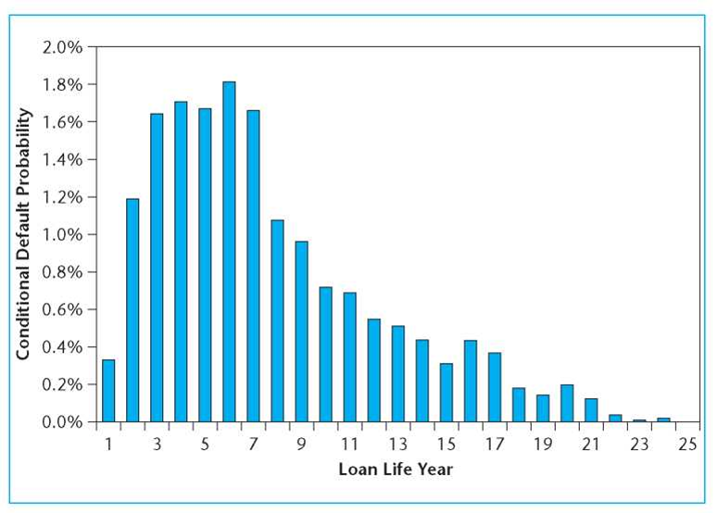
Typical Commercial Mortgage Hazard Rates by Loan Life Year (from Esaki et al, 2002)
Year
Hazard Rate (%)
Commercial mortgage hazard rates typically follow a humpbacked pattern. The probability of default is relatively low immediately after loan issuance but rises rapidly, peaking in the early to middle years (around years 3-7) before falling off in later years.
Based on ACLI data from 1972-2002, hazard probabilities peaked at 1.8% in the sixth year and fell rapidly after the seventh year. The implied mean time until default (if it occurs) is about seven years.

Slide 7
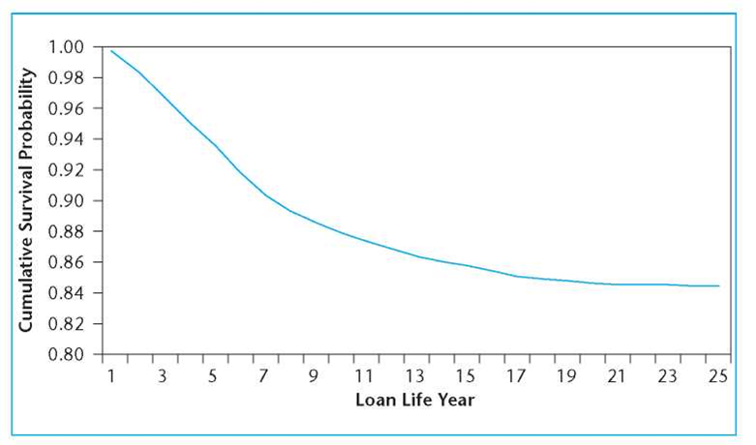
Commercial Mortgage Survival Rates (Esaki et al, 2002)
Year
Cumulative Survival Rate (%)
The cumulative survival function shows the probability that a loan has not defaulted through a given year. Based on ACLI data, the implied cumulative lifetime default probability is slightly under 16%.
This means almost one in six commercial mortgages issued by life insurance companies during the 1972-1997 period defaulted, though performance varied significantly by loan vintage year.

Slide 8
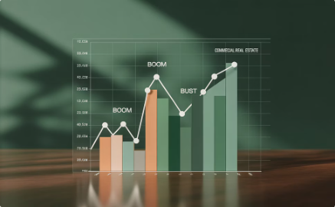
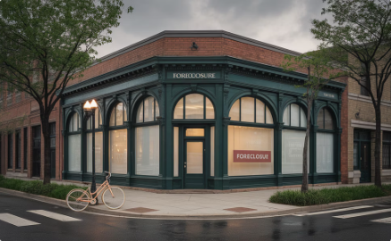

Default Rates Vary by Loan Vintage
Market Cycles Impact Default
Loans issued when property values were relatively high (early 1970s and mid-1980s) had much higher lifetime default rates, peaking at almost 28% for loans issued in 1986.
The "Santa Claus Approach"
Borrowers are rewarded (loaned more capital) when they have done well and penalized
(given less capital) when they have performed poorly during the recent past.
Cyclical Pattern
If lenders maintain constant LTV ratios while property values cycle, this creates a pattern
of higher defaults for loans originated during market peaks.

Slide 9
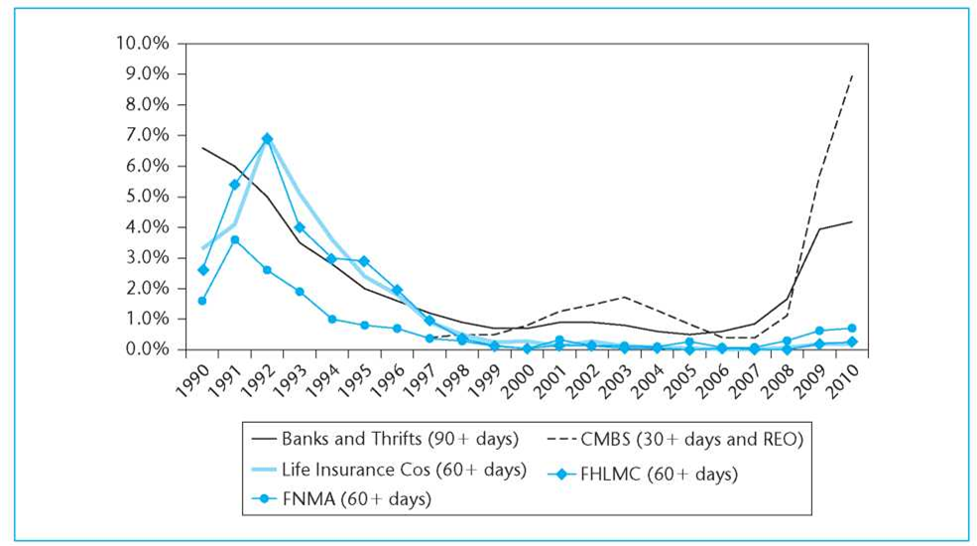
Default Rates by Lender Type: 1990-2010
CMBS (%)
Life Insurance (%)
Banks (%)
By 2010, CMBS loans were experiencing default rates comparable to the worst performance of the early 1990s. Life insurance companies performed better in the 2008-2010 downturn, possibly because they had learned from the previous cycle and maintained more conservative underwriting standards.
By 2011, the delinquency rate for the worst-performing cohort of loans issued during the 2007 peak of the bubble reached 12%.

Slide 10

Recovery Rates and Loss Severity
69%
31%
48.4%
Average Recovery Rate
Average Loss Severity
2023 Loss Severity
For liquidated loans in the Esaki study
Including foreclosure expenses, lost interest and principal
For $2.1B in loans disposed with losses (Fitch Ratings)
53.2%
Office Sector Loss
Highest loss severity among property types in 2023
A more detailed study by Ciochetti tracked 308 foreclosed mortgages from "cradle to grave" and found that while the average recovery was 57% based on reported property value at foreclosure, the average recovery was only 34% through to final disposition of the property.

Slide 11

Is It Surprising That So Many Commercial Mortgages Default?
No borrower plans to default on a loan when they take it out. Lenders go to great lengths to avoid making loans that will default. Yet about one out of every six long-term commercial mortgages in the United States defaults. Why?
The answer lies in property market volatility. The typical individual commercial property has an annual volatility in excess of 15%. With a standard 75% LTV ratio and property values following a random walk, there's approximately a one-sixth chance that a property will be worth less than the loan balance after seven years.
Even with modest expected appreciation of 2% per year, there remains about a one-sixth chance that the property would be worth only 75% of its current value or less after seven years - right at the typical LTV threshold.
Empirically observed default rates in commercial mortgages are consistent with evidence about property volatility.

Slide 12
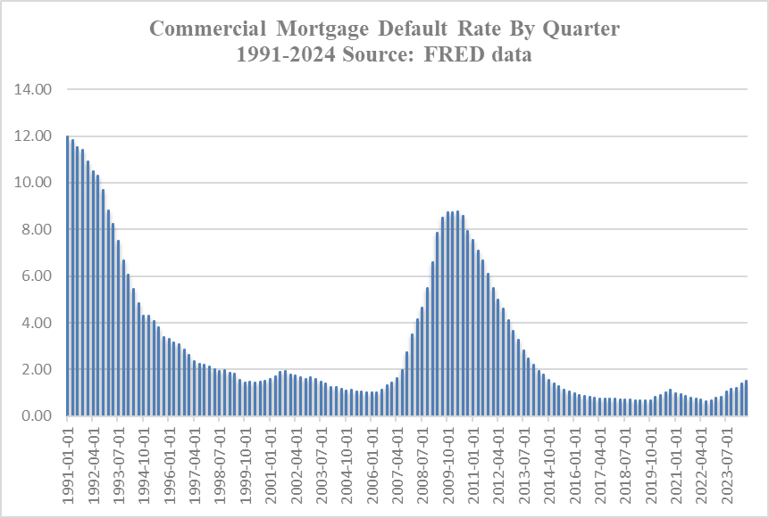
Commercial Mortgage Default Rates Over Time
Credit losses are higher during downturns in the commercial property market (mid-1970s, early 1990s). Losses peaked at almost 240 basis points in 1992 but were as low as 6-9 basis points during the boom years of the early 2000s, only to rise to close to 100 basis points again by 2010.
The average annual credit loss in the GLCMPI during the 1972-2004 period was 62 basis points.

Slide 13
Commercial Mortgage Underwriting: Purpose and Focus
Purpose of Underwriting
Focus on Properties
Borrower Considerations
In principle, underwriting aims to make default a rare event. More broadly, it ensures lenders are getting their desired expected return when making loans. Tighter underwriting criteria lower default probability and yield degradation, raising expected returns toward contractual yields.
Unlike residential mortgages, commercial mortgage underwriting focuses primarily on the property rather than the borrower. Since many commercial mortgages are non-recourse, and the property itself provides cash to service the loan, property quality and income are critical factors.
The borrower remains important. Financially troubled borrowers may use healthy properties as "cash cows" to bail out other losses. Conversely, successful borrowers represent potential repeat customers, which may influence lender flexibility.

Slide 14


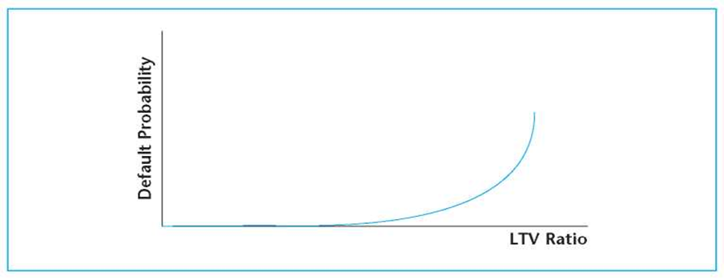


Initial Loan-to-Value Ratio (ILTV)
Primary Underwriting Criterion
Most fundamental measure of loan risk
Calculation
Loan Amount ÷ Property Value
Note the Nonlinear Relationship
Default probability increases sharply at higher LTVs
Traditional ILTV Limit
75% or lower (65% for riskier properties)
The ILTV ratio is directly related to the ex-ante default probability in the loan. Because the current market value of the property reflects the entire future income stream, ILTV is arguably the most important single underwriting criterion, reflecting both asset value and income coverage in a single measure.

Slide 15


Debt Service Coverage Ratio (DCR)
Primary Income-Based Criterion
Measures income relative to debt service
Calculation =
NOI ÷ Annual Debt Service
Typical Requirement
3
120% or higher depending on the quality and resiliency of the tenants
The DCR clearly makes sense as an underwriting criterion, as the NOI generated by the property is normally the primary source of cash to service the loan. The buffer provided by requiring DCR above 100% helps protect against cash flow squeezes.
The DCR criterion may be raised higher for riskier property types or during times when lenders are more risk-averse. Conversely, lower DCR hurdles may be accepted during periods of rapid inflation or when the loan market is "hot."

Slide 16





Additional Underwriting Metrics
Break-Even Ratio (BER)
Equity-Before-Tax Cash Flow
Loan Yield
(Debt Service + Operating Expenses) ÷ Potential Gross Income
Property NOI ÷ Loan Amount
NOI - Debt Service - Capital Improvement Expenditures
Relates loan to property pricing metrics
Typical limit: 85% or less
Red flag if projected to be negative
Multi-year Proforma
Cash flow projection extending to loan maturity
Examines criteria for all years, not just initial year

Slide 17









Variables and Loan Terms to Negotiate
Loan Term
Loan Amount
Maturity length
Total principal borrowed
Interest Rate
3
Contract rate
Other Terms
Fees, prepayment options, recourse provisions
Amortization
Principal repayment schedule
Commercial mortgages present a potentially large array of possible loan terms and variables that can be negotiated. The art of putting together a successful deal lies in finding a combination that maximizes both sides' preferences, requiring an understanding of how changing loan terms affects the ex ante risk and return.

Slide 18
Numerical Example: Bob's Office Building Loan
Loan Request
Market Conditions
$9,167,000 purchase-money mortgage
10-year Treasury bonds: 6% yield
100,000-SF single-tenant office building
Commercial mortgage spreads: 200 basis points
Purchase price: $12,222,000 (75% ILTV)
Required mortgage rate: 7.87% (MEY)
10-year interest-only, nonrecourse loan
Underwriting Criteria
No prepayment permitted (lockout)
Maximum ILTV < 75%
Maximum terminal LTV < 65%
Minimum DCR > 120%
Maximum BER < 85%

Slide 19
Analyzing Bob's Loan Application
Year
1
2
5
8
10
NOI
$1,100,000
$1,150,000
$1,200,000
$1,218,214
$1,299,428
Debt Service
$721,443
$721,443
$721,443
$721,443
$9,888,443
EBTCF
$378,557
$428,557
$478,557
($1,028,229)
$4,405,266
DCR
152%
159%
166%
169%
180%
BER
60%
59%
57%
56%
54%
The income-based metrics look good: DCR starts at 152% (above the 120% minimum) and improves over time. BER starts at 60%, well below the 85% maximum.
However, there are two problems: 1) A sharply negative EBTCF in year 8 when the lease expires, and 2) The DCF valuation at a 10% discount rate gives a present value of only $11,557,000, implying a 79% ILTV, which violates the 75% ILTV criterion.

Slide 20
Negotiating a Solution
Structure the Counterproposal
Develop Alternatives
With 40-year amortization, the balloon payment after 10 years would be $8,230,047, implying a TLTV ratio of 63%, below the 65% limit. Annual debt service would be $715,740, slightly less than Bob's original proposal.
Identify the Problems
Offer a smaller loan of $8.7 million (75% of $11,557,000) with some amortization to meet the terminal LTV requirement of 65%.
The loan application fails the ILTV criterion (79% vs. 75% limit) and would also fail the terminal LTV criterion without amortization.
This example demonstrates how trade-offs among loan terms can be manipulated to meet underwriting criteria. If the lender's underwriting criteria are competitive and the property market valuation is accurate, Bob should find it difficult to secure better terms elsewhere.

