Slide 1

Macro-Level Real Estate Investment Analysis
Welcome to an exploration of macro-level real estate investment analysis. We'll examine how real estate fits into the broader investment landscape and portfolio strategy.
This presentation covers strategic policy formulation, tactical policy implementation, and the critical role real estate plays in diversified investment portfolios.

Slide 2
Micro vs. Macro Investment Analysis
Micro-Level Analysis
Macro-Level Analysis
Focuses on individual properties and deals
Examines aggregates of properties and portfolio considerations
Property-specific metrics
Deal structure evaluation
Portfolio-wide allocation decisions
Individual asset performance
Mixed-asset portfolio management
Interface between real estate and other asset classes

Slide 3





Evolution of Macro-Level Analysis
Traditional Era
Real estate investment was primarily a micro-level endeavor focused on individual properties
Last Third of 20th Century
Macro-level analysis emerged as a distinct discipline in real estate investment
Late 20th Century
Rapid growth connecting Wall Street to Main Street in real estate investment
Present Day
Macro-level analysis drives modern real estate career paths and investment strategies

Slide 4






Three Major Decision Arenas
Tactical Policy
Seeks to profit from shorter-term opportunities
Strategic Policy
Market timing
Defines broad allocations and long-run objectives
Econometric forecasting
Implementation
Modern Portfolio Theory (MPT)
Carries out strategic and tactical policies effectively
Long-term allocation targets
Manager performance evaluation
Incentive structure alignment

Slide 5

Modern Portfolio Theory (MPT)
MPT is the cornerstone of strategic investment allocation, focusing on optimizing risk and return at the portfolio level.
Comprehensive Approach
Treats risk and return together in an integrated manner
Quantifiable Framework
Provides measurable implications of risk and return decisions
Portfolio-Level Focus
Addresses allocation at the level of the investor's overall wealth
Nobel Prize-Winning
Developed by Harry Markowitz, who won the 1990 Nobel Prize in Economics

Slide 6


Investor Preferences and Risk Tolerance
Conservative Investor
Aggressive Investor
More risk-averse with steeply curved indifference curves
More risk-tolerant with less steeply curved indifference curves
Requires significant additional return to accept more risk
Willing to accept more risk for moderate increases in return

Slide 7
Portfolio Dominance Concept
Dominant Portfolio
Dominated Portfolio
MPT's Primary Goal
Provides more return with equal or less risk, or less risk with equal or more return compared to another portfolio
Any portfolio that could be improved by moving to a dominant portfolio position
Help investors avoid holding dominated portfolios by moving "northwesterly" in the risk/return diagram

Slide 8



The Power of Diversification
Traditional Wisdom
"Don't put all your eggs in one basket"
Quantified Benefit
MPT quantifies diversification benefits in terms of risk and return
Optimal Allocation
Provides guidance on how many "eggs" should go in which "baskets"
Diversification may be one of the rare "free lunches" in economics, allowing investors to improve return without increasing risk, or reduce risk without reducing return.

Slide 9
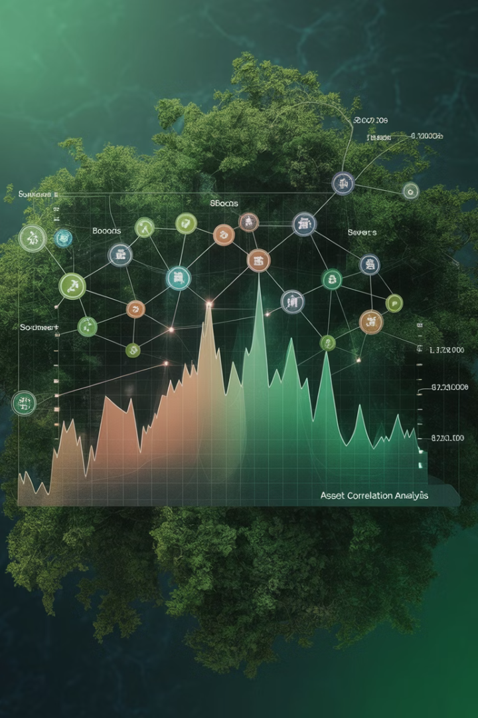



Correlation: The Key to Diversification
High Correlation
Assets that move together provide less diversification benefit
Low Correlation
Assets that don't move together provide greater diversification benefit. Assets with negative return correlations are hard to find but stabilize returns.
Real Estate Advantage
Direct property investments typically have lower correlation with stocks and bonds

Slide 10
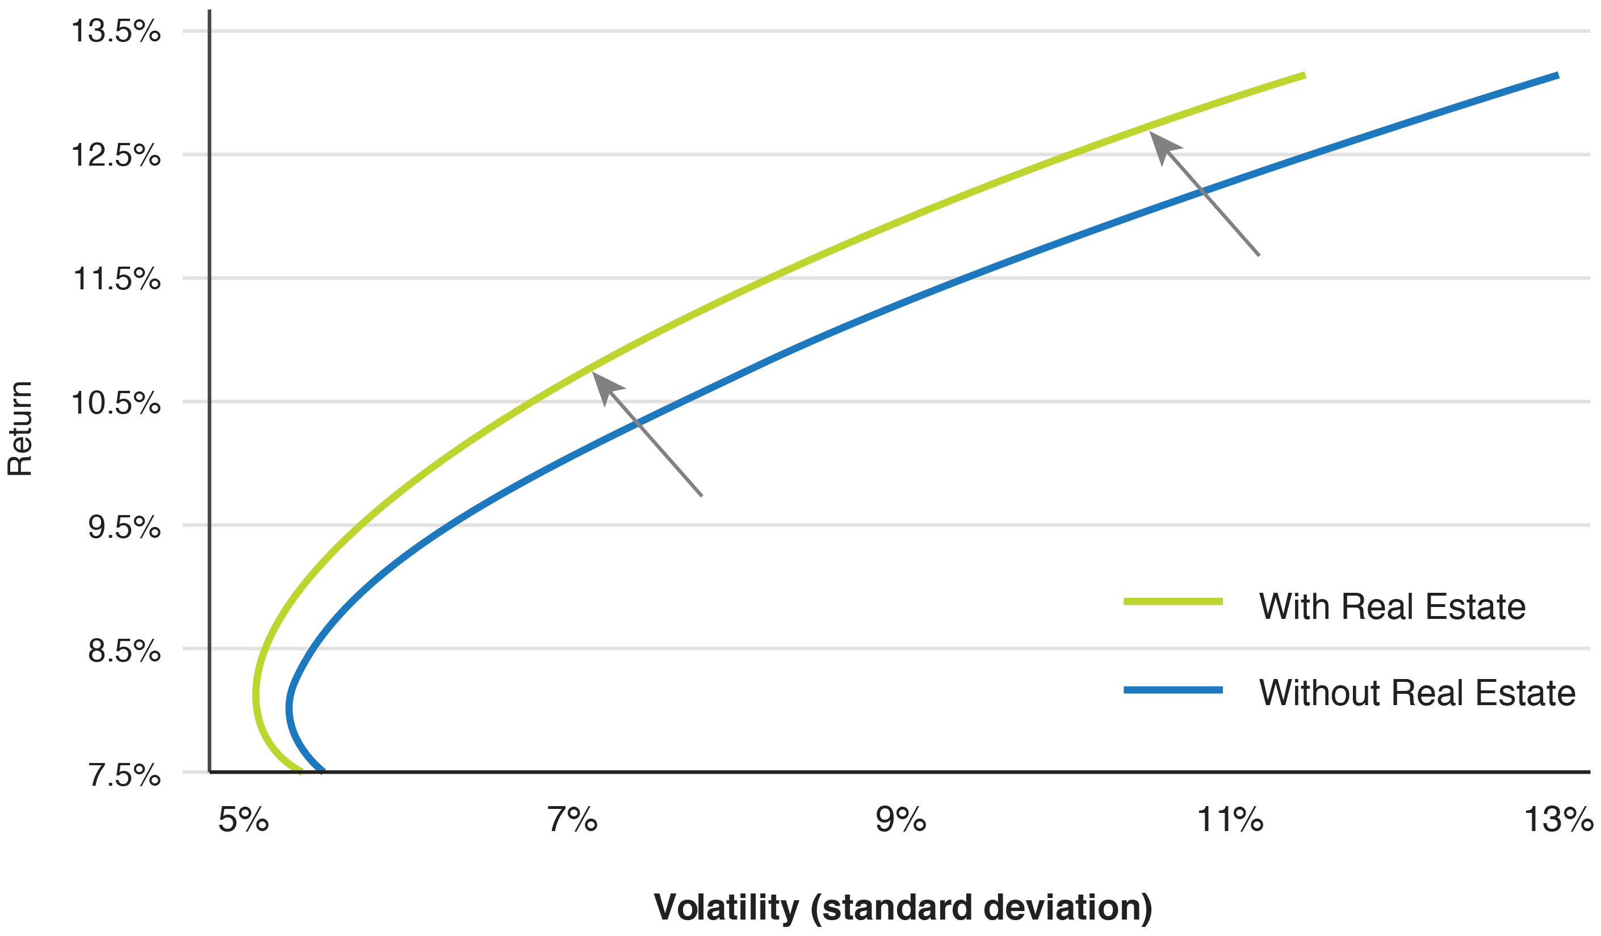
The Efficient Frontier
The efficient frontier represents the set of portfolios that offer the highest expected return
for a given level of risk. Here the blue line represents stocks and bonds and the green line
Represents the impact of including real estate.
Risk (Volatility)
Expected Return
Any portfolio on the efficient frontier is, by definition, not dominated by any other portfolio. For a given volatility, it maximizes expected return, and for a given expected return, it minimizes volatility.

Slide 11

Real Estate in the Mixed-Asset Portfolio
33%
1/3
3rd
Optimal Allocation
Market Value
Asset Class
Real estate represents about one-third of investable capital market value
Real estate is the third major asset class after stocks and bonds
Typical real estate allocation in conservative to moderate portfolios
Portfolio theory provides an underlying explanation for why real estate should occupy a prominent role in the average investment portfolio.

Slide 12



Another Role for Real Estate: Inflation Hedge
Liability Protection
Helps pension funds meet inflation-adjusted benefit obligations
COLA Coverage
Addresses cost-of-living adjustments in pension benefits
Real Asset Value
Based on physical product with intrinsic value that tends to rise with inflation
While real estate's primary role on the asset side is as a diversifier, its value on the liability side is often as an inflation hedge asset.

Slide 13






The Riskless Asset Construct
Two-Fund Theorem
Simplifies portfolio allocation decisions
Borrowing & Lending
Approximates debt financing and cash positions
Risk-Free Rate
Usually represented by Treasury bills
The riskless asset construct extends MPT by allowing investors to combine risk-free investments with risky portfolios. This creates a straight line on the risk-return diagram rather than a curved efficient frontier.

Slide 14

The Sharpe Ratio
Where:
rP
Expected return of the portfolio
rf
Risk-free rate (short term government bonds)
SP
Standard deviation (volatility) of the portfolio
The Sharpe ratio measures risk-adjusted return by dividing the risk premium by volatility. The optimal combination of risky assets is the one with the highest Sharpe ratio.

Slide 15
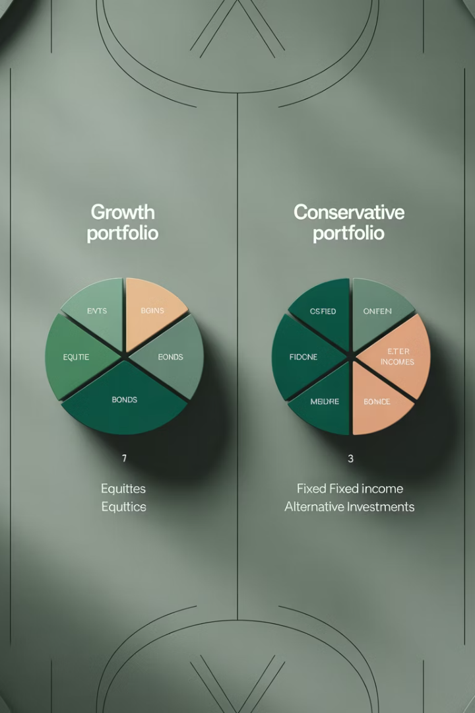
Sharpe-Maximizing vs. Variance-Minimizing
Portfolio Approach
Stocks
Bonds
Real Estate
Cash
Variance-Minimizing (7% target)
16%
48%
36%
0%
Sharpe-Maximizing (7% target)
25%
33%
32%
10%
The Sharpe-maximizing approach typically allocates more to higher-return assets like stocks compared to the variance-minimizing approach for conservative investors.

Slide 16


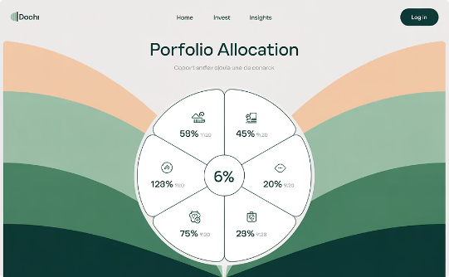
Risk Parity Portfolio (RPP)
Equal Risk Contribution
Uncertainty Protection
Practical Simplicity
Each asset class contributes the same amount to portfolio volatility
Less sensitive to errors in expected return forecasts
One specific portfolio point rather than a curve of possibilities

Slide 17
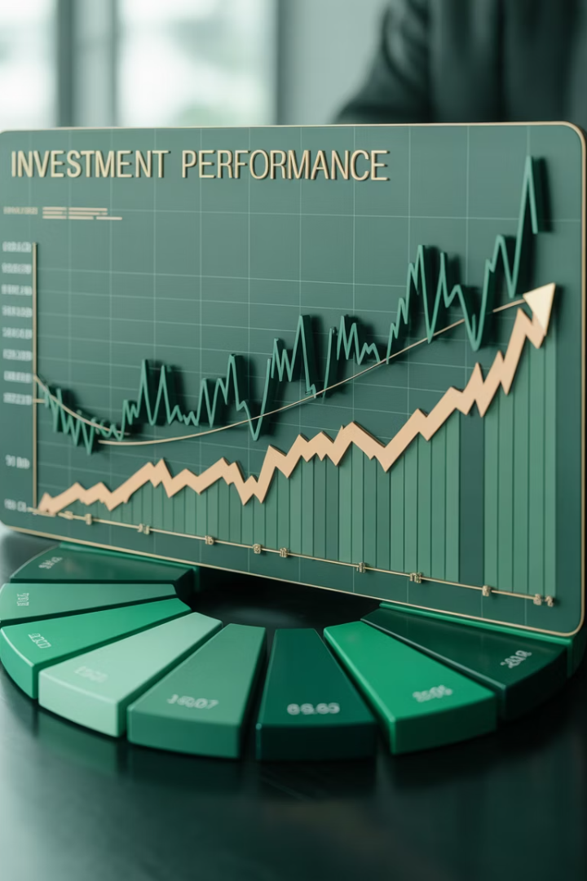
Passive Allocation Approach
Market-Based Allocation
"The market knows best" philosophy matches portfolio to market value shares
Benchmark Matching
Reduces risk of deviating from established performance benchmarks
Simplified Implementation
Requires less research and fewer resources than optimization approaches
Based on U.S. investable capital market shares, passive allocation might suggest a real estate allocation of approximately 10-36% depending on whether all real estate or just commercial real estate equity is considered.

Slide 18
Risk vs. Uncertainty in Portfolio Allocation
Risk (Known Unknowns)
Uncertainty (Unknown Unknowns) aka Black Swans
Quantifiable probabilities
Unquantifiable probabilities
Measurable volatility
Future expectations unclear
Historical data available
No reliable historical precedent
Can be modeled mathematically
Cannot be modeled effectively
The distinction between risk and uncertainty helps explain why some investors prefer simpler allocation approaches like Risk Parity over complex optimization models.

Slide 19
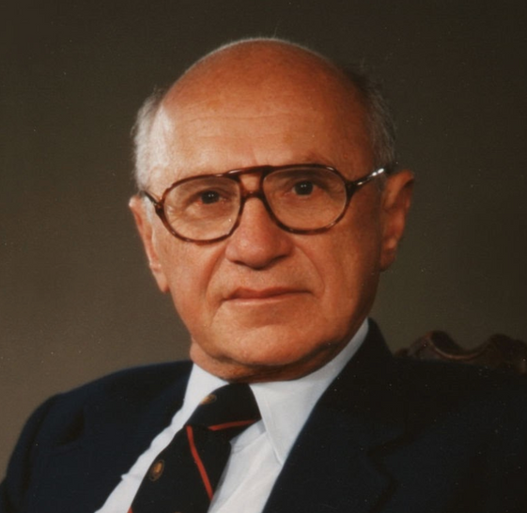
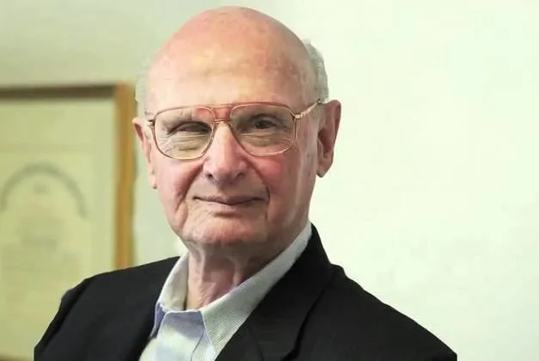

Is MPT Economics?
MPT earned Harry Markowitz (left above) a Nobel Prize in economics, yet it has unique characteristics in the world of economic theory. Unlike most economic theories based on market equilibrium, opportunity cost, or wealth maximization, MPT focuses on risk-return optimization.
When defending his PhD thesis, economist Milton Friedman (right above) reportedly commented that MPT was "a great theory, but it was finance or engineering, not economics." Whether economics or not, MPT remains a powerful tool for investment strategy. After Harry won the Nobel prize in economics, he asked Harry: “Now is it economics?”

Slide 20





Key Takeaways
Strategic Importance
Macro-level analysis is essential for optimal real estate investment allocation
Significant Allocation
All portfolio approaches suggest real estate deserves substantial allocation
Multiple Approaches
MPT, Risk Parity, and Passive Allocation each offer valuable perspectives
Dual Benefits
Real estate serves as both a portfolio diversifier and inflation hedge

Slide 21
Appendix on the mathematics of the Efficient Frontier

Slide 22
Making the analysis more formal & rigorous…
AT THE HEART OF PORTFOLIO THEORY ARE TWO BASIC MATHEMATICAL FACTS:
1) PORTFOLIO RETURN IS A LINEAR FUNCTION OF THE ASSET WEIGHTS (w, allocation, share of portfolio):
IN PARTICULAR, THE PORTFOLIO EXPECTED RETURN IS A WEIGHTED AVERAGE OF THE EXPECTED RETURNS TO THE INDIVIDUAL ASSETS. E.G., WITH TWO ASSETS ("i" & "j"):
r_{p} = ωr_{i} + (1-ω)r_{j}
WHERE ω_{i} IS THE SHARE OF PORTFOLIO TOTAL VALUE INVESTED IN ASSET i.
e.g., If Asset A has E[r_{A}]=5% and Asset B has E[r_{B}]=10%, then a 50/50 Portfolio (50% A + 50% B) will have E[r_{P}]=7.5%.

Slide 23
THE 2ND FACT:
2) PORTFOLIO VOLATILITY IS A NON-LINEAR FUNCTION OF THE ASSET WEIGHTS:
SUCH THAT THE PORTFOLIO VOLATILITY IS LESS THAN A WEIGHTED AVERAGE OF THE VOLATILITIES OF THE INDIVIDUAL ASSETS. E.G., WITH TWO ASSETS:
s_{P} = SQRT[ w²(s_{i})² + (1-w)²(s_{j})² + 2w(1-w)s_{i}s_{j}C_{ij} ]
< ws_{i} + (1-w)s_{j} , where: s=StDev, C=correl
WHERE s_{i} IS THE RISK (MEASURED BY STD.DEV.) OF ASSET i.
e.g., If Asset A has StdDev[r_{A}]=5% and Asset B has StdDev[r_{B}]=10%, then a 50/50 Portfolio (50% A + 50% B) will have StdDev[r_{P}] < 7.5% (conceivably even < 5%).
➔ This is the beauty of Diversification. It is at the core of Portfolio Theory. It is perhaps the only place in economics where you get a “free lunch”: In this case, less risk without necessarily reducing your expected return!

Slide 24
Here’s a picture of the first mathematical fact:
e.g., where P is { (1/2)A & (1/2)B }…
Expected Return
B
10%
7.5%
P
5%
A

Slide 25
Here’s a picture of both the two mathematical facts:
e.g., where P is { (1/2)A & (1/2)B }…
Expected Return
B
10%
P
7.5%
5%
A
5%
7.5%
10%
Volatility
< 7.5%
The red line is the complete picture, both return and risk.

Slide 26
KEY POINT:
If
  Risk that matters to investor is risk in overall wealth (this is really a threshold point in the theory, a starting point),
Then (this is just straightforward math):
  Risk that matters in investments (assets) is covariance with overall wealth (contribution to overall wealth volatility);
  Not the asset’s own volatility (Std.Dev) (This was not the traditional view and is not so intuitive)
(e.g., if investor portfolio primarily stocks & bonds, & if Real Estate has low correlation with stocks & bonds, then R.E. volatility may not matter to investor; because it may not contribute much to investor's wealth volatility.)
Covariance(i,j) = Stdev(i)*Stdev(j)*Correl(i,j)

Slide 27
22.2.4 STEP 1: FINDING THE “EFFICIENT FRONTIER”
SUPPOSE WE HAVE THE FOLLOWING RISK & RETURN EXPECTATIONS…
INVESTING IN ANY ONE OF THE THREE ASSET CLASSES WITHOUT DIVERSIFICATION ALLOWS THE INVESTOR TO ACHIEVE ONLY ONE OF THREE POSSIBLE RISK/RETURN POINTS…
Notes:
The two steps are going to be: (1) Identifying the “efficient frontier”, and then (ii) Ascertaining where (which portfolio) the investor should prefer on that frontier.
Note: The risk/return expectations employed in this example are not exactly equal to the historical risk/return performances of the three asset classes (see earlier statistics). But what matters for making investment decisions is ex ante expectations, as of the present looking forward into the future. Historical statistics provide relevant information, but not the whole story, in making the kind of subjective, informed judgments (estimates) that decision-makers must make.

Slide 28
INVESTING IN ANY ONE OF THE THREE ASSET CLASSES WITHOUT DIVERSIFICATION ALLOWS THE INVESTOR TO ACHIEVE ONLY ONE OF THE THREE POSSIBLE RISK/RETURN POINTS DEPICTED IN THE GRAPH BELOW…
IN A RISK/RETURN CHART LIKE THIS, ONE WANTS TO BE ABLE TO GET AS MANY RISK/RETURN COMBINATIONS AS POSSIBLE, AS FAR TO THE “NORTH” AND “WEST” AS POSSIBLE (more return, less risk).

Slide 29
ALLOWING PAIRWISE COMBINATIONS INCREASES THE RISK/RETURN POSSIBILITIES TO THESE…

Slide 30
FINALLY, IF WE ALLOW UNLIMITED DIVERSIFICATION AMONG ALL THREE ASSET CLASSES, WE ENABLE AN INFINITE NUMBER OF COMBINATIONS, THE “BEST” (I.E., MOST “NORTH” AND “WEST”) OF WHICH ARE SHOWN BY THE OUTSIDE (ENVELOPING) CURVE.
THIS IS THE “EFFICIENT FRONTIER” (IN THIS CASE OF THREE ASSET CLASSES).

Slide 31
“EFFICIENT FRONTIER” CONSISTS OF ALL ASSET COMBINATIONS (PORTFOLIOS) WHICH MAXIMIZE RETURN AND MINIMIZE RISK.
EFFICIENT FRONTIER IS AS FAR “NORTH” AND “WEST” AS YOU CAN POSSIBLY GET IN THE RISK/RETURN GRAPH.
A PORTFOLIO IS SAID TO BE “EFFICIENT” (i.e., represents one point on the efficient frontier) IF IT HAS THE MINIMUM POSSIBLE VOLATILITY FOR A GIVEN EXPECTED RETURN, AND/OR THE MAXIMUM EXPECTED RETURN FOR A GIVEN LEVEL OF VOLATILITY.
(Terminology note: This is a different definition of "efficiency" than the concept of informational efficiency applied to asset markets and asset prices.)

Slide 32
SUMMARY UP TO HERE:
DIVERSIFICATION AMONG RISKY ASSETS ALLOWS:
Ø GREATER EXPECTED RETURN TO BE OBTAINED
FOR ANY GIVEN RISK EXPOSURE, &/OR;
Ø LESS RISK TO BE INCURRED
FOR ANY GIVEN EXPECTED RETURN TARGET.
(This is called getting on the "efficient frontier".)
PORTFOLIO THEORY ALLOWS US TO:
Ø QUANTIFY THIS EFFECT OF DIVERSIFICATION
Ø IDENTIFY THE "OPTIMAL" (BEST) MIXTURE OF RISKY ASSETS
(It also allows to quantify how much it matters.)

Slide 33
POINTS ON FRONTIER ARE NON-DOMINATED, SO MPT LET’S INVESTOR PICK ANY ONE OF THEM. SO, SET YOUR TARGET RETURN TO REFLECT YOUR RISK PREFERENCE.
E.G., ARE YOU HERE (7%)?...
Exh.21-7A:

Slide 34
POINTS ON FRONTIER ARE NON-DOMINATED, SO MPT LET’S INVESTOR PICK ANY ONE OF THEM. SO, SET YOUR TARGET RETURN TO REFLECT YOUR RISK PREFERENCE.
OR ARE YOU HERE (9%)?...
Exh.21-7B:
Now, how do we implement such a portfolio analysis in practice? (Two steps…)
Notes:
How to determine the investor’s risk preferences (target risk and return) is not an exact science. There are some exercises that are often employed (e.g., asking the investor to choose betw various combinations of stocks and bonds, or between various risk/return simulated distributions, or to specify maximum acceptable probability of a given degree of specified loss, etc.,etc.). The final decision ends up usually being both intuitive and “political”, especially for decision-making entities that are “organizations” (e.g., institutions, firms, that is, collectivities of multiple individuals) as opposed to single wealthy individuals. Note that, from a “scientific” perspective, there is no rigorous way to quantitatively aggregate across individuals’ utility functions (“Arrow’s Impossibility Theorem” of welfare economics).

Slide 35

Step 1: FIND THE EFFICIENT FRONTIER. MATHEMATICALLY, PORTFOLIO ALLOCATION IS A "CONSTRAINED OPTIMIZATION" PROBLEM
==> Algebraic solution using calculus
==> Numerical solution using computer and "quadratic programming". Spreadsheets such as Excel include "Solvers" that can find optimal portfolios this way (via numerical search algorithms).
==> We have distributed an Excel optimizer file (& one comes in the CD at the back of the textbook).
Remember: Milton Friedman told Harry Markowitz in 1956 (HM defending his PhD dissertation): “This is not economics.”
What is it?...
“Optimal control”, a branch of Operations Research (OR) or “Engineering Systems” (MIT term).

Slide 36
Example: Given following expectations:
See the Excel mechanics example in 13-minute video linked here.
Assuming weights: (1/2)Stocks, (1/3)Bonds, (1/6)RE,
Portf mean (expected) return is:
Weighted Covariance Matrix gives the portfolio variance:
Portf variance is the sum across the 9 cells, each cell is: (w_{i})(w_{j})(SD_{i})(SD_{j})(CORR_{ij})
(1/2)(1/2)(.15)(.15)(1.00) | (1/2)(1/3)(.15)(.08)(0.30) | (1/2)(1/6)(.15)(.10)(0.25)
(1/2)(1/3)(.15)(.08)(0.30) | (1/3)(1/3)(.08)(.08)(1.00) | (1/3)(1/6)(.08)(.10)(0.15)
(1/2)(1/6)(.15)(.10)(0.25) | (1/3)(1/6)(.08)(.10)(0.15) | (1/6)(1/6)(.10)(.10)(1.00)
0.0056 | 0.0006 | 0.0003
0.0006 | 0.0007 | 0.0001
0.0003 | 0.0001 | 0.0003
SUM
= 0.0086
SQRT(0.0086) = 9.26% = Portf Volatility
Notes:
See how this computation works in cell E25 applied to range E21:G23 on the “Optimizer” tab of the “HW1PortfTemplate.xls” workbook.

Slide 37
HOW THE STEP 1 PROBLEM IS SOLVED IN EXCEL…
Set the problem up in Excel® as on the earlier slide.
Invoke the Excel Solver so as to:
Find the weights (w_{ST,} w_{BD,} w_{RE} ) such that they:
  Are all positive,
  Sum to 1,
  Produce portf mean return r_{P} = target return, and
  They minimize the portfolio volatility (or variance).
Repeat for various different target return points to
Trace out the efficient frontier.

Slide 38
22.2.5. STEP 2: PICK A RETURN TARGET FOR YOUR OVERALL WEALTH THAT REFLECTS YOUR RISK PREFERENCES...
E.G., ARE YOU HERE (7%)?...

Slide 39
22.2.5. STEP 2: PICK A RETURN TARGET FOR YOUR OVERALL WEALTH THAT REFLECTS YOUR RISK PREFERENCES...
OR ARE YOU HERE (9%)?...
Notes:
How to determine the investor’s risk preferences (target risk and return) is not an exact science. There are some exercises that are often employed (e.g., asking the investor to choose betw various combinations of stocks and bonds, or between various risk/return simulated distributions, or to specify maximum acceptable probability of a given degree of specified loss, etc.,etc.). The final decision ends up usually being both intuitive and “political”, especially for decision-making entities that are “organizations” (e.g., institutions, firms, that is, collectivities of multiple individuals) as opposed to single wealthy individuals. Note that, from a “scientific” perspective, there is no rigorous way to quantitatively aggregate across individuals’ utility functions (“Arrow’s Impossibility Theorem” of welfare economics).
The big picture is that: First, MPT is an important intellectual exercise to build your intuition about portfolio allocation and investment planning but rarely enters directly and majorly into actual portfolio allocation decisions in the real world very specifically (though it underlies why institutions are interested in including real estate in their portfolios – MPT was influential in the ERISA law that governs pension fund investment policy), but; Second, MPT underlies the classical Capital Asset Pricing Model (CAPM) and the CAPM does enter into actual real world portfolio allocation strategies in a big way, because the CAPM provides the theoretical and intuitive underpinning for conforming portfolio allocations to “the market”, which in practice translates to matching your portfolio allocations to the weights in a major benchmark portfolio (e.g., include a lot of stocks in your portfolio because the “market” – society’s total wealth – includes a lot of stocks, or, include a lot of Apple stock in your stock portfolio because Apple is a large-cap stock that has a relatively large weight in the overall stock market…). Thus, indirectly (via the classical CAPM), MPT does substantially influence typical real world portfolio allocation decision strategies.

Slide 40
Let optimizer (e.g., Excel “Solver”®) find the portfolios (asset class shares) that trace out this frontier…
by specifying target returns,
then minimize portf vol.
Portf Expected Return
Max-vol
asset class
For starting point (left-hand edge of “area chart”)
You want this.
Min-vol
asset class
Not this.
Min-vol
portf
Portf Volatility
Notes:
Find the Min-Vol Portfolio (MVP) using the Solver without the target return constraint. Place the value of the return of that MVP into the lowest return target value in cell B8. Then use the other four return targets that are given by the pre-entered formulas in cells B9:B12 (which are equally-spaced to the maximum possible all-positive-weights portfolio return).

Slide 41
22.2.6
Major Implications of Portfolio Theory for Real Estate Investment
Portfolio Composition
MinVar Portf Retn
6.1%
Lower
Portfolio Target Return E[r]
Higher
Core real estate assets typically make up a large share of efficient (non-dominated) portfolios for conservative to moderate return targets.

