Slide 1

Real Estate Investment Management and Derivatives
This presentation explores the principles and tools used in real estate investment management, focusing on performance attribution, benchmarking, and evaluation techniques specific to private property investments.

Slide 2
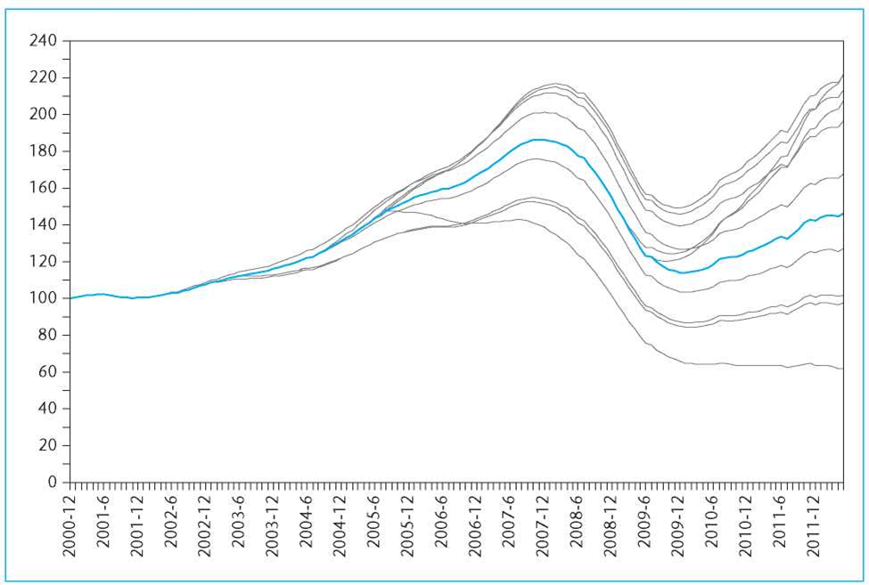
Property-Level Investment Performance
Individual Property Returns Compared to the Blue Line Aggregate Average
Individual Properties
Individual Property Dispersion
Individual property investments can perform dramatically
differently from market averages.
Manager's Challenge
Investment managers must identify "winners" and avoid
the worst "losers" in the property market. Try and beat
The blue line in the graph to the right.
Performance Range
Properties can end up 50% below or above aggregate
index values.
Statistical Perspective
Property-level performance dispersion appears random in time,
direction, and magnitude.

Slide 3
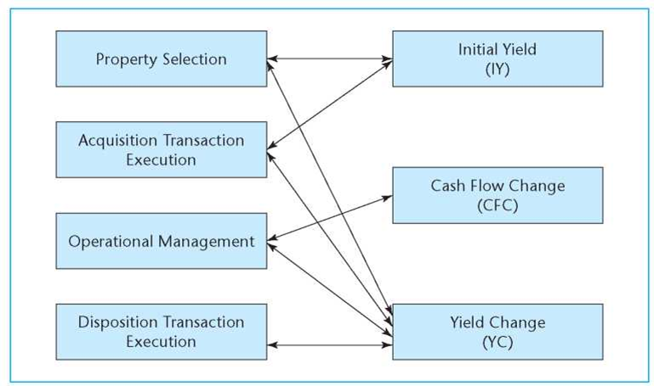
Four Fundamental Property Management Responsibilities
Property Selection
Picking "good" properties (bargains as found)
Acquisition Execution
Skillful negotiation and due diligence
Operational Management
Property marketing, leasing, tenant servicing, expense management
Disposition Execution
Timing, finding the right buyer, negotiation
These four responsibilities directly relate to the three IRR attributes: Initial Yield (IY), Cash Flow Change (CFC),
and Yield Change (YC).

Slide 4
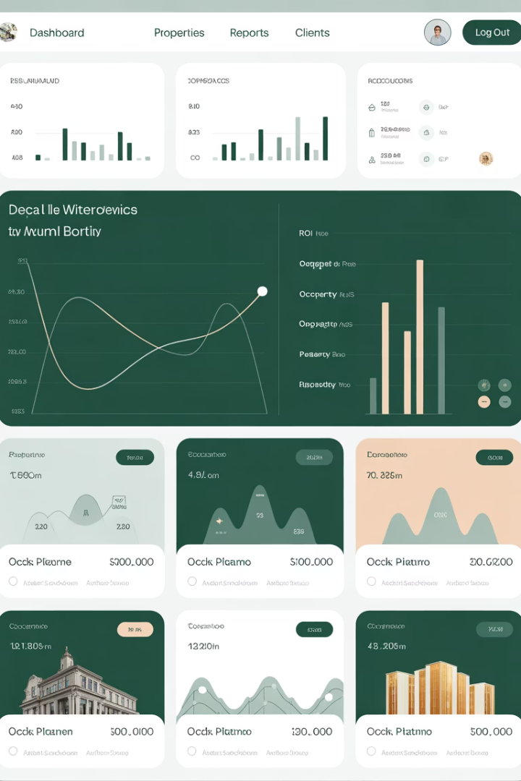




Property-Level Performance Attribution
Diagnostic Purpose
Helps managers understand property-level sources of performance results.
Benchmarking
Compares performance with appropriate cohort of similar properties over same period.
Insight Generation
Reveals strengths and weaknesses in property management approach.
Accountability
Sets expectations within investment management organization.

Slide 5
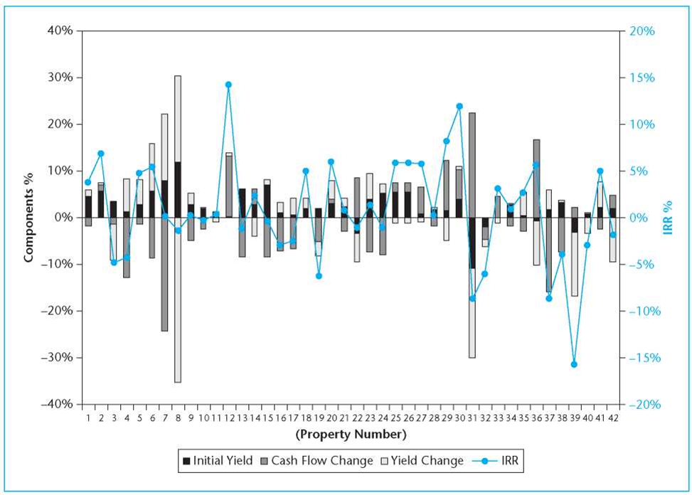
Property-Level IRR Attributes Example
Analysis of 42 institutional real estate investments compared to NCREIF benchmarks revealed. Average value = $51 US Million.
42
10.3
Properties
Years
Randomly-numbered institutional properties analyzed
Average holding period across properties
5.64%
Performance SD
Standard deviation of differential performance

Slide 6

Key Findings from Property-Level Analysis
Initial Yield Strength
Relatively stable and favorable initial yield performance across investments suggests effective acquisition capabilities.
Cash Flow Impact
Cash Flow Change (CFC) was the strongest determinant of whether properties beat their benchmarks.
Top Performers
All top nine performers had positive CFC components relative to benchmark.
Improvement Opportunity
Properties generally not as effectively managed as benchmarks regarding ongoing cash flow during holding period.

Slide 7






Portfolio-Level Performance Attribution
Selection
Which specific properties are chosen
Individual asset choices
Allocation
More "micro-level" decisions
How capital is distributed across market segments
Includes operational management
Property types (office, retail, etc.)
Geographic regions
Interaction
Broader "macro" decisions
Combined effect of allocation and selection
Nonlinear relationship
Cross-product effect
Difficult to attribute precisely

Slide 8

Portfolio Attribution Example: Bob vs. Sue
Weights
Bob
Sue
Industrial
90%
10%
Office
10%
90%
Returns
Bob
Sue
Total portfolio
9.20%
9.70%
Industrial properties
9.00%
7.00%
Office properties
11.00%
10.00%
Sue outperformed Bob by 50 basis points overall, despite Bob's superior selection performance,
because Sue's allocation to better-performing office properties dominated.

Slide 9
Quantifying Performance Attribution
Conditional on Manager Selection
Conditional on Manager Allocation
Unconditional (Most Logical)
Allocation: +1.60%
Allocation: +2.40%
Allocation: +1.60%
Selection: -1.90%
Selection: -1.90%
Selection: -1.10%
Interaction: +0.80%
Total: +0.50%
Total: +0.50%
Total: +0.50%
The unconditional approach provides the most logical quantification by separating the pure effects from the interaction effect.

Slide 10





Investment Performance Evaluation
Quantitative Metrics
Peer Universe
Performance Range
Evaluation Outcome
Competing managers with similar specialties, focus, and objectives.
Average returns over 3-5 year periods compared to benchmarks and peer groups.
Typically shows 5th to 95th percentile range with middle quartiles highlighted.
Determines rehiring, incentive fees, or potential replacement of managers.

Slide 11



Benchmarks in Private Real Estate
No Passive Index Possible
Private real estate requires active operational management of properties.
Peer Group Indices
NCREIF and MSCI/IPD indices reflect performance of most private real estate managers.
Property vs. Fund Level
Property-level indices track underlying assets; fund-level indices track investor experience.
Benchmarks represent the average of "alternatives" an investor could have achieved with different managers.

Slide 12
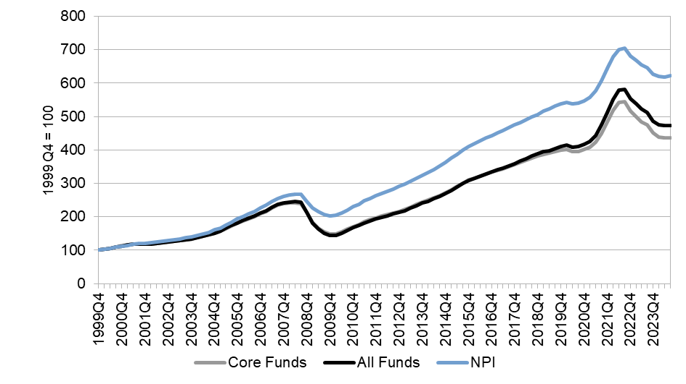
Fund Performance Comparison (2000-2023)
Core funds provided less total return than underlying properties (NPI) due to management fees and leverage effects during market downturns.

Slide 13

Leverage Impact on Fund Performance
Market Upswing
Property values rise from 100 to 150. Fund has 33% LTV ratio ($100 equity, $50 debt).
Market Crash
Property values fall by one-third to 100. Fund loses half its equity value, now at 50% LTV.
De-Leveraging
Fund raises $17 in new equity to pay down debt to $33, returning to 33% LTV.
Partial Recovery
Property market recovers to 125, leaving fund with $92 equity and $33 debt.
Result: Property-level TWR is -4%, while fund-level TWR is -6.5%, 250 basis points lower due to leverage timing.

Slide 14
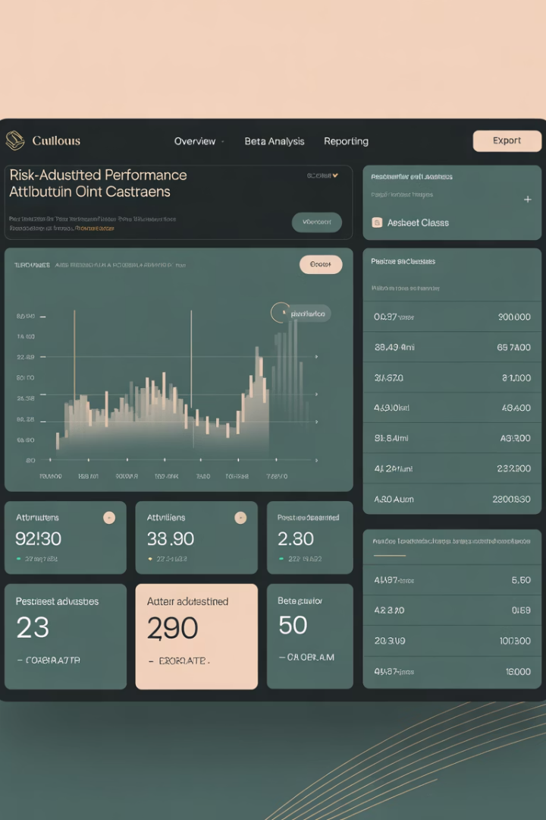
Risk-Adjusted Performance Attribution
Risk Consideration
Traditional attribution analysis assumes manager's portfolio has same risk as benchmark.
Sector Risk Differences
Some sectors are riskier than others, affecting apparent selection or allocation decisions.
Risk Adjustment Method
Using beta as risk measure, sectors should be adjusted to same risk level before attribution analysis.
Performance Context
Managers may outperform by allocating to riskier sectors or underperform with less risky portfolio.

Slide 15
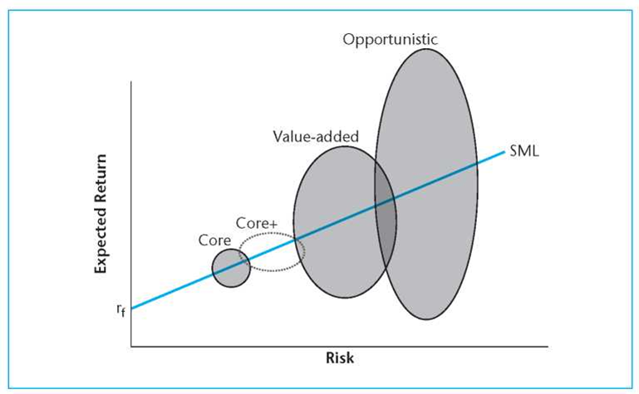
Real Estate Investment Styles
Core
Stabilized properties, low leverage (20-30% LTV), lower returns but less risk.
Value-Added
Properties needing leasing or turnaround, moderate leverage (50% LTV), higher returns.
Opportunistic
Development, distressed assets, high leverage (50-70% LTV), highest risk and return targets. We see the widest range of performance.
Investment styles define types of assets and management policies, especially regarding financial leverage use.

Slide 16
Core-Plus: Expanding the Traditional Core
Traditional Core Mind-Set
"New" Core Mind-Set
Long leases
Income resilience and growth potential
Credit tenants
Low sensitivity to economic cycles
Inflation-protected lease clauses
Market conditions pass inflation to rents
Minimal near-term capex
Predictable long-term capex
Low operational intensity
Established operating model
Gateway city locations
Locations with long-term liquidity
Traditional sectors only
Any sector meeting core criteria

Slide 17

Performance Metrics by Investment Style
Core & Value-Add Funds
Use time-weighted returns (TWRs) based on holding period returns (HPRs).
Opportunistic Funds
Use money-weighted returns (IRRs) like venture capital or private equity funds.
Capital Flow Control
TWRs appropriate when managers lack discretion over equity capital flow timing.
Vintage Year Importance
When using IRRs, must control for fund vintage year in benchmarking.

Slide 18
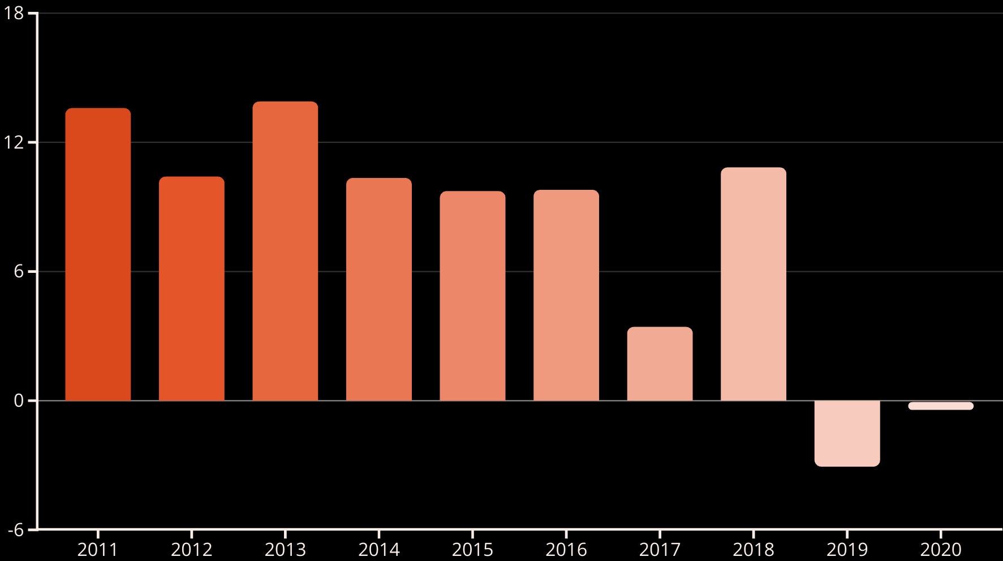
Value-Add Funds Performance by Vintage
Covid and the office market impacts can be seen in funds started in 2019 and 2020.
Most value-add funds from 2011-2022 failed to achieve their 13-16% target returns. Only the 2013 cohort was successful, with post-GFC recovery vintages performing best.

Slide 19




Investment Style Characteristics
Investment styles exist on a spectrum from low risk/return (core) to high risk/return (opportunistic), with fuzzy boundaries between categories.

Slide 20





Key Takeaways
Performance Attribution
Breaks down returns into components to understand sources of performance.
Property Management
Four key responsibilities directly impact investment performance.
Benchmarking
Uses peer group indices rather than passive indices in private real estate.
Investment Styles
Core, value-add, and opportunistic styles require different performance metrics.

