Slide 1

Understanding Real Estate Investment Trusts (REITs)
REITs offer a unique investment vehicle that bridges public stock markets and private property markets. They provide investors liquid access to real estate while offering property owners access to public equity markets.

Slide 2
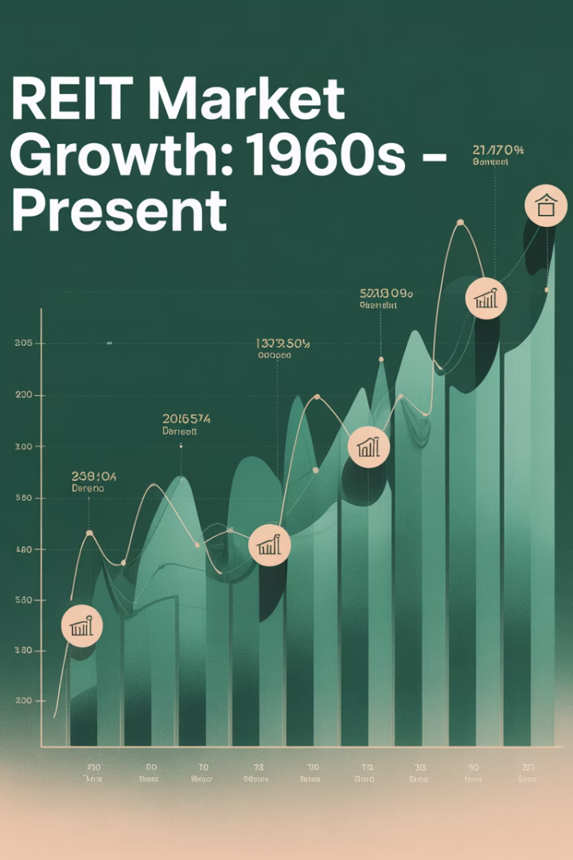
The Evolution of REITs
1
1960s Origins
Created by U.S. Congress in 1960 to give small investors access to diversified real estate portfolios.
2
1986 Reform
Removal of external management requirement sparked the "Modern REIT Era" of the 1990s.
3
Global Expansion
By 2022, REITs existed in at least 37 countries with $1.9 trillion market capitalization.
4
Today's Market
Over 600 listed REITs worldwide, with increasing institutional investment.

Slide 3








REIT Market Growth Sources
Market Value Appreciation
Rising property portfolio values
Secondary Equity Offerings
$0.7 trillion raised in U.S. (1992-2022)
Conversion of Existing Companies
Property companies adopting REIT status
IPO Market
317 REIT IPOs in U.S. alone (1992-2022)

Slide 4
Shifting Property Focus
2000 REIT Market
2025 REIT Market
Traditional commercial real estate dominated the market:
Alternative categories gained significant market share:
Office buildings
Infrastructure
Multi-family residential
Healthcare facilities
Retail properties
Student housing
Industrial facilities
Single-family rentals (SFR)
These four categories represented over 75% of U.S. REIT market capitalization.
Self-storage facilities
Data Centers
Office and retail lost their preeminence in the market while
infrastructure and residential has increased.

Slide 5




Vertical Integration of Modern REITs
Land Acquisition
Raw land acquisition and "land banking" for future development
Development
Construction of structures on acquired land
Property Ownership
Holding stabilized operational properties as investments
Property Management
Operational management and tenant services

Slide 6

REIT Regulatory Requirements for favorable pass-through tax treatment
Distribution Test
At least 90% of annual taxable income must be distributed to shareholders as dividends each year.
Asset Test
75%+ of total assets must be real estate, mortgages, cash, or federal government securities.
Income Test
At least 75% of income must come from passive sources like rents and mortgage interest.
Ownership Test
No five or fewer individuals may own more than 50% of stock, and must have at least 100 shareholders.

Slide 7

International REIT Regulations
Country
Distribution Requirement
Leverage Ceiling
Cross-Border Investment
United States
90% of income
No specific limit
Allowed
Australia
100% of income
No specific limit
Allowed
Japan
90% of income
No specific limit
Allowed
France
95% of income
No specific limit
Allowed
UK
90% of income
No specific limit
Allowed

Slide 8





REIT Income Measures
Potential Gross Income (PGI)
Total potential revenue if properties were fully leased
Net Operating Income (NOI)
PGI minus vacancy and operating expenses
EBITDA
NOI minus general and administrative expenses
Funds From Operations (FFO)
EBITDA minus interest expenses
Adjusted FFO (AFFO)
FFO plus depreciation minus capital expenditures

Slide 9
Valuing REITs: Two Approaches
Cash Flow Approach
Net Asset Value Approach
Views REIT as a stream of future cash flows:
Views REIT as a collection of real estate assets:
Uses Gordon Growth Model
Estimates value of all properties
Considers dividend growth rate
Adjusts for non-asset-based value
Accounts for plowback ratio
Subtracts liabilities
Evaluates management's ability to find growth opportunities
Divides by number of shares
Compares Price/NAV ratio to identify potential mispricing
Formula: E = DIV₁/(r-g)

Slide 10
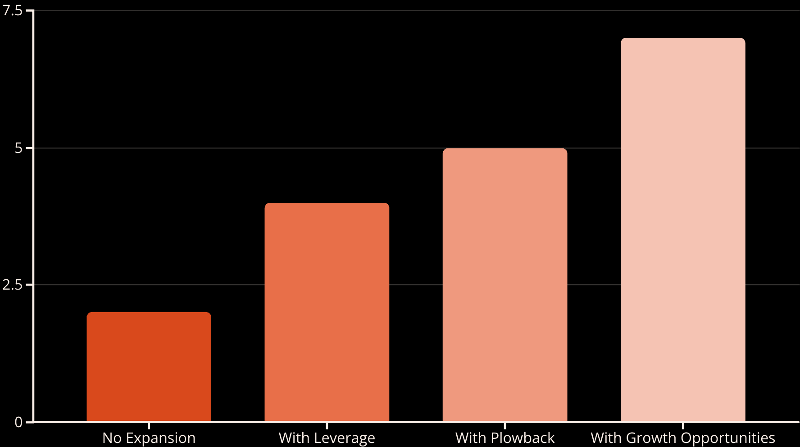
The Gordon Growth Model for REITs
The Gordon Growth Model values REITs based on expected dividends and growth rates. Even small changes in growth expectations can significantly impact REIT values. A 1% increase in growth rate from 2% to 3% can increase share value by over 11%.

Slide 11








REIT Public/Private Arbitrage (Public Values to NAV)
If REIT Share Values Are Higher
Growth Opportunity
Sell shares: REITs buy properties in private market at lower valuations
REITs become growth stocks with higher P/E multiples
Private Market Values Higher
Income Focus
REITs sell properties into private market at premium and buy back their own stock shares.
REITs become income stocks with lower P/E multiples

Slide 12
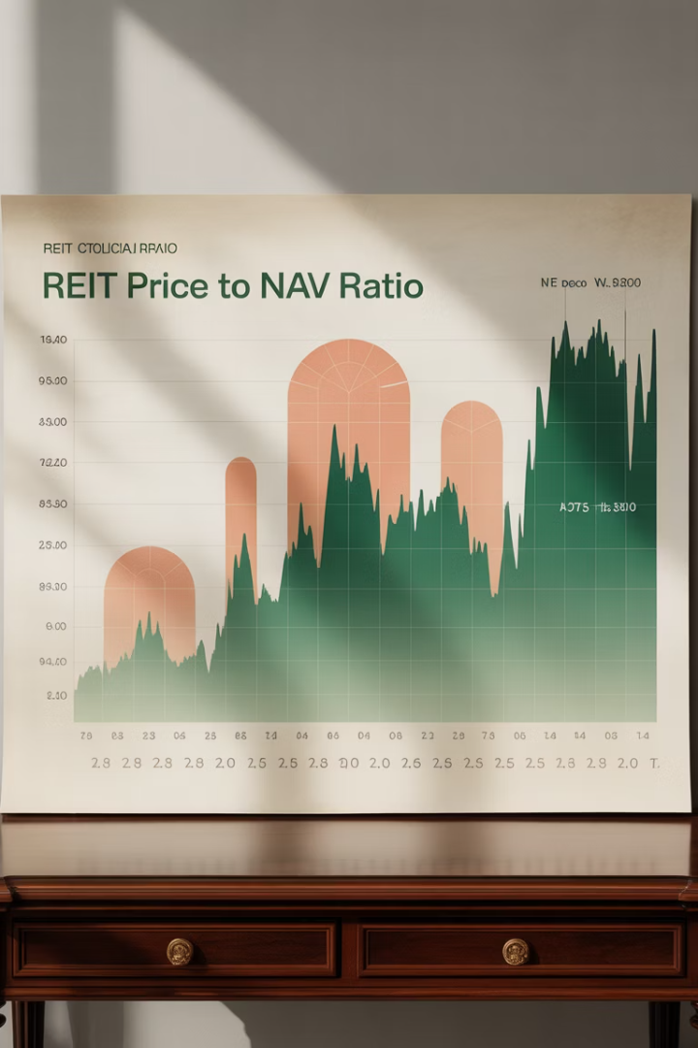
REIT Price to NAV Ratio History
75%
120%
95%
2009 Low
2016 Peak
2022 Average
During financial crisis, REITs traded at deep discounts to NAV
Premium pricing reflected growth opportunities
Near parity between public and private valuations
The premium or discount of REIT share prices to their Net Asset Value follows a mean-reverting pattern. This creates opportunities for strategic capital deployment between public and private markets.

Slide 13





REIT Management Strategies
Specialization
Focus on specific property types allows management expertise and easier market analysis. Modern REITs typically specialize in one or two related property types.
Vertical Integration
Controlling multiple stages of real estate production provides flexibility to profit from changing market valuations while maintaining operational scale.
Scale Economies
Larger REITs may benefit from lower average costs and improved capital access. Average REIT size grew from $212M in 1984 to $3B in 2022.
Branding
Building brand recognition among space users can create franchise value, especially for consumer-facing properties like retail and housing.

Slide 14








REIT Financial Strategy Balancing Act
Growth Pressure
Distribution Requirement
Stock market rewards growth, pushing REITs to expand
90% income payout rule necessitates external capital for growth
Market Sensitivity
Leverage Considerations
Stock market severely penalizes excessive leverage
Debt can enhance returns but increases risk

Slide 15
REIT vs. Private Real Estate Investment
REIT Advantages
Private Real Estate Advantages
Greater liquidity
Better portfolio diversification
Lower management costs (±25 basis points)
Lower correlation with stocks
Professional management
Less market volatility
Access to niche property types
More control over property selection
Smaller minimum investment
Potential for direct value creation

Slide 16
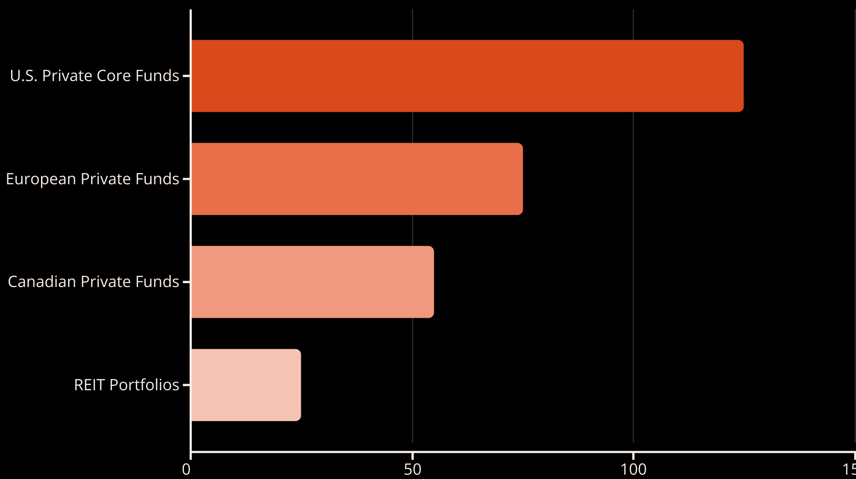
REIT Investment Management Costs Are Much Lower than for Direct Private Funds
Basis Points Annual Management Costs
REIT portfolio management costs are significantly lower than private real estate vehicles. U.S. private funds typically charge 125 basis points compared to just 25 basis points for REIT portfolios.

Slide 17



REIT Stock Market Characteristics
Low Beta Stocks
Small Cap Correlation
Leverage Impact
REITs generally have lower volatility relative to the overall market, but are not zero-beta investments.
REITs show higher correlations with small-cap stocks than with large-cap stocks.
Changing patterns in betas and correlations are mainly attributable to industry-wide dynamics in REIT leverage.

Slide 18

REIT Growth vs. Income Classification
Growth Stocks
When stock market values property higher than private market, REITs can grow by acquiring properties. This creates higher price/earnings multiples.
Income Stocks
REITs typically function as income stocks with stable dividends. They often have lower price/earnings multiples than growth stocks.
Shrinking Stocks
When private market values property higher than stock market, REITs can create value by selling properties and buying their own stock shares or going private through leveraged buyouts.

Slide 19
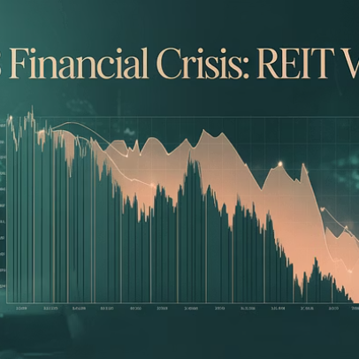

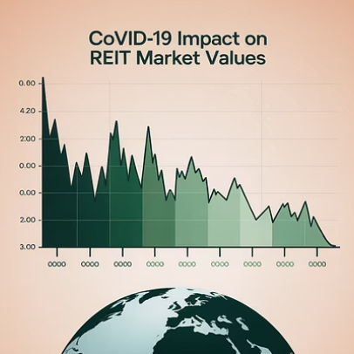

REIT Market Volatility
REITs experience significant market volatility. During the 2008 financial crisis, U.S. REIT share prices fell 75% from peak to trough. However, REITs maintained access to equity markets even during crises, with $24 billion raised in 2009.

Slide 20





The Future of REITs
Global Expansion
Innovation
Institutional Growth
Continued adoption of REIT structures in emerging markets
Pioneering investment in new alternative property types.
Increasing allocation from large institutional investors
Consolidation
Continued industry consolidation as scale advantages persist
REITs have evolved from a slow-starting investment vehicle in 1960 to a global industry with $1.9 trillion market capitalization. Their ability to provide tax-efficient, liquid real estate exposure ensures their continued importance in investment portfolios.

